Slide 1
Purple Team: Group Presentation
Oliver, Natalie, Mike, Jennie & fran

Slide 2
Task Overview
Retail Industry
Collected Various background over years
TARGET: SALE FORECASTS
MISSION: DATA PREPROCESSING

Slide 3
Mission Rundown
Data Linking
Data Description
Data Cleaning
Data Reduction
Data Transformation
Data Discretisation and Generalisation
Modelling and Prediction

Slide 4
Data Linking

Slide 5
Data Linking
4 Tables of store data
Insert tables into SQLite Database
Issues with linking in SQLite Database
Python – pandas merge function
Results

Slide 6
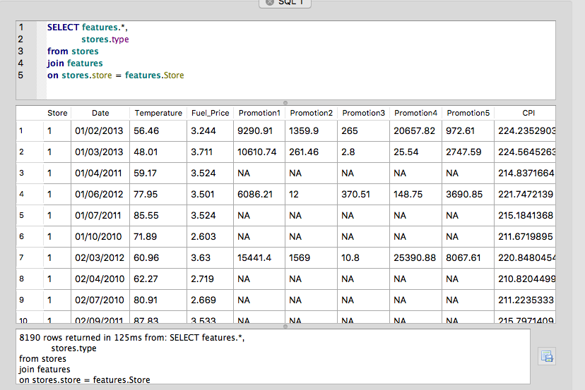
Data Linking

Slide 7
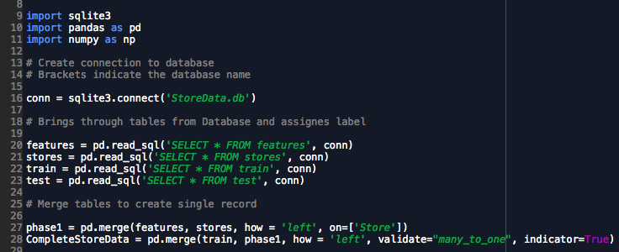
Data Linking

Slide 8
Data Linking
Error Checking
Validate and Indicator Function

Slide 9
Data Linking

Slide 10
Data Linking
Error Checking
Validate and Indicator Function

Slide 11
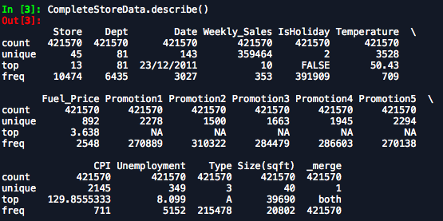
Data Linking

Slide 12
Data Linking

Slide 13
Data Description, summarisation & visualisation

Slide 14
Data description, visualisation and summarisation
Column | Description | Data source |  |  | Data type |  | Measures of central tendency |  |  | Min | Max | SD
 |  | Stores.csv | features.csv | train.csv
 |  |  |  |  |  |  | mean | median | mode
Store | the anonymised store number | Y | Y | Y | Numeric | Interval
Type | store type, A: supercentre, B: superstore, C: supermarket | Y | N | N | Categoric | nominal
Size | store size (in square feet) | Y | N | N | Numeric | Interval | 130287.60 | 126512.00 | 39690.00 | 34875.00 | 219622.00 | 63825.27
Date | the week with the dated Friday | N | Y | Y | Numeric | Ordinal
Temperature | average temperature in the region | N | Y | N | Numeric | Interval | 59.36 | 60.71 | 70.28 | -7.29 | 101.95 | 18.68
Fuel_Price | cost of fuel in the region | N | Y | N | Numeric | Interval | 3.41 | 3.51 | 3.64 | 2.47 | 4.47 | 0.43
Promotions | anonymised data related to promotions, mainly price reductions that the retailer is running. Promotion data is only available after Nov. 2011, and is not available for all stores all the time. Any missing value is marked with an NA. | N | Y | N | Boolean
CPI | the consumer price index | N | Y | N | Numeric | Interval | 172.46 | 182.76 | 132.72 | 126.06 | 228.98 | 39.74
Unemployment | the unemployment rate | N | Y | N | Numeric | Interval
IsHoliday | whether the week is a special holiday week | N | Y | Y | Binary
Department | the anonymised department number | N | N | Y | Numeric | Interval
Weekly_Sales | sales for the given department in the given store | N | N | Y | Numeric | Interval | 15981.26 | 7612.03 |  | -4988.94 | 693099.4 | 22712.16

Slide 15
Data description, visualisation and summarisation
Column | Description | Data source |  |  | Data type
 |  | Stores.csv | features.csv | train.csv
Store | the anonymised store number | Y | Y | Y | Numeric | Interval
Type | store type, A: supercentre, B: superstore, C: supermarket | Y | N | N | Categoric | nominal
Size | store size (in square feet) | Y | N | N | Numeric | Interval
Date | the week with the dated Friday | N | Y | Y | Numeric | Ordinal
Temperature | average temperature in the region | N | Y | N | Numeric | Interval
Fuel_Price | cost of fuel in the region | N | Y | N | Numeric | Interval
Promotions ** | Price Reduction Promotion Held | N | Y | N | Boolean
CPI | the consumer price index | N | Y | N | Numeric | Interval
Unemployment | the unemployment rate | N | Y | N | Numeric | Interval
IsHoliday | whether the week is a special holiday week | N | Y | Y | Binary
Department | the anonymised department number | N | N | Y | Numeric | Interval
Weekly_Sales | sales for the given department in the given store | N | N | Y | Numeric | Interval
** anonymised data related to promotions, mainly price reductions that the retailer is running. Promotion data is only available after Nov. 2011, and is not available for all stores all the time. Any missing value is marked with an NA.
Notes:
To start the process of data description, visualisation and summarisation we first plan on creating summary tables depicting the source of the data, and type of data. The data type helps us identify which descriptive statistics to use to best visualise basic features of the data as well as to identify any outliers, missing value. For example temperature a scatter plot of temperature against date would be useful to identify any outliers i.e. very cold temperatures in summer. Where as store type would be best visualised by a bar graph etc…

Slide 16
Data description, visualisation and summarisation
Some values have been evaluated in the overall situation
Column | Measures of central tendency |  |  | Min | Max | SD
 | mean | median | mode
Size | 130287.60 | 126512.00 | 39690.00 | 34875.00 | 219622.00 | 63825.27
Temperature | 59.36 | 60.71 | 70.28 | -7.29 | 101.95 | 18.68
Fuel_Price | 3.41 | 3.51 | 3.64 | 2.47 | 4.47 | 0.43
CPI | 172.46 | 182.76 | 132.72 | 126.06 | 228.98 | 39.74
Similar Work will be performed with individual store type
Notes:
For the numeric interval data it is also possible to measure central tendency

Slide 17
Data Cleaning

Slide 18
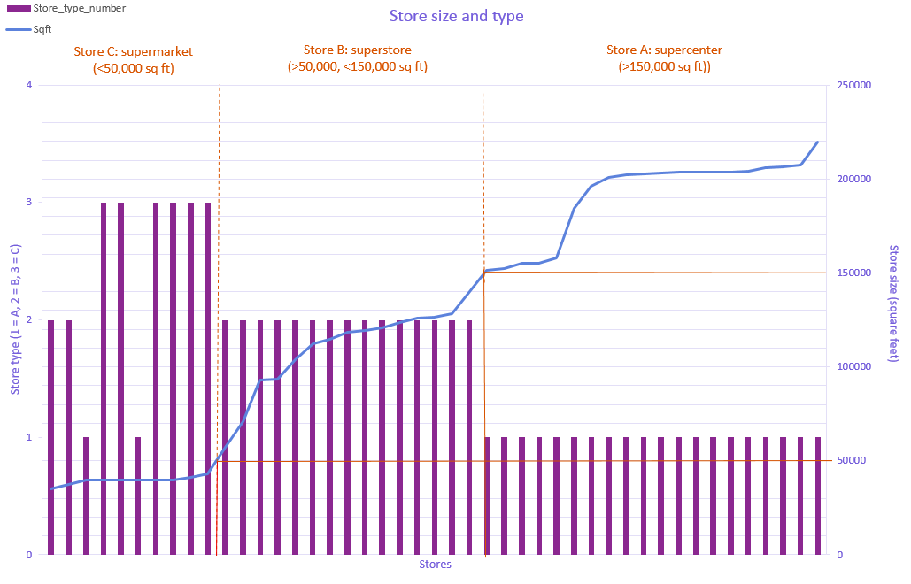
Data visualisation -> Data cleaning
Notes:
We will produce visual outputs for the data to both identify and variables that are redundancy or irrelevant and secondly to identify any data that may need cleaning i.e. because the data is incomplete, noisy or inconsistent.
For example if you plot store type against- square footage as would be expected there is a correlation, i.e. larger stores are supercentres while smaller stores are supermarkets. However arguable the data is inconsistent as two of the stores under 50,000 square feet are classified as supercentres and two as superstores. Suggesting either the store type of store size has been misreported. Indeed when you look at the stores with the potentially inconsistent data a store with a square footage of 39 thousand square feet has been classified as a supercentre where stores of the exact same size have been classified supermarkets- so this would be corrected. Due to the error also being in classifying the stores square footage rather than store type would be used in the predictive model (to prevent redundancy).
As you can see from the above graph some departments do not exist. Maybe they have been discontinued before the begging of the analysis period. The departments that do not exist in any of the stores will be removed from the analysis, as obviously you cannot predict sales for a store that does not exist. Departments which only exist in 10% of stores will be further investigated and removed from analysis unless an obvious reason is found, i.e. store 34 is the only one to have department 65,

Slide 19
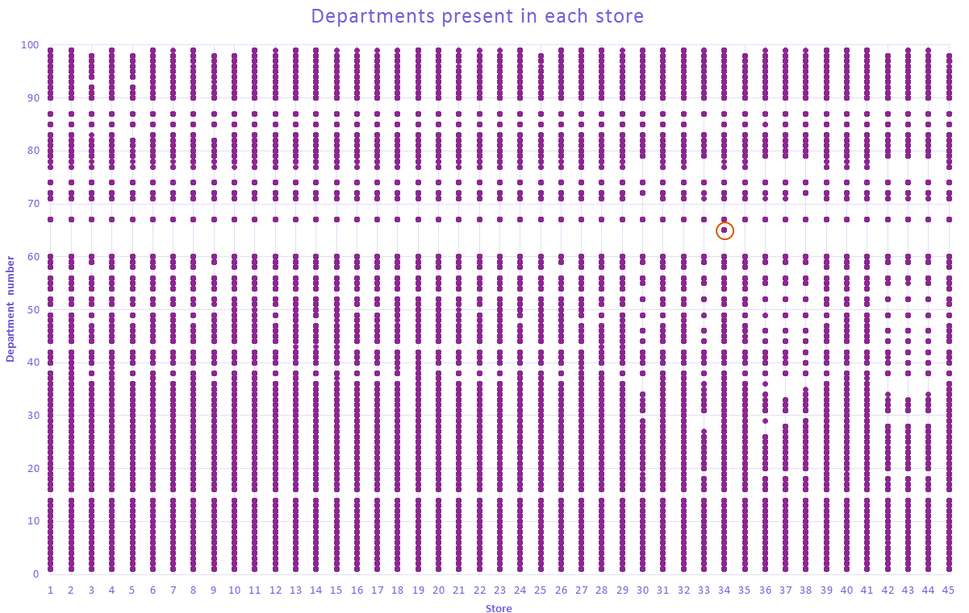
Data visualisation -> Data cleaning
Notes:
We will produce visual outputs for the data to both identify and variables that are redundancy or irrelevant and secondly to identify any data that may need cleaning i.e. because the data is incomplete, noisy or inconsistent.
For example if you plot store type against- square footage as would be expected there is a correlation, i.e. larger stores are supercentres while smaller stores are supermarkets. However arguable the data is inconsistent as two of the stores under 50,000 square feet are classified as supercentres and two as superstores. Suggesting either the store type of store size has been misreported. Indeed when you look at the stores with the potentially inconsistent data a store with a square footage of 39 thousand square feet has been classified as a supercentre where stores of the exact same size have been classified supermarkets- so this would be corrected. Due to the error also being in classifying the stores square footage rather than store type would be used in the predictive model (to prevent redundancy).
As you can see from the above graph some departments do not exist. Maybe they have been discontinued before the begging of the analysis period. The departments that do not exist in any of the stores will be removed from the analysis, as obviously you cannot predict sales for a store that does not exist. Departments which only exist in 10% of stores will be further investigated and removed from analysis unless an obvious reason is found, i.e. store 34 is the only one to have department 65,

Slide 20
Data Reduction

Slide 21
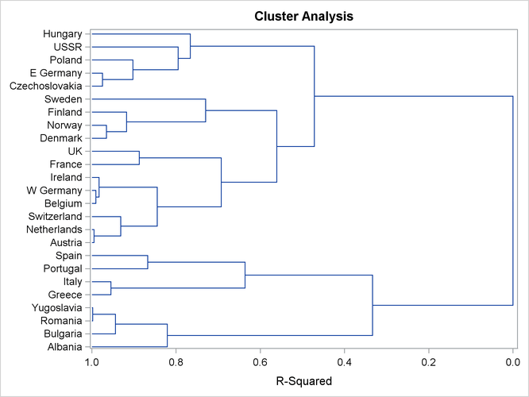
Data Reduction - Clustering
Clustering - Dendrogram
Notes:
http://support.sas.com/documentation/cdl/en/statug/66859/HTML/default/viewer.htm#statug_distance_gettingstarted01.htm

Slide 22
Data Reduction – Variable Selection
Variable Selection – ANOVA
Variable Redundancy & Irrelevancy – Correlational Analysis
Sample

Slide 23
Data Transformation

Slide 24
Data Transformation
Mainly Considering 3 parts
Filtering
Standardisation
Date-Duration Transformation

Slide 25
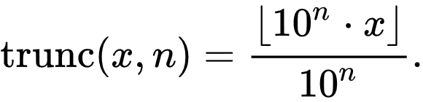
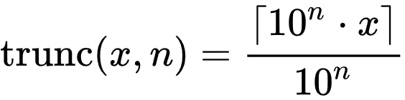
Data Transformation - Filtering
1. Correlation
From correlation coefficient from 0 to 1
2. Truncation
Minimum
Maximum

Slide 26
Data Transformation - Filtering
Filtering by Truncate
Coherent with Data Cleaning
Use Correlation to find
Detect Correlation > 1 Case ← Debug work required

Slide 27
Data Transformation - Standardisation
Setting score
Use min-max normalisation
Advantage
Access from different dimension
Outline the causality in different dimensions

Slide 28
Data Transformation - Standardisation
Cross-Sectional Analysis
Treated
Control

Slide 29
Data Transformation - Standardisation
Before and After Analysis
Treated:
Control:

Slide 30
Data Transformation - Standardisation
Difference in Difference Analysis

Slide 31
Data Transformation – Date-Duration Transformation
Date-Duration Transformation
Time-Series analysis
Indexing from the start date

Slide 32
Data Transformation – Date-Duration Transformation
Allow further analysis
Frequency Analysis
Generate model for Prediction Purpose

Slide 33
Data discretization & generalisation

Slide 34
Data Discretisation
Binning Method
Histogram Analysis
Clustering Analysis
Decision-Tree Analysis
Correlation Analysis
Some of these have been applied

Slide 35
Data Generalisation
Categorical Attributes
Categories originally exist (Store Type)
Formed by the binning method (Store Size)
3-4-5 rule will be applied for store size categorisation

Slide 36
Data Generalisation
Possible Question: For each store type, should they enlarge their store or reduce their store?
Perform Correlation Analysis

Slide 37
The predictive model

Slide 38
Variable input
Correlation analysis to identify the continuous attributes that have the strongest influences on sales in the train data e.g. temperature, unemployment rate, CPI
Example:
Notes:
Example correlogram or correlation matrix

Slide 39
Devising the models
Variance testing between store types
Cluster analysis on department type and week of the year
Number of models devised according to variance and clustering results
    Different models for each store type (3 minimum)
    Using continuous variables that provide the most explanatory power
    Dummy categorical/binary variables e.g. holiday or not; presence of promotion

Slide 40
Model validation
Use model to predict the sales data in the test data file
R² and AIC statistical testing on models to examine fit
ANOVA test for significant differences between model iterations
Notes:
Diagnostic testing to ensure model assumptions are being met

Slide 41
Diagnostic testing
Homoscedasticity
Multicollinearity between variables
Linearity of the model
Any necessary transformations to variables

