Slide 1
MorphoScope Test
Synthetic Data

Slide 2
Synthetic volumes
Generated volumes to demonstrate and validate the spread quantification algorithm:
1. spread_concept
Demonstrates what spread measures:
- Spheres of different sizes: spread scales with size
- Ellipsoids elongated in different axes: anisotropic spread
- Same geometry at different intensities: spread unchanged

Slide 3
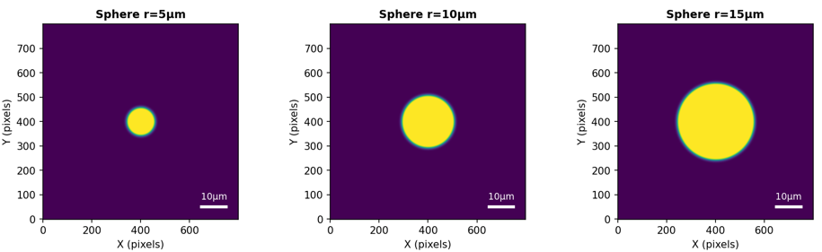
Different Size
Image filename | Spread x [um] | Spread y [um] | Spread z [um] | Spread x*y [um2] | Spread x*y*z [um3] | Axonal Volume (integrated intensity) | Geometric volume [um3]
01_sphere_r10um.tif | 4.92 | 4.92 | 4.77 | 24.25 | 115.73 | 136351944 | 7483.12
02_sphere_r5um.tif | 2.69 | 2.69 | 2.69 | 7.22 | 19.42 | 22129333 | 1668.67
03_sphere_r15um.tif | 7.48 | 7.48 | 5.4 | 56.01 | 302.7 | 350742052 | 16815.4

Slide 4
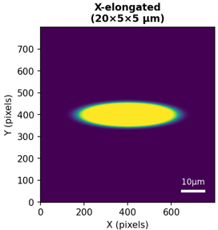
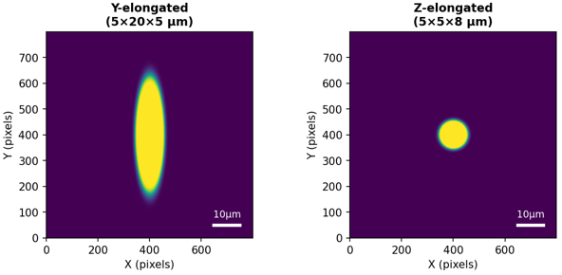
Ellipsoids elongated in different axes
Image filename | Spread x [um] | Spread y [um] | Spread z [um] | Spread x*y [um2] | Spread x*y*z [um3] | Axonal Volume (integrated intensity) | Geometric volume [um3]
04_ellipsoid_x_elongated.tif | 10.75 | 2.69 | 2.69 | 28.89 | 77.68 | 88519429 | 6674.97
05_ellipsoid_y_elongated.tif | 2.69 | 10.75 | 2.69 | 28.89 | 77.68 | 88519429 | 6674.97
06_ellipsoid_z_elongated.tif | 2.69 | 2.69 | 4.28 | 7.24 | 30.96 | 35320684 | 2576.04

Slide 5
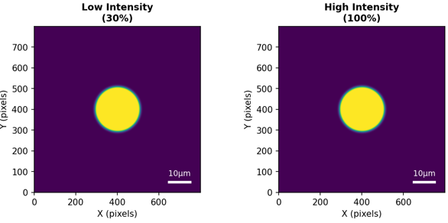
Same geometry at different intensities
Image filename | Spread x [um] | Spread y [um] | Spread z [um] | Spread x*y [um2] | Spread x*y*z [um3] | Axonal Volume (integrated intensity) | Geometric volume [um3]
07_sphere_low_intensity.tif | 4.93 | 4.93 | 4.77 | 24.27 | 115.81 | 68469140 | 7483.12
08_sphere_high_intensity.tif | 4.92 | 4.92 | 4.77 | 24.25 | 115.73 | 136351944 | 7483.12

Slide 6
Synthetic volumes
2. pca_rotation
Demonstrates PCA axis alignment:
- Same ellipsoid at different rotations
- After PCA alignment, all should give similar spread values

Slide 7
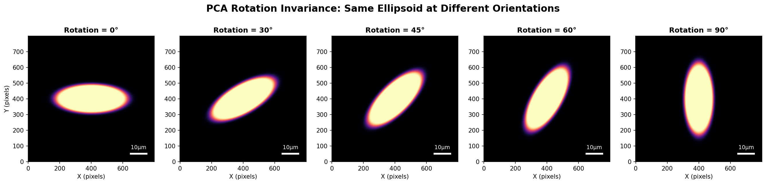
pca_rotation
Image filename | Spread x [um] | Spread y [um] | Spread z [um] | Spread x*y [um2] | Spread x*y*z [um3] | Axonal Volume (integrated intensity) | Geometric volume [um3]
ellipsoid_rot000deg.tif | 10.75 | 4.3 | 2.69 | 46.23 | 124.28 | 141631563 | 10681.05
ellipsoid_rot030deg.tif | 10.75 | 4.3 | 2.69 | 46.23 | 124.29 | 141632397 | 10681.37
ellipsoid_rot045deg.tif | 10.75 | 4.3 | 2.69 | 46.23 | 124.29 | 141633041 | 10679.69
ellipsoid_rot060deg.tif | 4.3 | 10.75 | 2.69 | 46.23 | 124.29 | 141632094 | 10677.37
ellipsoid_rot090deg.tif | 4.3 | 10.75 | 2.69 | 46.23 | 124.28 | 141631563 | 10681.05

Slide 8
Synthetic volumes
3. fasciculation
Demonstrates the biological phenomenon:
- fasciculated (dusk state): axons bundled tightly, low X/Y/Z spread
- defasciculated (dawn state): axons spread out, high X/Y/Z spread

Slide 9
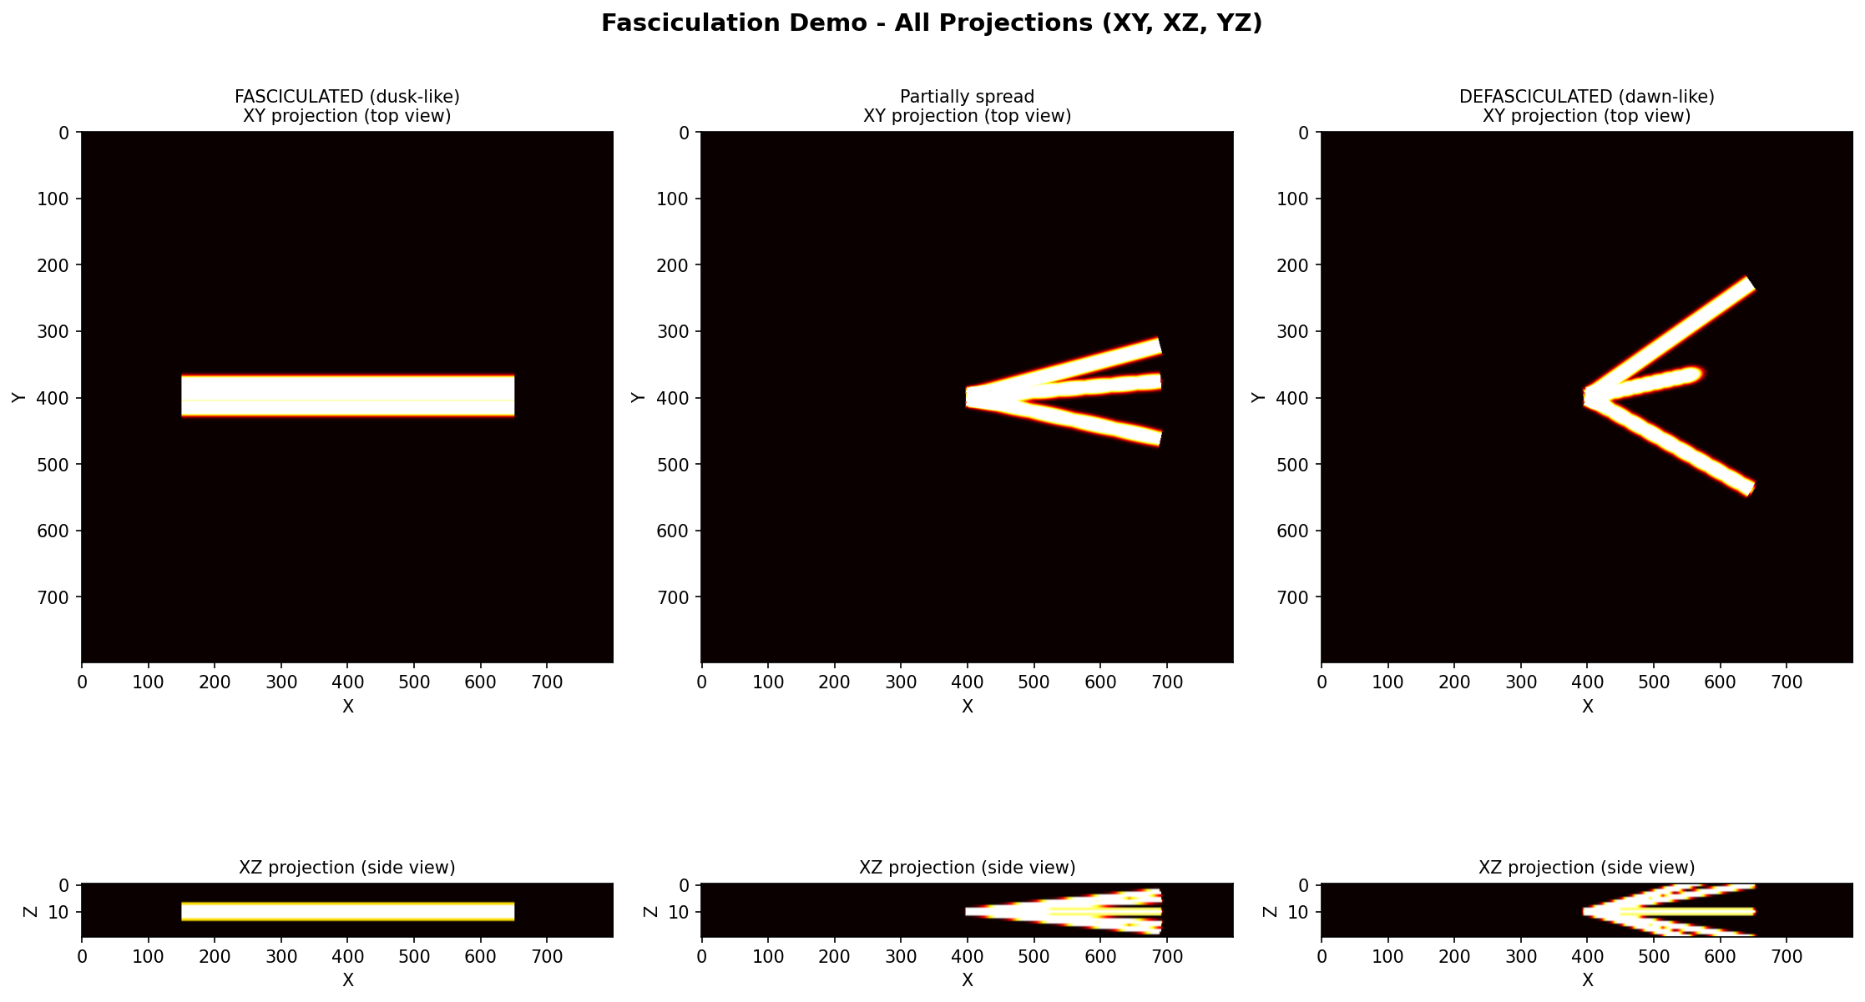
Fasciculation

Slide 10
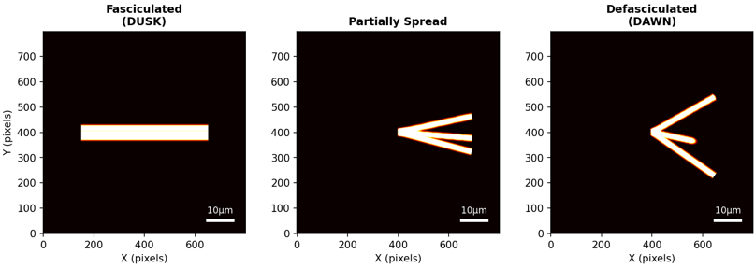
Fasciculation
Image filename | Spread x [um] | Spread y [um] | Spread z [um] | Spread x*y [um2] | Spread x*y*z [um3] | Axonal Volume (integrated intensity) | Geometric volume [um3]
01_fasciculated_tight.tif | 14.46 | 1.57 | 1.58 | 22.64 | 35.88 | 32252376 | 2164.32
02_partially_spread.tif | 7.76 | 3.41 | 3.4 | 26.44 | 89.81 | 17342503 | 1510.53
03_defasciculated_spread.tif | 6.35 | 6.27 | 5.06 | 39.82 | 201.38 | 15146038 | 1348.25

Slide 11
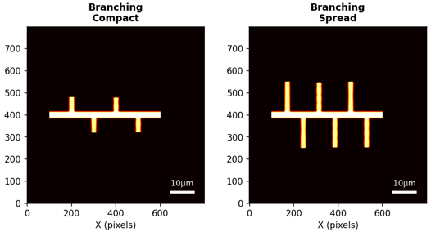
Fasciculation
Image filename | Spread x [um] | Spread y [um] | Spread z [um] | Spread x*y [um2] | Spread x*y*z [um3] | Axonal Volume (integrated intensity) | Geometric volume [um3]
04_branching_compact.tif | 13.78 | 1.79 | 0.8 | 24.71 | 19.87 | 11582964 | 1042.2
05_branching_spread.tif | 13.48 | 3.94 | 0.99 | 53.16 | 52.8 | 17024859 | 1638.99

Slide 12
Synthetic volumes
4. axonal_volume
Demonstrates axonal volume measurement:
- Same size, different intensity: different volume
- Different sizes: different volume
- Shell vs solid: spread similar, volume different

Slide 13
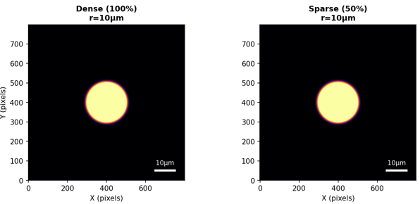
Axonal_volume: Same size, different intensity: different volume
Image filename | Spread x [um] | Spread y [um] | Spread z [um] | Spread x*y [um2] | Spread x*y*z [um3] | Axonal Volume (integrated intensity) | Geometric volume [um3]
01_dense_structure.tif | 4.92 | 4.92 | 4.77 | 24.25 | 115.73 | 136351944 | 7483.12
02_sparse_structure.tif | 4.93 | 4.93 | 4.77 | 24.27 | 115.81 | 68469140 | 7483.12

Slide 14
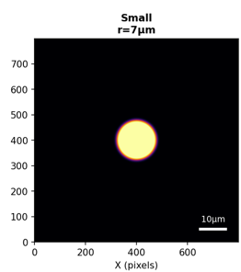
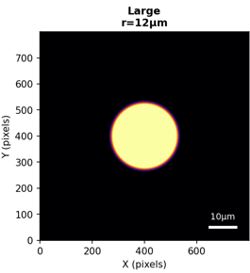
Axonal_volume: Different sizes: different volume
Image filename | Spread x [um] | Spread y [um] | Spread z [um] | Spread x*y [um2] | Spread x*y*z [um3] | Axonal Volume (integrated intensity) | Geometric volume [um3]
03_small_full.tif | 3.57 | 3.57 | 3.57 | 12.72 | 45.4 | 52822099 | 3431.19
04_large_full.tif | 5.93 | 5.93 | 5.15 | 35.14 | 181.09 | 212496592 | 10841.24

Slide 15
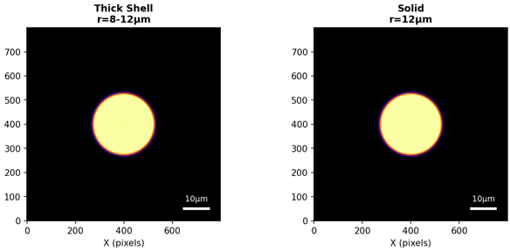

Axonal_volume: Shell vs solid: spread similar, volume different
Image filename | Spread x [um] | Spread y [um] | Spread z [um] | Spread x*y [um2] | Spread x*y*z [um3] | Axonal Volume (integrated intensity) | Geometric volume [um3]
05_thick_shell.tif | 6.54 | 6.54 | 5.54 | 42.72 | 236.45 | 151716712 | 10841.24
06_solid_sphere.tif | 5.93 | 5.93 | 5.15 | 35.14 | 181.09 | 212496592 | 10841.24

Slide 16
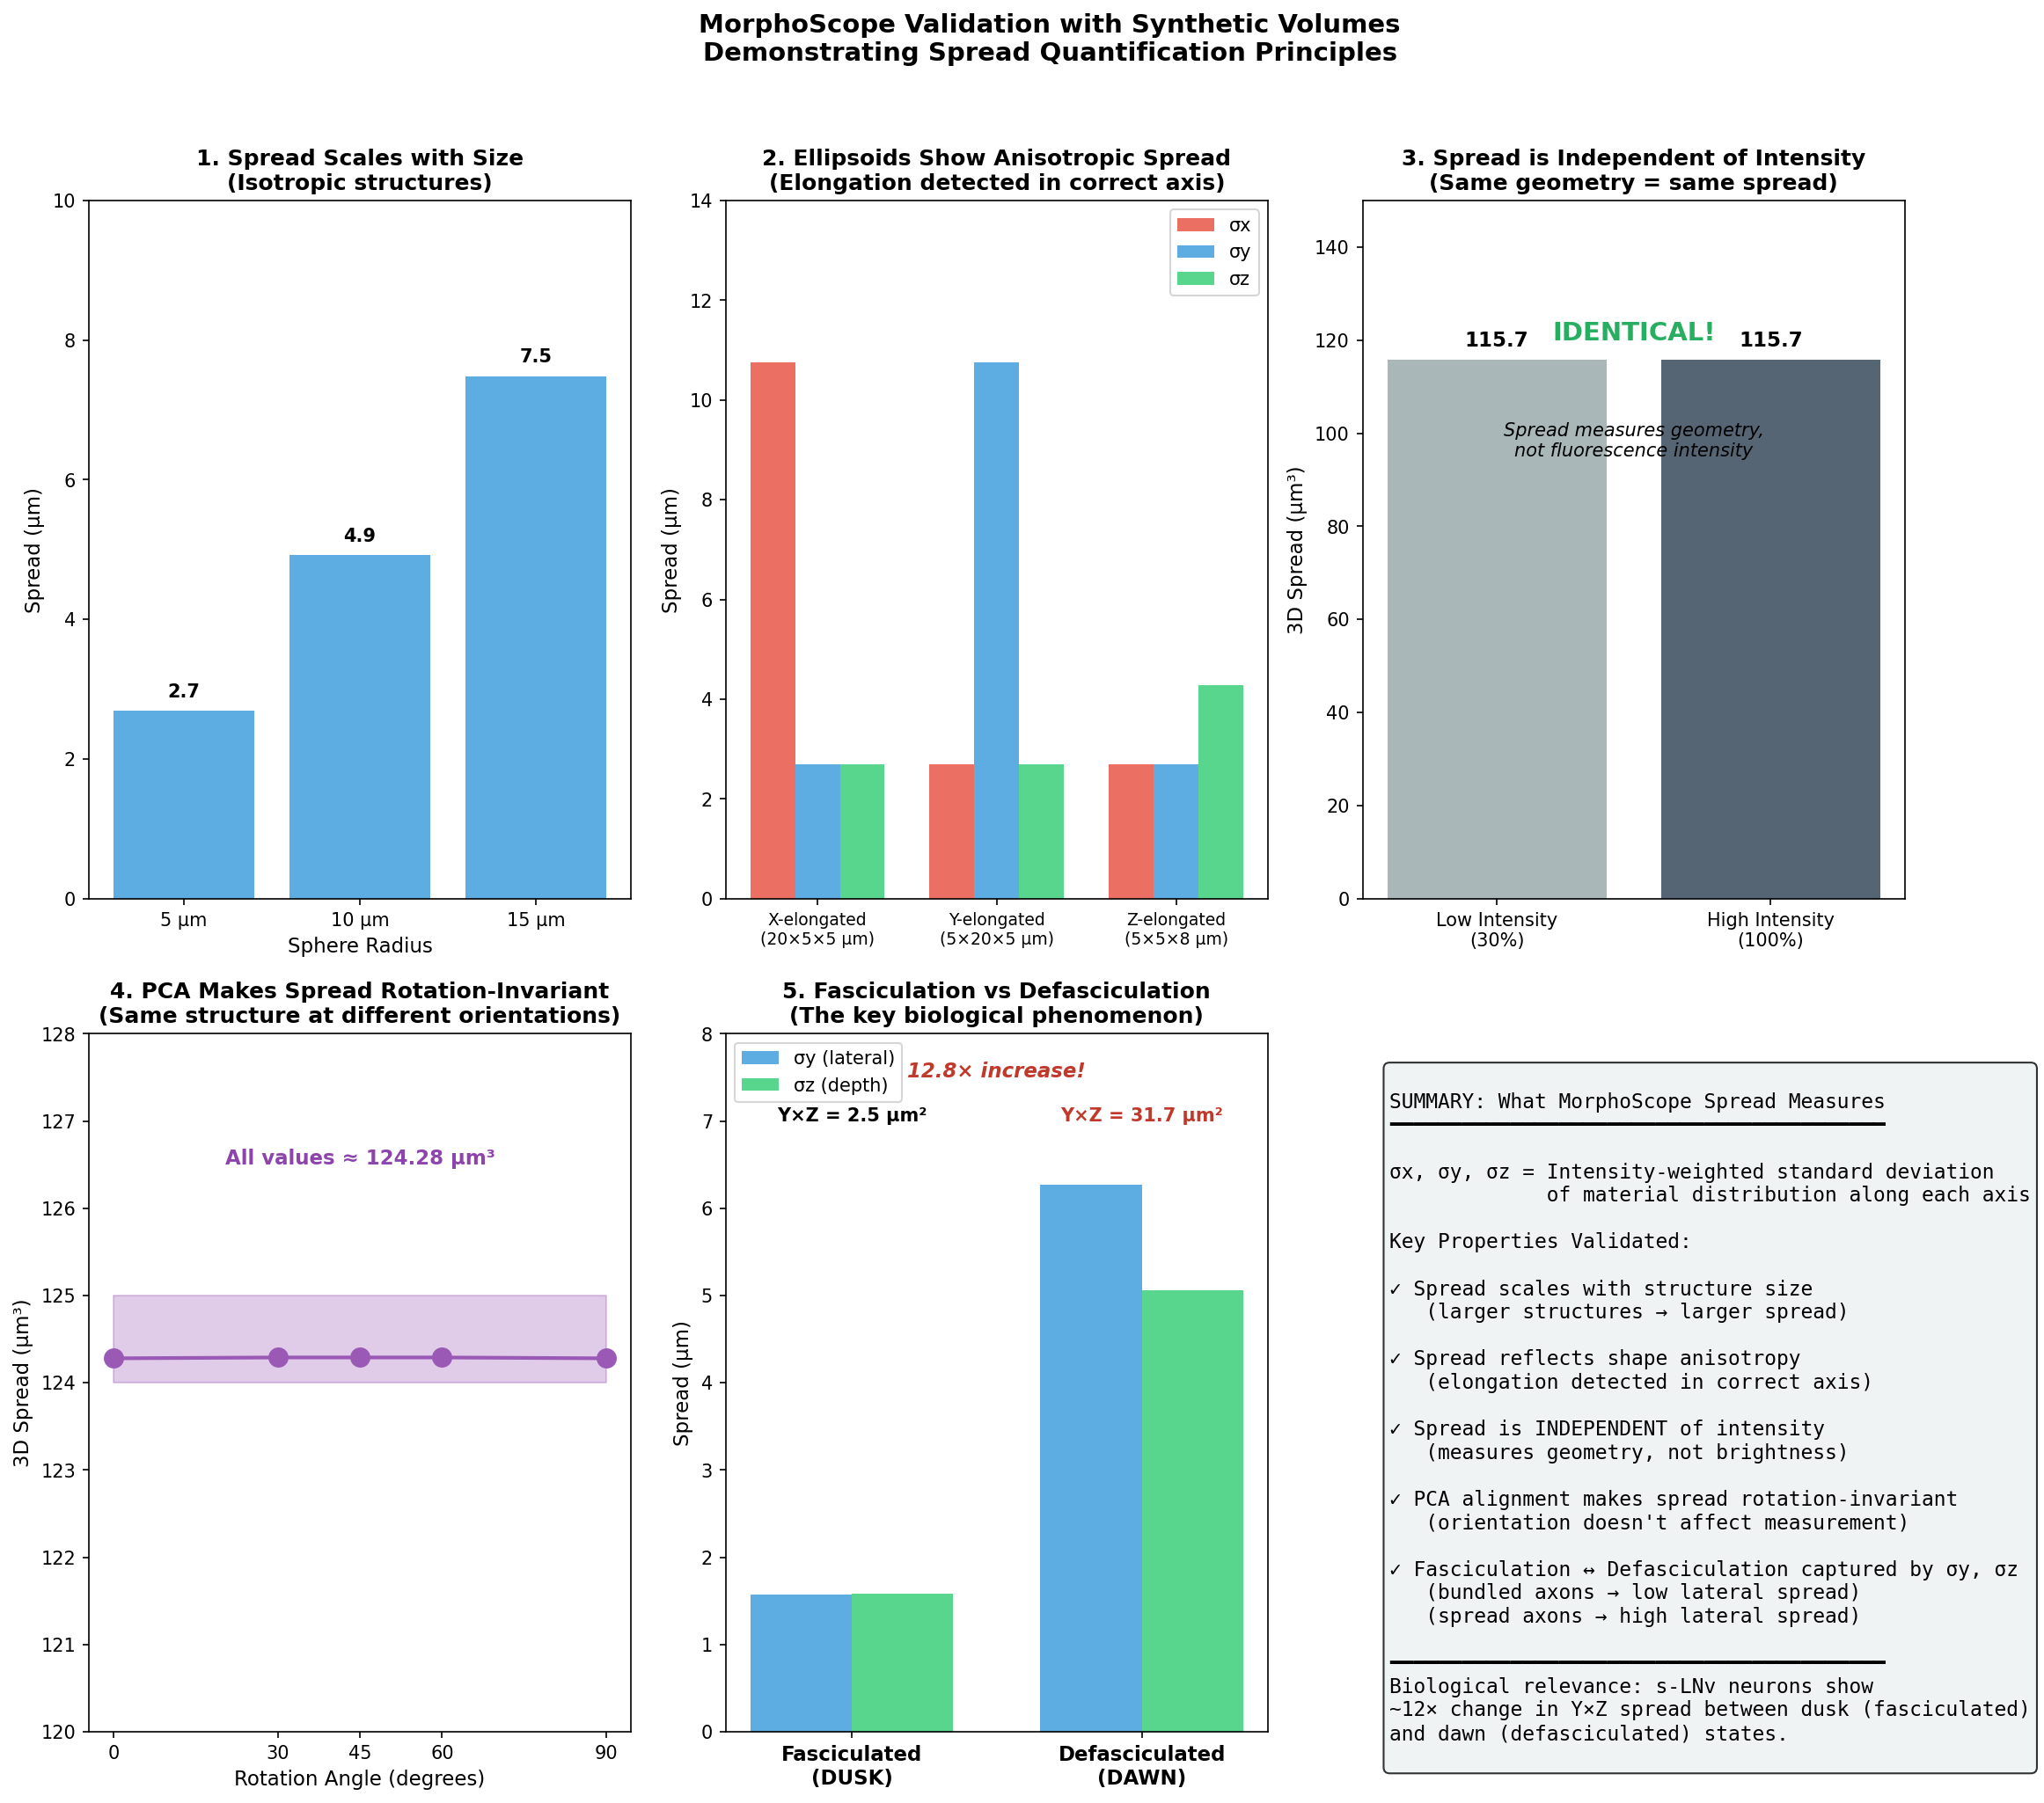

Slide 17
