Slide 1
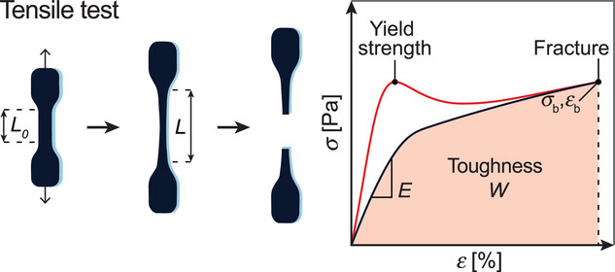
Tough Hydrogels for Load‐Bearing Applications
Advanced Science, Volume: 11, Issue: 12, First published: 15 January 2024, DOI: (10.1002/advs.202307404)
Notes:
Uniaxial tensile test experiment of a plastically deforming material (red) and an elastic hydrogel (black).
IF THIS IMAGE HAS BEEN PROVIDED BY OR IS OWNED BY A THIRD PARTY, AS INDICATED IN THE CAPTION LINE, THEN FURTHER PERMISSION MAY BE NEEDED BEFORE ANY FURTHER USE. PLEASE CONTACT WILEY'S PERMISSIONS DEPARTMENT ON PERMISSIONS@WILEY.COM OR USE THE RIGHTSLINK SERVICE BY CLICKING ON THE 'REQUEST PERMISSIONS' LINK ACCOMPANYING THIS ARTICLE. WILEY OR AUTHOR OWNED IMAGES MAY BE USED FOR NON-COMMERCIAL PURPOSES, SUBJECT TO PROPER CITATION OF THE ARTICLE, AUTHOR, AND PUBLISHER.

