Slide 1
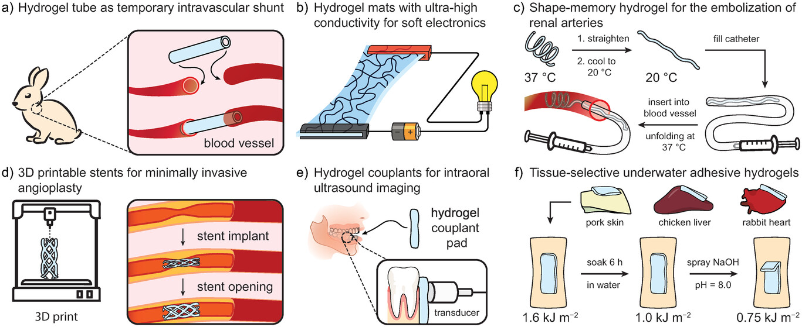
Tough Hydrogels for Load‐Bearing Applications
Advanced Science, Volume: 11, Issue: 12, First published: 15 January 2024, DOI: (10.1002/advs.202307404)
Notes:
Chosen examples of tough hydrogels applied in the areas of a) tissue engineering, b) soft electronics, c) shape memory materials, d) 3D printing, e) biomedical devices, and f) adhesives. Notably, the majority of the highlighted examples ultimately serve biomedical applications.
IF THIS IMAGE HAS BEEN PROVIDED BY OR IS OWNED BY A THIRD PARTY, AS INDICATED IN THE CAPTION LINE, THEN FURTHER PERMISSION MAY BE NEEDED BEFORE ANY FURTHER USE. PLEASE CONTACT WILEY'S PERMISSIONS DEPARTMENT ON PERMISSIONS@WILEY.COM OR USE THE RIGHTSLINK SERVICE BY CLICKING ON THE 'REQUEST PERMISSIONS' LINK ACCOMPANYING THIS ARTICLE. WILEY OR AUTHOR OWNED IMAGES MAY BE USED FOR NON-COMMERCIAL PURPOSES, SUBJECT TO PROPER CITATION OF THE ARTICLE, AUTHOR, AND PUBLISHER.

