Slide 1
18EC2015 - DIGITAL SIGNAL PROCESSING
Implementation Of Image Compressor Using Python
V.FRANCLIN
URK22EC2001

Slide 2
TABLE OF CONTENTS
Introduction.
Description.
Algorithm.
Library Function.
Compiler Used.
Output.
Application.

Slide 3
INTRODUCTION
Learn to build an image compressor in Python using libraries like Pillow or OpenCV.
This tutorial teaches essential image processing and compression techniques, enabling efficient management of image data in your projects.

Slide 4
DESCRIPTION
Get The Image: Start by loading the image you want to compress.
Reduce The File Size: Use Python to shrink the image's file size while keeping its quality as good as possible.
Save The Compressed Image: Once compressed, save the smaller image file.
Enjoy The Smaller File: Now you have an image that takes up less space but still looks good.

Slide 5
ALGORITHM
JPEG Compression: For balanced lossy and lossless compression.
PNG Compression: For lossless compression, preserving detail and quality.
WebP Compression: Offers better compression ratios than JPEG and PNG.
BPG (Better Portable Graphics): Provides superior compression with comparable quality.

Slide 6
LIBRARY FUNCTION
PIL (Python Imaging Library): Adds image processing capabilities. Imported with import PIL.
tkinter.filedialog: Part of tkinter for creating GUI’s. Used to open a file dialog for selecting image files.
askopenfilenames( ): Opens a file dialog to select one or more files.
convert( ): Converts image to RGB mode.
save( ): Saves the converted image as "Output.jpg" in JPEG format with optimized compression and quality level of 10.

Slide 7
COMPILER USED
Python project: Encrypting audio data with "cryptography" library.
Development environment: Visual Studio Code (VSCode).
VSCode advantages: Seamless Python integration, user-friendly interface, robust debugging.
Platform agnostic: Supports collaborative development across different OS.

Slide 8
CODE
import PIL from tkinter.filedialog import* from PIL import Image file=askopenfilenames() img=Image.open(file[0]) rgb_img=img.convert('RGB') rgb_img.save("Output.jpg","JPEG",optimize=True,quality=10)

Slide 9
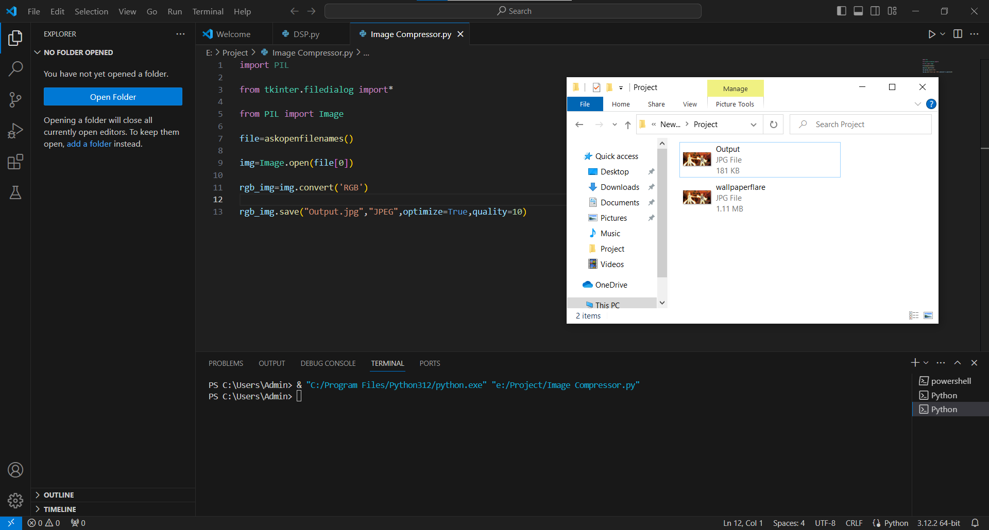
OUTPUT

Slide 10
APPLICATION
Image compression is an important application in medical fields, research, commercial, and defense.
The large files of image can't be quickly processed and cannot be stored efficiently.

Slide 11
THANK YOU

