Slide 1

ASL Fingerspelling
Recognition
Group Omicron – Martí Ponsa and Franco Olano

Slide 2
Table of contents
01
05
02
06
03
07
04
Introduction
Results & Discussion
State of the Art
Conclusions
Methodology
Demo application
Experiments

Slide 3
01
Introduction

Slide 4
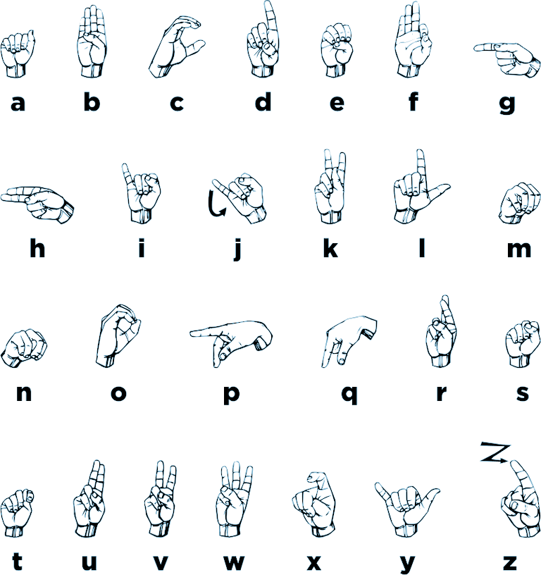
American Sign Language (ASL) Fingerspelling

Slide 5
Why is this topic relevant?
1.
2.
3.
Real-World Computer Vision Challenges
General Hand Expressions Recognizability
Accessibility and Communication
This is a key topic related to communication between deaf and hearing people.
Lighting variation, background noise and similar classes are all challenging factors that need to be addressed.
Interpret any hand symbol as an specific symbol a person desires, extending the capability of a system to recognize hand gestures.

Slide 6
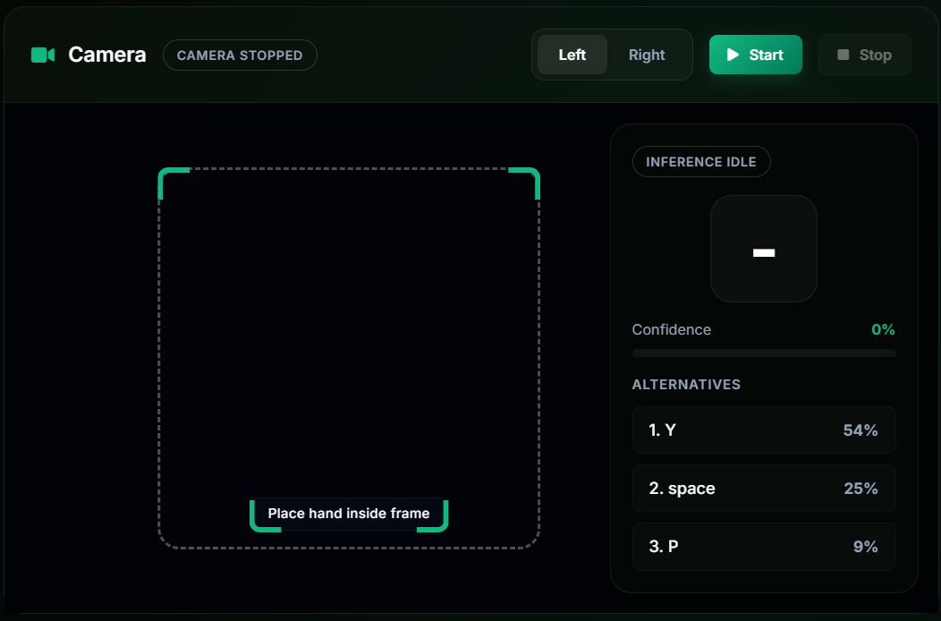
We come from Computer Engineering so….
We couldn’t resist building a working app on top of a model.
BUT FIRST…
We needed to train a model that fulfills the needs of the application.
A small preview ;)

Slide 7
Which models would work best?

Slide 8
02
State of the Art

Slide 9
A little bit of history…
Image classification is dominated by convolutional neural networks (CNNs), following the success of AlexNet.
Start of modern deep learning era
(win ImageNet)
Multi-scale inception feature extraction
Optimized inception for accuracy
Efficient inverted residual design
AlexNet (2012)
GoogLeNet (2014)
InceptionV3 (2015)
MobileNetV2 (2018)
VGGNet (2014)
ResNet (2015)
MobileNetV1 (2017)
Very deep, simple architectures
Residual connections enable very deep networks
Lightweight depthwise convolution network

Slide 10
Current State of the Art
Hybrid CNN-Transformer Networks
Spatiotemporal Keypoint & Skeleton-Based Models
Multimodal RGB-D (Depth) Networks
Neuromorphic & Spiking Neural Networks (SNNs)

Slide 11
Where is our project situated?

Slide 12
03
Methodology

Slide 13
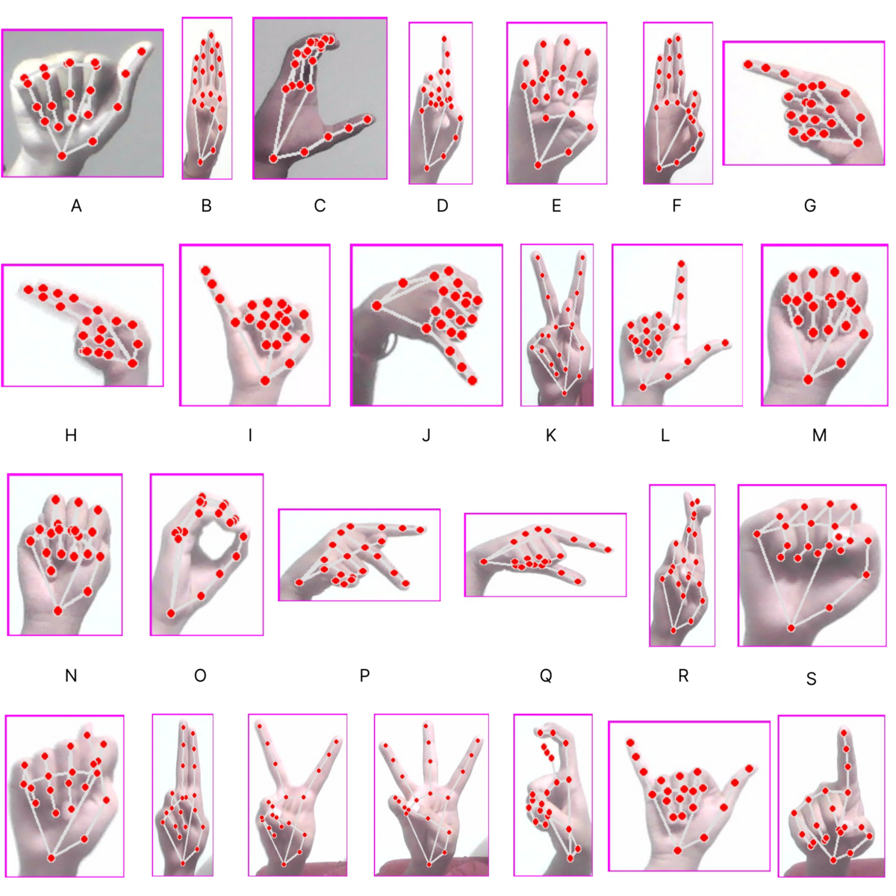
Dataset Analysis & Composition
Balanced Class Distribution
26 Base Classes: Alphabetical A-Z letters.
3 Extension Classes: 'space', 'del', and 'nothing'.
Volume: 3,000 images per class (balanced dataset).
Resolution: 200x200 pixel RGB images.
Variability: Diverse backgrounds and lighting conditions across folders.

Slide 14
Data Augmentation Strategy
"Safe" Augmentations:
Simulating natural variations without changing sign meaning:
Random Affine: Rotation (±15∘) & Translation (±10%).
Color Jitter: Brightness & Contrast shifts (±0.2).
Normalization: ImageNet channel statistics.
"Dangerous" Augmentations:
Prohibited transformations that break legibility:
Horizontal Flips: Mirroring changes fundamental hand sign semantics.
Extreme Rotations: Unrealistic hand poses lead to poor generalization.

Slide 15
Splitting Strategy & Constraints
1.
2.
3.
Pre-split Shuffling
Data Leakage Risk
70 / 15 / 15 Split
70% Training, 15% Validation, 15% Testing. Randomized split with fixed seed (42) for reproducibility.
Thorough shuffling of class directories to ensure homogeneous representation of backgrounds and subjects.
Due to missing subject IDs, strict subject-independent splitting is not possible. Results may be optimistic.

Slide 16
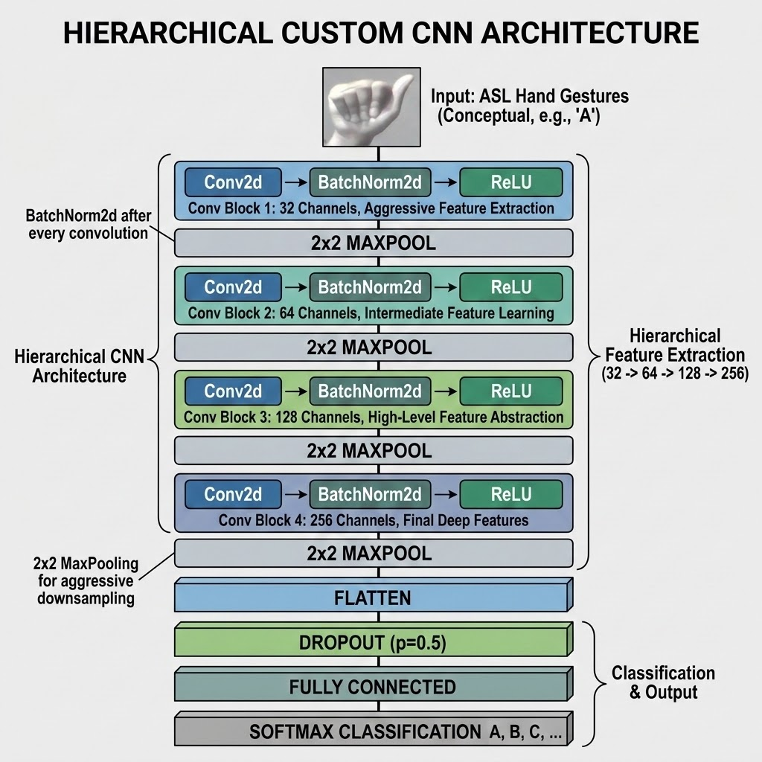
Custom CNN Architecture
Hierarchical Feature Extraction
4 Conv Blocks: Increasing channel depth (32 → 64 → 128 → 256).
Normalization: BatchNorm2d after every convolution for stable training.
Spatial Pooling: 2x2 MaxPooling for aggressive downsampling.
Regularization: Dropout (p=0.5) before final classification.

Slide 17
Advanced Architectures
MobileNetV2
Efficiency & Edge Ready
Inverted Residual Blocks.
Depthwise Separable Convolutions.
Ideal for real-time webcam demo.
InceptionV3
Multi-Scale Feature Tracking
Parallel factorized convolutions.
Parallel 1x1, 3x3, and 5x5 filters.
Superior for fine details (M vs N).

Slide 18

Execution Workflow (Kaggle)
Shuffling and batching on Kaggle scratch disks.
GPU acceleration (nvidia tesla t4) with dynamic checkpointing.
Data Pipeline
Training
Architecture
Metrics Export
PyTorch model definition (Custom vs Pre-trained).
Detailed CSV export for macro and per-class analysis.

Slide 19
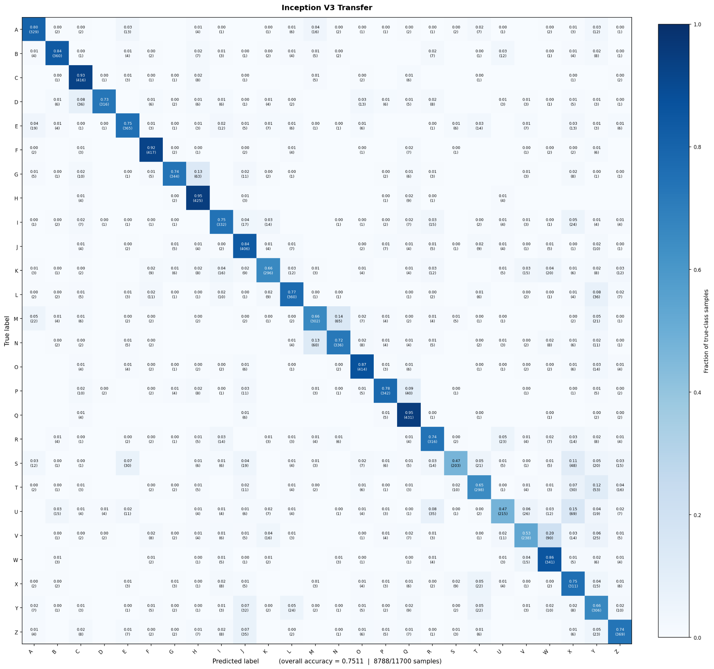
Evaluation Design
Beyond Accuracy
Macro F1: Tracks uniform performance across all classes, preventing masked blind spots.
Confusion Matrix: Visualizing heatmaps to identify structural confusion between similar hand shapes.
Per-Class Metrics: Per-class F1 Score

Slide 20
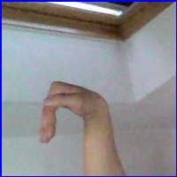

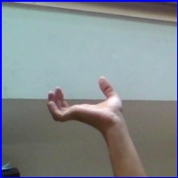
Phase 2: Transfer learning for 29-class Extension
After model evaluation comparison….
DEL
NOTHING
SPACE
Select best model checkpoint
Rebuild the neural network
Change the output layer for a 29-class classifier
Perform fine tuning to the model
Evaluate the model with the same metrics

Slide 21
04
Experiments

Slide 22
Comparative Architecture: Custom CNN
Objective: Establish an empirical baseline using our custom topology to isolate hand silhouettes and test classical optimization behaviors.
Custom CNN + SGD + Momentum
Our strict baseline framework.
Examines classical stochastic gradient descent on non-pretrained feature maps.
Custom CNN + Adam
Replaces fixed momentum with adaptive first and second-moment tracking.
Evaluates convergence acceleration and how adaptive step sizes navigate loss plateaus.

Slide 23
Comparative Architecture: InceptionV3
Objective: Evaluate a high-capacity network that utilizes parallel, multi-scale receptive fields crucial for capturing fine structural variations (e.g., distinguishing letters like M vs. N).
From Scratch
Investigates if a complex, deep network can self-assemble detailed hand features entirely from raw data.
Uses a baseline step size with SGD + Momentum.
Transfer Learning / Feature Extraction
Freezes the deep ImageNet base to leverage its highly optimized, pre-trained multiscale extractors.
Uses a scaled-down learning rate to prevent gradient shock on the new linear head.

Slide 24
Comparative Architecture: MobileNetV2
Objective: Benchmark a highly efficient network engineered with depthwise separable convolutions and inverted residuals, targeted for low-latency web applications.
From Scratch
Tests if efficient localized depthwise channels can map hand trajectories organically without an introductory prior distribution (same as with InceptionV3).
Transfer Learning / Feature Extraction
Freezes the residual features base. It utilizes pre-optimized spatial shortcuts for fast alphabet recognition.

Slide 25
Hyperparameter Justification
Hyperparameter | Chosen Value | Justification for Selection | Affected Experiments
Epochs | 5 | 30hs of GPU usage on Kaggle limitation, fast experimentation. | All 6 Experiments
Batch Size | 10 | Force stochastic gradient noise into the path and avoid early local minima. | All 6 Experiments
Base Learning Rate | 1×10⁻³ | Standard established default for cross-entropy minimization across computer vision models. | All 6 Experiments
Loss Function | CrossEntropyLoss | Standard mathematical loss for multi-class categorization problems. | All 6 Experiments
SGD Learning Rate | 1×10⁻³ | Small step size to isolate and map the true geometry of the loss surface. | Experiment 1 (Custom + SGD)
SGD Momentum | 0.9 | To accelerate convergence into the most meaningful directions. | Experiment 1 (Custom + SGD)

Slide 26
Hyperparameter Justification
Hyperparameter | Chosen Value | Justification for Selection | Affected Experiments
Adam Learning Rate | 1×10⁻³ | Safely fine-tune step scales dynamically. | Experiment 2 (Custom + Adam)
Adam Beta 1 (β1​) | 0.9 | Maintaining stable forward direction memory. | Experiment 2 (Custom + Adam)
Adam Beta 2 (β2​) | 0.999 | Ensure that the scale normalization acts smoothly. | Experiment 2 (Custom + Adam)

Slide 27

Fine tuning the Best Model
……..It was MobilenetV2
Trained the model with the full dataset and same hyperparameters, replacing the original classifier with a 29-class classifier.
3 Feature Layers were unfrozen. A total of 1,243,229
parameters.

Slide 28
05
Results
& Discussion

Slide 29
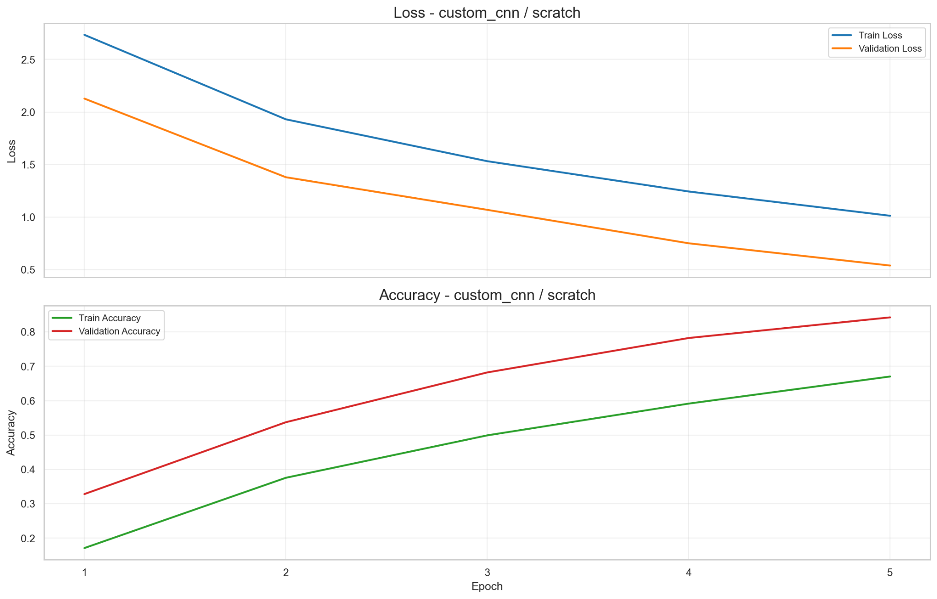
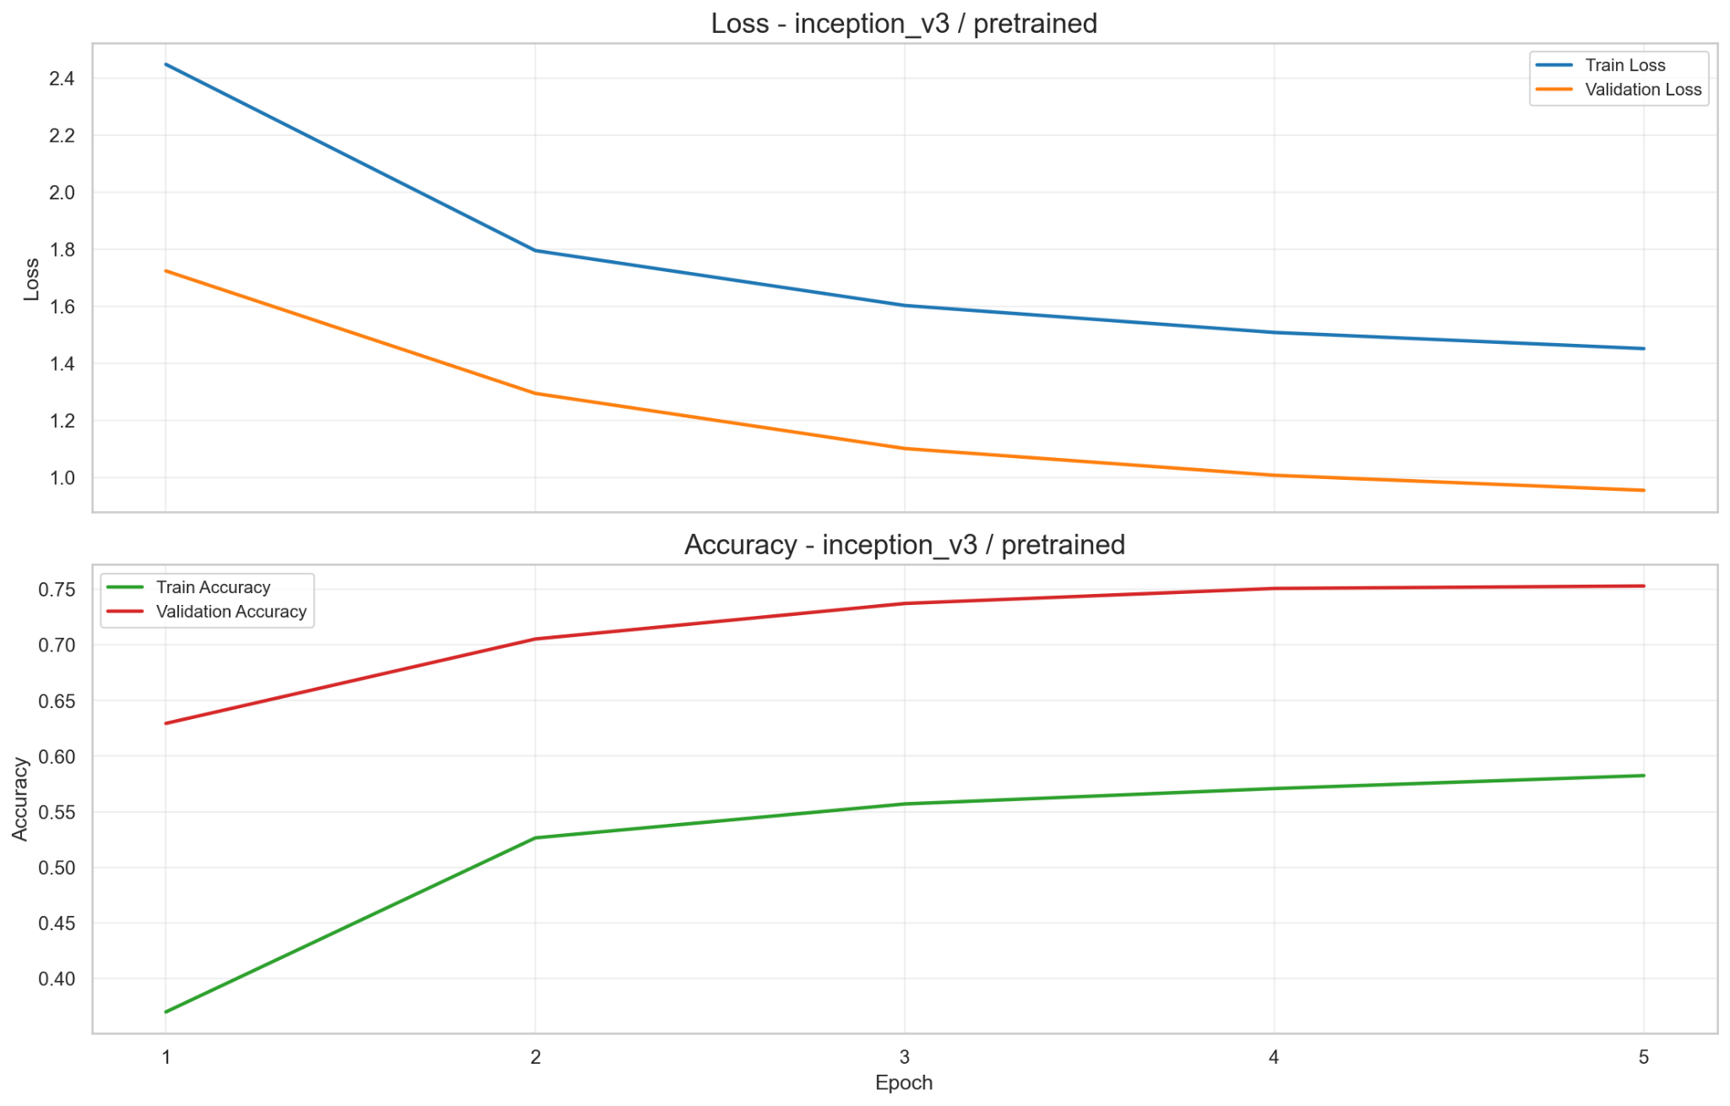
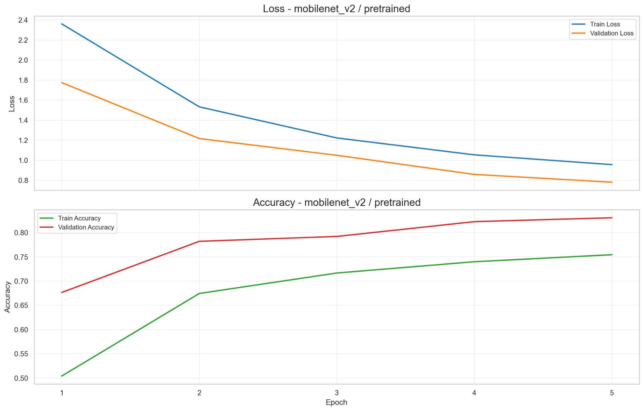
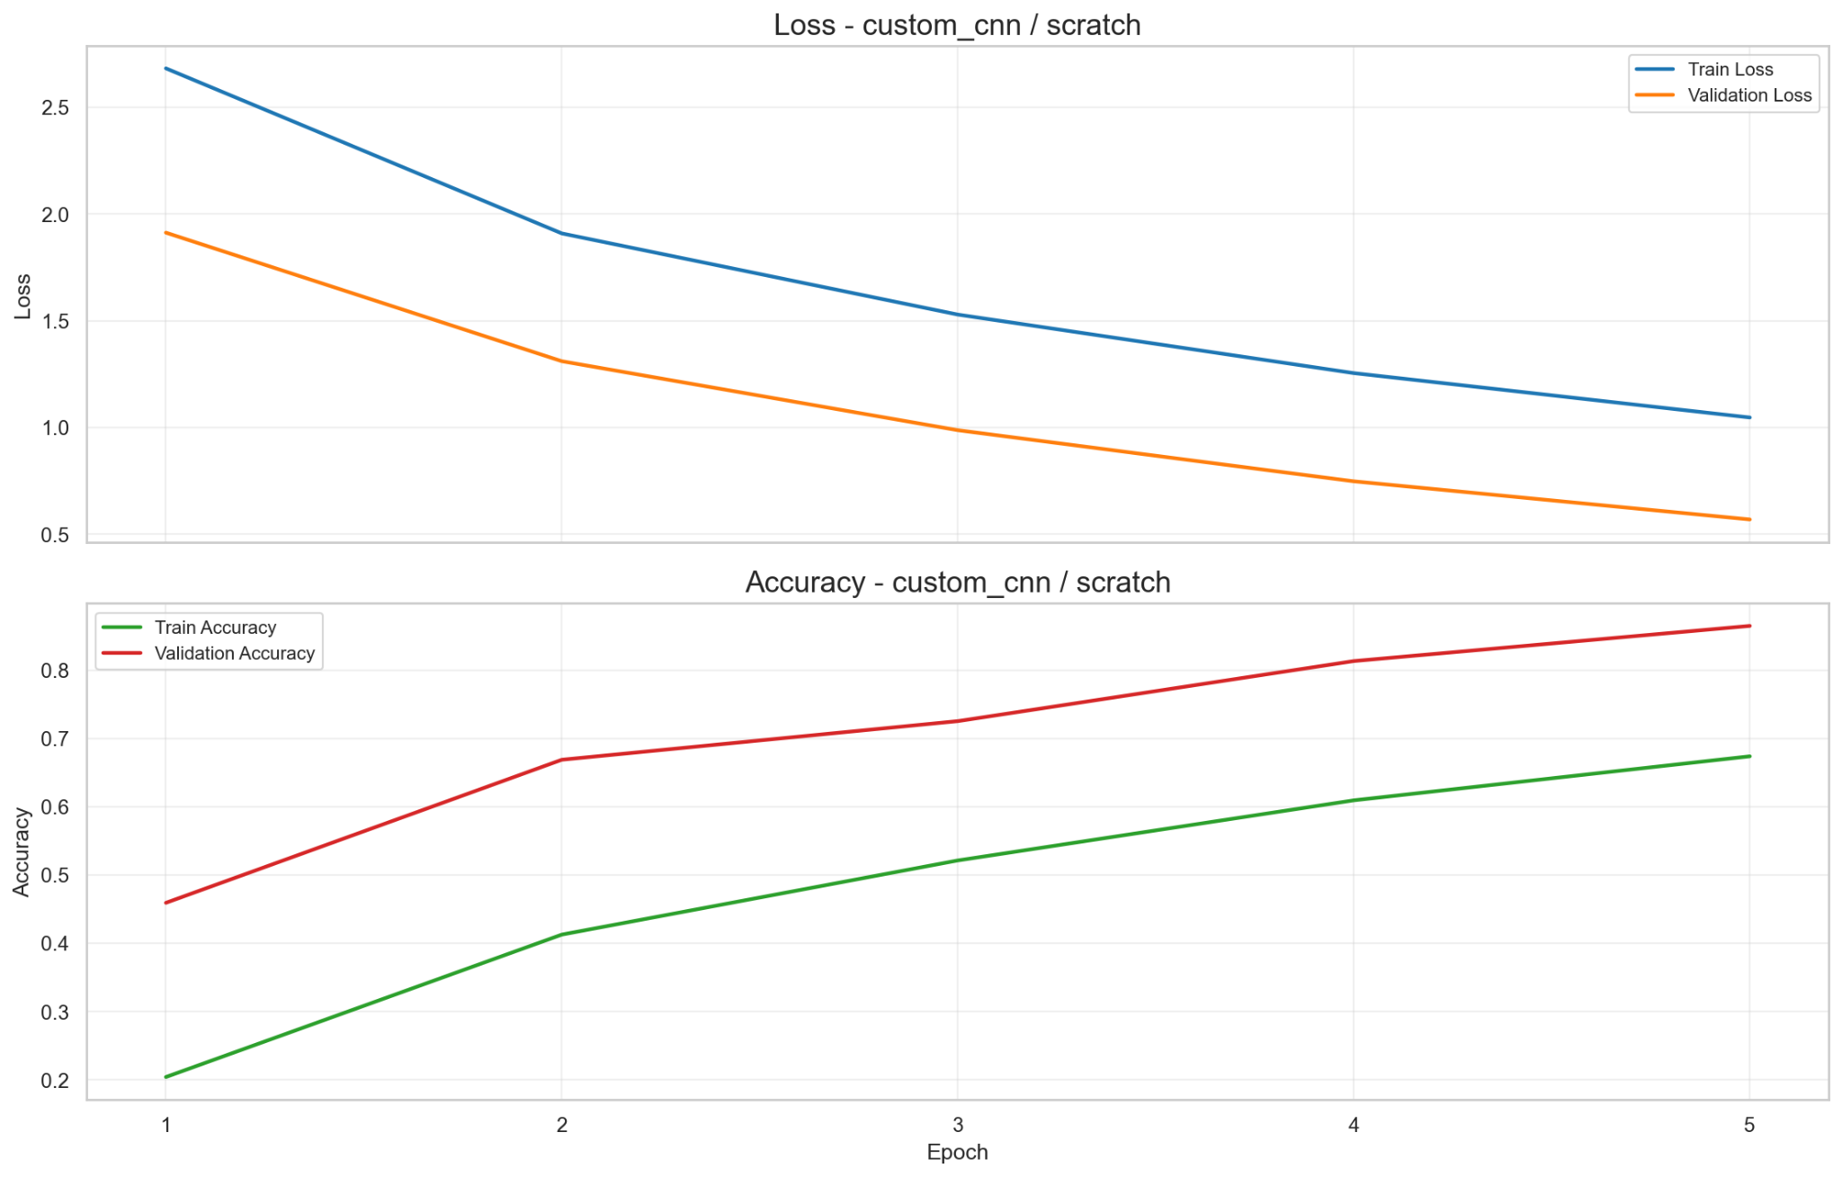
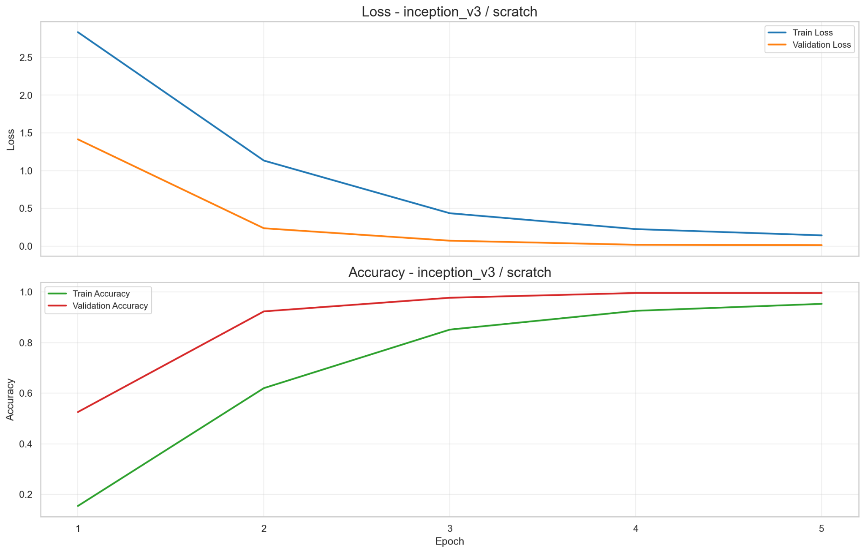
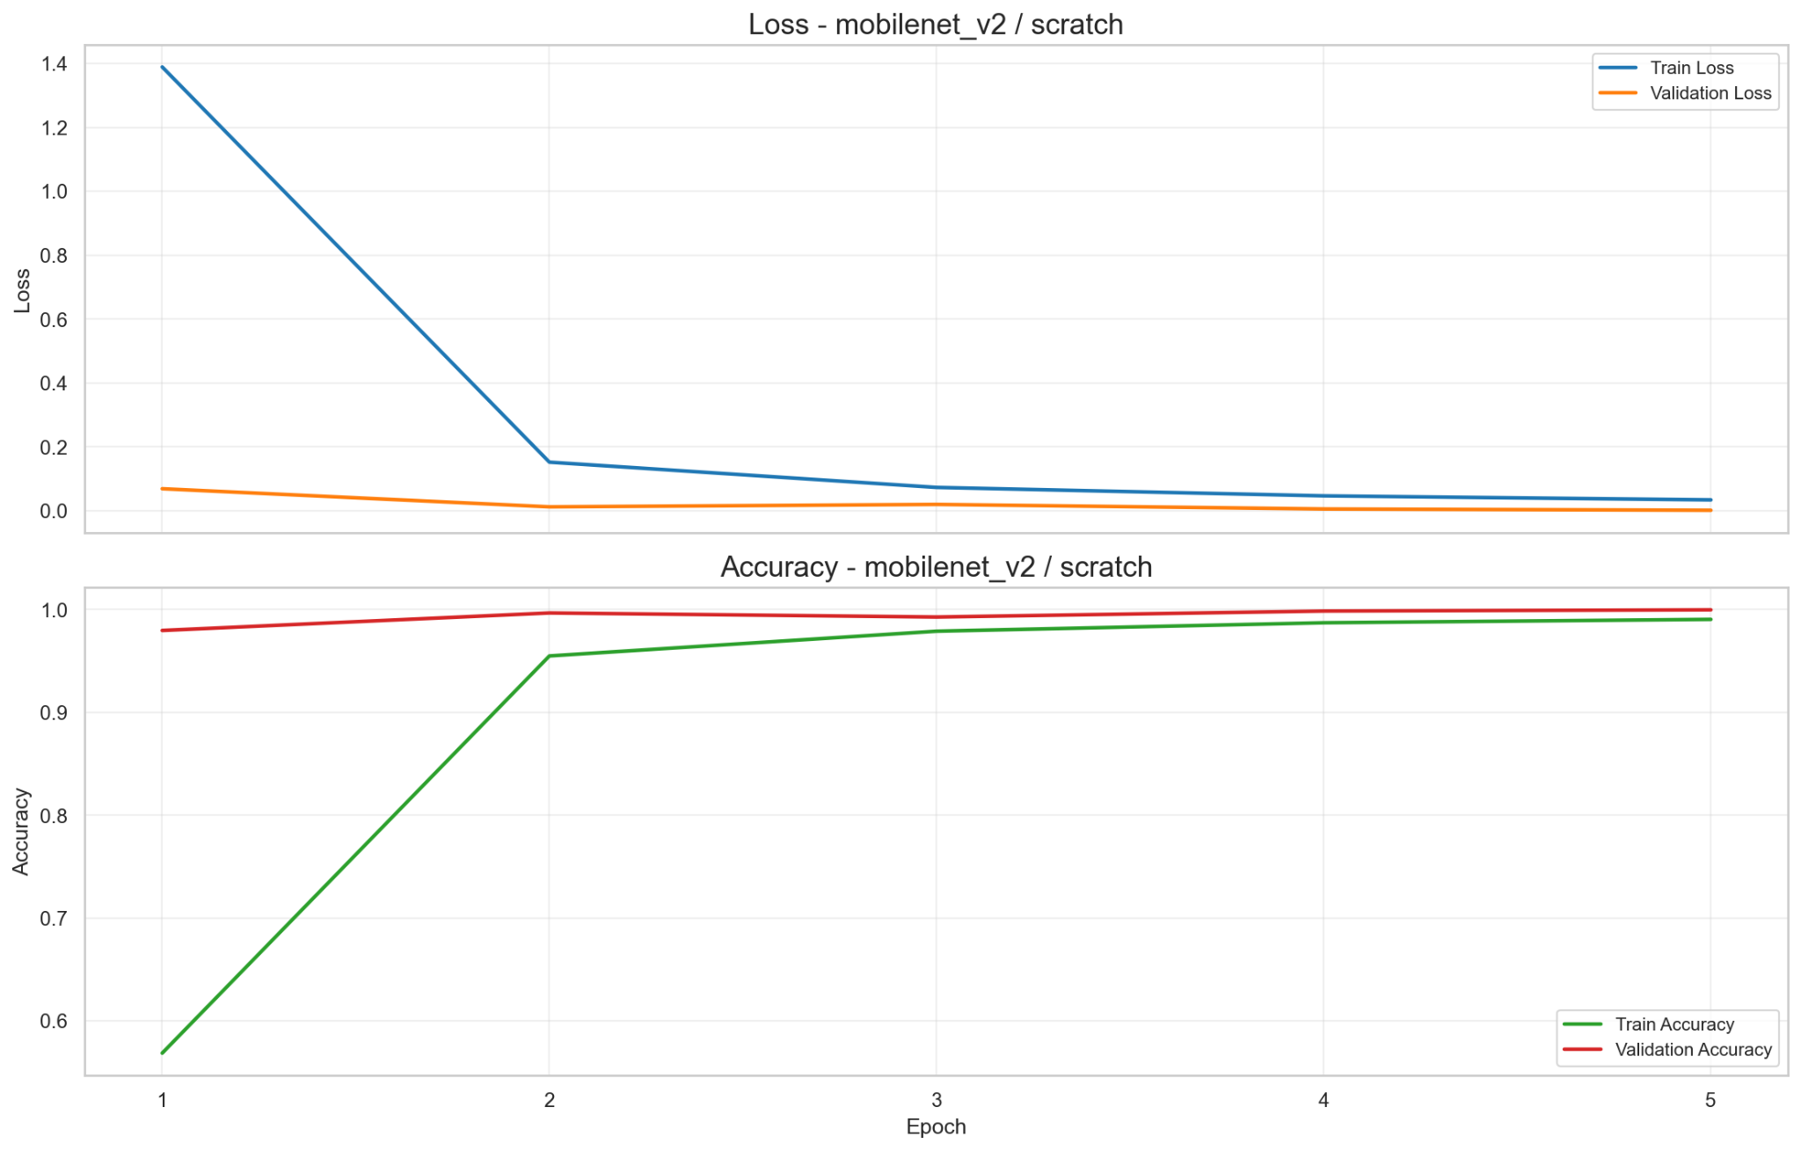
Loss & Accuracy Curves: Training and Validation
Custom - SDG
InceptionV3 - FE
MobilenetV2 - FE
Custom - Adam
InceptionV3 - Full
MobilenetV2 - Full

Slide 30
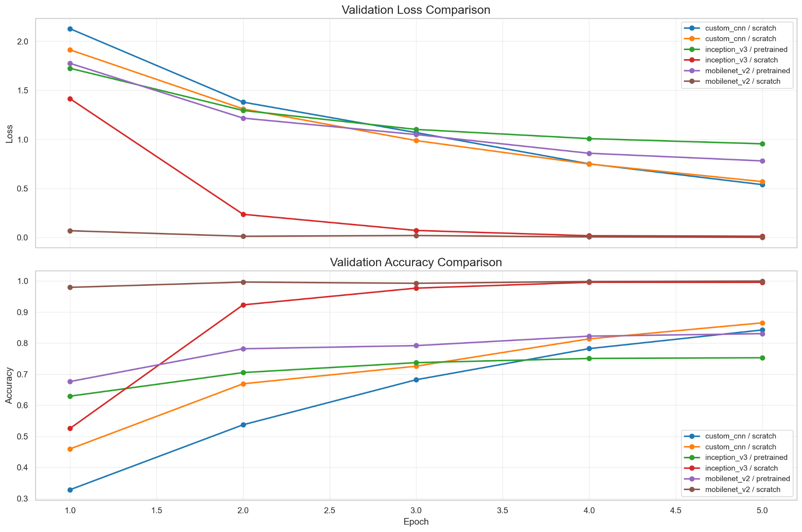

Slide 31
Training Summary
Experiment | Trainable Parameters | Epochs | Training Loss | Validation Loss | Training Accuracy | Validation Accuracy
Custom + SGD Momentum | 396,058 | 5 | 1.0126 | 0.5388 | 0.6703 | 0.8424
Custom + Adam | 396,058 | 5 | 1.0473 | 0.5698 | 0.6742 | 0.8653
InceptionV3 - Feature Extraction | 53,274 | 5 | 1.4519 | 0.9548 | 0.5824 | 0.7529
InceptionV3 - Full | 21,838,842 | 5 | 0.1425 | 0.0126 | 0.9530 | 0.9958
MobilenetV2 - Feature Extraction | 33,306 | 5 | 0.9560 | 0.7806 | 0.7543 | 0.8305
MobilenetV2 - Full | 2,257,178 | 5 | 0.0342 | 0.0017 | 0.9904 | 0.9997

Slide 32
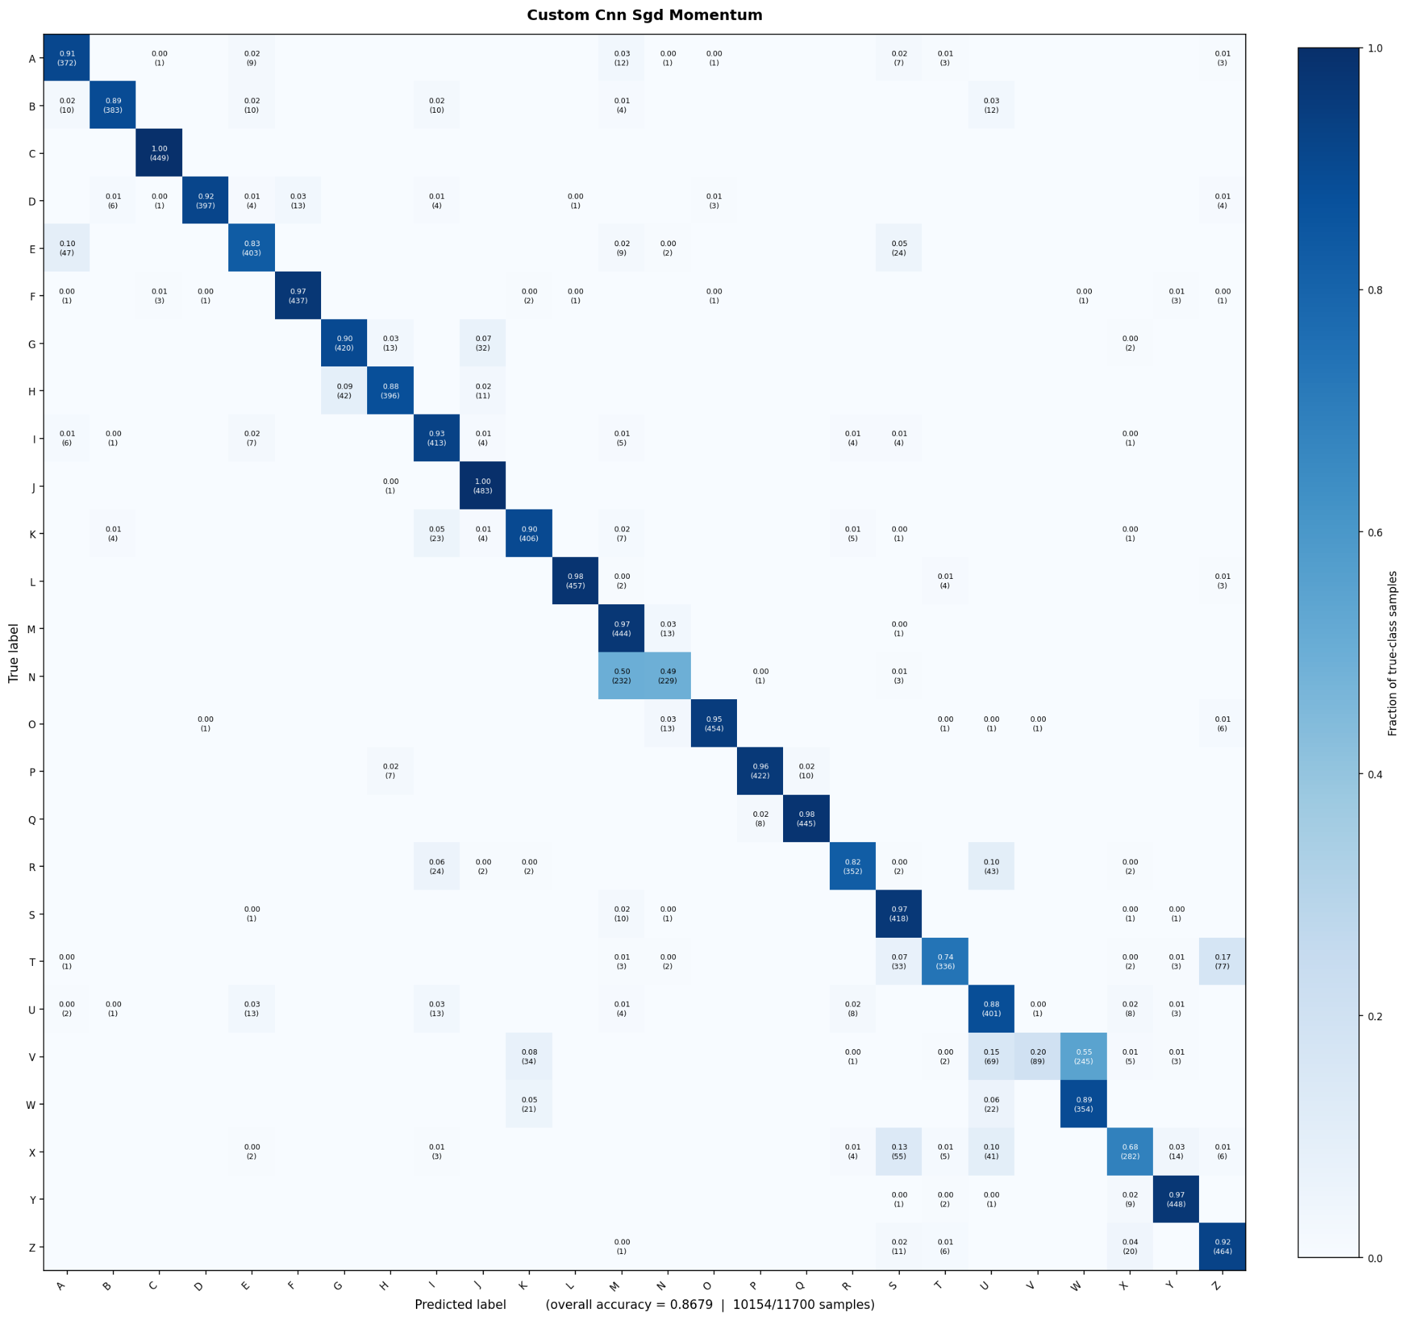
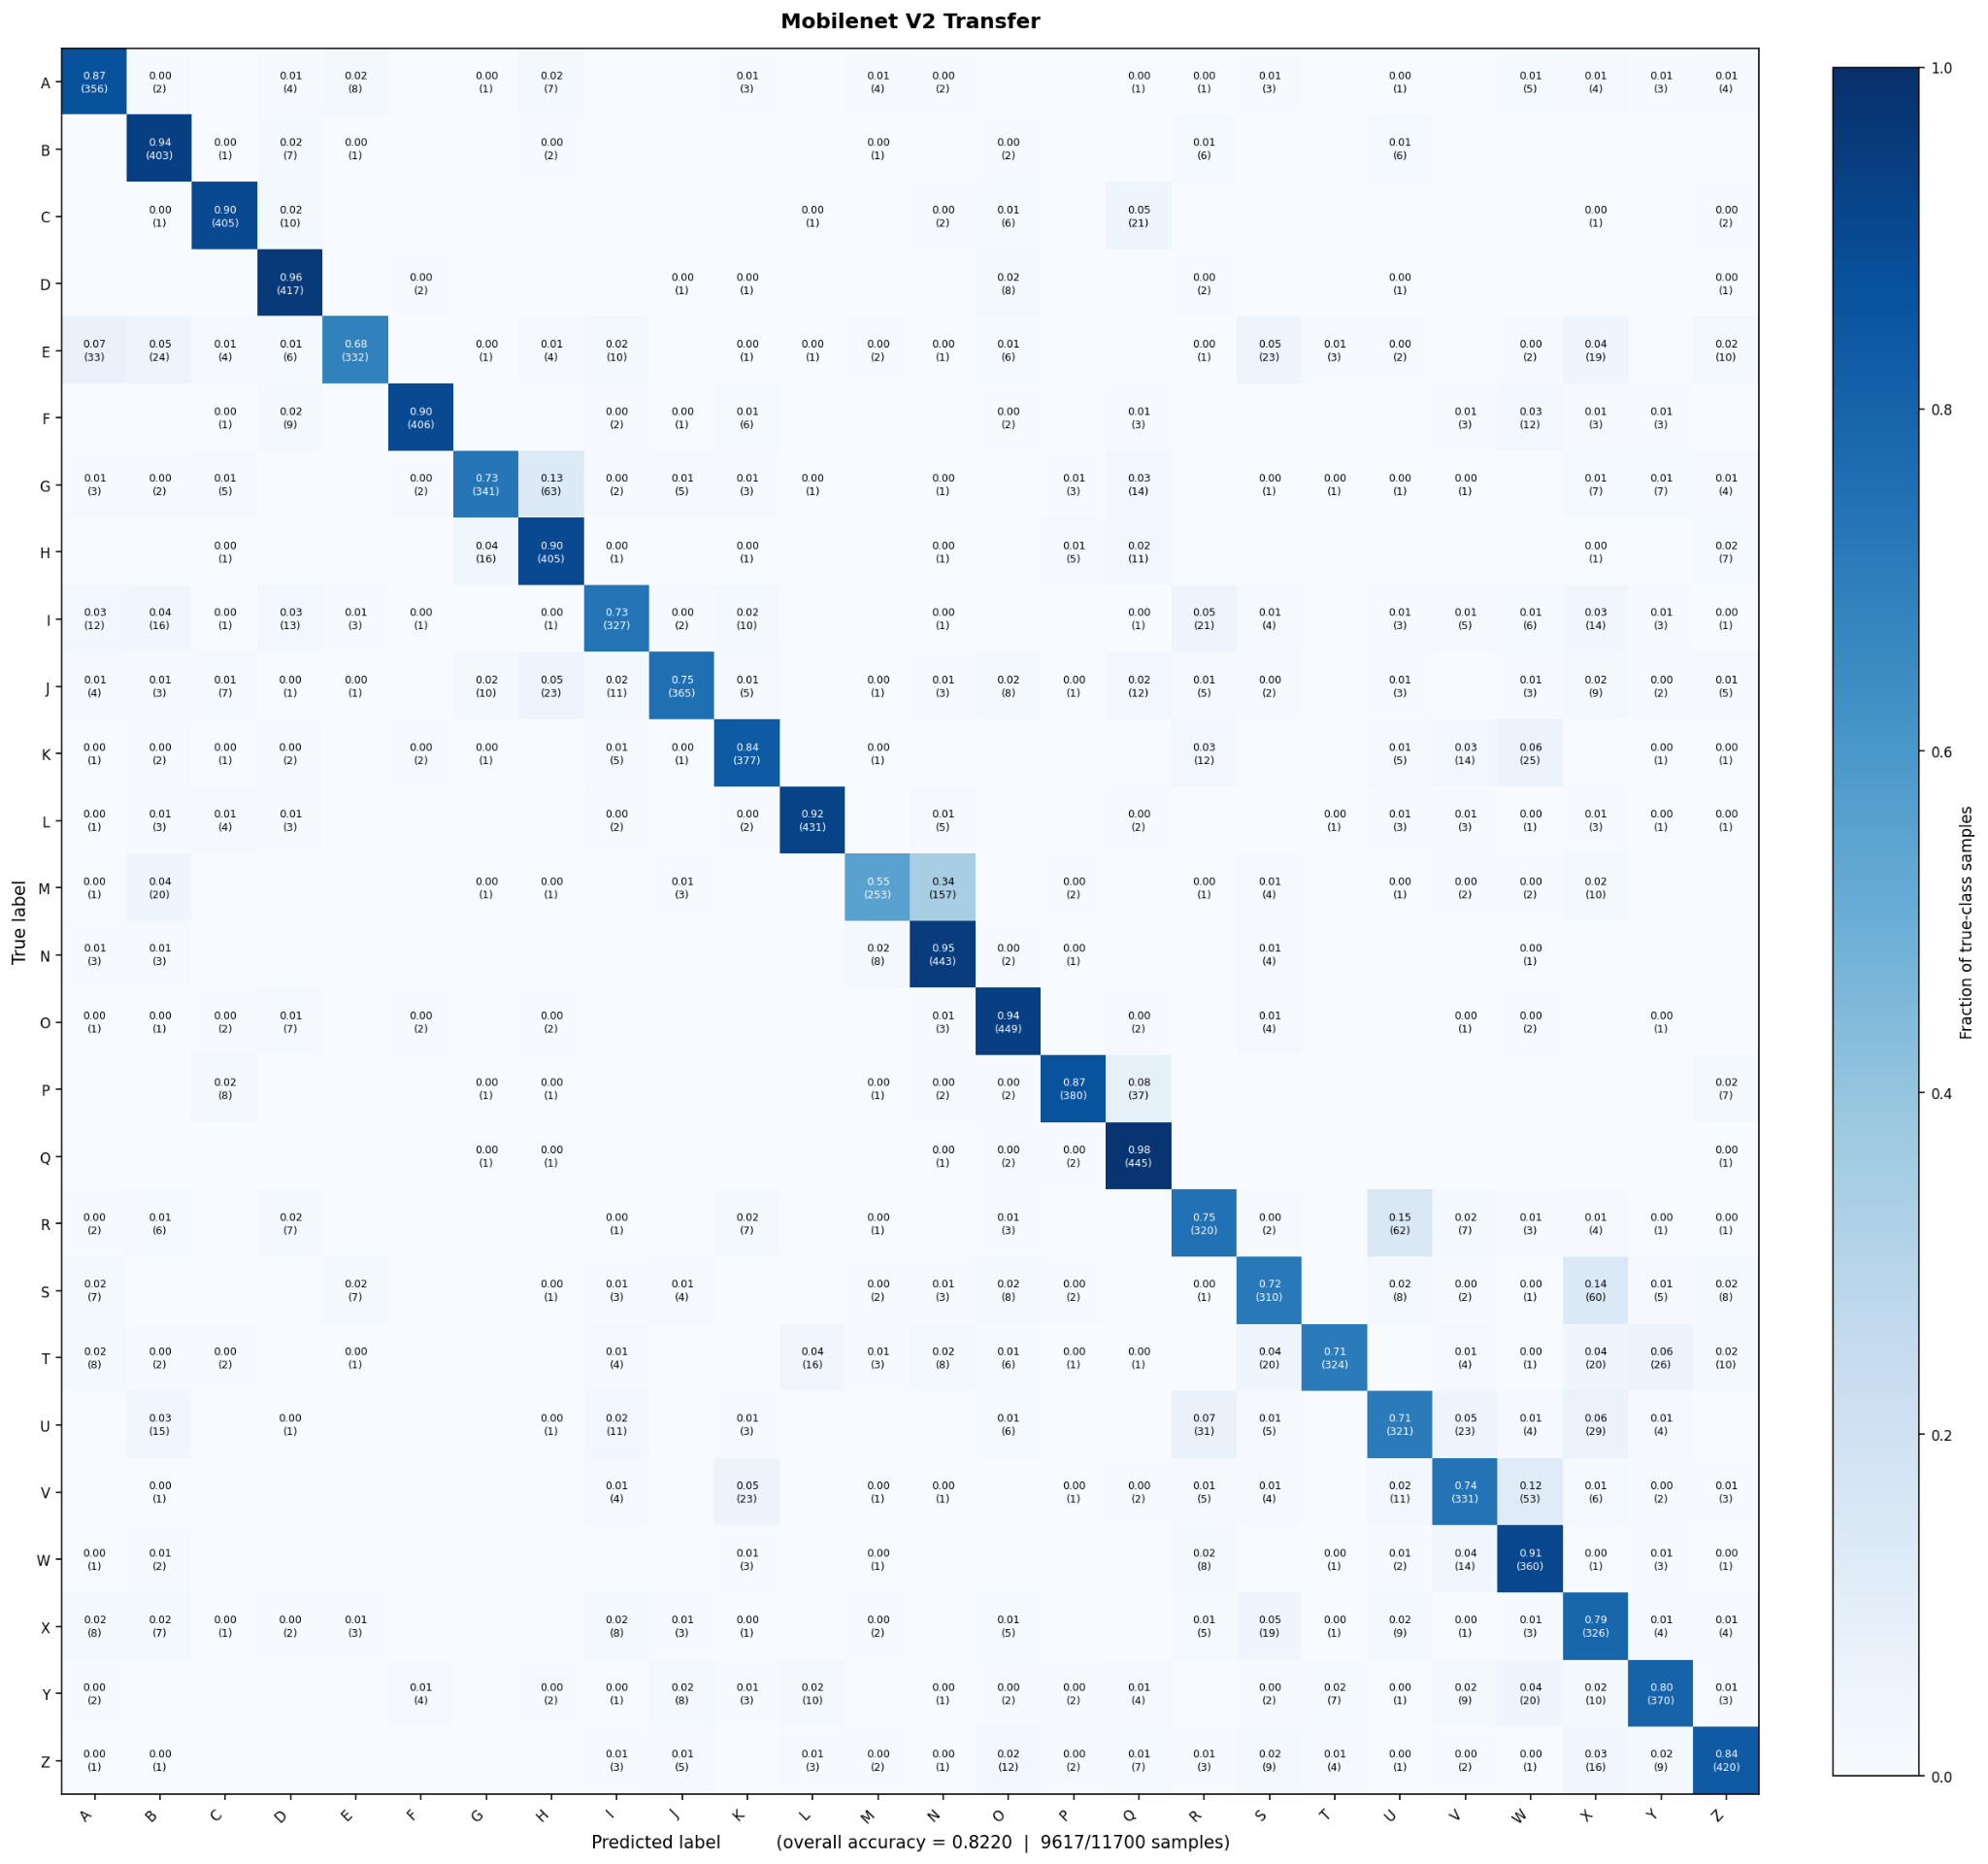

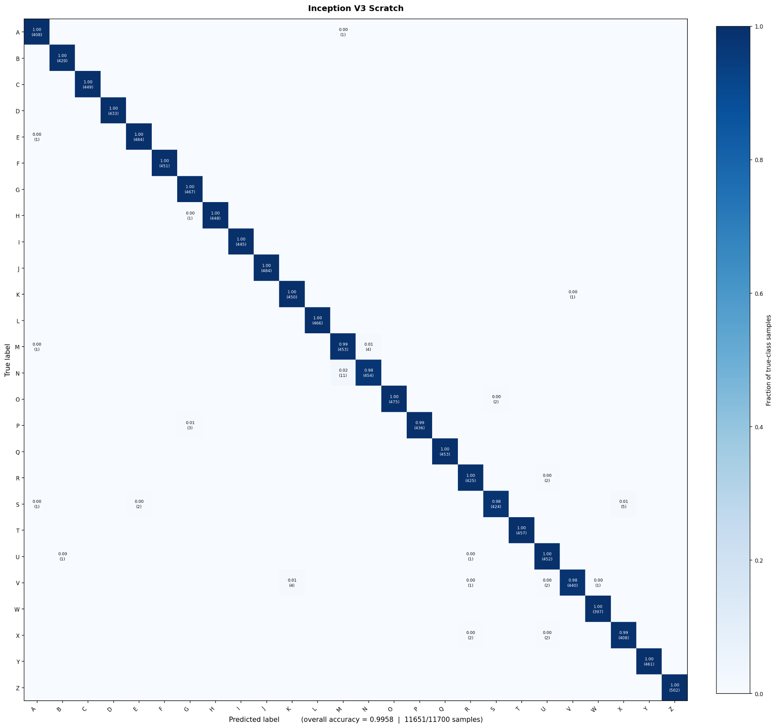

Confusion Matrices
Custom - SGD
InceptionV3 - FE
MobilenetV2 - FE
Custom - Adam
InceptionV3 - Full
MobilenetV2 - Full

Slide 33
Per-class F1 Score
F1 = 2 x Precision x Recall Precision + Recall
Custom- SGD
Custom- Adam
InceptionV3 - FE
InceptionV3 - Full
MobilenetV2 - FE
MobilenetV2 - Full
A 0.8773
B 0.9296
C 0.9944
D 0.9543
E 0.8629
F 0.9700
G 0.9041
H 0.9145
I 0.8834
J 0.9470
K 0.8864
L 0.9881
M 0.7455
N 0.6308
O 0.9700
P 0.9701
Q 0.9801
R 0.8789
S 0.8427
T 0.8235
U 0.7681
V 0.3302
W 0.7101
X 0.7570
Y 0.9572
Z 0.8705
A 0.8032
B 0.8285
C 0.9933
D 0.9462
E 0.8261
F 0.9550
G 0.9307
H 0.9369
I 0.9550
J 0.9803
K 0.9407
L 0.9360
M 0.8042
N 0.8400
O 0.9829
P 0.9761
Q 0.9866
R 0.8709
S 0.8970
T 0.6351
U 0.7967
V 0.5047
W 0.7209
X 0.7751
Y 0.9315
Z 0.8252
A 0.7995
B 0.8551
C 0.8421
D 0.8315
E 0.7749
F 0.8919
G 0.8103
H 0.8292
I 0.7511
J 0.7518
K 0.7210
L 0.7834
M 0.6958
N 0.7567
O 0.8492
P 0.8142
Q 0.8368
R 0.7289
S 0.5988
T 0.6819
U 0.5702
V 0.6102
W 0.7486
X 0.6201
Y 0.5666
Z 0.7500
A 0.9951
B 0.9988
C 1.0
D 1.0
E 0.9969
F 1.0
G 0.9957
H 0.9988
I 1.0
J 1.0
K 0.9944
L 1.0
M 0.9815
N 0.9837
O 0.9978
P 0.9965
Q 1.0
R 0.9929
S 0.9883
T 1.0
U 0.9912
V 0.9898
W 0.9987
X 0.9890
Y 1.0
Z 1.0
A 0.8347
B 0.8547
C 0.9080
D 0.9045
E 0.7895
F 0.9333
G 0.8119
H 0.8411
I 0.7785
J 0.8276
K 0.8377
L 0.9278
M 0.6828
N 0.8047
O 0.8926
P 0.9036
Q 0.8759
R 0.7538
S 0.7311
T 0.8110
U 0.7173
V 0.7609
W 0.7982
X 0.6827
Y 0.8167
Z 0.8433
A 0.9987
B 1.0
C 1.0
D 1.0
E 1.0
F 1.0
G 1.0
H 1.0
I 1.0
J 1.0
K 1.0
L 1.0
M 0.9978
N 0.9978
O 1.0
P 1.0
Q 1.0
R 1.0
S 0.9988
T 1.0
U 1.0
V 1.0
W 1.0
X 1.0
Y 1.0
Z 1.0

Slide 34
Testing Metrics Summary
Experiment | Trainable Parameters | Epochs | Loss | Macro F1 | Accuracy
Custom + SGD Momentum | 396,058 | 5 | 0.5308 | 0.8595 | 0.8459
Custom + Adam | 396,058 | 5 | 0.5607 | 0.8684 | 0.8716
InceptionV3 - Feature Extraction | 53,274 | 5 | 0.9609 | 0.7488 | 0.7511
InceptionV3 - Full | 21,838,842 | 5 | 0.0178 | 0.9957 | 0.9958
MobilenetV2 - Feature Extraction | 33,306 | 5 | 0.7909 | 0.8201 | 0.8219
MobilenetV2 - Full | 2,257,178 | 5 | 0.0013 | 0.9997 | 0.9997

Slide 35
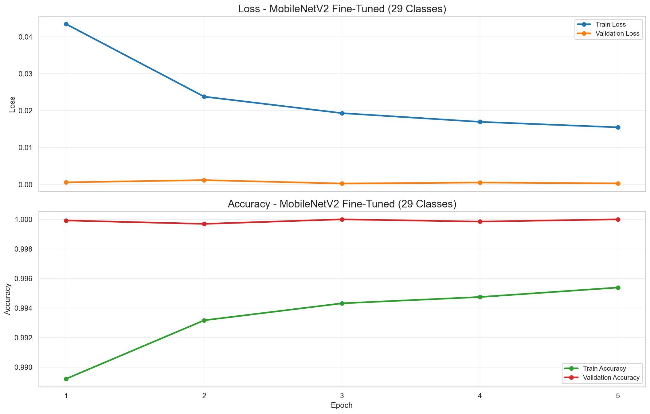
Loss & Accuracy Curves: 29-class Extension

Slide 36
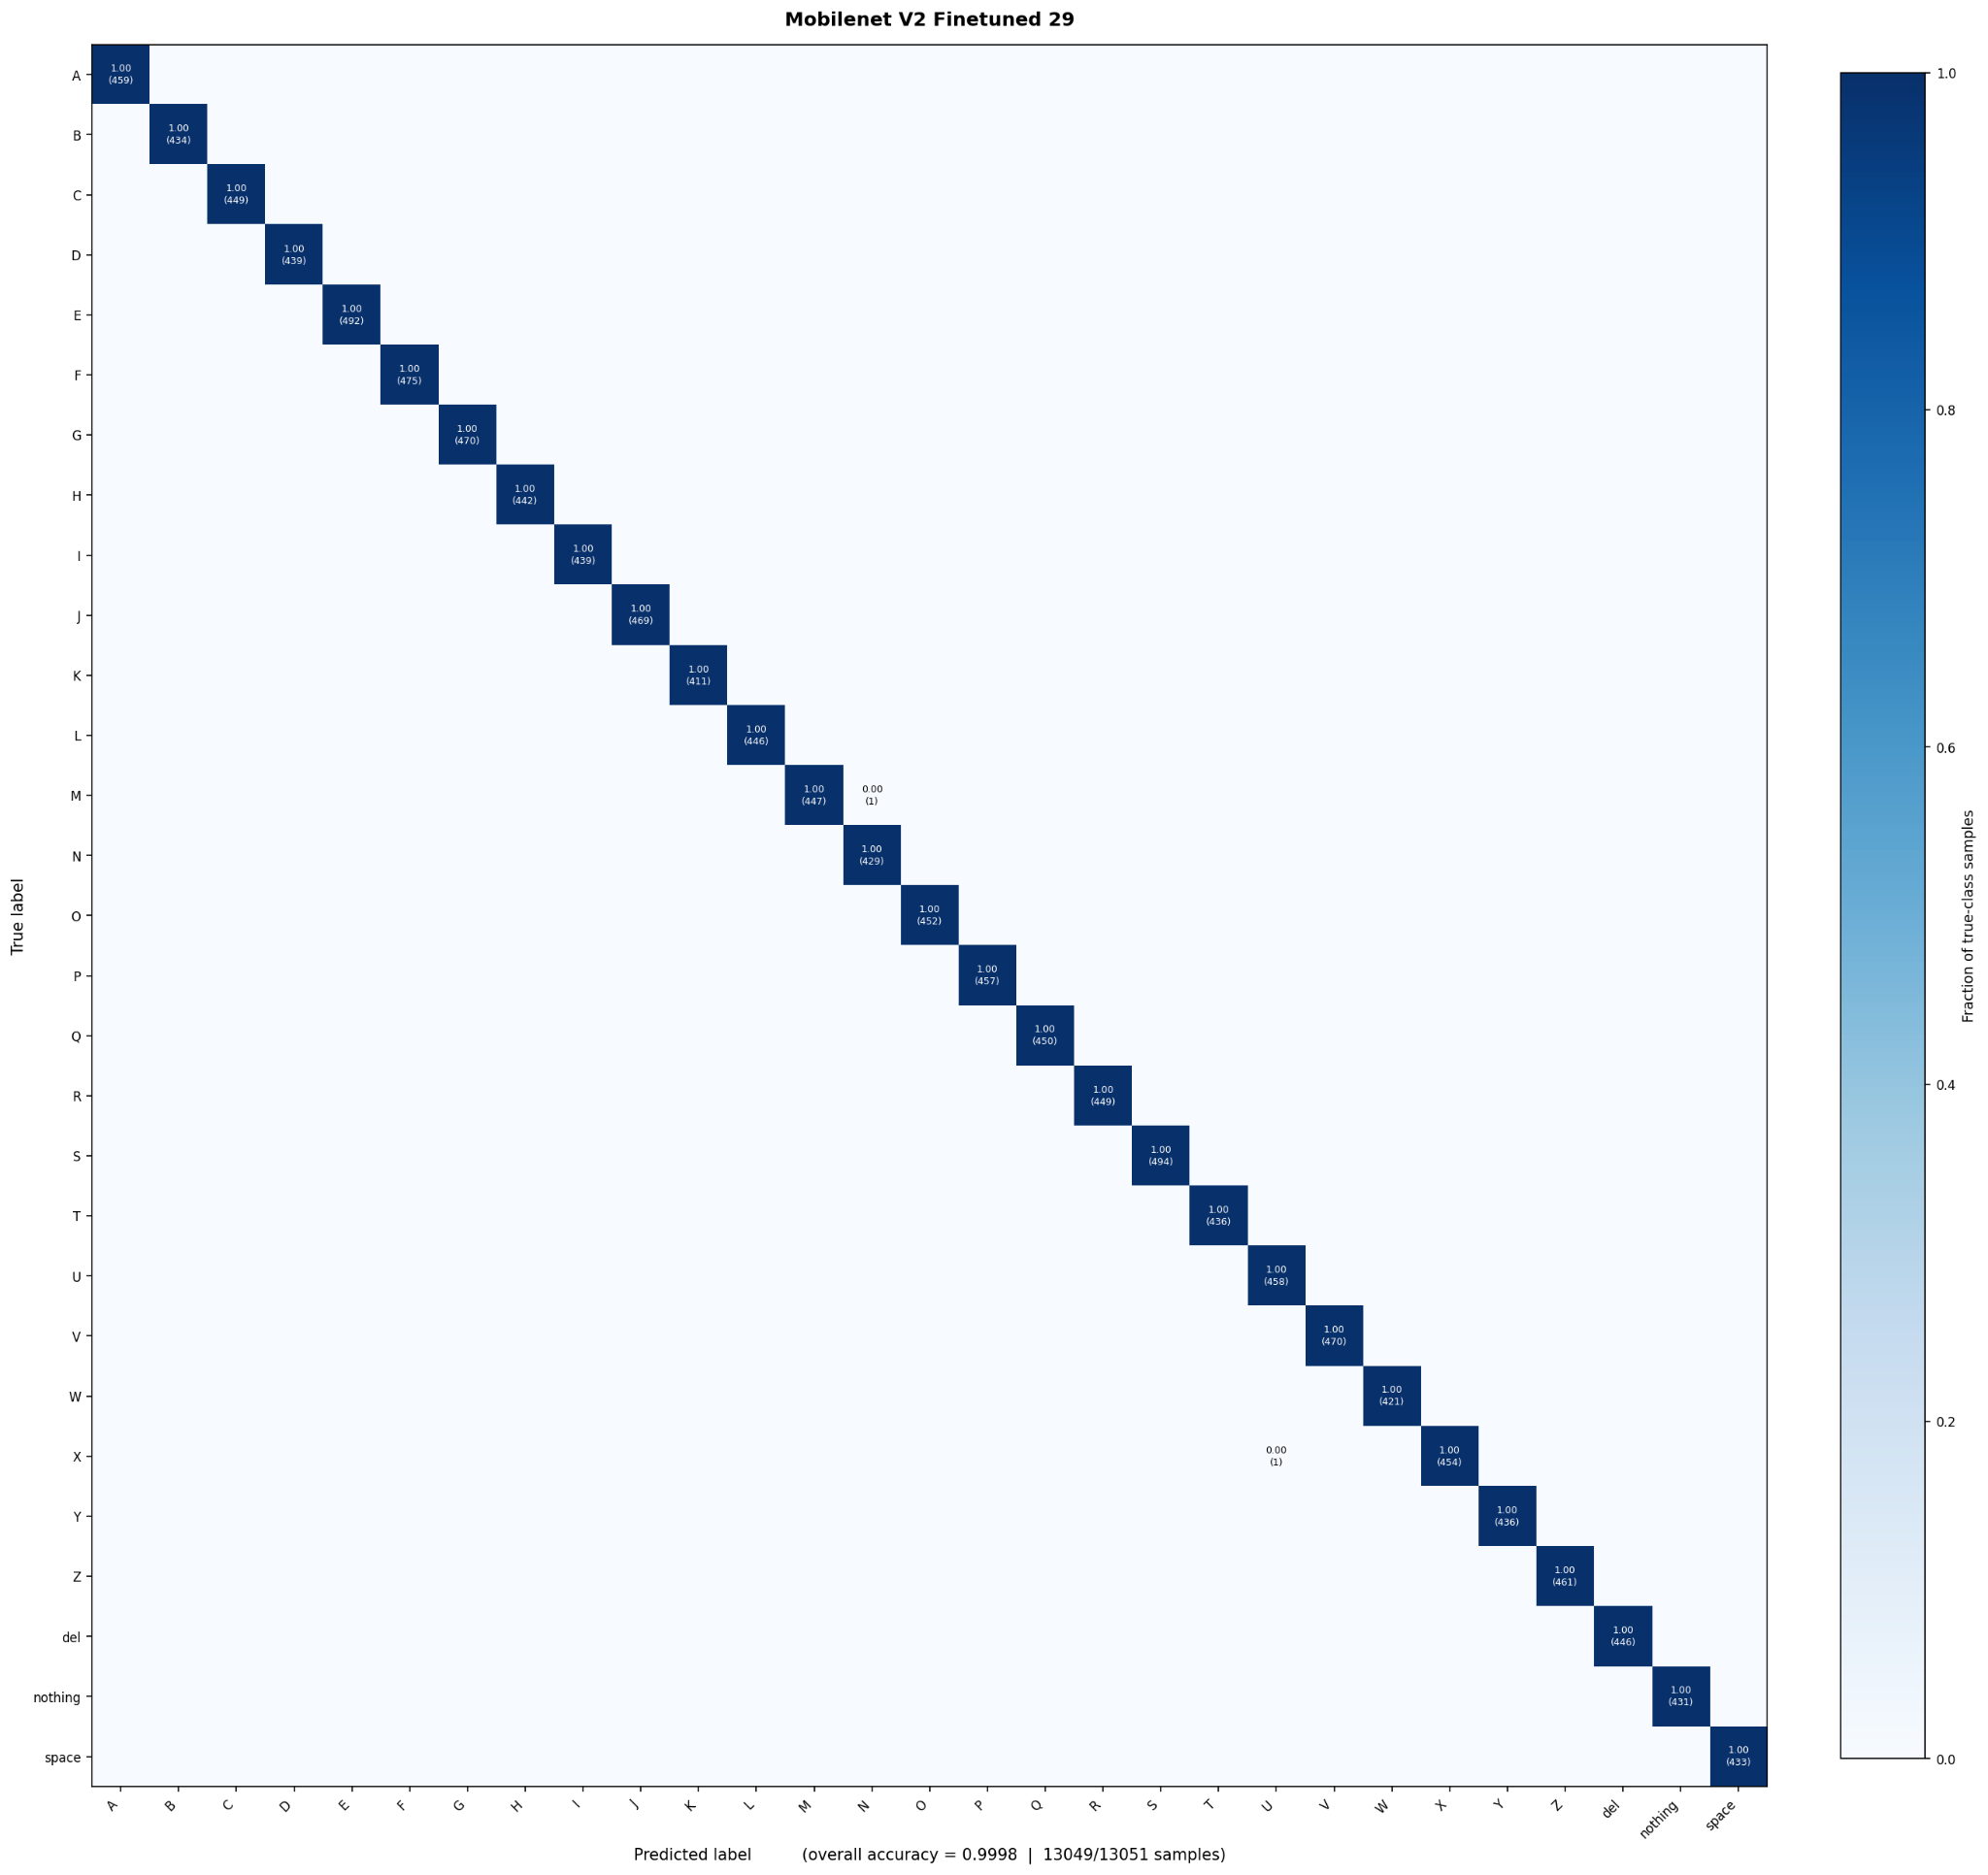
Testing Evaluation on 29-class MobilenetV2
Per-class F1
A 1.0
B 1.0
C 1.0
D 1.0
E 1.0
F 1.0
G 1.0
H 1.0
I 1.0
J 1.0
K 1.0
L 1.0
M 0.9988
N 0.9988
O 1.0
P 1.0
Q 1.0
R 1.0
S 1.0
T 1.0
U 0.9989
V 1.0
W 1.0
X 0.9988
Y 1.0
Z 1.0
del 1.0
nothing 1.0
space 1.0
Experiment | Trainable Parameters | Epochs | Loss | Macro F1 | Accuracy
MobilenetV2 - 29-class Extension | 1,243,229 | 5 | 0.0007 | 0.9998 | 0.9998

Slide 37
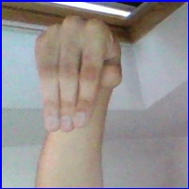
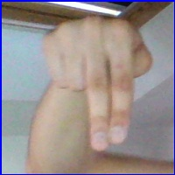
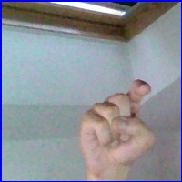
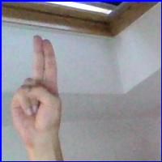
Letters being mixed up are similar.
M with N
X with U

Slide 38
06
Conclusions

Slide 39
Part 1: Model Comparison
Feature Extraction Limitations
Custom CNN Efficiency
Pre-trained ImageNet weights are optimized for generic objects, and training a small number of parameters (only 0.2% of weights in InceptionV3) is not enough.
A small, custom 4-block CNN built from scratch with only 396,058 parameters outperformed both well-known arquitectures on feature extraction.
Optimizer Convergence
MobilenetV2 vs. InceptionV3
Adam had a (small but) better performance on the Custom CNN. Adaptive learning rates optimizers produce a faster convergence.
Receptive fields size difference may have had an effect on the different architecture’s performance.

Slide 40
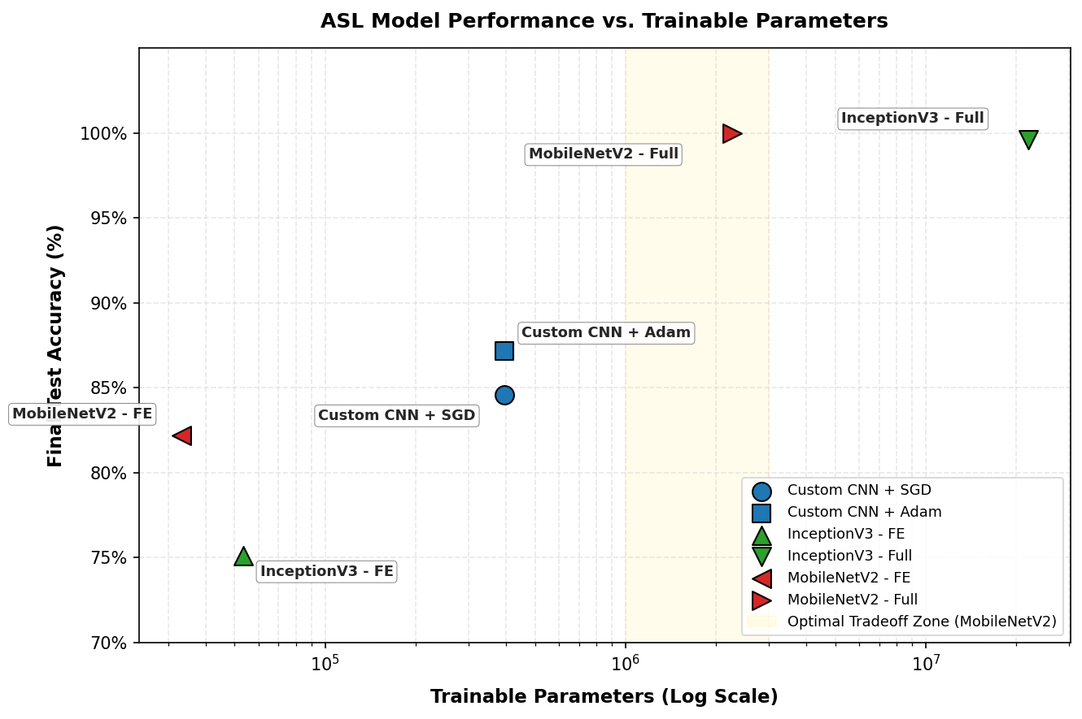
Correlation between Trainable Parameters and Accuracy

Slide 41
Part 2: Fine Tuning
Prevention of Catastrophic Forgetting
By copying the pre-trained classifier weights on the already trained 26-classes, the model had a seeded the decision boundaries for the letters A–Z from the beginning.
Feature Orthogonality of the New Classes
Because these classes have a low probability of overlapping with the letter clusters in the feature space, the classification head separated them easily

Slide 42
07
Demo application

Slide 43

Putting the model into practice

Slide 44




Want to try it yourself?
https://francolano.github.io/ASL-Recognition-DL/

Slide 45

Thank you!

