Slide 1
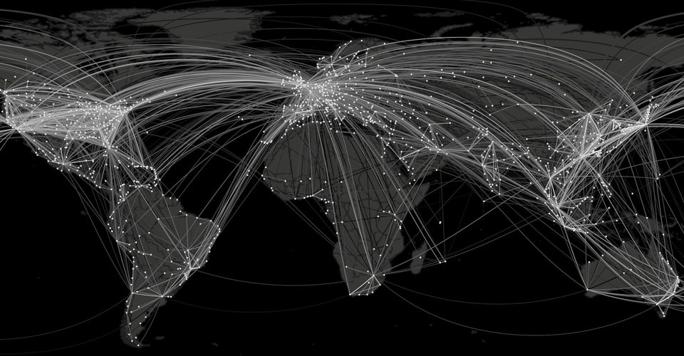
Coronavirus Perception and Evolution
Term Project - Web Data & Digital Analytics
F. Boeglin, A. Chabaud, K. Donmez, R. Hug

Slide 2

AG
EN
DA
01
Introduction – Coronavirus under the Loop
02
Network Analysis – Worldwide Air Routes
03
Text Mining – Countries’ Reactions
04
Conclusion & Limitations
Notes:
© Copyright Showeet.com

Slide 3

How can we use network analysis and text mining to analyze the perception and evolution of Coronavirus?
By using available information about the spread of the Coronavirus and the measures taken by different countries, we try to see :
Network analysis: what are the similarities between the spread of the virus and the structure of worldwide air routes?
Text Mining: how did the overall sentiment about this pandemic evolve over time, and what were different countries’ reactions?
By combining our findings, we develop conclusions about the perception and evolution of Coronavirus between selected countries
Introduction

Slide 4
Network Analysis
The Data
The Analysis
OpenFlights – 2012
59,036 routes
3,209 airports
531 airlines
Directed network
Modeling the network
Hubs
Comparison with Coronavirus map

Slide 5
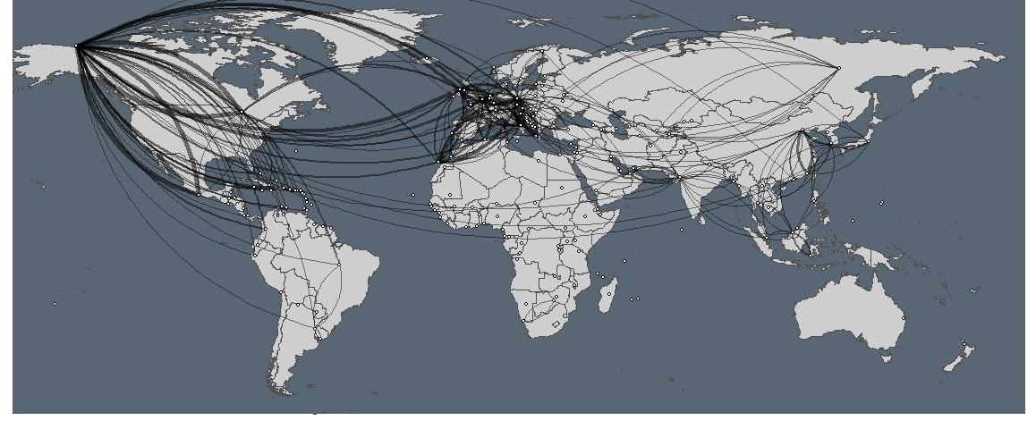
Modeling
Worldwide air routes
Very heavy database: originally listing the connections between airports, by airlines; grouped by country
Weight of connection: same connection from different airports
Representation: only the connections with weight > 5; width of the edges represents weight
Observations: Graph density is 0.214, but some areas seem more connected
Mediterranean basin
Europe-US
US-Central America
South-East Asia

Slide 6
Hubs
Central countries for worldwide air routes
Hubs Ranking
United States | 1
Germany | 0,764852
United Kingdom | 0,700827
France | 0,605118
Canada | 0,590904
Italy | 0,583538
Mexico | 0,498101
Spain | 0,465886
Greece | 0,264316
Morocco | 0,143263
Austria | 0,132506
Netherlands | 0,112909
Algeria | 0,106361
Switzerland | 0,10193
COVID-19 Cases per one million population*
Spain | 5661
Ireland | 4657
Belgium | 4612
United States | 4133
Singapore | 4072
Italy | 3623
Switzerland | 3502
United Kingdom | 3229
France | 2711
Portugal | 2705
Sweden | 2606
Belarus | 2530
Netherlands | 2488
Germany | 2051
In line with model visualization: mostly countries in Mediterranean basin + United States & Mexico
Apparent similarity with COVID-19 cases: 8 of the 14 most touched countries are also among the top 14 worldwide hubs
*Of countries with a population over four million; China and Iran excluded
As of 11 May 2020 10:39 GMT
Source: worldometer

Slide 7
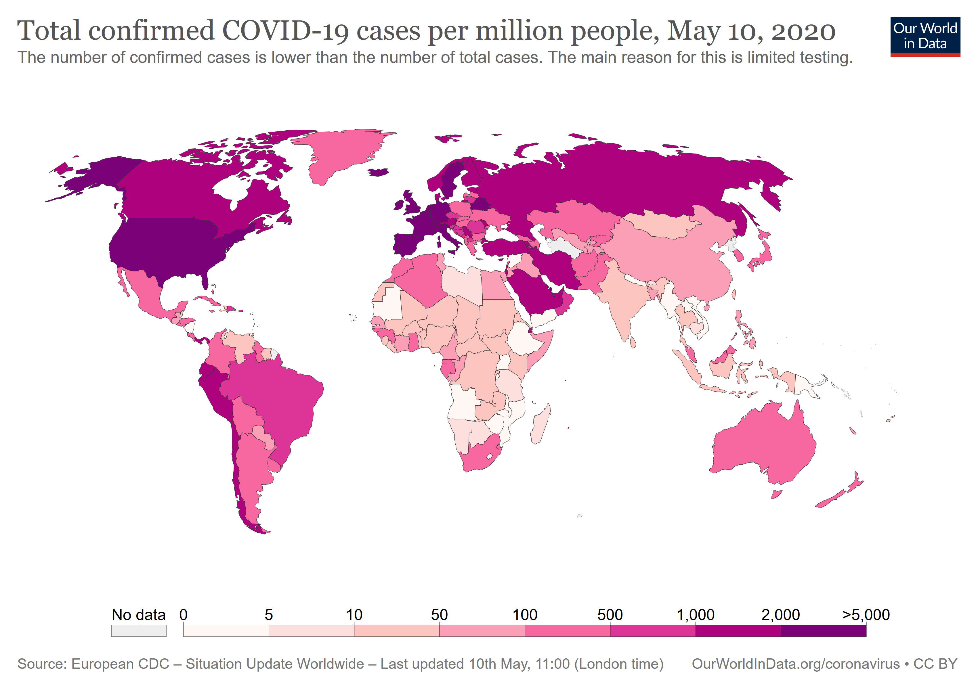
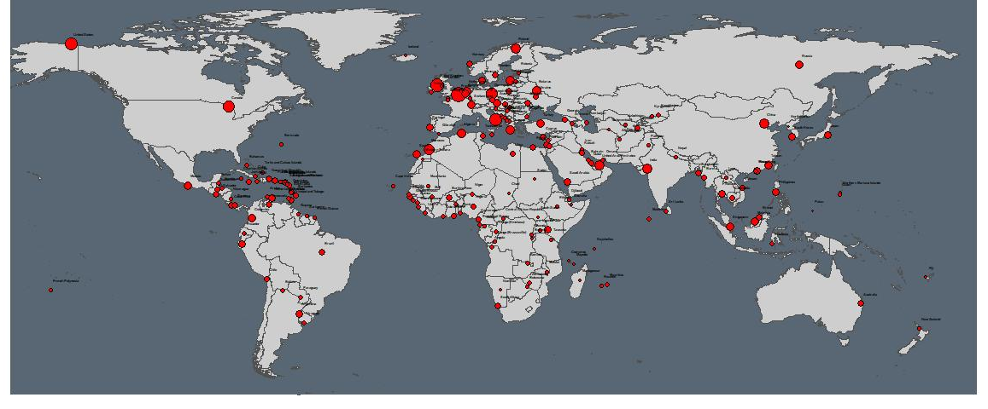
Map Comparison
Inferences by comparing the two maps
Similarities: in general, it seems that there is some correlation between the worldwide air routes and the spread of the Coronavirus
Multitude of factors: there are many factors that explain the spread, and the worldwide air routes are only one aspect
Limitations: our model presents limitations, as our data is static & older vs. a dynamic & constant evolution of the pandemic
Countries for text mining: choice of countries based on this network analysis
US: main hub and strongly touched
Germany: second biggest hub, but not too strongly touched
UK: third hub and interesting change of strategy

Slide 8
Text Mining
The Data
The Analysis
Opinion leaders’ tweets from selected countries
US, UK, Germany
A politician, a national influencer, a news media
Measures of the three countries
Sentiment analysis over time
Comparison between opinion leaders in each country
Comparison across countries

Slide 9
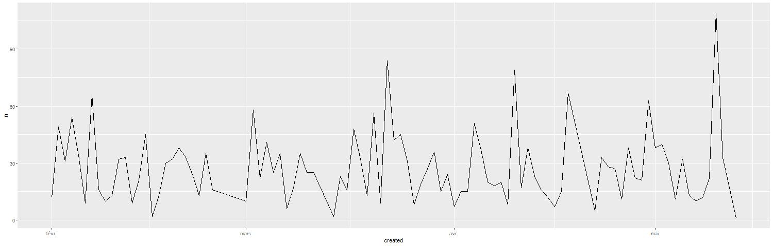


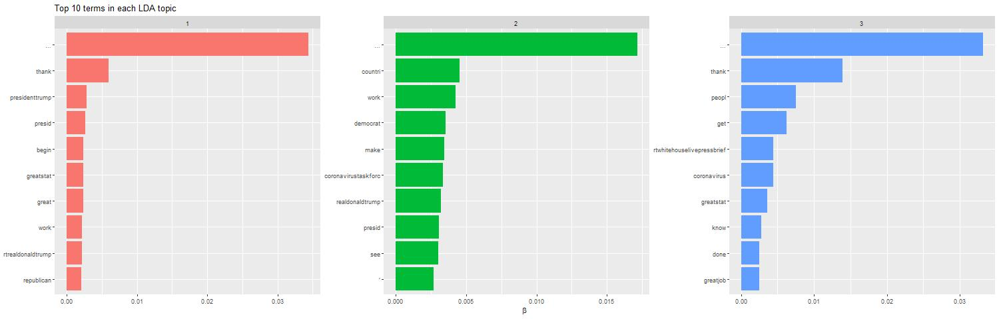
Sentiment Analysis
Procedure
Collecting the data:
Limitation in tweet numbers; challenge of finding people who tweet enough but not too much
Taking only tweets between February 1st and May 12th
Sometimes taking retweets when interesting
Analyzing and exporting the data:
Sentiment evolution over time for each person
General and polarized wordcloud for each person to check for main words
Topic analysis for each person to make sure that Coronavirus is at least one main topic
Aggregated sentiment evolution and polarized wordcloud for countries comparison
Comparing and making inferences:
Keeping in mind our limitations
Dynamic evolution; spread of the virus inside the country and actions taken over time
All the graphs are in the appendix

Slide 10
Countries’ Actions
Specific measures taken by each country
Time to take the measures
Effectiveness of measures

Slide 11
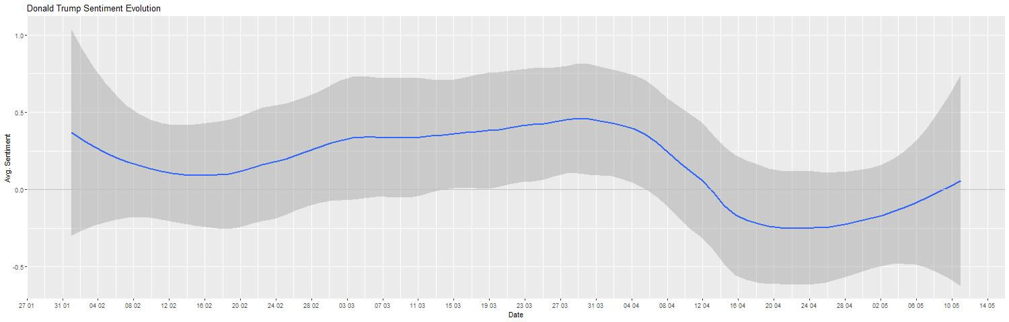
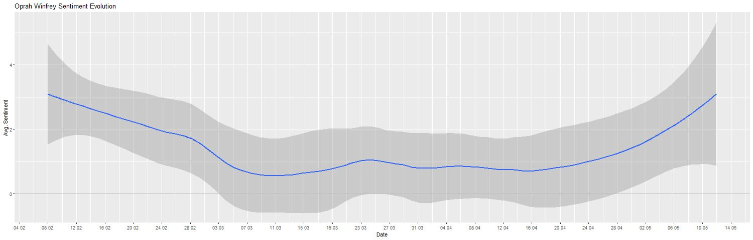
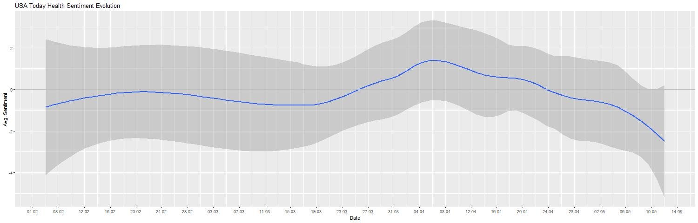
United States
Opinion Leaders’ Level
Trump (with retweets), Oprah Winfrey (with retweets), USA Today Health
Differences & similarities

Slide 12

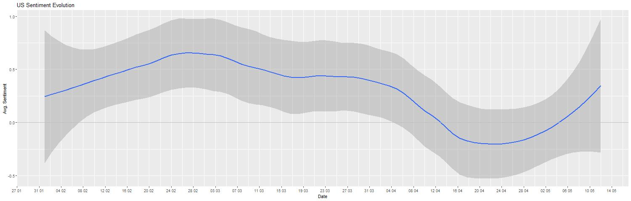
United States
Country’s Level
Inferences from measures
Wordcloud

Slide 13
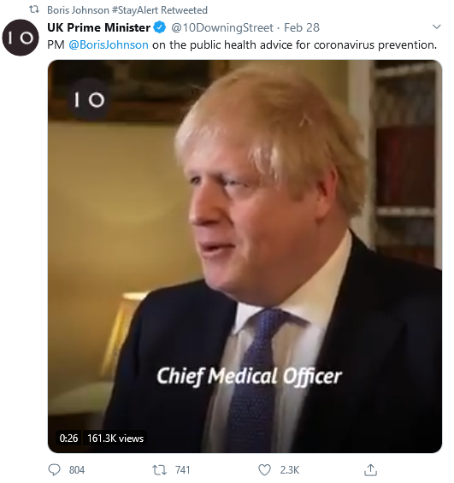
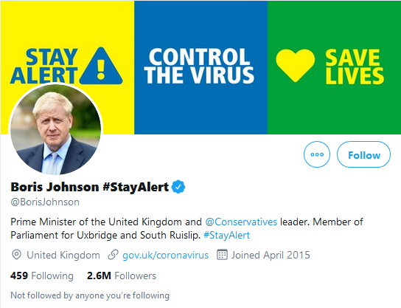
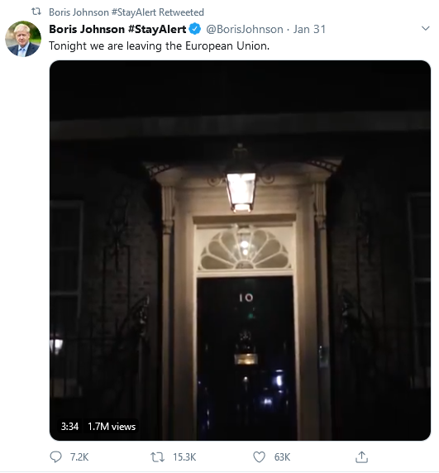
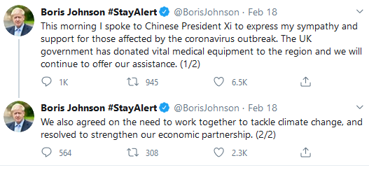
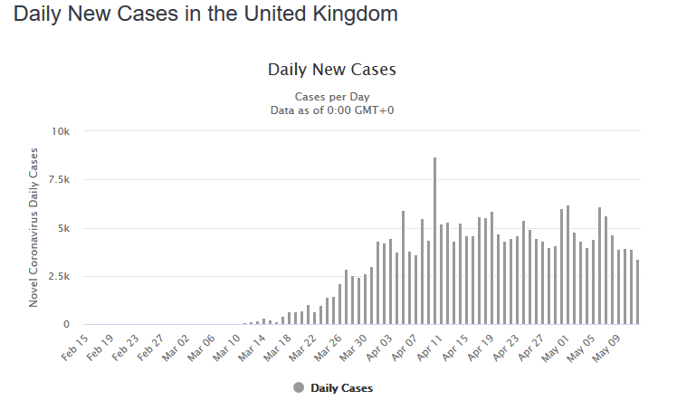
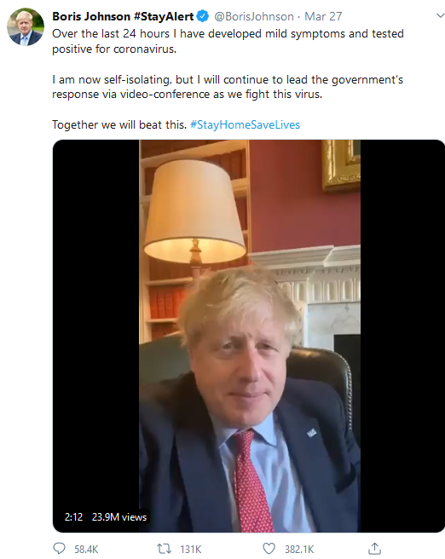
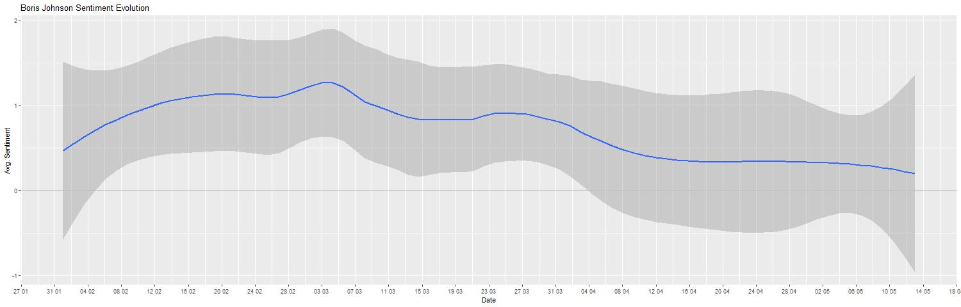

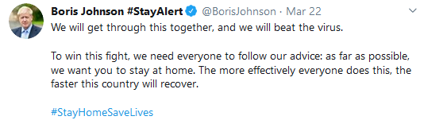
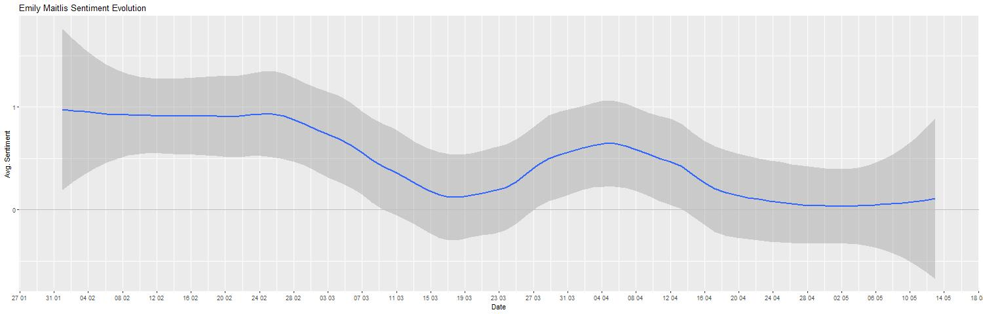
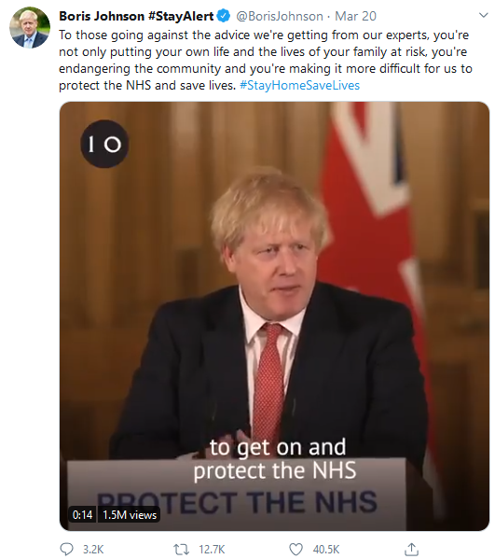
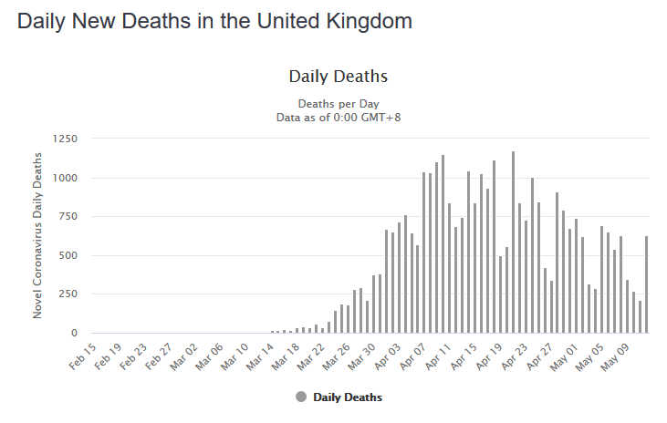
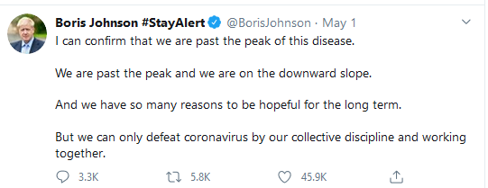
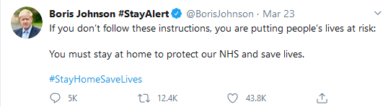
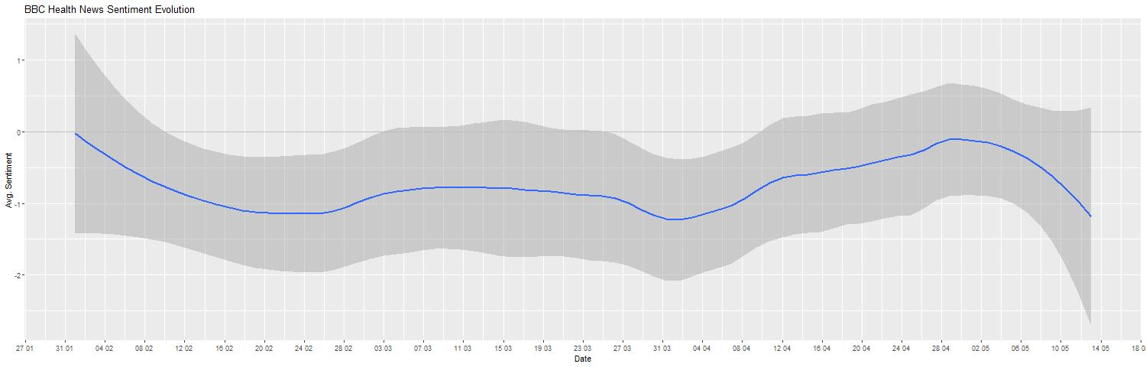
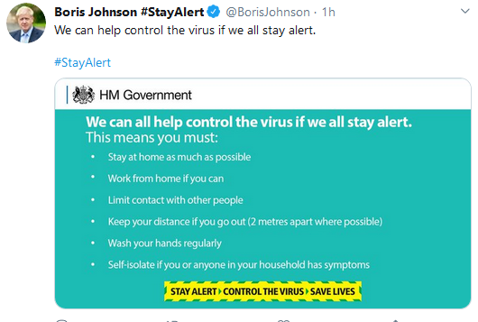
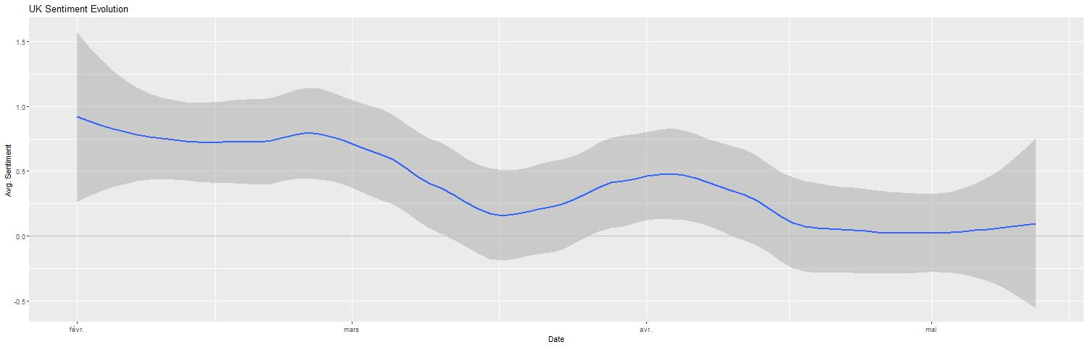
United Kingdom
First case confirmed (31. januar)
advising UK nationals against all but essential international travel (17. March)
WHO: Pandemic March 11
23. March Lock down
Opinion Leaders’ Level
Social distancing
Boris Johnson (only from mid-March), Emily Maitlis (with retweets), BBC Health News
Differences
Notes:
https://www.worldometers.info/coronavirus/country/uk/
Emily Mathis asentiment evolution develops against the direction of the other (beginning of April)
The strongest ups and down are from boris johnson
January 31 United Kingdom confirms its first case.
February 3 Ministries of health from G7 countries agree to coordinate their responses to the outbreak.
February 4 United Kingdom and France advise against all but essential travel to mainland China. → healt news sentiment evolution goes down util end of april
February 10 The United Kingdom declares that the coronavirus constitutes a serious and imminent threat to public health. → Johnsons sentiment rather goes up → maybe because he now thinks that they have a plan.
March 11 – WHO Pandemic
March 9 UK advises against all but essential travel to Italy
March 23 United Kingdom announces lockdown. → the sentiment of all three graph drops! Most of all boris johnson a further reason for that might be that he is tested positive on coronavirus.
Boris Johnson
March 27: boris johnson teste corona-positive → sentiment goes down
6. April johnson im Spital
Boris → 12-27 april keine posts → Intensivstation
Situation int the country gets worse and worse → asks the people to please follow the rules (2 mr distance, … )
1. mai: corona peak reached → still sentiment goes down → many people coronavirus still a threat.
Emily Maitlis
Downturn end of february →uk declares coronavirus as a serous imminent threat.
Lowest point: mid march →
Even goes up, when lockdown is anounced
Beginning of april agein down and then slowly but steadyli up again
BBC health:
Sentiment is always below zero starting from beginning of february.
Mai -> anounced that peak is reched → sentiment almost zero and then it decreases again

Slide 14

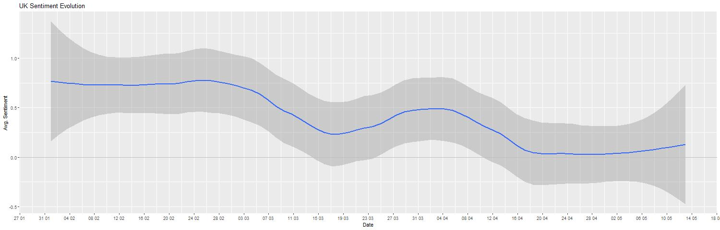
United Kingdom
Country’s Level
Inferences from measures
Wordcloud
Notes:
Mid april may deaths in the uk → mai 1. peak reached
From beginning of may, sentiment starts again

Slide 15
Germany
Opinion Leaders’ Level
Angela Merkel,…
Differences

Slide 16
Germany
Country’s Level
Inferences from measures
Wordcloud

Slide 17
Countries’ Comparison
Sentiment Analysis Across Countries
Similarities
Differences
Comparison with strategy

Slide 18
Final Notes
Conclusion
Limitations
Can explain to some extent
Old data
Limited data
Non-representative

Slide 19
Thank
YOU!
ANY QUESTION?

Slide 20
Appendix
Additional data

Slide 21
Donal Trump
Wordclouds & Topics

Slide 22

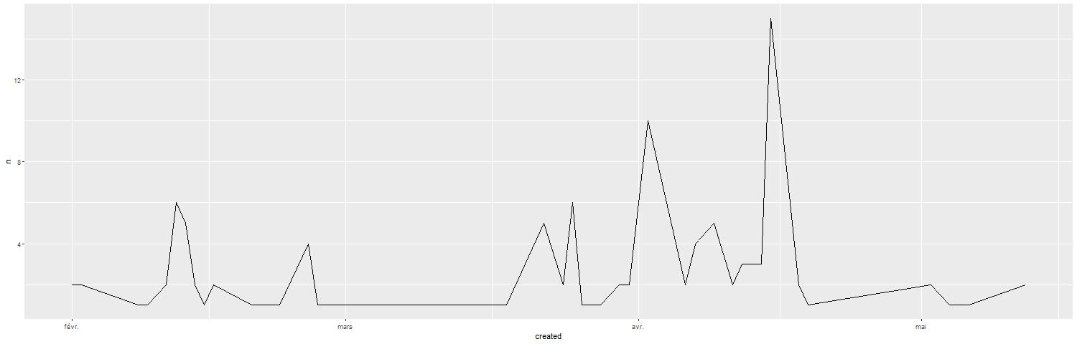

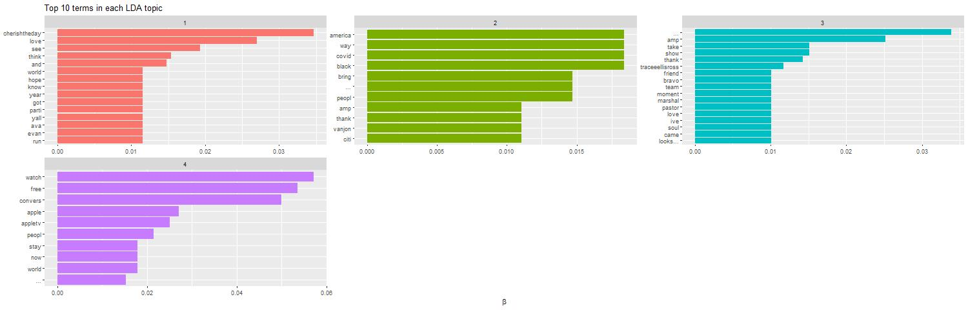
Oprah Winfrey
Wordclouds & Topics

Slide 23

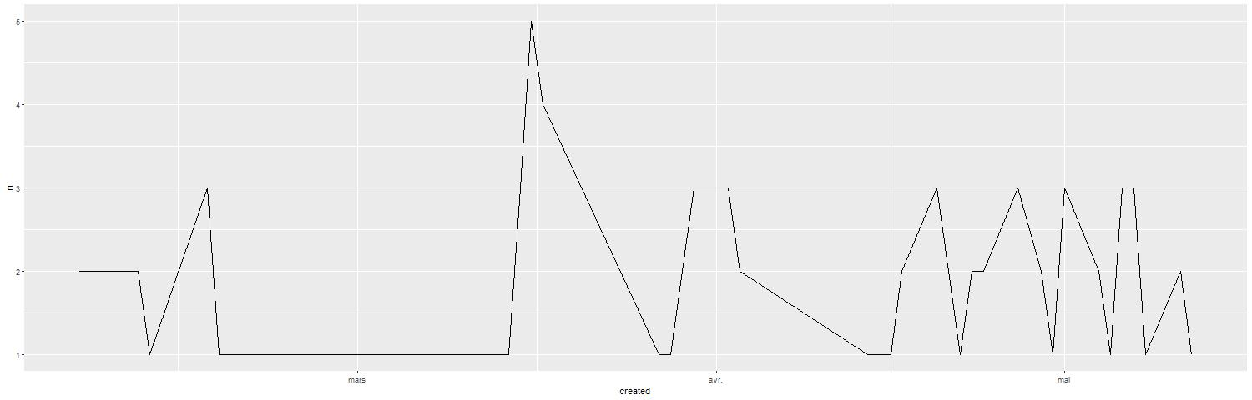

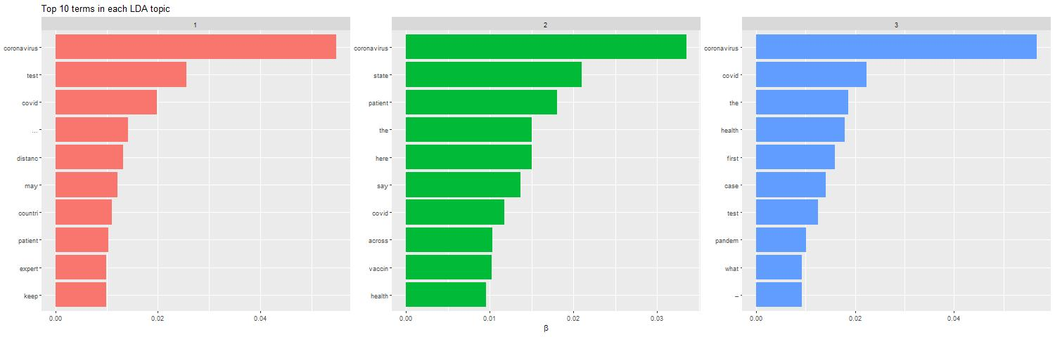
USA Today Health
Wordclouds & Topics

Slide 24

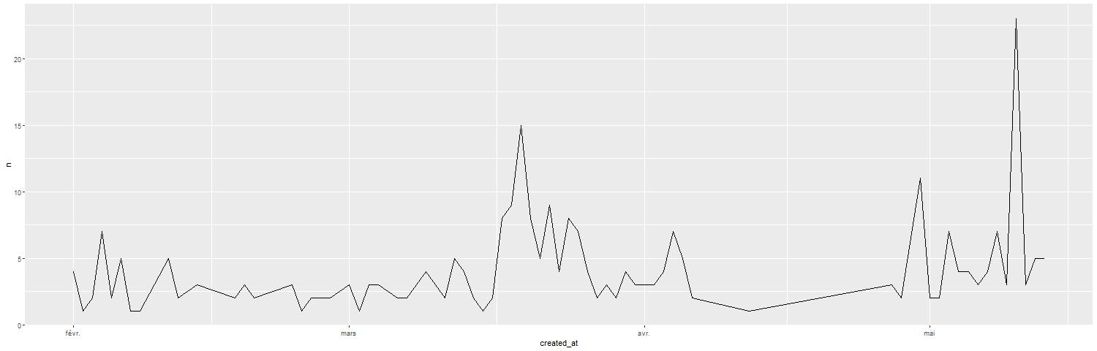

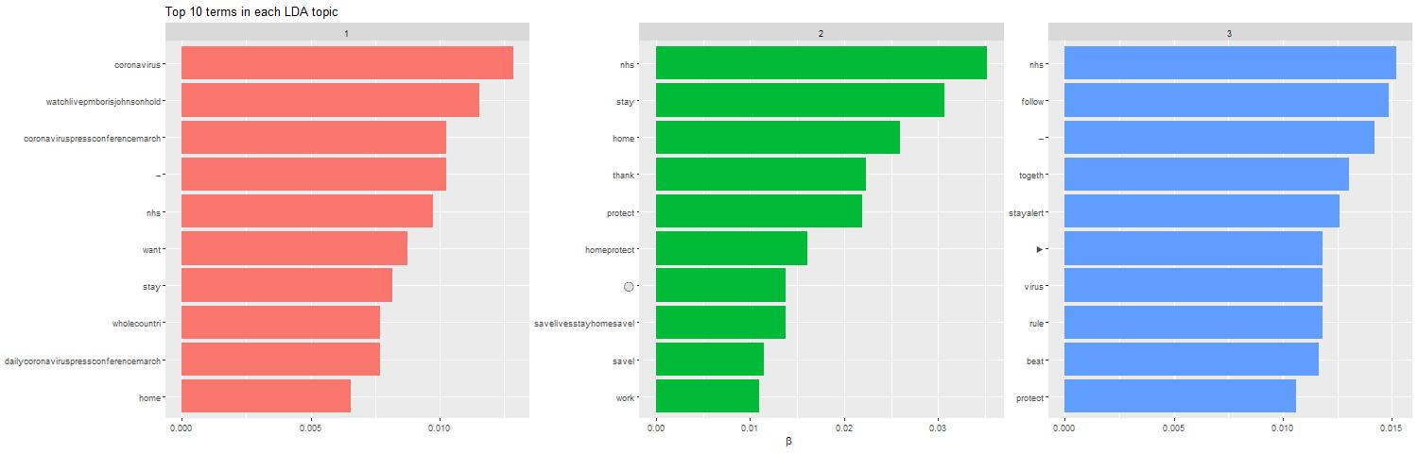
Boris Johnson
Wordcloud & Topics

Slide 25

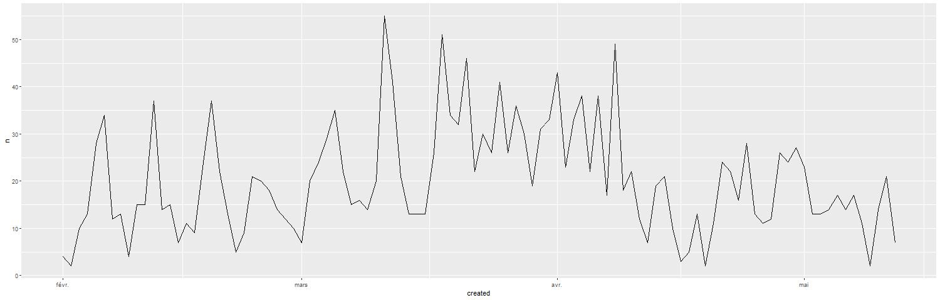

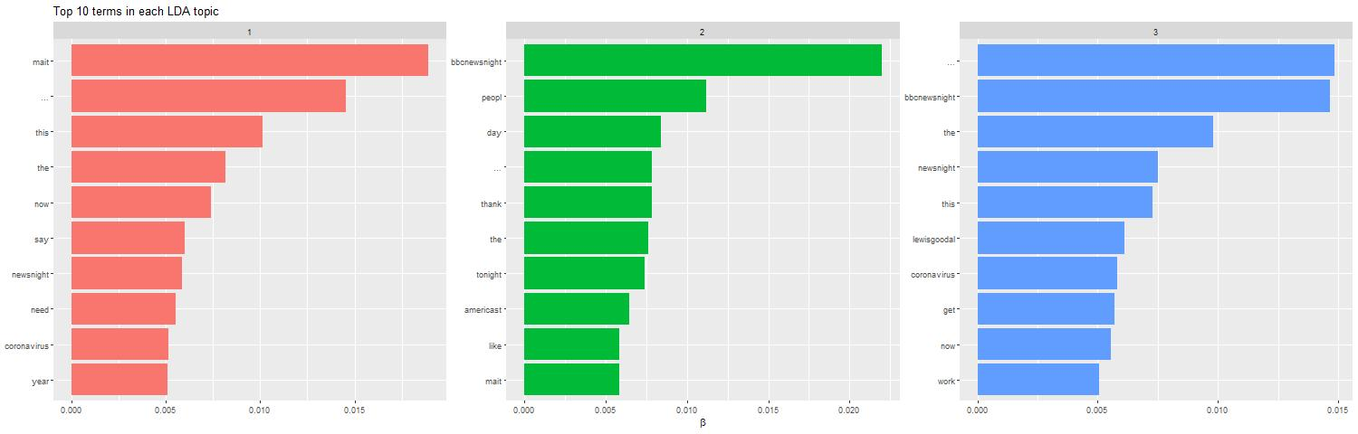
Emily Maitlis
Wordcloud & Topics

Slide 26

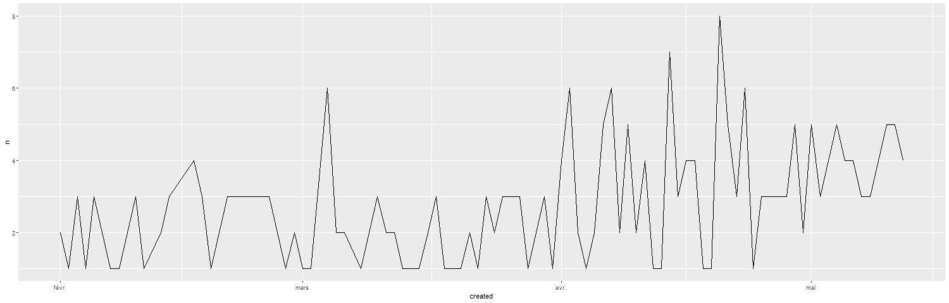

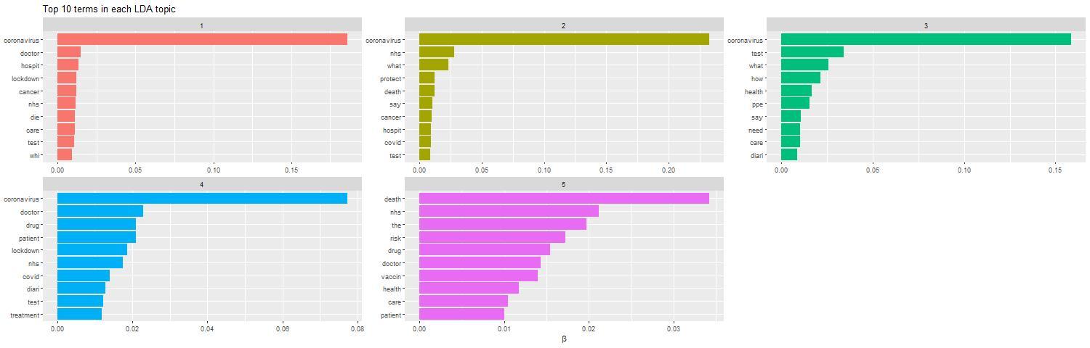
BBC Health News
Wordcloud & Topics

