Slide 1
DBMS Praktikum
Florian Schauer, Franca Speth
Comparison of Interpretability Tools for a Human Resource Dataset
Summer Term 2020

Slide 2

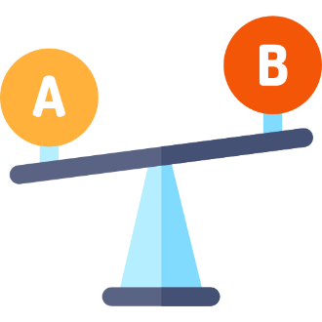





Agenda
1. Problem
Definition
7. Comparison of Tools
2. Data
Preparation
6. Interpret Model with AIX360
3. Model
Training
5. Interpret Model with InterpretML
4. Model
Evaluation

Slide 3





Use Case and Research Question
Employee turnover can cost up to 150% of his/her annual income.
Employee departures cost a company time, money, and other resources.
W. G. Bliss, 2011
SHRM, 2008
Is it possible to predict whether an employee is going to leave the company?
How does the model make the prediction ?
Notes:
SHRM = Society for Human Resource Management

Slide 4
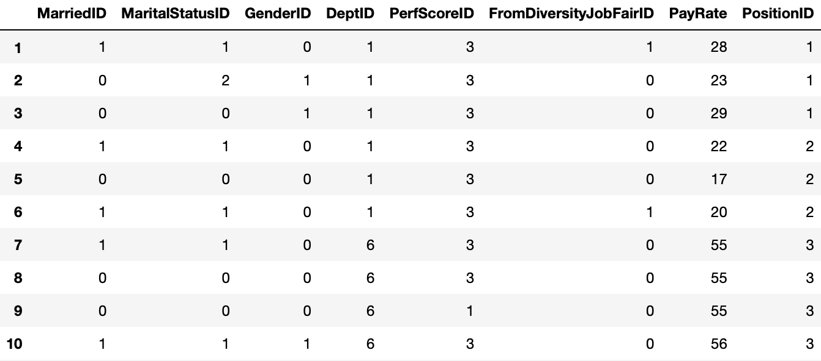



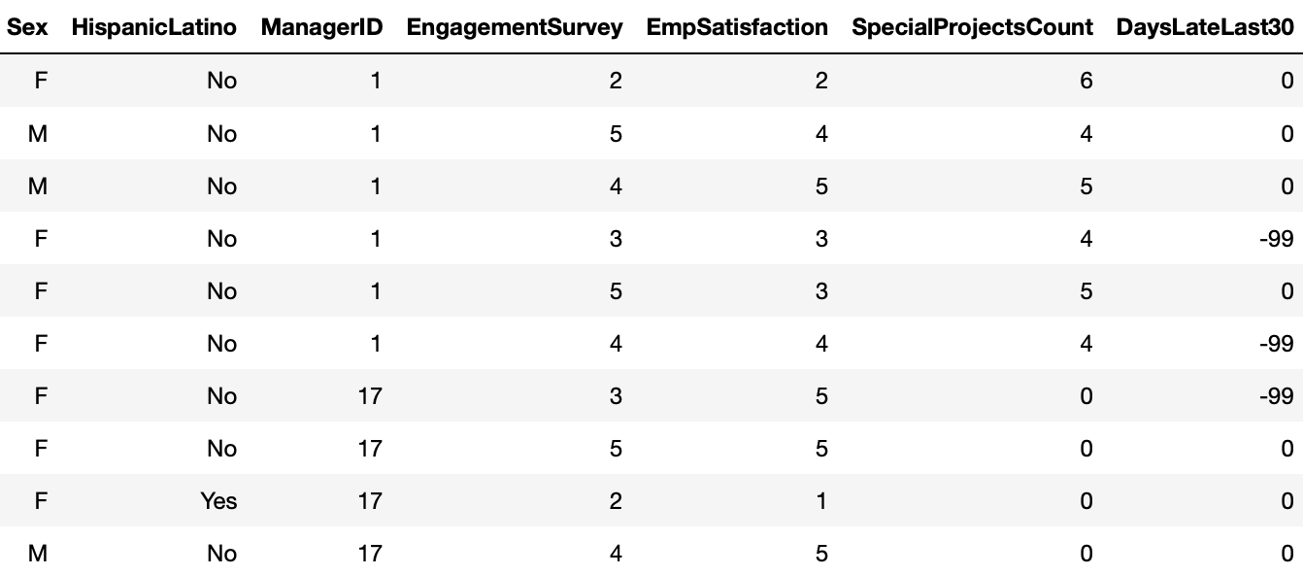

Dataset and Source of the Data
Usability 9.4/10
Open License
https://creativecommons.org/licenses/by-sa/4.0/
Code examples available
Notes:
Drawback: No Column descriptions

Slide 5

Dataset and Data Preparation
replace missing values with -99
DaysLateLast30 and ManagerID
round float variables and convert them to integer
PayRate and EnagagementSurvey
dummy coding of categorical variables
Sex and HispanicLatino
Split 80% Training Data and 20 % Test Data
Target variable: Termd
for 0 = still working for the company
for 1 = terminated

Slide 6


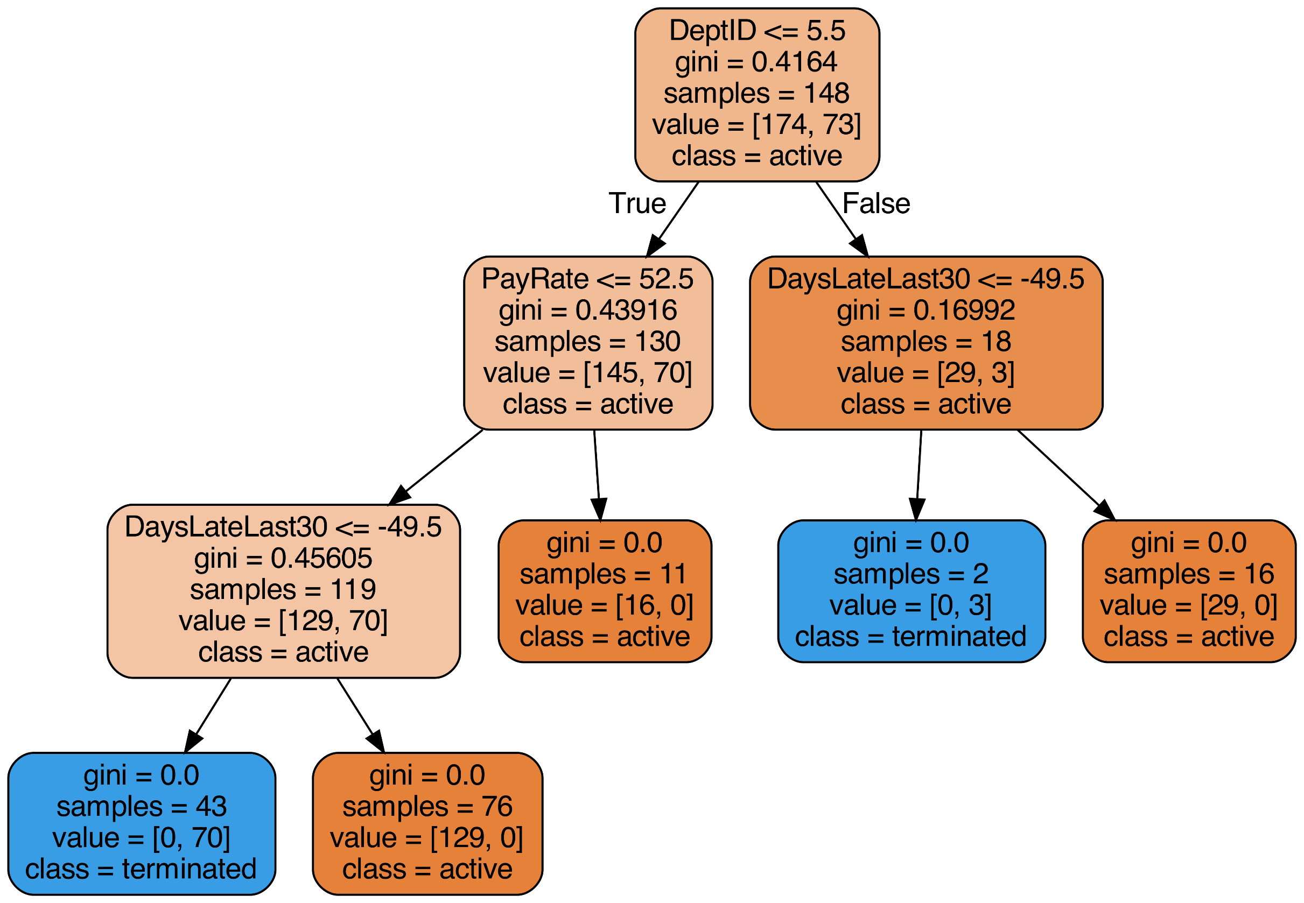

Data Analysis with Random Forest
Visualisation of Tree Nr. 80 for our Input Data:
Random sampling of training data points when building trees
Random subsets of features considered when splitting nodes
Result of first Analysis: 100 % Accuracy for Test Data !?

Slide 7

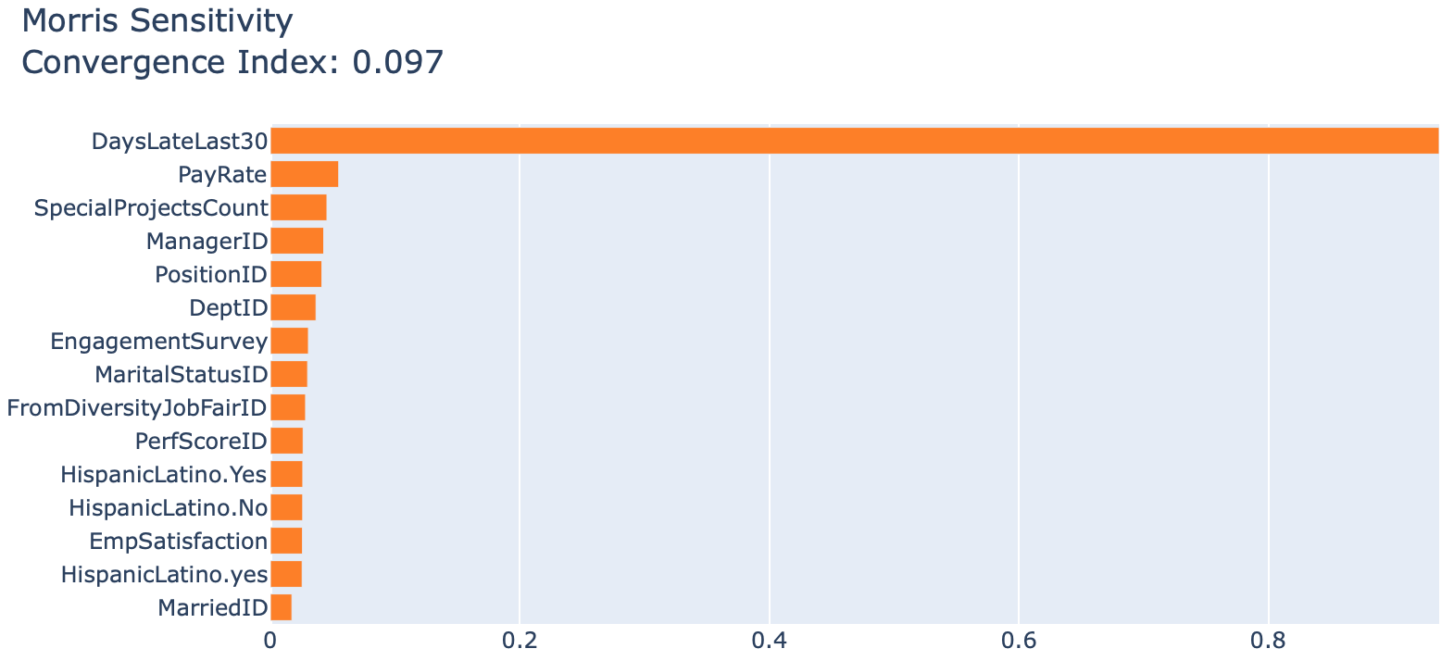
Insights of first Analysis with InterpretML
The variable DayLateLast30 seems to have a very strong influence, but why?
Instead of replacing the missing values of that variable with -99 we tried droping the data with missing values.
Diagram 1: InterpretML Morris Sensitivity for the model
Result: only one class remained, thats why the variable was so important and the accuracy reached 100 %
InterpretML was helpful to detect that the variable should not be used for the model because it leads to bias.

Slide 8
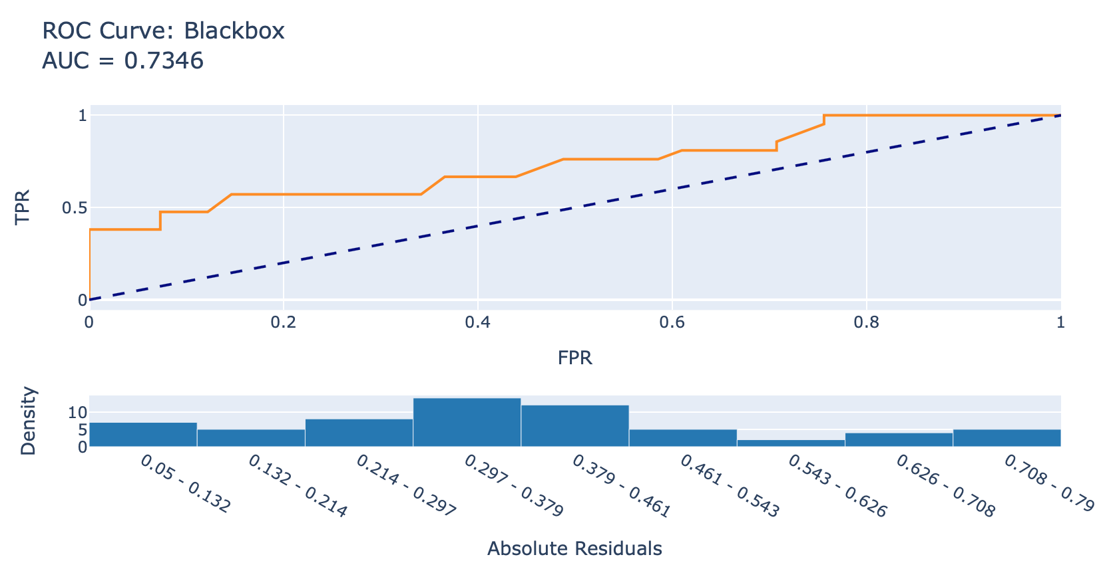
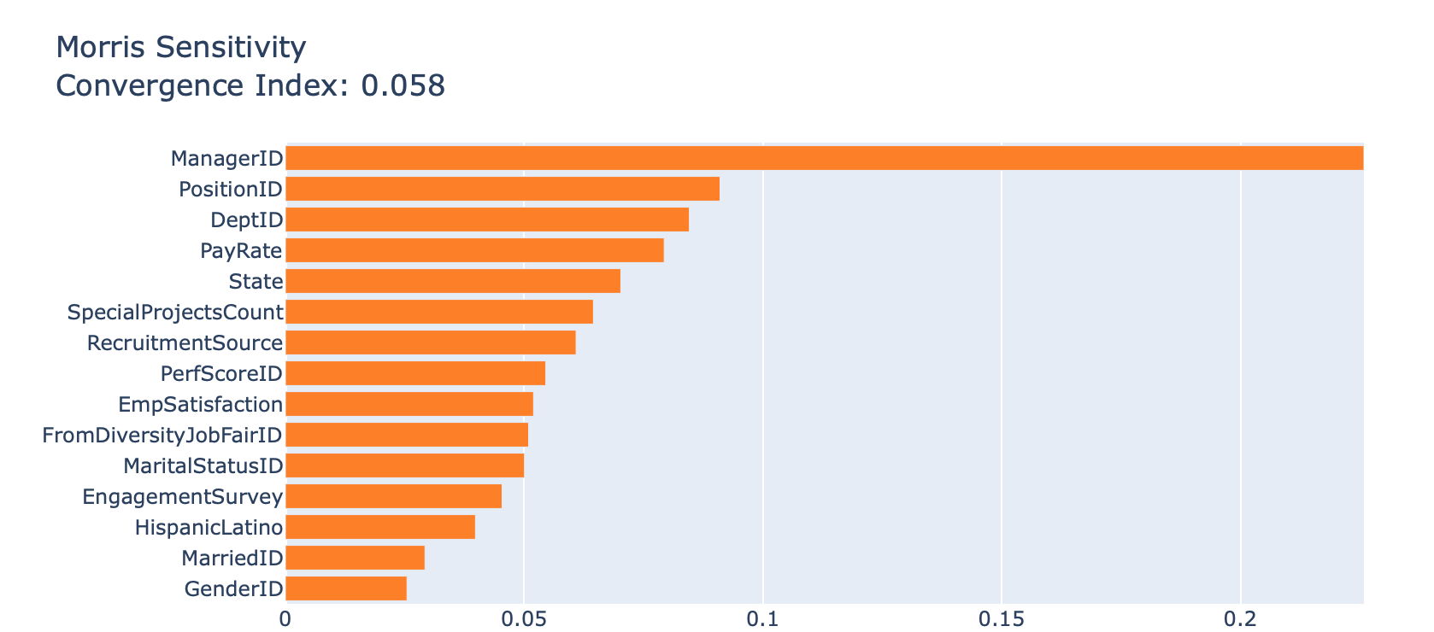
New Model after Bias was detected
Model information:
number of trees in the forest = 100
bootstrapping = True
Random state = 1
Results for prediction:
Accuracy value = 0.77
Precision for active (class 0) = 0.75
Precision for terminated (class 1) = 0.89
Diagram 2: InterpretML ROC Curve for model
without DaysLateLast30
Diagram 3: InterpretML Morris Sensitivity for model
without DaysLateLast30

Slide 9
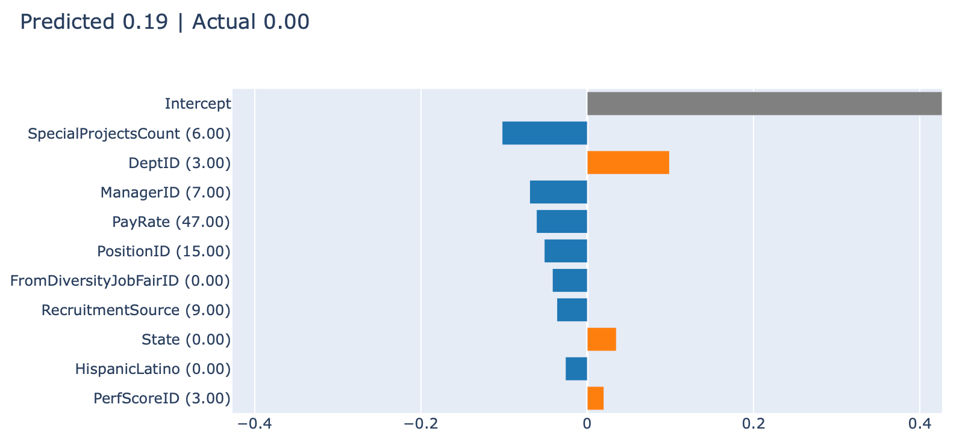
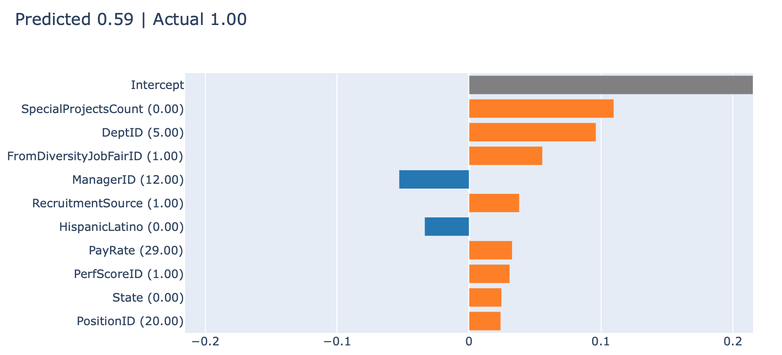
How does the model make correct predictions?
Diagram 4: InterpretML tabular Lime Explainer for object [3]
How to read Lime tabular Diagrams of InterpretML:
Predicted → probability for model to choose class 1 (terminated)
Actual → value of the acutal class
The bars show the influence of the variables with the linear model fit to that specific case.
Interpretation of Diagram 4 (person is still active class 0):
a high number of special projects has a pos. influence (staying active)
the manager, the pay rate and being in the position of a Network Engineer also lead to staying active
Interpretation of Diagram 5 (person terminated class 1):
no special projects, working in production and being sourced from diversity job fair in this case had a strong impact on termination
Diagram 5: InterpretML tabular Lime Explainer for object [18]
→ In both predictions the two variables SpecialProjectCount and
DeptID appear to have high influences

Slide 10
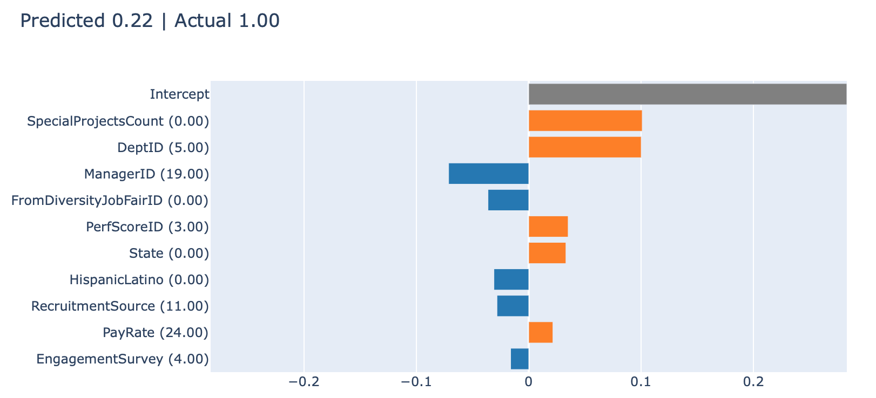
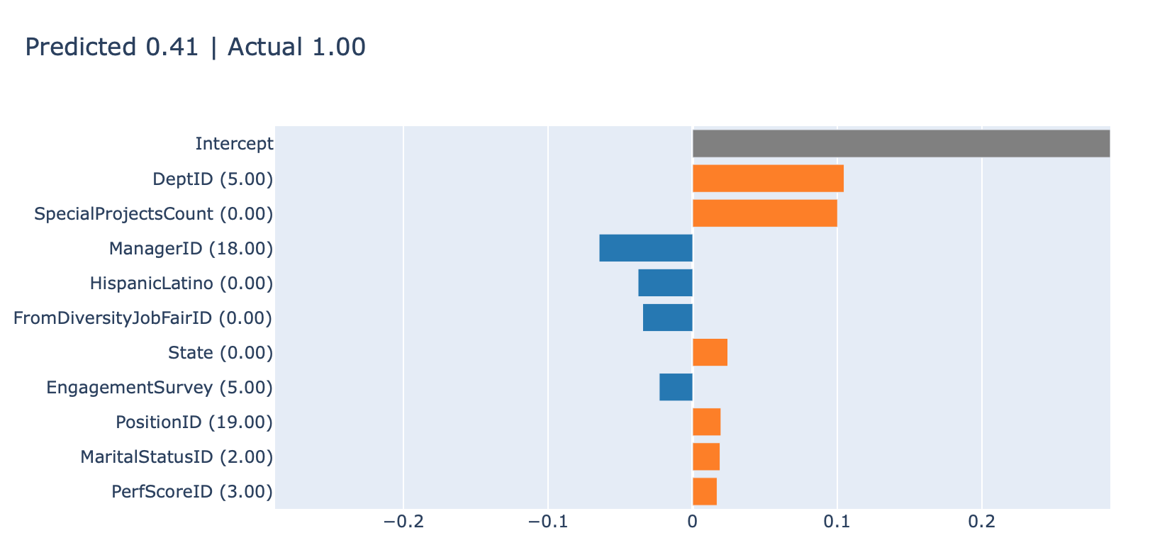
When does the Model make mistakes?
Diagram 6: InterpretML tabular Lime Explainer for object [1]
The variable HispanicLationo seems to have a influence on predicting that someone will stay active, when in reality that person terminated.
Since that specific variable is based on race the model could be biased.
Result of excluding that variable from the model:
Precision from 0.89 to 1.00 for class 1 (terminated) no change for the other class
leaving the variable out had no impact on overall accuracy
therefore the variable can be excluded from the model without a negative influence
Diagram 7: InterpretML tabular Lime Explainer for object [10]

Slide 11


Interpret ML benefits and improvements
gives a good overview over the specific decisions a model makes
possibility to detect mistakes or bias in the model
nice visualisation of results
good interpretability for categorical variables
easy usage also for general overview because you can use the dropdown option
no support for float, therefore possible loss of information because we need to round variables
usage not straight forward, notebook examples don‘t give explanations on how to interpret the results
we could not include the definition of the target variables values instead the diagrams included only the integer of the class
including a translation of categorical variables would make interpretation easier (DepID 5 = production)

Slide 12
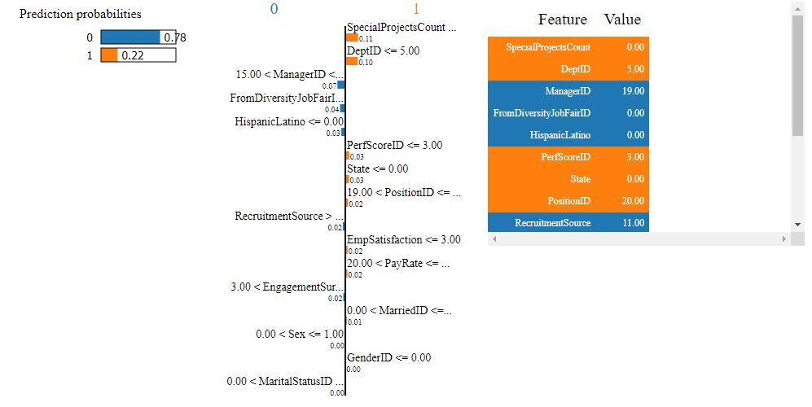
Interpretability with LIME on AIX360
Interpretation of AIX360 visualization for a specific tuple:
person still active
Manager and diversity have a significant impact
Diagram has odd scaling
Diagram 8: AIX360 tabular Lime Explainer for object [1]

Slide 13
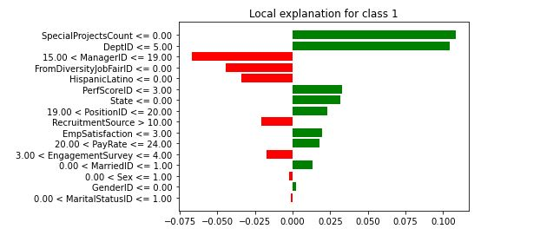
Interpretability with LIME on AIX360
LIME includes a visualization using pyplot
More intuitive chart and better scaling than AIX360
Yet, not as good as the possibilities InterpretML offers
Diagram 9: AIX360 tabular Lime Explainer for object with pyplot [1]

Slide 14
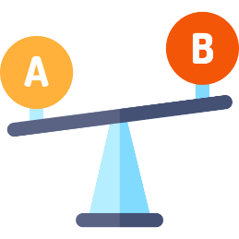
Interpret ML vs. AIX360
modern website and large GitHub
easier coding for equivalent results
many and nice visualization options
can also be used to compare different models
notebooks examples not well explained
float variables need to be rounded
powerful toolbox, but hard to navigate and understand
supports images, text and tabular for explanation
works with ranges of the variables for the local model
few examples in official GitHub
documentation is spare
only one way for visualization

Slide 15
List of Sources
All icons used in the presentation are assesed via https://www.flaticon.com
AIX360. (2020). Docs. URL: https://aix360.readthedocs.io/en/latest/lbbe.html#lime-explainers (last access 10.06.2020)
Allen, D. G. (2008). Retaining talent: A guide to analyzing and managing employee turnover.
Github. (2020). AIX360. URL: https://github.com/IBM/AIX360 last access on 10.06.2020.
Github. (2020). InterpretML. URL: https://github.com/interpretml/interpret last access on 10.06.2020.
Kaggle. (2020). Human Resources Data Set. URL: https://www.kaggle.com/rhuebner/human-resources-data-set last access on 10.06.2020.
RPubs. (2020). HR Codebook-13. URL: https://rpubs.com/rhuebner/HRCodebook-13 last access on 10.06.2020.
SHRM Foundations. Bliss, W. G. (2011). The Advisor-Cost of Employee Turnover.
Towards Data Science. (2020). An Implementation and Explanation of the Random Forest in Python. URL: https://towardsdatascience.com/an-implementation-and-explanation-of-the-random-forest-in-python-77bf308a9b76 last access on 10.06.2020.
Wikipedia. Microsoft Logo. URL: https://de.wikipedia.org/wiki/Datei:Microsoft_logo.svg last access on 10.06.2020.
Wikipedia. Kaggle Logo. URL: https://de.wikipedia.org/wiki/Kaggle#/media/Datei:Kaggle_logo.png last access on 10.06.2020.

