Slide 1


sectionA-folder
js
Javascript files
css
CSS style files
img
Pictures and diagrams files
refs
Third party tools files
<sectionA-filename>.adoc
Documentation files
include
sectionB-folder
<sectionB-filename>.adoc
Documentation files

Slide 2
section-folder
Export to png, jpg
copy
Pictures and diagrams files
PNG
img
Third party tools
copy
Third party tools files
refs
integrate
ADOC
<section-filename>.adoc
Documentation files
Convert with pandoc

Slide 3


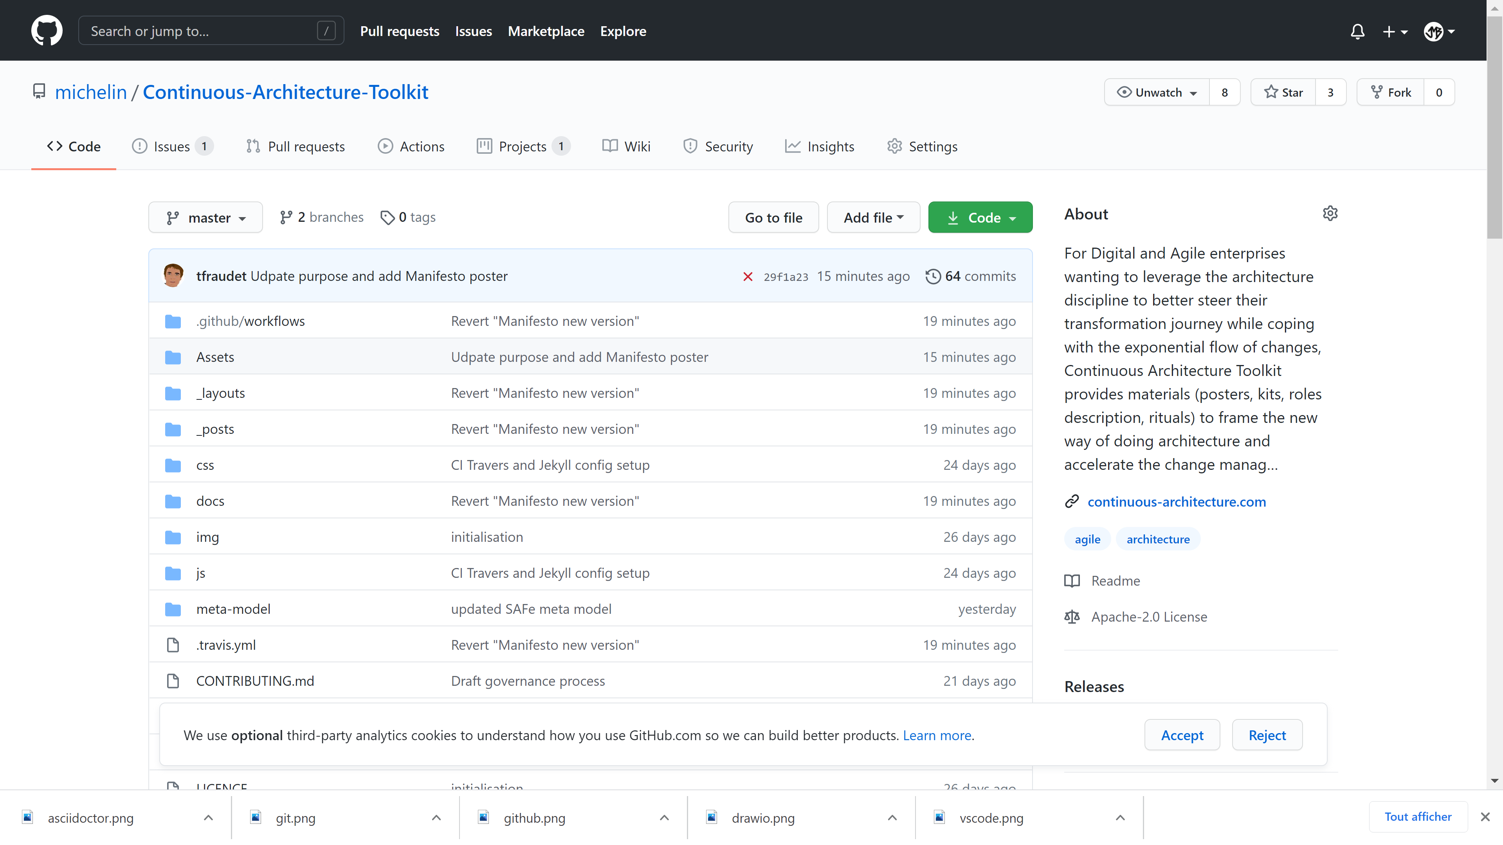
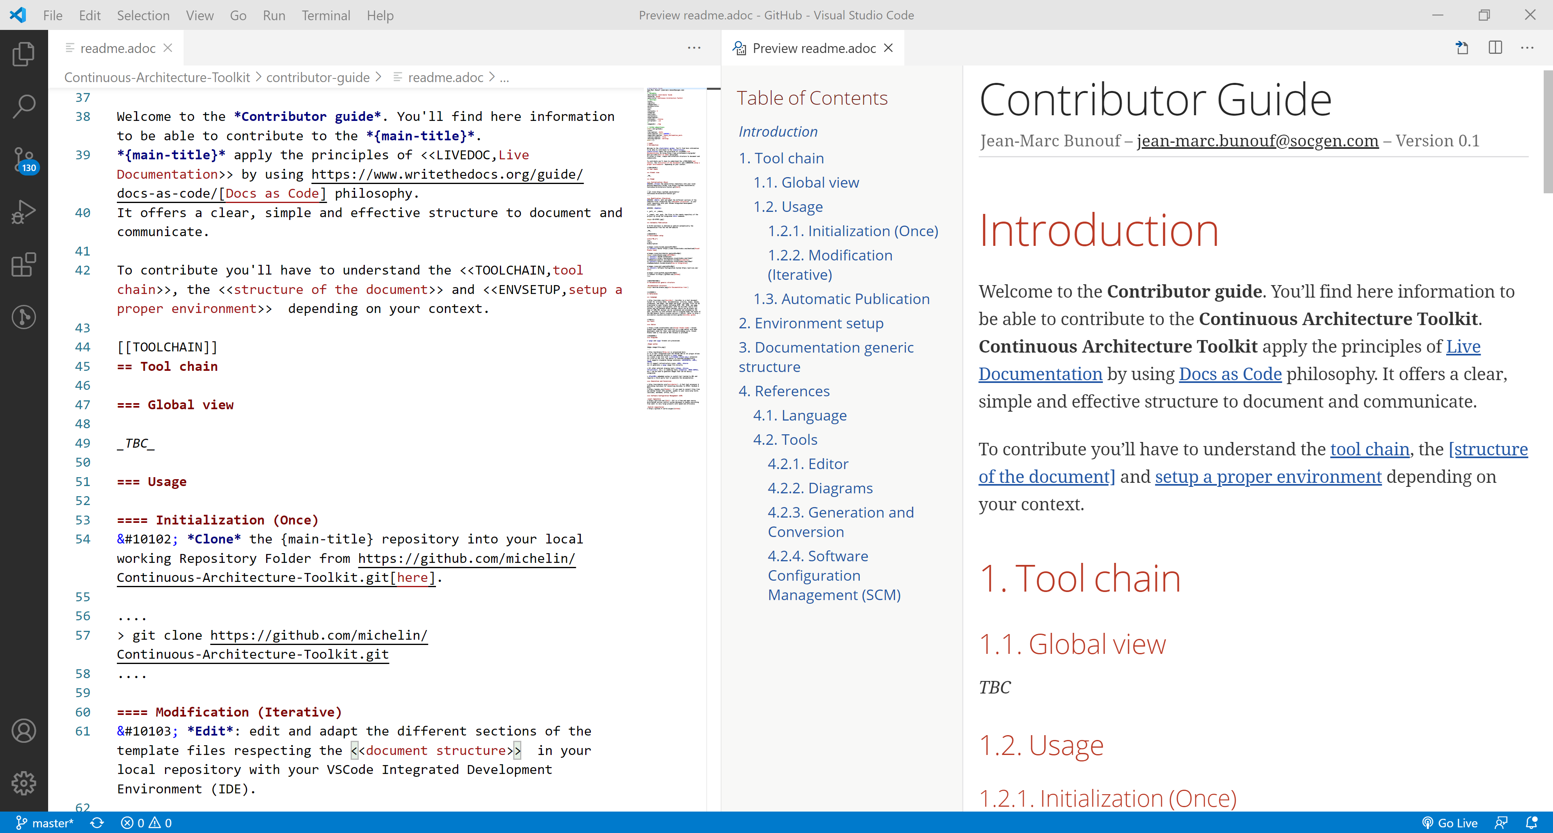


GitHub
VSCode
extensions
GitHub
1
2
3
Clone
Edit
Update
Automatic publication

