Slide 1

DEFI 4 – Comment favoriser l’exposition de la data (comment devenir une data driven company)
9 OCTOBRE 2023

Slide 2
Idées clés
Mesurer la valeur créé et l’usage
Expliquer le why du data driven
Un datalake est par nature transverse est utile si bcps de silos -> permet des use cases transverse jusque là impossible. Mais on ne met pas tout dans le lake seulement si on a un usage y compris le cas Michel de la compta
Le lake n’est ”jamais le source d’autres applis” sauf dans le cadre d’explo controllée, un aggregated data product. Les data sets exposes sont pour un usage connu
Documenter les patterns archi pour exposer la donnée (dans un lake ou pas).
Systématiquement décrire la données (notamment pour le catalog)
Avoir un data lab (explo/ inno) sourcé sur les lakes et controllés. Pas directement sur les sources
Data market place est un canal (comme API/Topics)
Design authority globale inter domaines
Les leviers - accélérateurs
Les Freins - Pitfalls
Un sponsor fort
Catalog (owner, cycle de vie & lineage …)
Langage commun (pas universel) au niveau domaine
Data lineage
Gouvernance fédérée et distribuée
Team product IT & Biz
Responsabilité (inclus les end points d’exposition) aux équipes produits
Des plateformes techniques communes
Rupture technologique app & data
Diversité plateforme data = TCO ⬀
Intéropérabilité tech
Peu de skills (tech & data model) dans les équipes
Pourquoi exposer? Quelle valeur?
On explore pas dans l’absolu
On evite de tout déverser dans un lake (RGPD)
Se sourcer directement sur le modèle interne (couplage)
Ownership & responsabilité

Slide 3
ROLES - MISSIONS
Chief data office (attention gouvernance centralisée)
Data / Domain owner
Architecte mais à priori pas besoin de spécialiser pour la data
Data engineer (maturité différente par rapport au soft eng)
Data steward & custodian
Urgent de remettre à plat les rôles data car il y en a trop
Et si on appliquer une approche produit, les Product Owner / Product mgr remplaceraient une bonne partie de role (data owner déjà)
PRACTICES - TOOLS
Catalogue de donnée
Data plateform
Continuous archi fonctionne quasiment tel quel si on applique l’approche produit sur la data

Slide 4
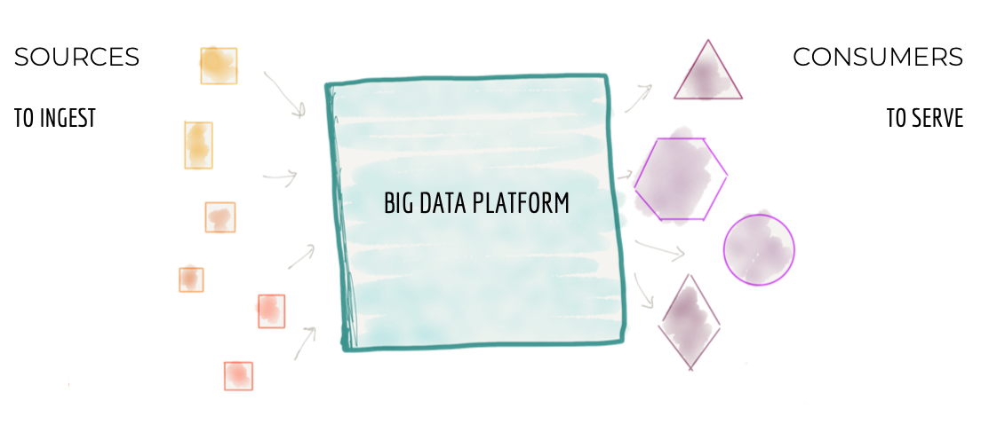
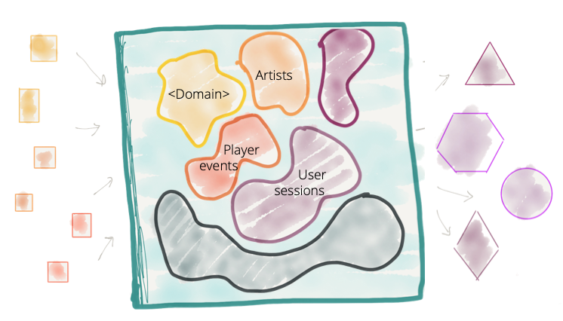

9 OCTOBRE 2023

Slide 5
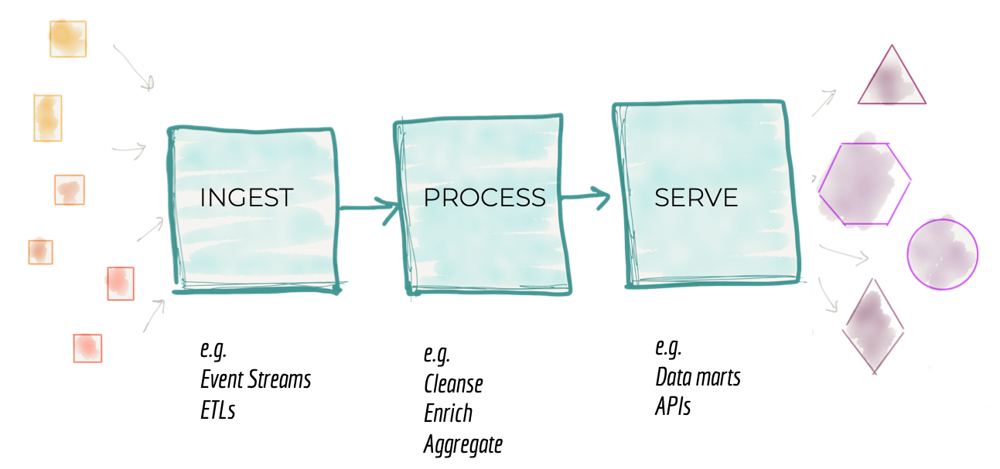
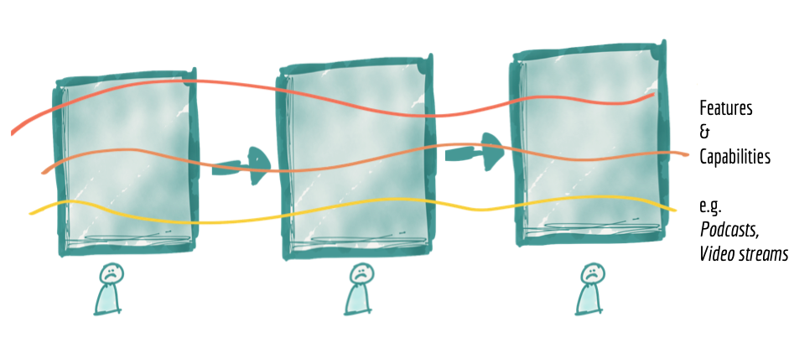
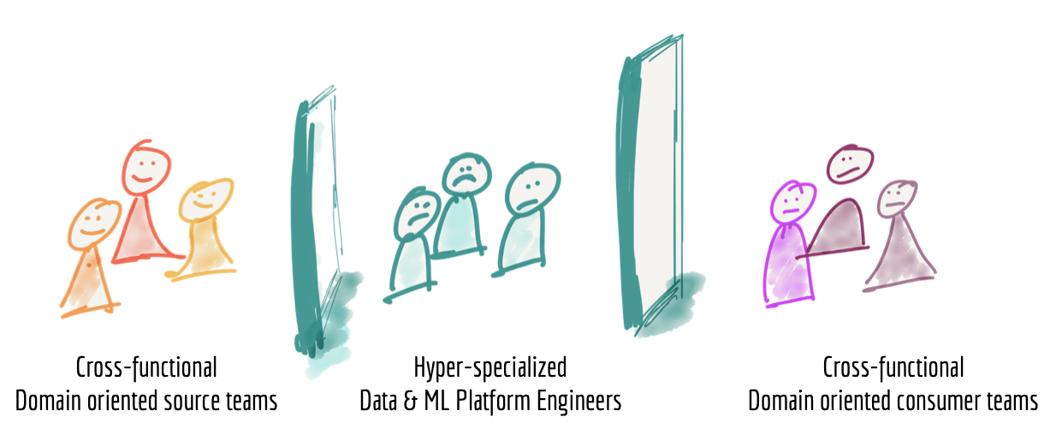
9 OCTOBRE 2023

Slide 6
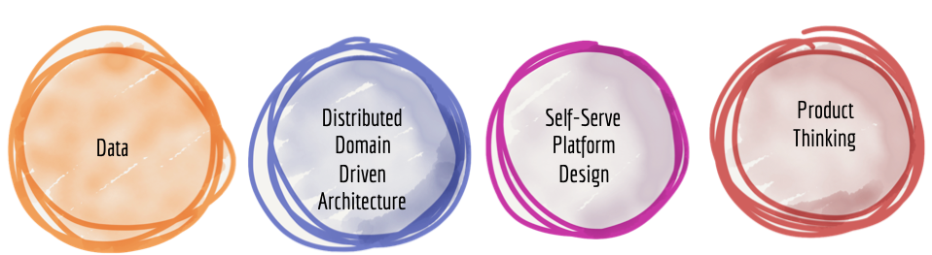
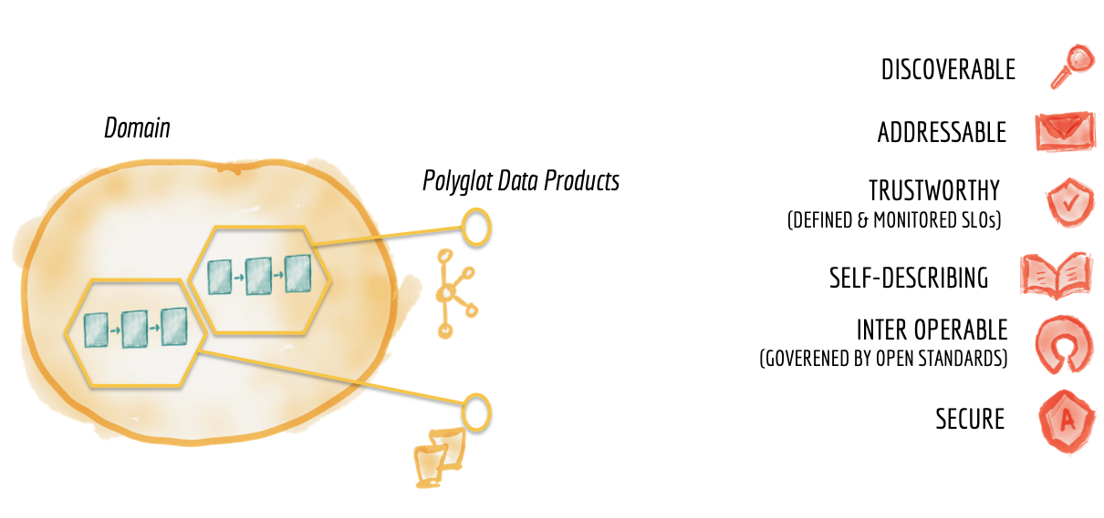
9 OCTOBRE 2023

Slide 7



What is a data product ?
Data product
Documented in a Data catalog
Metadata describing the product and the business terms
Access management process compliant with security rules
Published data set that can be accessed by others
Enables consumers to perform cross-domain data analysis
Preferred format are files, tables or views but also all kind of API
Data quality expectations / SLA are described and monitored
Addressable in a Data platform
Through a query engine with examples and best practices
With usage and access monitoring
Source or native data products
Aggregated data products
Fit for purpose data products
Aligned with the structure, lifecycle and semantic of the data source.
Should be developed by a team that is as close as possible to where the data is originally generated.
Aligned with a particular business concept aggregated from multiple domains
Providing the data as much as possible liked with the different dimentions
Data products that are transformed and modeled to fit a set of specific use cases
Often the result of a machine learning or analytics computation
Domain team
Is responsible of the operations
We measure the data product success through data usage, number of data consumer and their satisfaction !
Notes:
Data support: Business (Self-Service), Feature Teams, Data-Owners (data
referencing), etc.
Management of access rights: requests for validation from Data Owners and other
Data-architecture (where to store the data), validation of compliance with
standards and best practices, and monitoring of the debt backlog
Monitoring the creation and compliance of descriptor files
O
Updating of Data Catalog and Data Models
O
Coaching of other Data Stewards (juniors or those not frequently applying a
process), and inter-Data Steward collaboration
Animation of the internal network and global IT Data Steward network
C
Being the priority contact for Data Architects and Data Owners
Being key players in data quality: knowing key figures, recommending controls, etc.
responsible for the quality of data in their respective domains
Define and apply best practices and standards
Oversight, management, and validation of the design of the data models (database and MicroStrategy) in the AMN data warehouse and data marts.
Oversight, management, and validation of the data approach in the CDL as it relates to AMN and our team’s usage of the data.
Participation in OPEN program changes that impact the AMN data models.
Participation in Collibra implementation and ongoing content integration from MicroStrategy.
Connection point for data governance roles at group and regional level.
There are other minor activities as well but the above are the primary ones. The job code used was 001912 Data Architect (Digital Data Management) if that helps with a reference point.

Slide 8
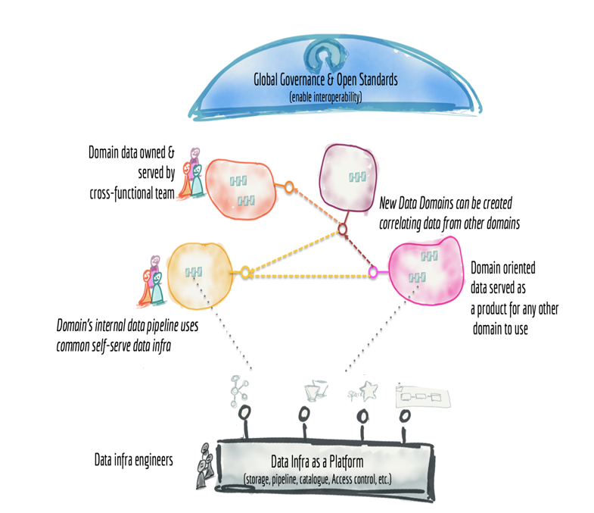
Distributed data
domains

Slide 9
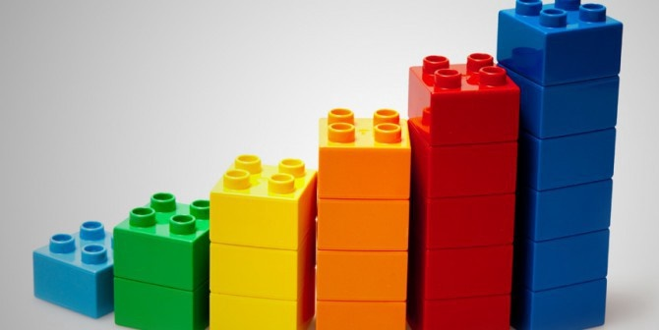
In 2021, we have identified the data domains and measured their exposition
In 2022, we need to reinforce the link between the domains and their data products and measure their usage
Business
Services
Market
&Sales
Manufacturing
R&D
Supply chain
Production
Finance
SES
Tire
Quality
DMINT
Industry
supply chain
Parties
Consumer
DMP
Vehicle
Material
Sell-OUt
Tire lifecycle
& usage
Products
Performances
Maintenance
Notes:
Data Domain
A data domain is a high-level classification of data representing a major topic of interest of the organization.
Data domains are assigned to one data owner and can be split in sub data domains
Data domains contains different business entities and organize their definition, exposition and quality and security policies

Slide 10
Data Platforms

Slide 11






Several platforms sharing their knowledge and practices
Focus on a common « experience » and « capabilities » provided to domains
One Data World :
to ensure data platform capabilities governance
One common backlog and roadmap
Regular demo and sharing between teams
Data catalog
D1
data platform
Protecting core secrets
Factory
Dataware
Deployed in the plant
Corporate
data lake
Transverse data platform
Ultim
data lake
Vehicle and Tire usage

Slide 12
Federated governance

Slide 13

Data catalog deployment crystalized data governance Maturation
Federated Governance
Support a distributed orgnization
Data
Owner /
Data
Steward
Business Data Model
Communities and data domains (like Stock, Product etc)
Business terms, data concepts, data attributes and policies
Operational Data Model
Logical : Logical view to abstract physical model, and highlight interconnection between products
Physical : List of physical files and tables
Data
Custodian
Data catalog as a one stop shop for data
Beyond the technical deployment of a tool, Data Catalog crystallize Data Governance maturation and structure the governance
Data Owners define and align themselves on their perimeter. They take ownership of the Enterprise Data Model and a common language by defining Domains and Business Terms
Data custodians describes all the physical tables and datasets that are automatically scanned by Data Catalog.
The 2 approaches come together and make it possible to bridge the gap between the physical model and the logical model.
Notes:
Business Model :::: EDM { Diagram/ Relationship to be done in Archi and metadata information in collibra }
Domain ( subject areas like Stock, Product etc)
Business terms ( Definition of business terms, domains like logical stock, physical stock )
Operation Model
Logical : combined list of data products for a particular domain. Interconnection of all these products will form Logical Model. { Relationship within and between data products to be done in Archi and metadata information in collibra }
Physical : List of files/ entities which are physically present. ( Relationship in Archi , entity & attribute definitions in collibra}

