Slide 1
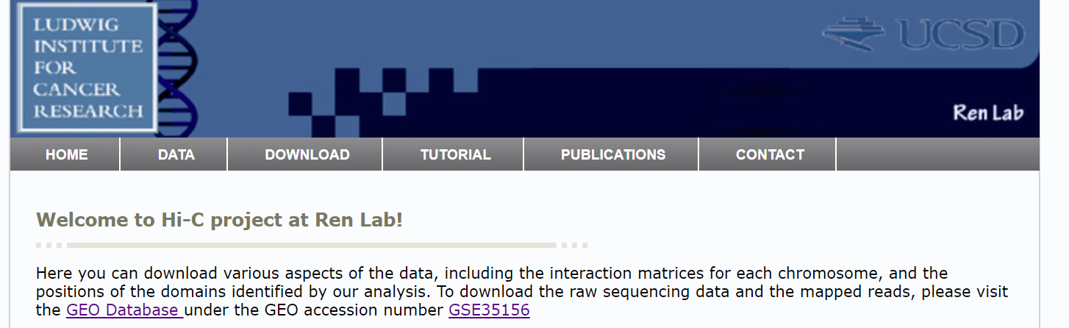
3D Definition -- Hi-C
GSE35156_GSM862720_J1_mESC_HindIII_ori_HiC.nodup.hic.summary.txt.gz

Slide 2
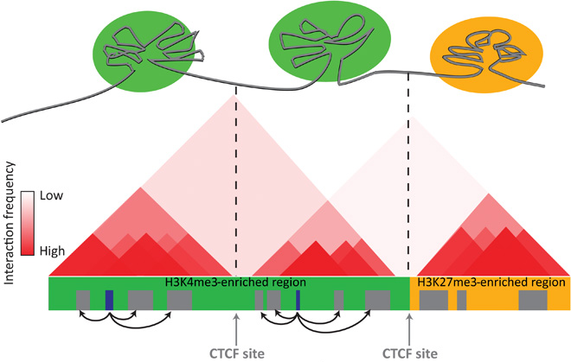
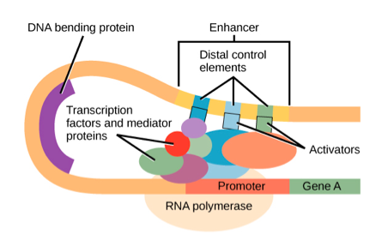
TADs and Significant Interactions
Topologically associating domains: regions of high chromatin interactions
Chromatin interactions/ loops: contacts between regions far from each other on the linear DNA sequence but close in 3D spaces
TAD | Loop

Slide 3
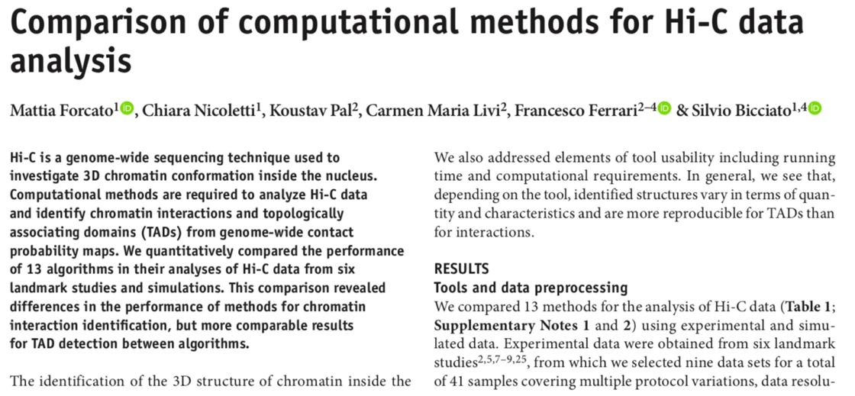
Software Research

Slide 4
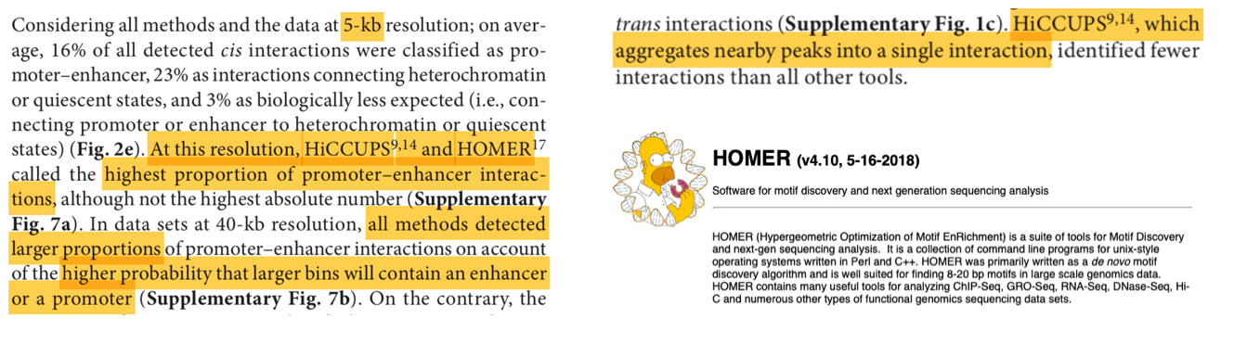
HOMER vs HiCCUPS

Slide 5
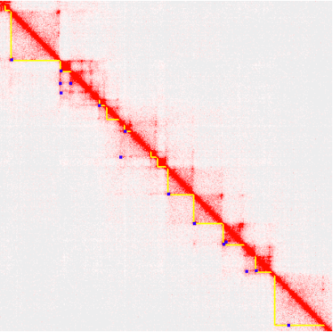
Homer Flowchart
hic.summary
homer-style format tag directory
TAD and Loops
makeTagDirectory
findTADsAndLoops
Hi-C Summary Format
Read Name
Chr for read 1
Pos for read 1
Strand of read 1
Chr for read 2
Pos for read 2
Stand for read 2
file is here → /home/jimmy/Bitsstor03/hi-c/
Copy the file to your directory!!

Slide 6
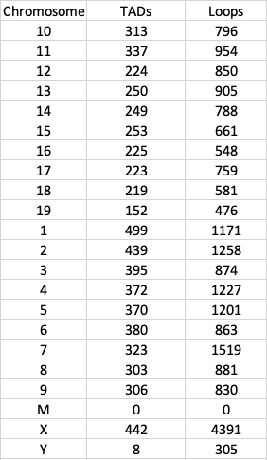
Homer Results
 | All Included | M,X,Y Excluded
Loops | 21838 | 17142
TADs | 6282 | 5832
TADs Average | 1051186 | -
Loop Average | 992.636364 | 902.210526
Loop Minimum | 0 | 476
Loop Maximum | 4391 | 1519
Loop Median | 856.5 | 863
Loop Standard Deviation | 810.812137 | 268.819762

Slide 7
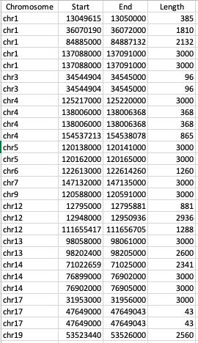
Loops intersect with Super Enhancer
Amount | 28
Average length | 1895.42857
Minimum length | 43
Maximum length | 3000
Median length | 2450.5
Mode length | 3000
Standard Deviation | 1177.97418

