Slide 1

Complexity Analysis of Algorithms
Jordi Cortadella
Jordi Petit (Python version)
Department of Computer Science

Slide 2
Estimating runtime
What is the runtime of g(n)?
def g(n: int): for i in range(n):
f()
def g(n: int): for i in range(n):
for j in range(n):
f()

Slide 3
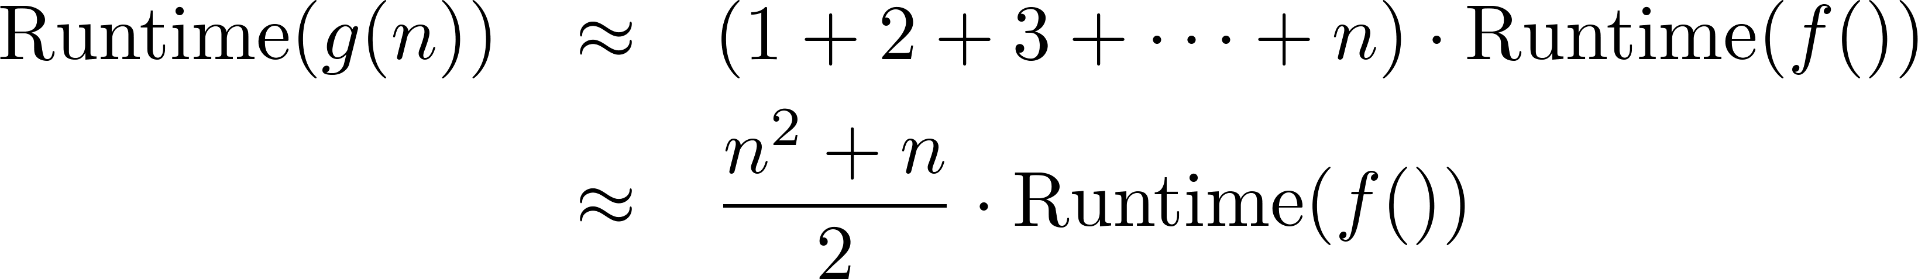
Estimating runtime
What is the runtime of g(n)?
def g(n: int): for i in range(n):
for j in range(i + 1):
f()

Slide 4
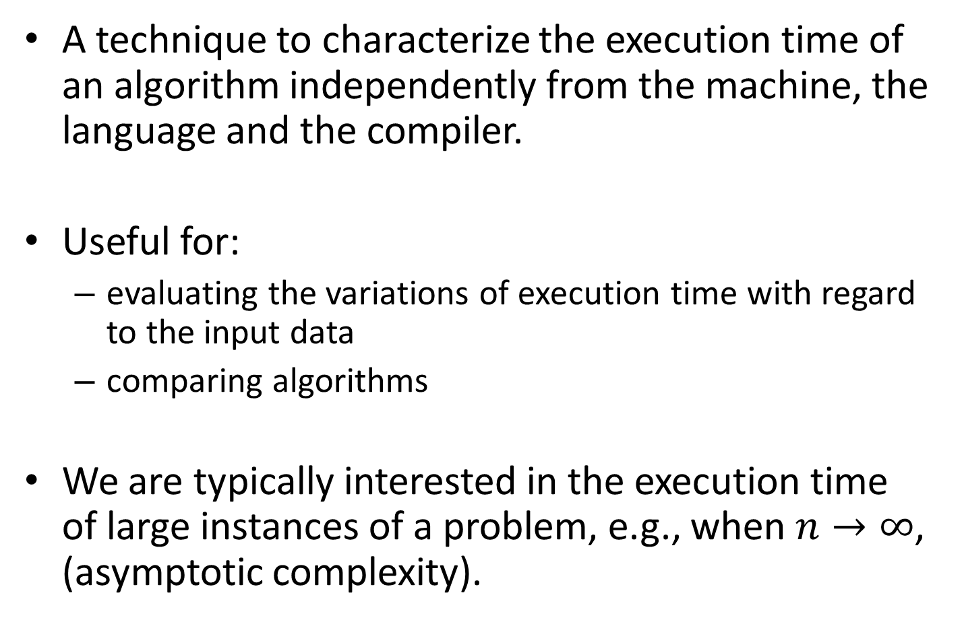
Complexity analysis
A technique to characterize the execution time of an algorithm independently from the machine, the language and the compiler.
Useful for:
evaluating the variations of execution time with regard to the input data
comparing algorithms
We are typically interested in the execution time of large instances of a problem, e.g., when $n→∞$, (asymptotic complexity).

Slide 5
Big O
A method to characterize the execution time of an algorithm:
Adding two square matrices is O(n²)
Searching in a dictionary is O(log n)
Sorting a vector is O(n log n)
Solving Towers of Hanoi is O(2^{n})
Multiplying two square matrices is O(n³)
…
The O notation only uses the dominating terms of the execution time. Constants are disregarded.

Slide 6
Big O: formal definition
Let T(n) be the execution time of an algorithm when the size of input data is n.
T(n) is O(f(n)) if there are positive constants c and n₀ such that T(n) ≤ c⋅f(n) when n ≥ n₀.
c⋅f(n)
T(n)
n₀
n

Slide 7
Big O: example
Let T(n) = 3n² + 100n + 5, then T(n) = O(n²)
Proof:
Let c = 4 and n₀ = 100.05
For n ≥ 100.05, we have that 4n² ≥ 3n² + 100n + 5
T(n) is also O(n³), O(n⁴), etc. Typically, the smallest complexity is used.

Slide 8
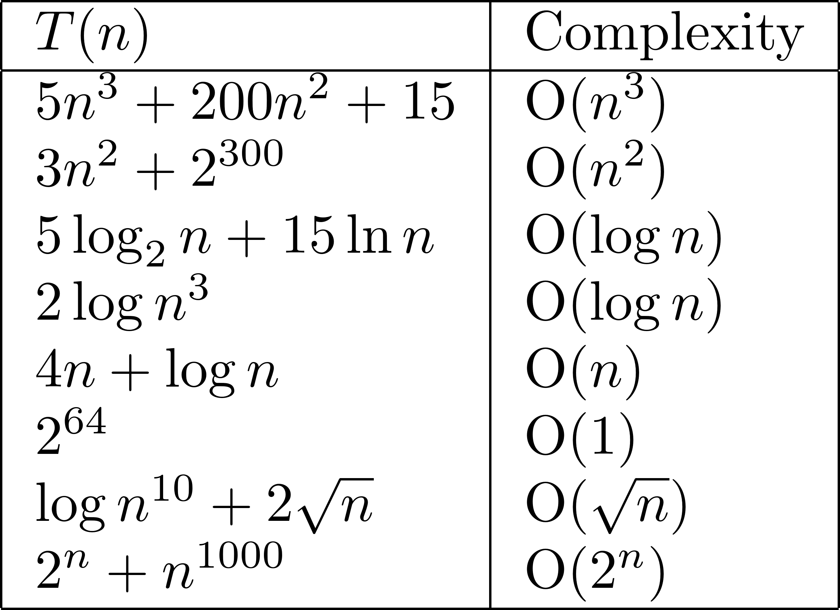
Big O: examples

Slide 9
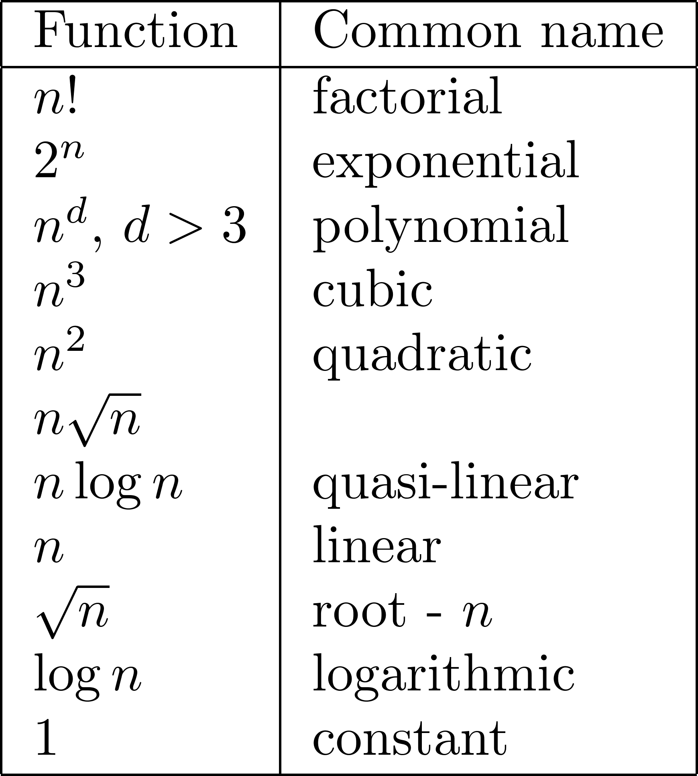
Complexity ranking

Slide 10
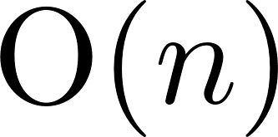
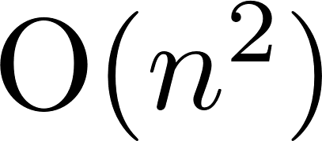
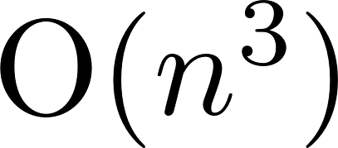
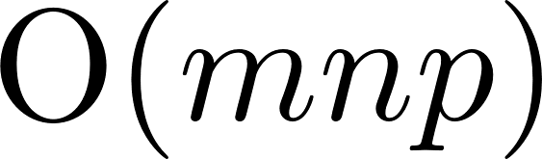
Complexity analysis: examples
Let us assume that f() has complexity O(1)
for i in range(n): f()
for i in range(n):
for j in range(n): f()
for i in range(n):
for j in range(i): f()
for i in range(n):
for j in range(n):
for k in range(n): f()
for i in range(m):
for j in range(n):
for k in range(p): f()

Slide 11
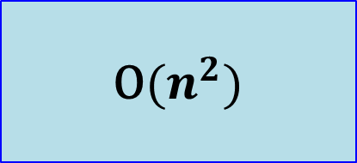
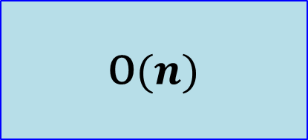
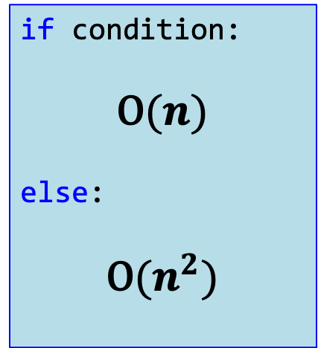
Complexity analysis: examples
$$\text{O}(n^{2})$$
if condition:
$$\text{O}(n)$$
else:
$$\text{O}(n^{2})$$
$$\text{O}(n)$$

Slide 12
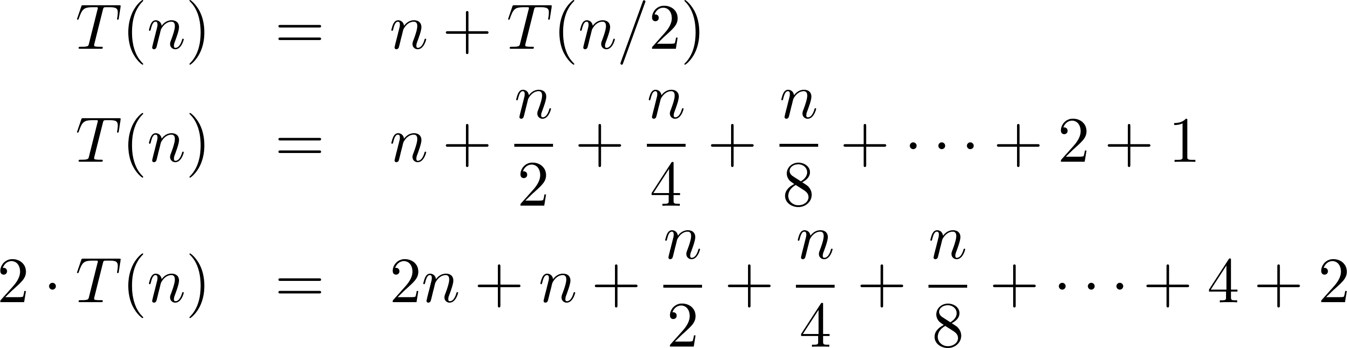
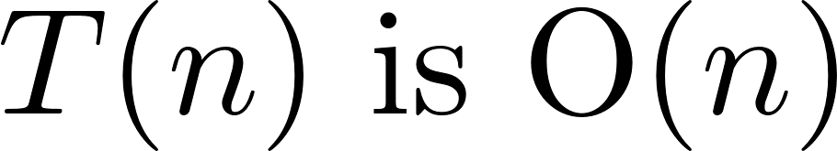
Complexity analysis: recursion
def f(n: int): if n > 0: DoSomething(n) # O(n) f(n // 2)

Slide 13
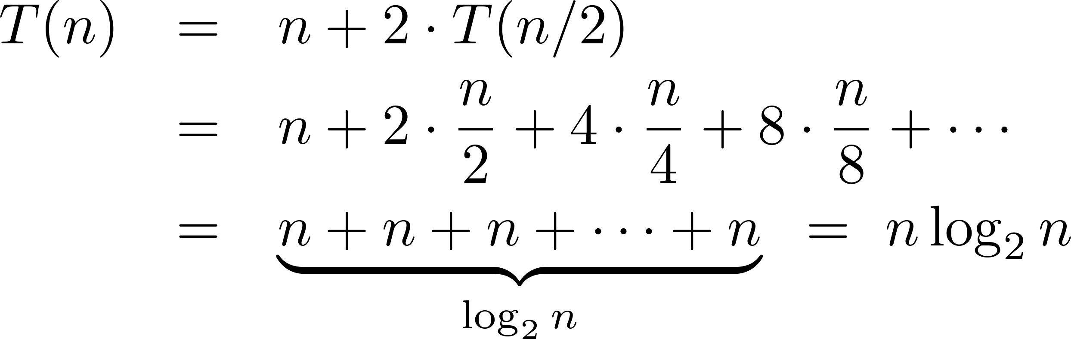
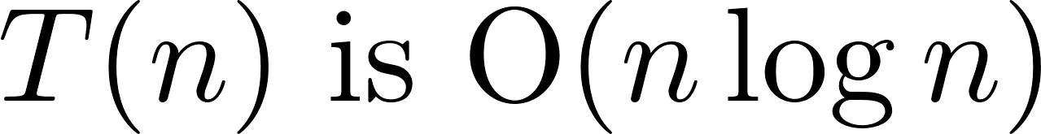
Complexity analysis: recursion
def f(n: int): if n > 0: DoSomething(n) # O(n) f(n // 2)
f(n // 2)
n
n/2
n/4
n/4
n/2
n/4
n/4
…
…
…
…
…
…
…
…
1
1
1
1
1
1
1
1
1
1
1
1
1
1
1
1

Slide 14
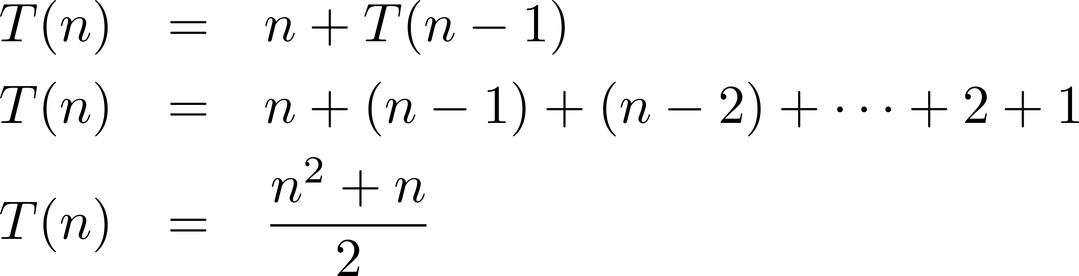
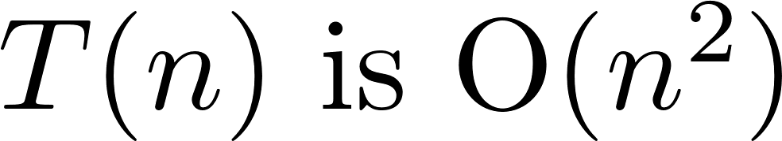
Complexity analysis: recursion
def f(n: int): if n > 0: DoSomething(n) # O(n) f(n - 1)

Slide 15
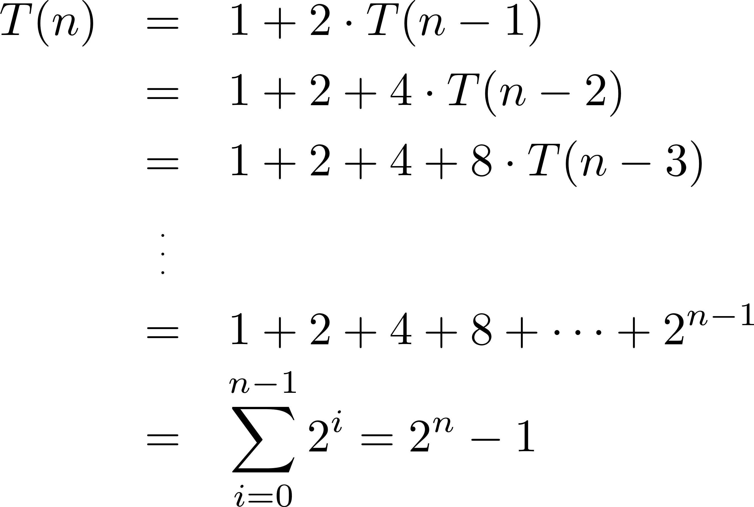
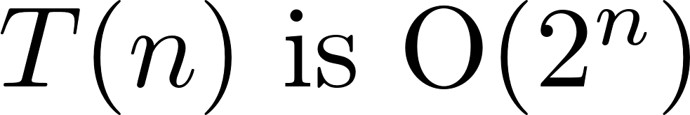
Complexity analysis: recursion
def f(n: int): if n > 0: DoSomething(n) # O(n) f(n - 1)
f(n – 1)

Slide 16
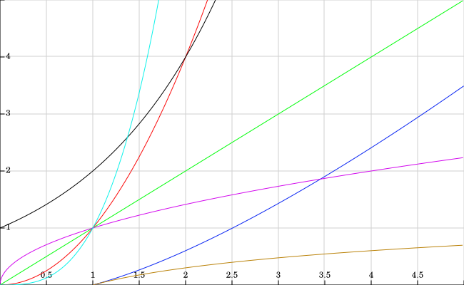
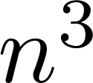

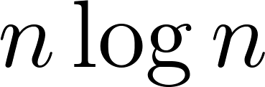
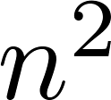
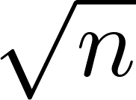

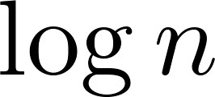
Asymptotic complexity (small values)

Slide 17
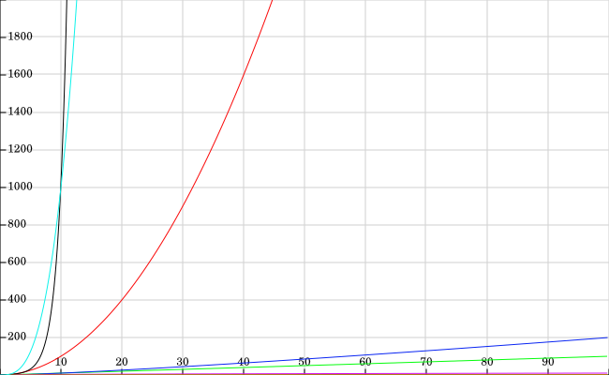
Asymptotic complexity (larger values)

Slide 18
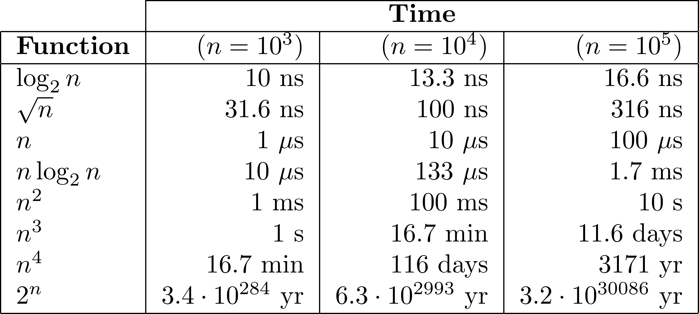
Execution time: example
Let us consider that every operation can be executed in 1 ns (10⁻⁹ s).

Slide 19
How about “big data”?
Source: Jon Kleinberg and Éva Tardos, Algorithm Design, Addison Wesley 2006.
This is often the practical limit for big data

Slide 20
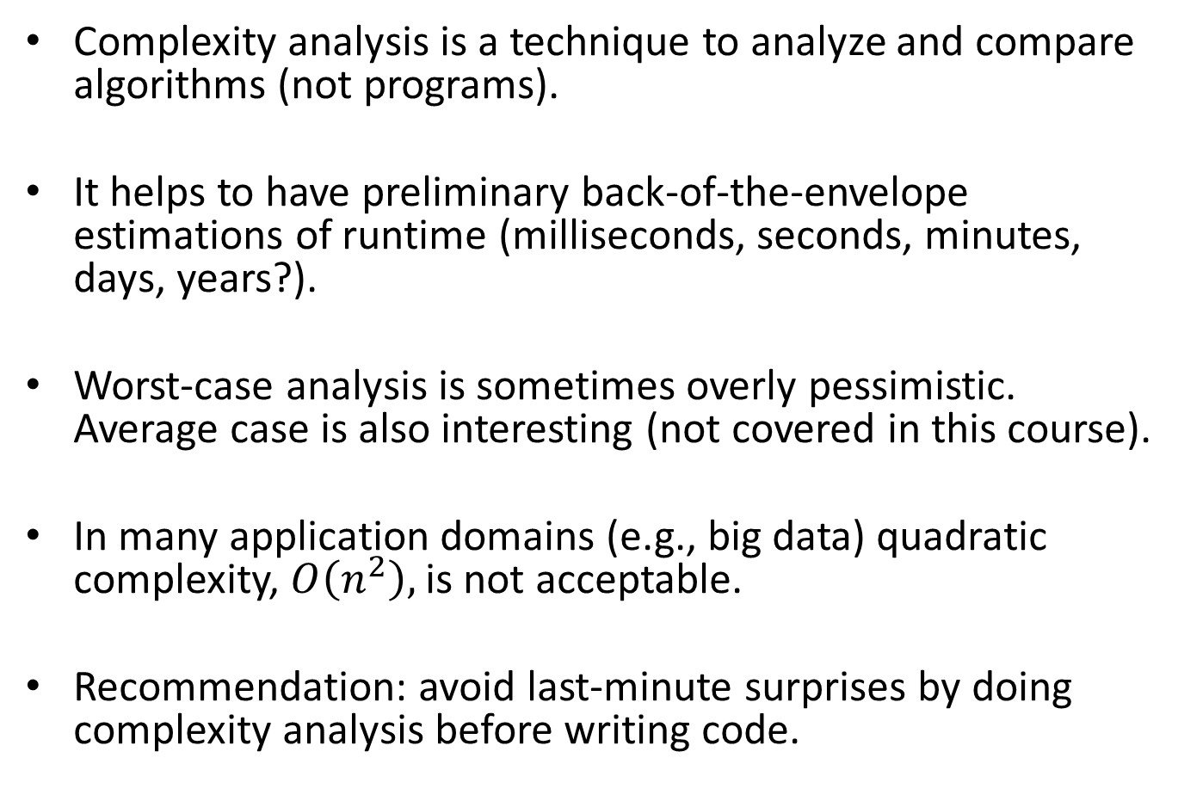
Summary
Complexity analysis is a technique to analyze and compare algorithms (not programs).
It helps to have preliminary back-of-the-envelope estimations of runtime (milliseconds, seconds, minutes, days, years?).
Worst-case analysis is sometimes overly pessimistic. Average case is also interesting (not covered in this course).
In many application domains (e.g., big data) quadratic complexity, $O\left(n^{2}\right),$ is not acceptable.
Recommendation: avoid last-minute surprises by doing complexity analysis before writing code.

