Slide 1
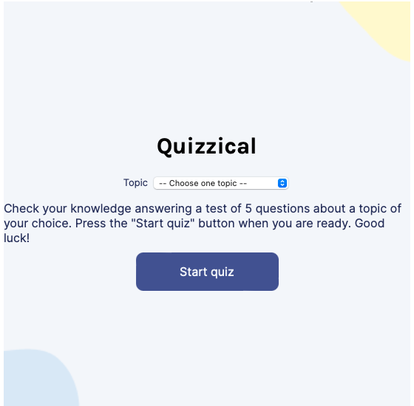
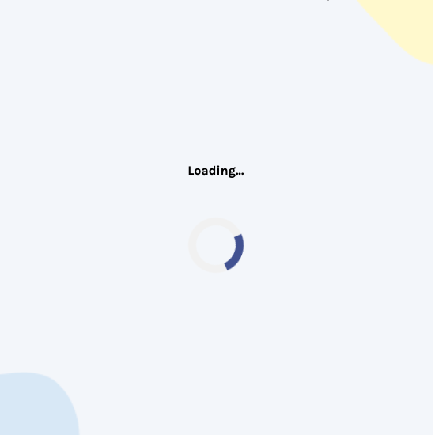
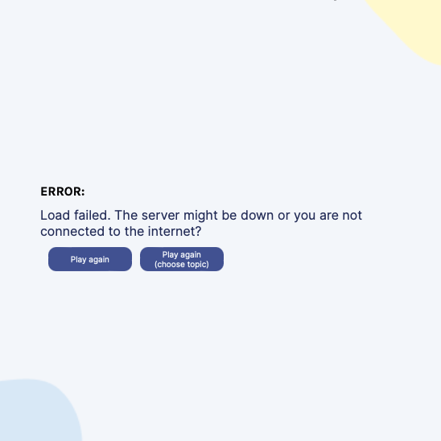
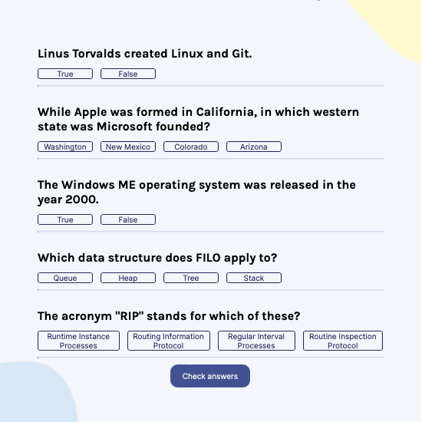
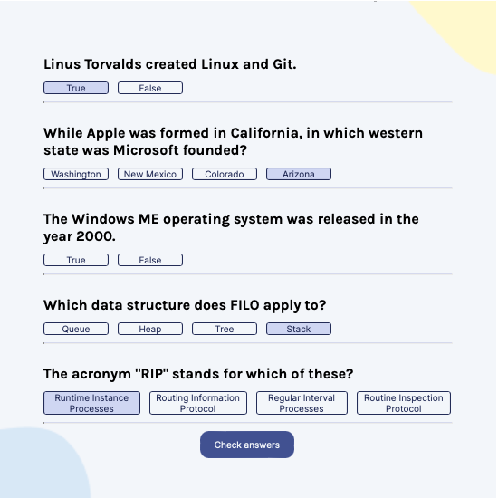
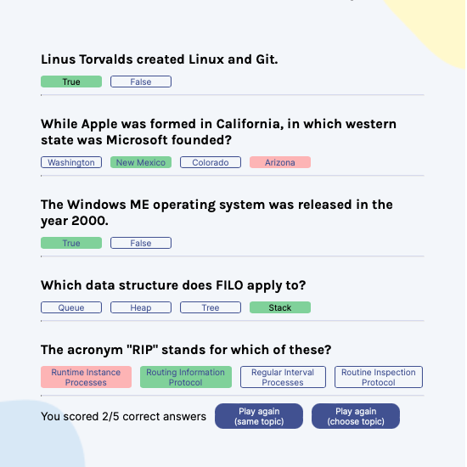
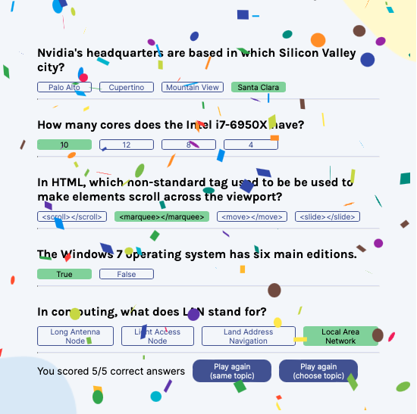
play again (same topic)
play again (choose topic)
play again (same topic)
server response
yes
error ?
start quiz
(with topic)
start quiz
(no topic)
no
play again (same topic)
play again (choose topic)
select answers
check answers
no
all correct?
yes
play again (choose topic)

