Slide 1
Differential gene expression

Slide 2
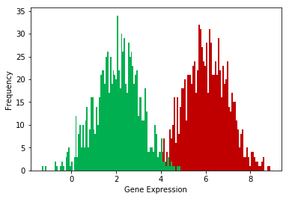
DE genes
UMAP-2
UMAP-1
Compare the gene expression distribution in green cells vs. red cells for every gene
Extract genes that are significantly different based on statistical tests

Slide 3
scRNA-seq is a more complex data type
Bulk Data
scRNA-seq Data
Gene | Abundance
B3GAT2 | 48
NPL | 122
T2 | 87
1700010I14RIK | 34
AK020722 | 88
B930003M22RIK | 25
AK163153 | 258
AGPAT4 | 329
MAP3K4 | 89
IGF2R | 608
AIRN | 48
MRPL18 | 1352
TCP1 | 1236
RNASEL | 629
ACAT2 | 513
Gene | Cell 1 | Cell 2 | Cell 3 | … | Cell N
B3GAT2 | 0 | 1 | 0 | … | 0
NPL | 0 | 0 | 1 | … | 0
T2 | 0 | 0 | 0 | … | 0
1700010I14RIK | 0 | 1 | 0 | … | 0
AK020722 | 0 | 0 | 0 | … | 1
B930003M22RIK | 0 | 0 | 1 | … | 0
AK163153 | 0 | 1 | 0 | … | 0
AGPAT4 | 0 | 0 | 0 | … | 0
MAP3K4 | 1 | 0 | 0 | … | 0
IGF2R | 2 | 0 | 0 | … | 0
AIRN | 0 | 2 | 0 | … | 0
MRPL18 | 0 | 0 | 0 | … | 0
TCP1 | 3 | 0 | 0 | … | 0
RNASEL | 0 | 1 | 2 | … | 0
ACAT2 | 1 | 1 | 0 | … | 0

Slide 4
Use differential gene expression analysis to identify genes or transcripts that are expressed at significantly different levels between two or more groups of samples.

Slide 5
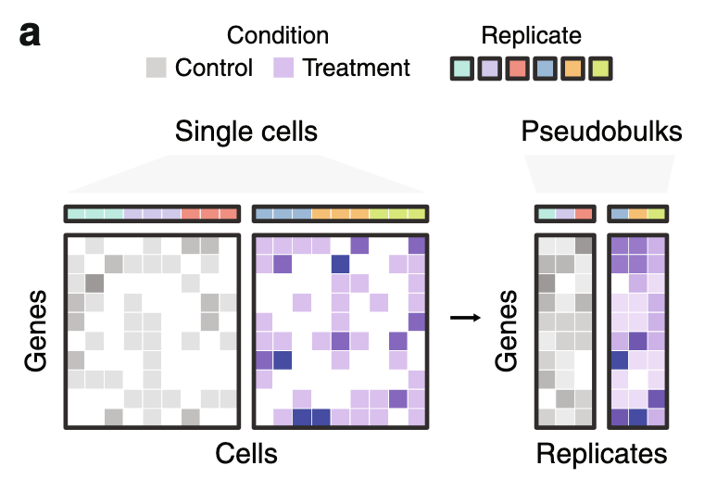
Pseudo-bulk vs single-cell methods
Pseudobulk methods: aggreagte within a biological replicate before applying statistical test
Single-cell-based methods compare individual cells.
Data observation: sparse with few highly-expresssed genes
Squair, J. W. et al. Confronting false discoveries in single-cell differential expression. Nat Commun 12, 5692 (2021).

Slide 6
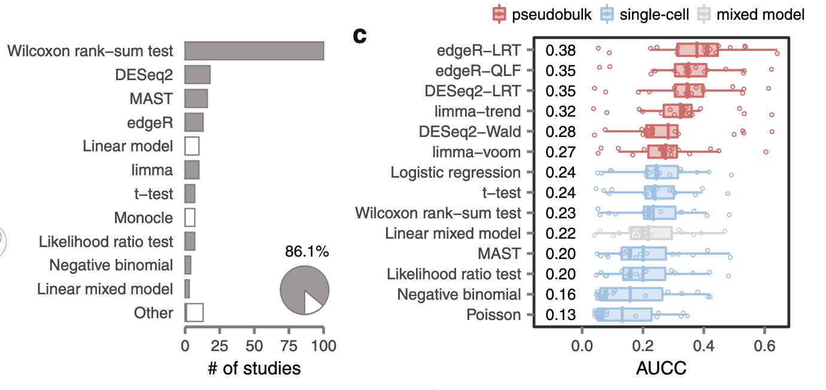
Pseudo-bulk methods outperform single-cell methods, but single-cell methods are more popular
Area under the concordance curve (AUCC) measures concordance of DE analysis of matched single-cell and bulk RNA-seq data.
Squair, J. W. et al. Confronting false discoveries in single-cell differential expression. Nat Commun 12, 5692 (2021).

Slide 7
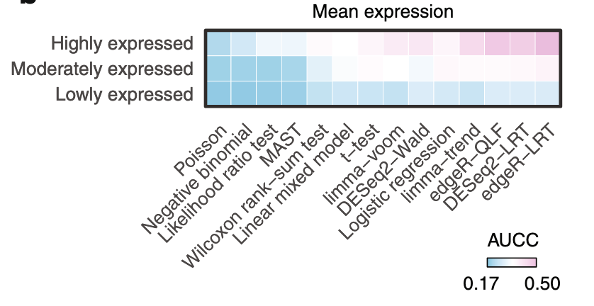
Minimal difference for lowly expressed genes but large differences for highly expressed genes
Single-cell
pseudobulk
Single-cell methods identify highly expressed genes as DE, even when their expression remained unchanged.

Slide 8
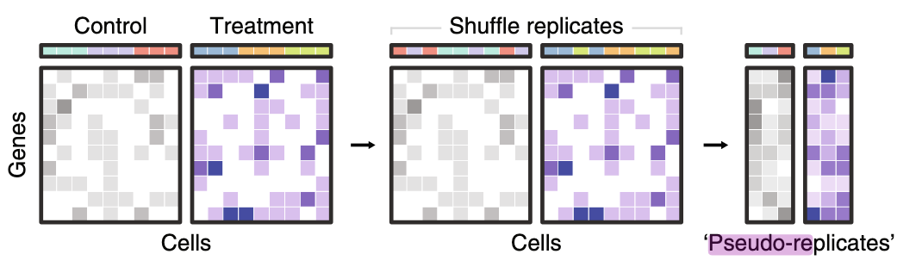
Random aggregation does not improve performance
Notes:
Do these pseudo replicates correspond to “cell subtypes”?

Slide 9
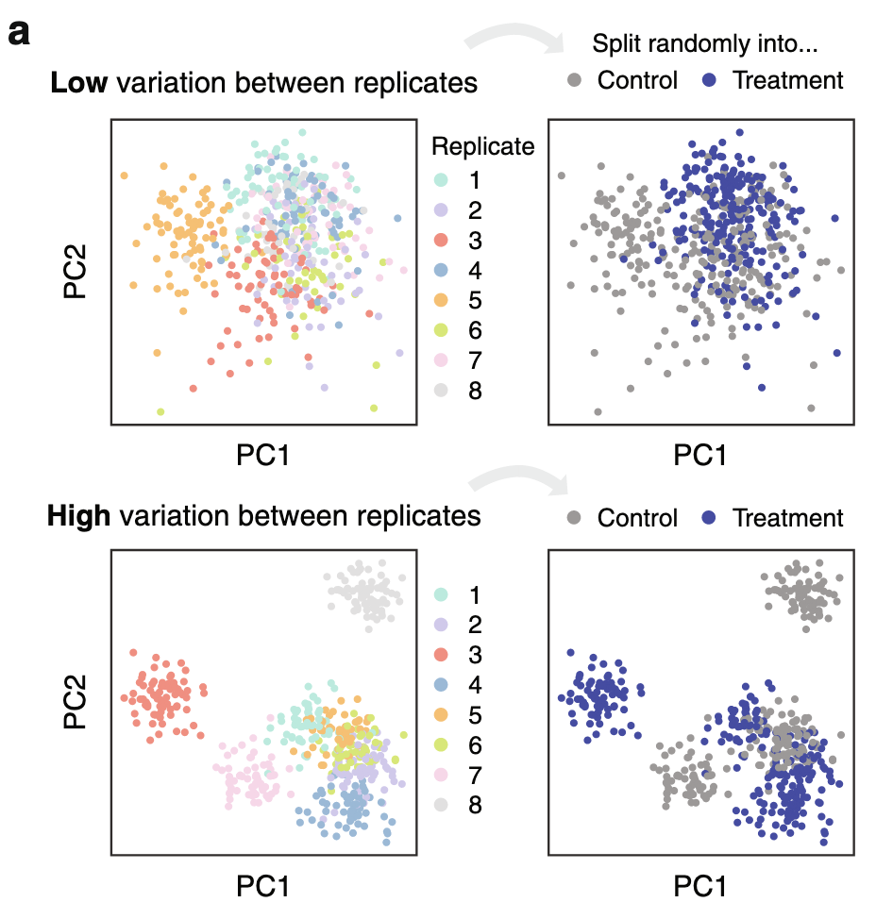
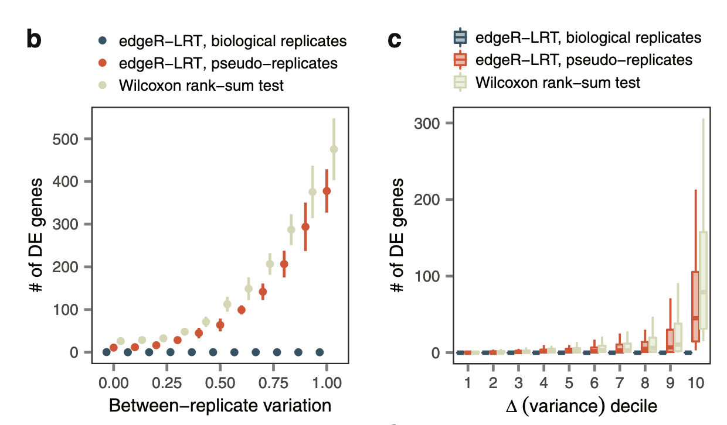
False discoveries arise in the absence of any biological difference
Simulated single-cell data with different degrees of heterogeneity between replicates. Each replicate is randomly assigned to control or treatment group, so there is an absence of any difference between groups.
Notes:
Single-cell methods identified genes as DE that are most variable between replicates
Pseudobulk abollished false discoveries BUT pseudoreplicates introduced them again

Slide 10
Summary
presence of variability between replicates is unavoidable, and can be attributed to both technical factors and intrinsic biological differences
single-cell DE methods conflate variability between biological replicates with the effect of a biological perturbation
Pseudobulk methods are more robust to this

Slide 11
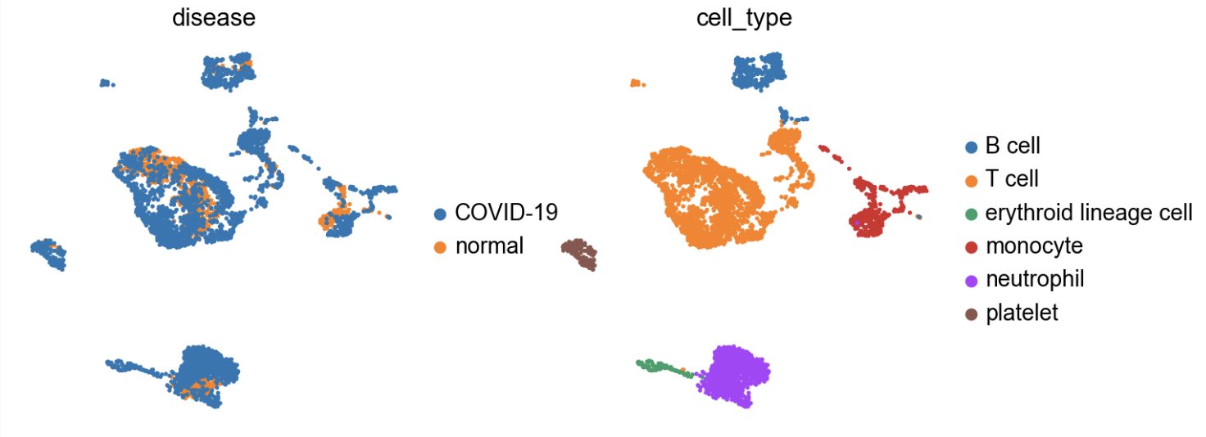
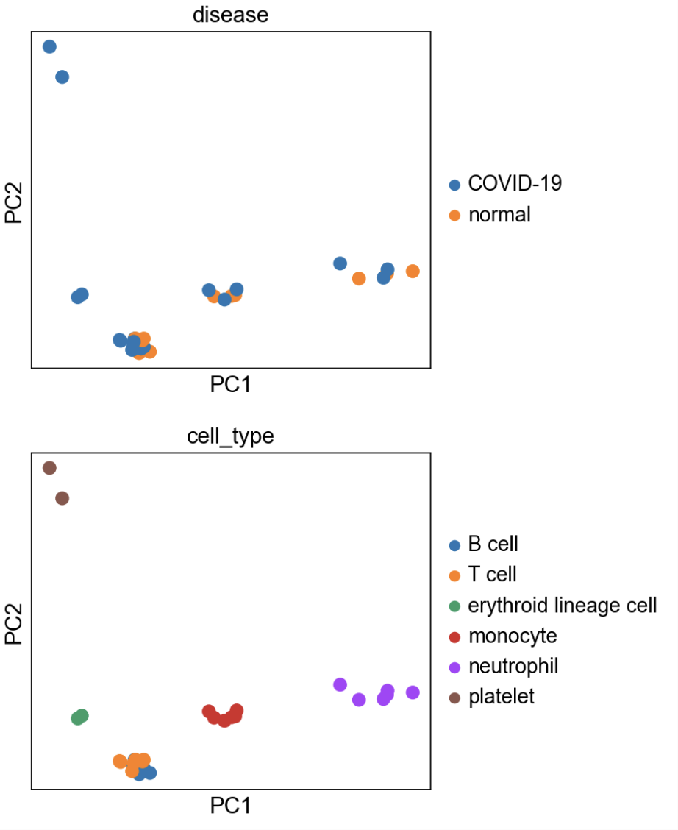
DGE analysis
Subsetting the cell type(s) of interest to perform DEA.
Extracting their raw integer counts.
Summing their counts per gene into a single profile if they pass QC.
Performing DEA if at least two biological replicates per condition are available (more replicates are recommended).
Pseudobulking:
Single cells within a sample are not independent of each other
If we treat cells as samples, we are not testing the variation across a population of samples, rather the variation inside an individual one
decoupler.get_pseudobulk
Squair J.W., et al 2021 Nat. Comm.
Notes:
After the annotation of clusters into cell identities, we often would like to perform DEA between conditions within particular cell types to further characterize them. DEA can be performed at the single-cell level, but the obtained p-values are often inflated as each cell is treated as a sample.
We know that single cells within a sample are not independent of each other, since they were isolated from the same environment. If we treat cells as samples, we are not testing the variation across a population of samples, rather the variation inside an individual one. Moreover, if a sample has more cells than another it might bias the results.

Slide 12
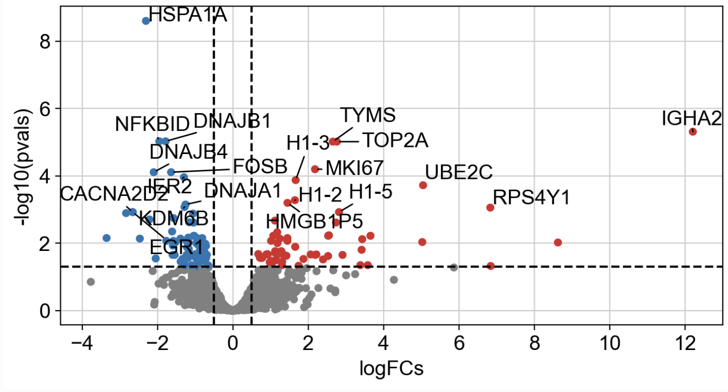
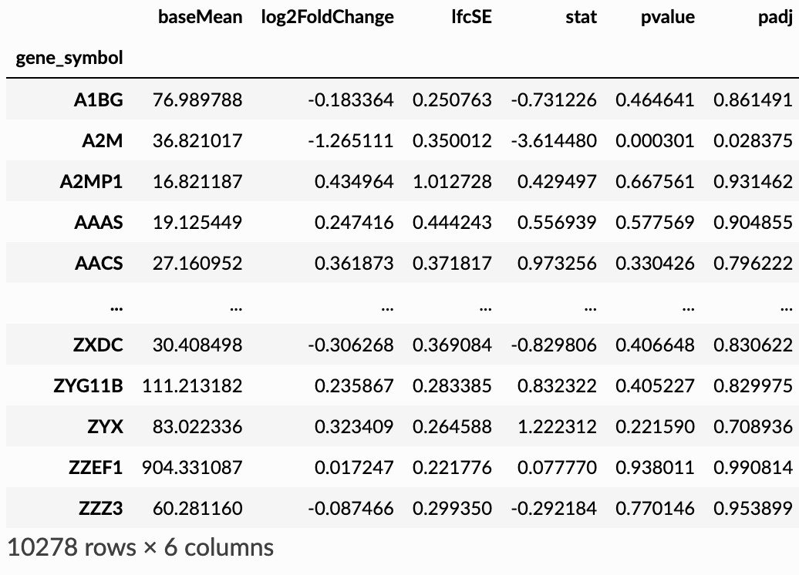

DGE analysis – contrasting between conditions
Experimental design to compare GEX in a given cell type
UMAP-2
DESeq2
EdgeR
limma
UMAP-1
Muzellec B. et al., 2023 Bioinformatics

Slide 13
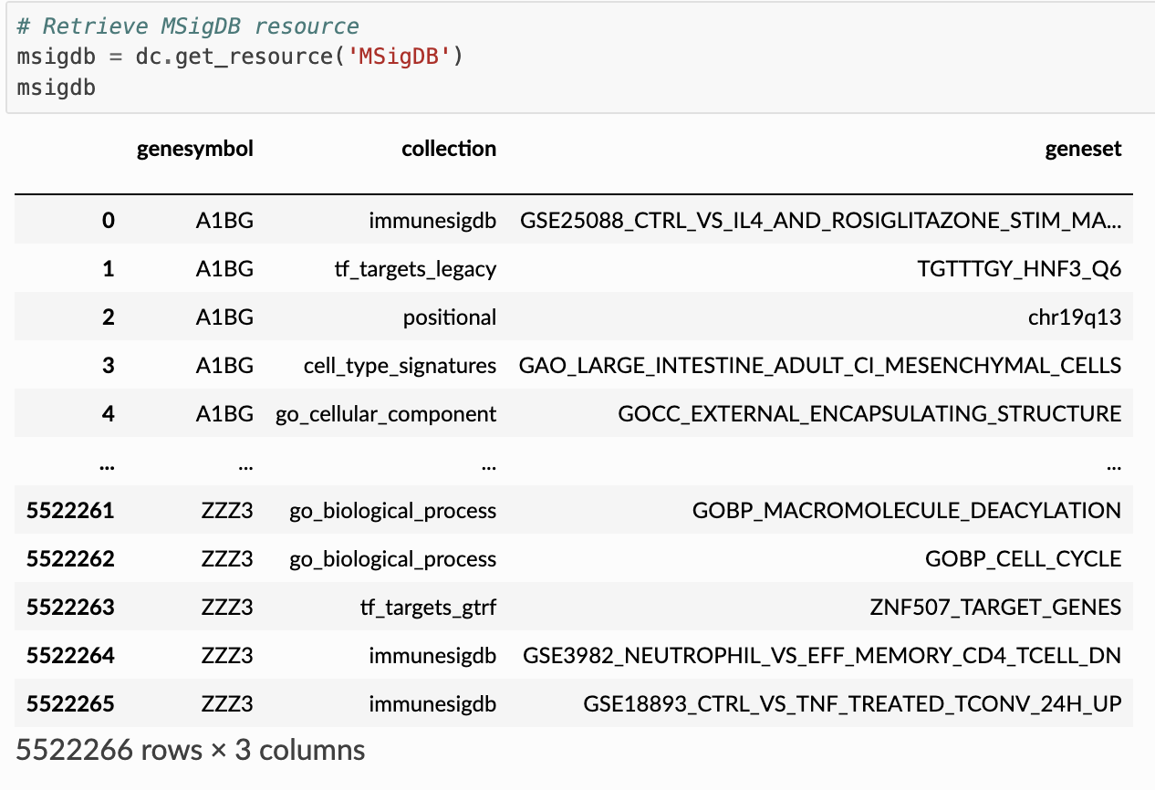
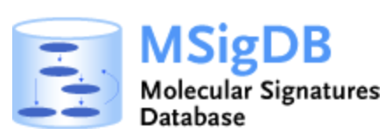
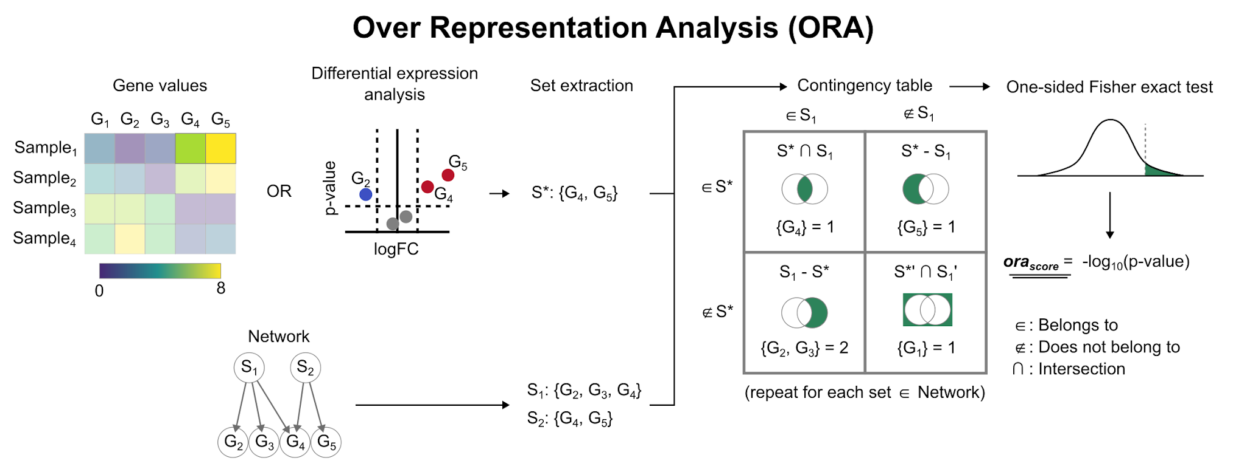
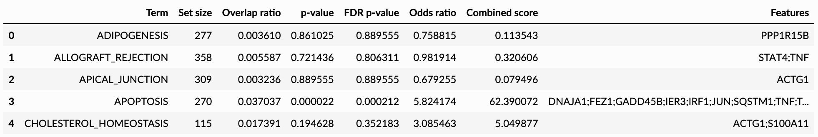
DGE analysis – Gene Set Enrichment Analysis
Database collection of gene sets annotated to different biological processes
Infer functional enrichment
Filter by a given collection
https://decoupler-py.readthedocs.io/

Slide 14
Github
git add .
git commit -m “MEANINGFUL MESSAGE”
git push

