Slide 1


Modelling Advisory Group (MAG) Hydrological Uncertainty Workshop Global Sensitivity Analysis using the SAFE toolbox 23 September 2025
Francesca Pianosi University of Bristol
Access to software, papers, example: https://safetoolbox.github.io/
Pianosi is funded under the DAFNI Centre of Excellence for Resilient Infrastructure Analysis within the UKRI Building a Secure and Resilient World program, with grant number ST/Y003713/1

Slide 2
How to run a Jupyter Notebooks from browser (no need to install anything on your computer!)
Overview:
1. Download all the required files (Jupyter Notebook + data files + python code files) to your computer from:
https://github.com/FrancescaPianosi/GSAtraining/
2. Upload and run the Jupyter Notebook in your browser through the page:
https://colab.research.google.com (Google Colab - if you have a Google account)
https://safetoolbox.github.io/demos/lab/index.html (Jupyterlite - if you do not have a Google account)
We will use the Jupyter Notebook called GR6J_GSA_Notebook.ipynb but if the interactive visualization is too slow or gets stuck, use GR6J_GSA_Notebook_static.ipynb instead (this is more likely to happen if you are using the Jupyterlite)
Notes:
Put number of flood properties at risk plot

Slide 3
Detailed instructions to download the required files

Slide 4
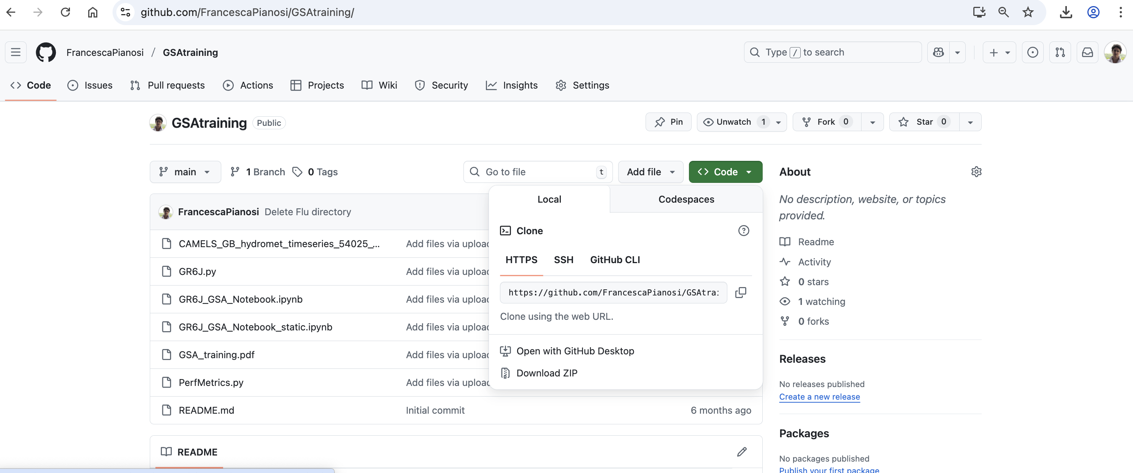
1. Download all the required files to your computer
Go to: https://github.com/FrancescaPianosi/GSAtraining/
Click on < > Code Download ZIP
Unzip the folder on your computer
1
2
Notes:
Improvements: 1) Put number of flood properties at risk plot
2) Say something about why me used models more specifically – forecasting (eg early warning) vs projecting (eg long-term risk assessment) – build in discussion of what we expect from a model (crystal ball, metaphor, etc)

Slide 5
Detailed instructions if you are using Google Colab

Slide 6
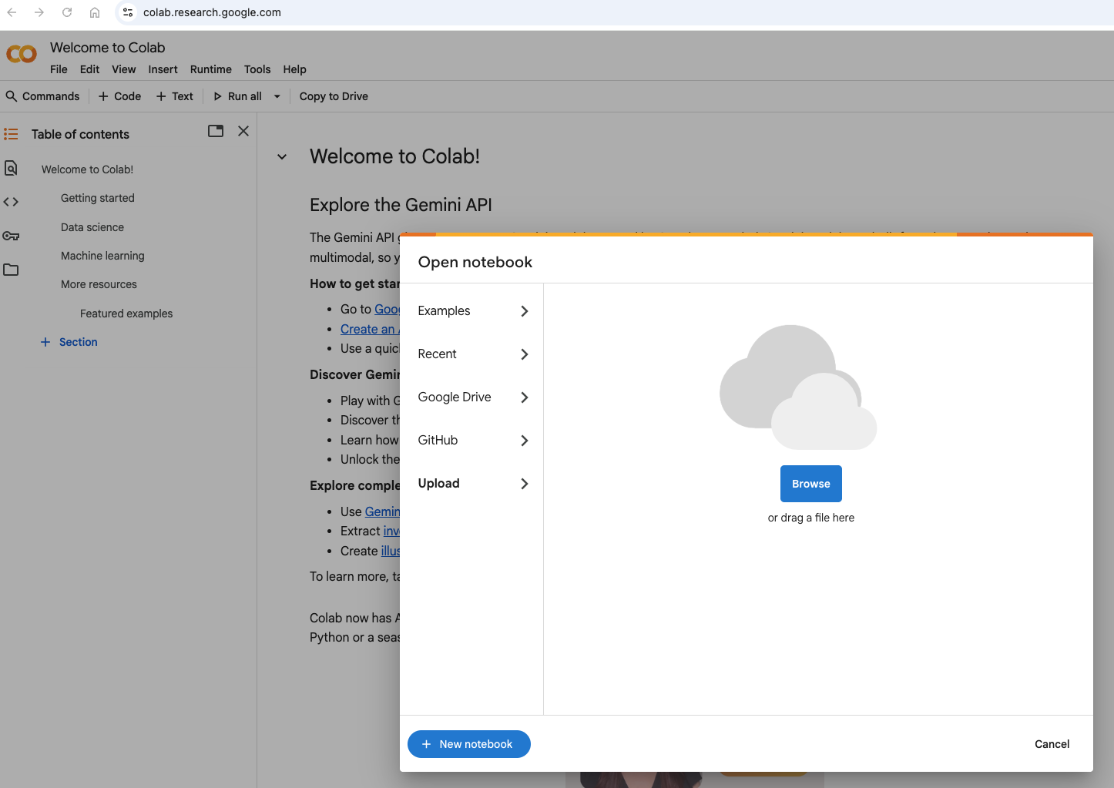
2. Upload the Jupyter Notebook in your browser using Google Colab
Go to: https://colab.research.google.com
A pop-up window should automatically open
Choose “Upload”
Find the GR6J_GSA_Notebook.ipynb file on your computer
Notes:
Add aleatory and epistemic uncertainty – to some extent quantifiable and reducible
"Deep uncertainty" refers to a state where decision-makers lack consensus or knowledge regarding the appropriate models, probability distributions, or value judgments for understanding and conceptualising complex problems – unquantifiable and irreducible
aleatory uncertainty, e.g. due to random measurement errors, and epistemic uncertainty, i.e. due to lack of knowledge - to some extent

Slide 7
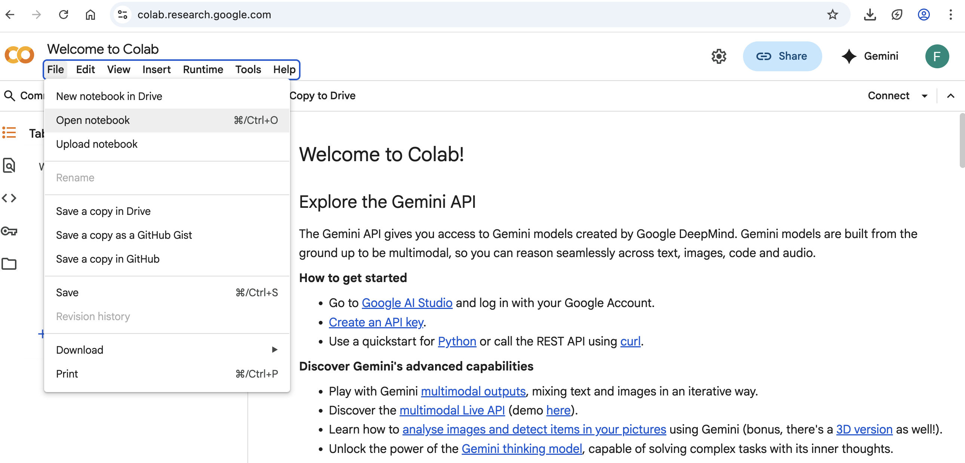
2. Upload the Jupyter Notebook in your browser using Google Colab - Troubleshooting
If the upload pop-up window does not open automatically open, go to:
File
Open notebook

Slide 8
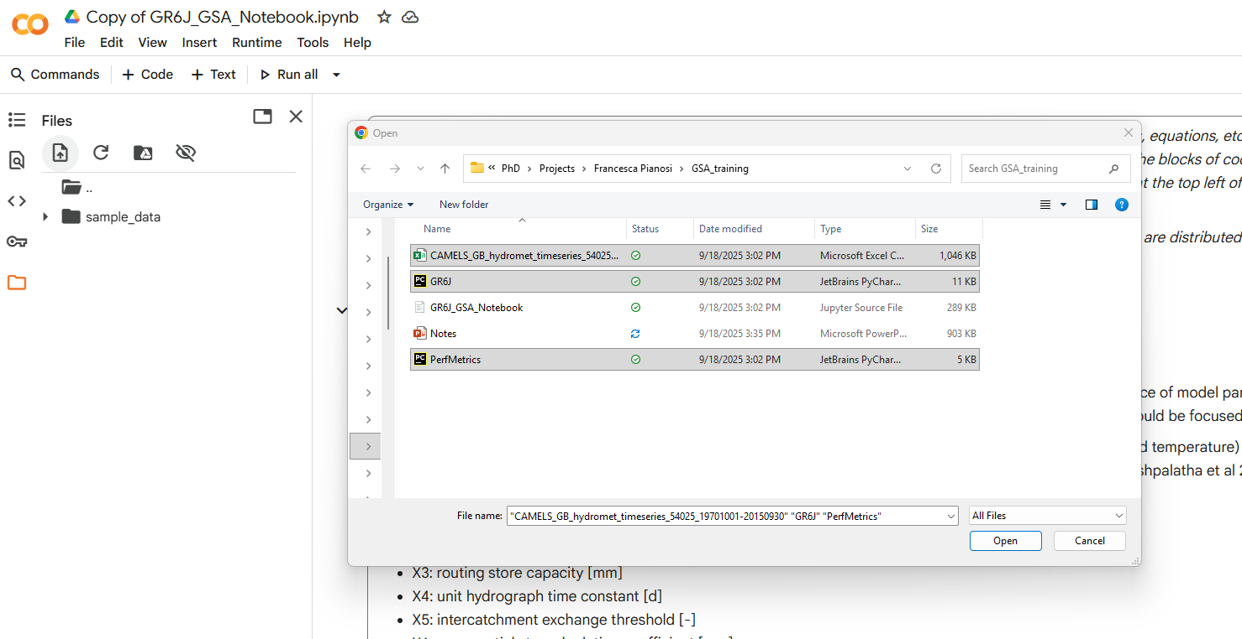
3. Upload other required files (.csv data file and two .py code files)
2
3
1
It takes a few seconds to show the Files page.
4

Slide 9
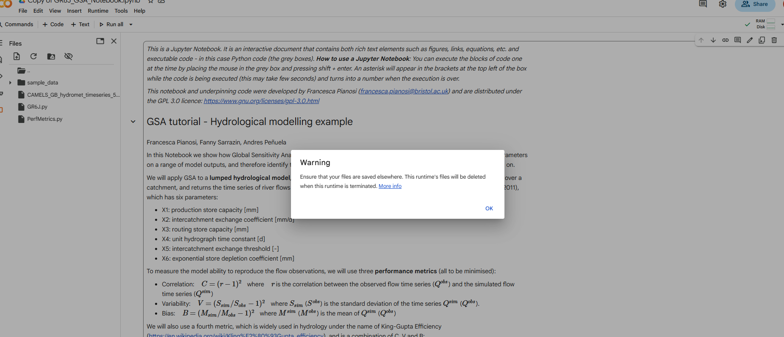
4. Ignore the warning message

Slide 10
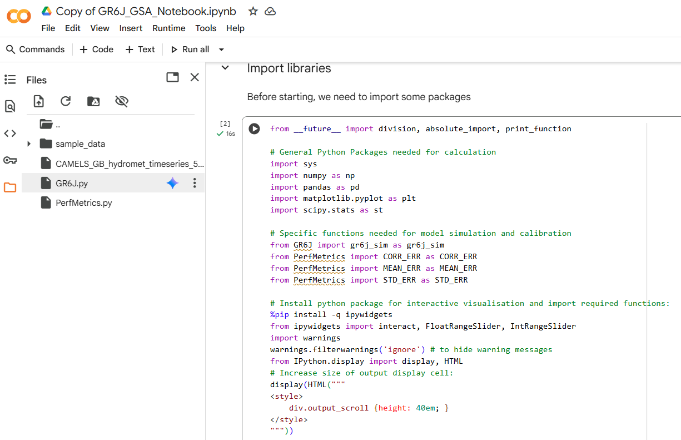
5. Check that all the required files have been uploaded

Slide 11
6. Run the code
The Jupyter Notebook includes cells of executable code and cells of text with explanations of what is going on
The cells of code can be executed one at the time by clicking on the “run” icon.
If the code has been executed correctly, a green tick will appear. If the execution produces any plot or numerical results, they will appear under the cell

Slide 12
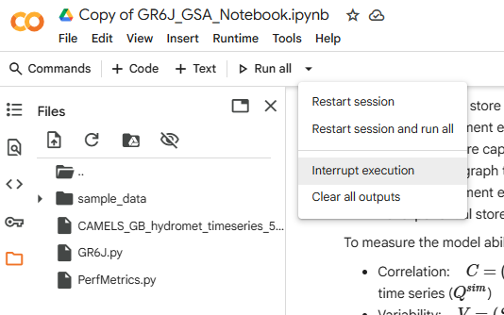
6. Run the code - Troubleshooting
Normally all commands should run in less than a minute
If it takes longer than that, the system may be stuck and you may need to interrupt the execution and repeat
1
2

Slide 13
Instructions if you are using JupyterLite

Slide 14
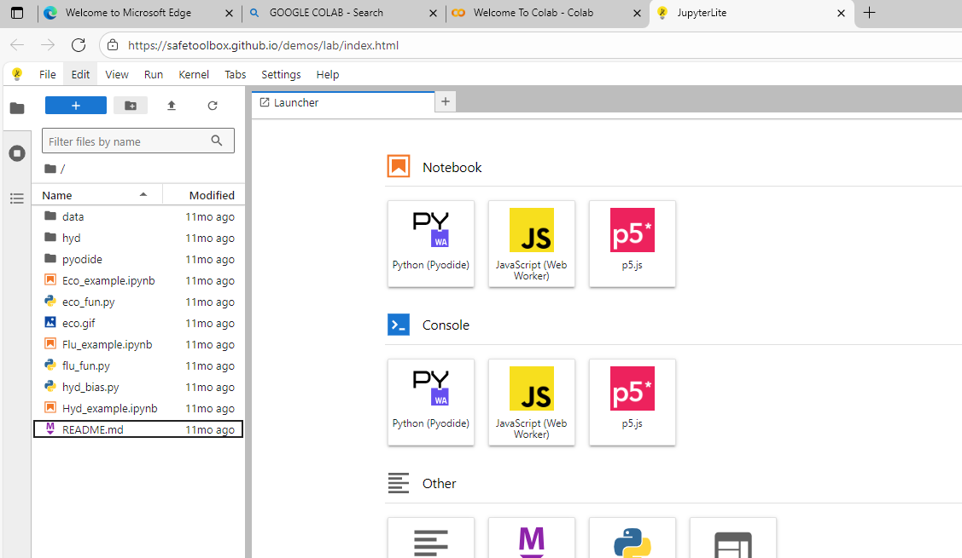
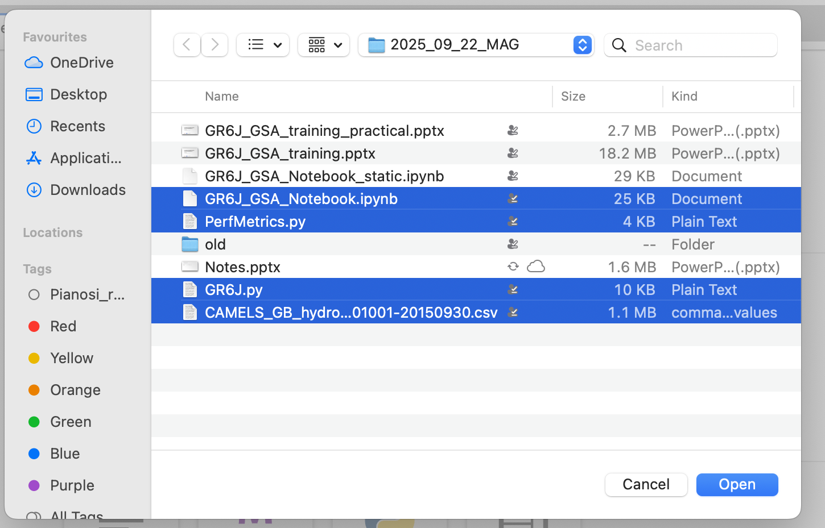
2. Upload the Jupyter Notebook in your browser using Google Colab
Go to: https://safetoolbox.github.io/demos/lab/index.html
Click on the Upload Files icon on the top left
Find all the files needed on your computer (GR6J_GSA_Notebook.ipynb + GR6J.py and PerfMetrics.py + .csv datafile)

Slide 15
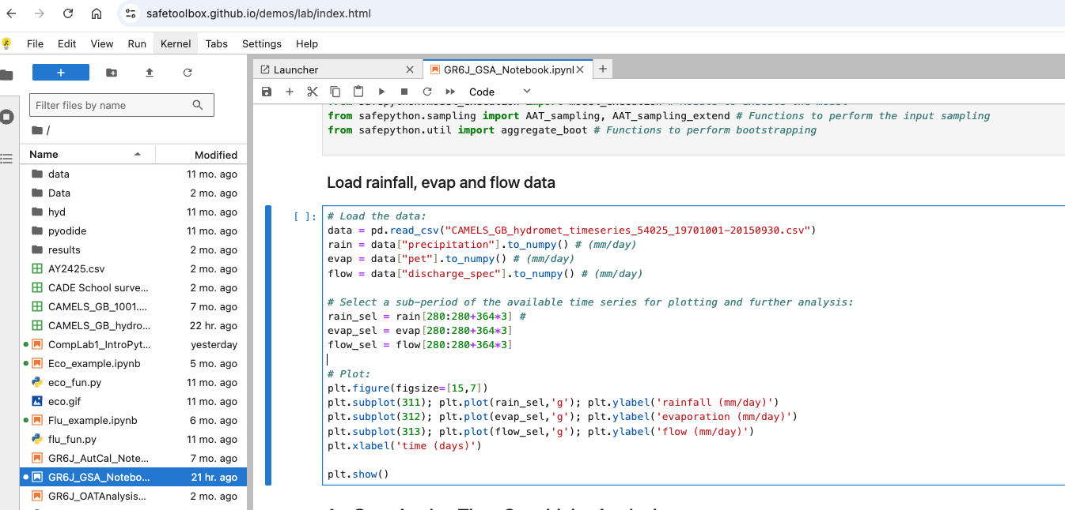
3. Run the code
The Jupyter Notebook includes cells of executable code and cells of text with explanations of what is going on.
The cells of code can be executed one at the time by selecting the cell with the mouse and clicking the “run” icon at the top (or shift+enter).
While the code is running, an asterisk will appear in the brackets next to the cell code. If the code has been executed correctly, the asterisk will be replaced by a number. If the execution produces any plot or numerical results, they will appear under the cell

Slide 16
3. Run the code - Troubleshooting
Normally all commands should run in less than a minute
If it takes longer than that, the system may be stuck and you may need to interrupt the execution and repeat

