Slide 1

Estimation and Learning in Aerospace
Prof. Marco Lovera
Marco Cocomazzi Francesco Pezzi
2025/2026
School of Industrial and Information Engineering
Master of Science – Space Engineering

Slide 2
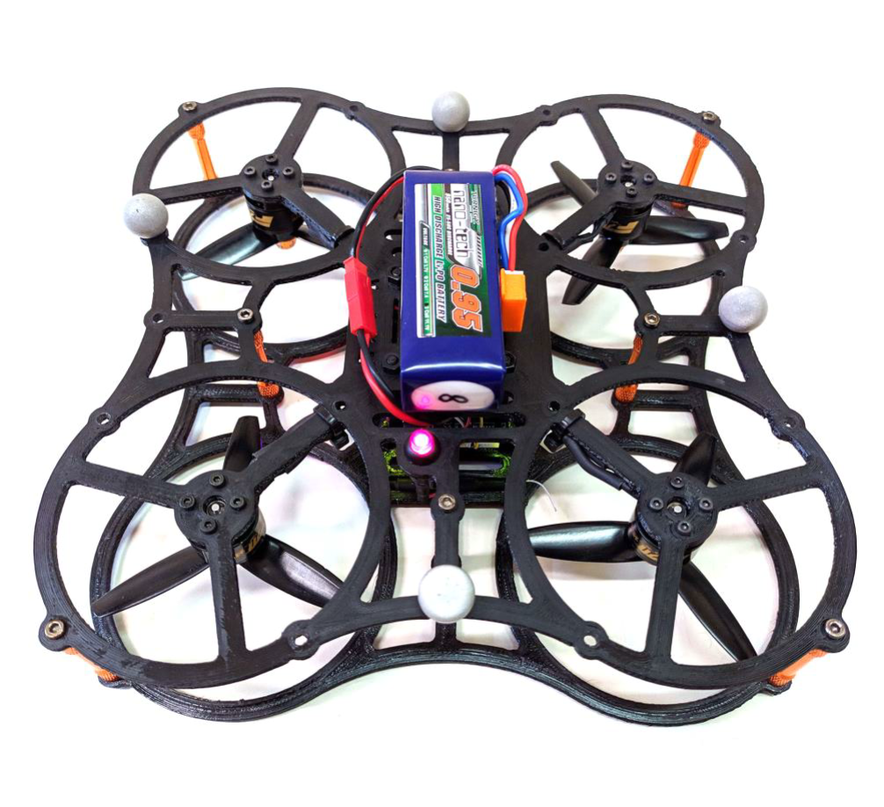
Project Tasks
Task 1
System identification of longitudinal dynamics from simulated data, using the frequency-domain grey-box method
Task 2
Sensitivity analysis to perturbations in measurement noise properties
Task 3
Analysis of the best model in a Monte Carlo study

Slide 3
Project Tasks
Task 1
System identification of longitudinal dynamics from simulated data, using the frequency-domain grey-box method
PSD Estimation
FRF Estimation
Frequency-domain grey-box
Estimation through periodograms
Comparison between different estimation methods.
Dynamic parameters identification
3/49
Notes:
Breakdown of different points related to task 1, where we start with the PSD estimation through periodograms, then this estiamation is used to evaluate the FRF, comparing different methods. Finally, FRF estimated data are used for grey boc model identification

Slide 4
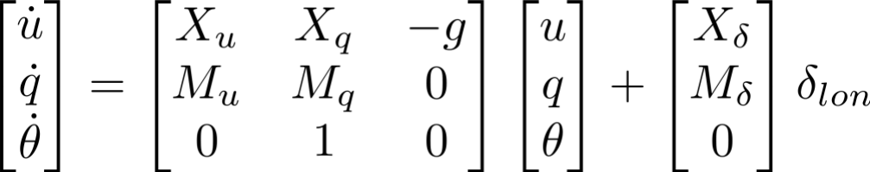
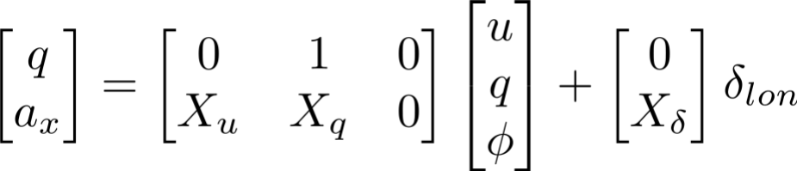
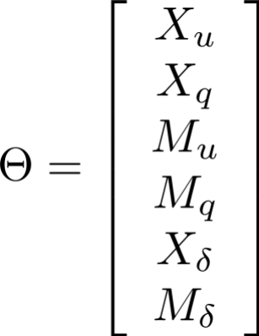
Linearised model for longitudinal dynamics
State Equation
u: Longitudinal (body) velocity [m/s]
q: Pitch rate [rad/s]
ϴ: Pitch angle [rad]
a_{x}: Longitudinal (body) acceleration [m/s2]
δ_{lon}: Pitch moment [normalised to -1, +1 range]
Output Equation
Model Parameters:
X_{u}: Axial damping
X_{q}: Pitch-to-force parasitic coupling
M_{u}: Speed stability
M_{q}: Pitch damping
X_{δ}: Control force derivative
M_{δ}: Control authority
Notes:
First, we introduce the linearised model for the longitudinal dynamics. As we can see, the state is characterised by longitudinal velocity, pitch rate and pitch angle, the output by acceleration and pitch rate itself and the input is a normalised pitch moment

Slide 5
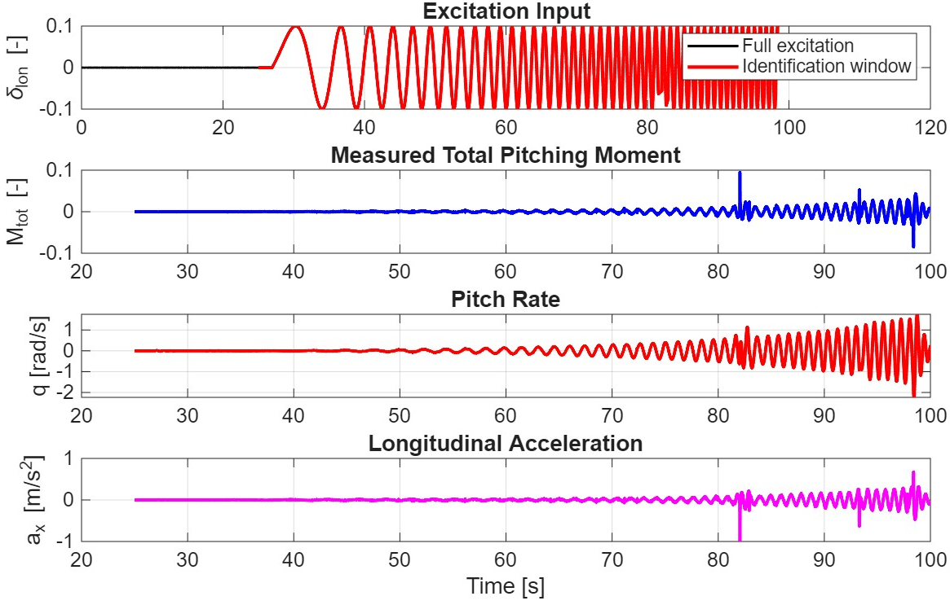
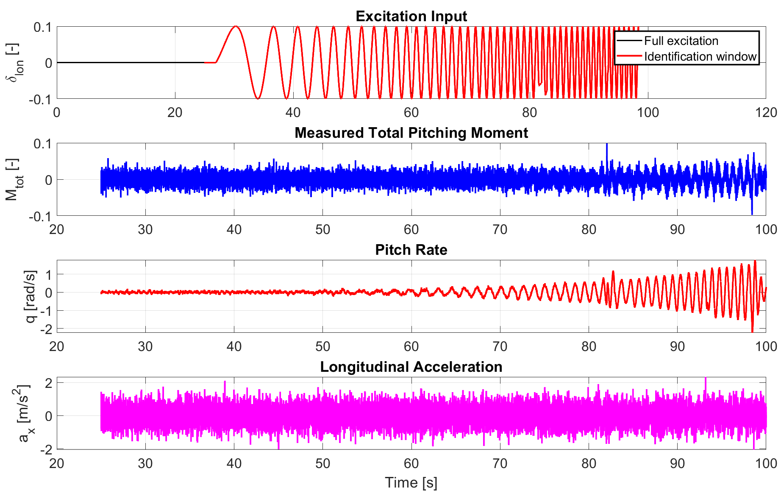
Data Exctraction
Baseline Excitation Input
Long duration sweep exciting longitudinal dynamics.
Signal cut between 25 and 100s.
Actual System Input
Total Pitching Moment.
Outputs:
Pitch rate (q) and Longitudinal Acceleration (a_{x}).
Mean removal
Notes:
The objective is to perform the estimate based on the given input data and resulting output ones. The given input is a sweep that allows to excite different frequences in time. As consquence of this input, the control will act resulting in the overall Mtot and we will see in output pitch rate and longitudinal acceleration. It is relevant to note here that the exciting signal is a pitch moment, directly affecting the pitch rate and only indirectly the longitudinal acceleration. From the collected data, a mean removal operation is performed to focus only on deviations and not on static biases

Slide 6
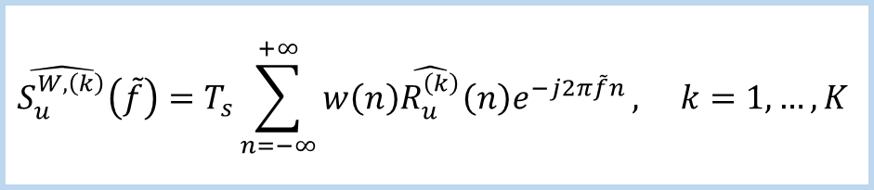

PSD Estimation
Problem
Solution
Implementation
High Variance of the PSD estimators
Avaraging to reduce variance
Overlapped Avaraging to reduce bias
FIRST ITERATION:
K = 50
50 % overlap
Windowed Estimator (Hamming Window)
Average Estimate on the Total Number of Sequence
$$\hat{S_{u}^{W,\left(k\right)}}\left(\tilde{f}\right)=T_{s}\sum_{n=−∞}^{+∞}{w\left(n\right)\hat{R_{u}^{\left(k\right)}}\left(n\right)e^{−j2π\tilde{f}n}}, k=1,…,K$$
$$\hat{S_{u}}\left(\tilde{f}\right)=\frac{1}{K}\sum_{k=1}^{K}{\hat{S_{u}^{W,\left(k\right)}}\left(\tilde{f}\right)}$$
Notes:
As introduced before and in line with what seen in the theory, the first step to estimate the FRF is the estimation of the PSD associated to input and output data. We can do this through the so called periodogram, that are characterised by high variance. Hence, a possible solution is the usage of such estimators on overlapped datasets exctracted from the entire one, and averaging the estimates obtained on these different sequences. For this first iteration, we considered a classic overlap of 50% and K = 70

Slide 7
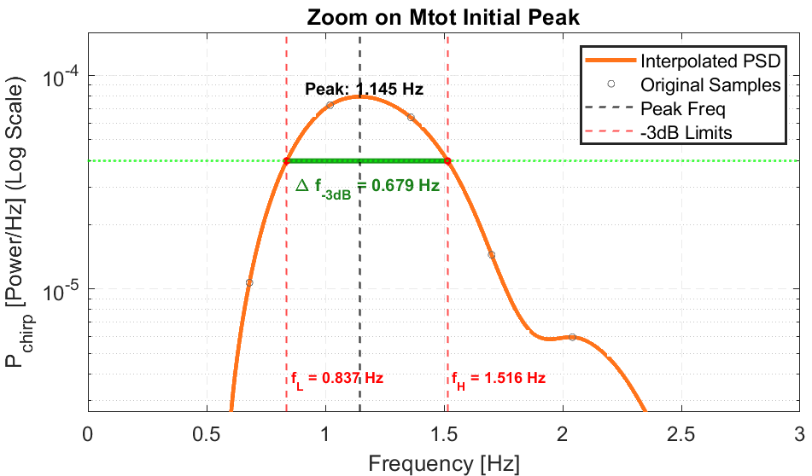
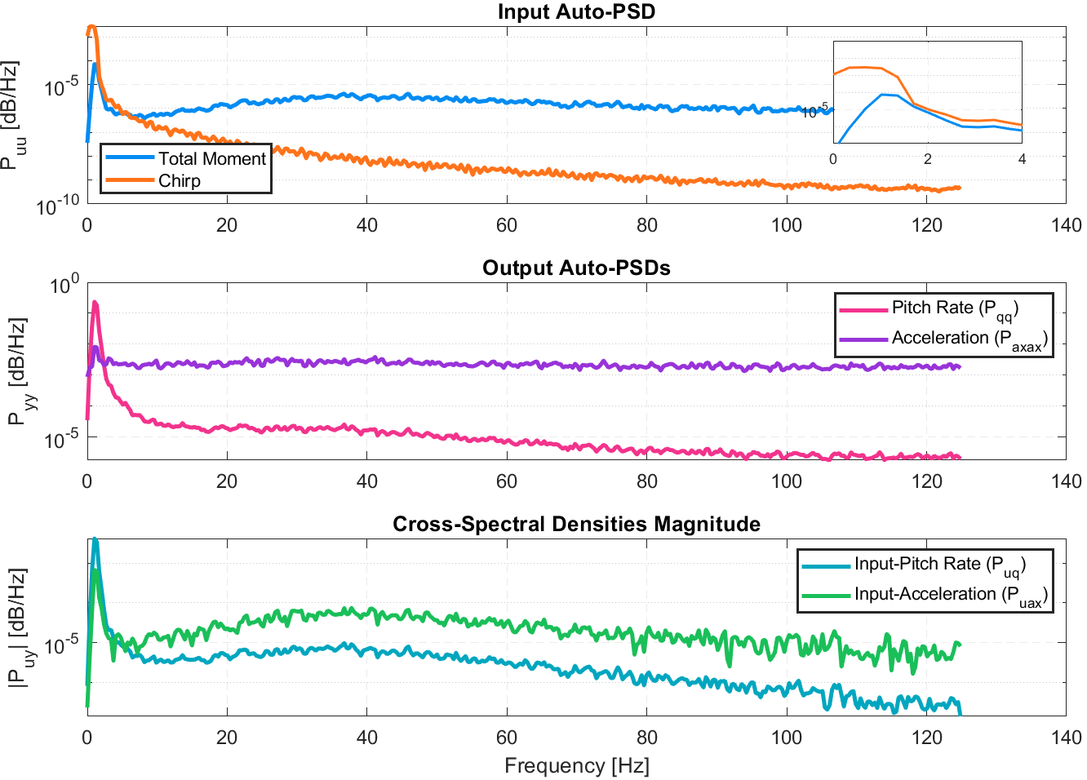
Power Spectral Density Analysis
Input PSD
Sweep signal is exciting low frequencies.
Output Auto-PSD
Peak corresponding to the excited frequencies.
Output Cross-PSD
As a consequence, the cross-correlation presents higher similarities in lower frequencies.
Notes:
From this setting, the input, output and cross PSD is evaluated. As we can see, the main frequences excited from the sweep are in the low range, resulting in a similar behavior also for the output. Hence, the higher correlation is related to such lower frequences. To have a better insight on the actual frequences mainly excited by the chirp, we propose a zoom.

Slide 8
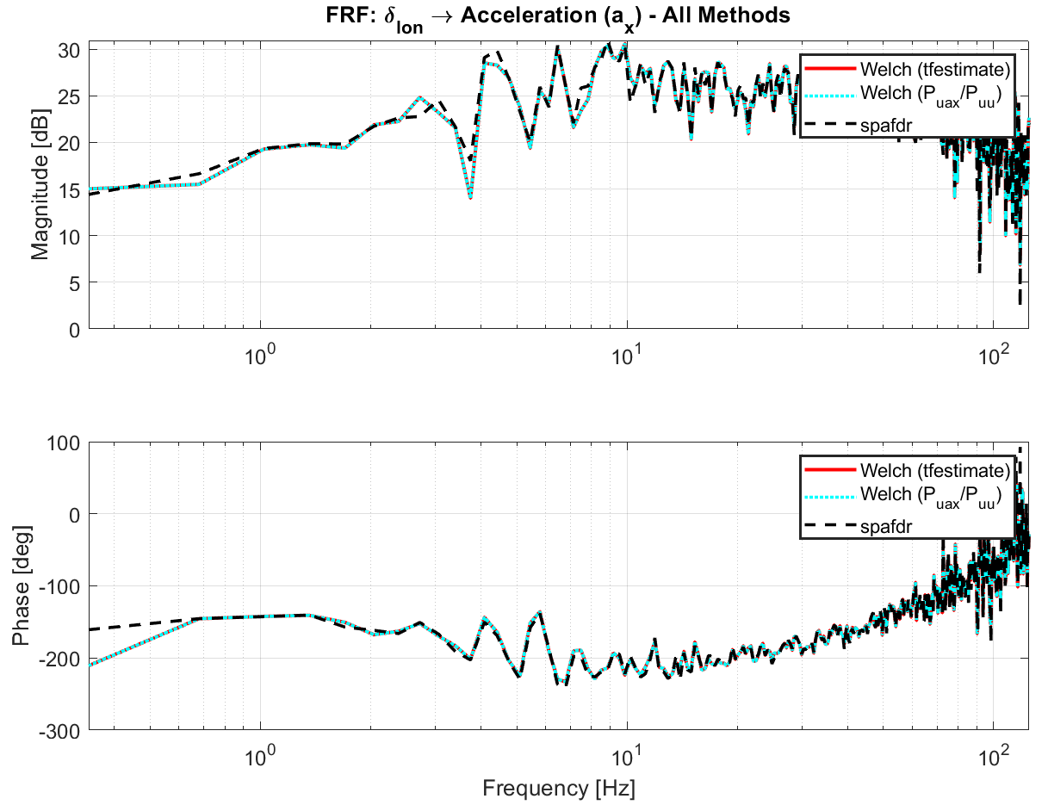
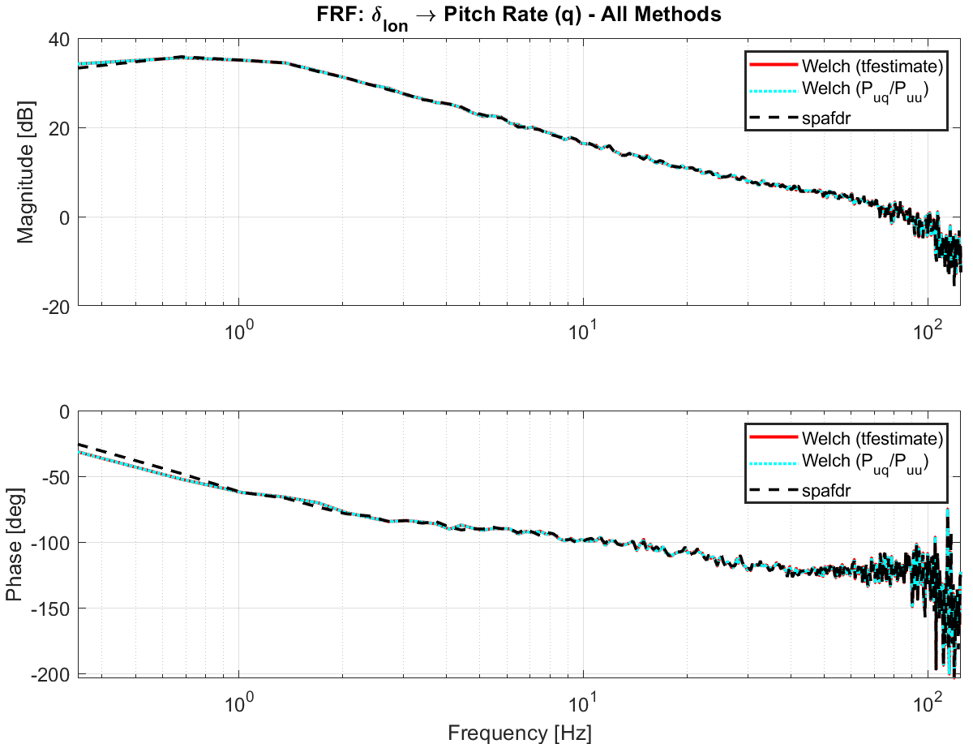
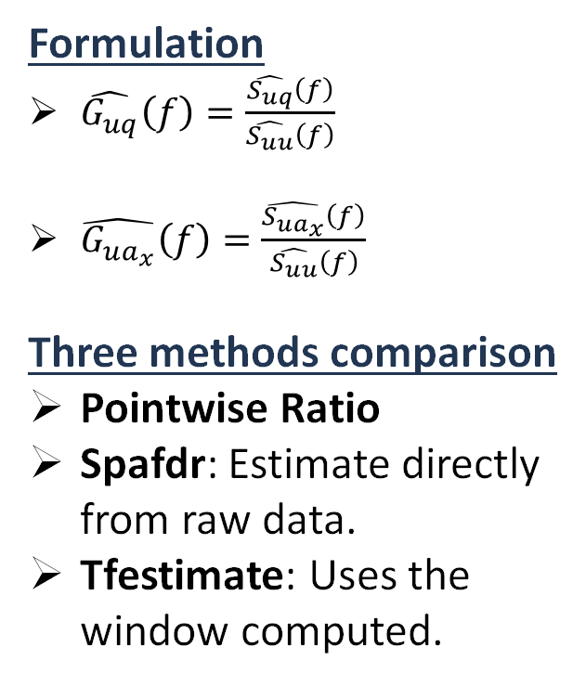
Frequency Response Function Estimation
Formulation
$\hat{G_{uq}}\left(f\right)=\frac{\hat{S_{uq}}\left(f\right)}{\hat{S_{uu}}\left(f\right)}$
$\hat{G_{ua_{x}}}\left(f\right)=\frac{\hat{S_{ua_{x}}}\left(f\right)}{\hat{S_{uu}}\left(f\right)}$
Three methods comparison
Pointwise Ratio
Spafdr: Estimate directly from raw data.
Tfestimate: Uses the window computed.

Slide 9
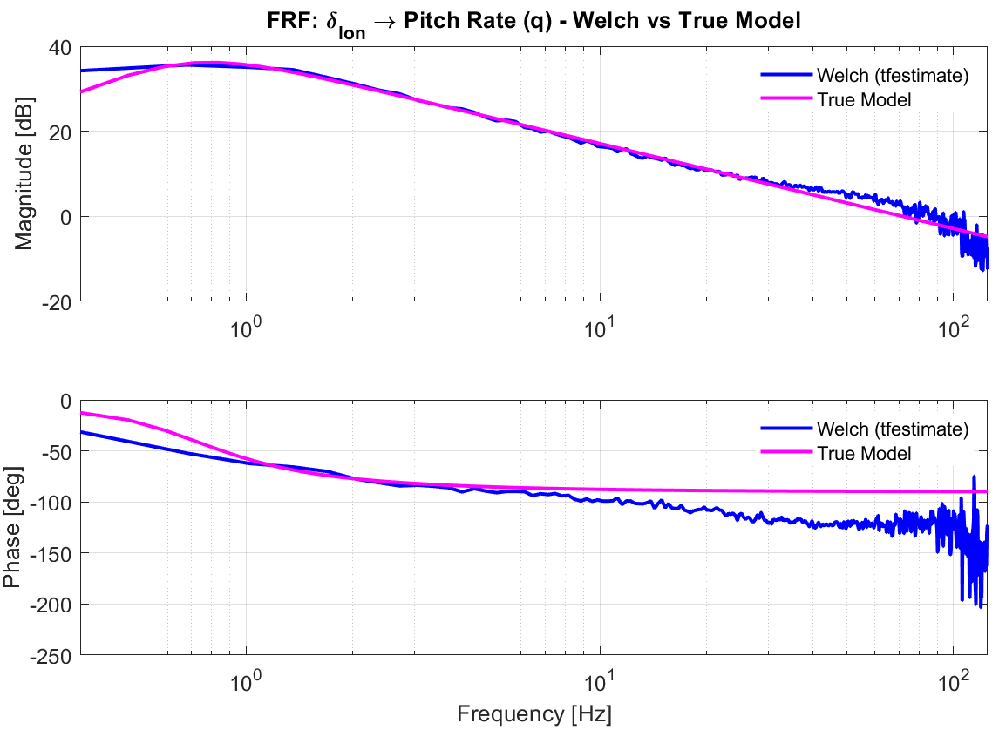
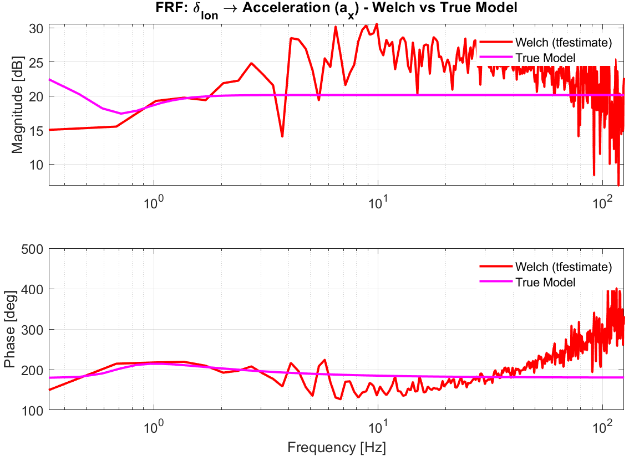
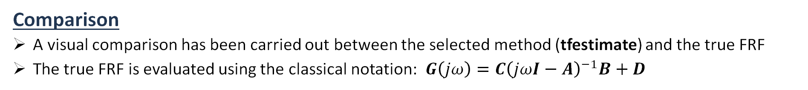
Frequency Response Function Comparison
Comparison
A visual comparison has been carried out between the selected method (tfestimate) and the true FRF
The true FRF is evaluated using the classical notation: $G\left(jω\right)=C{\left(jωI−A\right)}^{−1}B+D$

Slide 10
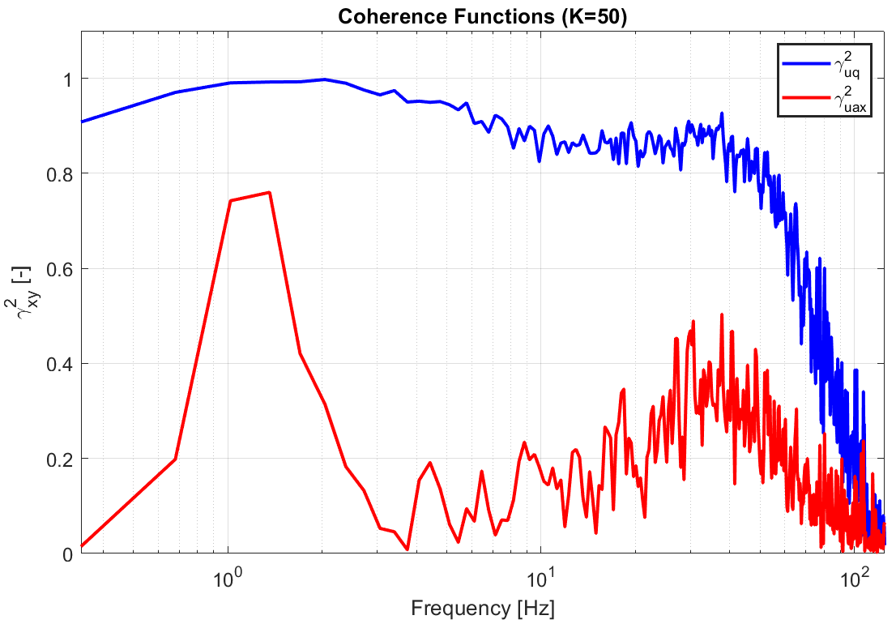
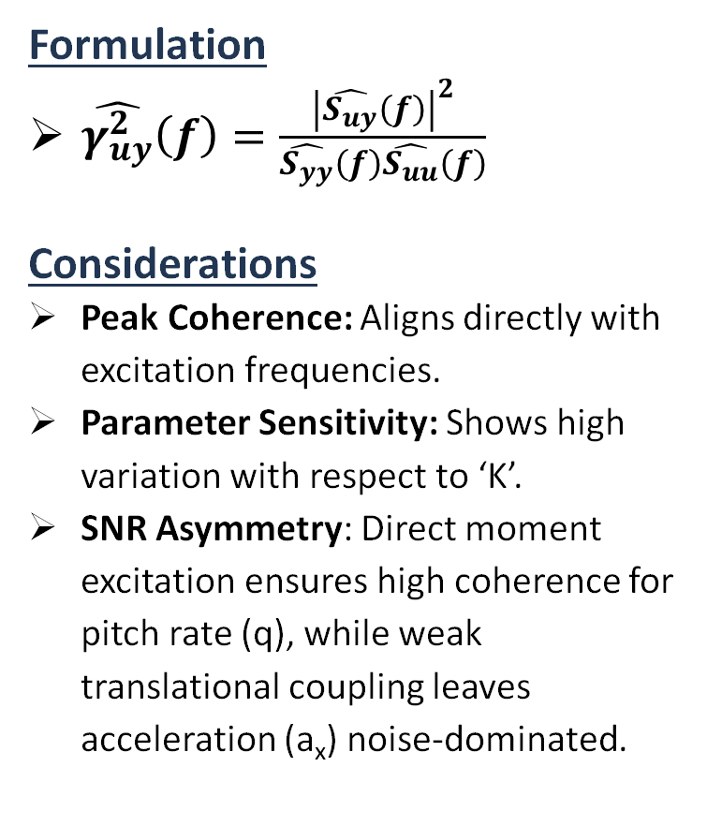
Coherence Analysis
Formulation
$\hat{γ_{uy}^{2}}\left(f\right)=\frac{{\left|\hat{S_{uy}}\left(f\right)\right|}^{2}}{\hat{S_{yy}}\left(f\right)\hat{S_{uu}}\left(f\right)}$
Considerations
Peak Coherence: Aligns directly with excitation frequencies.
Parameter Sensitivity: Shows high variation with respect to ‘K’.
SNR Asymmetry: Direct moment excitation ensures high coherence for pitch rate (q), while weak translational coupling leaves acceleration (a_{x}) noise-dominated.

Slide 11
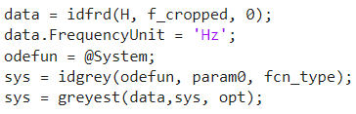
Grey Box Model: Initialization
Parameter | Physical Meaning | Expected Range | Initialization
X_{u} | Axial damping: Aerodynamic drag resistance to forward motion. | Strictly Negative (<0) | - 0.2
X_{q} | Parasitic coupling: Longitudinal force induced by pitch rotation. | Close to Zero (≈0) | 0.2
M_{u} | Speed stability: Pitching moment induced by asymmetric airflow during forward motion. | Negative (<0) | - 0.5
M_{q} | Pitch damping: Rotational aerodynamic braking (crucial for natural stability). | Strictly Negative (<0) | - 3
X_{δ} | Control force: Horizontal force induced by thrust vector tilting. | Negative (<0) | - 10
M_{δ} | Control authority: Pitching moment generated by differential rotor thrust. | Highly Positive (>>0) | 400
Grey Box Model
Grey-box model formulation and parameter estimation performed via MATLAB's ‘greyest’.
Initial Parameters
The initial conditions for the parameters to be estimated are set according to their physical meaning.

Slide 12


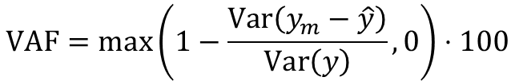
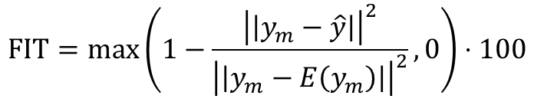
Grey Box Model: Performance metrics
The following parameters are evaluated to quantify the performances of the identified method.
Standard Deviation
Coefficient of Variation
$$σ_{\hat{θ_{i}}}=\sqrt{\text{diag}{\left(\text{Cov}\left(\hat{Θ}\right)\right)}_{i}}$$
$${\text{C}V}_{i}\left(\%\right)=\frac{σ_{\hat{θ_{i}}}}{\left|\hat{θ_{i}}\right|}⋅100$$
Fitting Percentage
Variance Accounted For (VAF)
$$\text{FIT}=\max\left(1−\frac{{\left|\left|y_{m}−\hat{y}\right|\right|}^{2}}{{\left|\left|y_{m}−E\left(y_{m}\right)\right|\right|}^{2}},0\right)⋅100$$
$$\text{VAF}=\max\left(1−\frac{\text{Var}\left(y_{m}−\hat{y}\right)}{\text{Var}\left(y\right)},0\right)⋅100$$

Slide 13
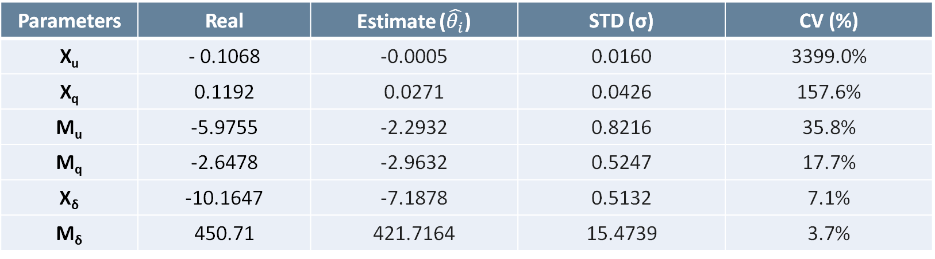
Grey Box Model: Results
Considerations
Strict Physical Consistency: All estimated parameters exhibit complete sign concordance with the truth model, confirming that the identification successfully preserves the underlying flight mechanics.
Negligible Parasitic Coupling (X_{u}): The high CV is inflated by its near-zero estimated magnitude (denominator effect), confirming that this specific coupling provides negligible information during the maneuver.
Open-Loop Instability Preservation: The identified state-space model correctly exhibits instability, matching the inherent unstable nature of the true nominal quadrotor system.
Parameters | Real | Estimate ($\hat{θ_{i}}$) | STD (σ) | CV (%)
X_{u} | - 0.1068 | -0.0005 | 0.0160 | 3399.0%
X_{q} | 0.1192 | 0.0271 | 0.0426 | 157.6%
M_{u} | -5.9755 | -2.2932 | 0.8216 | 35.8%
M_{q} | -2.6478 | -2.9632 | 0.5247 | 17.7%
X_{δ} | -10.1647 | -7.1878 | 0.5132 | 7.1%
M_{δ} | 450.71 | 421.7164 | 15.4739 | 3.7%

Slide 14
Grey Box Model: Results
Considerations
Channel Disparity: The Pitch Rate (q) exhibits solid validation metrics due to a high Signal-to-Noise Ratio (SNR) and direct control coupling. Conversely, the a_{x} channel metrics are severely degraded by sensor noise.
The "Negative FIT" Paradox (a_{x}): Mathematically, a FIT < 0% implies that the model output represents the validation data worse than its simple arithmetic mean.
Physical Interpretation: Since fitting procedure operates directly on the frequency-domain data, the extreme high-frequency variance of the measured Welch FRF heavily penalizes the metric.
Output Channel | Variance Accounted For (VAF) | FIT Percentage
Pitch Rate (q) | 94.2 % | 74.0 %
Long. Acceleration (a_{x}) | 21.2 % | -6.9 %

Slide 15
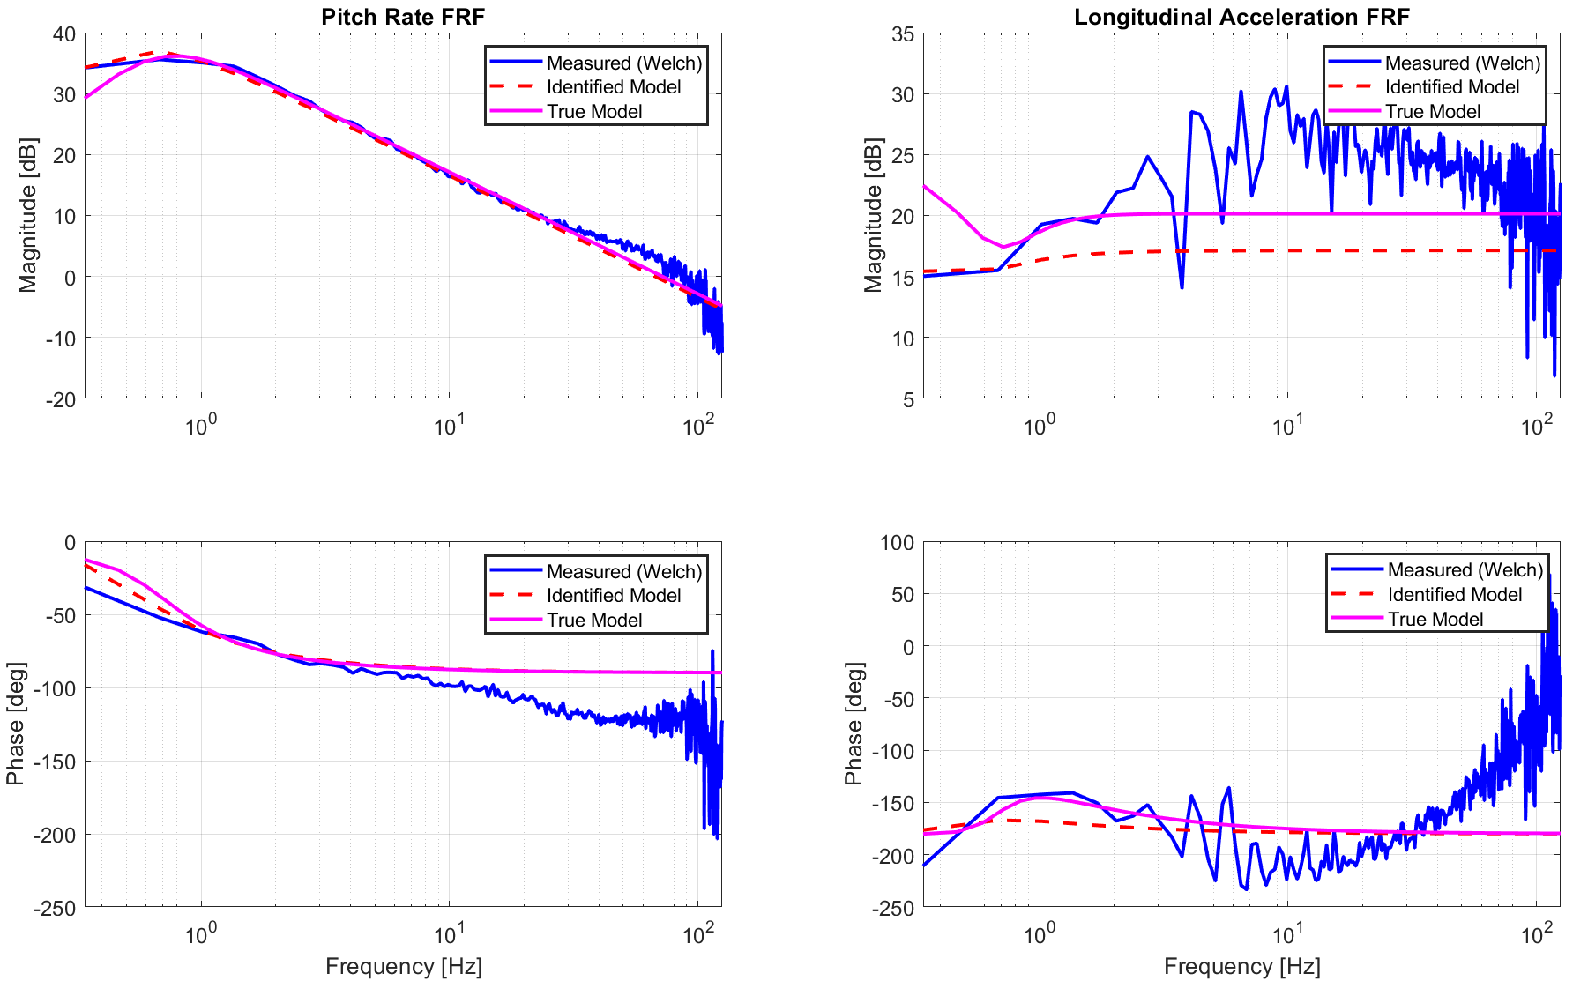
FRF Validation
Considerations
Model Fidelity: estimated FRF tracks the True Model significantly better than the raw measured (Welch) FRF, successfully filtering out high-frequency stochastic noise.
SNR-Driven Channel Disparity: Pitch Rate FRF is estimated with much higher accuracy than the acceleration, directly reflecting the direct control coupling on the rotational axis.

Slide 16
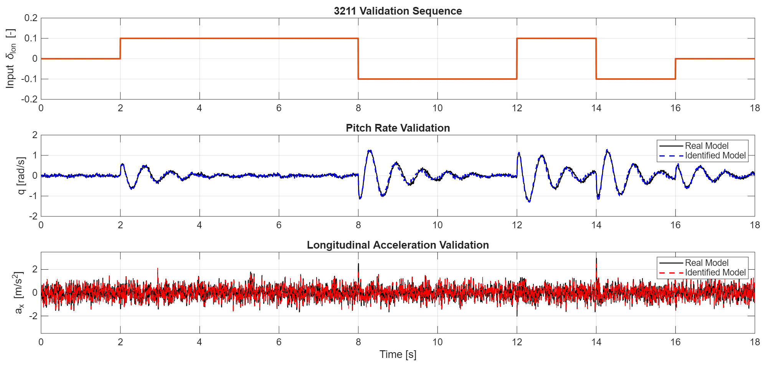
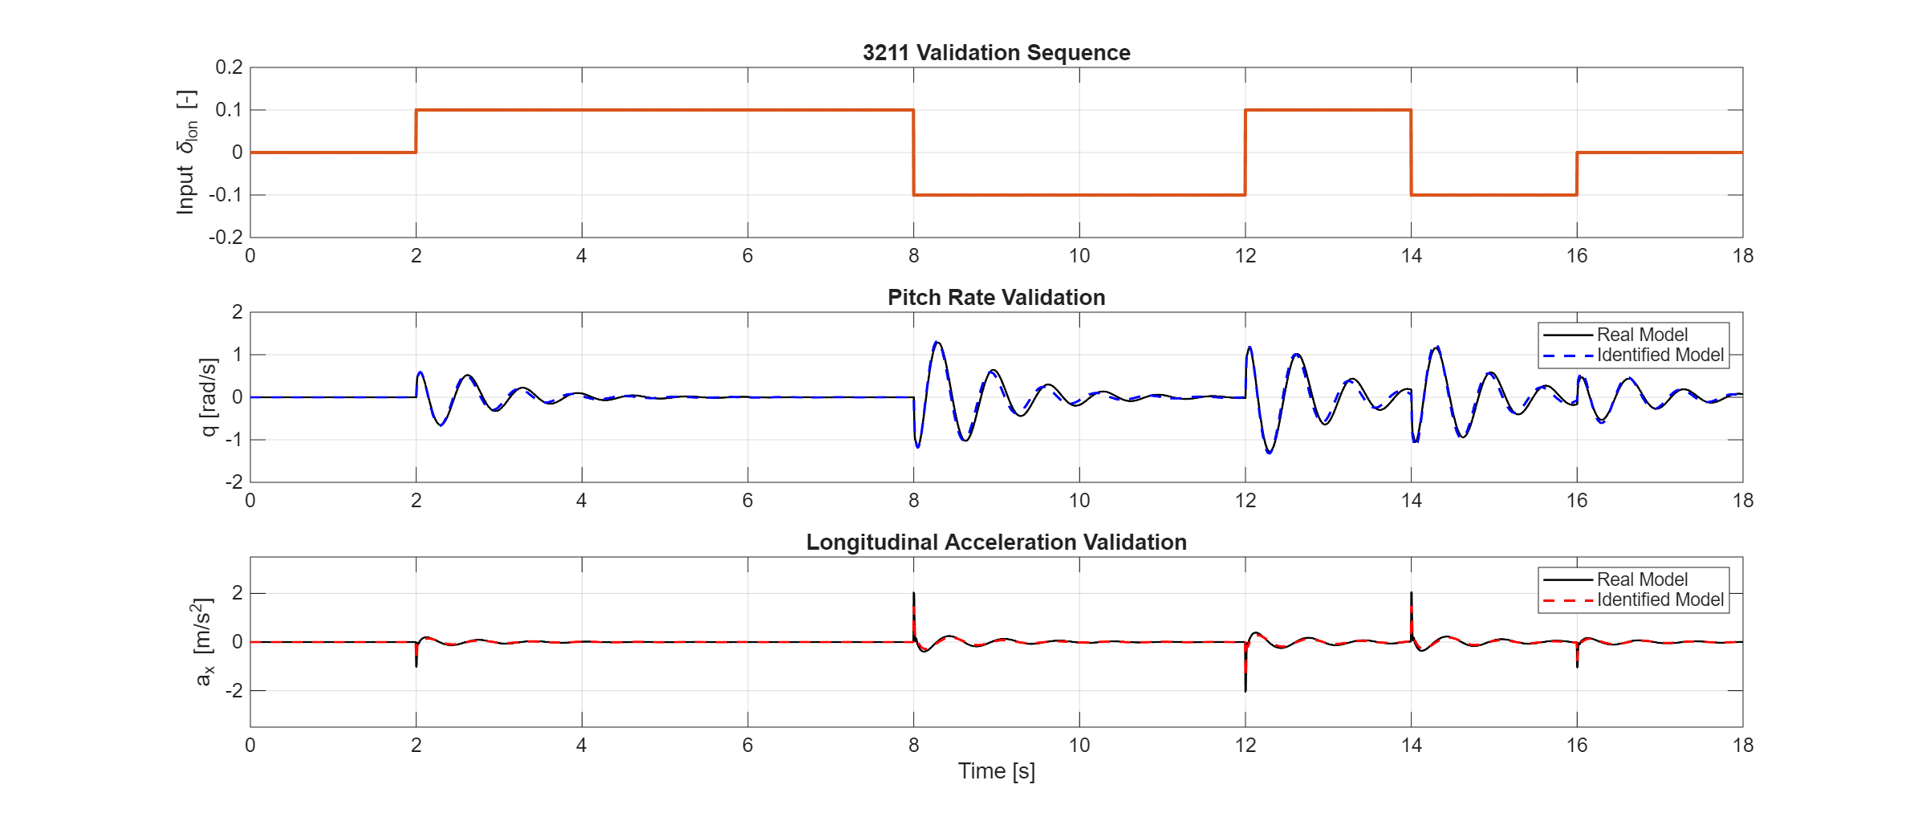
System Validation
Considerations
Simulation: The validation results demonstrate that the identified system accurately simulates the system dynamics.
Noise seed: Since the same seed was used, the noise profile is identical in both simulations.
Noise Free: A noise-free simulation of the identified model reveals the true dynamic evolution.
Notes:
La stima della frf per il coupling tra momento di beccheggio e accelerazione non risulata essere molto buona a causa dell’elevato noise ma soprattutto del signal to noise ratio. Per questo motivo la stima della risposta in tempo in termini di accelerazioni dovrebbe riultare alterata, invece la stima è comunque soddisfacente. Il modello sta perciò ricostruendo con buona precisione la dinamica forse attraverso la misura più precisa del pitch rate o la scarsa variabilità dell’accelerazione che risulta soltanto influenzata dalla dinamica accoppiata.

Slide 17
System Validation
Considerations
Simulation: The validation results demonstrate that the identified system accurately simulates the system dynamics.
Noise seed: Since the same seed was used, the noise profile is identical in both simulations.
Noise Free: A noise-free simulation of the identified model reveals the true dynamic evolution.
Direct Coupling Validation (q)
Pitch-to-Acceleration Preservation (ax)
Notes:
La stima della frf per il coupling tra momento di beccheggio e accelerazione non risulata essere molto buona a causa dell’elevato noise ma soprattutto del signal to noise ratio. Per questo motivo la stima della risposta in tempo in termini di accelerazioni dovrebbe riultare alterata, invece la stima è comunque soddisfacente. Il modello sta perciò ricostruendo con buona precisione la dinamica forse attraverso la misura pi

Slide 18
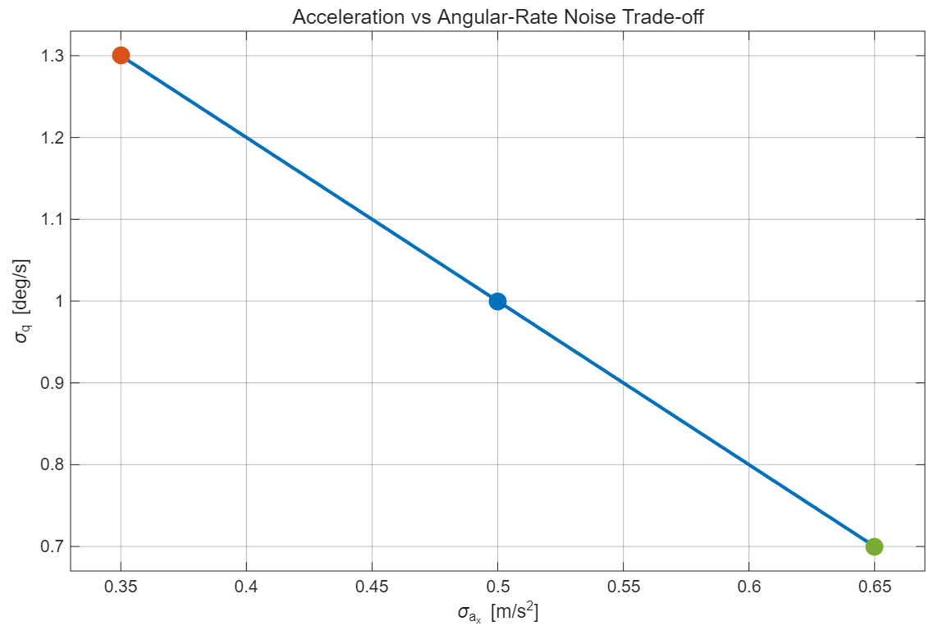
Project Tasks
Task 2
Sensitivity analysis to perturbations in measurement noise properties
Case 1: σq = 1.3, σax = 0.35
Case 2: σq = 0.5, σax = 0.5
Case 3: σq = 0.7, σax = 0.65
The procedure described so far is repeated for the other two cases.

Slide 19
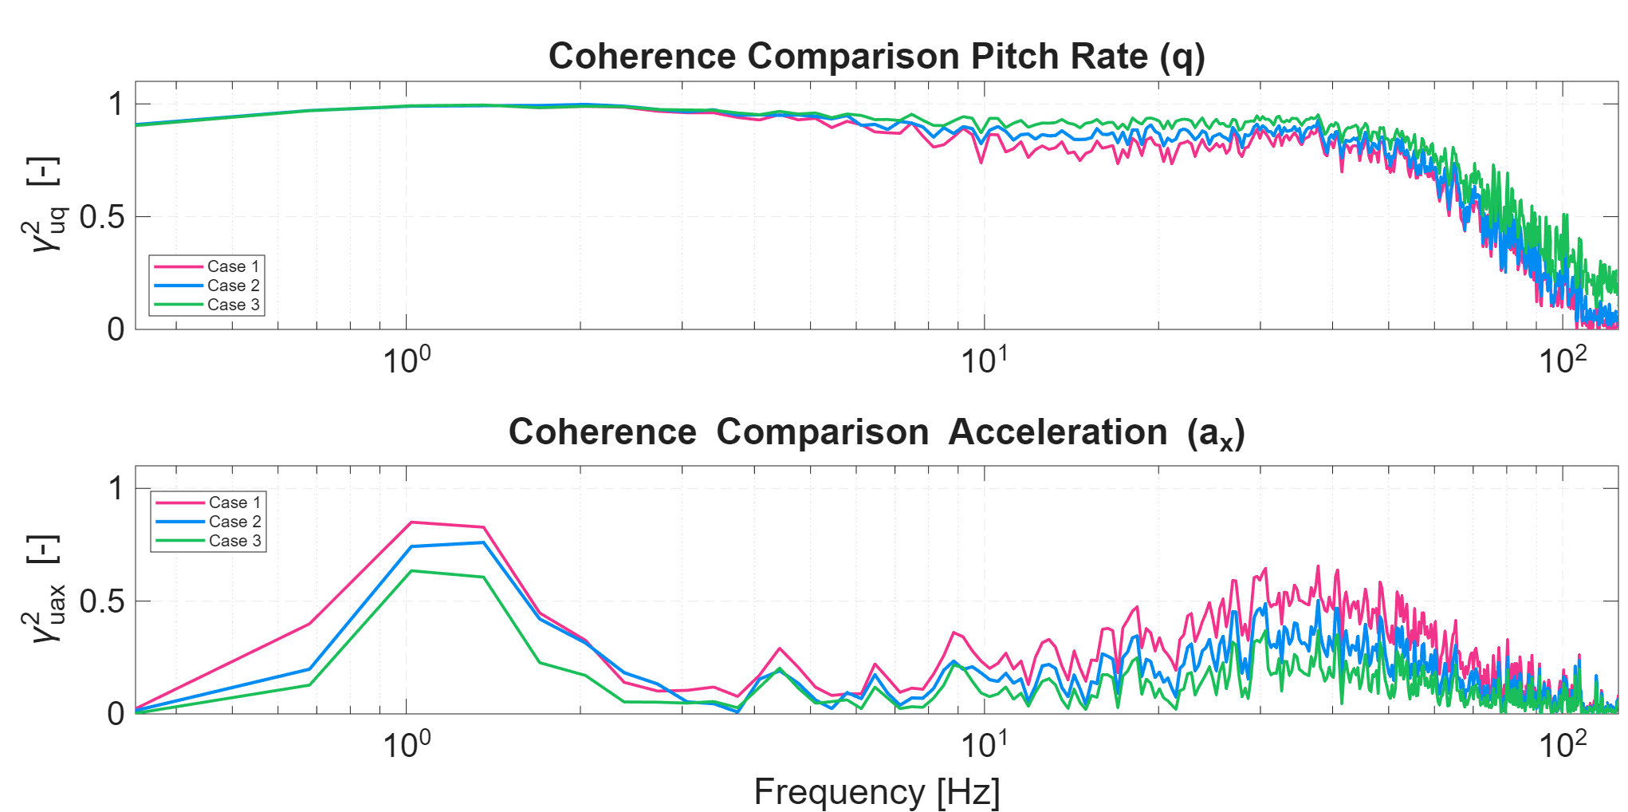
Coherence Comparison
Considerations
Pitch Rate: Coherence is highly consistent across all three cases, with small differences at high frequencies.
Acceleration: Notable differences appear among the cases: lower acceleration noise (std) yields higher coherence, especially in the low-frequency region of interest.

Slide 20
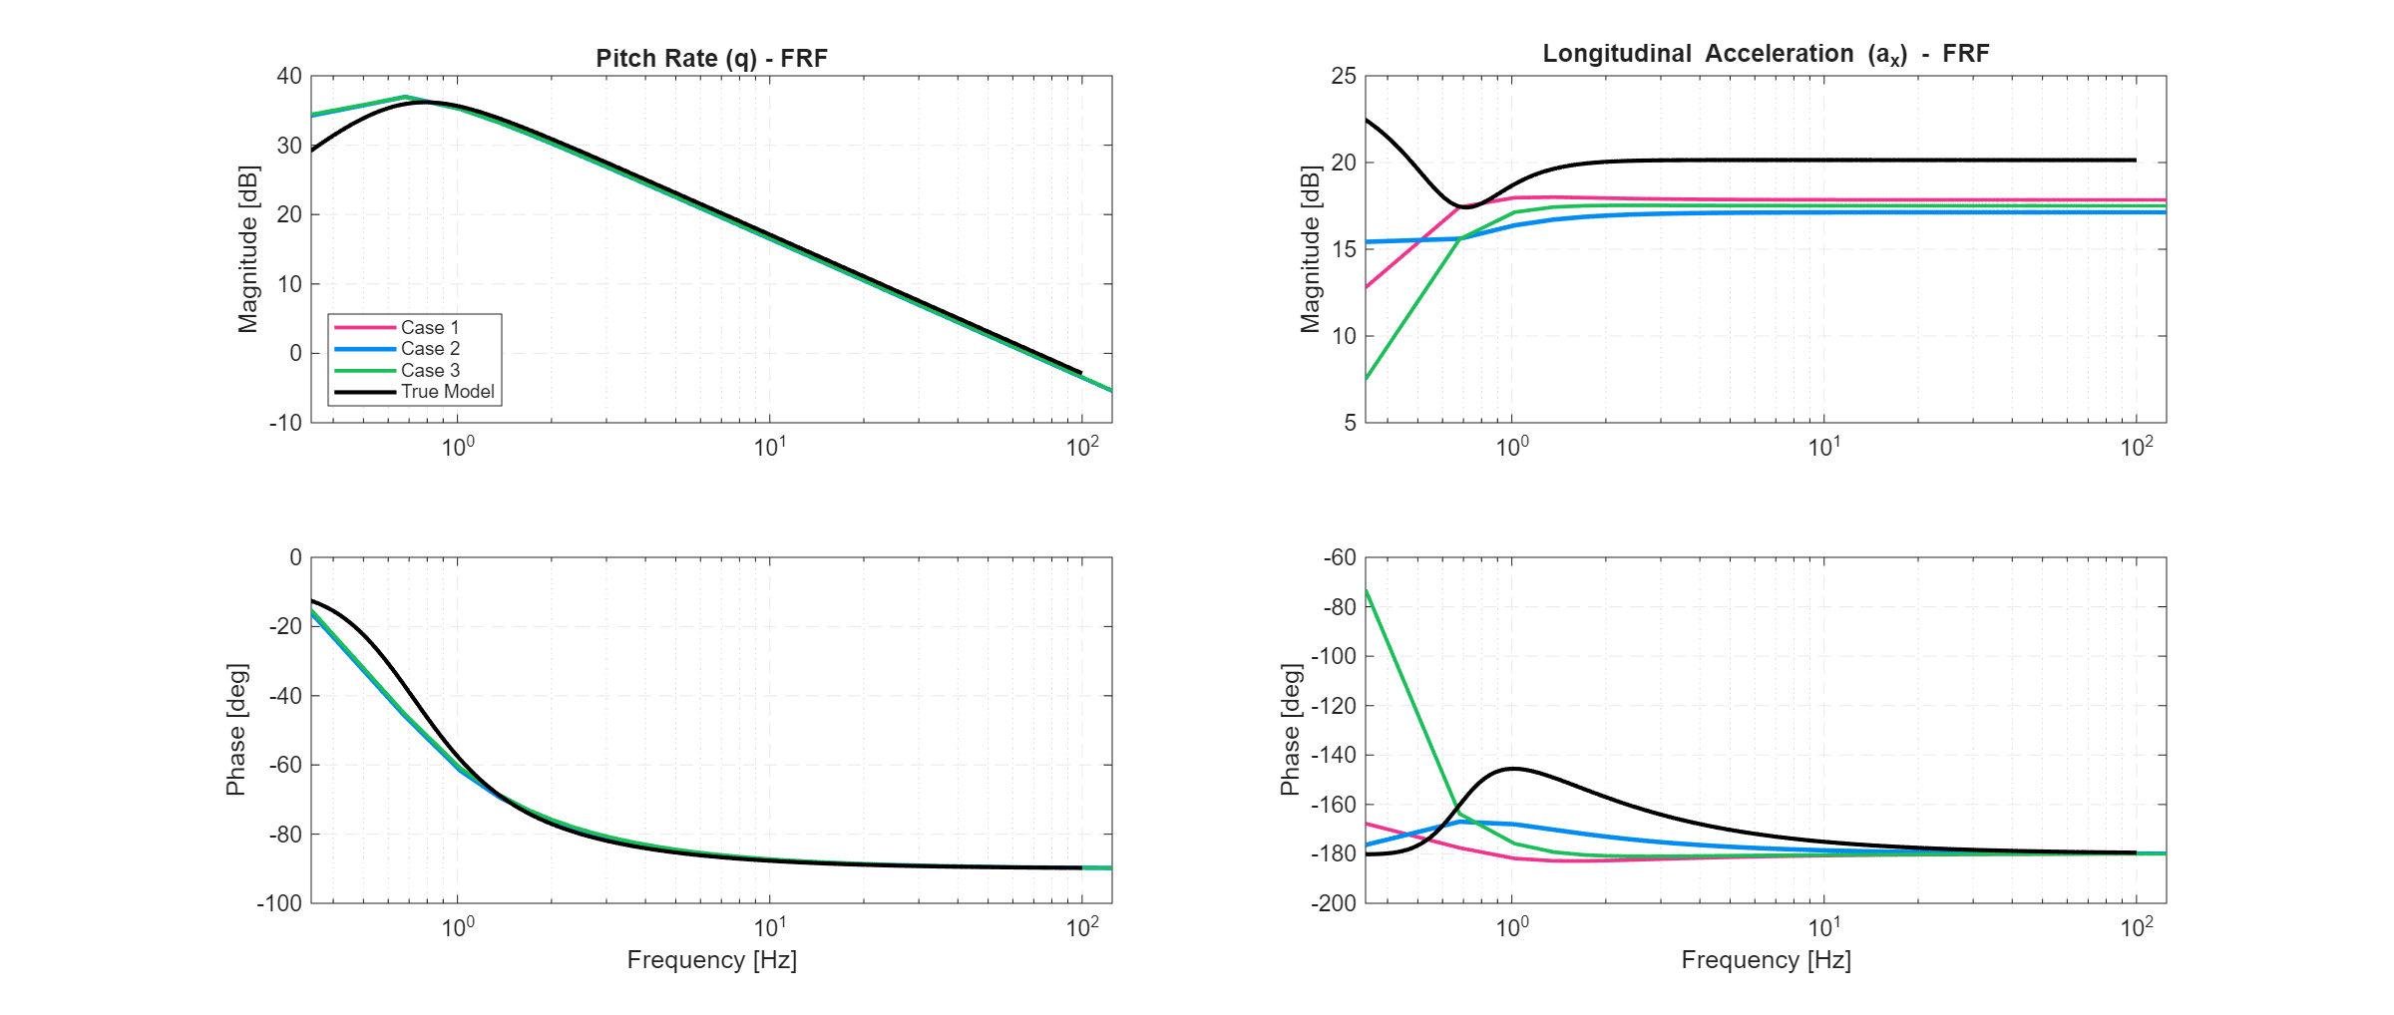
FRF Comparison
Considerations
Pitch Rate: Differences in the pitch rate FRF are negligible across all cases.
Acceleration: The FRF for the first case shows the best agreement in magnitude with respect to the true model.

Slide 21
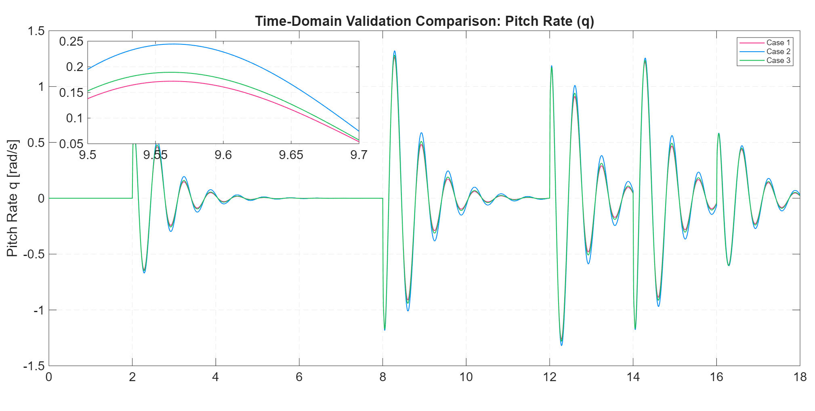
Time-domain validation:
pitch rate
Considerations
Negligible Discrepancies: Time-domain responses (q and ax) show near-identical behavior across all noise tuning cases.
Metric Insensitivity: The absolute differences between the simulated cases are too marginal to be considered a discriminant metric for model selection.

Slide 22
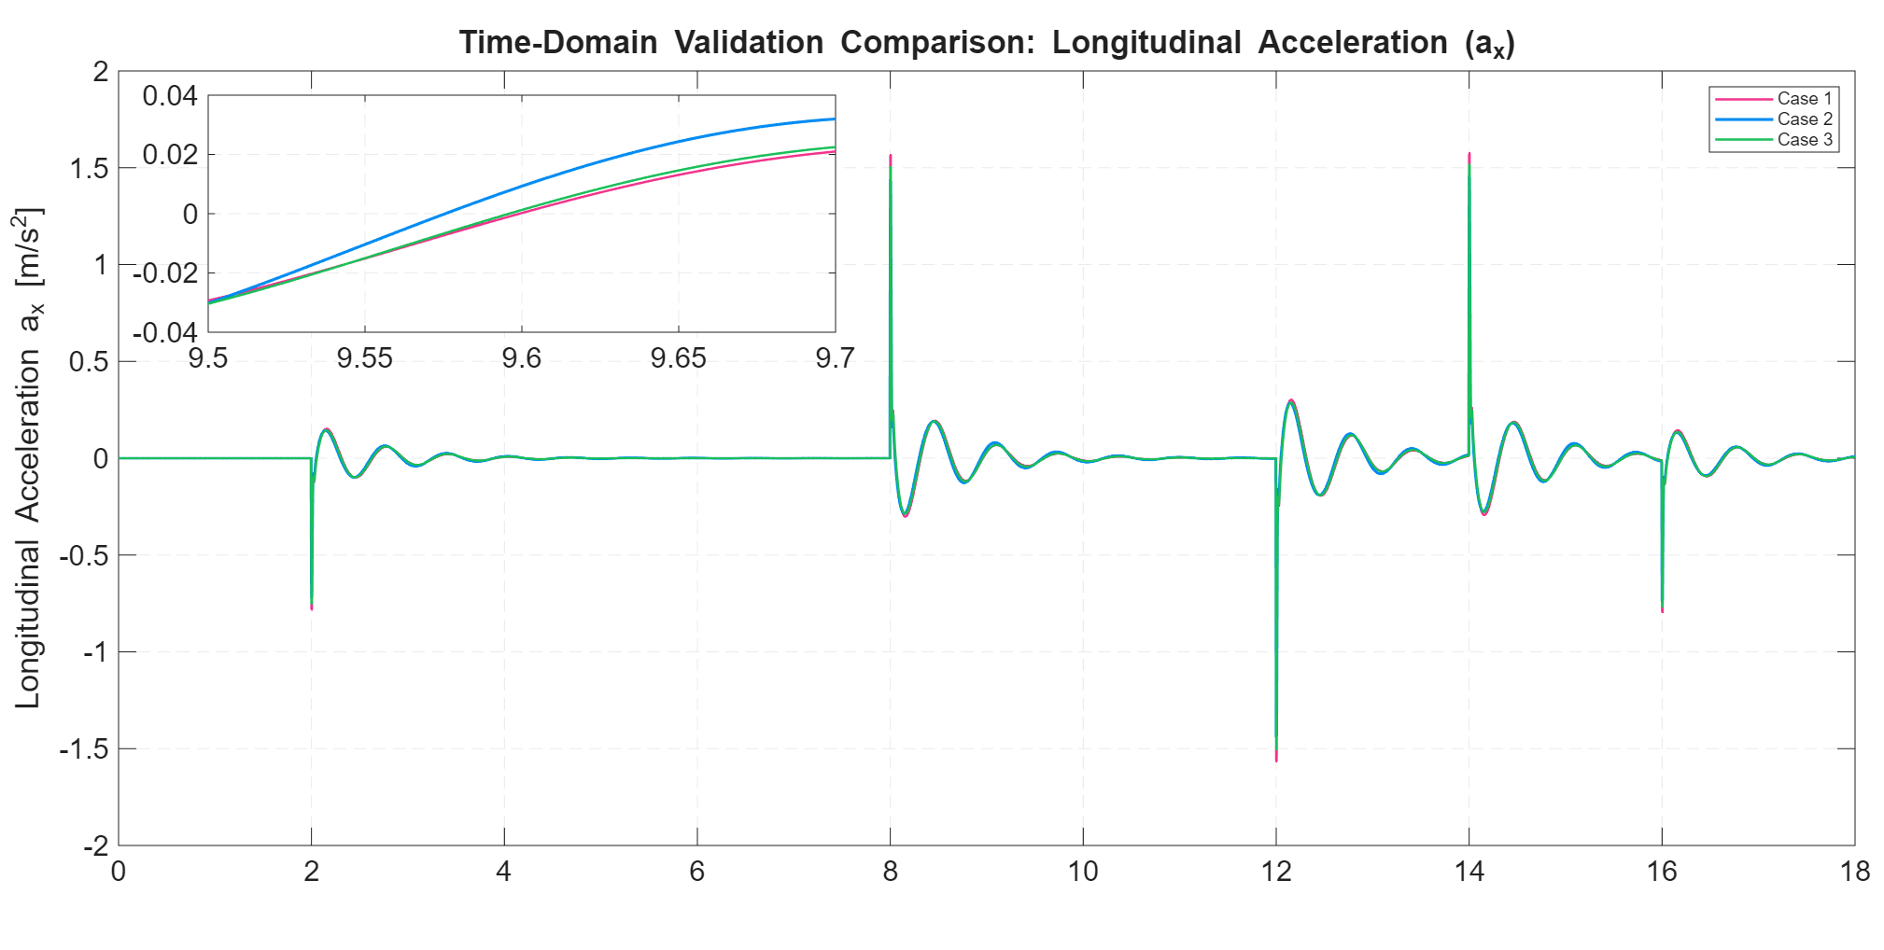
Time-domain validation:
acceleration
Considerations
Negligible Discrepancies: Time-domain responses (q and ax) show near-identical behavior across all noise tuning cases.
Metric Insensitivity: The absolute differences between the simulated cases are too marginal to be considered a discriminant metric for model selection.

Slide 23
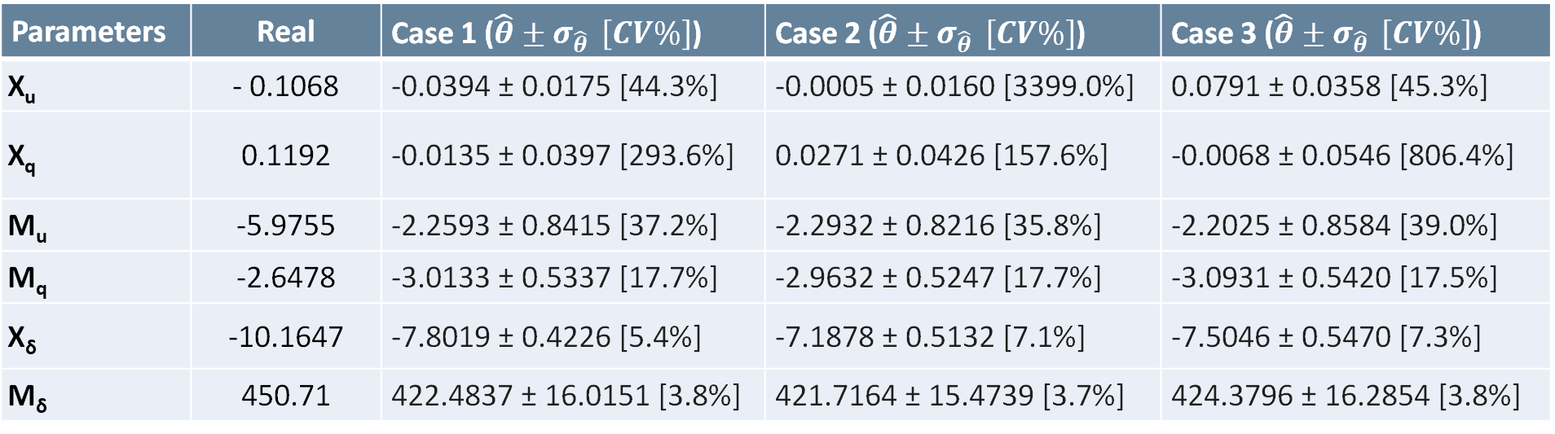
Comparison Results (I)
Considerations
Consistency of Primary Derivatives (M_{q}, X_{δ}, M_{δ}) : The dominant parameters governing the primary flight dynamics remain extremely consistent across all three noise scenarios.
X_{u} and X_{q} Bias Trend: Although sometimes estimated with a opposite sign, their near-zero magnitude and standard deviation interval encompass the physically consistent range.
Parameters | Real | Case 1 ($\hat{θ}±σ_{\hat{θ}} \left[CV\%\right]$) | Case 2 ($\hat{θ}±σ_{\hat{θ}} \left[CV\%\right]$) | Case 3 ($\hat{θ}±σ_{\hat{θ}} \left[CV\%\right]$)
X_{u} | - 0.1068 | -0.0394 ± 0.0175 [44.3%] | -0.0005 ± 0.0160 [3399.0%] | 0.0791 ± 0.0358 [45.3%]
X_{q} | 0.1192 | -0.0135 ± 0.0397 [293.6%] | 0.0271 ± 0.0426 [157.6%] | -0.0068 ± 0.0546 [806.4%]
M_{u} | -5.9755 | -2.2593 ± 0.8415 [37.2%] | -2.2932 ± 0.8216 [35.8%] | -2.2025 ± 0.8584 [39.0%]
M_{q} | -2.6478 | -3.0133 ± 0.5337 [17.7%] | -2.9632 ± 0.5247 [17.7%] | -3.0931 ± 0.5420 [17.5%]
X_{δ} | -10.1647 | -7.8019 ± 0.4226 [5.4%] | -7.1878 ± 0.5132 [7.1%] | -7.5046 ± 0.5470 [7.3%]
M_{δ} | 450.71 | 422.4837 ± 16.0151 [3.8%] | 421.7164 ± 15.4739 [3.7%] | 424.3796 ± 16.2854 [3.8%]
Notes:
X_{u} Bias Trend: The estimate of the axial damping (X_{u}) is systematically biased towards positive values. However, as the acceleration noise decreases, the estimated value shifts closer to zero, suggesting that excessive noise on the a_{x} channel artificially inflates this non-physical positive bias.

Slide 24
Comparison Results (II)
Recall
FIT (Normalized Root Mean Square Error): Evaluates the absolute, point-by-point distance between modeled and measured FRF. It heavily penalizes unmodeled high-frequency stochastic noise, which mathematically drives a_{x} FIT below zero.
VAF (Variance Accounted For): Measures the percentage of the signal's dynamic variance successfully captured by the model, remaining completely insensitive to static biases.
Scenario | VAF q (%) | VAF ax​ (%) | FIT q (%) | FIT ax​ (%)
Case 1 | 93.2 | 31.9 | 71.9 | -6.6
Case 2 | 94.2 | 21.2 | 74.0 | -6.9
Case 3 | 93.5 | 20.6 | 72.6 | -5.6

Slide 25

Comparison Results (II)
Considerations
Metric Discrepancy: A negative FIT combined with a positive VAF (as seen in the a_{x} channel) confirms that while the absolute pointwise error is large due to noise, the model still correctly captures a portion of the underlying dynamic trend.
Scenario | VAF q (%) | VAF ax​ (%) | FIT q (%) | FIT ax​ (%)
Case 1 | 93.2 | 31.9 | 71.9 | -6.6
Case 2 | 94.2 | 21.2 | 74.0 | -6.9
Case 3 | 93.5 | 20.6 | 72.6 | -5.6
Higher Coherence $γ_{u−ax}^{ }$ with comparable $γ_{u−q}^{ }$
CASE 1 SELECTED
Closer FRF magnitude for the u - a_{x} channel to the real one
The First Set yields improved results for the a_{x} channel while maintaining an optimal pitch response.
Higher VAF at comparable FIT

Slide 26
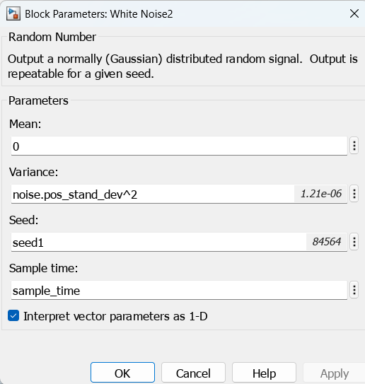
Project tasks
Task 3
Analysis of the best model in a Monte Carlo study
CASE 1 SELECTED
The Monte Carlo simulation is carried out using the first set of parameters.
σ_{q} = 1.3 σ_{ax} = 0.35
SEED GENERATION
The Simulink model includes five distinct noise sources; for every iteration, the Monte Carlo script generates a unique random seed for each source.

Slide 27
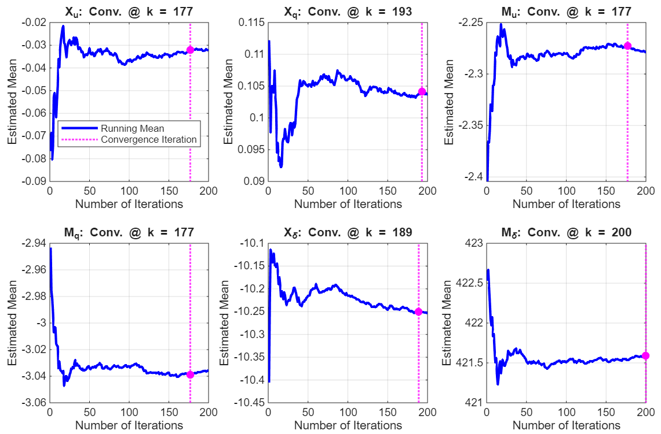
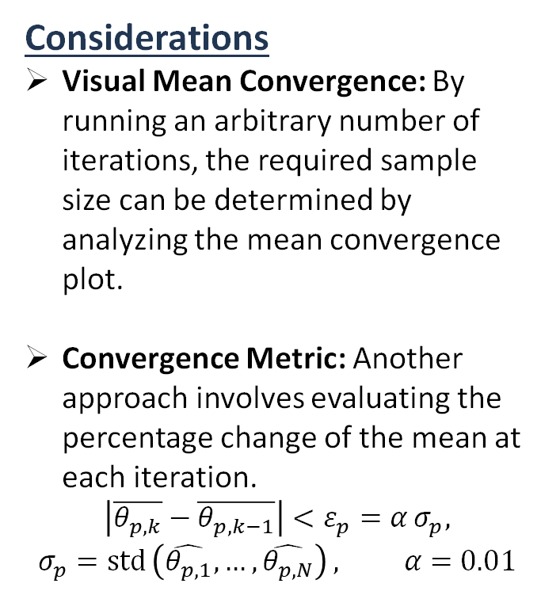
Number of iterations rationale
Considerations
Visual Mean Convergence: By running an arbitrary number of iterations, the required sample size can be determined by analyzing the mean convergence plot.
Convergence Metric: Another approach involves evaluating the percentage change of the mean at each iteration.
$$\left|\overline{θ_{p,k}}−\overline{θ_{p,k−1}}\right|<ε_{p}=α σ_{p},$$
$$σ_{p}=\operatorname{std}{​\left(\hat{θ_{p,1}},…,\hat{θ_{p,N}}\right)}, α=0.01$$

Slide 28
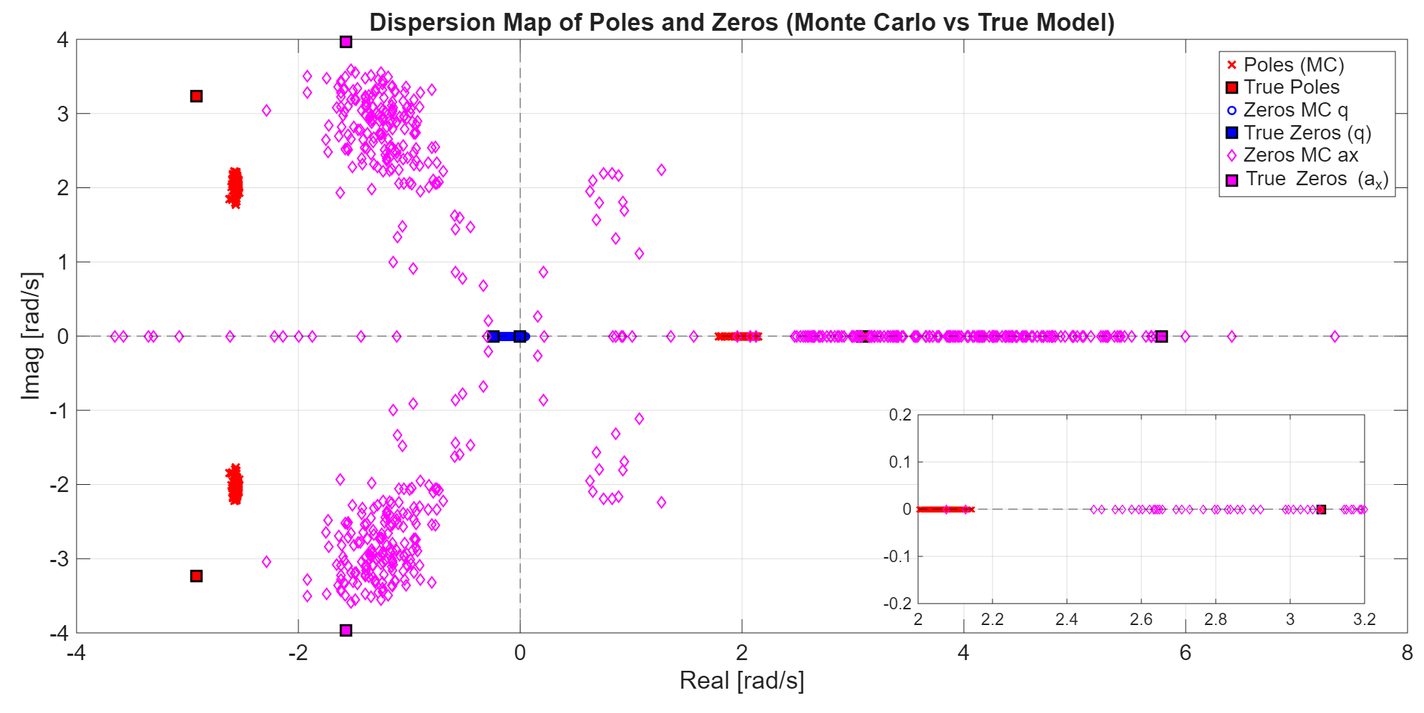
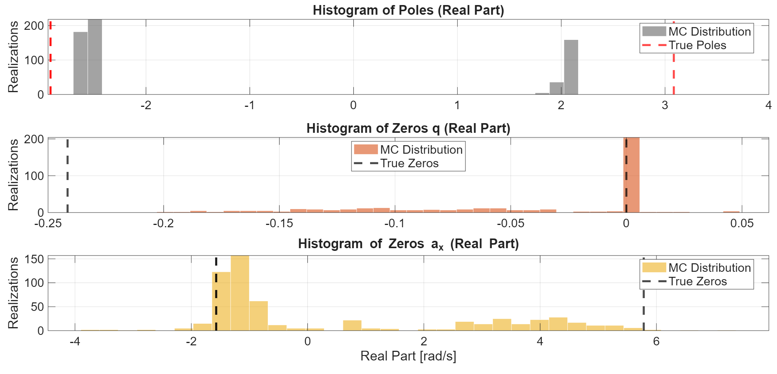
Zeros and Poles Dispersion
Considerations
Poles: Low variance and systematic bias. No change in sign reflects consistent system stability.
Pitch Rate Zeros: High identification accuracy and low variance reflected in a highly predictable response.
Acceleration Zeros: Sign changes cause inverse transient responses; high variance leads to low response predictability.

Slide 29
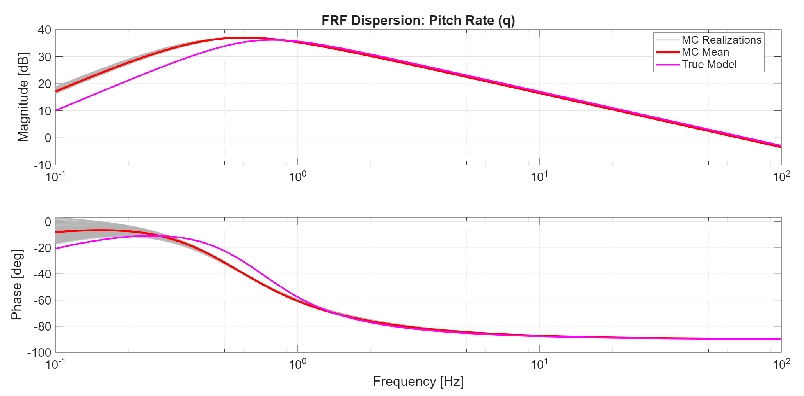
FRF Dispersion: pitch rate
Considerations
High Fidelity & Low Variance: Minimal pole-zero dispersion results in a tight mid-to-high frequency envelope for the MC ensemble.
Systematic Bias: Visible in low frequency range estimation.
Closed-Loop Readiness: The accurate tracking of the true model’s dynamics predict robust performance when closing the attitude feedback control loop.

Slide 30
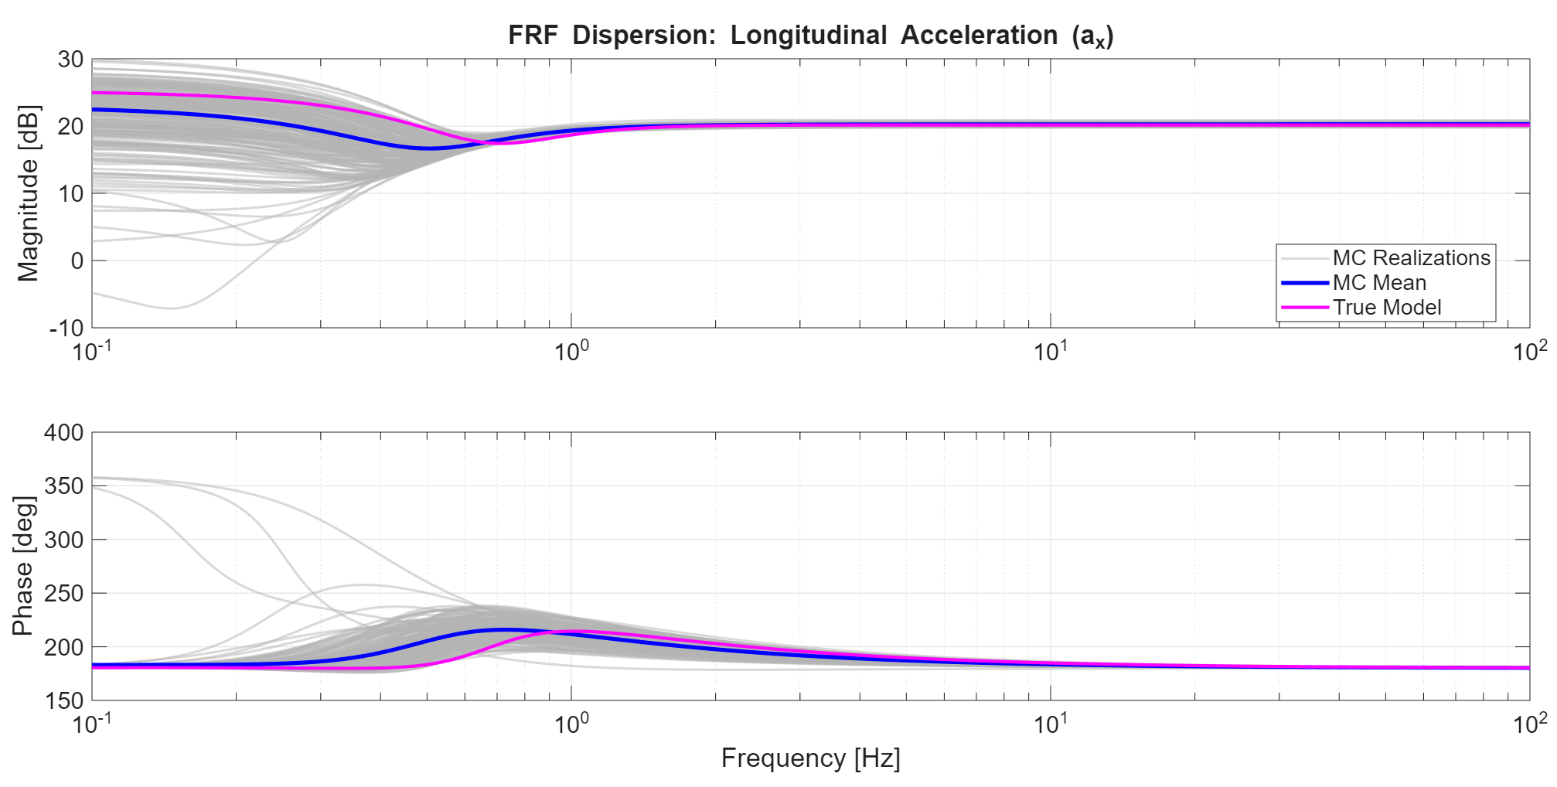
FRF Dispersion: acceleration
Considerations
High Variance: Severe low-frequency FRF dispersion across iterations due to zero uncertainty, contrasting with perfect convergence to the true model at high frequencies.
Sign Reversal: Clearly visible at 0.1 Hz, where realizations with opposite signs cause inverted starting magnitude baselines and a phase shift toward 360°.

Slide 31
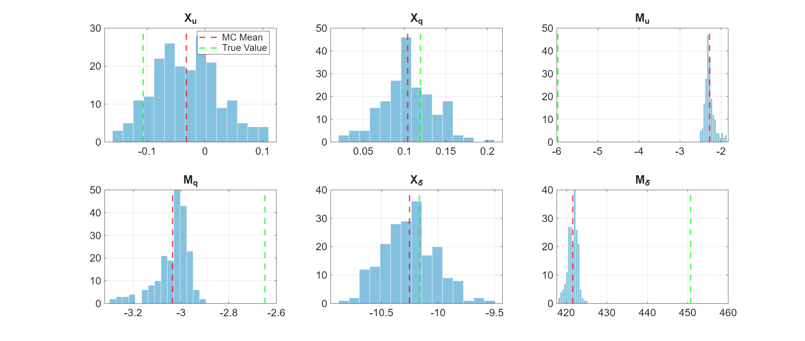
Hystograms of Parameters
Considerations
Bias: Intrinsic parameter bias, directly reflecting the systematic pole/zero shifts observed earlier.
Variance: The distribution exhibits a bell-shaped variance centered on the mean, often capturing the true value within its confidence interval.

Slide 32
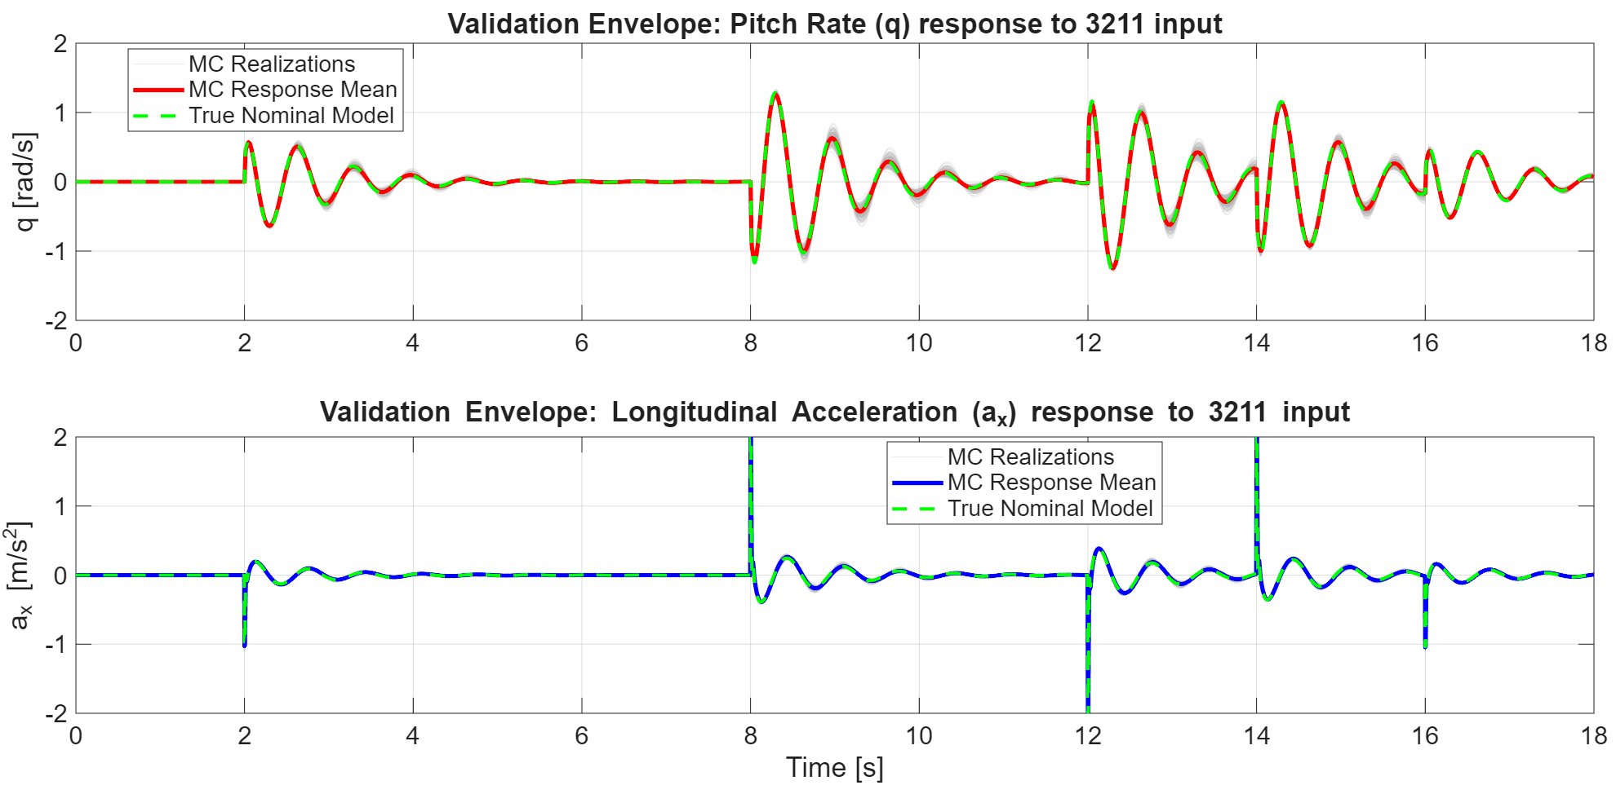
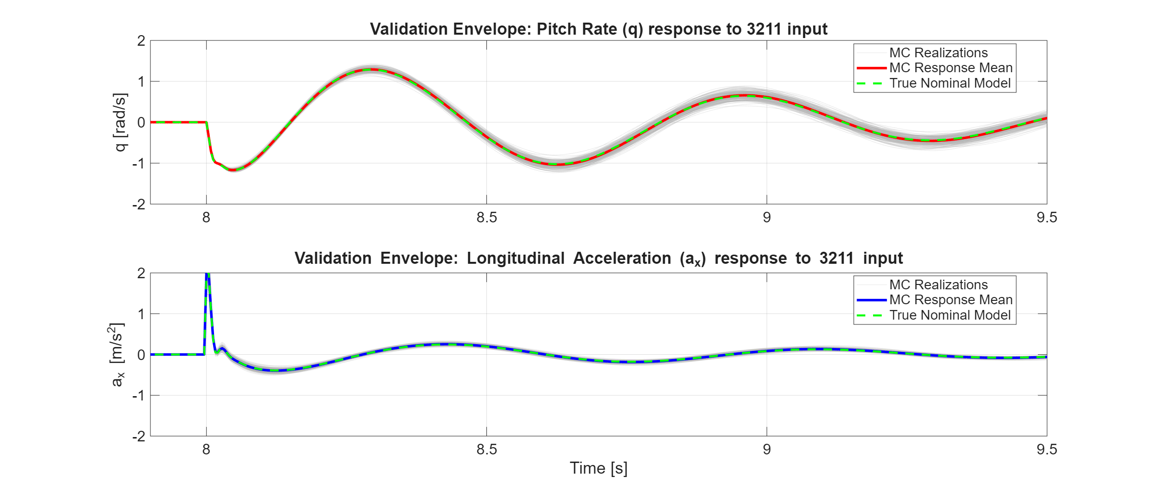
Validation
Considerations
Different Set Validation: evaluated all MC realizations against the same 3211 command and removing the stochastic noise seed.
Physical Consistency: Despite the systematic bias of certain parameters and the poor a_{x} FRF, no realization diverges. The models prove physical consistency, successfully capturing the macroscopic dynamic behavior of the system.
Notes:
-evaluated all MC realizations against the same 3211 command and locking the stochastic noise seed → This test purely isolates the impact of parameter dispersion from random sensor fluctuations.
-Physical Consistency: Despite the systematic bias of certain parameters and the poor a_{x} FRF, no realization diverges. The models prove physical consistency, successfully capturing the macroscopic dynamic behavior of the system. → Qui possiamo aggiungere il perchè a voce, ovvero che l’ax è solo una conseguenza del pitch e low coupling

Slide 33
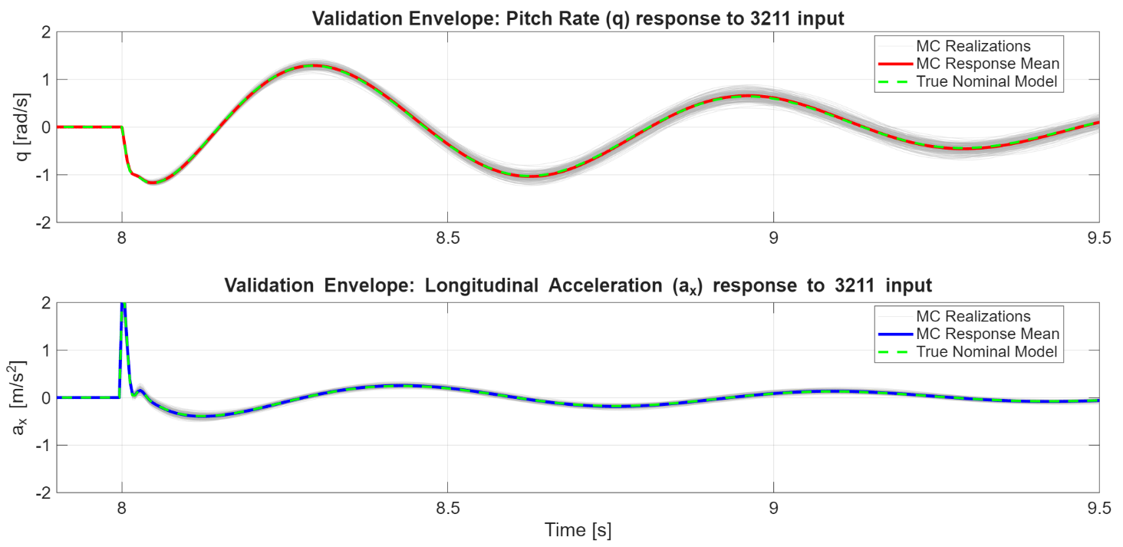
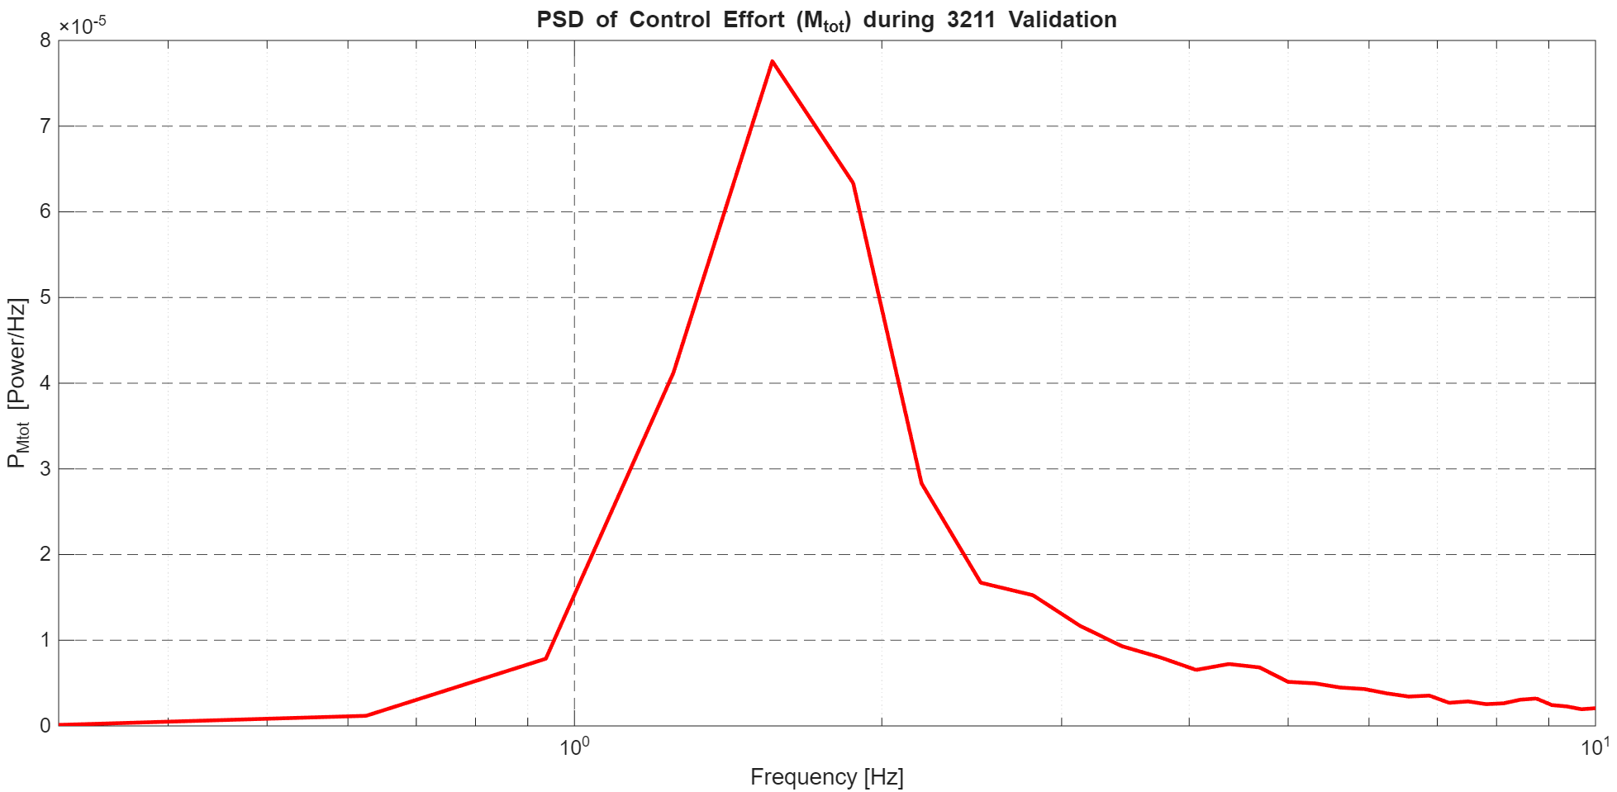
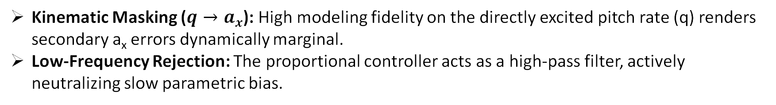
Validation
Why Good Results Despite Poor a_{x} FRF and Systematic Bias?
Kinematic Masking ($q→a_{x}$): High modeling fidelity on the directly excited pitch rate (q) renders secondary a_{x} errors dynamically marginal.
Low-Frequency Rejection: The proportional controller acts as a high-pass filter, actively neutralizing slow parametric bias.
Notes:
-evaluated all MC realizations against the same 3211 command and locking the stochastic noise seed → This test purely isolates the impact of parameter dispersion from random sensor fluctuations.
-Physical Consistency: Despite the systematic bias of certain parameters and the poor a_{x} FRF, no realization diverges. The models prove physical consistency, successfully capturing the macroscopic dynamic behavior of the system. → Qui possiamo aggiungere il perchè a voce, ovvero che l’ax è solo una conseguenza del pitch e low coupling

Slide 34
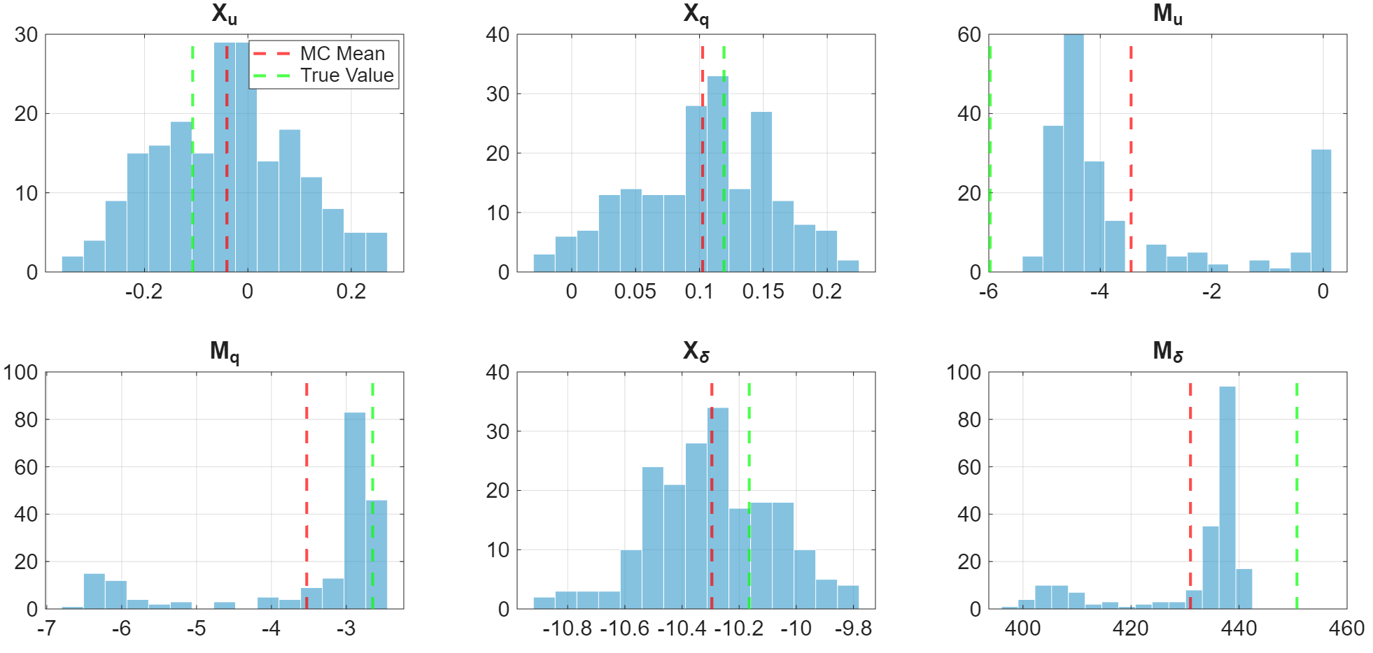
Bias reduction: K = 20 – Model Parameters
Considerations
Periodogram Bias Reduction: As dictated by theory, reducing K lowers the intrinsic bias of the periodogram in FRF estimation; this directly translates into less biased model parameters.
Higher Dispersion: Another predictable outcome is the increased variance in the FRF estimate, and consequently, in the model parameters.

Slide 35
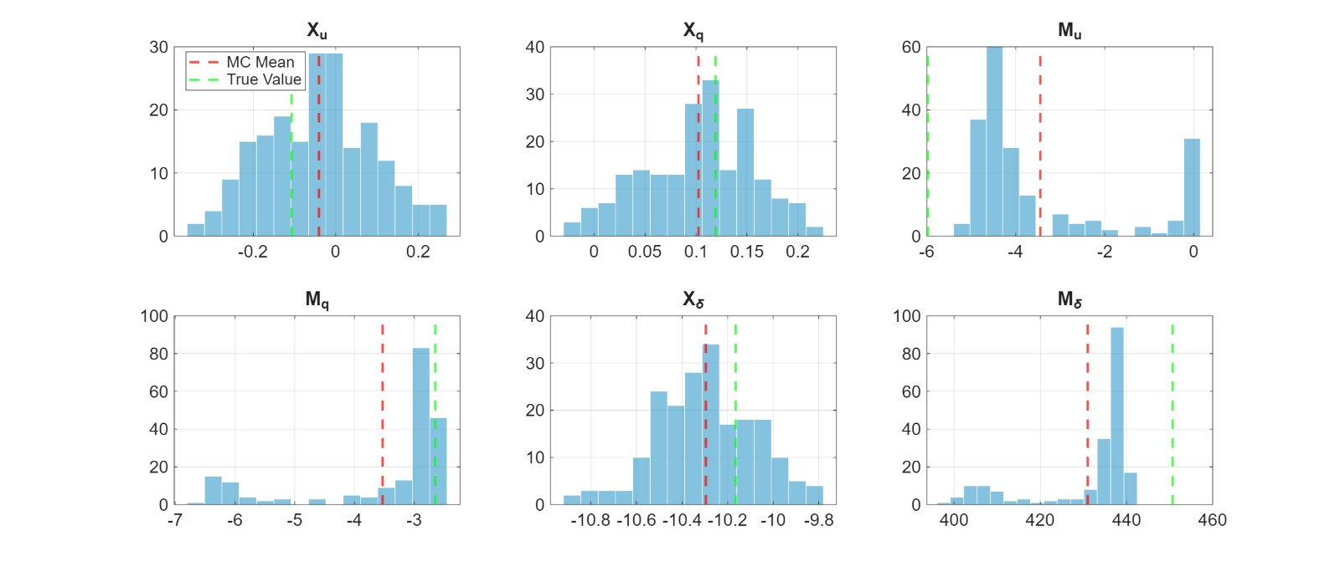
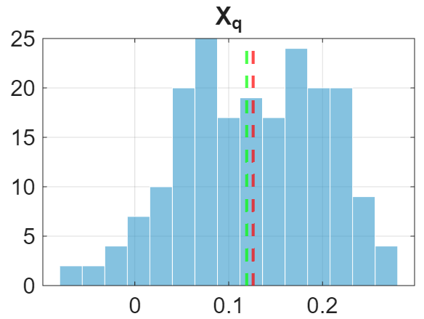
Bias reduction: Model Parameters Comparison
K = 20
K = 50

Slide 36
Bias reduction: Model Parameters Comparison
K = 20
K = 50

Slide 37
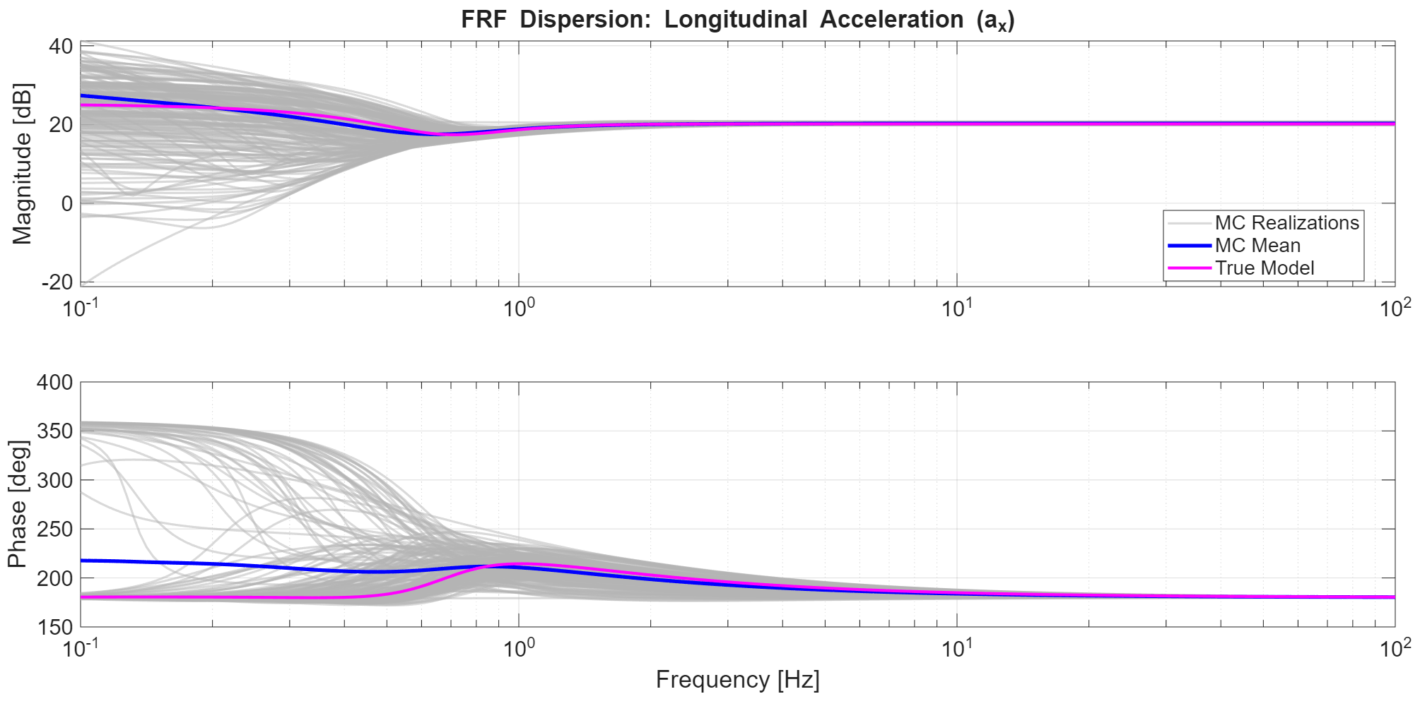
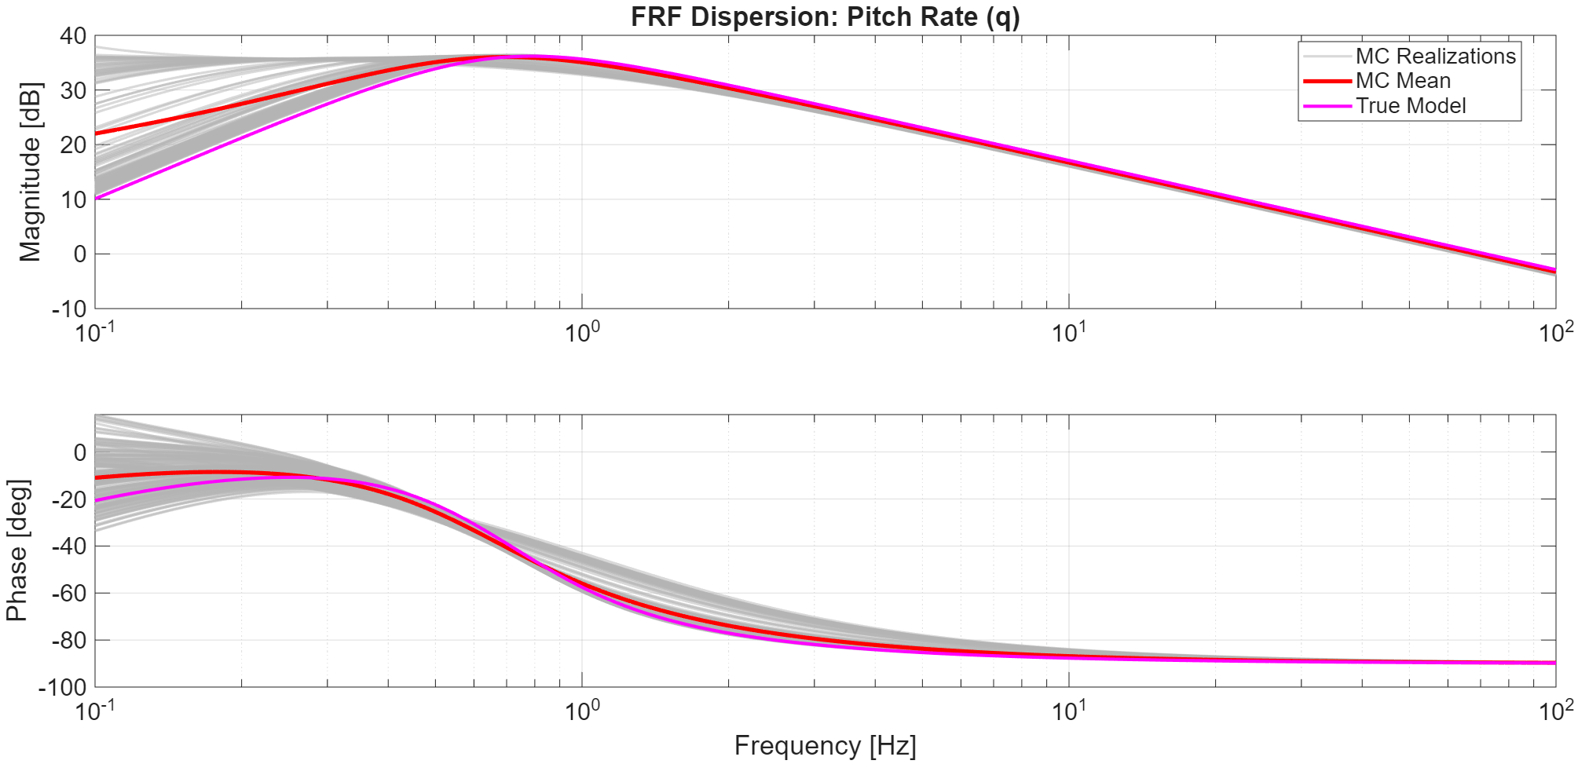
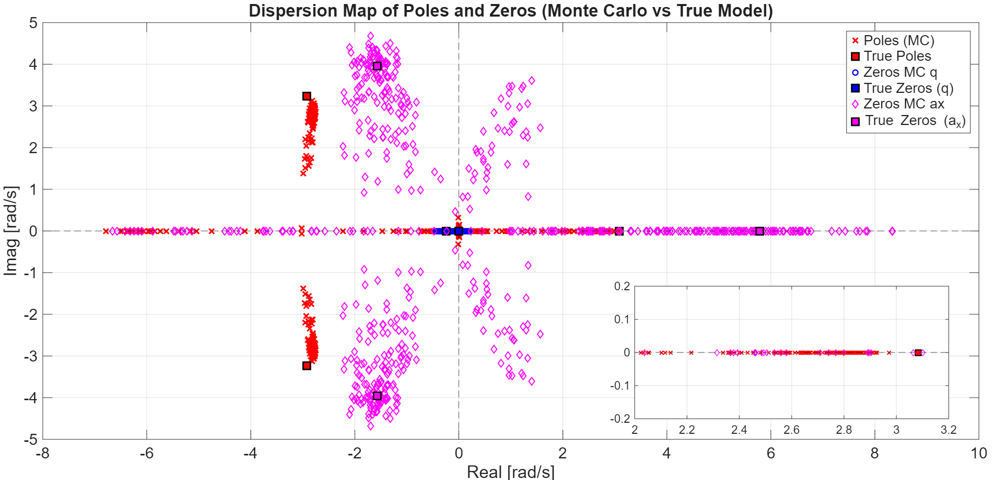
Bias reduction: K = 20 – Poles and FRF Dispersion
Considerations
Increased Pole-Zero Dispersion: widespread scatter across the complex plane. This high parametric variance directly challenges robust stability, as several realizations approach or cross into the Right-Half Plane.
Impact on FRF Envelope: Unlike the high-averaging case, even the pitch rate channel exhibits significant dispersion, increasing the global uncertainty of the identified ensemble.

Slide 38
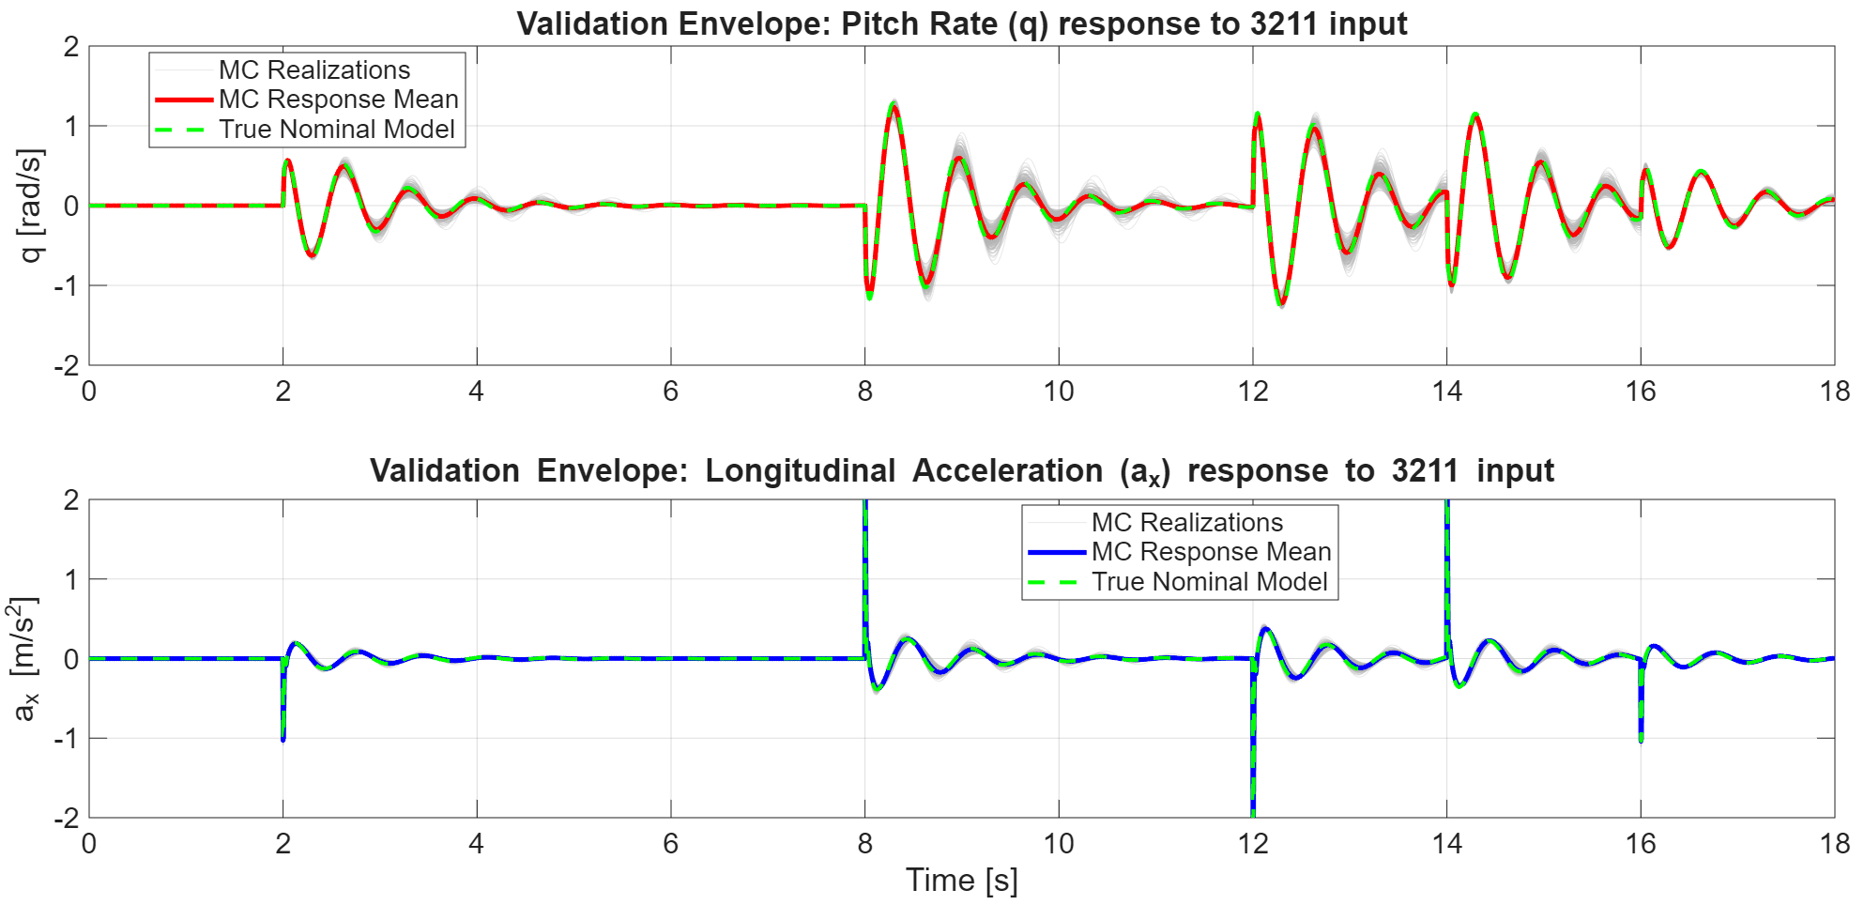

Bias reduction: K = 20 – MC Dataset Validation
Considerations
Closed-Loop Margin Erosion: Under identical validation conditions (3211 input, locked seed), the visibly broader time-domain dispersion confirms that severe open-loop pole/zero scatter directly erodes closed-loop stability margins compared to K=50.

Slide 39

Variance reduction: Frequency Cropping
Choice and Reasons:
Selective Bandwidth Cropping: Identification strictly confined to the M_{Tot}’s dominant spectral peak (-3dB threshold), deliberately discarding the low-excitation frequency tails.
Expected Variance Containment: Bypassing low-SNR regions insulates the optimizer from peripheral noise; paired with high Welch averaging (K = 50), this should tightly bound parameter dispersion across the ensemble.
NOTE
Only two discrete frequencies fall within the selected range for the FRF estimation

Slide 40

Variance reduction: Frequency Cropping - Model Parameters
Considerations
Confirmed Variance Compression: Restricting the fit exclusively to the two high-SNR points successfully insulates the optimizer from peripheral noise, yielding tighter parameter distributions and reduced variance.
Reduced Parametric Bias: Excluding very low frequencies bypasses intrinsic bias of the spectral estimator, reducing the distance between identified parameters and ground truth.

Slide 41



Variance reduction: Frequency Cropping – Poles and FRF Dispersion
Considerations
Tight Pole-Zero Clustering: widespread scatter collapses into highly localized clusters, confirming minimized stochastic variance. However, these clusters settle noticeably further from the ground-truth, visually manifesting the systematic parametric bias.
Narrow FRF Envelope: Consequently, frequency-domain dispersion also collapses: the realizations form an exceptionally tight envelope across all channels, though the ensemble mean clearly diverges from the True Model curve.

Slide 42


Variance reduction: Frequency Cropping – Dataset validation
Considerations
Validation confirms the prior analysis, showing reduced variance as Monte Carlo solutions tightly cluster around the mean even with the highlighted systematic bias

Slide 43
Combined bias and variance reduction
Reduction of Bias
Through K Decrease
Reduction of Variance Through Frequency Cropping
Possible Best Combination
Notes:
Reducing K, we have higher variance in the frequency range considered, bringing to a worst estimation of PSD through periodogram and hence of the FRF

Slide 44

Combined bias and variance reduction
Considerations
Bias: As expected, reducing K leads to a decrease in parameter estimation bias.
Variance: The extended frequency crop helps reduce the overall variance of the estimates.
Best estimate: Overall, this simulation proves to be the best configuration since all conflicting effects are well balanced.

Slide 45



Combined bias and variance reduction
Considerations
Bias: As expected, reducing K leads to a decrease in parameter estimation bias.
Variance: The extended frequency crop helps reduce the overall variance of the estimates.
Best estimate: Overall, this simulation proves to be the best configuration since all conflicting effects are well balanced.

Slide 46

Combined bias and variance reduction
Considerations
Bias: As expected, reducing K leads to a decrease in parameter estimation bias.
Variance: The extended frequency crop helps reduce the overall variance of the estimates.
Best estimate: Overall, this simulation proves to be the best configuration since all conflicting effects are well balanced.

Slide 47
Final Considerations
High K (K = 50)
Low K
(K = 20)
Strict Frequency Cropping
Variance-Oriented Baseline
Resolution-Oriented
Selective SNR Approach
Low Spectral Variance: High averaging ensures noise-resilient FRF estimates.
Intrinsic FRF Bias: Systematic periodogram bias results in a distorted low-frequency FRF
Closed-Loop Performance: Provides robust tracking and stable transient responses.
Reduced Intrinsic Bias: Better capture of low-frequency trends through higher spectral resolution.
High Parameter Dispersion: Severe increase in variance across Monte Carlo realizations.
Closed-Loop Performance: Reduction of stability margins, leading to degraded tracking.
Variance Compression: Focusing on high-SNR peaks minimizes stochastic uncertainty.
Reduced Bias: The removal of low-frequency components intrinsically minimizes system bias.
Closed-Loop Performance: Provides robust tracking and stable transient responses.
Notes:
Reducing K, we have higher variance in the frequency range considered, bringing to a worst estimation of PSD through periodogram and hence of the FRF

Slide 48
Final Considerations
K = 20 and Frequency Cropping
Balanced Combination
Balanced Averaging (K = 20): Lowers intrinsic bias while keeping noise strictly bounded within the analyzed frequency range.
Relaxed Cropping: Expanding the window preserves the slow-dynamics slope (good bias) while successfully rejecting peripheral noise.
Optimal Convergence: Yields the most accurate parameter estimates and the highest-fidelity closed-loop response.
Notes:
Reducing K, we have higher variance in the frequency range considered, bringing to a worst estimation of PSD through periodogram and hence of the FRF

Slide 49
A
K
T
E
Y
H
T
T
O
O
U
N
I
F
T
T
O
R
N
E
A
H
N

