Slide 1
Machine Learning pt. 1: Unsupervised ACE 592 SAE

Slide 2
Unsupervised Machine Learning
Most of us know what supervised machine learning is, but what is “unsupervised learning”?
Essentially, it is inference for data that is not labeled.
This amounts to attempting to learn latent patterns or variables in the data rather than predict explicit labels.

Slide 3
Two Algorithms We Will Go Over
Principal Component Analysis
- For learning the implicit “components” of a data set.
2. K-Means Clustering
- For discovering groupings in the variable space.

Slide 4
Principal Component Analysis (PCA)
Essentially an orthogonal, linear transformation that translates the data into a new coordinate system.
In this coordinate system, the first component explains the most variance, the second component explains the second most amount of variance, etc.
The new dimensions of the system are linear combinations of existing variables.

Slide 5
How PCA chooses the components
For a given set of data, it tries to find a line/plane where:
Errors are minimized (like OLS).
Variation is maximized (red dots on the line are as spread out as possible).
So PCA is also trying to maximize the variation the component explains!
Graph taken from this very cool explanation from Stack Overflow

Slide 6
PCA and Linear Algebra
Using spectral decomposition, we can always make a new orthogonal coordinate system for any square symmetric matrix. The result is given by its eigenvectors.
When we do this to the covariance matrix of the data, the eigenvectors are equivalent to the principal components.
Notice that at the magenta lines the new “frame” would make the points uncorrelated.
Graph taken from this very cool explanation from Stack Overflow

Slide 7
What this means
PCA components can be found by Singular Value Decomposition or other methods of finding eigenvectors.
PCA components will be orthogonal to one another (a property of eigenvectors of symmetric matrices).
PCA components will be linear combinations of all the variables in the data.

Slide 8
Why do we care?
With PCA, we can express large numbers of features concisely in a way that maximizes explained variance.
We can use this to reduce the dimensionality of a dataset.
We can construct “indices” that represent several different variables on aggregate.

Slide 9
The Downside
PCA components do not have clear “units.” They can be included as control variables, but seldom have an interpretation in a regression model.
The eigenvectors may be related to variables in the data in any way, and not necessarily in a way that makes them interpretable.
Because of the above, PCA is a great first step for a prediction model or clustering model. Whether it actually tells you useful things about the data is variable.

Slide 10
Example: Photo Classification
In a given photo, its likely that not every pixel matters.
Doing PCA on a photo will summarize several pixels into a reduced number of components.
Classifying on these components can be just as effective and much more efficient!

Slide 11
Economics Example: Asset Indices
In Demography and Public Health, it is popular to use PCA with a data set of assets to produce an “asset index.”
The result will be some components which are correlated with variables in the data, and may or may not be interpretable.
This can be used to “rank” households based on the amount of assets they have.

Slide 12
PCA Hyperparameters
The principal hyperparameter in PCA is the number of components.
Recall that the first will explain the most variance, and the second the second most. The components will explain less and less as they increase.
How should we choose?

Slide 13
PCA Hyperparameters
The principal hyperparameter in PCA is the number of components.
Recall that the first will explain the most variance, and the second the second most. The components will explain less and less as they increase.
How should we choose?
The number of components that explains “enough of the data.”

Slide 14
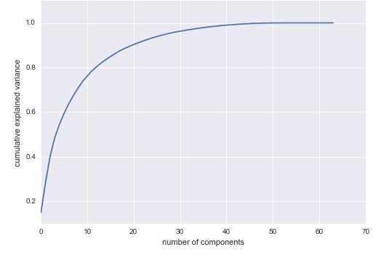
PCA Hyperparameters
Heuristics for Selection:
A threshold of explained variance.
Ex: keep the number of components that explains 70% of the data.
Good for when you are putting PCA components into a model, for example.
The “elbow rule”: choose where the gains start to level out.

Slide 15
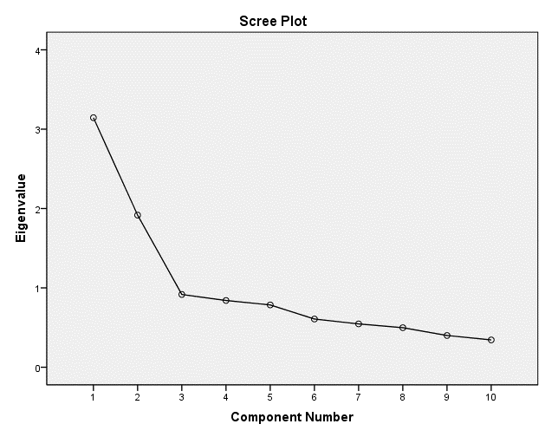
PCA Hyperparameters
Heuristics for Selection:
2. A threshold of eigenvalues.
Ex: Keep components that have eigenvalues more than 1, or the
“Kaiser Criterion.”
This rule is more for keeping the components that “matter the most.”
The “elbow rule”: but this time upside down!

Slide 16
Application of PCA

Slide 17
K-Means Clustering
An algorithm to determine implicit groupings in data based on correlations in features.
Determines K clusters from N observations where each observation belongs to the cluster with the nearest mean, or cluster centroid.
Minimizes within-cluster squared Euclidean distances.

Slide 18
How it Basically Works (Lloyd’s algorithm)
Assign K initial centroid points.
Assign each observation to the centroid which is the closest (minimum Euclidean distance).
Recalculate the means for each cluster.
Repeat 2 and 3 until the means stop moving.

Slide 19
How it Basically Works (Lloyd’s algorithm)

Slide 20
How it Basically Works (Lloyd’s algorithm)
This method is not guaranteed to reach the minimum.
There are several variations of this method:
- K-medians clustering (uses medians).
- K-mediods clustering (uses mediod points that are actually in the data).
- Gaussian mixture models (generalized version of K-means).

Slide 21
Example: Dimension Reduction
An Econometrica paper by Bonhomme and Manresa applies a clustering algorithm to reduce the number of fixed effects necessary in a model.
They refer to this as a “group fixed effects estimator.”
They benchmark this method against Mixture Distributions, a more widely used method in economics.

Slide 22
Example: Data Exploration with PCA
K-means clustering algorithm is fairly useful for trying to understand the implicit patterns in our data.
PCA is often used as a first step to reduce the dimensions of the data. The clustering algorithm is then applied to find groups.
The groups may or may not be economically meaningful, but it can be a good starting point.

Slide 23
K-Means Hyperparameter
The main hyperparameter that must be chosen is the number of clusters.
How do we know which number is the best?

Slide 24
K-Means Hyperparameter
The main hyperparameter that must be chosen is the number of clusters.
How do we know which number is the best?
2 is likely to not be helpful, whereas K=N is equivalent to what we already have.
We need just enough clusters to see groupings.

Slide 25
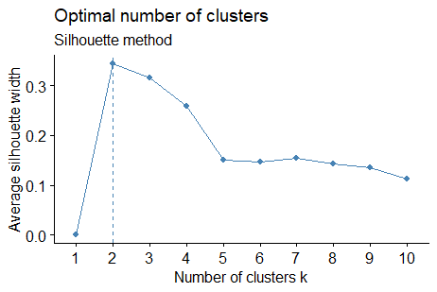
Heuristics for Selection
Heuristic #1: Choose the K at the elbow of the average silhouette score.
Silhoutte score measures the distance between points and their cluster centers.
Obs have positive values if they are closest to their assigned cluster, negative if closer to another cluster.

Slide 26
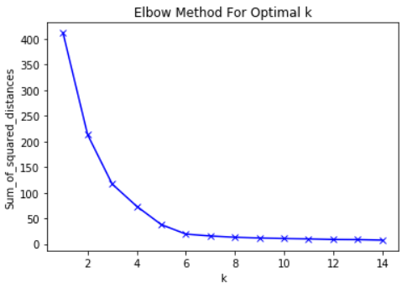
Heuristics for Selection
Heuristic #2: Choose the K at the elbow of the within-sum of squared distances (called “inertia”).
Inertia is essentially the function being minimized. In theory, this should be smallest for the optimal number.
Because K-means doesn’t always find the minimum, it won’t always decrease monotonically.

Slide 27
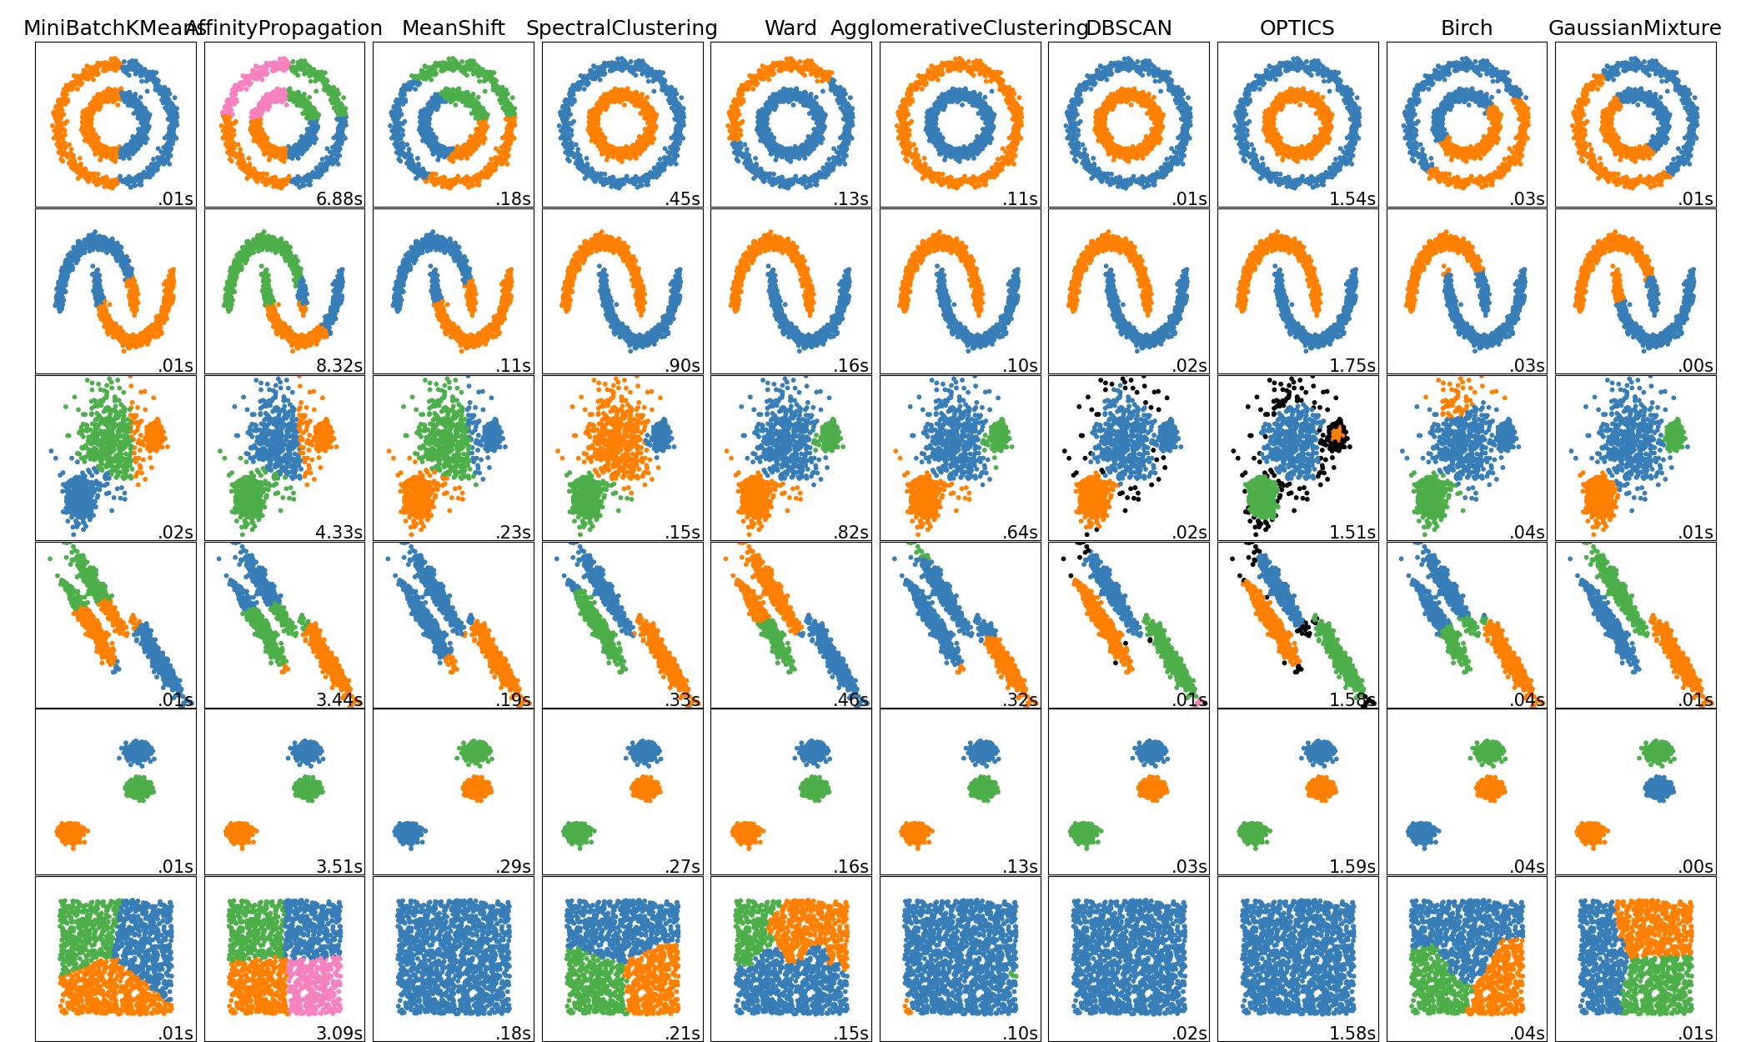
Alternative Clustering Methods

Slide 28
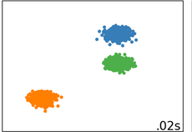
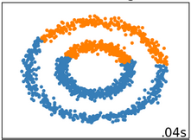
Weaknesses of K-means
Good for K-means
It does well for compactness, but not well for connectivity.
For cases in which there is high connectivity, Spectral Clustering or Hierarchical Clustering is a better option.
Bad for K-means

Slide 29
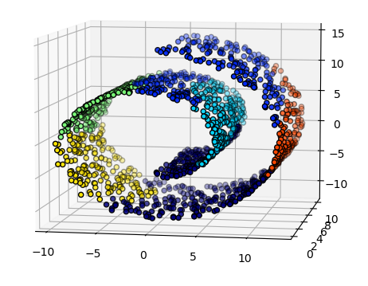
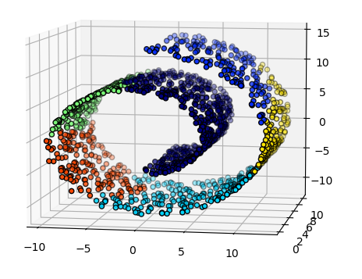
Imposing Constraints
No constraints
Some methods can allow you to impose constraints such as Hierarchical Clustering.
This helps if you have a priori information about the shape.
Shape constraints

Slide 30
Application of K-means

