Slide 1


Nonparametric modelling for spaced repetition scheduling
Francesco Giammaria, Giacomo Randazzo, Matteo S. Savino
Politecnico di Milano - 17/12/2020

Slide 2
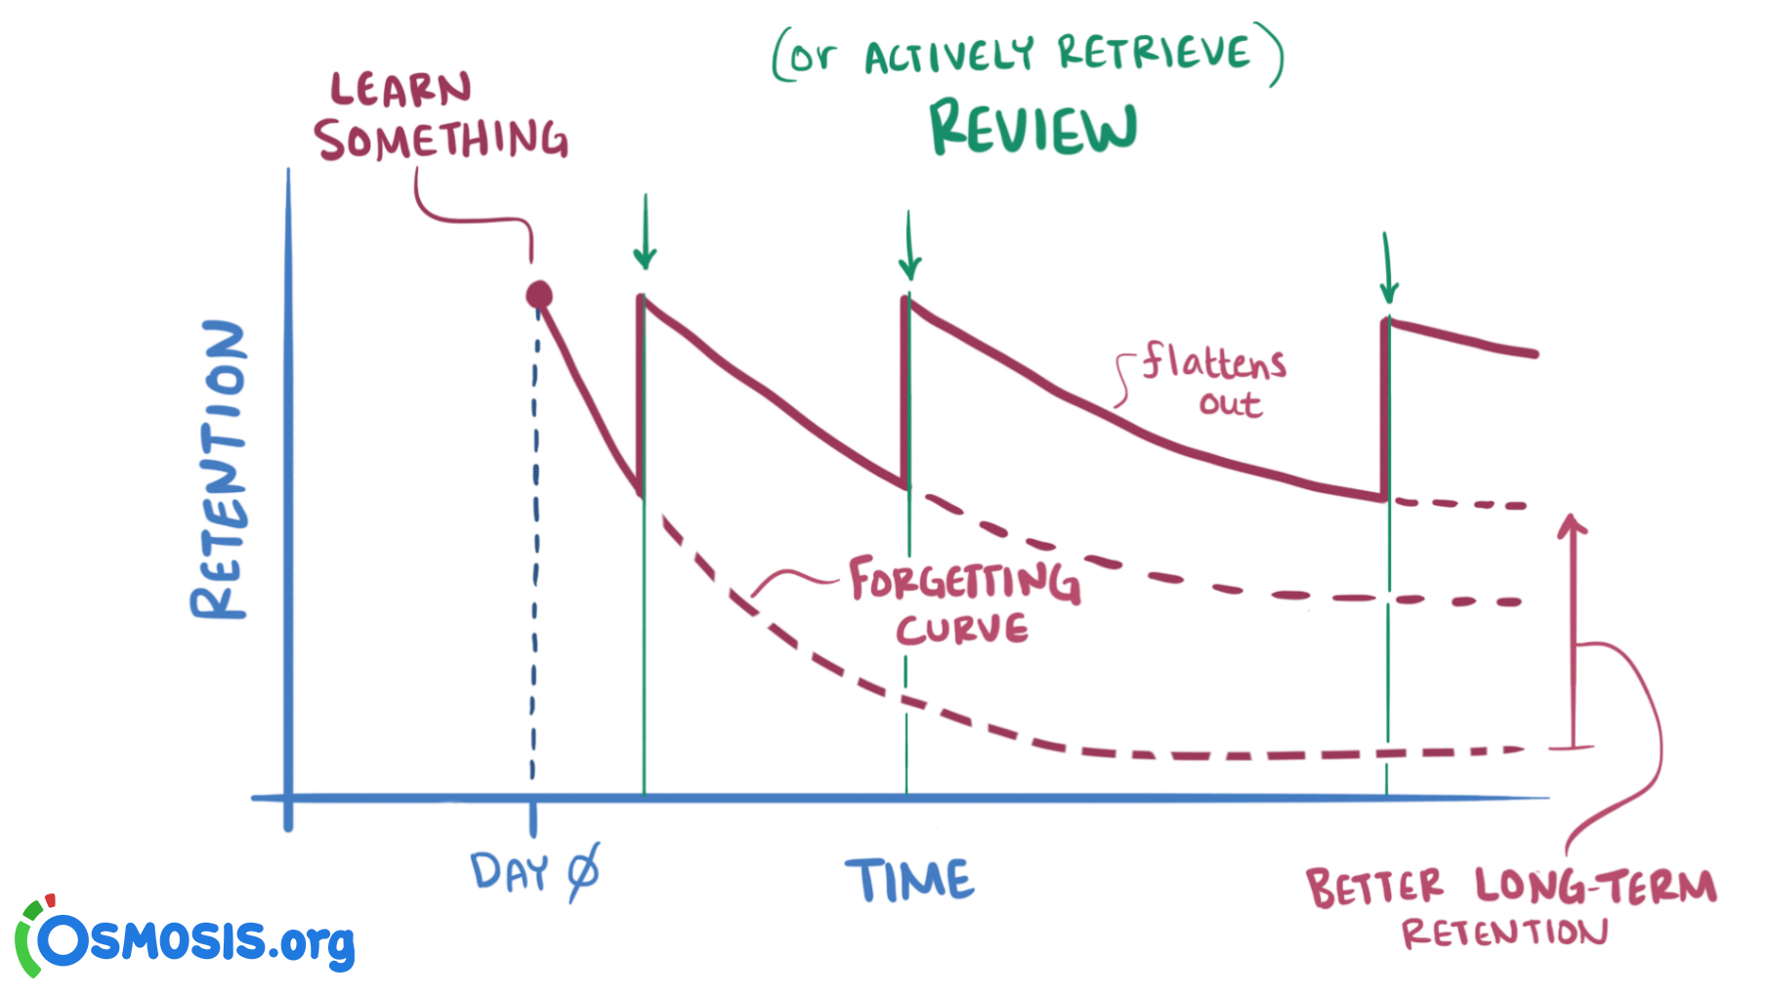
Spaced Repetition
Spaced repetition is a method for memorizing concepts:
No cramming, reviews spaced through time
Increasing durations between reviews as one learns the item
Software schedules each review

Slide 3

and Half-Life Regression
Duolingo is a language learning app:
Relies on spaced repetition under the hood
Half-Life Regression model to estimate the user’s probability of recalling an item at any point in time after the last review
Half-Life Regression paper + dataset:
2 weeks of real usage data
115’000 users
13 million word recall probabilities

Slide 4
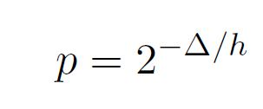
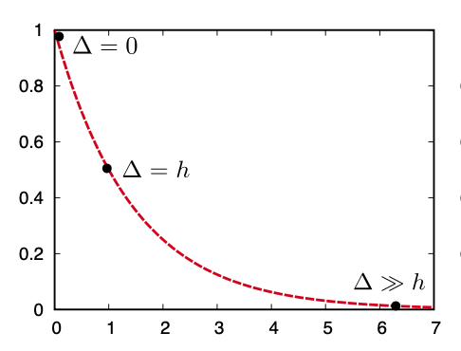
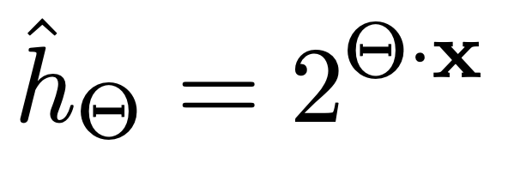
Model
lag time
Forgetting Curve Model:
(Ebbinghaus, 1885)
Half-life
p-recall
Half-Life Regression Model:

Slide 5
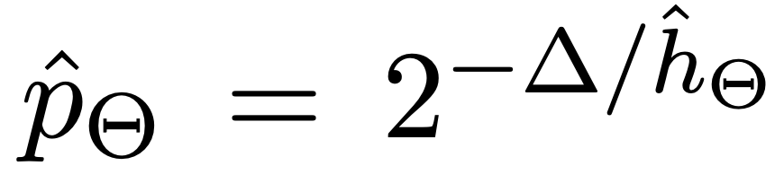
Model
lag time
Forgetting Curve Model:
(Ebbinghaus, 1885)
Half-life
p-recall
Half-Life Regression Model:
parameters
feature variables
GOALS:
develop the best model in order to improve the users’ experience

Slide 6
Model
lag time
Forgetting Curve Model:
(Ebbinghaus, 1885)
Half-life
p-recall
Half-Life Regression Model:
parameters
feature variables
GOALS:
develop the best model in order to improve the users’ experience

Slide 7
DATA EXPLORATION

Slide 8

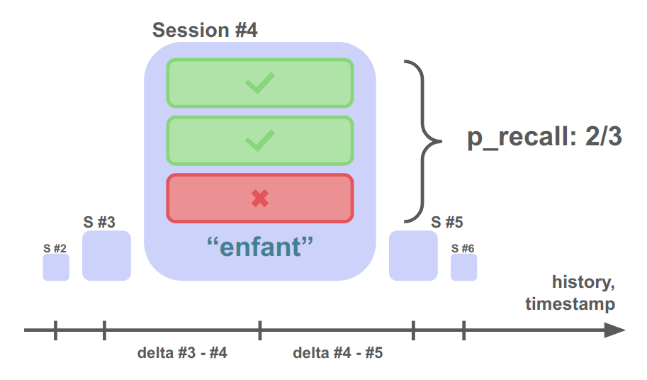
Our Data
p_recall - proportion of exercises from this lesson/practice where the word/lexeme was correctly recalled
timestamp - UNIX timestamp of the current lesson/practice
delta - time (in seconds) since the last lesson/practice that included this word/lexeme
user_id - student user ID who did the lesson/practice (anonymized)
learning_language - language being learned
ui_language - user interface language (presumably native to the student)
lexeme_id - system ID for the lexeme tag (i.e., word)
lexeme_string - lexeme tag (see below)
history_seen - total times user has seen the word/lexeme prior to this lesson/practice
history_correct - total times user has been correct for the word/lexeme prior to this lesson/practice
session_seen - times the user saw the word/lexeme during this lesson/practice
session_correct - times the user got the word/lexeme correct during this lesson/practice

Slide 11
Our Data
We created some new variables:
delta_day = delta / (24*3600)
p_recall = history_correct / history_seen
avg_user_p = mean value of the p_recall scores of every user (if the user is new, we consider the mean value of the whole dataset)

Slide 12
PLOTS

Slide 13
OUR GOALS

Slide 14
Goals
Duolingo's HLR model is parametric: we have built a nonparametric model with the same goals.
Highligth the patterns in the dataset, i.e. the relations between the variable p_recall and the others.

Slide 15
OUR MODELS

Slide 16
Model 1 (Duolingo-like)
delta_day
learning_language
p_recall
history_seen
history_correct
We resort to GAM using some cubic splines

Slide 17
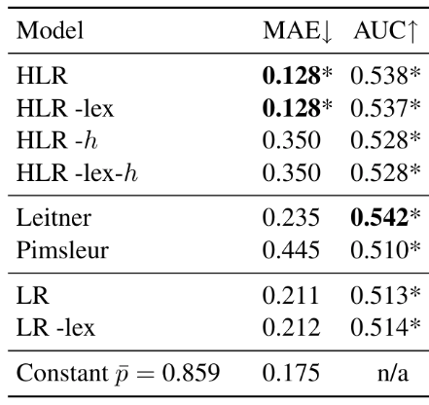
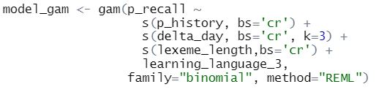
Model 1 Results
MAE: 0.167
Model (1) (on a validation set, different from the paper’s test set)
(Test set) Results from the Half-Life Regression paper.

Slide 18
Model 2

Slide 19

Model 2 Results
Permutation Test:
p-value = 0
MAE: 0.122
AUC: 0.625
Model (2) (on a validation set, different from the paper’s test set)
MAE: 0.128
AUC: 0.538
HLR model (on paper’s test set)
VS

Slide 20
This is the part when we started to have some doubts…

Slide 21
Are we sure that exists a
link between p_recall and all the other variables?

Slide 22
OUR NEW! GOALS

Slide 23
Find a robust statistical non parametric tool to verify our thesis

Slide 24
Non parametric tests ecc…

Slide 25
Non parametric tests ecc…

Slide 26
CONCLUSIONS

Slide 27
Conclusions ecc…

Slide 28
THANK YOU !!!

Slide 29
References
Settles, Meeder (2016) A Trainable Spaced Repetition Model for Language Learning. In Proceedings of the Association for Computational Linguistics (ACL), pages 1848-1858.
Settles, Burr (2017) Replication Data for: A Trainable Spaced Repetition Model for Language Learning. https://doi.org/10.7910/DVN/N8XJME, Harvard Dataverse, V1
Matuschak and Nielsen (2019) How can we develop transformative tools for thought? https://numinous.productions/ttft, San Francisco

