Slide 1
NCA Single Dose PK

Slide 2
NCA Overview
NCA of individual data from PKDATA (pk_all_sd.csv). For each subject and dose the NCA parameters will be summarized. For each subject the full time-course will be shown in grey, the data used for each analysis will be shown in green, the observed AUC will be shown by a green shaded region, and extrapolated values and data used for extrapolation will be shown in orange

Slide 3
Subject: 1, Dose: 1
Nobs: 9
Dose: 30.00
Dose (CU): 3.00e+07
Cmax: 9.95e+03
C0 Extrap: NA
Tmax: 1.00
Half-life: 422.56
Time interval: 1 - 671.9999
Vp (obs): 3.01e+03
Vss (obs): 6.07e+03
Vss (pred): 6.06e+03
CL (obs): 12.77
CL (pred): 12.81
AUC last: 1.76e+06
AUC (inf,pred): 2.34e+06
AUC (inf,obs): 2.35e+06

Slide 4
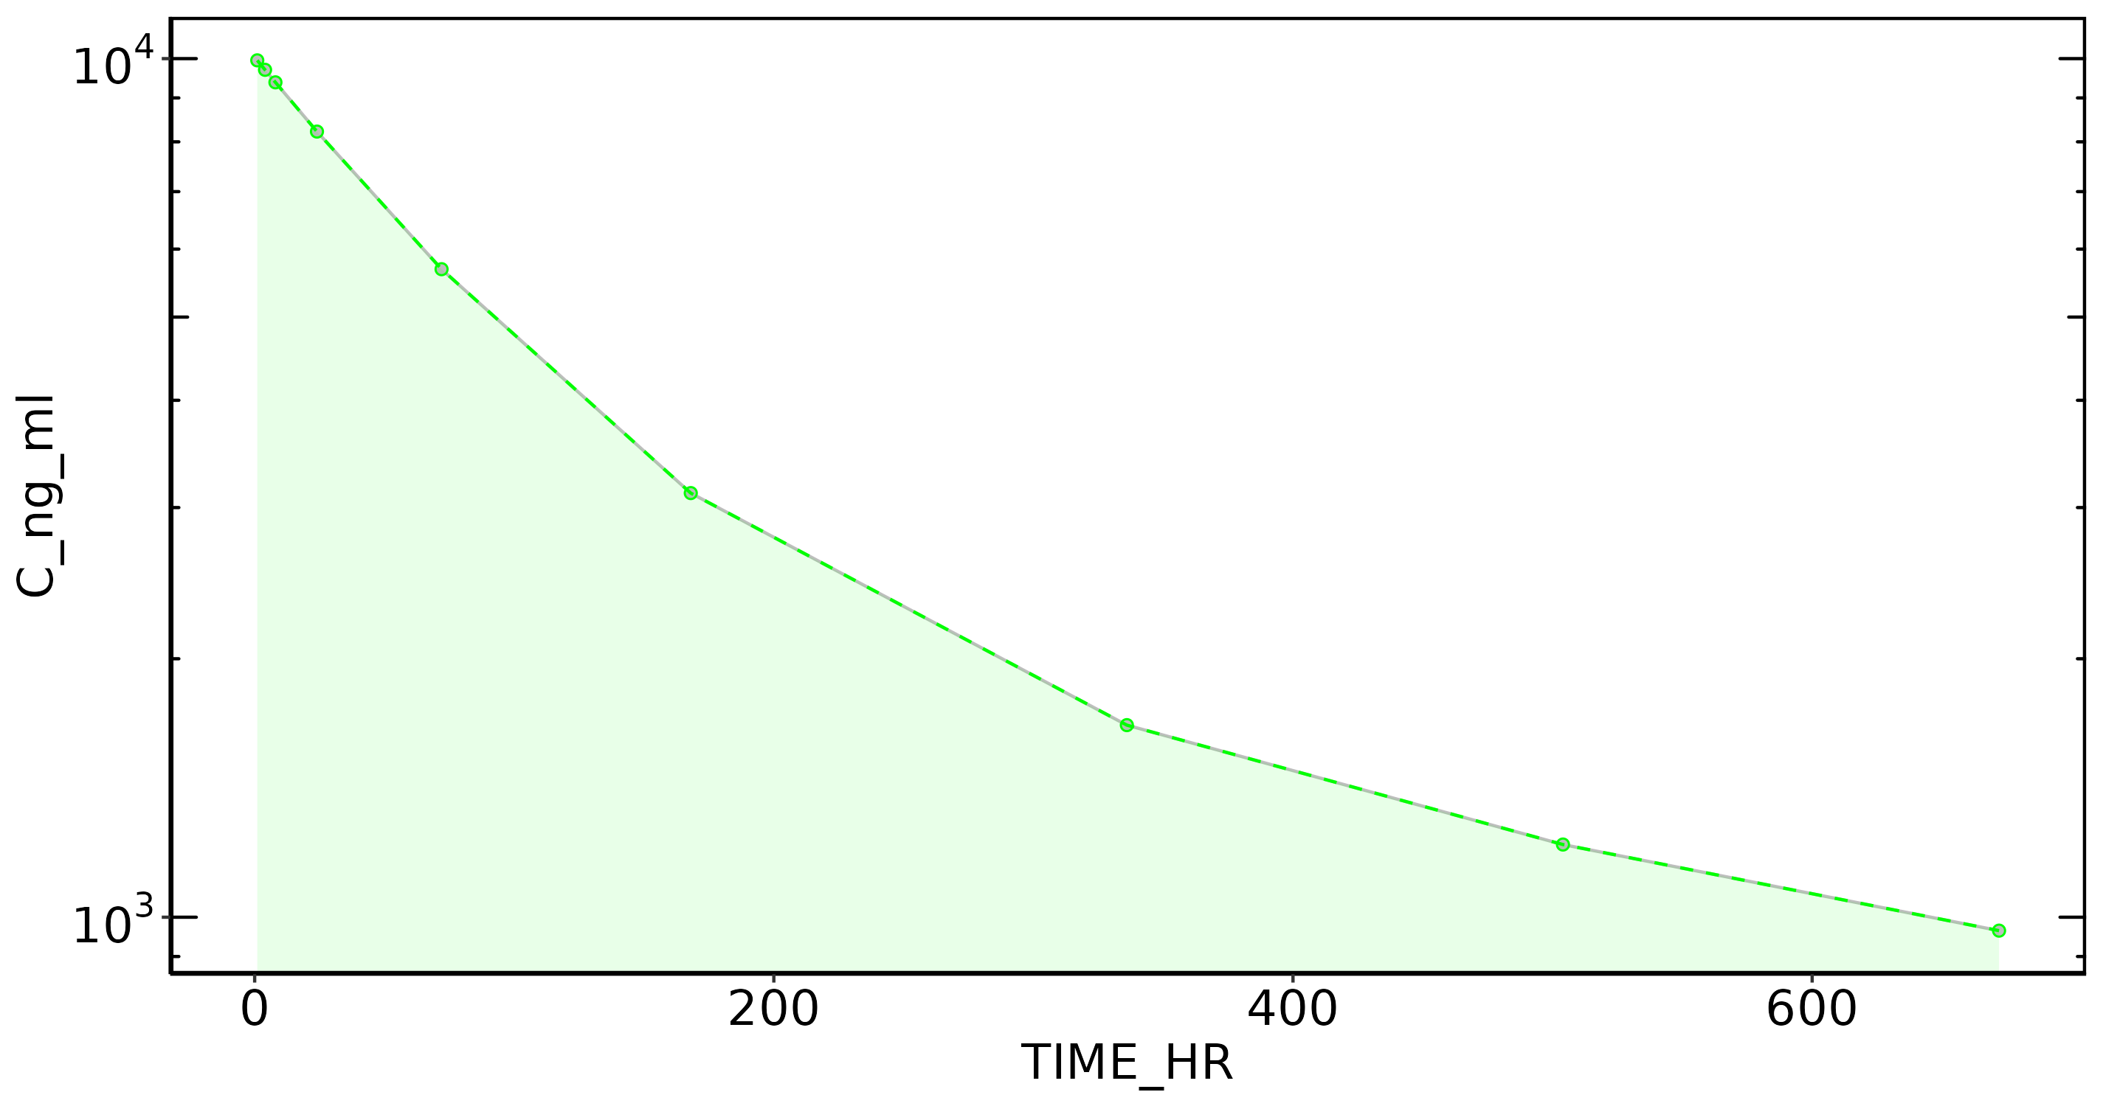
Subject: 1

Slide 5
Subject: 2, Dose: 1
Nobs: 9
Dose: 30.00
Dose (CU): 3.00e+07
Cmax: 1.13e+04
C0 Extrap: NA
Tmax: 1.00
Half-life: 476.52
Time interval: 1 - 671.9999
Vp (obs): 2.66e+03
Vss (obs): 5.06e+03
Vss (pred): 5.06e+03
CL (obs): 7.57
CL (pred): 7.57
AUC last: 2.51e+06
AUC (inf,pred): 3.96e+06
AUC (inf,obs): 3.96e+06

Slide 6
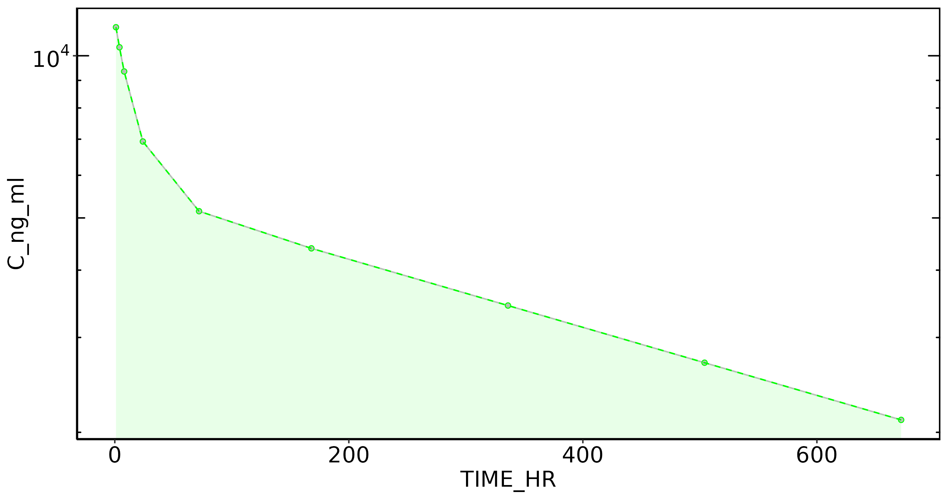
Subject: 2

Slide 7
Subject: 3, Dose: 1
Nobs: 9
Dose: 30.00
Dose (CU): 3.00e+07
Cmax: 7.42e+03
C0 Extrap: NA
Tmax: 1.00
Half-life: 500.40
Time interval: 1 - 671.9999
Vp (obs): 4.04e+03
Vss (obs): 5.52e+03
Vss (pred): 5.51e+03
CL (obs): 8.19
CL (pred): 8.22
AUC last: 2.32e+06
AUC (inf,pred): 3.65e+06
AUC (inf,obs): 3.66e+06

Slide 8
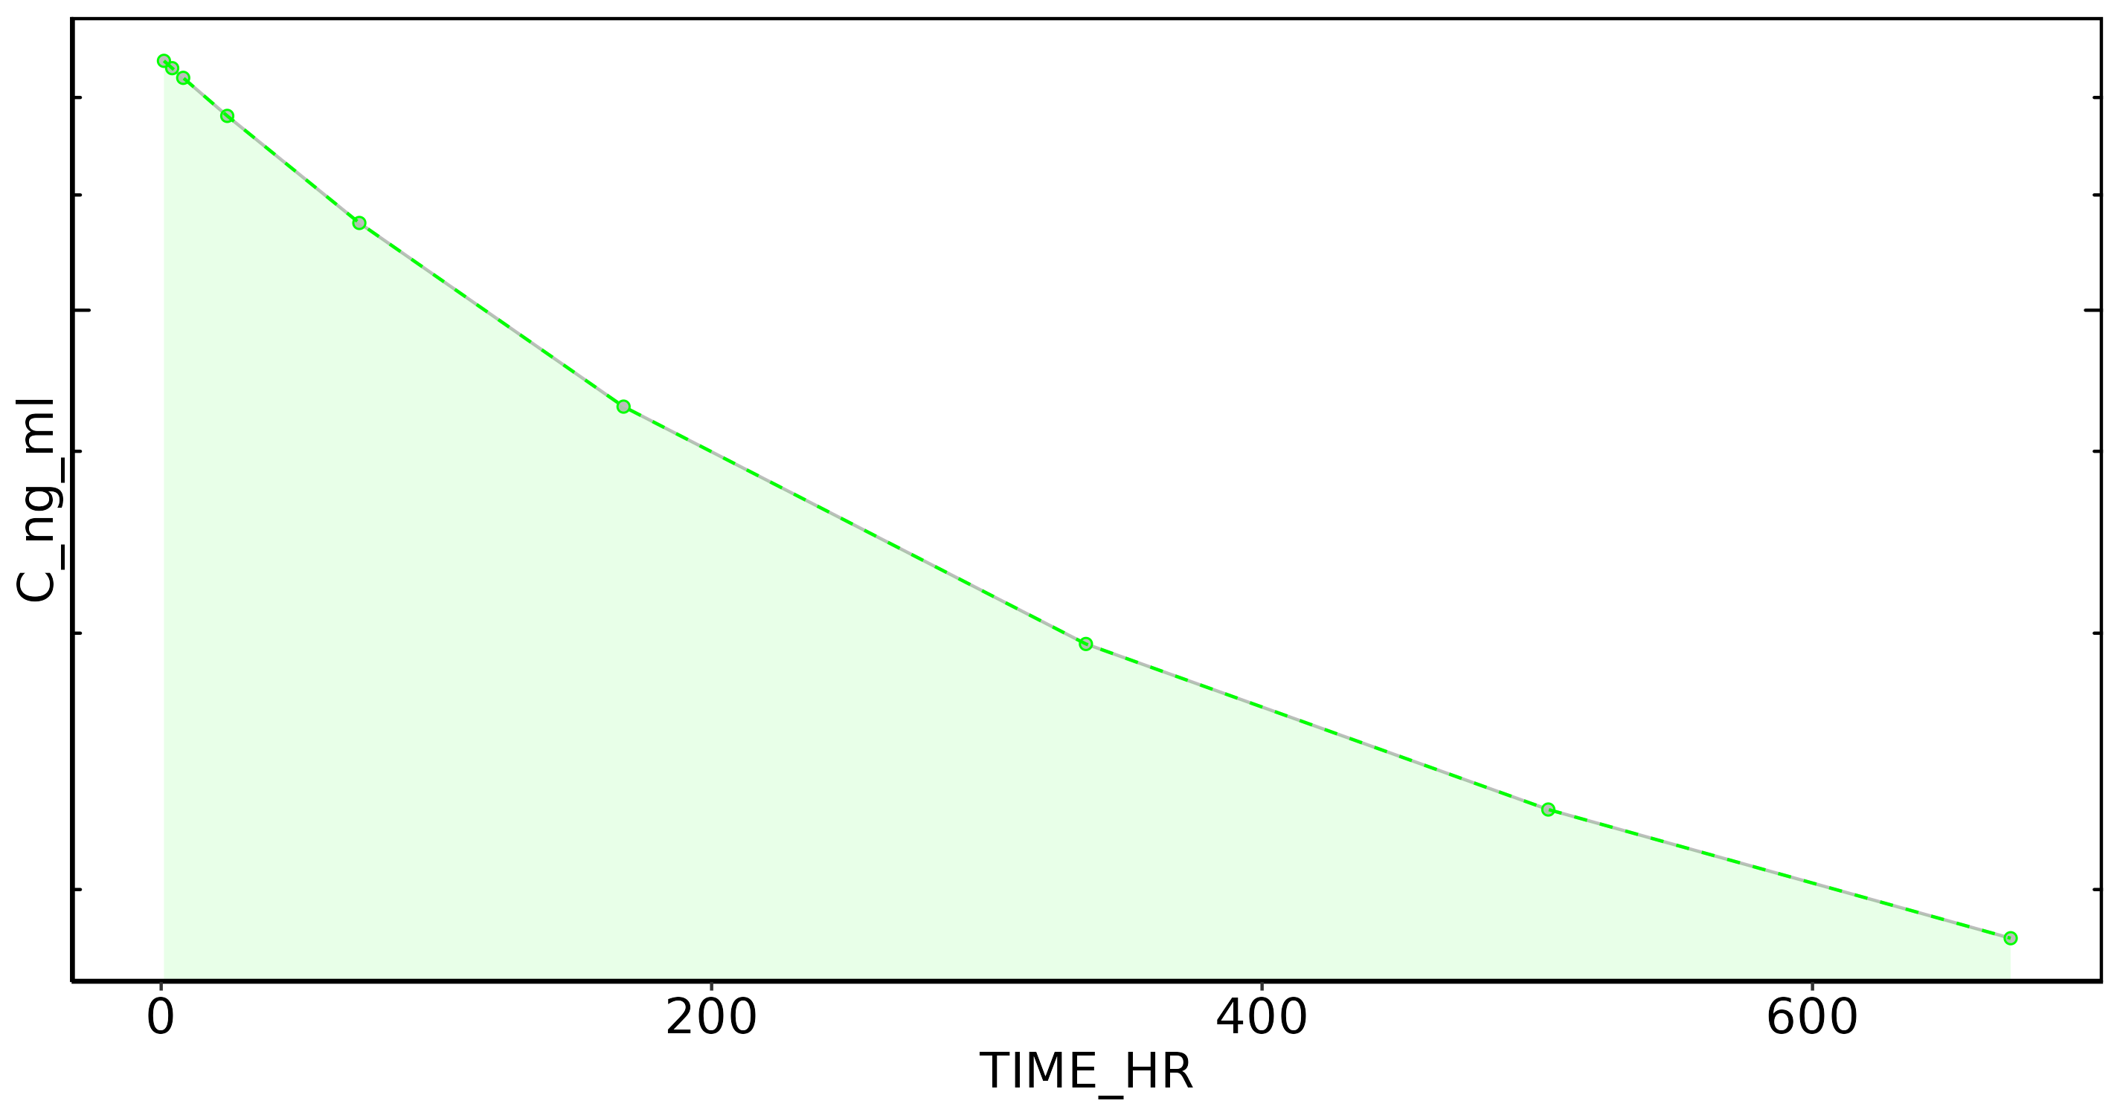
Subject: 3

Slide 9
Subject: 4, Dose: 1
Nobs: 9
Dose: 30.00
Dose (CU): 3.00e+07
Cmax: 5.76e+03
C0 Extrap: NA
Tmax: 1.00
Half-life: 589.25
Time interval: 1 - 671.9999
Vp (obs): 5.21e+03
Vss (obs): 8.43e+03
Vss (pred): 8.43e+03
CL (obs): 10.03
CL (pred): 10.03
AUC last: 1.65e+06
AUC (inf,pred): 2.99e+06
AUC (inf,obs): 2.99e+06

Slide 10
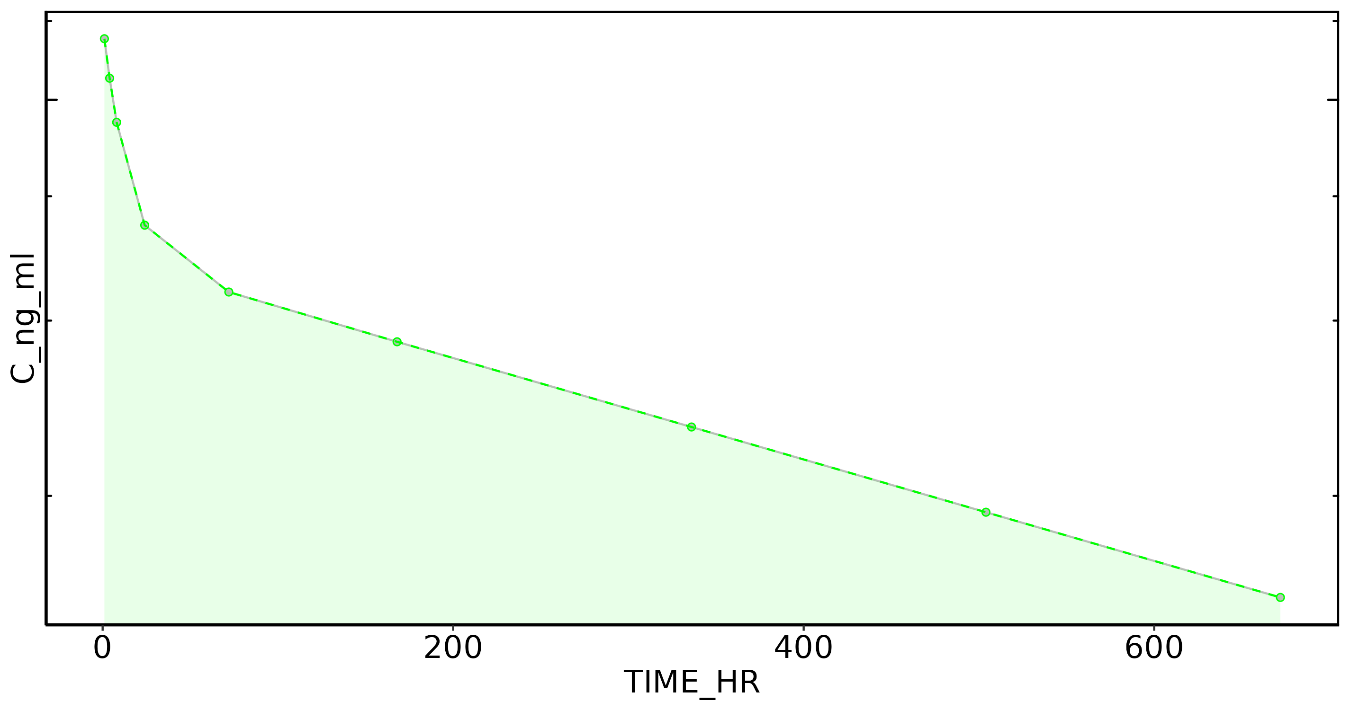
Subject: 4

Slide 11
Subject: 5, Dose: 1
Nobs: 9
Dose: 30.00
Dose (CU): 3.00e+07
Cmax: 6.46e+03
C0 Extrap: NA
Tmax: 1.00
Half-life: 573.57
Time interval: 1 - 671.9999
Vp (obs): 4.65e+03
Vss (obs): 7.30e+03
Vss (pred): 7.30e+03
CL (obs): 8.90
CL (pred): 8.90
AUC last: 1.89e+06
AUC (inf,pred): 3.37e+06
AUC (inf,obs): 3.37e+06

Slide 12
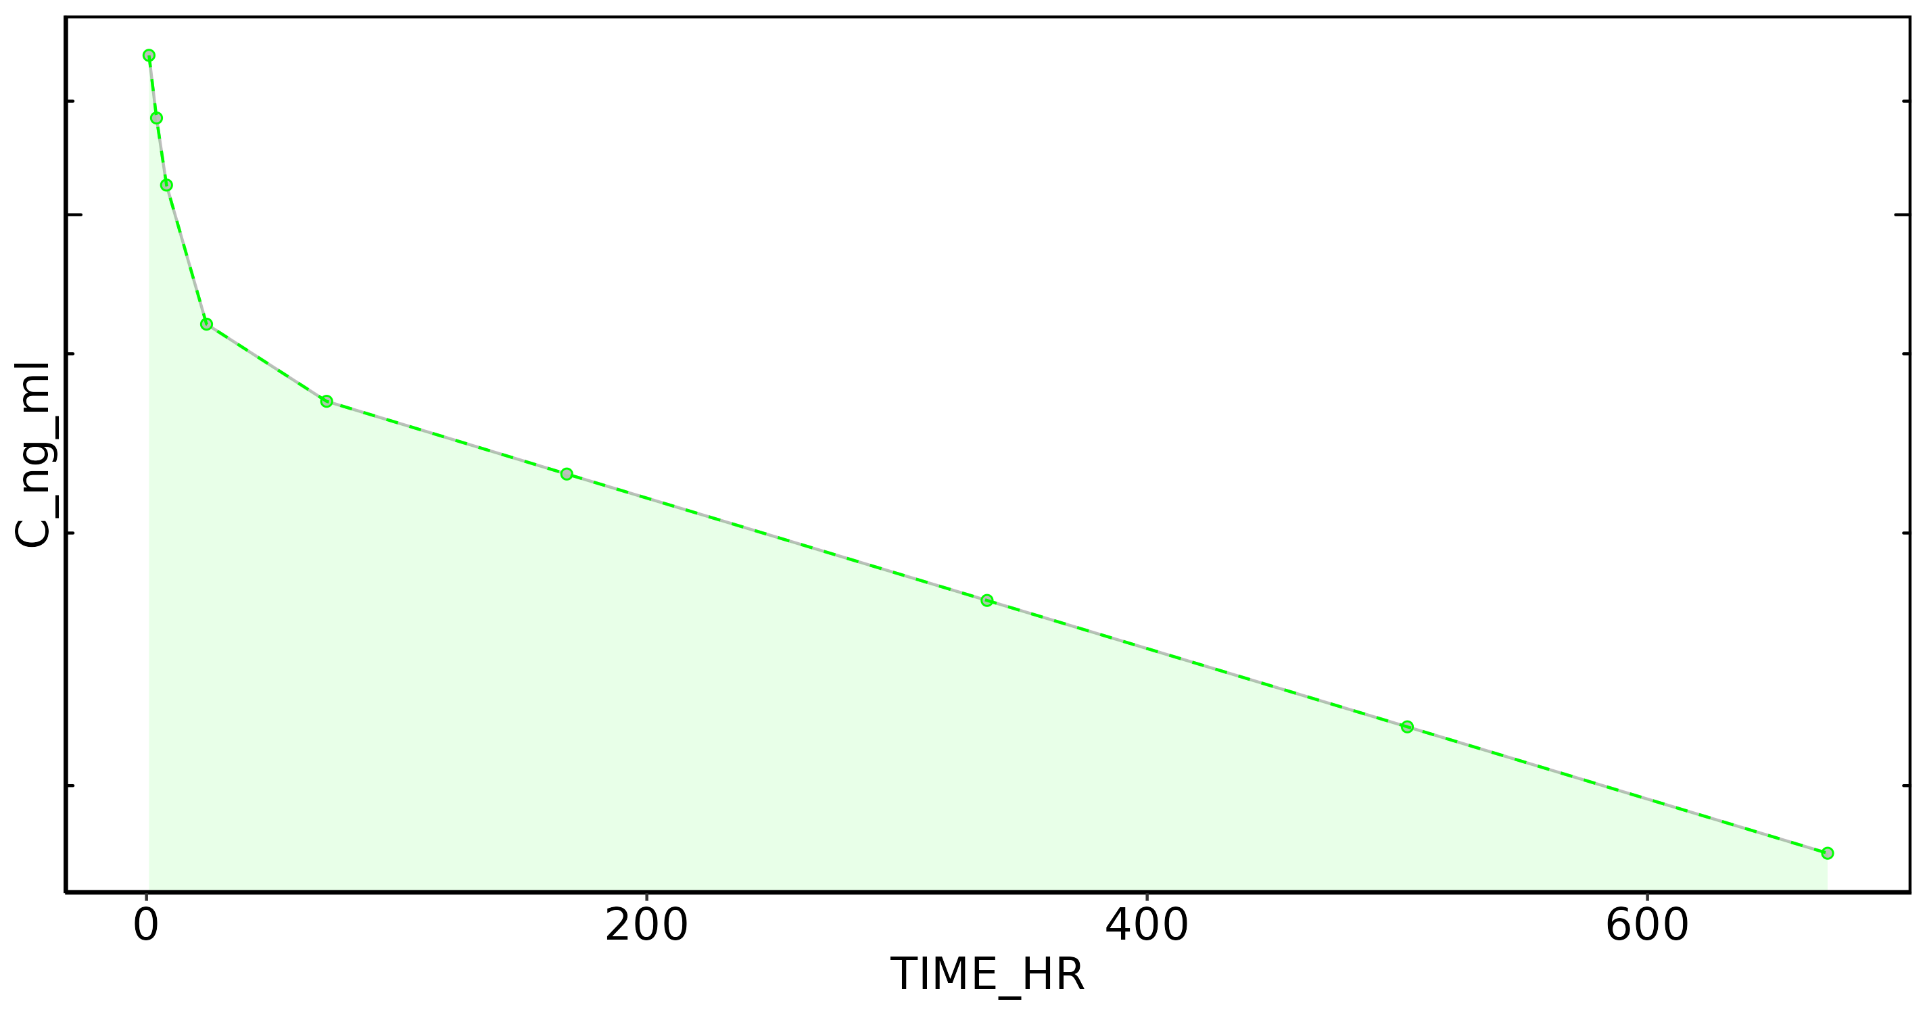
Subject: 5

Slide 13
Subject: 6, Dose: 1
Nobs: 9
Dose: 30.00
Dose (CU): 3.00e+07
Cmax: 9.46e+03
C0 Extrap: NA
Tmax: 1.00
Half-life: 526.00
Time interval: 1 - 671.9999
Vp (obs): 3.17e+03
Vss (obs): 5.41e+03
Vss (pred): 5.41e+03
CL (obs): 7.32
CL (pred): 7.32
AUC last: 2.45e+06
AUC (inf,pred): 4.10e+06
AUC (inf,obs): 4.10e+06

Slide 14
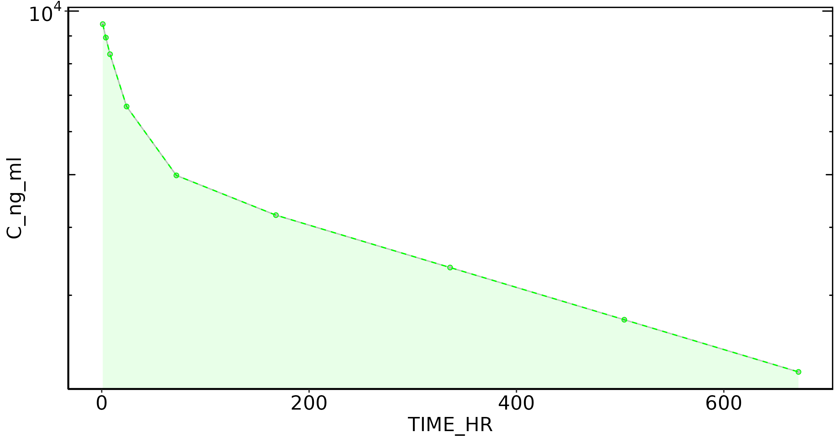
Subject: 6

Slide 15
Subject: 7, Dose: 1
Nobs: 9
Dose: 30.00
Dose (CU): 3.00e+07
Cmax: 1.38e+04
C0 Extrap: NA
Tmax: 1.00
Half-life: 627.42
Time interval: 1 - 671.9999
Vp (obs): 2.17e+03
Vss (obs): 4.38e+03
Vss (pred): 4.38e+03
CL (obs): 5.01
CL (pred): 5.01
AUC last: 3.23e+06
AUC (inf,pred): 5.99e+06
AUC (inf,obs): 5.99e+06

Slide 16
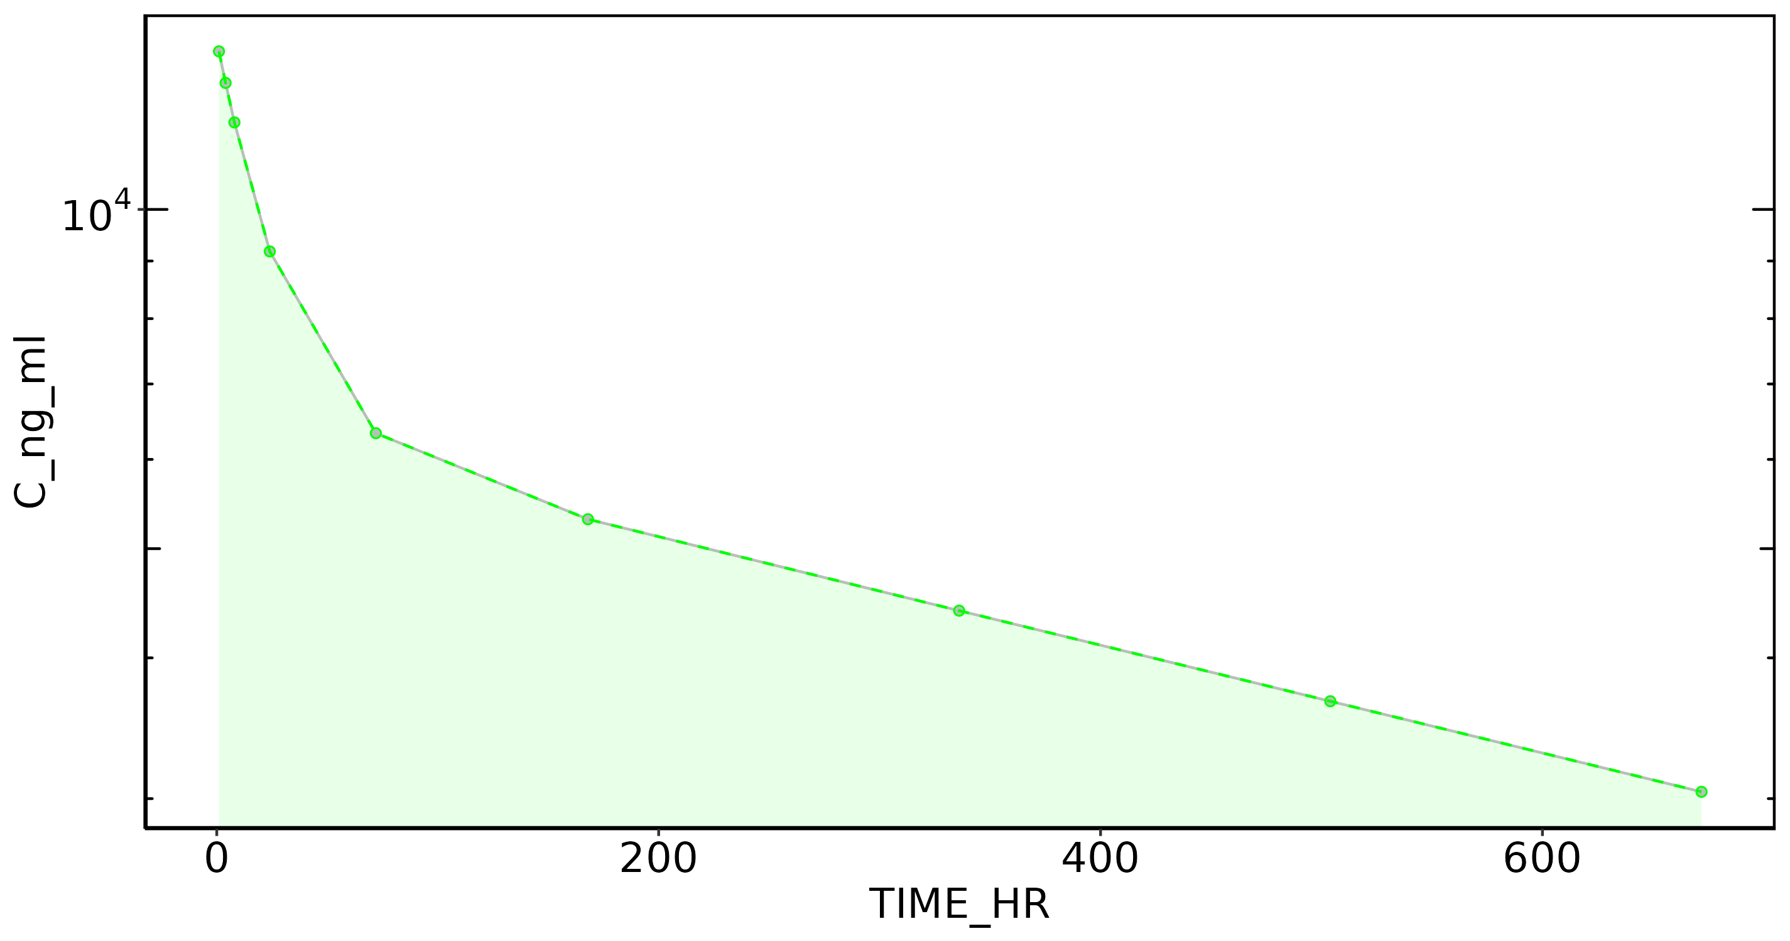
Subject: 7

Slide 17
Subject: 8, Dose: 1
Nobs: 9
Dose: 30.00
Dose (CU): 3.00e+07
Cmax: 7.16e+03
C0 Extrap: NA
Tmax: 1.00
Half-life: 567.44
Time interval: 1 - 671.9999
Vp (obs): 4.19e+03
Vss (obs): 6.91e+03
Vss (pred): 6.91e+03
CL (obs): 8.97
CL (pred): 8.97
AUC last: 1.97e+06
AUC (inf,pred): 3.34e+06
AUC (inf,obs): 3.34e+06

Slide 18
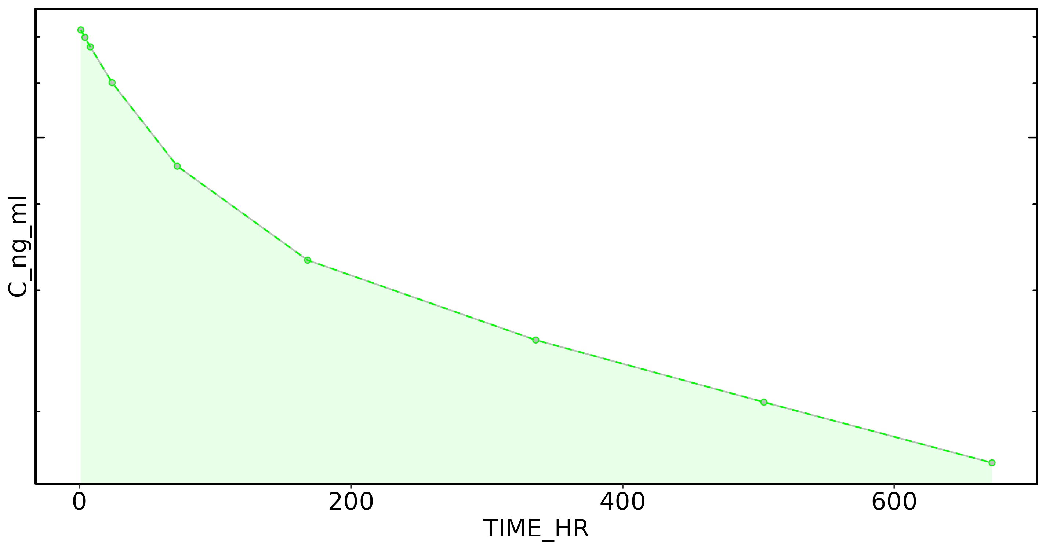
Subject: 8

Slide 19
Subject: 9, Dose: 1
Nobs: 9
Dose: 30.00
Dose (CU): 3.00e+07
Cmax: 9.18e+03
C0 Extrap: NA
Tmax: 1.00
Half-life: 561.36
Time interval: 1 - 671.9999
Vp (obs): 3.27e+03
Vss (obs): 6.12e+03
Vss (pred): 6.12e+03
CL (obs): 8.40
CL (pred): 8.41
AUC last: 2.18e+06
AUC (inf,pred): 3.57e+06
AUC (inf,obs): 3.57e+06

Slide 20
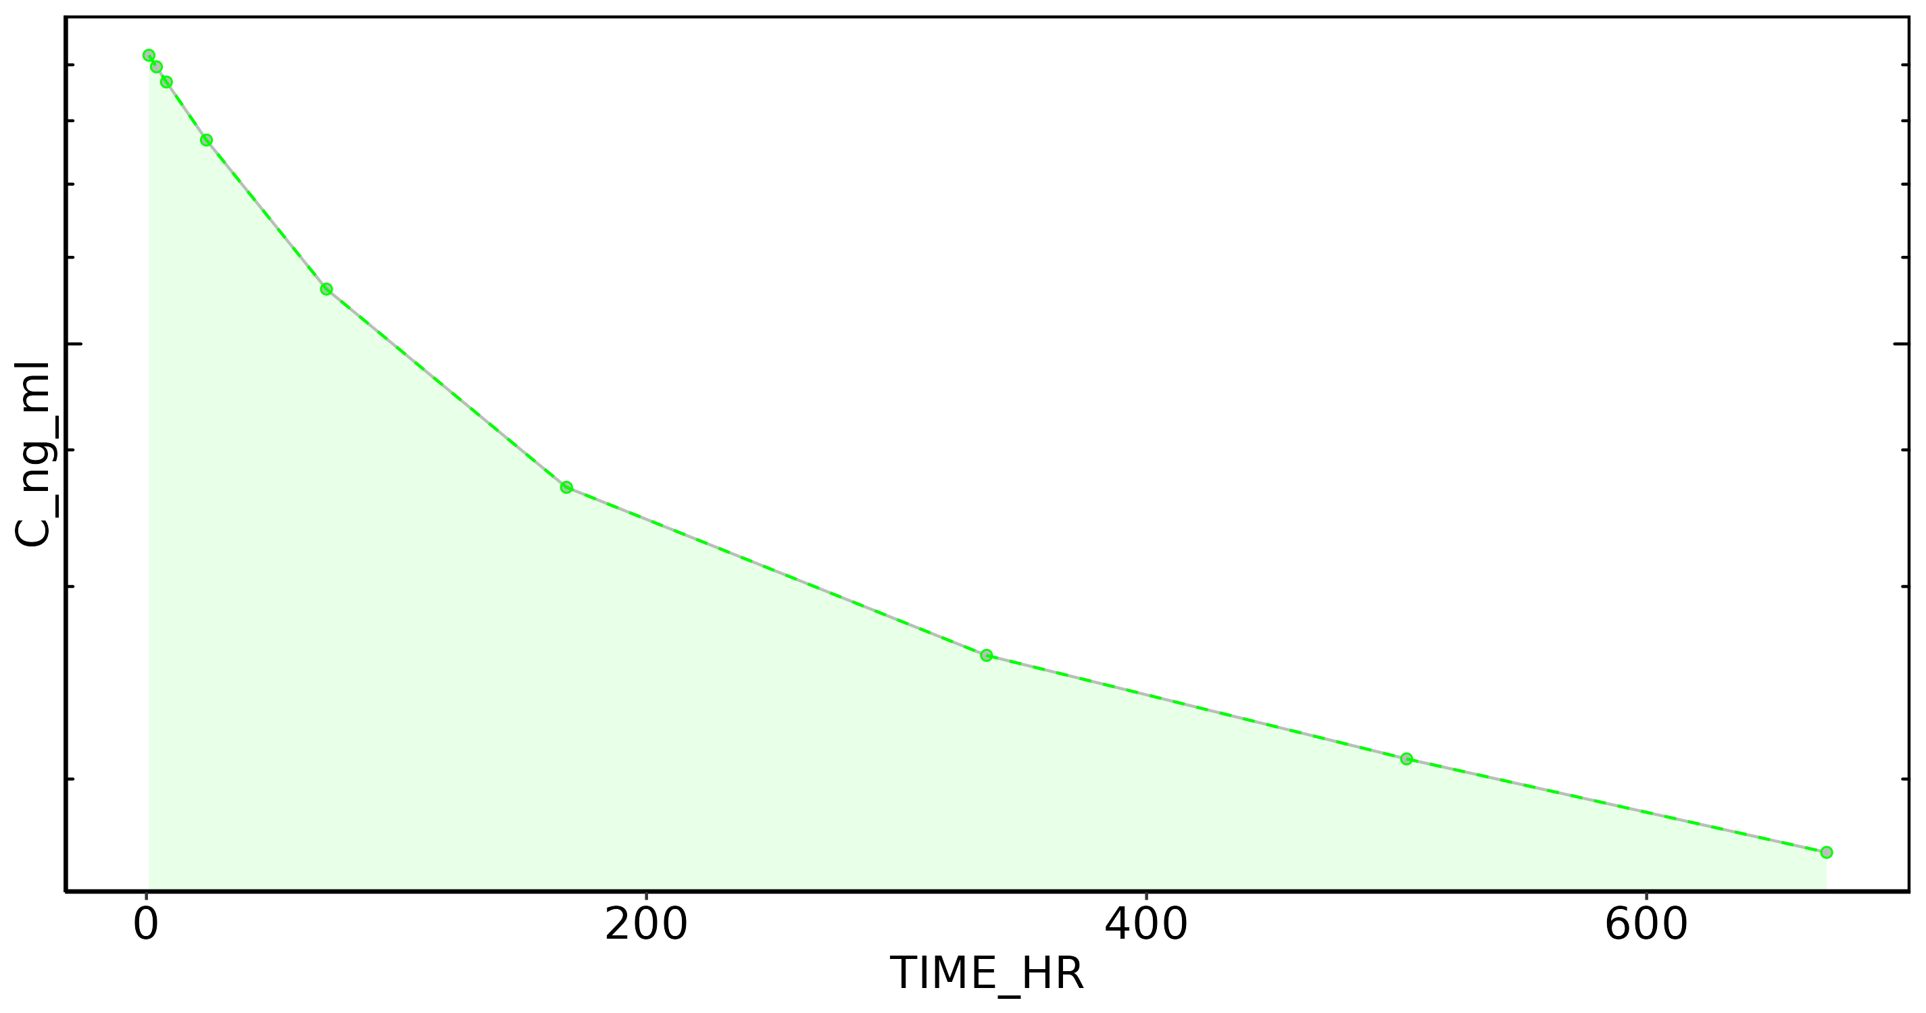
Subject: 9

Slide 21
Subject: 10, Dose: 1
Nobs: 9
Dose: 30.00
Dose (CU): 3.00e+07
Cmax: 4.76e+03
C0 Extrap: NA
Tmax: 1.00
Half-life: 499.57
Time interval: 1 - 671.9999
Vp (obs): 6.30e+03
Vss (obs): 1.02e+04
Vss (pred): 1.02e+04
CL (obs): 15.49
CL (pred): 15.51
AUC last: 1.25e+06
AUC (inf,pred): 1.93e+06
AUC (inf,obs): 1.94e+06

Slide 22
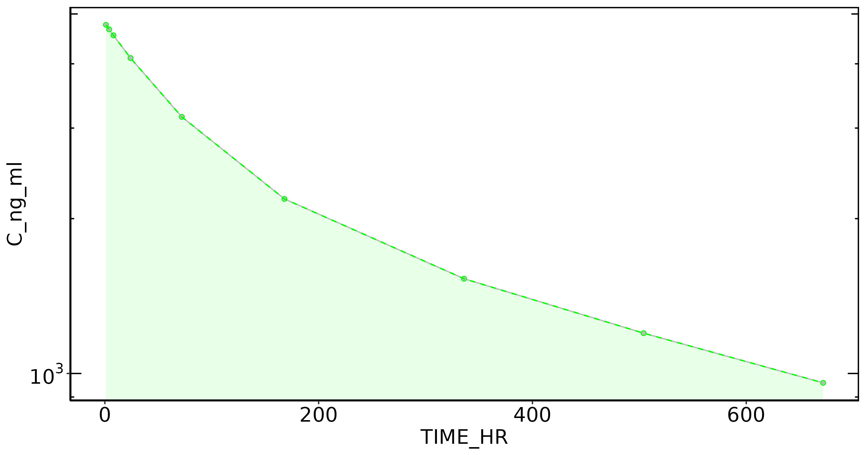
Subject: 10

Slide 23
Subject: 11, Dose: 1
Nobs: 9
Dose: 30.00
Dose (CU): 3.00e+07
Cmax: 4.67e+03
C0 Extrap: NA
Tmax: 1.00
Half-life: 598.79
Time interval: 1 - 671.9999
Vp (obs): 6.43e+03
Vss (obs): 8.57e+03
Vss (pred): 8.57e+03
CL (obs): 10.14
CL (pred): 10.14
AUC last: 1.63e+06
AUC (inf,pred): 2.96e+06
AUC (inf,obs): 2.96e+06

Slide 24
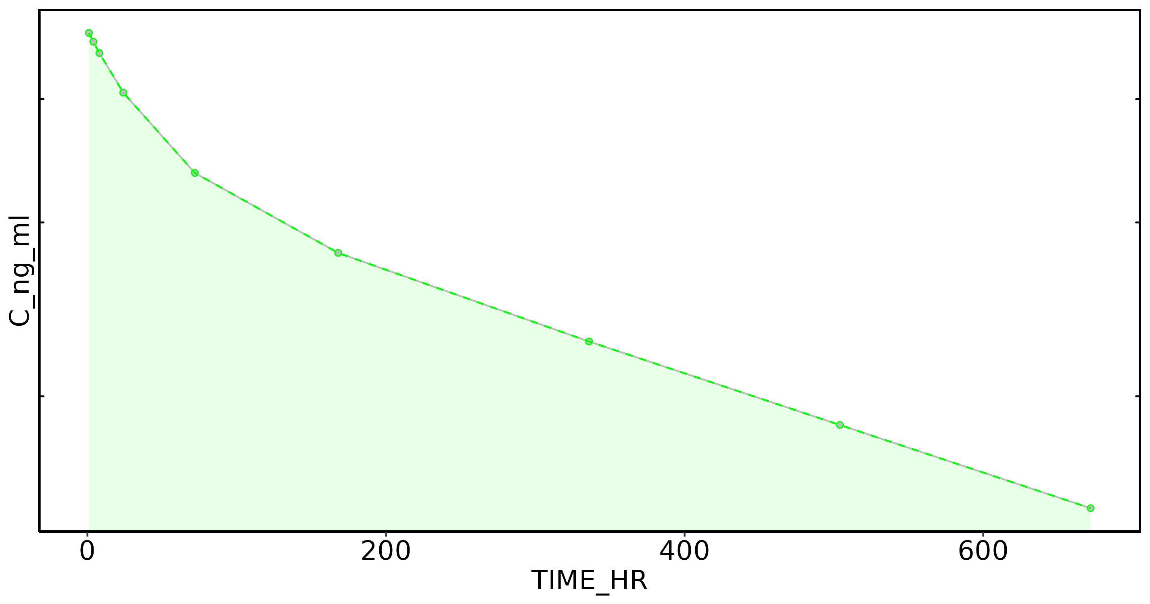
Subject: 11

Slide 25
Subject: 12, Dose: 1
Nobs: 9
Dose: 30.00
Dose (CU): 3.00e+07
Cmax: 1.21e+04
C0 Extrap: NA
Tmax: 1.00
Half-life: 545.91
Time interval: 1 - 671.9999
Vp (obs): 2.47e+03
Vss (obs): 4.98e+03
Vss (pred): 4.98e+03
CL (obs): 7.25
CL (pred): 7.26
AUC last: 2.62e+06
AUC (inf,pred): 4.13e+06
AUC (inf,obs): 4.14e+06

Slide 26
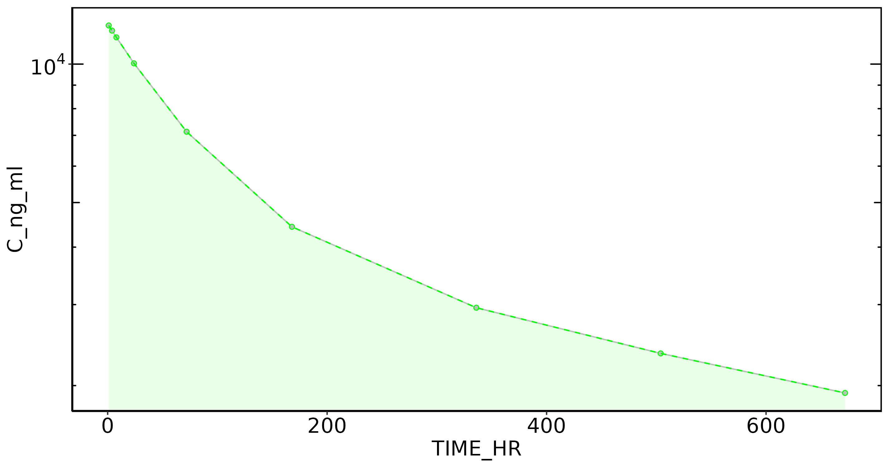
Subject: 12

Slide 27
Subject: 13, Dose: 1
Nobs: 9
Dose: 30.00
Dose (CU): 3.00e+07
Cmax: 6.38e+03
C0 Extrap: NA
Tmax: 1.00
Half-life: 581.37
Time interval: 1 - 671.9999
Vp (obs): 4.70e+03
Vss (obs): 6.90e+03
Vss (pred): 6.90e+03
CL (obs): 8.29
CL (pred): 8.30
AUC last: 2.01e+06
AUC (inf,pred): 3.62e+06
AUC (inf,obs): 3.62e+06

Slide 28
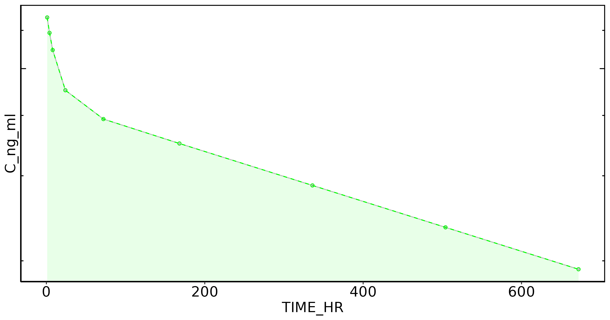
Subject: 13

Slide 29
Subject: 14, Dose: 1
Nobs: 9
Dose: 30.00
Dose (CU): 3.00e+07
Cmax: 5.13e+03
C0 Extrap: NA
Tmax: 1.00
Half-life: 549.25
Time interval: 1 - 671.9999
Vp (obs): 5.85e+03
Vss (obs): 8.35e+03
Vss (pred): 8.35e+03
CL (obs): 10.72
CL (pred): 10.72
AUC last: 1.62e+06
AUC (inf,pred): 2.80e+06
AUC (inf,obs): 2.80e+06

Slide 30

Subject: 14

Slide 31
Subject: 15, Dose: 1
Nobs: 9
Dose: 30.00
Dose (CU): 3.00e+07
Cmax: 4.91e+03
C0 Extrap: NA
Tmax: 1.00
Half-life: 750.63
Time interval: 1 - 671.9999
Vp (obs): 6.11e+03
Vss (obs): 7.98e+03
Vss (pred): 7.98e+03
CL (obs): 7.51
CL (pred): 7.52
AUC last: 1.89e+06
AUC (inf,pred): 3.99e+06
AUC (inf,obs): 3.99e+06

Slide 32

Subject: 15

Slide 33
Subject: 16, Dose: 1
Nobs: 9
Dose: 30.00
Dose (CU): 3.00e+07
Cmax: 7.58e+03
C0 Extrap: NA
Tmax: 1.00
Half-life: 619.32
Time interval: 1 - 671.9999
Vp (obs): 3.96e+03
Vss (obs): 8.60e+03
Vss (pred): 8.60e+03
CL (obs): 9.94
CL (pred): 9.94
AUC last: 1.64e+06
AUC (inf,pred): 3.02e+06
AUC (inf,obs): 3.02e+06

Slide 34
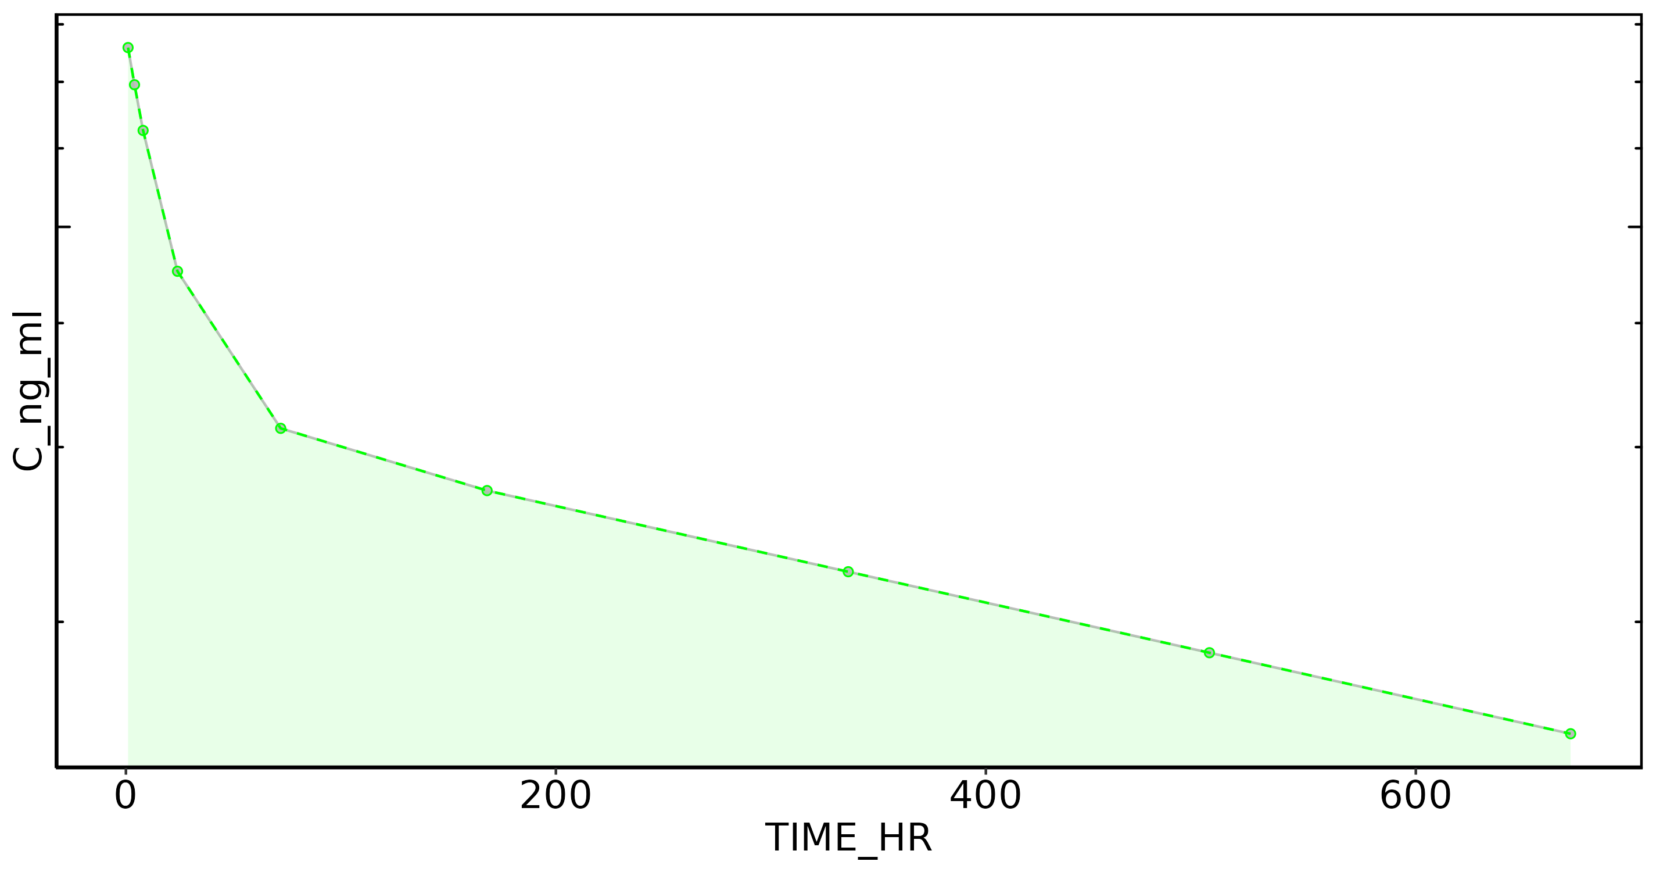
Subject: 16

Slide 35
Subject: 17, Dose: 1
Nobs: 9
Dose: 30.00
Dose (CU): 3.00e+07
Cmax: 1.02e+04
C0 Extrap: NA
Tmax: 1.00
Half-life: 507.27
Time interval: 1 - 671.9999
Vp (obs): 2.93e+03
Vss (obs): 5.18e+03
Vss (pred): 5.18e+03
CL (obs): 7.43
CL (pred): 7.43
AUC last: 2.50e+06
AUC (inf,pred): 4.04e+06
AUC (inf,obs): 4.04e+06

Slide 36
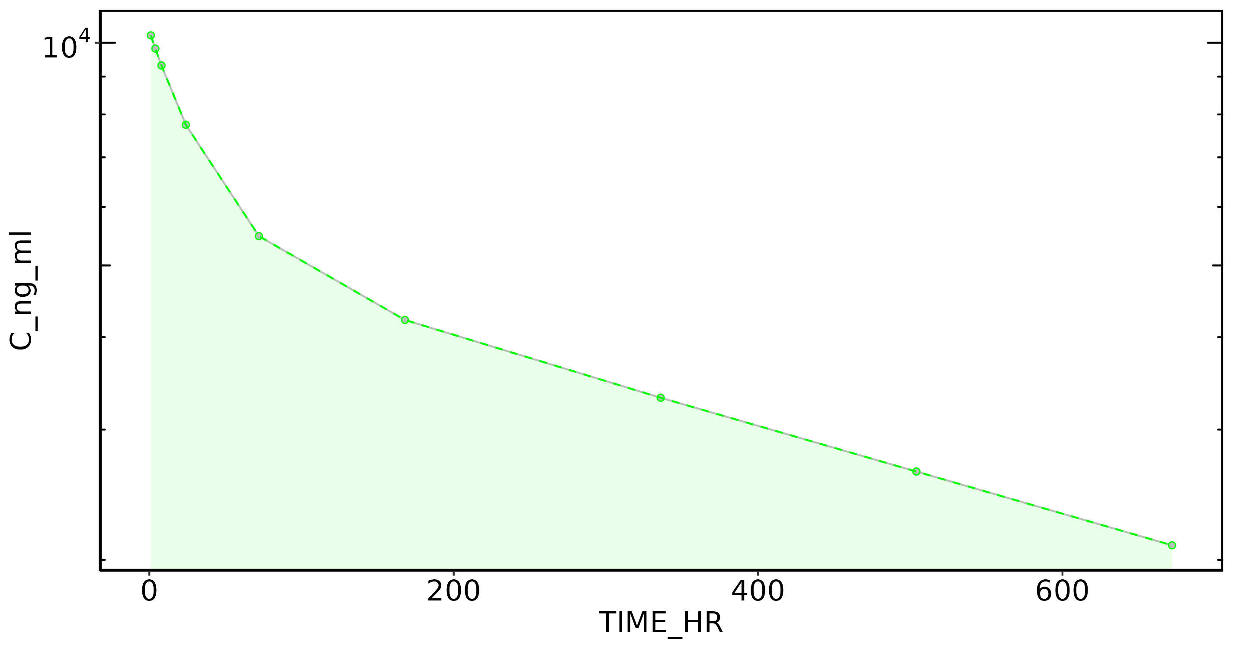
Subject: 17

Slide 37
Subject: 18, Dose: 1
Nobs: 9
Dose: 30.00
Dose (CU): 3.00e+07
Cmax: 1.06e+04
C0 Extrap: NA
Tmax: 1.00
Half-life: 639.33
Time interval: 1 - 671.9999
Vp (obs): 2.83e+03
Vss (obs): 4.90e+03
Vss (pred): 4.90e+03
CL (obs): 5.79
CL (pred): 5.80
AUC last: 2.90e+06
AUC (inf,pred): 5.17e+06
AUC (inf,obs): 5.18e+06

Slide 38

Subject: 18

Slide 39
Subject: 19, Dose: 1
Nobs: 9
Dose: 120.00
Dose (CU): 1.20e+08
Cmax: 1.57e+04
C0 Extrap: NA
Tmax: 72.00
Half-life: 347.71
Time interval: 1 - 671.9999
Vp (obs): NA
Vss (obs): 8.63e+03
Vss (pred): 8.61e+03
CL (obs): 18.41
CL (pred): 18.53
AUC last: 4.96e+06
AUC (inf,pred): 6.48e+06
AUC (inf,obs): 6.52e+06

Slide 40
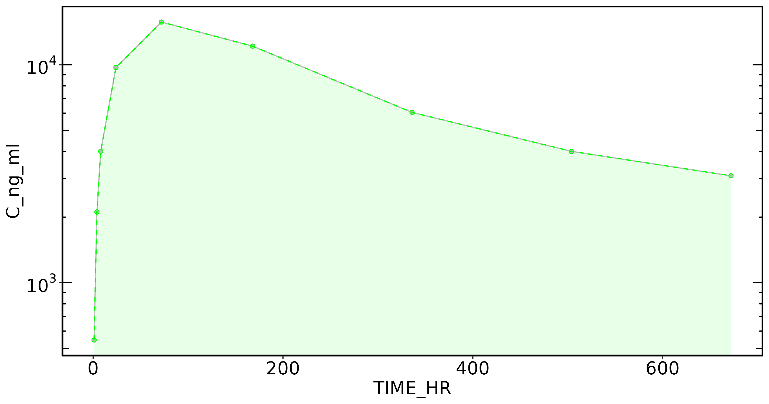
Subject: 19

Slide 41
Subject: 20, Dose: 1
Nobs: 9
Dose: 120.00
Dose (CU): 1.20e+08
Cmax: 1.30e+04
C0 Extrap: NA
Tmax: 168.00
Half-life: 498.66
Time interval: 1 - 671.9999
Vp (obs): NA
Vss (obs): 7.89e+03
Vss (pred): 7.89e+03
CL (obs): 10.08
CL (pred): 10.07
AUC last: 6.77e+06
AUC (inf,pred): 1.19e+07
AUC (inf,obs): 1.19e+07

Slide 42
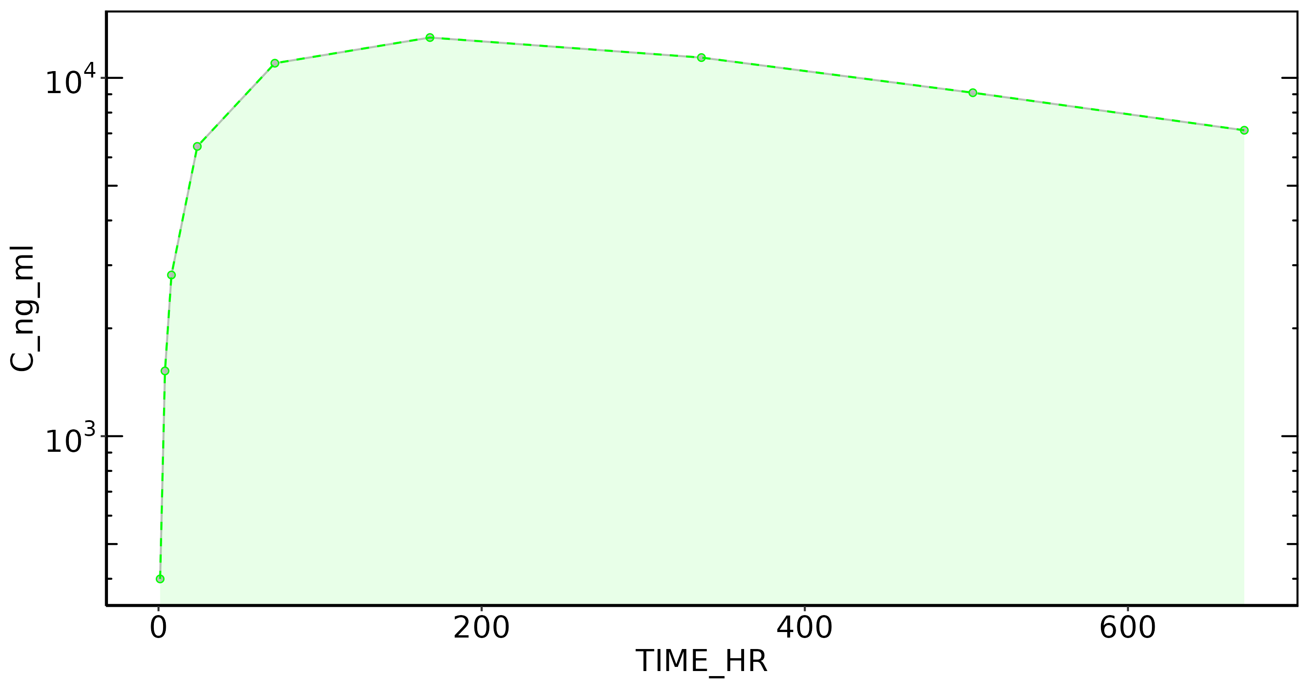
Subject: 20

Slide 43
Subject: 21, Dose: 1
Nobs: 9
Dose: 120.00
Dose (CU): 1.20e+08
Cmax: 1.51e+04
C0 Extrap: NA
Tmax: 72.00
Half-life: 459.79
Time interval: 1 - 671.9999
Vp (obs): NA
Vss (obs): 7.79e+03
Vss (pred): 7.79e+03
CL (obs): 11.52
CL (pred): 11.57
AUC last: 6.57e+06
AUC (inf,pred): 1.04e+07
AUC (inf,obs): 1.04e+07

Slide 44
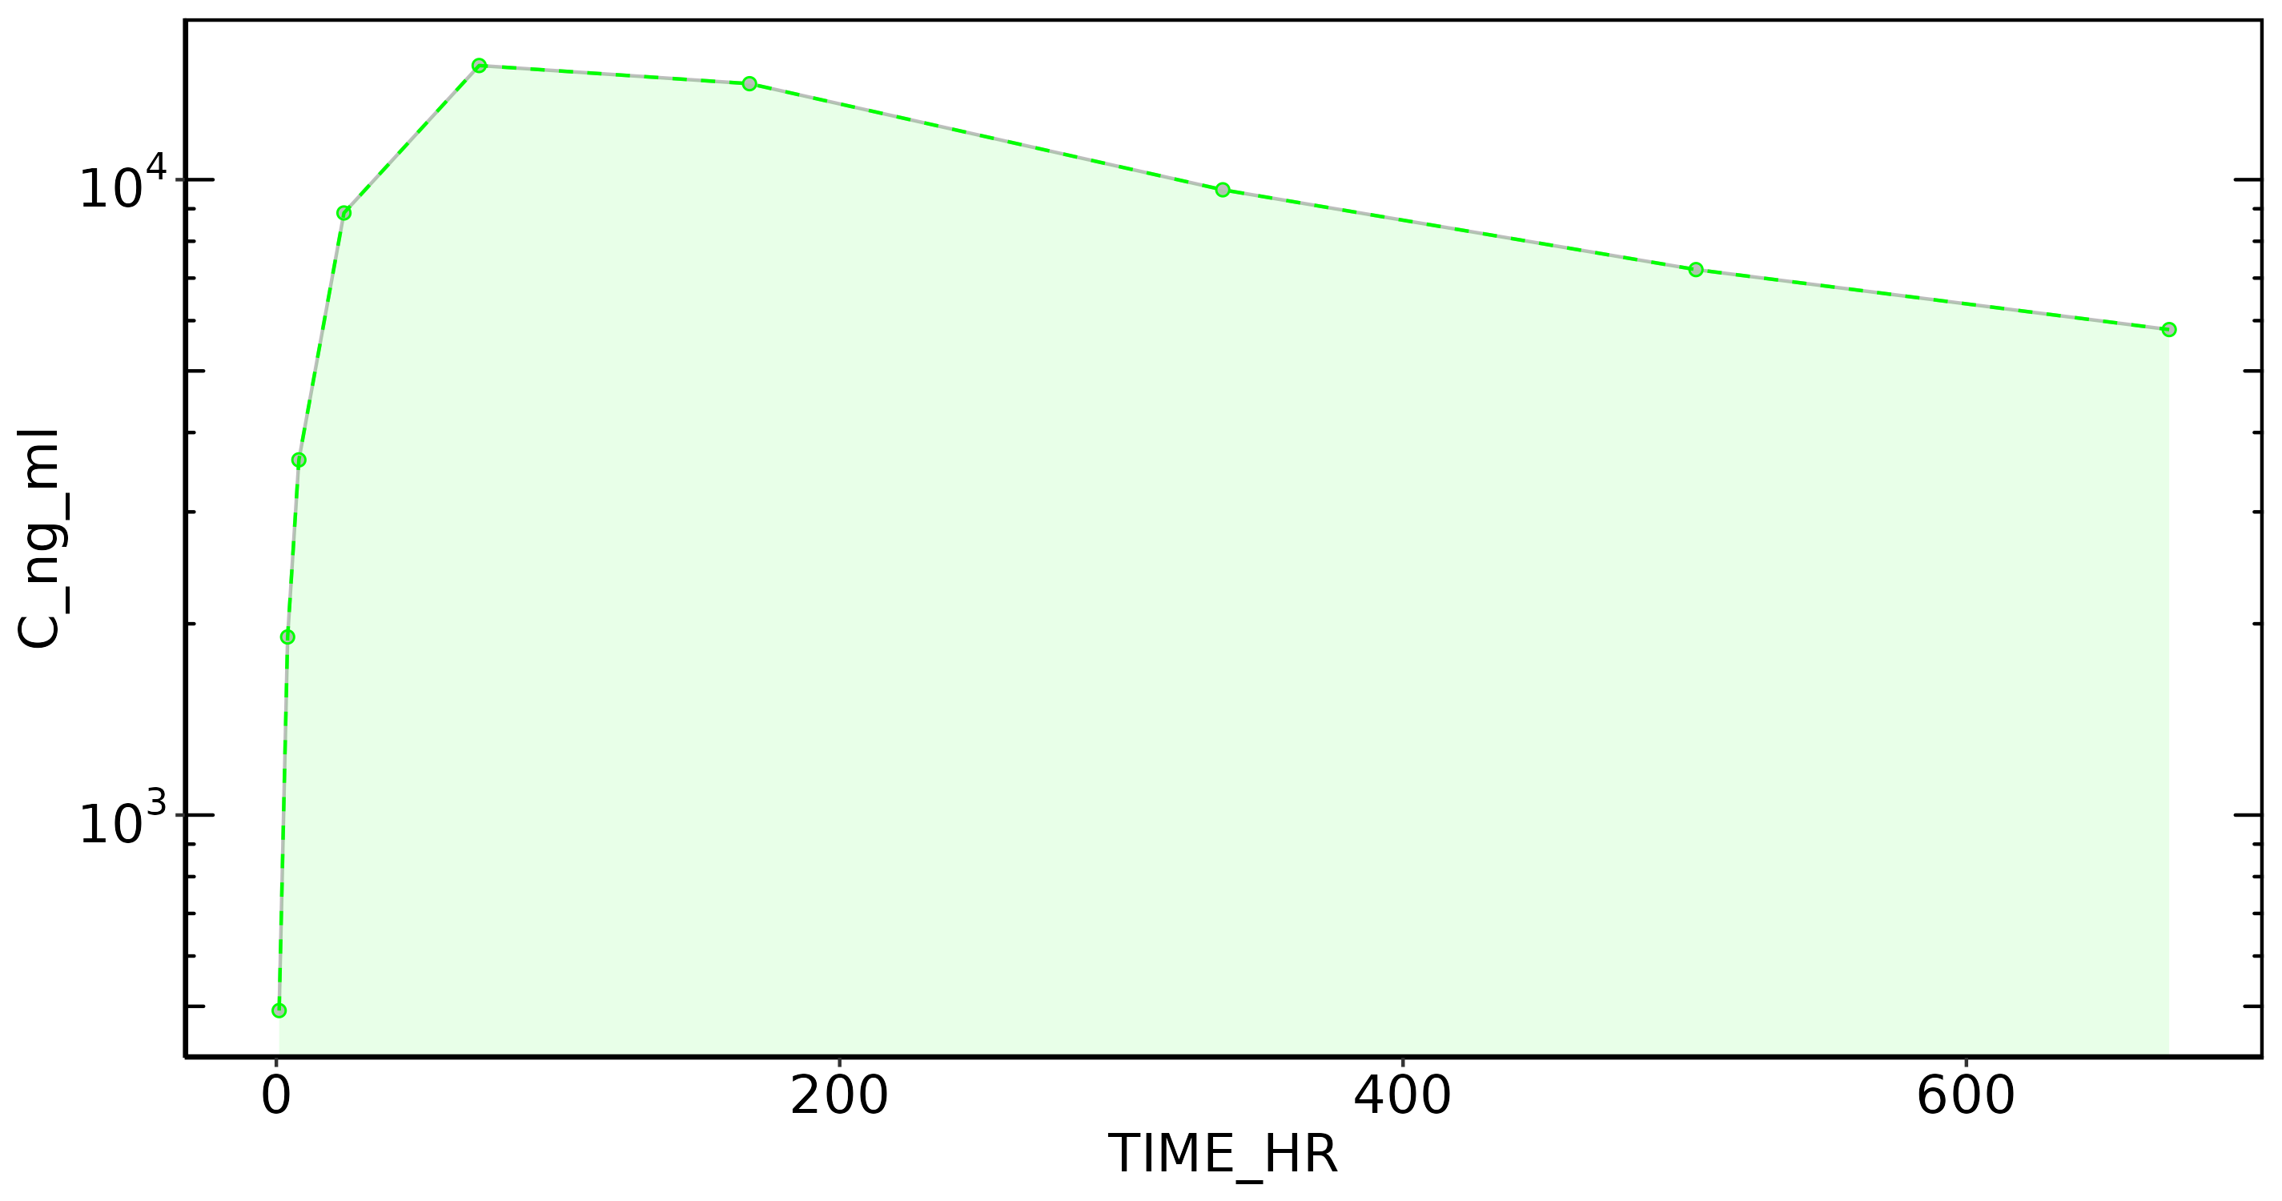
Subject: 21

Slide 45
Subject: 22, Dose: 1
Nobs: 9
Dose: 120.00
Dose (CU): 1.20e+08
Cmax: 7.48e+03
C0 Extrap: NA
Tmax: 336.00
Half-life: NA
Time interval: 1 - 671.9999
Vp (obs): NA
Vss (obs): NA
Vss (pred): NA
CL (obs): NA
CL (pred): NA
AUC last: 4.22e+06
AUC (inf,pred): NA
AUC (inf,obs): NA

Slide 46
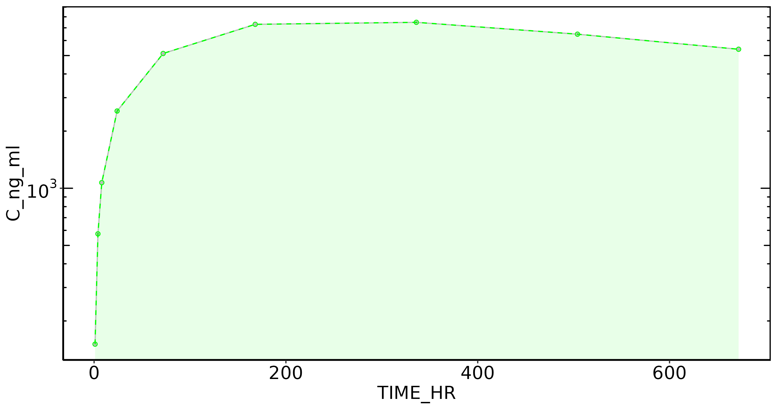
Subject: 22

Slide 47
Subject: 23, Dose: 1
Nobs: 9
Dose: 120.00
Dose (CU): 1.20e+08
Cmax: 9.30e+03
C0 Extrap: NA
Tmax: 168.00
Half-life: 608.98
Time interval: 1 - 671.9999
Vp (obs): NA
Vss (obs): 1.11e+04
Vss (pred): 1.11e+04
CL (obs): 11.70
CL (pred): 11.68
AUC last: 5.05e+06
AUC (inf,pred): 1.03e+07
AUC (inf,obs): 1.03e+07

Slide 48
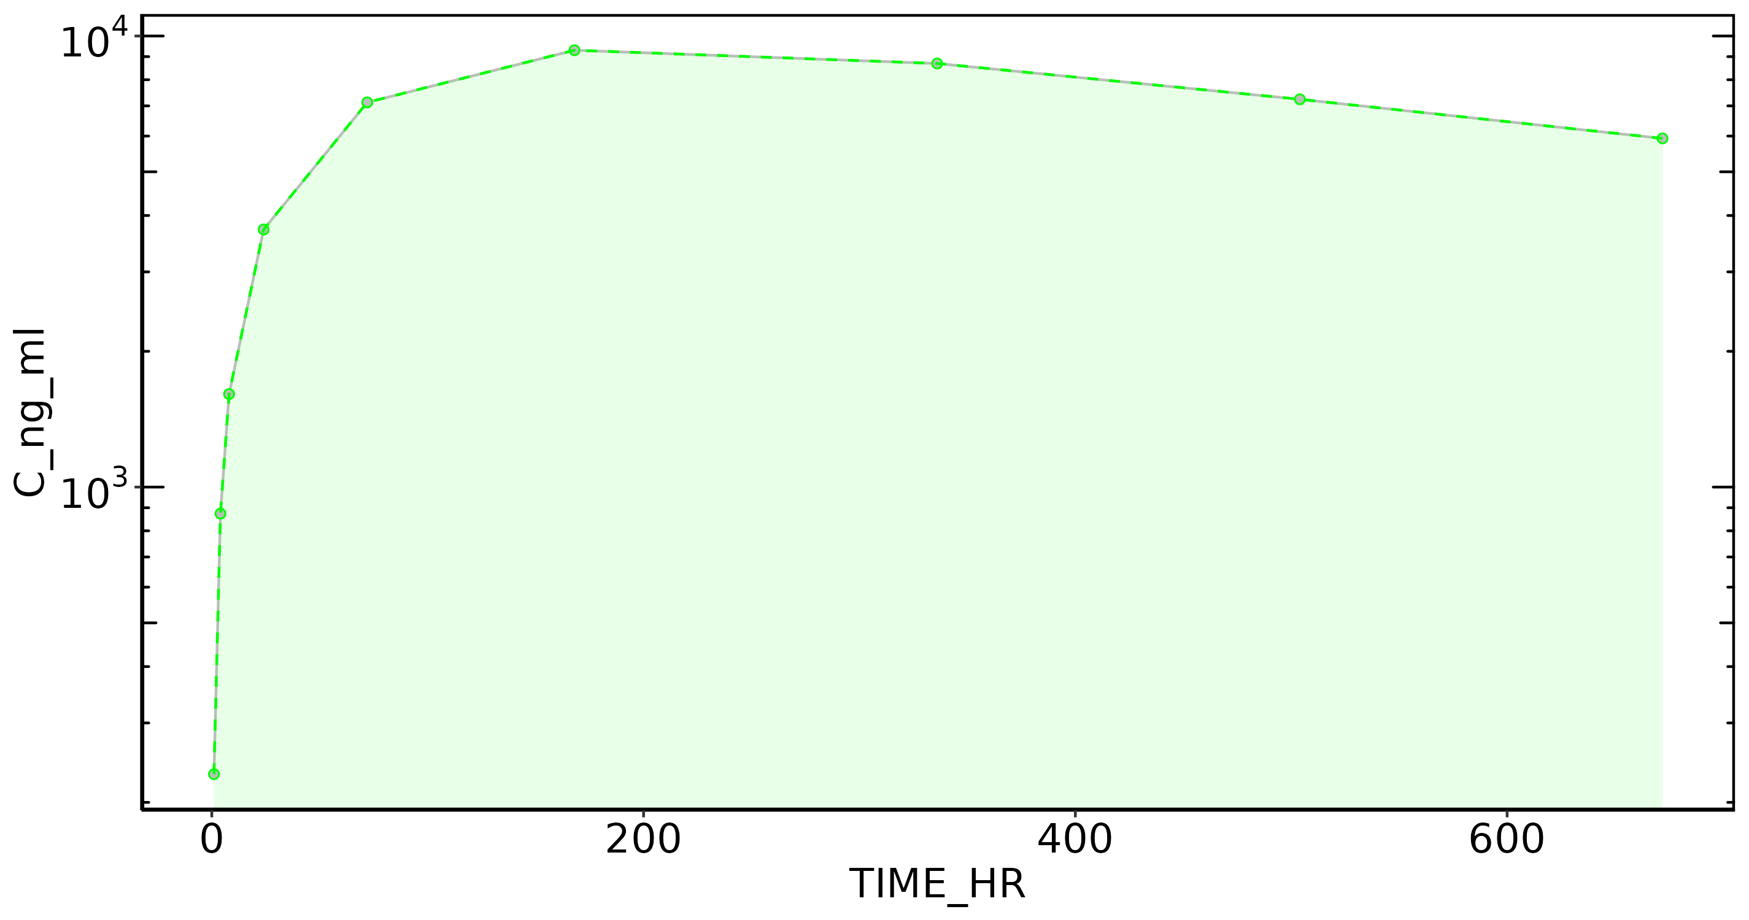
Subject: 23

Slide 49
Subject: 24, Dose: 1
Nobs: 9
Dose: 120.00
Dose (CU): 1.20e+08
Cmax: 1.32e+04
C0 Extrap: NA
Tmax: 168.00
Half-life: 528.19
Time interval: 1 - 671.9999
Vp (obs): NA
Vss (obs): 7.93e+03
Vss (pred): 7.93e+03
CL (obs): 9.90
CL (pred): 9.90
AUC last: 6.82e+06
AUC (inf,pred): 1.21e+07
AUC (inf,obs): 1.21e+07

Slide 50
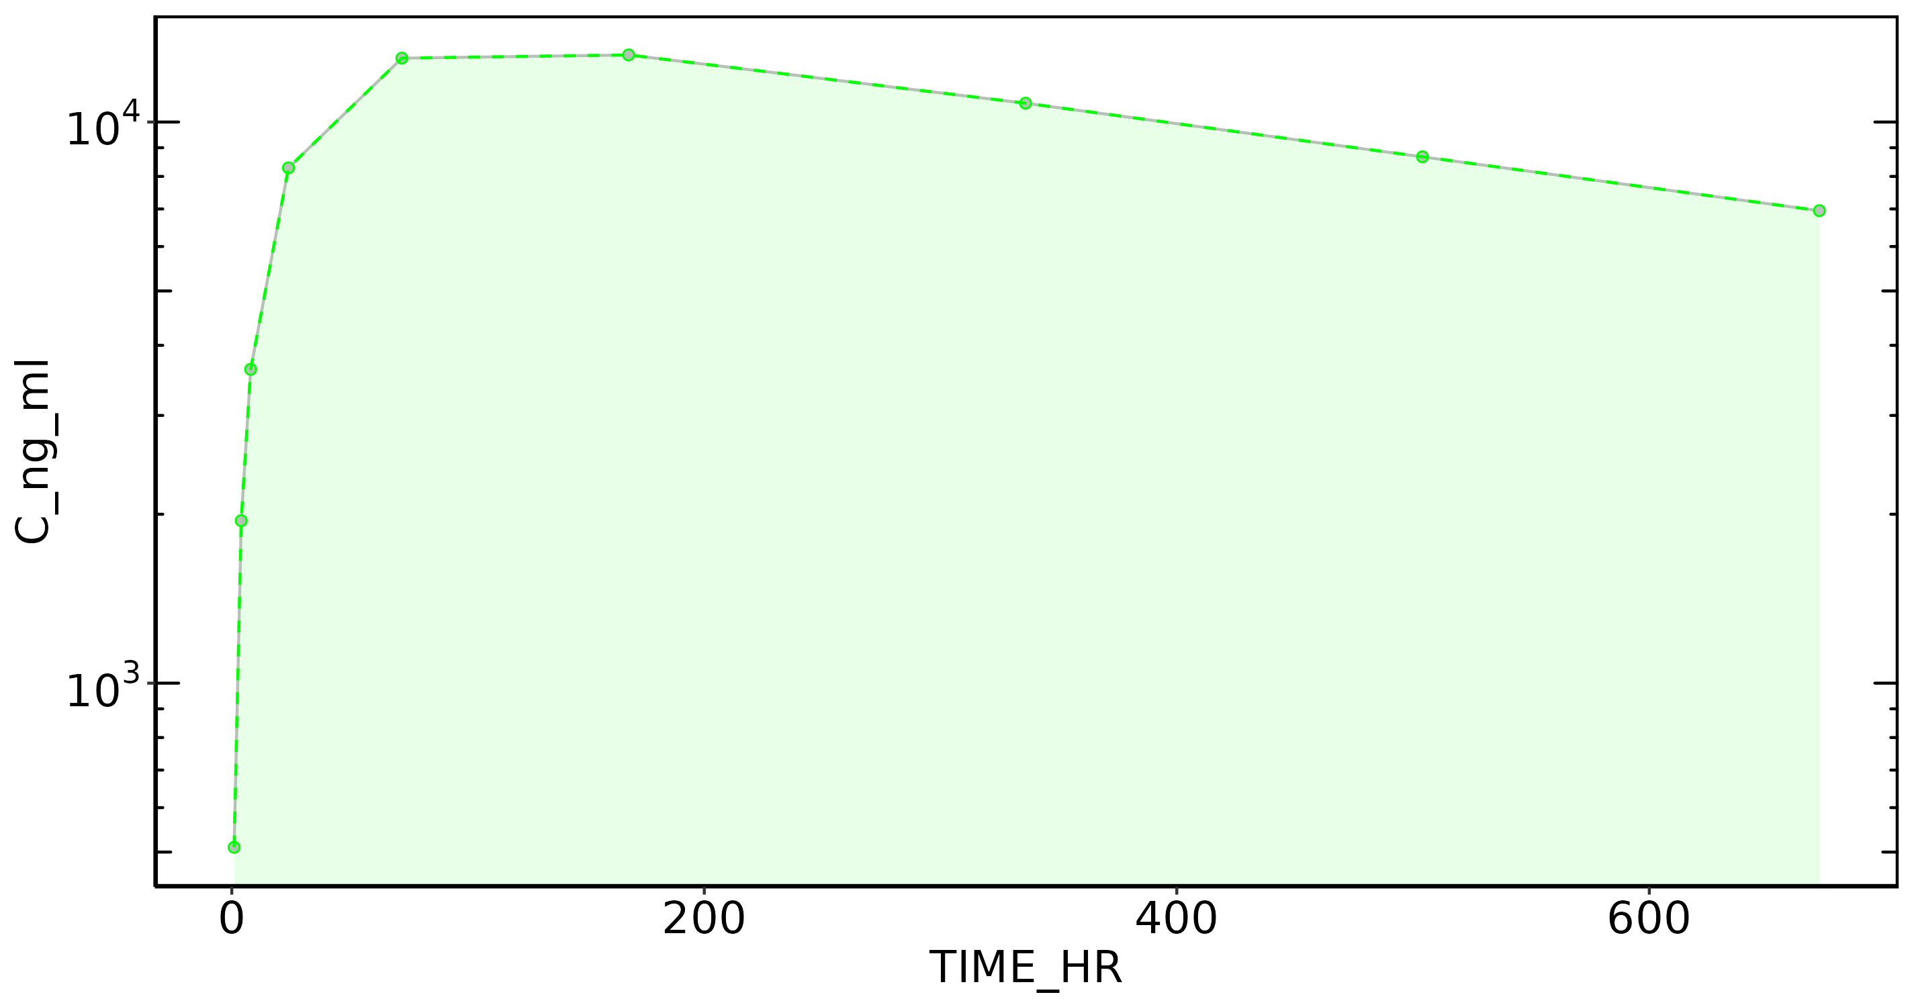
Subject: 24

Slide 51
Subject: 25, Dose: 1
Nobs: 9
Dose: 120.00
Dose (CU): 1.20e+08
Cmax: 1.92e+04
C0 Extrap: NA
Tmax: 72.00
Half-life: 628.70
Time interval: 1 - 671.9999
Vp (obs): NA
Vss (obs): 6.23e+03
Vss (pred): 6.23e+03
CL (obs): 6.77
CL (pred): 6.77
AUC last: 9.14e+06
AUC (inf,pred): 1.77e+07
AUC (inf,obs): 1.77e+07

Slide 52
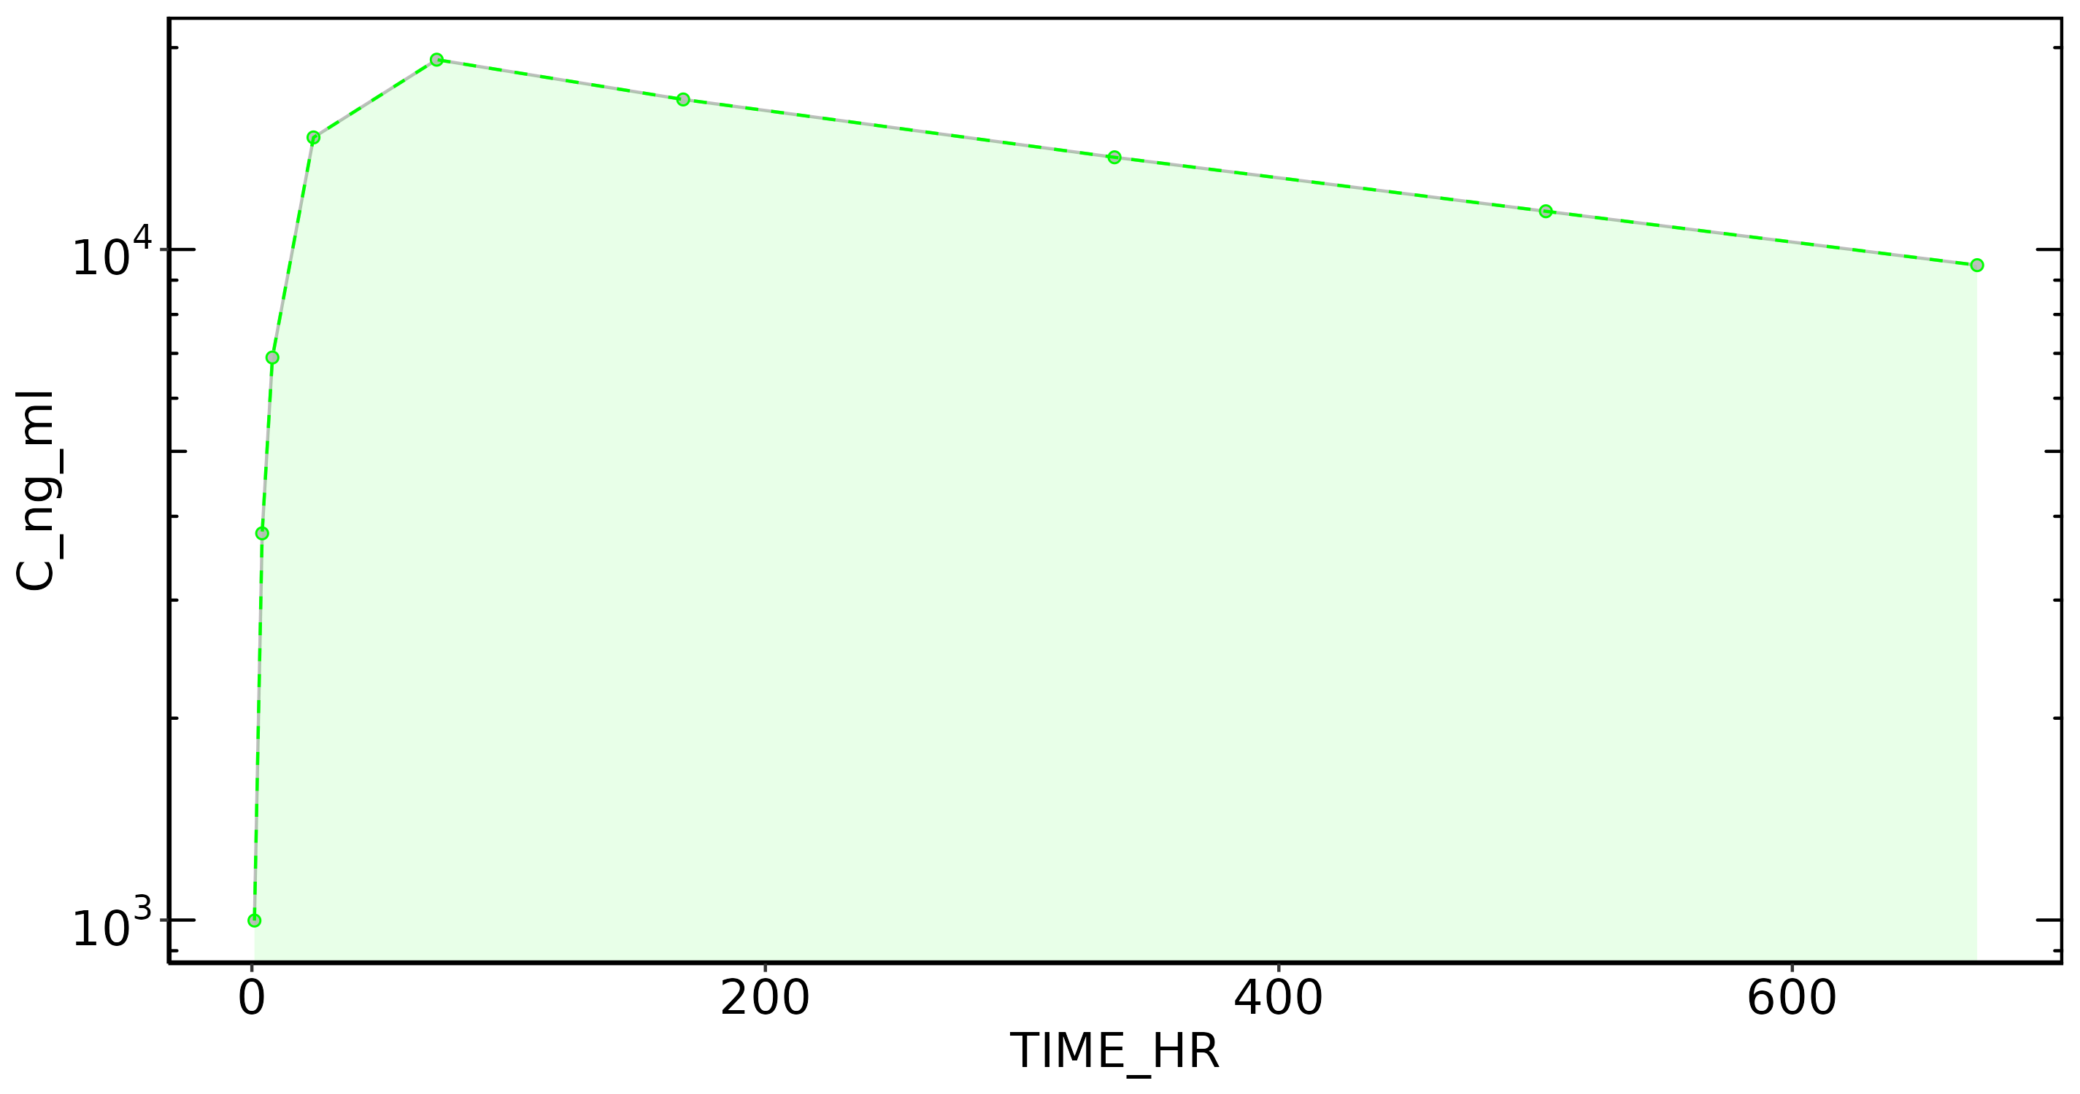
Subject: 25

Slide 53
Subject: 26, Dose: 1
Nobs: 9
Dose: 120.00
Dose (CU): 1.20e+08
Cmax: 1.06e+04
C0 Extrap: NA
Tmax: 168.00
Half-life: 548.32
Time interval: 1 - 671.9999
Vp (obs): NA
Vss (obs): 1.03e+04
Vss (pred): 1.04e+04
CL (obs): 12.37
CL (pred): 12.39
AUC last: 5.29e+06
AUC (inf,pred): 9.69e+06
AUC (inf,obs): 9.70e+06

Slide 54
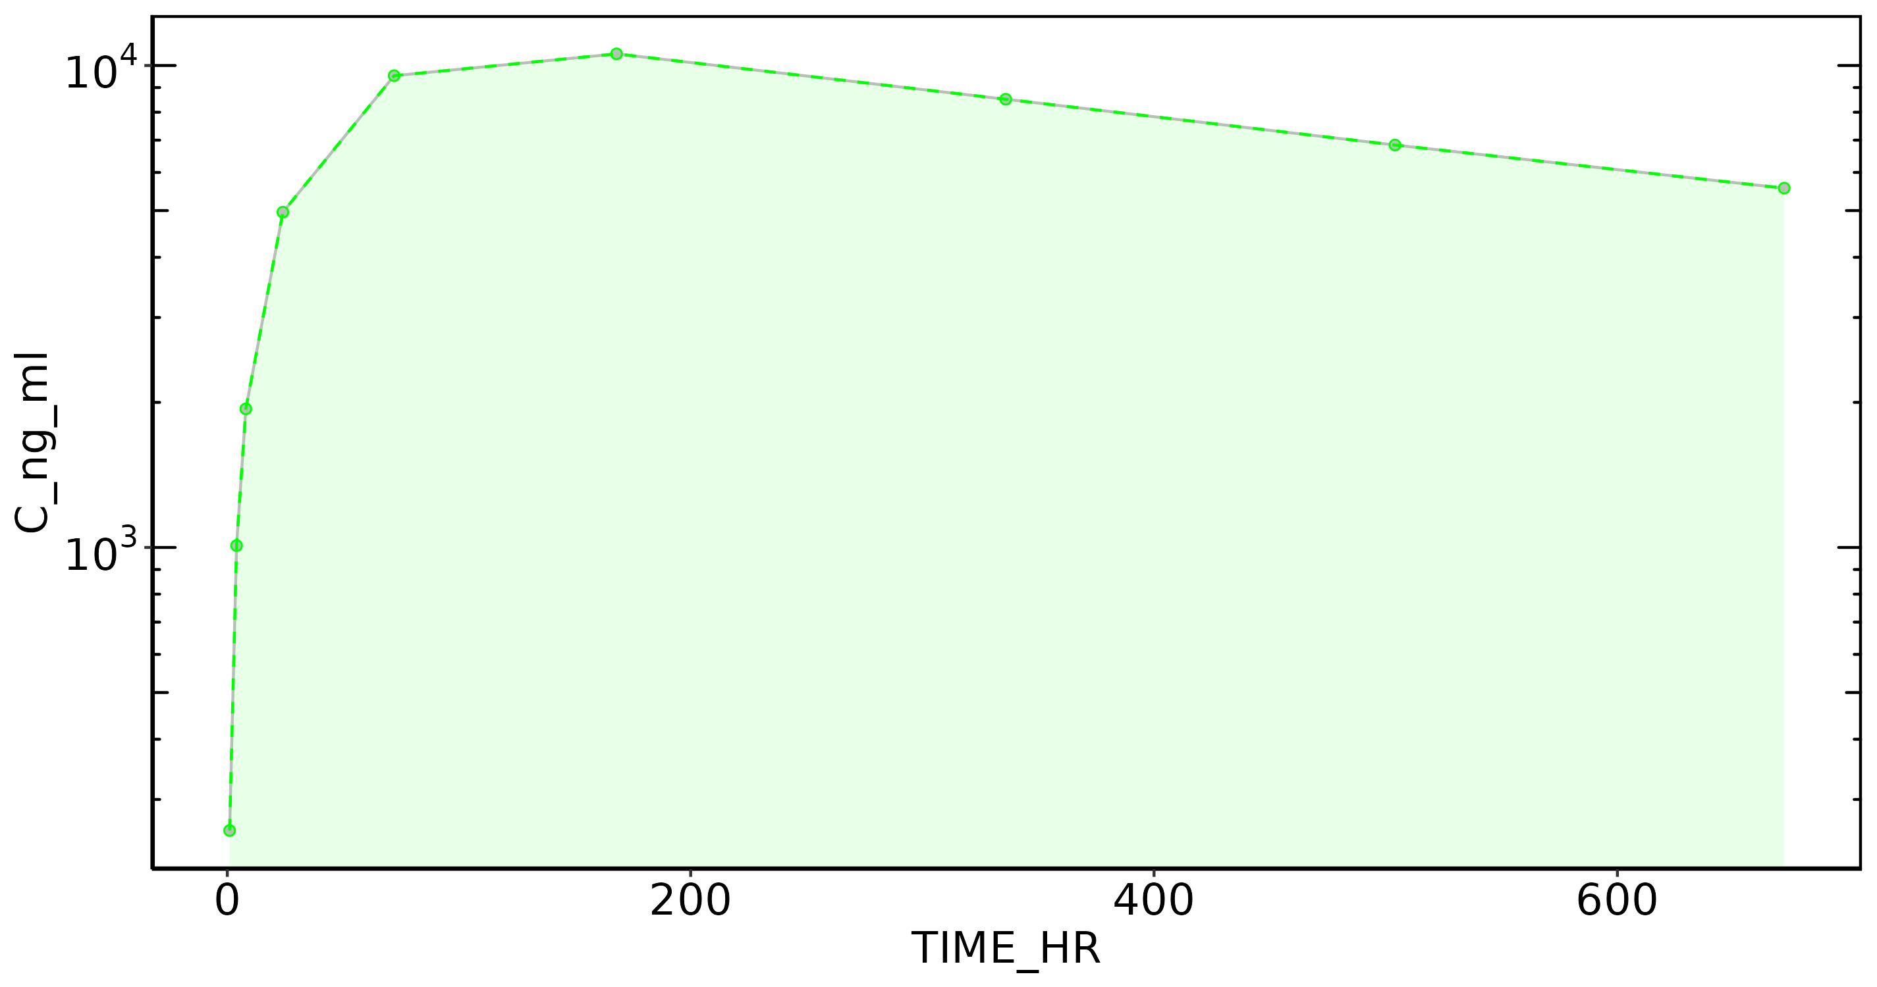
Subject: 26

Slide 55
Subject: 27, Dose: 1
Nobs: 9
Dose: 120.00
Dose (CU): 1.20e+08
Cmax: 1.25e+04
C0 Extrap: NA
Tmax: 168.00
Half-life: 490.90
Time interval: 1 - 671.9999
Vp (obs): NA
Vss (obs): 8.97e+03
Vss (pred): 8.97e+03
CL (obs): 12.11
CL (pred): 12.15
AUC last: 5.89e+06
AUC (inf,pred): 9.88e+06
AUC (inf,obs): 9.91e+06

Slide 56
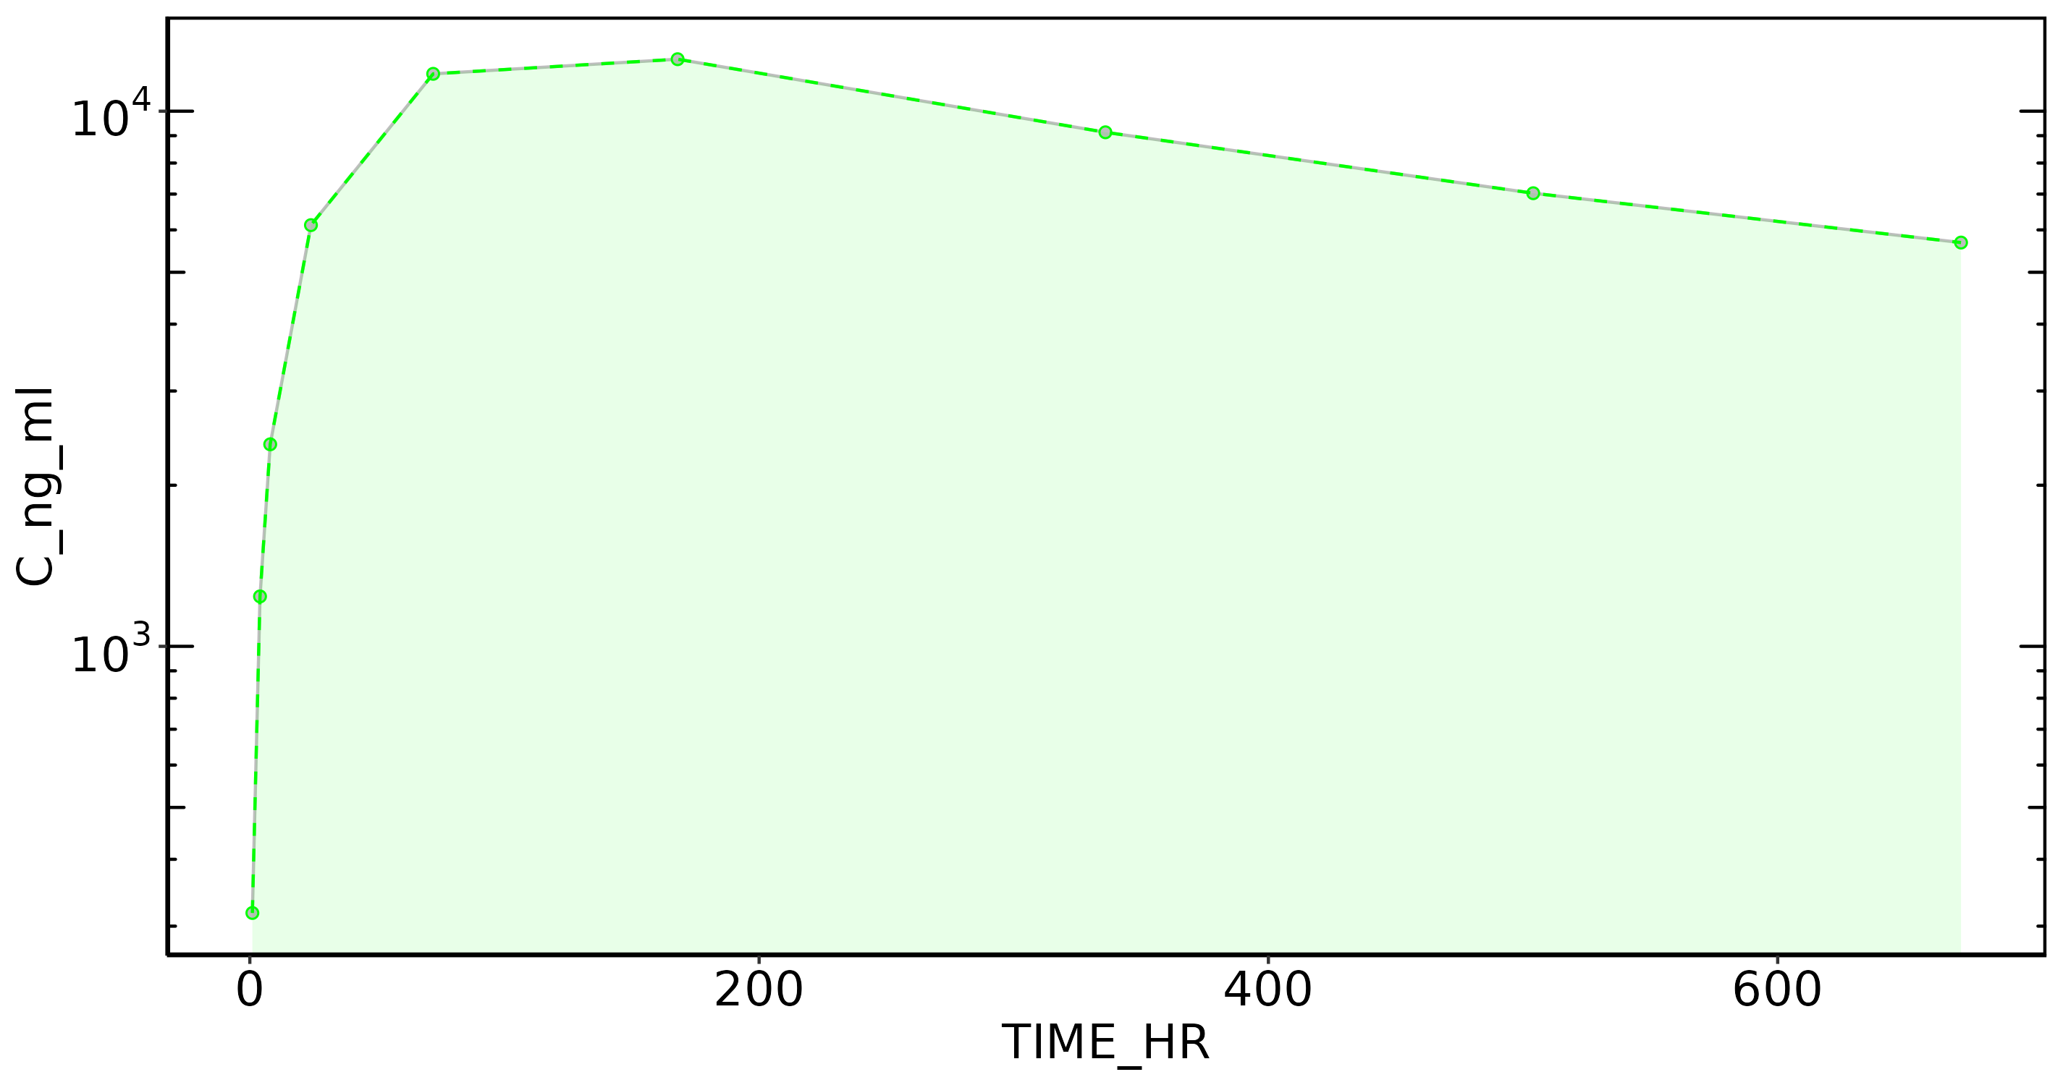
Subject: 27

Slide 57
Subject: 28, Dose: 1
Nobs: 9
Dose: 120.00
Dose (CU): 1.20e+08
Cmax: 5.87e+03
C0 Extrap: NA
Tmax: 168.00
Half-life: 550.59
Time interval: 1 - 671.9999
Vp (obs): NA
Vss (obs): 1.77e+04
Vss (pred): 1.77e+04
CL (obs): 20.27
CL (pred): 20.25
AUC last: 3.10e+06
AUC (inf,pred): 5.93e+06
AUC (inf,obs): 5.92e+06

Slide 58
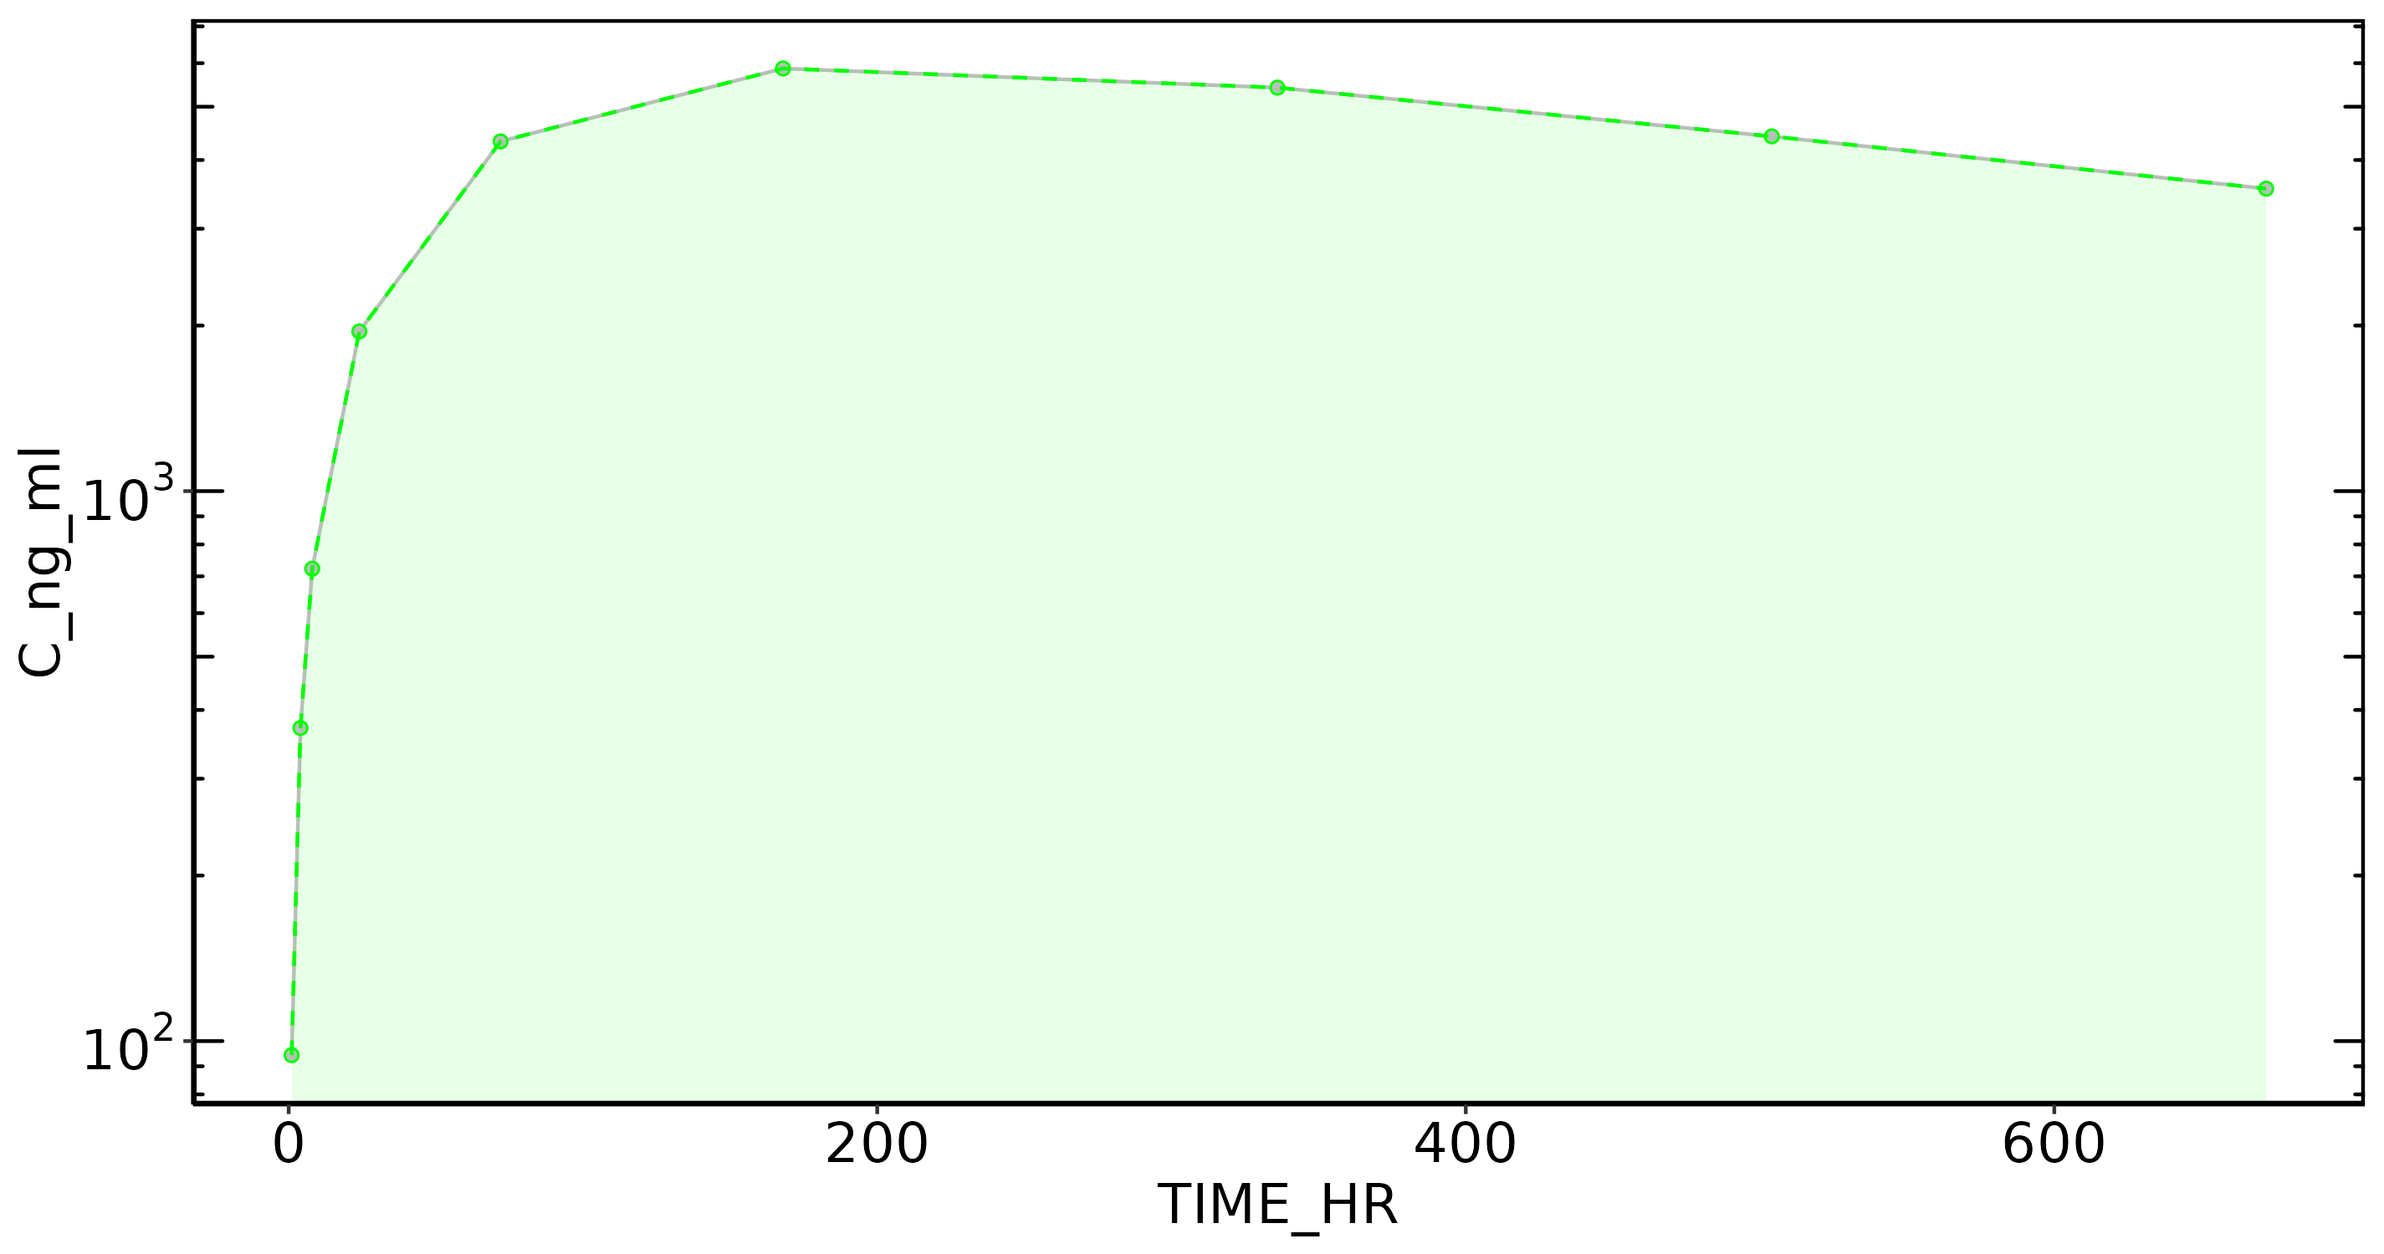
Subject: 28

Slide 59
Subject: 29, Dose: 1
Nobs: 9
Dose: 120.00
Dose (CU): 1.20e+08
Cmax: 8.25e+03
C0 Extrap: NA
Tmax: 168.00
Half-life: 616.00
Time interval: 1 - 671.9999
Vp (obs): NA
Vss (obs): 1.29e+04
Vss (pred): 1.29e+04
CL (obs): 13.54
CL (pred): 13.53
AUC last: 4.38e+06
AUC (inf,pred): 8.87e+06
AUC (inf,obs): 8.86e+06

Slide 60
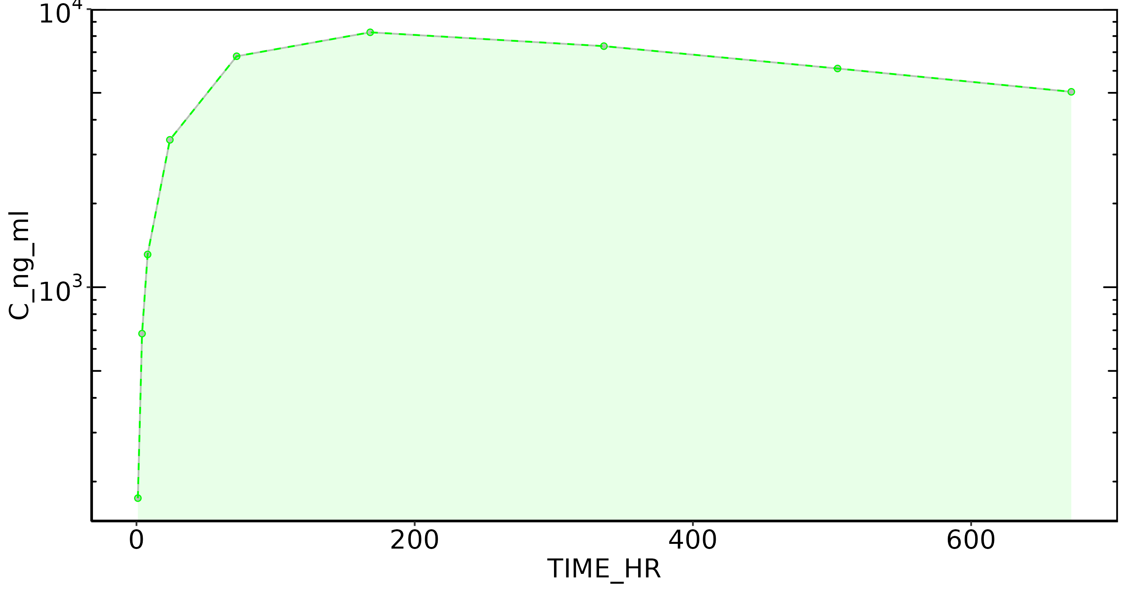
Subject: 29

Slide 61
Subject: 30, Dose: 1
Nobs: 9
Dose: 120.00
Dose (CU): 1.20e+08
Cmax: 1.39e+04
C0 Extrap: NA
Tmax: 168.00
Half-life: 480.49
Time interval: 1 - 671.9999
Vp (obs): NA
Vss (obs): 7.84e+03
Vss (pred): 7.84e+03
CL (obs): 10.45
CL (pred): 10.47
AUC last: 6.73e+06
AUC (inf,pred): 1.15e+07
AUC (inf,obs): 1.15e+07

Slide 62
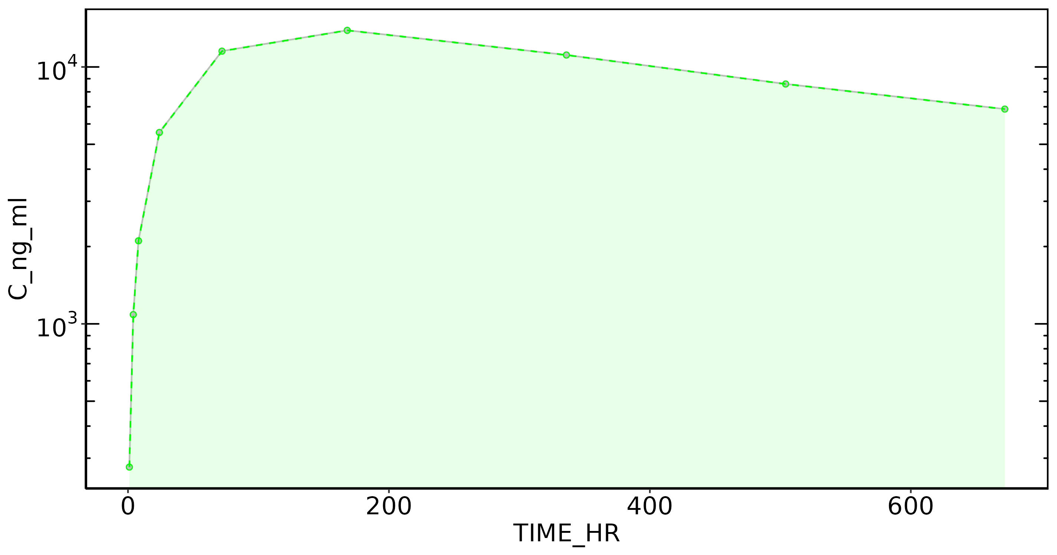
Subject: 30

Slide 63
Subject: 31, Dose: 1
Nobs: 9
Dose: 120.00
Dose (CU): 1.20e+08
Cmax: 1.05e+04
C0 Extrap: NA
Tmax: 168.00
Half-life: 589.13
Time interval: 1 - 671.9999
Vp (obs): NA
Vss (obs): 1.01e+04
Vss (pred): 1.01e+04
CL (obs): 11.15
CL (pred): 11.15
AUC last: 5.53e+06
AUC (inf,pred): 1.08e+07
AUC (inf,obs): 1.08e+07

Slide 64
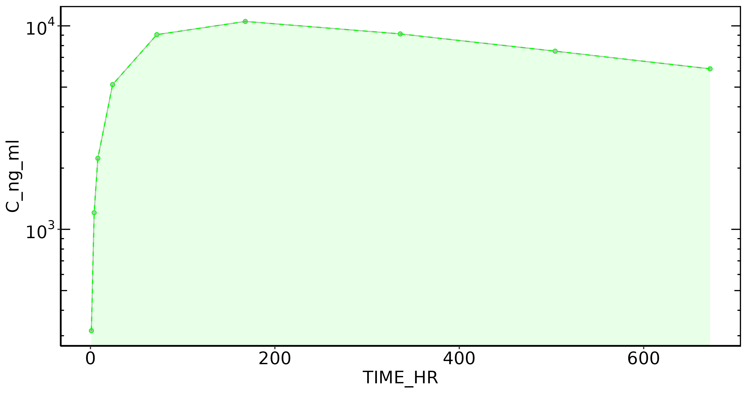
Subject: 31

Slide 65
Subject: 32, Dose: 1
Nobs: 9
Dose: 120.00
Dose (CU): 1.20e+08
Cmax: 8.46e+03
C0 Extrap: NA
Tmax: 168.00
Half-life: 559.89
Time interval: 1 - 671.9999
Vp (obs): NA
Vss (obs): 1.25e+04
Vss (pred): 1.24e+04
CL (obs): 14.40
CL (pred): 14.39
AUC last: 4.43e+06
AUC (inf,pred): 8.34e+06
AUC (inf,obs): 8.34e+06

Slide 66

Subject: 32

Slide 67
Subject: 33, Dose: 1
Nobs: 9
Dose: 120.00
Dose (CU): 1.20e+08
Cmax: 1.05e+04
C0 Extrap: NA
Tmax: 72.00
Half-life: 744.06
Time interval: 1 - 671.9999
Vp (obs): NA
Vss (obs): 1.12e+04
Vss (pred): 1.12e+04
CL (obs): 10.19
CL (pred): 10.20
AUC last: 5.35e+06
AUC (inf,pred): 1.18e+07
AUC (inf,obs): 1.18e+07

Slide 68
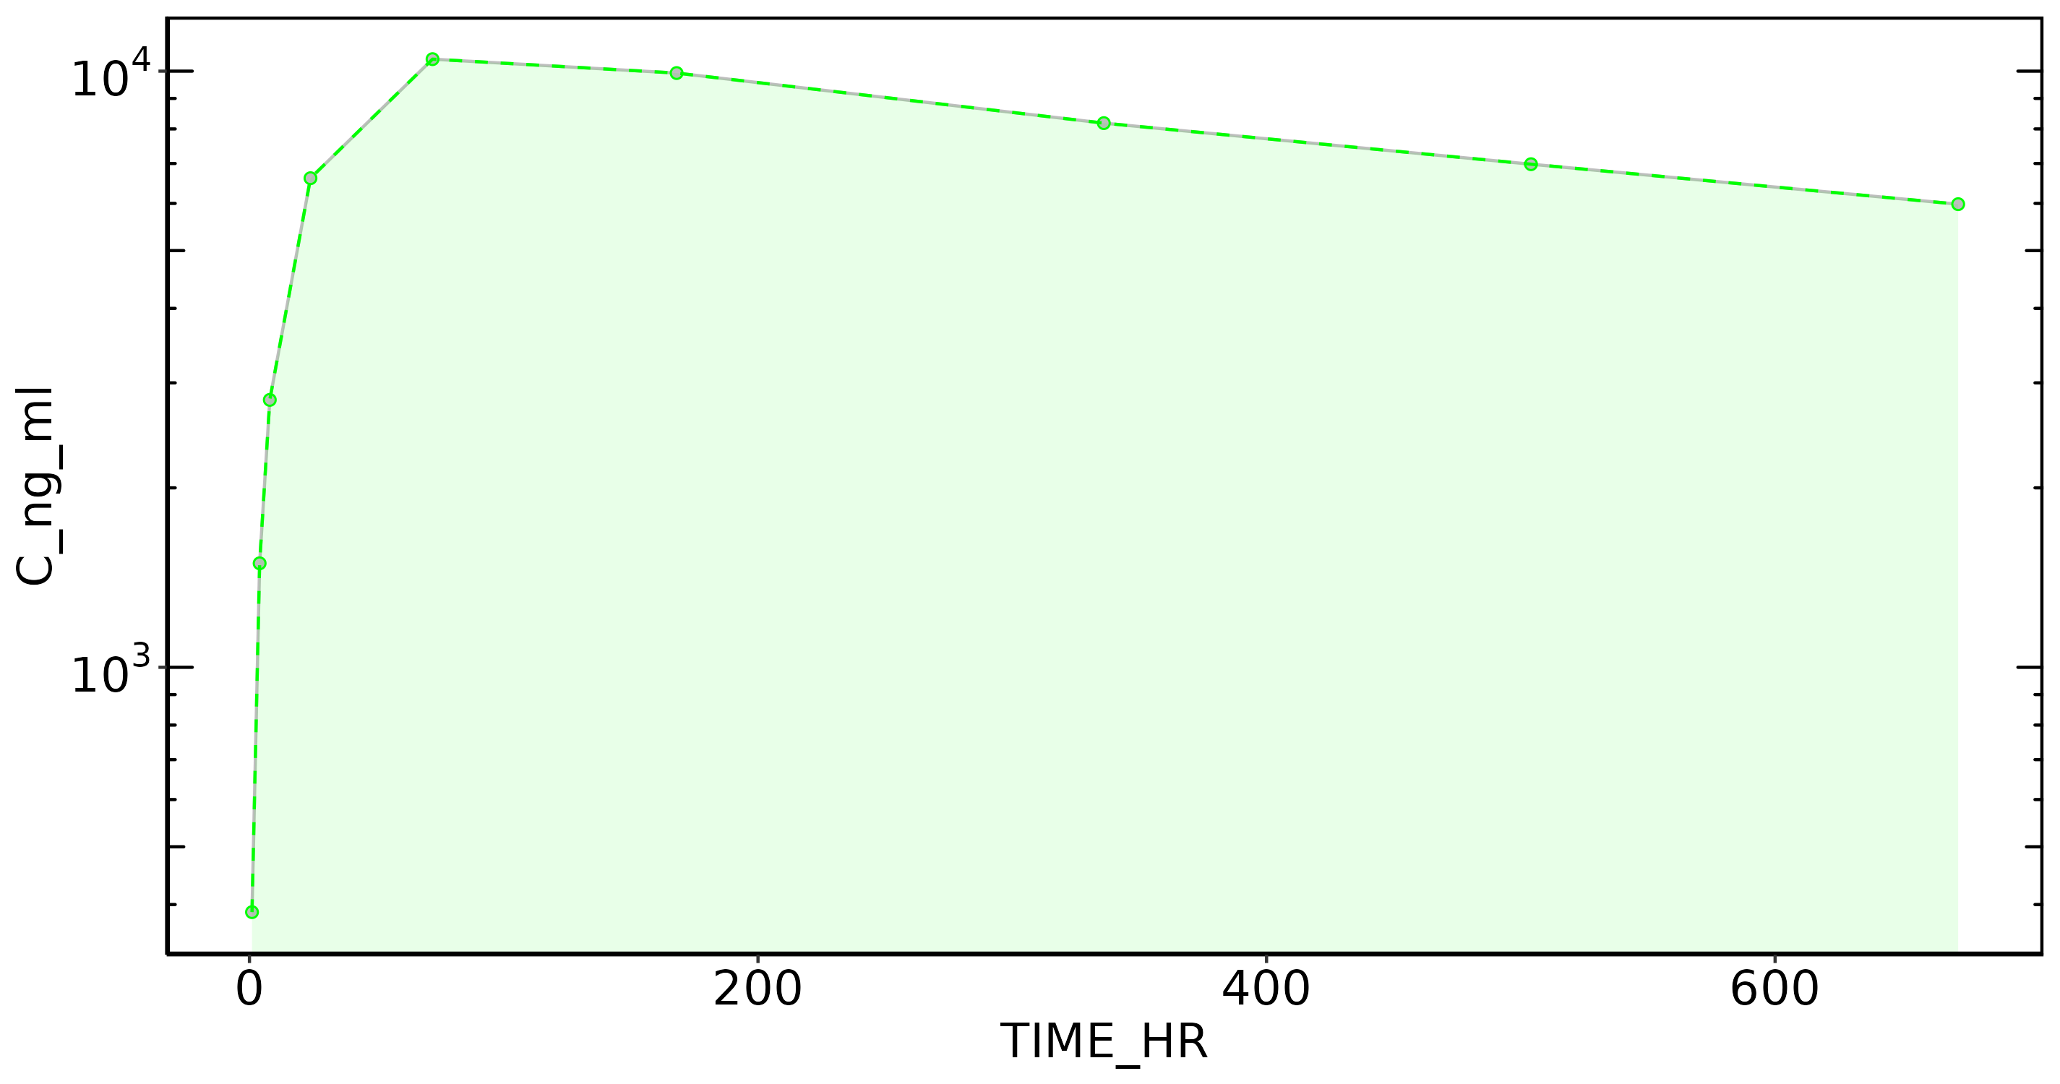
Subject: 33

Slide 69
Subject: 34, Dose: 1
Nobs: 9
Dose: 120.00
Dose (CU): 1.20e+08
Cmax: 6.95e+03
C0 Extrap: NA
Tmax: 336.00
Half-life: NA
Time interval: 1 - 671.9999
Vp (obs): NA
Vss (obs): NA
Vss (pred): NA
CL (obs): NA
CL (pred): NA
AUC last: 3.95e+06
AUC (inf,pred): NA
AUC (inf,obs): NA

Slide 70
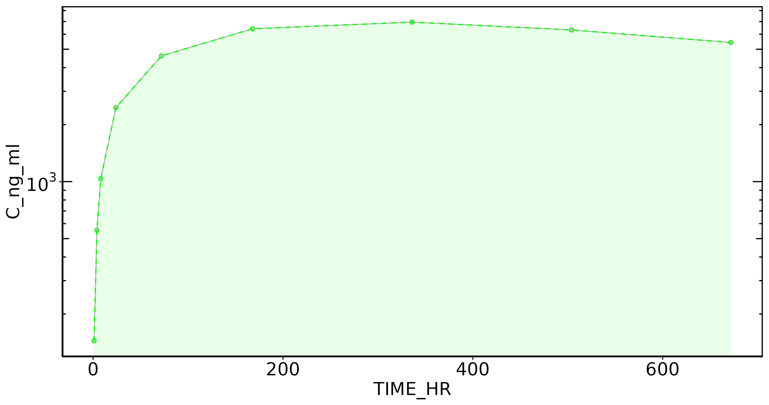
Subject: 34

Slide 71
Subject: 35, Dose: 1
Nobs: 9
Dose: 120.00
Dose (CU): 1.20e+08
Cmax: 1.66e+04
C0 Extrap: NA
Tmax: 72.00
Half-life: 505.91
Time interval: 1 - 671.9999
Vp (obs): NA
Vss (obs): 7.44e+03
Vss (pred): 7.44e+03
CL (obs): 10.07
CL (pred): 10.07
AUC last: 7.12e+06
AUC (inf,pred): 1.19e+07
AUC (inf,obs): 1.19e+07

Slide 72
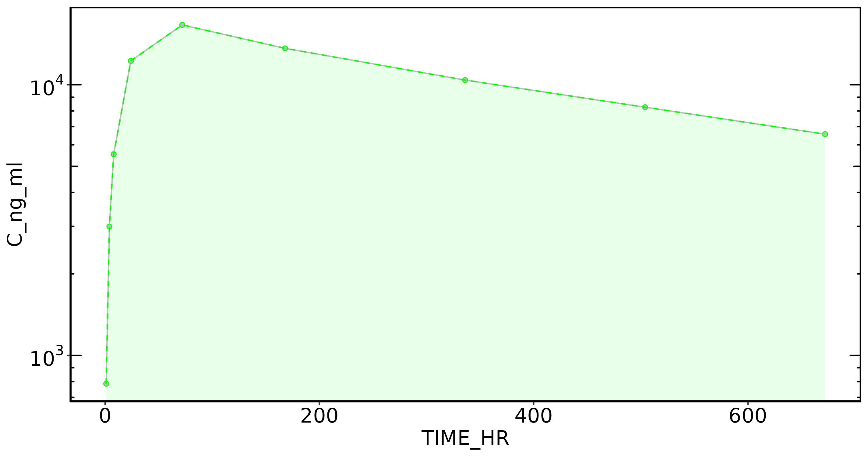
Subject: 35

Slide 73
Subject: 36, Dose: 1
Nobs: 9
Dose: 120.00
Dose (CU): 1.20e+08
Cmax: 1.86e+04
C0 Extrap: NA
Tmax: 72.00
Half-life: 570.50
Time interval: 1 - 671.9999
Vp (obs): NA
Vss (obs): 6.81e+03
Vss (pred): 6.81e+03
CL (obs): 8.28
CL (pred): 8.32
AUC last: 8.11e+06
AUC (inf,pred): 1.44e+07
AUC (inf,obs): 1.45e+07

Slide 74
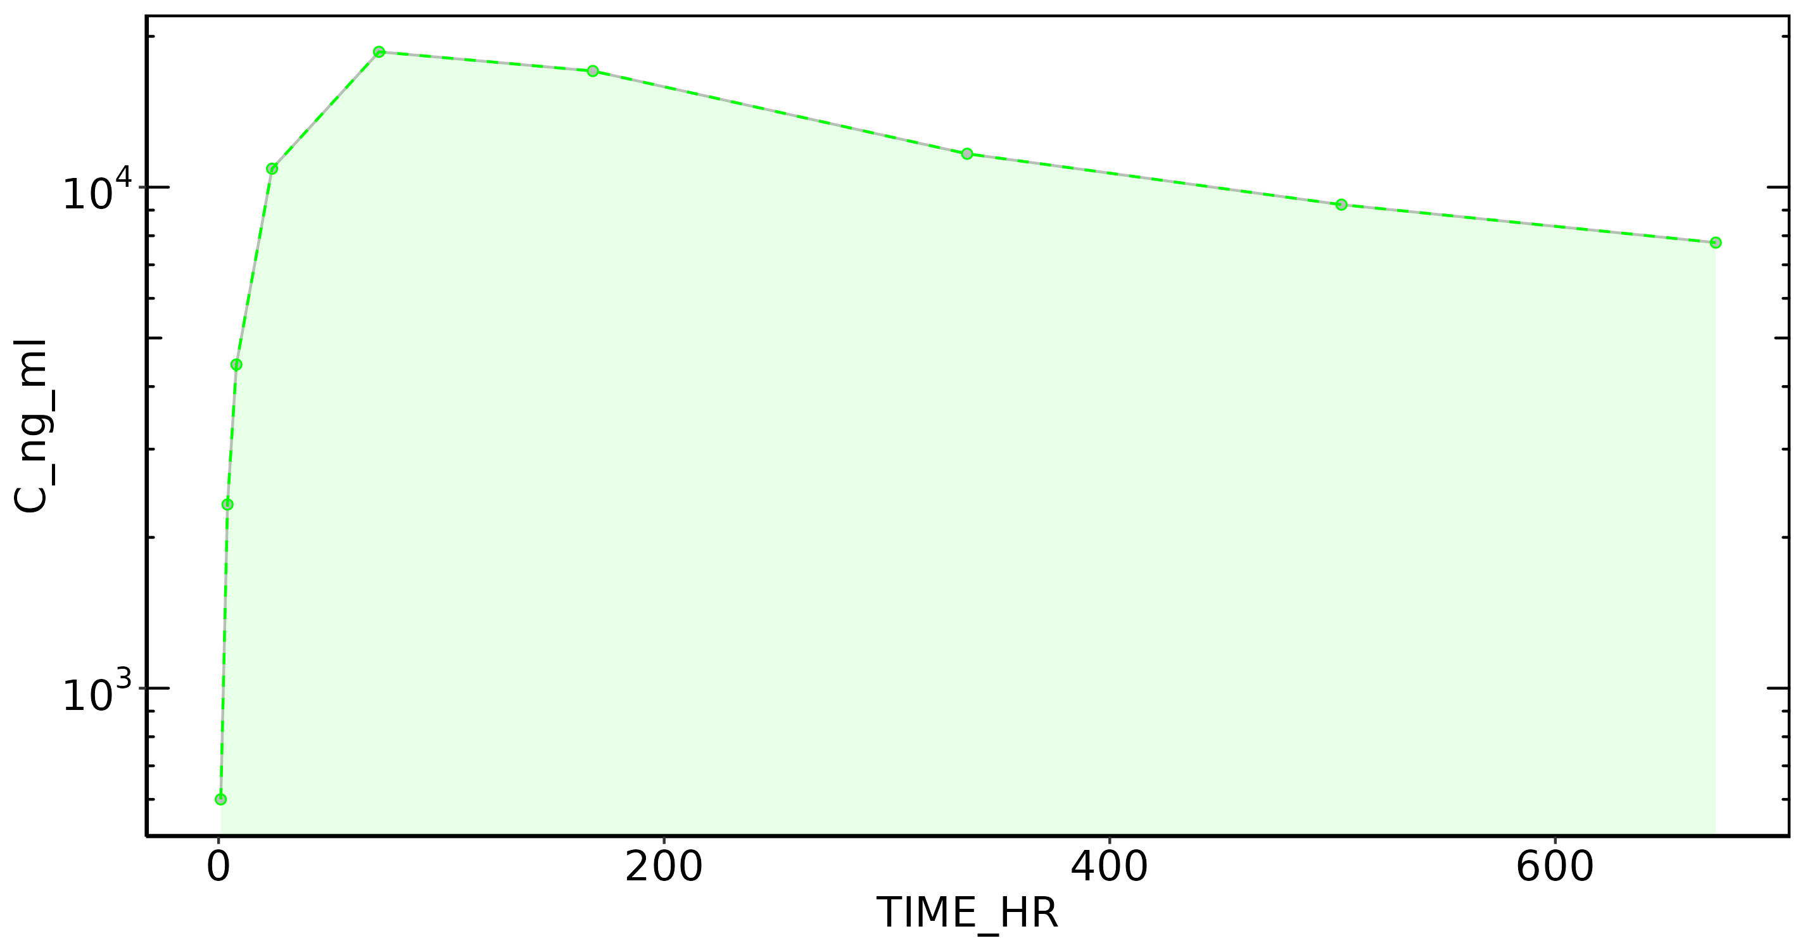
Subject: 36

Slide 75
Subject: 37, Dose: 1
Nobs: 9
Dose: 300.00
Dose (CU): 3.00e+08
Cmax: 9.95e+04
C0 Extrap: NA
Tmax: 1.00
Half-life: 422.56
Time interval: 1 - 671.9999
Vp (obs): 3.01e+03
Vss (obs): 6.07e+03
Vss (pred): 6.06e+03
CL (obs): 12.77
CL (pred): 12.81
AUC last: 1.76e+07
AUC (inf,pred): 2.34e+07
AUC (inf,obs): 2.35e+07

Slide 76

Subject: 37

Slide 77
Subject: 38, Dose: 1
Nobs: 9
Dose: 300.00
Dose (CU): 3.00e+08
Cmax: 1.13e+05
C0 Extrap: NA
Tmax: 1.00
Half-life: 476.52
Time interval: 1 - 671.9999
Vp (obs): 2.66e+03
Vss (obs): 5.06e+03
Vss (pred): 5.06e+03
CL (obs): 7.57
CL (pred): 7.57
AUC last: 2.51e+07
AUC (inf,pred): 3.96e+07
AUC (inf,obs): 3.96e+07

Slide 78

Subject: 38

Slide 79
Subject: 39, Dose: 1
Nobs: 9
Dose: 300.00
Dose (CU): 3.00e+08
Cmax: 7.42e+04
C0 Extrap: NA
Tmax: 1.00
Half-life: 500.40
Time interval: 1 - 671.9999
Vp (obs): 4.04e+03
Vss (obs): 5.52e+03
Vss (pred): 5.51e+03
CL (obs): 8.19
CL (pred): 8.22
AUC last: 2.32e+07
AUC (inf,pred): 3.65e+07
AUC (inf,obs): 3.66e+07

Slide 80
Subject: 39

Slide 81
Subject: 40, Dose: 1
Nobs: 9
Dose: 300.00
Dose (CU): 3.00e+08
Cmax: 5.76e+04
C0 Extrap: NA
Tmax: 1.00
Half-life: 589.25
Time interval: 1 - 671.9999
Vp (obs): 5.21e+03
Vss (obs): 8.43e+03
Vss (pred): 8.43e+03
CL (obs): 10.03
CL (pred): 10.03
AUC last: 1.65e+07
AUC (inf,pred): 2.99e+07
AUC (inf,obs): 2.99e+07

Slide 82
Subject: 40

Slide 83
Subject: 41, Dose: 1
Nobs: 9
Dose: 300.00
Dose (CU): 3.00e+08
Cmax: 6.46e+04
C0 Extrap: NA
Tmax: 1.00
Half-life: 573.57
Time interval: 1 - 671.9999
Vp (obs): 4.65e+03
Vss (obs): 7.30e+03
Vss (pred): 7.30e+03
CL (obs): 8.90
CL (pred): 8.90
AUC last: 1.89e+07
AUC (inf,pred): 3.37e+07
AUC (inf,obs): 3.37e+07

Slide 84
Subject: 41

Slide 85
Subject: 42, Dose: 1
Nobs: 9
Dose: 300.00
Dose (CU): 3.00e+08
Cmax: 9.46e+04
C0 Extrap: NA
Tmax: 1.00
Half-life: 526.00
Time interval: 1 - 671.9999
Vp (obs): 3.17e+03
Vss (obs): 5.41e+03
Vss (pred): 5.41e+03
CL (obs): 7.32
CL (pred): 7.32
AUC last: 2.45e+07
AUC (inf,pred): 4.10e+07
AUC (inf,obs): 4.10e+07

Slide 86

Subject: 42

Slide 87
Subject: 43, Dose: 1
Nobs: 9
Dose: 300.00
Dose (CU): 3.00e+08
Cmax: 1.38e+05
C0 Extrap: NA
Tmax: 1.00
Half-life: 627.42
Time interval: 1 - 671.9999
Vp (obs): 2.17e+03
Vss (obs): 4.38e+03
Vss (pred): 4.38e+03
CL (obs): 5.01
CL (pred): 5.01
AUC last: 3.23e+07
AUC (inf,pred): 5.99e+07
AUC (inf,obs): 5.99e+07

Slide 88

Subject: 43

Slide 89
Subject: 44, Dose: 1
Nobs: 9
Dose: 300.00
Dose (CU): 3.00e+08
Cmax: 7.16e+04
C0 Extrap: NA
Tmax: 1.00
Half-life: 567.44
Time interval: 1 - 671.9999
Vp (obs): 4.19e+03
Vss (obs): 6.91e+03
Vss (pred): 6.91e+03
CL (obs): 8.97
CL (pred): 8.97
AUC last: 1.97e+07
AUC (inf,pred): 3.34e+07
AUC (inf,obs): 3.34e+07

Slide 90
Subject: 44

Slide 91
Subject: 45, Dose: 1
Nobs: 9
Dose: 300.00
Dose (CU): 3.00e+08
Cmax: 9.18e+04
C0 Extrap: NA
Tmax: 1.00
Half-life: 561.36
Time interval: 1 - 671.9999
Vp (obs): 3.27e+03
Vss (obs): 6.12e+03
Vss (pred): 6.12e+03
CL (obs): 8.40
CL (pred): 8.41
AUC last: 2.18e+07
AUC (inf,pred): 3.57e+07
AUC (inf,obs): 3.57e+07

Slide 92
Subject: 45

Slide 93
Subject: 46, Dose: 1
Nobs: 9
Dose: 300.00
Dose (CU): 3.00e+08
Cmax: 4.76e+04
C0 Extrap: NA
Tmax: 1.00
Half-life: 499.57
Time interval: 1 - 671.9999
Vp (obs): 6.30e+03
Vss (obs): 1.02e+04
Vss (pred): 1.02e+04
CL (obs): 15.49
CL (pred): 15.51
AUC last: 1.25e+07
AUC (inf,pred): 1.93e+07
AUC (inf,obs): 1.94e+07

Slide 94

Subject: 46

Slide 95
Subject: 47, Dose: 1
Nobs: 9
Dose: 300.00
Dose (CU): 3.00e+08
Cmax: 4.67e+04
C0 Extrap: NA
Tmax: 1.00
Half-life: 598.79
Time interval: 1 - 671.9999
Vp (obs): 6.43e+03
Vss (obs): 8.57e+03
Vss (pred): 8.57e+03
CL (obs): 10.14
CL (pred): 10.14
AUC last: 1.63e+07
AUC (inf,pred): 2.96e+07
AUC (inf,obs): 2.96e+07

Slide 96
Subject: 47

Slide 97
Subject: 48, Dose: 1
Nobs: 9
Dose: 300.00
Dose (CU): 3.00e+08
Cmax: 1.21e+05
C0 Extrap: NA
Tmax: 1.00
Half-life: 545.91
Time interval: 1 - 671.9999
Vp (obs): 2.47e+03
Vss (obs): 4.98e+03
Vss (pred): 4.98e+03
CL (obs): 7.25
CL (pred): 7.26
AUC last: 2.62e+07
AUC (inf,pred): 4.13e+07
AUC (inf,obs): 4.14e+07

Slide 98

Subject: 48

Slide 99
Subject: 49, Dose: 1
Nobs: 9
Dose: 300.00
Dose (CU): 3.00e+08
Cmax: 6.38e+04
C0 Extrap: NA
Tmax: 1.00
Half-life: 581.37
Time interval: 1 - 671.9999
Vp (obs): 4.70e+03
Vss (obs): 6.90e+03
Vss (pred): 6.90e+03
CL (obs): 8.29
CL (pred): 8.30
AUC last: 2.01e+07
AUC (inf,pred): 3.62e+07
AUC (inf,obs): 3.62e+07

Slide 100
Subject: 49

Slide 101
Subject: 50, Dose: 1
Nobs: 9
Dose: 300.00
Dose (CU): 3.00e+08
Cmax: 5.13e+04
C0 Extrap: NA
Tmax: 1.00
Half-life: 549.25
Time interval: 1 - 671.9999
Vp (obs): 5.85e+03
Vss (obs): 8.35e+03
Vss (pred): 8.35e+03
CL (obs): 10.72
CL (pred): 10.72
AUC last: 1.62e+07
AUC (inf,pred): 2.80e+07
AUC (inf,obs): 2.80e+07

Slide 102

Subject: 50

Slide 103
Subject: 51, Dose: 1
Nobs: 9
Dose: 300.00
Dose (CU): 3.00e+08
Cmax: 4.91e+04
C0 Extrap: NA
Tmax: 1.00
Half-life: 750.63
Time interval: 1 - 671.9999
Vp (obs): 6.11e+03
Vss (obs): 7.98e+03
Vss (pred): 7.98e+03
CL (obs): 7.51
CL (pred): 7.52
AUC last: 1.89e+07
AUC (inf,pred): 3.99e+07
AUC (inf,obs): 3.99e+07

Slide 104
Subject: 51

Slide 105
Subject: 52, Dose: 1
Nobs: 9
Dose: 300.00
Dose (CU): 3.00e+08
Cmax: 7.58e+04
C0 Extrap: NA
Tmax: 1.00
Half-life: 619.32
Time interval: 1 - 671.9999
Vp (obs): 3.96e+03
Vss (obs): 8.60e+03
Vss (pred): 8.60e+03
CL (obs): 9.94
CL (pred): 9.94
AUC last: 1.64e+07
AUC (inf,pred): 3.02e+07
AUC (inf,obs): 3.02e+07

Slide 106

Subject: 52

Slide 107
Subject: 53, Dose: 1
Nobs: 9
Dose: 300.00
Dose (CU): 3.00e+08
Cmax: 1.02e+05
C0 Extrap: NA
Tmax: 1.00
Half-life: 507.27
Time interval: 1 - 671.9999
Vp (obs): 2.93e+03
Vss (obs): 5.18e+03
Vss (pred): 5.18e+03
CL (obs): 7.43
CL (pred): 7.43
AUC last: 2.50e+07
AUC (inf,pred): 4.04e+07
AUC (inf,obs): 4.04e+07

Slide 108

Subject: 53

Slide 109
Subject: 54, Dose: 1
Nobs: 9
Dose: 300.00
Dose (CU): 3.00e+08
Cmax: 1.06e+05
C0 Extrap: NA
Tmax: 1.00
Half-life: 639.33
Time interval: 1 - 671.9999
Vp (obs): 2.83e+03
Vss (obs): 4.90e+03
Vss (pred): 4.90e+03
CL (obs): 5.79
CL (pred): 5.80
AUC last: 2.90e+07
AUC (inf,pred): 5.17e+07
AUC (inf,obs): 5.18e+07

Slide 110

Subject: 54

Slide 111
NCA Summary
Subject | N | Dose | Dose | Dose | Cmax | Tmax | Halflife | Vp | Vss | Vss
 | Obs | Number | Dataset | Conc Units |  |  |  | Observed | Observed | Predicted
1 | 9 | 1 | 30 | 3.00e+07 | 9.95e+03 | 1 | 422.56 | 3.01e+03 | 6.07e+03 | 6.06e+03
2 | 9 | 1 | 30 | 3.00e+07 | 1.13e+04 | 1 | 476.52 | 2.66e+03 | 5.06e+03 | 5.06e+03
3 | 9 | 1 | 30 | 3.00e+07 | 7.42e+03 | 1 | 500.40 | 4.04e+03 | 5.52e+03 | 5.51e+03
4 | 9 | 1 | 30 | 3.00e+07 | 5.76e+03 | 1 | 589.25 | 5.21e+03 | 8.43e+03 | 8.43e+03
5 | 9 | 1 | 30 | 3.00e+07 | 6.46e+03 | 1 | 573.57 | 4.65e+03 | 7.30e+03 | 7.30e+03
6 | 9 | 1 | 30 | 3.00e+07 | 9.46e+03 | 1 | 526.00 | 3.17e+03 | 5.41e+03 | 5.41e+03
7 | 9 | 1 | 30 | 3.00e+07 | 1.38e+04 | 1 | 627.42 | 2.17e+03 | 4.38e+03 | 4.38e+03
8 | 9 | 1 | 30 | 3.00e+07 | 7.16e+03 | 1 | 567.44 | 4.19e+03 | 6.91e+03 | 6.91e+03
9 | 9 | 1 | 30 | 3.00e+07 | 9.18e+03 | 1 | 561.36 | 3.27e+03 | 6.12e+03 | 6.12e+03
10 | 9 | 1 | 30 | 3.00e+07 | 4.76e+03 | 1 | 499.57 | 6.30e+03 | 1.02e+04 | 1.02e+04

Slide 112
NCA Summary
Subject | N | Dose | Dose | Dose | C0 | CL | CL | AUC | AUC | AUC
 | Obs | Number | Dataset | Conc Units | Extrap | Obs | Pred | Last | Inf(Pred) | Inf(Obs)
1 | 9 | 1 | 30 | 3.00e+07 |  | 12.77 | 12.81 | 1.76e+06 | 2.34e+06 | 2.35e+06
2 | 9 | 1 | 30 | 3.00e+07 |  | 7.57 | 7.57 | 2.51e+06 | 3.96e+06 | 3.96e+06
3 | 9 | 1 | 30 | 3.00e+07 |  | 8.19 | 8.22 | 2.32e+06 | 3.65e+06 | 3.66e+06
4 | 9 | 1 | 30 | 3.00e+07 |  | 10.03 | 10.03 | 1.65e+06 | 2.99e+06 | 2.99e+06
5 | 9 | 1 | 30 | 3.00e+07 |  | 8.90 | 8.90 | 1.89e+06 | 3.37e+06 | 3.37e+06
6 | 9 | 1 | 30 | 3.00e+07 |  | 7.32 | 7.32 | 2.45e+06 | 4.10e+06 | 4.10e+06
7 | 9 | 1 | 30 | 3.00e+07 |  | 5.01 | 5.01 | 3.23e+06 | 5.99e+06 | 5.99e+06
8 | 9 | 1 | 30 | 3.00e+07 |  | 8.97 | 8.97 | 1.97e+06 | 3.34e+06 | 3.34e+06
9 | 9 | 1 | 30 | 3.00e+07 |  | 8.40 | 8.41 | 2.18e+06 | 3.57e+06 | 3.57e+06
10 | 9 | 1 | 30 | 3.00e+07 |  | 15.49 | 15.51 | 1.25e+06 | 1.93e+06 | 1.94e+06

Slide 113
NCA Summary
Subject | N | Dose | Dose | Dose | Cmax | Tmax | Halflife | Vp | Vss | Vss
 | Obs | Number | Dataset | Conc Units |  |  |  | Observed | Observed | Predicted
11 | 9 | 1 | 30 | 3.00e+07 | 4.67e+03 | 1 | 598.79 | 6.43e+03 | 8.57e+03 | 8.57e+03
12 | 9 | 1 | 30 | 3.00e+07 | 1.21e+04 | 1 | 545.91 | 2.47e+03 | 4.98e+03 | 4.98e+03
13 | 9 | 1 | 30 | 3.00e+07 | 6.38e+03 | 1 | 581.37 | 4.70e+03 | 6.90e+03 | 6.90e+03
14 | 9 | 1 | 30 | 3.00e+07 | 5.13e+03 | 1 | 549.25 | 5.85e+03 | 8.35e+03 | 8.35e+03
15 | 9 | 1 | 30 | 3.00e+07 | 4.91e+03 | 1 | 750.63 | 6.11e+03 | 7.98e+03 | 7.98e+03
16 | 9 | 1 | 30 | 3.00e+07 | 7.58e+03 | 1 | 619.32 | 3.96e+03 | 8.60e+03 | 8.60e+03
17 | 9 | 1 | 30 | 3.00e+07 | 1.02e+04 | 1 | 507.27 | 2.93e+03 | 5.18e+03 | 5.18e+03
18 | 9 | 1 | 30 | 3.00e+07 | 1.06e+04 | 1 | 639.33 | 2.83e+03 | 4.90e+03 | 4.90e+03
19 | 9 | 1 | 120 | 1.20e+08 | 1.57e+04 | 72 | 347.71 | NA | 8.63e+03 | 8.61e+03
20 | 9 | 1 | 120 | 1.20e+08 | 1.30e+04 | 168 | 498.66 | NA | 7.89e+03 | 7.89e+03

Slide 114
NCA Summary
Subject | N | Dose | Dose | Dose | C0 | CL | CL | AUC | AUC | AUC
 | Obs | Number | Dataset | Conc Units | Extrap | Obs | Pred | Last | Inf(Pred) | Inf(Obs)
11 | 9 | 1 | 30 | 3.00e+07 |  | 10.14 | 10.14 | 1.63e+06 | 2.96e+06 | 2.96e+06
12 | 9 | 1 | 30 | 3.00e+07 |  | 7.25 | 7.26 | 2.62e+06 | 4.13e+06 | 4.14e+06
13 | 9 | 1 | 30 | 3.00e+07 |  | 8.29 | 8.30 | 2.01e+06 | 3.62e+06 | 3.62e+06
14 | 9 | 1 | 30 | 3.00e+07 |  | 10.72 | 10.72 | 1.62e+06 | 2.80e+06 | 2.80e+06
15 | 9 | 1 | 30 | 3.00e+07 |  | 7.51 | 7.52 | 1.89e+06 | 3.99e+06 | 3.99e+06
16 | 9 | 1 | 30 | 3.00e+07 |  | 9.94 | 9.94 | 1.64e+06 | 3.02e+06 | 3.02e+06
17 | 9 | 1 | 30 | 3.00e+07 |  | 7.43 | 7.43 | 2.50e+06 | 4.04e+06 | 4.04e+06
18 | 9 | 1 | 30 | 3.00e+07 |  | 5.79 | 5.80 | 2.90e+06 | 5.17e+06 | 5.18e+06
19 | 9 | 1 | 120 | 1.20e+08 |  | 18.41 | 18.53 | 4.96e+06 | 6.48e+06 | 6.52e+06
20 | 9 | 1 | 120 | 1.20e+08 |  | 10.08 | 10.07 | 6.77e+06 | 1.19e+07 | 1.19e+07

Slide 115
NCA Summary
Subject | N | Dose | Dose | Dose | Cmax | Tmax | Halflife | Vp | Vss | Vss
 | Obs | Number | Dataset | Conc Units |  |  |  | Observed | Observed | Predicted
21 | 9 | 1 | 120 | 1.20e+08 | 1.51e+04 | 72 | 459.79 | NA | 7.79e+03 | 7.79e+03
22 | 9 | 1 | 120 | 1.20e+08 | 7.48e+03 | 336 | NA | NA | NA | NA
23 | 9 | 1 | 120 | 1.20e+08 | 9.30e+03 | 168 | 608.98 | NA | 1.11e+04 | 1.11e+04
24 | 9 | 1 | 120 | 1.20e+08 | 1.32e+04 | 168 | 528.19 | NA | 7.93e+03 | 7.93e+03
25 | 9 | 1 | 120 | 1.20e+08 | 1.92e+04 | 72 | 628.70 | NA | 6.23e+03 | 6.23e+03
26 | 9 | 1 | 120 | 1.20e+08 | 1.06e+04 | 168 | 548.32 | NA | 1.03e+04 | 1.04e+04
27 | 9 | 1 | 120 | 1.20e+08 | 1.25e+04 | 168 | 490.90 | NA | 8.97e+03 | 8.97e+03
28 | 9 | 1 | 120 | 1.20e+08 | 5.87e+03 | 168 | 550.59 | NA | 1.77e+04 | 1.77e+04
29 | 9 | 1 | 120 | 1.20e+08 | 8.25e+03 | 168 | 616.00 | NA | 1.29e+04 | 1.29e+04
30 | 9 | 1 | 120 | 1.20e+08 | 1.39e+04 | 168 | 480.49 | NA | 7.84e+03 | 7.84e+03

Slide 116
NCA Summary
Subject | N | Dose | Dose | Dose | C0 | CL | CL | AUC | AUC | AUC
 | Obs | Number | Dataset | Conc Units | Extrap | Obs | Pred | Last | Inf(Pred) | Inf(Obs)
21 | 9 | 1 | 120 | 1.20e+08 |  | 11.52 | 11.57 | 6.57e+06 | 1.04e+07 | 1.04e+07
22 | 9 | 1 | 120 | 1.20e+08 |  | NA | NA | 4.22e+06 | NA | NA
23 | 9 | 1 | 120 | 1.20e+08 |  | 11.70 | 11.68 | 5.05e+06 | 1.03e+07 | 1.03e+07
24 | 9 | 1 | 120 | 1.20e+08 |  | 9.90 | 9.90 | 6.82e+06 | 1.21e+07 | 1.21e+07
25 | 9 | 1 | 120 | 1.20e+08 |  | 6.77 | 6.77 | 9.14e+06 | 1.77e+07 | 1.77e+07
26 | 9 | 1 | 120 | 1.20e+08 |  | 12.37 | 12.39 | 5.29e+06 | 9.69e+06 | 9.70e+06
27 | 9 | 1 | 120 | 1.20e+08 |  | 12.11 | 12.15 | 5.89e+06 | 9.88e+06 | 9.91e+06
28 | 9 | 1 | 120 | 1.20e+08 |  | 20.27 | 20.25 | 3.10e+06 | 5.93e+06 | 5.92e+06
29 | 9 | 1 | 120 | 1.20e+08 |  | 13.54 | 13.53 | 4.38e+06 | 8.87e+06 | 8.86e+06
30 | 9 | 1 | 120 | 1.20e+08 |  | 10.45 | 10.47 | 6.73e+06 | 1.15e+07 | 1.15e+07

Slide 117
NCA Summary
Subject | N | Dose | Dose | Dose | Cmax | Tmax | Halflife | Vp | Vss | Vss
 | Obs | Number | Dataset | Conc Units |  |  |  | Observed | Observed | Predicted
31 | 9 | 1 | 120 | 1.20e+08 | 1.05e+04 | 168 | 589.13 | NA | 1.01e+04 | 1.01e+04
32 | 9 | 1 | 120 | 1.20e+08 | 8.46e+03 | 168 | 559.89 | NA | 1.25e+04 | 1.24e+04
33 | 9 | 1 | 120 | 1.20e+08 | 1.05e+04 | 72 | 744.06 | NA | 1.12e+04 | 1.12e+04
34 | 9 | 1 | 120 | 1.20e+08 | 6.95e+03 | 336 | NA | NA | NA | NA
35 | 9 | 1 | 120 | 1.20e+08 | 1.66e+04 | 72 | 505.91 | NA | 7.44e+03 | 7.44e+03
36 | 9 | 1 | 120 | 1.20e+08 | 1.86e+04 | 72 | 570.50 | NA | 6.81e+03 | 6.81e+03
37 | 9 | 1 | 300 | 3.00e+08 | 9.95e+04 | 1 | 422.56 | 3.01e+03 | 6.07e+03 | 6.06e+03
38 | 9 | 1 | 300 | 3.00e+08 | 1.13e+05 | 1 | 476.52 | 2.66e+03 | 5.06e+03 | 5.06e+03
39 | 9 | 1 | 300 | 3.00e+08 | 7.42e+04 | 1 | 500.40 | 4.04e+03 | 5.52e+03 | 5.51e+03
40 | 9 | 1 | 300 | 3.00e+08 | 5.76e+04 | 1 | 589.25 | 5.21e+03 | 8.43e+03 | 8.43e+03

Slide 118
NCA Summary
Subject | N | Dose | Dose | Dose | C0 | CL | CL | AUC | AUC | AUC
 | Obs | Number | Dataset | Conc Units | Extrap | Obs | Pred | Last | Inf(Pred) | Inf(Obs)
31 | 9 | 1 | 120 | 1.20e+08 |  | 11.15 | 11.15 | 5.53e+06 | 1.08e+07 | 1.08e+07
32 | 9 | 1 | 120 | 1.20e+08 |  | 14.40 | 14.39 | 4.43e+06 | 8.34e+06 | 8.34e+06
33 | 9 | 1 | 120 | 1.20e+08 |  | 10.19 | 10.20 | 5.35e+06 | 1.18e+07 | 1.18e+07
34 | 9 | 1 | 120 | 1.20e+08 |  | NA | NA | 3.95e+06 | NA | NA
35 | 9 | 1 | 120 | 1.20e+08 |  | 10.07 | 10.07 | 7.12e+06 | 1.19e+07 | 1.19e+07
36 | 9 | 1 | 120 | 1.20e+08 |  | 8.28 | 8.32 | 8.11e+06 | 1.44e+07 | 1.45e+07
37 | 9 | 1 | 300 | 3.00e+08 |  | 12.77 | 12.81 | 1.76e+07 | 2.34e+07 | 2.35e+07
38 | 9 | 1 | 300 | 3.00e+08 |  | 7.57 | 7.57 | 2.51e+07 | 3.96e+07 | 3.96e+07
39 | 9 | 1 | 300 | 3.00e+08 |  | 8.19 | 8.22 | 2.32e+07 | 3.65e+07 | 3.66e+07
40 | 9 | 1 | 300 | 3.00e+08 |  | 10.03 | 10.03 | 1.65e+07 | 2.99e+07 | 2.99e+07

Slide 119
NCA Summary
Subject | N | Dose | Dose | Dose | Cmax | Tmax | Halflife | Vp | Vss | Vss
 | Obs | Number | Dataset | Conc Units |  |  |  | Observed | Observed | Predicted
41 | 9 | 1 | 300 | 3.00e+08 | 6.46e+04 | 1 | 573.57 | 4.65e+03 | 7.30e+03 | 7.30e+03
42 | 9 | 1 | 300 | 3.00e+08 | 9.46e+04 | 1 | 526.00 | 3.17e+03 | 5.41e+03 | 5.41e+03
43 | 9 | 1 | 300 | 3.00e+08 | 1.38e+05 | 1 | 627.42 | 2.17e+03 | 4.38e+03 | 4.38e+03
44 | 9 | 1 | 300 | 3.00e+08 | 7.16e+04 | 1 | 567.44 | 4.19e+03 | 6.91e+03 | 6.91e+03
45 | 9 | 1 | 300 | 3.00e+08 | 9.18e+04 | 1 | 561.36 | 3.27e+03 | 6.12e+03 | 6.12e+03
46 | 9 | 1 | 300 | 3.00e+08 | 4.76e+04 | 1 | 499.57 | 6.30e+03 | 1.02e+04 | 1.02e+04
47 | 9 | 1 | 300 | 3.00e+08 | 4.67e+04 | 1 | 598.79 | 6.43e+03 | 8.57e+03 | 8.57e+03
48 | 9 | 1 | 300 | 3.00e+08 | 1.21e+05 | 1 | 545.91 | 2.47e+03 | 4.98e+03 | 4.98e+03
49 | 9 | 1 | 300 | 3.00e+08 | 6.38e+04 | 1 | 581.37 | 4.70e+03 | 6.90e+03 | 6.90e+03
50 | 9 | 1 | 300 | 3.00e+08 | 5.13e+04 | 1 | 549.25 | 5.85e+03 | 8.35e+03 | 8.35e+03

Slide 120
NCA Summary
Subject | N | Dose | Dose | Dose | C0 | CL | CL | AUC | AUC | AUC
 | Obs | Number | Dataset | Conc Units | Extrap | Obs | Pred | Last | Inf(Pred) | Inf(Obs)
41 | 9 | 1 | 300 | 3.00e+08 |  | 8.90 | 8.90 | 1.89e+07 | 3.37e+07 | 3.37e+07
42 | 9 | 1 | 300 | 3.00e+08 |  | 7.32 | 7.32 | 2.45e+07 | 4.10e+07 | 4.10e+07
43 | 9 | 1 | 300 | 3.00e+08 |  | 5.01 | 5.01 | 3.23e+07 | 5.99e+07 | 5.99e+07
44 | 9 | 1 | 300 | 3.00e+08 |  | 8.97 | 8.97 | 1.97e+07 | 3.34e+07 | 3.34e+07
45 | 9 | 1 | 300 | 3.00e+08 |  | 8.40 | 8.41 | 2.18e+07 | 3.57e+07 | 3.57e+07
46 | 9 | 1 | 300 | 3.00e+08 |  | 15.49 | 15.51 | 1.25e+07 | 1.93e+07 | 1.94e+07
47 | 9 | 1 | 300 | 3.00e+08 |  | 10.14 | 10.14 | 1.63e+07 | 2.96e+07 | 2.96e+07
48 | 9 | 1 | 300 | 3.00e+08 |  | 7.25 | 7.26 | 2.62e+07 | 4.13e+07 | 4.14e+07
49 | 9 | 1 | 300 | 3.00e+08 |  | 8.29 | 8.30 | 2.01e+07 | 3.62e+07 | 3.62e+07
50 | 9 | 1 | 300 | 3.00e+08 |  | 10.72 | 10.72 | 1.62e+07 | 2.80e+07 | 2.80e+07

Slide 121
NCA Summary
Subject | N | Dose | Dose | Dose | Cmax | Tmax | Halflife | Vp | Vss | Vss
 | Obs | Number | Dataset | Conc Units |  |  |  | Observed | Observed | Predicted
51 | 9 | 1 | 300 | 3.00e+08 | 4.91e+04 | 1 | 750.63 | 6.11e+03 | 7.98e+03 | 7.98e+03
52 | 9 | 1 | 300 | 3.00e+08 | 7.58e+04 | 1 | 619.32 | 3.96e+03 | 8.60e+03 | 8.60e+03
53 | 9 | 1 | 300 | 3.00e+08 | 1.02e+05 | 1 | 507.27 | 2.93e+03 | 5.18e+03 | 5.18e+03
54 | 9 | 1 | 300 | 3.00e+08 | 1.06e+05 | 1 | 639.33 | 2.83e+03 | 4.90e+03 | 4.90e+03

Slide 122
NCA Summary
Subject | N | Dose | Dose | Dose | C0 | CL | CL | AUC | AUC | AUC
 | Obs | Number | Dataset | Conc Units | Extrap | Obs | Pred | Last | Inf(Pred) | Inf(Obs)
51 | 9 | 1 | 300 | 3.00e+08 |  | 7.51 | 7.52 | 1.89e+07 | 3.99e+07 | 3.99e+07
52 | 9 | 1 | 300 | 3.00e+08 |  | 9.94 | 9.94 | 1.64e+07 | 3.02e+07 | 3.02e+07
53 | 9 | 1 | 300 | 3.00e+08 |  | 7.43 | 7.43 | 2.50e+07 | 4.04e+07 | 4.04e+07
54 | 9 | 1 | 300 | 3.00e+08 |  | 5.79 | 5.80 | 2.90e+07 | 5.17e+07 | 5.18e+07

