Slide 1


Report project isw2
Francesco Astolfi
Link to the repo
Project analized:
Francesco Astolfi

Slide 2

Milestone 1 the dataset
Francesco Astolfi

Slide 3
How the dataset is built :
The dataset is built for each release to enable walk-forward training and to allow users to reconstruct the history and evolution of each bug, including its labeling. Each release analyzes the commits and tickets that were during its lifecycle, commit from Github with the linkage on the tickets from Jira .
For each project, only the first 33% of the available releases were selected.
However, for smaller projects like BookKeeper, it was necessary to use up to 50% of the releases to ensure sufficient data for analysis.

Slide 4
How the bug are selected
Buggyness is assigned based on commits linked to bug-related tickets. If a commit modifies one or more methods and is associated with a bug fix ticket, those methods are labeled as buggy.
Then labeling procedure propagates buggyness from the injected version( or the evaluated one )
up to the fixed version.
Feature like nr, age, nAuth are assigned by a class evaluation, all the others are assigned at method evaluation. CK metrics by the support library, nSmell by the PMDrunner

Slide 5
Which metrics and why
Features such as nr, age, and nAuth are computed at the class level, while all other features are evaluated at the method level.
CK metrics (e.g: loc, wmc, fanin, fanout) are extracted using a support library.
nSmell is computed using a custom PMD runner.
The actionable evaluated feature that could be easy measurable and just track a good way of coding, the analysis is focused on find which of this simple element is more correlated to the buggyness.

Slide 6
Some of the introduced Improvements:
Commit caching was implemented to optimize performance.
The analysis was executed in parallel across multiple threads.
A maximum number of classes per commit was analyzed; any excess was cached and assigned to other threads.
Persistence-related data was encapsulated and hidden from the rest of the project through the use of a DAO
All constants and path definitions relevant to the project were centralized in a single class to facilitate future reconfiguration.
All training and test files that have not yet been written are generated.
During the commit analysis, partial writes may occur to allow better monitoring and tracking of the process.
Despite these improvements, the project remains difficult to configure and understand.

Slide 7
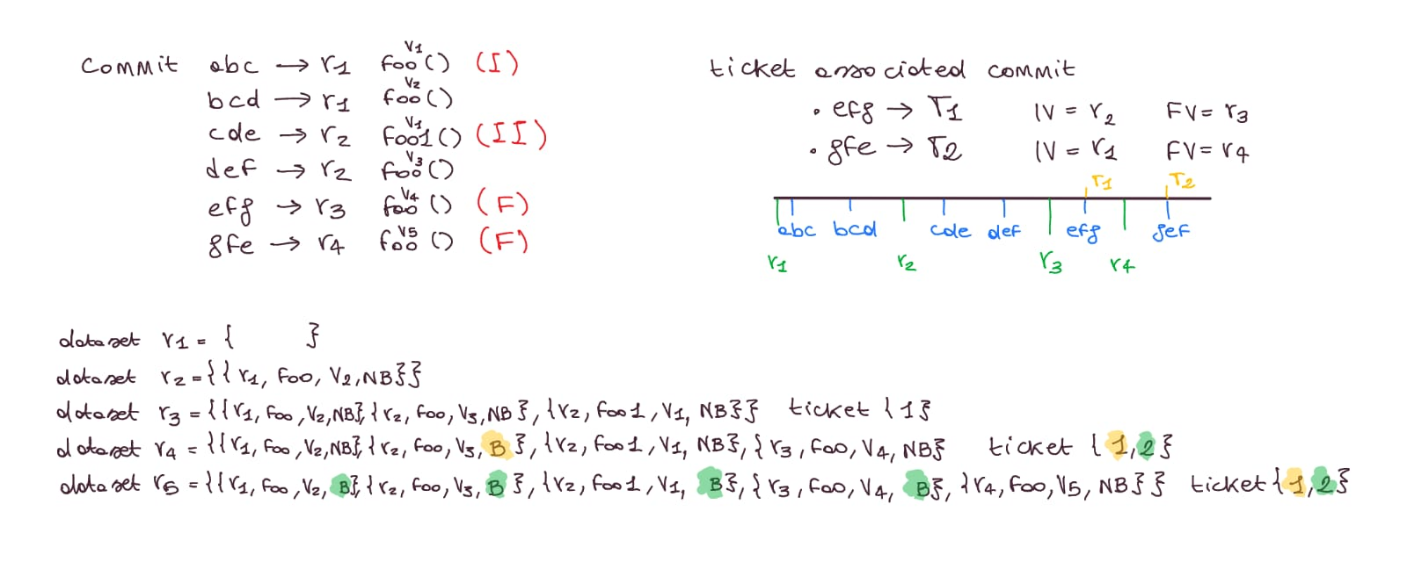
Some warnings [P1]
Even if a release contains tickets associated with bugs, it is acceptable that no buggy methods appear in the results. This is because some of those tickets may refer to commits made in the current release, rather than to commits from previous releases.
However, the labeling of buggy methods is based only on the commits pushed to GitHub before the start of the release currently being analyzed. Therefore, if a bug is introduced and fixed within the same release, it may not be labeled as buggy.

Slide 8
Some Warnings [P2]
Association of buggyness in a release dataset :
Even if a method is associated with a specific commit, it may also belong to a broader set of methods modified by other commits. This occurs due to a rebalancing of the methods to be processed in the cache. However, this behavior does not affect the labeling of buggyness.
The identification of buggy methods is based on the methods modified in commits linked to bug-related tickets. jGit is used to extract the methods changed in each commit.
Then, buggyness is assigned to the affected version, considering the interval from the injected version to the fixed version.
Approach of evaluation of the Injected Version when it missing:
Cold start proportion at the beginning
“Incremental”, each release take the ticket available in the current release , opening version before the release starts, evaluate proportion on the ticket that have a valid injected version.
Adjust the injected version of the ticket that not have a valid one with proportion

Slide 9
Future improvements:
More precise evaluation of metrics (Age, NR, NAuth) at method level
This choice adds complexity to the project but improves the accuracy of the metrics.
The method-level approach is also scalable, allowing for analysis of code evolution on a per-release basis, rather than relying only on cumulative results across all releases.
More understandable code
More documented code even if it contains 0 smells on SonarCloud is difficult to understand especially the metrics calculation and the labeling
Improve the resilience on bug
Introduce test that improve the confidence on the code.
  Reduce the complexity of the set up
The current codebase is hard to set up it requires cloning external repositories to use JGit, relies on hardcoded paths, and demands a non-trivial configuration effort making it potentially non-portable across different systems.

Slide 10
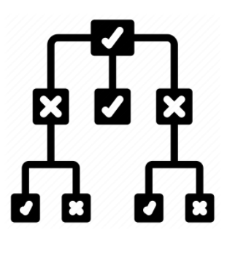
Milestone 2
Compare the 3 Classifiers
Francesco Astolfi
The Models

Slide 11
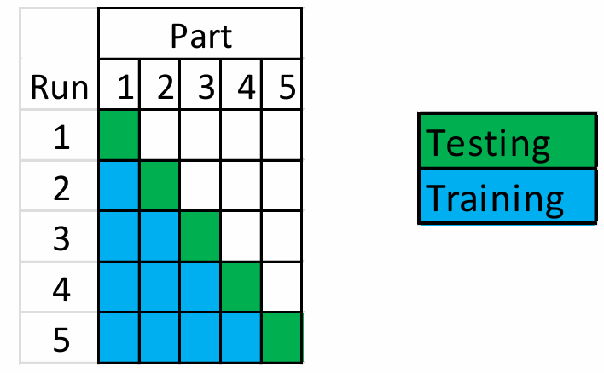
Training testing procedure:
The evaluation process follows a walk-forward approach.
The dataset is maintained in chronological order over time, and the smallest unit used for splitting is the software release.
The Models

Slide 12
Warning about the dataset !
The first available release for training is release 2, as the goal is to verify whether the previous release contains bugs. For this reason, the commits considered belong to the previous release. Only tickets already open at the start of the current release are considered — tickets opened during the current release are not yet visible at inspection time and will only become available from the following release onwards. The final test release is the only exception, as it utilizes all commits and tickets available throughout the project.
The Models

Slide 13
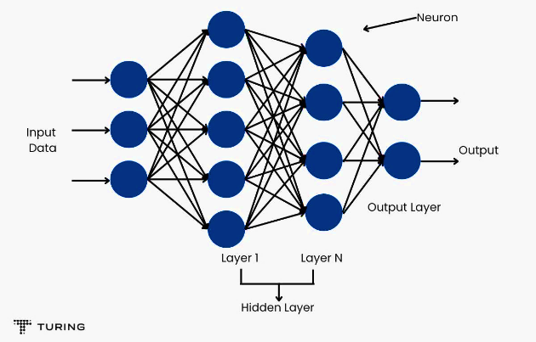
considered Models :
Multi-Layer Perceptron:
This is the most sophisticated model, requiring more time and computational resources due to its complexity. It is particularly useful for tasks involving data that do not exhibit a linear correlation and is commonly used to learn how to process and model complex input data.
Stochastic Gradient Descent (SGD):
This is the simplest model for a task, but it may underfit more complex problems.
Its main advantage lies in the ease of interpretability, as anyone can easily understand how decisions are made.
Random Forest :
Random Forest is generally one of the most accurate models across a wide range of scenarios.
It combines the predictions of multiple decision trees to improve overall performance and reduce the risk of overfitting.

Slide 14
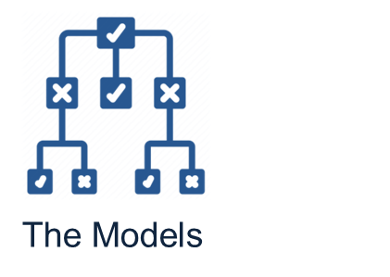
Evaluation metrics
Auc :
The Area Under the Curve (AUC) refers to the area under the ROC curve, which plots the recall (true positive rate) on the y-axis and the false positive rate on the x-axis.
The key advantage of this metric is that it is independent of the decision threshold used to distinguish between positive and negative instances.
Y-axis TP/TP+FN
X-axis FP/ FP+TN
Precision :
This metric evaluates how well the model can correctly predict positive instances while discarding the negative ones.
It is generally easier to maximize either this measure or recall individually, but it is not easy to optimize both simultaneously.
Recall:
Instead of precision, recall is used because the "snoring" behavior cannot produce false positives and even if it does, they are less critical than false negatives.
A false negative (i.e., an instance that is actually positive but predicted as negative) is considered more harmful in this context.
Kappa :
The number of time that the model is better
than a random model.

Slide 15

Applied theory during training
Feature selection :
A ranked greedy approach was used, where for each of the n evaluated features,
only p (with p < n) were selected based on their ranking to optimize the evaluation process.
This method considers features jointly rather than treating them independently.
Sampling :
To mitigate the strong class imbalance buggy methods are a small minority of all instances random undersampling was applied to the training set only: instances of the majority (non-buggy) class were randomly discarded until the two classes reached a comparable size.
Preprocessing:
From all the methods in the dataset, the identifying features such as MethodName, ClassName, ClassPath, and Release are removed.
These features are excluded as they serve only to uniquely identify a method within a specific release and are not useful for training or evaluating predictive models.

Slide 16
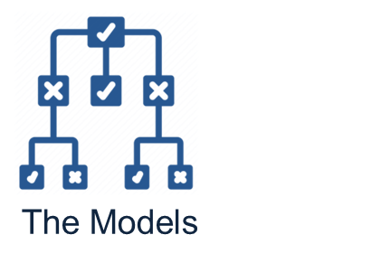
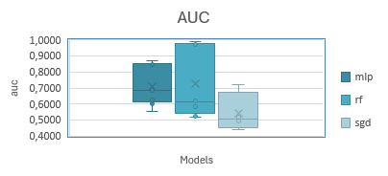
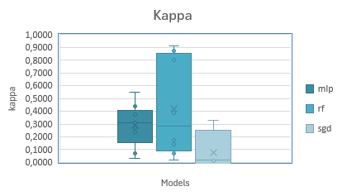
Experiments done :
link to the document
 | Training set | Training Process | Testing set | Classifier | Feature selection | Sampling | Precision | Recall | Auc | Kappa
1 | Openjpa | Walk-Forward | Openjpa | rf | false | true | 0,7492 | 0,9430 | 0,9728 | 0,8012
2 | Openjpa | Walk-Forward | Openjpa | mlp | false | false | 0,3655 | 0,8458 | 0,8735 | 0,3778
3 | Openjpa | Walk-Forward | Openjpa | sgd | false | false | 0,3595 | 0,6806 | 0,7218 | 0,3264
4 | Openjpa | CrossValidation | Openjpa | rf | false | false | 0,9680 | 0,9850 | 0,9910 | 0,9129
5 | Openjpa | CrossValidation | Openjpa | mlp | false | false | 0,8100 | 0,8090 | 0,8590 | 0,4388
6 | Openjpa | CrossValidation | Openjpa | sgd | false | false | 0,7870 | 0,9330 | 0,6380 | 0,3252
7 | Bookkeeper | Walk-Forward | Bookkeeper | rf | false | false | 0,8258 | 0,3624 | 0,6200 | 0,3900
8 | Bookkeeper | Walk-Forward | Bookkeeper | mlp | false | false | 0,5822 | 0,4130 | 0,5547 | 0,3078
9 | Bookkeeper | Walk-Forward | Bookkeeper | sgd | true [age] | false | 0,2997 | 0,5234 | 0,4926 | 0,0100
10 | Bookkeeper | CrossValidation | Bookkeeper | mlp | false | false | 0,8160 | 0,8210 | 0,8440 | 0,5472
11 | Bookkeeper | CrossValidation | Bookkeeper | rf | false | false | 0,9460 | 0,9460 | 0,9820 | 0,8717
12 | Bookkeeper | CrossValidation | Bookkeeper | sgd | false | false | 0,6940 | 0,6940 | 0,5000 | 0,0000
13 | Openjpa | Walk-Forward | Bookkeeper | mlp | false | false | 0,5148 | 0,0403 | 0,6833 | 0,0318
14 | Openjpa | Walk-Forward | Bookkeeper | mlp | true [age,nr] | false | 0,5252 | 0,4260 | 0,6282 | 0,2708
15 | Openjpa | Walk-Forward | Bookkeeper | rf | true[age,nr] | false | 0,7633 | 0,1276 | 0,5847 | 0,1437
16 | Openjpa | Walk-Forward | Bookkeeper | sgd | true[age,nr] | false | 0,3235 | 0,4322 | 0,5172 | 0,0316
17 | Openjpa | CrossValidation[Model 4 trained] | Bookkeeper | rf | false | false | 0,6640 | 0,6980 | 0,6040 | 0,1735
18 | Openjpa | CrossValidation[Model 5 trained] | Bookkeeper | mlp | false | false | 0,7060 | 0,9850 | 0,6000 | 0,0714
19 | Openjpa | CrossValidation[Model 6 trained] | Bookkeeper | sgd | false | false | 0,6800 | 0,7000 | 0,5160 | 0,0441
20 | Bookkeeper | Walk-Forward | Openjpa | mlp | false | false | 0,3752 | 0,5235 | 0,6932 | 0,3288
21 | Bookkeeper | Walk-Forward | Openjpa | sgd | true [age] | false | 0,1144 | 0,4809 | 0,4426 | -0,0490
22 | Bookkeeper | Walk-Forward | Openjpa | rf | false | false | 0,1496 | 0,4532 | 0,5196 | 0,0212
23 | Bookkeeper | CrossValidation[Model 10 trained] | Openjpa | mlp | false | false | 0,6950 | 0,7090 | 0,6300 | 0,2366
24 | Bookkeeper | CrossValidation[Model 11 trained] | Openjpa | rf | false | false | 0,6280 | 0,6570 | 0,5240 | 0,0700
25 | Bookkeeper | CrossValidation[Model 12 trained] | Openjpa | sgd | false | false | 0,7220 | 1,0000 | 0,5000 | 0,0000
 | Number of set for bookkeeper : 5 |  |  |  |  | Number of set for openjpa: 12
  Multi-Layer Perceptron
  Get maybe not the best results but is more stable than the random forest
Experimental discover
The most interesting aspect is observing the drop performance when training on OpenJPA and testing on Bookkeeper, and vice versa.

Slide 17
The more correlated feature to the buggyness
Metrics evaluated by 10-cross validation
OpenJPA
link to the document
Bookkeeper:
OPENJPA |  | Smell Correlation | Bug Correlation
1 | loc | 0.5847 | 0.1386
2 | wmc | 0.4341 | 0.1221
3 | assignmentQTY | 0.4538 | 0.1061
4 | mathOpQTY | 0.2166 | 0.0463
5 | TryCatchQTY | 0.1635 | 0.0737
6 | qtyReturn | 0.174 | 0.0868
7 | fanin | 0.0135 | 0.0847
8 | fanout | 0.3762 | 0.1683
9 | age | 0.0217 | 0.1195
10 | nAuth | 0.041 | 0.2574
11 | nr | 0.0568 | 0.4395
12 | nSmell | — | 0.0731
BOOKKEEPER |  | Smell Correlation | Bug Correlation
1 | loc | 0.69269 | 0.09747
2 | wmc | 0.57613 | 0.04225
3 | assignmentQTY | 0.58412 | 0.04935
4 | mathOpQTY | 0.41173 | 0.07979
5 | TryCatchQTY | 0.3765 | 0.0954
6 | qtyReturn | 0.14486 | 0.0868
7 | fanin | -0.00431 | 0.00761
8 | fanout | 0.26399 | 0.1683
9 | age | 0.0151 | 0.10463
10 | nAuth | 0.01244 | 0.2206
11 | nr | 0.02656 | 0.14766
12 | nSmell | — | 0.07386
The most actionable features most correlated with buggyness are LOC (Lines of Code) and fan-out, which measures how many times a method invokes other functions.

Slide 18

Milestone 3
The refactored Method
Francesco Astolfi

Slide 19
Refactored Method ( Milestone 3)
Rationale for Selecting the Target Method
History of the method
Description of the selected Method
Criteria for identifying Refactoring Targets with the method
Resulting refactored method
What if analysis

Slide 20
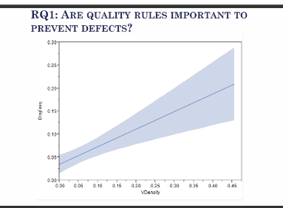
Intro
I chose this method because all the evaluated metrics were significantly high, and after a few releases, the methods underwent substantial changes and no longer exhibited any bugs.
Therefore, I aimed to test the software engineering theory which suggests that a lower number of code smells corresponds to a reduced probability of defects.
These are the collected metrics before my refactoring on the 4.1.0 :
release | method | path | loc | age | nAuth | nr | nSmell | buggy
4.1.0 | run | hedwig-server/src/main/java/org/apache/hedwig/admin/console/HedwigConsole.java | 114 | 0 | 1 | 1 | 27 | True
4.2.0 | run | hedwig-server/src/main/java/org/apache/hedwig/admin/console/HedwigConsole.java | 39 | 216 | 2 | 7 | 1 | True
4.2.1 | run | hedwig-server/src/main/java/org/apache/hedwig/admin/console/HedwigConsole.java | 39 | 286 | 2 | 7 | 1 | False
Refactored
Methods

Slide 21
Instant of inspection of the ticket at the begin of each release.
Release 4.2.0 id=3
No ticket
Release 4.2.1 id = 4
BOOKKEEPER-457 | Iv_evaluated=4.1.0
 | Iv=null
 | Ov=4.2.0
 | Fv=4.2.0
BOOKKEEPER-439 | Iv_evaluated=4.1.0
 | Iv=null
 | Ov=4.2.0
 | Fv=4.2.0
BOOKKEEPER-330 | Iv_evaluated=4.1.0
 | Iv=null
 | Ov=4.2.0
 | Fv=4.2.0
Release 4.2.0 test
BOOKKEEPER-561 | Iv_evaluated=4.1.0
 | Iv=null
 | Ov=4.2.1
 | Fv=4.2.1
BOOKKEEPER-557 | Iv_evaluated=4.1.0
 | Iv=null
 | Ov=4.2.1
 | Fv=4.2.1
HISTORY OF THE METHOD
As previously observed, we can assume that the method was introduced in release 4.1.0 and remained buggy for the first two subsequent releases.
Each bug persisted, on average, for one release cycle.
This analysis is based on the corresponding issue fix tickets.
 | 4.0.0 | 4.1.0 | 4.2.0 | 4.2.1 | 4.2.2[test]
Train 2 [4.1.0] | not exist
Train 3 [4.2.0] | not exist | FN
Train 4 [4.2.1] ticket 457,439 e 330 | not exist | TP | FN
Test 5 [4.2.2] ticket 561 e 557 | not exist | TP | TP | TN
Link to the document
Refactored
Methods

Slide 22
DESCRIPTION OF THE METHOD:
The method exposes an interface for executing commands on a console.
It supports execution both through the JLine library and via a simpler mode that does not rely on it.
This design choice support the method’s usability, making it more
user-friendly.
At first examining the method, what stood out was the complexity introduced by a relatively high number of catch blocks, which made it difficult to read.
Although the associated metric of trycatch value may appear low, it is actually among the highest compared to other methods in the BookKeeper project.
release | method | loc | wmc | assignmentsQty | mathOperationsQty | qtyTry Catch | qtyReturn | fanin | fanout | age | nAuth | nr | nSmell | buggy
4.1.0 | run | 114 | 20 | 37 | 1 | 3 | 0 | 1 | 7 | 0 | 1 | 1 | 27 | True
4.2.0 | run | 39 | 7 | 9 | 1 | 1 | 0 | 1 | 7 | 216 | 2 | 7 | 1 | True
4.2.1 | run | 39 | 7 | 9 | 1 | 1 | 0 | 1 | 7 | 286 | 2 | 7 | 1 | False
Refactored
Methods

Slide 23
Criteria for the refactor:
I chose to refactor this method also because it provided an opportunity to observe how it was refactored in the subsequent version.
The method showed a significant reduction across several metrics; however, it was not possible to simply copy and paste the refactored code, as the changes were not straightforward.
Although the core functionality remained the same, there was no clearly defined or transparent refactoring process.
release | method | loc | wmc | assignmentsQty | mathOperationsQty | qtyTryCatch | qtyReturn | fanin | fanout | age | nAuth | nr | nSmell | buggy
4.01.00 | run | 114 | 20 | 37 | 1 | 3 | 0 | 1 | 7 | 0 | 1 | 1 | 27 | True
4.02.00 | run | 39 | 7 | 9 | 1 | 1 | 0 | 1 | 7 | 216 | 2 | 7 | 1 | True
Refactored
Methods

Slide 24
Criteria for the refactor:
For the refactoring process, I chose to divide the method into multiple smaller functions, each with its own specific responsibility.
The intention was to potentially increase the overall complexity metrics at the class level, while reducing the complexity values for each individual method. Create a class that best represents the domain of a console with terminal, commands, chronology.
Refactored
Methods

Slide 25
Resulting refactored method:
For the refactoring, I chose to subdivide the method into multiple functions, each with its own specific responsibility.
The expectation was to increase the overall complexity metrics while reducing the complexity values of the individual methods.
 | loc | wmc | assignmentsQty | mathOperationsQty | qtyTryCatch | qtyReturn | fanin | fanout | nSmell
old | 114 | 20 | 37 | 1 | 3 | 0 | 1 | 7 | 27
Refactored | 7,6 | 1,6 | 1,6 | 0 | 0,133 | 0,2 | 1,133 | 1,533 | 1,533
release | method | className | loc | wmc | assignmentsQty | mathOperationsQty | qtyTryCatch | qtyReturn | fanin | fanout | nSmell | buggy
4.1.0 | runJLineConsole | HedwigConsole | 11 | 2 | 1 | 0 | 1 | 0 | 1 | 4 | 1 | False
4.1.0 | executeShutdownSequence | HedwigConsole | 10 | 2 | 1 | 0 | 1 | 0 | 1 | 2 | 1 | False
4.1.0 | runInteractiveMode | HedwigConsole | 8 | 2 | 0 | 0 | 0 | 0 | 1 | 3 | 0 | False
4.1.0 | runSimpleConsole | HedwigConsole | 7 | 2 | 2 | 0 | 0 | 0 | 2 | 1 | 1 | False
4.1.0 | executeLine | HedwigConsole | 8 | 2 | 0 | 0 | 0 | 0 | 3 | 3 | 0 | False
4.1.0 | run_refactored | HedwigConsole | 7 | 2 | 0 | 0 | 0 | 0 | 0 | 4 | 1 | False
4.1.0 | isJLineAvailable | HedwigConsole | 11 | 2 | 0 | 0 | 1 | 2 | 1 | 0 | 0 | False
4.1.0 | initializeConsole | HedwigConsole | 5 | 1 | 2 | 0 | 0 | 0 | 1 | 1 | 0 | False
4.1.0 | loadHistoryEntries | HedwigConsole$ConsoleHandler | 14 | 3 | 4 | 0 | 0 | 0 | 1 | 1 | 6 | False
4.1.0 | initializeCommandMethods | HedwigConsole$ConsoleHandler | 4 | 1 | 2 | 0 | 0 | 0 | 1 | 0 | 2 | False
4.1.0 | setupCompletor | HedwigConsole$ConsoleHandler | 6 | 1 | 3 | 0 | 0 | 0 | 1 | 0 | 4 | False
4.1.0 | getHistoryFile | HedwigConsole$ConsoleHandler | 6 | 1 | 2 | 0 | 0 | 1 | 1 | 0 | 0 | False
4.1.0 | initializeConsoleReader | HedwigConsole$ConsoleHandler | 5 | 1 | 2 | 0 | 0 | 0 | 1 | 0 | 2 | False
4.1.0 | runCommandLoop | HedwigConsole$ConsoleHandler | 7 | 2 | 1 | 0 | 0 | 0 | 1 | 2 | 0 | False
4.1.0 | setupJLineConsole | HedwigConsole$ConsoleHandler | 6 | 1 | 0 | 0 | 0 | 0 | 1 | 4 | 0 | False
4.1.0 | setupHistory | HedwigConsole$ConsoleHandler | 10 | 1 | 5 | 0 | 0 | 0 | 1 | 2 | 6 | False
 |  | Totali | 114 | 24 | 24 | 0 | 2 | 3 | 17 | 23 | 23
 |  | Medie | 7,6 | 1,6 | 1,6 | 0 | 0,133333 | 0,2 | 1,133333 | 1,533333 | 1,533333
Refactored
Methods

Slide 26
Correlated smell metrics
The only metrics that increased relative to the original method are:
qtyReturn : rises due to the decomposition into multiple smaller methods, each returning its own value instead of the single monolithic method returning nothing (qtyReturn = 0 in the original).
fanin : increases because more methods are now being called by one another, reflecting a higher (but more balanced) level of internal coupling. Unlike the original, where a single method drove all logic, the refactored design distributes calls across the new sub-methods, producing a more even fanin/fanout ratio.
 | loc | wmc | assignmentsQty | mathOperationsQty | qtyTryCatch | qtyReturn | fanin | fanout | nSmell
old | 114 | 20 | 37 | 1 | 3 | 0 | 1 | 7 | 27
Refactored | 7,6 | 1,6 | 1,6 | 0 | 0,133 | 0,2 | 1,133 | 1,533 | 1,533
BOOKKEEPER |  | Smell Correlation | Bug Correlation
1 | loc | 0.69269 | 0.09747
2 | wmc | 0.57613 | 0.04225
3 | assignmentQTY | 0.58412 | 0.04935
4 | mathOpQTY | 0.41173 | 0.07979
5 | TryCatchQTY | 0.3765 | 0.0954
6 | qtyReturn | 0.14486 | 0.0868
7 | fanin | -0.00431 | 0.00761
8 | fanout | 0.26399 | 0.1683
9 | age | 0.0151 | 0.10463
10 | nAuth | 0.01244 | 0.2206
11 | nr | 0.02656 | 0.14766
12 | nSmell | — | 0.07386
The increase in qtyReturn and fanin is justified by the fact that both metrics exhibit negligible correlation with buggyness and nSmell, and represent an expected side effect of decomposing the original method into smaller, single-responsibility units. Conversely, the metrics most strongly correlated with defect-proneness and code smells — loc, wmc, and fanout — show a substantial reduction. The refactoring therefore correctly improved code maintainability and reduced technical debt, in line with the objectives of the analysis.
Refactored
Methods

Slide 27

Intro
I chose this method because all the evaluated metrics were significantly high, and after several releases, the method underwent sugnificant changes and no longer exhibited any bugs.
Analyzing this method provided me with an opportunity to gain a deeper understanding of the historical development within my project.
release | method | path | loc | age | nAuth | nr | nSmell | buggy
0.09.00 | eval | openjpa-kernel/src/main/java/org/apache/openjpa/kernel/jpql/JPQLExpressionBuilder.java | 212 | 45 | 2 | 8 | 14 | False
0.09.06 | eval | openjpa-kernel/src/main/java/org/apache/openjpa/kernel/jpql/JPQLExpressionBuilder.java | 212 | 185 | 3 | 9 | 14 | False
0.09.07 | eval | openjpa-kernel/src/main/java/org/apache/openjpa/kernel/jpql/JPQLExpressionBuilder.java | 213 | 334 | 1 | 3 | 14 | True
1.00.00 | eval | openjpa-kernel/src/main/java/org/apache/openjpa/kernel/jpql/JPQLExpressionBuilder.java | 213 | 457 | 2 | 2 | 14 | True
1.00.01 | eval | openjpa-kernel/src/main/java/org/apache/openjpa/kernel/jpql/JPQLExpressionBuilder.java | 213 | 529 | 1 | 2 | 14 | True
1.00.02 | eval | openjpa-kernel/src/main/java/org/apache/openjpa/kernel/jpql/JPQLExpressionBuilder.java | 232 | 629 | 2 | 6 | 14 | True
1.01.00 | eval | openjpa-kernel/src/main/java/org/apache/openjpa/kernel/jpql/JPQLExpressionBuilder.java | 3 | 723 | 4 | 8 | 0 | True
1.00.03 | eval | openjpa-kernel/src/main/java/org/apache/openjpa/kernel/jpql/JPQLExpressionBuilder.java | 3 | 785 | 1 | 1 | 0 | False
1.02.00 | eval | openjpa-kernel/src/main/java/org/apache/openjpa/kernel/jpql/JPQLExpressionBuilder.java | 3 | 804 | 1 | 1 | 0 | False
2.0.0-M1 | eval | openjpa-kernel/src/main/java/org/apache/openjpa/kernel/jpql/JPQLExpressionBuilder.java | 3 | 974 | 1 | 6 | 0 | False
1.02.01 | eval | openjpa-kernel/src/main/java/org/apache/openjpa/kernel/jpql/JPQLExpressionBuilder.java | 3 | 1022 | 3 | 7 | 0 | False
2.0.0-M2 | eval | openjpa-kernel/src/main/java/org/apache/openjpa/kernel/jpql/JPQLExpressionBuilder.java | 268 | 1098 | 4 | 13 | 14 | False
Refactored
Methods

Slide 28
History of the method
Instant of inspection of the ticket at the begin of each release.
As seen before we can assume that the method was introduced in even before the 0.9.0 born as Non Buggy but then from 0.9.7 to 1.1.0 result as buggy. And in the future is no more buggy, for simplicity there is a report just until the release 1.2.0 but even in the successive release is no more buggy.
Ex : 1.0.0-1.0.2.
Release 0.9.0,0.9.6,0.9.7,1.0.0
No ticket
Release 1.0.1
OPENJPA-244 | Iv_evaluated=0.9.7
 | Iv=null
 | Ov=1.0.0
 | Fv=1.0.0
Release 1.0.2
No ticket
Release 1.1.0
OPENJPA-420 | Iv_evaluated=1.0.0
 | Iv=1.0.0
 | Ov=1.0.1
 | Fv=1.0.2
Release 1.0.3
OPENJPA-590 | Iv_evaluated=1.0.2
 | Iv=null
 | Ov=1.1.0
 | Fv=1.1.0
OPENJPA-595 | Iv_evaluated=1.0.2
 | Iv= 1.0.0
 | Ov=1.1.0
 | Fv= 1.1.0
OPENJPA-547 | Iv_evaluated=1.0.2
 | Iv=null
 | Ov=1.1.0
 | Fv=1.1.0
Link to the document
 | 0.9.0 | 0.9.6 | 0.9.7 | 1.0.0 | 1.0.1 | 1.0.2 | 1.1.0 | 1.0.3 | 1.2.0
Train 2 [0.9.6] | FN
Train 3 [0.9.7] | FN | FN
Train 4 [1.0.0] | FN | FN | FN
Train 5 [1.0.1] ticket 244 | FN | FN | TP | FN
Train 6 [1.0.2] | FN | FN | TP | FN | FN
Train 7 [1.1.0] ticket 420 | FN | FN | TP | TP | TP | FN
train 8 [1.0.3] ticket 586 & 547 | FN | FN | TP | TP | TP | TP | TP
train 9 [1.2.0] ticket 495 | FN | FN | TP | TP | TP | TP | TP | TP | FN
Refactored
Methods

Slide 29
Description of the method:
The method expose an interface for query written in JPQL a java persistence query language and it converts it to an expression so that the program could execute it. The first thing that impressed me is the complexity of handle all the method by switch statement, not evaluated metrics in actual condition.
release | method | loc | wmc | assignmentsQty | mathOperationsQty | qtyTryCatch | qtyReturn | fanin | fanout | nSmell
0.09.00 | eval | 212 | 81 | 61 | 2 | 0 | 56 | 12 | 55 | 14
0.09.06 | eval | 212 | 81 | 61 | 2 | 0 | 56 | 11 | 33 | 14
0.09.07 | eval | 213 | 83 | 61 | 2 | 0 | 57 | 12 | 55 | 14
1.00.00 | eval | 213 | 83 | 61 | 2 | 0 | 57 | 12 | 55 | 14
1.00.01 | eval | 213 | 83 | 61 | 2 | 0 | 57 | 12 | 55 | 14
1.00.02 | eval | 232 | 88 | 68 | 5 | 0 | 60 | 12 | 50 | 14
1.01.00 | eval | 3 | 2 | 0 | 0 | 0 | 1 | 1 | 0 | 0
1.00.03 | eval | 3 | 2 | 0 | 0 | 0 | 1 | 1 | 0 | 0
1.02.00 | eval | 3 | 2 | 0 | 0 | 0 | 1 | 1 | 0 | 0
2.0.0-M1 | eval | 3 | 2 | 0 | 0 | 0 | 1 | 1 | 0 | 0
1.02.01 | eval | 3 | 2 | 0 | 0 | 0 | 1 | 1 | 0 | 0
2.0.0-M2 | eval | 268 | 109 | 68 | 2 | 0 | 77 | 12 | 50 | 14
Refactored
Methods

Slide 30
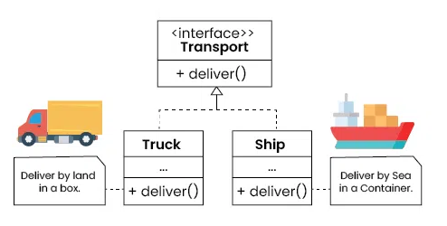
Criteria for the refactor:
I chose to refactor in order to decompose the code and adopt a more modular approach.
From this analysis, I also decided to extend the analysis to the class level, considering nested inner classes within the same file.
The refactoring was based on applying a registry pattern, where a factory uses a JPQL node to return the corresponding JPQL expression.
For the refactor I decided to decompose the code and adopt a more modular approach. From this analysis, I also decided to extend the analysis to the class level, considering nested inner classes within the same file. The refactoring was based on applying a registry pattern, where a factory uses a JPQL node to return the corresponding JPQL expression.
Refactored
Methods

Slide 31
Resulting refactored method:
For the refactoring, I chose to subdivide the method into multiple functions, each assigned a specific responsibility.
The expectation was to increase the overall complexity metrics while reducing the complexity values of the individual methods.
Full excel Table
release | method | className | loc | wmc | assignQty | mathOp | tryC | qtyRet | fanin | fanout | nSmell
0.9.7 | eval | JPQLExpressionBuilder$EvaluationContext | 3 | 1 | 0 | 0 | 0 | 1 | 3 | 1 | 0
0.9.7 | supports | JPQLExpressionBuilder$TrimEvaluator | 3 | 2 | 0 | 0 | 0 | 1 | 0 | 0 | 0
0.9.7 | supports | JPQLExpressionBuilder$LocateEvaluator | 3 | 2 | 0 | 0 | 0 | 1 | 0 | 0 | 0
0.9.7 | evaluate | JPQLExpressionBuilder$DateTimeFunctionEvaluator | 12 | 4 | 0 | 0 | 0 | 3 | 0 | 3 | 0
0.9.7 | getExpression | JPQLExpressionBuilder$EvaluationContext | 3 | 1 | 0 | 0 | 0 | 1 | 3 | 1 | 0
 | …
 | Total |  | 425 | 202 | 41 | 2 | 0 | 110 | 84 | 180 | 22
 | Average |  | 4,775 | 2,270 | 0,461 | 0,022 | 0,000 | 1,236 | 0,944 | 2,022 | 0,247
release | method | className | loc | wmc | assignQty | mathOp | tryC | qtyRet | fanin | fanout | nSmell
0.9.7 | eval | JPQLExpressionBuilder | 213 | 83 | 61 | 2 | 0 | 57 | 5 | 71 | 14
Refactored
Methods

Slide 32
Resulting refactored method:
 | method | className | loc | wmc | assignmentsQty | mathOperationsQty | qtyTryCatch | qtyReturn | fanin | fanout | nSmell
New Version | Eval | Total | 425 | 202 | 41 | 2 | 0 | 110 | 84 | 180 | 22
 |  | Average | 4,775 | 2,270 | 0,461 | 0,022 | 0,000 | 1,236 | 0,944 | 2,022 | 0,247
Old Version | eval | JPQLExpressionBuilder | 213 | 83 | 61 | 2 | 0 | 57 | 12 | 55 | 14
Unlike the BookKeeper case, the OpenJPA refactoring produces a uniform reduction across all metrics, including qtyReturn and fanin. This is due to the adoption of a registry pattern: the original monolithic eval method — which handled all JPQL node types via a large switch statement — was replaced by a family of small, specialised evaluator classes, each exposing a single evaluate() method with minimal coupling.
Notably, qtyTryCatch drops to an average of 0.02, a value that correlates with nSmell but shows negligible correlation with buggyness. This suggests that the reduction in exception-handling blocks contributes to a cleaner code structure in terms of smell density, without being a direct driver of defect probability in this project.
As a result, the average per-method complexity drops drastically across all dimensions, while the total structural complexity is distributed across 11 new methods rather than concentrated in one.
OPENJPA |  | Smell Correlation | Bug Correlation
1 | loc | 0.5847 | 0.1386
2 | wmc | 0.4341 | 0.1221
3 | assignmentQTY | 0.4538 | 0.1061
4 | mathOpQTY | 0.2166 | 0.0463
5 | TryCatchQTY | 0.1635 | 0.0737
6 | qtyReturn | 0.174 | 0.0868
7 | fanin | 0.0135 | 0.0847
8 | fanout | 0.3762 | 0.1683
9 | age | 0.0217 | 0.1195
10 | nAuth | 0.041 | 0.2574
11 | nr | 0.0568 | 0.4395
12 | nSmell | — | 0.0731
Refactored
Methods

Slide 33

Milestone 4
What if Analysis
Francesco Astolfi

Slide 34
What If Analysis
Create:
  B+: Portion of A with NSmells >0
  C portion of A with NSmells =0.
  B: B+ manipulated with feature NSmells set to 0
Train BClassifier on A, aka BClassifierA
Predict A, B, B+, C and create a Table like in slide 14
Analyze the Table and answer: How many buggy methods could have
been prevented by having zero smells?
In total
In proportion
Out of the preventable ones

Slide 35
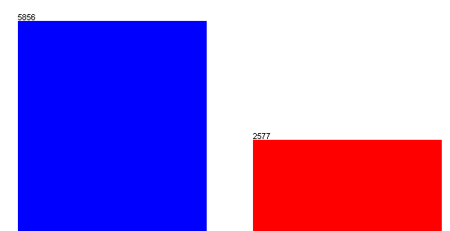

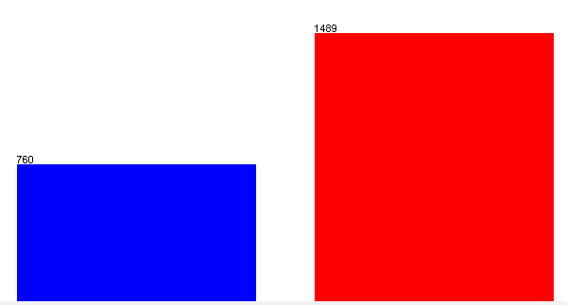
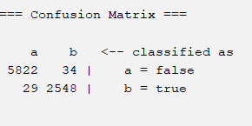
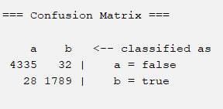
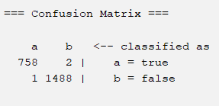
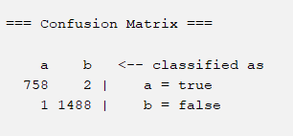
What if 0 smells?
Actual
A
Matrix
C
Matrix
B+
Matrix
B
Matrix
5856
42945
10702
10702
42959
1489
4367
1489
6095
6095
6102
2577
14514
6102
760
1817
14251
760
2577 actual bug
1817 actual bug,
nSmell==0
1489 actual bug,
smell>0
1489 actual bug,
smell set to 0
Multi Layer Parceptron Trained on A
A
Matrix
C
Matrix
B+
Matrix
B
Matrix
What if
analysis
2552
predicted bug
1821
predicted bug
1490
predicted bug
1490
predicted bug

Slide 36
Experimental learning:
B
Matrix
B
Matrix
Link to the document
10702
1489
6095
760
6102
BOOKKEEPER |  | Smell Correlation | Bug Correlation
1 | loc | 0.69269 | 0.09747
2 | wmc | 0.57613 | 0.04225
3 | assignmentQTY | 0.58412 | 0.04935
4 | mathOpQTY | 0.41173 | 0.07979
5 | TryCatchQTY | 0.3765 | 0.0954
6 | qtyReturn | 0.14486 | 0.0868
7 | fanin | -0.00431 | 0.00761
8 | fanout | 0.26399 | 0.1683
9 | age | 0.0151 | 0.10463
10 | nAuth | 0.01244 | 0.2206
11 | nr | 0.02656 | 0.14766
12 | nSmell |  | 0.07386
1490
predicted bug
1489 actual bug
smell set to 0
  In the Bookkeeper dataset, the model accurately predict bugs even in the absence of smells. In fact, performance slightly improves without them for example, in the C matrix (where smell = 0), the model misclassifies only 3 bugs compared to the original A matrix.
What if
analysis
  As a result we can see that there is a low correlation between smell and bug, but also that all the strong correlated feature with the nSmell are not so much strong also for the bug prediction maybe this is also due to the fact that the number of instance is too low for training ( the model not learned the correlation between loc and buggyness as we generally expected)

Slide 37
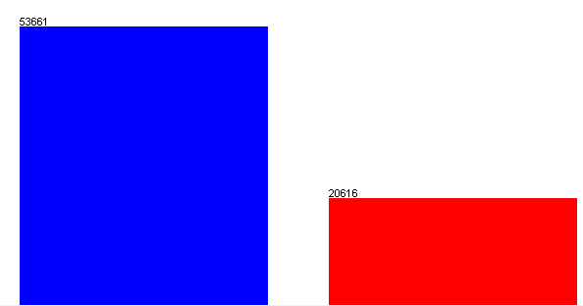
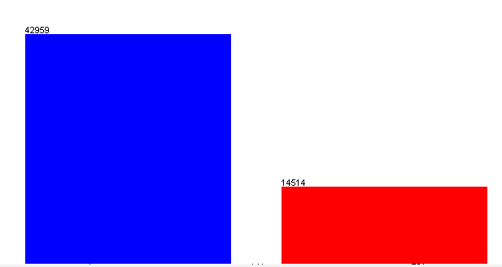

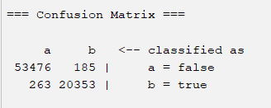
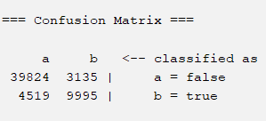
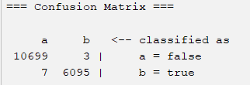
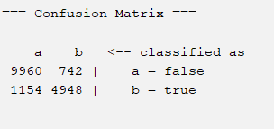

What if 0 smells?
Actual
A
Matrix
C
Matrix
B+
Matrix
B
Matrix
42945
10702
53661
42959
10702
6095
14514
6102
6102
20616
14251
20616 actual bug
14251 actual bug,
nSmell==0
6102 actual bug,
nSmell>0
6102 actual bug,
nSmell set to 0
Multi Layer Parceptron Trained on A
A
Matrix
C
Matrix
B+
Matrix
B
Matrix
20538
predicted bug
13130
predicted bug
6098
predicted bug
5690
predicted bug

Slide 38
Lesson learned :
B
Matrix
B
Matrix
10702
Link to the document
6102
OPENJPA |  | Smell Correlation | Bug Correlation
1 | loc | 0.5847 | 0.1386
2 | wmc | 0.4341 | 0.1221
3 | assignmentQTY | 0.4538 | 0.1061
4 | mathOpQTY | 0.2166 | 0.0463
5 | TryCatchQTY | 0.1635 | 0.0737
6 | qtyReturn | 0.174 | 0.0868
7 | fanin | 0.0135 | 0.0847
8 | fanout | 0.3762 | 0.1683
9 | age | 0.0217 | 0.1195
10 | nAuth | 0.041 | 0.2574
11 | nr | 0.0568 | 0.4395
12 | nSmell |  | 0.0731
6102 actual bug
smell set to 0
5690
predicted bug
  The number of bug that could be removed without the smell is:
  6102 – 5690 = 412 the ( 7.2%)
  [Actual] – [Predicted with 0 smell]
  OpenJPA shows a relatively low injection of code smells. Only about 7.2% of bugs appear to be correlated with the presence of smells.
  Note: This is an approximate analysis, as no normalization or filtering was applied to reduce the influence of features correlated with buggyness (e.g., LOC). Large methods with hundreds of lines can still be marked as "0 smell" but be highly defect-prone.

