Slide 1


Report project isw2
Francesco Astolfi
Link to the repo
Project analized:
Francesco Astolfi

Slide 2

Milestone 1 the dataset
Francesco Astolfi

Slide 3

How the dataset is built :
The dataset is built for each release to enable walk-forward training and to allow users to reconstruct the history and evolution of each bug, including its labeling. Each release analyzes the commits that were pushed to GitHub before the start of the release, and considers all tickets that were published before the end of the release being analyzed.
For each project, only the first 33% of the available releases were selected.
However, for smaller projects like BookKeeper, it was necessary to use up to 55% of the releases to ensure sufficient data for analysis.

Slide 4

How the bug are selected
Buggyness is assigned based on commits linked to bug-related tickets. If a commit modifies one or more methods and is associated with a bug ticket, those methods are labeled as buggy.
Then labeling procedure propagates buggyness from the injected version( or the evaluated one )
up to the fixed version.
Feature like nr, age, nAuth are assigned by a class evaluation, all the others are assigned at method evaluation. CK metrics by the support library, nSmell by the PMDrunner

Slide 5
Wich metrics and why
Features such as nr, age, and nAuth are computed at the class level, while all other features are evaluated at the method level.
CK metrics (e.g: loc, wmc, fanin, fanout) are extracted using a support library.
nSmell is computed using a custom PMD runner.
The actionable evaluated feature are all feature that could be easy mesurable and just track a good way of coding, the analisis is focused on find wich of this simple element is more correlated to the buggyness.

Slide 6
Some of the introduced improved
Commit caching was implemented to optimize performance.
The analysis was executed in parallel across multiple threads.
A maximum number of classes per commit was analyzed; any excess was cached and assigned to other threads.
Persistence-related data was encapsulated and hidden from the rest of the project through the use of a DAO
All constants and path definitions relevant to the project were centralized in a single class to facilitate future reconfiguration.
All training and test files that have not yet been written are generated.
During the commit analysis, partial writes may occur to allow better monitoring and tracking of the process.
Despite these improvements, the project remains difficult to configure and understand.

Slide 7
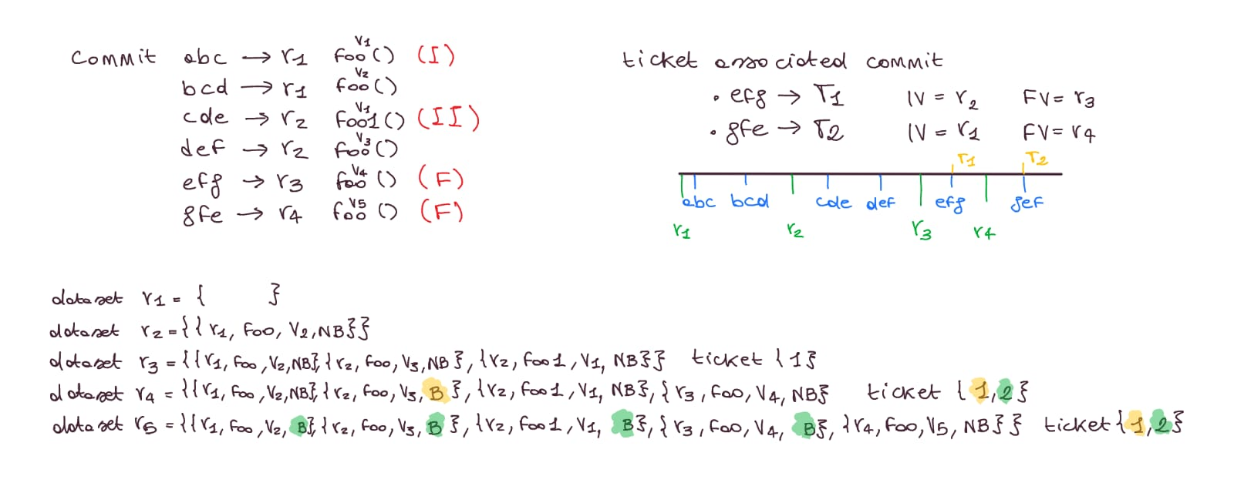
Some adverstment
Even if a release contains tickets associated with bugs, it is acceptable that no buggy methods appear in the results. This is because some of those tickets may refer to commits made in the current release, rather than to commits from previous releases.
However, the labeling of buggy methods is based only on the commits pushed to GitHub before the start of the release currently being analyzed. Therefore, if a bug is introduced and fixed within the same release, it may not be labeled as buggy in this context.

Slide 8
Some adverstment
Association of buggyness in a release dataset :
Even if a method is associated with a specific commit, it may also belong to a broader set of methods modified by other commits. This occurs due to a rebalancing of the methods to be processed in the cache. However, this behavior does not affect the labeling of buggyness.
The identification of buggy methods is based on the methods modified in commits linked to bug-related tickets. jGit is used to extract the methods changed in each commit.
Then, buggyness is assigned to the affected version, considering the interval from the injected version to the fixed version.
Approach of evaluation of the Injected Version when it missing:
Cold start proportion at the beginning
Incremental, each release take the ticket available, opening version before the release starts, evaluate proportion on the ticket that have a valid injected version.
Adjust the injected version of the ticket that not have a valid one with proportion

Slide 9
Future improvements:
Two approaches:
More precise evaluation of metrics (Age, NR, NAuth) at method level
This choice adds complexity to the project but improves the accuracy of the metrics.
The method-level approach is also scalable, allowing for analysis of code evolution on a per-release basis, rather than relying only on cumulative results across all releases.
Simplify the project by evaluating only at the end, maintaining class-level metrics
This option makes the project simpler by analyzing the entire codebase only at the final stage, keeping metrics at class level.
Hybrid approach:
Maintain the final project view, but evaluate only Age, NAuth, and NR metrics commit-by-commit.

Slide 10
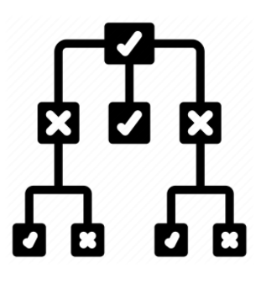
Milestone 2
Compare the 3 classificators
Francesco Astolfi
The Models

Slide 11
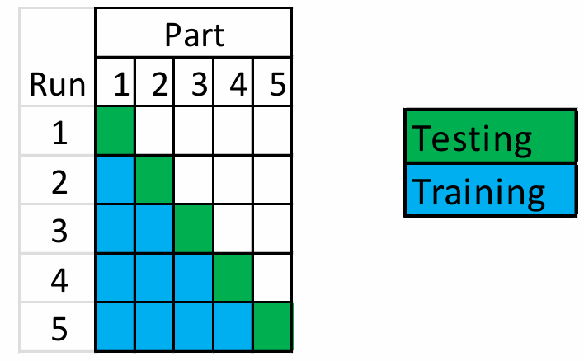
Training testing procedure:
The training process follows a walk-forward approach.
The dataset is maintained in chronological order over time, and the smallest unit used for splitting is the software release.
The Models

Slide 12
Important notes about the dataset !
The first available release for training is release 2, as the goal is to verify whether the previous release contains bugs.
For this reason, the commits considered belong to the previous release, while the tickets taken into account refer to the current release.
Only the final test release utilizes all commits available throughout the project.
The Models

Slide 13
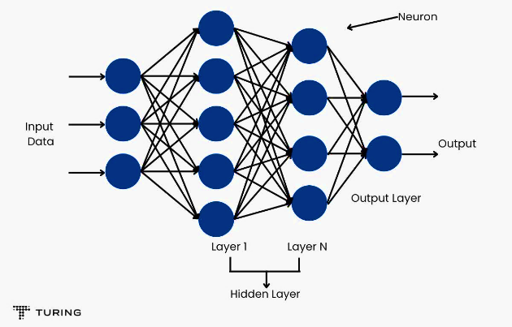
Models considerated
Multi Layer Parceptron:
This is the most sophisticated model, requiring more time and computational resources due to its complexity. It is particularly useful for tasks involving data that do not exhibit a linear correlation and is commonly used to learn how to process and model complex input data.
Statistic Gradient Descendent:
This is the simplest model for a task, but it may underfit more complex problems.
Its main advantage lies in the ease of interpretability, as anyone can easily understand how decisions are made.
Statistic Gradient Descendent:
Random Forest is generally one of the most accurate models across a wide range of scenarios.
It combines the predictions of multiple decision trees to improve overall performance and reduce the risk of overfitting.

Slide 14
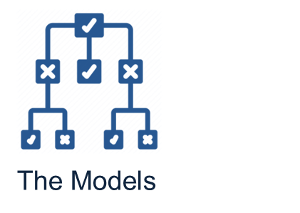
Evaluation metrics
Auc :
The Area Under the Curve (AUC) refers to the area under the ROC curve, which plots the recall (true positive rate) on the y-axis and the false positive rate on the x-axis.
The key advantage of this metric is that it is independent of the decision threshold used to distinguish between positive and negative instances.
Y-axis TP/TP+FN
X-axis FP/ FP+TN
Precision :
This metric evaluates how well the model can correctly predict positive instances while discarding the negative ones.
It is generally easier to maximize either this measure or recall individually, but it is not easy to optimize both simultaneously.
Recall:
Instead of precision, recall is used because the "snoring" behavior cannot produce false positives and even if it does, they are less critical than false negatives.
A false negative (i.e., an instance that is actually positive but predicted as negative) is considered more harmful in this context.
Kappa :
The number of time that the model is better
than a random model.

Slide 15


Applied teory during training
Feature selection :
A ranked greedy approach was used, where for each of the n evaluated features,
only p (with p < n) were selected based on their ranking to optimize the evaluation process.
This method considers features jointly rather than treating them independently.
Sampling :
If there were more positive instances than negative ones, a portion of the positive instances was discarded in order to balance the number of samples between the two classes.
Preprocessing:
From all the methods in the dataset, the identifying features such as MethodName, ClassName, ClassPath, and Release are removed.
These features are excluded as they serve only to uniquely identify a method within a specific release and are not useful for training or evaluating predictive models.

Slide 16
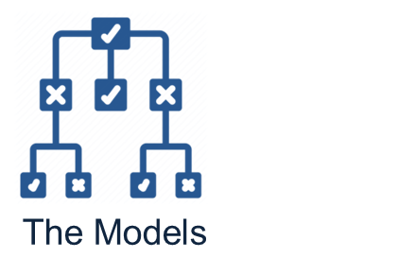
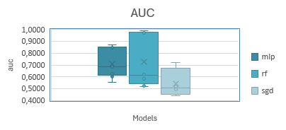
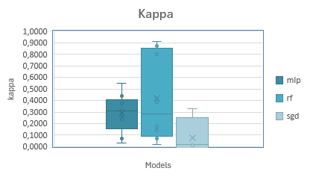
Experiments done :
link to the document
 | Training set | Training Process | Testing set | Classifier | Feature selection | Sampling | Precision | Recall | Auc | Kappa
1 | Openjpa | Walk-Forward | Openjpa | rf | false | true | 0,7492 | 0,9430 | 0,9728 | 0,8012
2 | Openjpa | Walk-Forward | Openjpa | mlp | false | false | 0,3655 | 0,8458 | 0,8735 | 0,3778
3 | Openjpa | Walk-Forward | Openjpa | sgd | false | false | 0,3595 | 0,6806 | 0,7218 | 0,3264
4 | Openjpa | CrossValidation | Openjpa | rf | false | false | 0,9680 | 0,9850 | 0,9910 | 0,9129
5 | Openjpa | CrossValidation | Openjpa | mlp | false | false | 0,8100 | 0,8090 | 0,8590 | 0,4388
6 | Openjpa | CrossValidation | Openjpa | sgd | false | false | 0,7870 | 0,9330 | 0,6380 | 0,3252
7 | Bookkeeper | Walk-Forward | Bookkeeper | rf | false | false | 0,8258 | 0,3624 | 0,6200 | 0,3900
8 | Bookkeeper | Walk-Forward | Bookkeeper | mlp | false | false | 0,5822 | 0,4130 | 0,5547 | 0,3078
9 | Bookkeeper | Walk-Forward | Bookkeeper | sgd | true [age] | false | 0,2997 | 0,5234 | 0,4926 | 0,0100
10 | Bookkeeper | CrossValidation | Bookkeeper | mlp | false | false | 0,8160 | 0,8210 | 0,8440 | 0,5472
11 | Bookkeeper | CrossValidation | Bookkeeper | rf | false | false | 0,9460 | 0,9460 | 0,9820 | 0,8717
12 | Bookkeeper | CrossValidation | Bookkeeper | sgd | false | false | 0,6940 | 0,6940 | 0,5000 | 0,0000
13 | Openjpa | Walk-Forward | Bookkeeper | mlp | false | false | 0,5148 | 0,0403 | 0,6833 | 0,0318
14 | Openjpa | Walk-Forward | Bookkeeper | mlp | true [age,nr] | false | 0,5252 | 0,4260 | 0,6282 | 0,2708
15 | Openjpa | Walk-Forward | Bookkeeper | rf | true[age,nr] | false | 0,7633 | 0,1276 | 0,5847 | 0,1437
16 | Openjpa | Walk-Forward | Bookkeeper | sgd | true[age,nr] | false | 0,3235 | 0,4322 | 0,5172 | 0,0316
17 | Openjpa | CrossValidation[Model 4 trained] | Bookkeeper | rf | false | false | 0,6640 | 0,6980 | 0,6040 | 0,1735
18 | Openjpa | CrossValidation[Model 5 trained] | Bookkeeper | mlp | false | false | 0,7060 | 0,9850 | 0,6000 | 0,0714
19 | Openjpa | CrossValidation[Model 6 trained] | Bookkeeper | sgd | false | false | 0,6800 | 0,7000 | 0,5160 | 0,0441
20 | Bookkeeper | Walk-Forward | Openjpa | mlp | false | false | 0,3752 | 0,5235 | 0,6932 | 0,3288
21 | Bookkeeper | Walk-Forward | Openjpa | sgd | true [age] | false | 0,1144 | 0,4809 | 0,4426 | -0,0490
22 | Bookkeeper | Walk-Forward | Openjpa | rf | false | false | 0,1496 | 0,4532 | 0,5196 | 0,0212
23 | Bookkeeper | CrossValidation[Model 10 trained] | Openjpa | mlp | false | false | 0,6950 | 0,7090 | 0,6300 | 0,2366
24 | Bookkeeper | CrossValidation[Model 11 trained] | Openjpa | rf | false | false | 0,6280 | 0,6570 | 0,5240 | 0,0700
25 | Bookkeeper | CrossValidation[Model 12 trained] | Openjpa | sgd | false | false | 0,7220 | 1,0000 | 0,5000 | 0,0000
 | Number of set for bookkeeper : 5 |  |  |  |  | Number of set for openjpa: 12
  Multi Layer Parceptron
  Get maybe not the best results but is more stable than the random forest
Experimental discover
The most interesting aspect is observing the in performance when training on OpenJPA and testing on Bookkeeper, and vice versa.

Slide 17
The more correlated feature to the buggyness
OpenJPA
link to the document
Bookkeeper:
OPENJPA |  | Smell Correlation | Bug Correlation
1 | loc | 0.5847 | 0.1386
2 | wmc | 0.4341 | 0.1221
3 | assignmentQTY | 0.4538 | 0.1061
4 | mathOpQTY | 0.2166 | 0.0463
5 | TryCatchQTY | 0.1635 | 0.0737
6 | qtyReturn | 0.174 | 0.0868
7 | fanin | 0.0135 | 0.0847
8 | fanout | 0.3762 | 0.1683
9 | age | 0.0217 | 0.1195
10 | nAuth | 0.041 | 0.2574
11 | nr | 0.0568 | 0.4395
12 | nSmell |  | 0.0731
BOOKKEEPER |  | Bug Correlation
1 | loc | 0.09747
2 | wmc | 0.04225
3 | assignmentQTY | 0.04935
4 | mathOpQTY | 0.07979
5 | TryCatchQTY | 0.0954
6 | qtyReturn | 0.0868
7 | fanin | 0.00761
8 | fanout | 0.1683
9 | age | 0.10463
10 | nAuth | 0.2206
11 | nr | 0.14766
12 | nSmell | 0.07386
The most actionable features most correlated with buggyness are LOC (Lines of Code) and fan-out, which measures how many times a method invokes other functions.

Slide 18

Milestone 3
The refactored Method
Francesco Astolfi

Slide 19
Refactored Method ( Milestone 3)
Rationale for Selecting the Target Method
History of the method
Description of the selected Method
Criteria for identifying Refactoring Targets with the method
Resulting refactored method
What if analysis

Slide 20
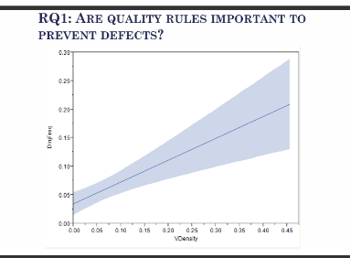
Intro
I chose this method because all the evaluated metrics were significantly high, and after a few releases, the methods underwent substantial changes and no longer exhibited any bugs.
Therefore, I aimed to test the software engineering theory which suggests that a lower number of code smells corresponds to a reduced probability of defects.
The following are the results of this analysis:
release | method | path | loc | age | nAuth | nr | nSmell | buggy
4.1.0 | run | hedwig-server/src/main/java/org/apache/hedwig/admin/console/HedwigConsole.java | 114 | 0 | 1 | 1 | 27 | True
4.2.0 | run | hedwig-server/src/main/java/org/apache/hedwig/admin/console/HedwigConsole.java | 39 | 216 | 2 | 7 | 1 | True
4.2.1 | run | hedwig-server/src/main/java/org/apache/hedwig/admin/console/HedwigConsole.java | 39 | 286 | 2 | 7 | 1 | False
Refactored
Methods

Slide 21
Release 4.2.0 id=3
No ticket
Release 4.2.1 id = 4
BOOKKEEPER-457 | Iv_evaluated=4.1.0
 | Iv=null
 | Ov=4.2.0
 | Fv=4.2.0
BOOKKEEPER-439 | Iv_evaluated=4.1.0
 | Iv=null
 | Ov=4.2.0
 | Fv=4.2.0
BOOKKEEPER-330 | Iv_evaluated=4.1.0
 | Iv=null
 | Ov=4.2.0
 | Fv=4.2.0
Release 4.2.0 test
BOOKKEEPER-561 | Iv_evaluated=4.1.0
 | Iv=null
 | Ov=4.2.1
 | Fv=4.2.1
BOOKKEEPER-557 | Iv_evaluated=4.1.0
 | Iv=null
 | Ov=4.2.1
 | Fv=4.2.1
HISTORY OF THE METHOD
As previously observed, we can assume that the method was introduced in release 4.1.0 and remained buggy for the first two subsequent releases.
Each bug persisted, on average, for one release cycle—equivalent to approximately 143 days.
This analysis is based on the corresponding issue fix tickets.
 | 4.0.0 | 4.1.0 | 4.2.0 | 4.2.1 | 4.2.2[test]
Train 2 [4.1.0] | not exist
Train 3 [4.2.0] | not exist | nb
Train 4 [4.2.1] ticket 457,439 e 330 | not exist | b | nb
Test 5 [4.2.2] ticket 561 e 557 | not exist | b | b | nb
Link to the document
Refactored
Methods

Slide 22
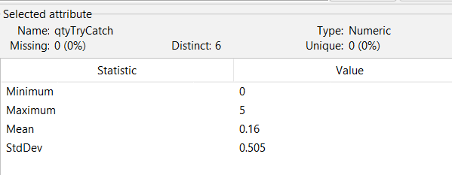
DESCRIPTION OF THE METHOD:
The method exposes an interface for executing commands on a console.
It supports execution both through the JLine library and via a simpler mode that does not rely on it.
This design choice support the method’s usability, making it more
userfriendly.
At first examining the method, what stood out was the complexity introduced by an undefined number of catch blocks, which made it difficult to read.
Although the associated metric of trycatch value may appear low, it is actually among the highest compared to other methods in the BookKeeper project.
release | method | loc | wmc | assignmentsQty | mathOperationsQty | qtyTry Catch | qtyReturn | fanin | fanout | age | nAuth | nr | nSmell | buggy
4.01.00 | run | 114 | 20 | 37 | 1 | 3 | 0 | 1 | 7 | 0 | 1 | 1 | 27 | VERO
4.02.00 | run | 39 | 7 | 9 | 1 | 1 | 0 | 1 | 7 | 216 | 2 | 7 | 1 | VERO
4.02.01 | run | 39 | 7 | 9 | 1 | 1 | 0 | 1 | 7 | 286 | 2 | 7 | 1 | FALSO
Refactored
Methods

Slide 23
Criteria for the refactor:
I chose to refactor this method also because it provided an opportunity to observe how it was refactored in the subsequent version.
The method showed a significant reduction across several metrics; however, it was not possible to simply copy and paste the refactored code, as the changes were not straightforward.
Although the core functionality remained the same, there was no clearly defined or transparent refactoring process.
release | method | loc | wmc | assignmentsQty | mathOperationsQty | qtyTryCatch | qtyReturn | fanin | fanout | age | nAuth | nr | nSmell | buggy
4.01.00 | run | 114 | 20 | 37 | 1 | 3 | 0 | 1 | 7 | 0 | 1 | 1 | 27 | VERO
4.02.00 | run | 39 | 7 | 9 | 1 | 1 | 0 | 1 | 7 | 216 | 2 | 7 | 1 | VERO
Refactored
Methods

Slide 24
Criteria for the refactor:
For the refactoring process, I chose to divide the method into multiple smaller functions, each with its own specific responsibility.
The intention was to potentially increase the overall complexity metrics at the class level, while reducing the complexity values for each individual method. Create a class that best represents the domain of a console with terminal, commands, chronology.
[ Refactor from AI assistant in IntelliJ]
Refactored
Methods

Slide 25
Resulting refactored method:
For the refactoring, I chose to subdivide the method into multiple functions, each with its own specific responsibility.
The expectation was to increase the overall complexity metrics while reducing the complexity values of the individual methods.
 | loc | wmc | assignmentsQty | mathOperationsQty | qtyTryCatch | qtyReturn | fanin | fanout | nSmell
Totals | 114 | 24 | 24 | 0 | 2 | 3 | 17 | 23 | 23
Average | 7,6 | 1,6 | 1,6 | 0 | 0,133 | 0,2 | 1,133 | 1,533 | 1,533
release | method | className | loc | wmc | assignmentsQty | mathOperationsQty | qtyTryCatch | qtyReturn | fanin | fanout | nSmell | buggy
4.01.00 | runJLineConsole | HedwigConsole | 11 | 2 | 1 | 0 | 1 | 0 | 1 | 4 | 1 | False
4.01.00 | executeShutdownSequence | HedwigConsole | 10 | 2 | 1 | 0 | 1 | 0 | 1 | 2 | 1 | False
4.01.00 | runInteractiveMode | HedwigConsole | 8 | 2 | 0 | 0 | 0 | 0 | 1 | 3 | 0 | False
4.01.00 | runSimpleConsole | HedwigConsole | 7 | 2 | 2 | 0 | 0 | 0 | 2 | 1 | 1 | False
4.01.00 | executeLine | HedwigConsole | 8 | 2 | 0 | 0 | 0 | 0 | 3 | 3 | 0 | False
4.01.00 | run_refactored | HedwigConsole | 7 | 2 | 0 | 0 | 0 | 0 | 0 | 4 | 1 | False
4.01.00 | isJLineAvailable | HedwigConsole | 11 | 2 | 0 | 0 | 1 | 2 | 1 | 0 | 0 | False
4.01.00 | initializeConsole | HedwigConsole | 5 | 1 | 2 | 0 | 0 | 0 | 1 | 1 | 0 | False
4.01.00 | loadHistoryEntries | HedwigConsole$ConsoleHandler | 14 | 3 | 4 | 0 | 0 | 0 | 1 | 1 | 6 | False
4.01.00 | initializeCommandMethods | HedwigConsole$ConsoleHandler | 4 | 1 | 2 | 0 | 0 | 0 | 1 | 0 | 2 | False
4.01.00 | setupCompletor | HedwigConsole$ConsoleHandler | 6 | 1 | 3 | 0 | 0 | 0 | 1 | 0 | 4 | False
4.01.00 | getHistoryFile | HedwigConsole$ConsoleHandler | 6 | 1 | 2 | 0 | 0 | 1 | 1 | 0 | 0 | False
4.01.00 | initializeConsoleReader | HedwigConsole$ConsoleHandler | 5 | 1 | 2 | 0 | 0 | 0 | 1 | 0 | 2 | False
4.01.00 | runCommandLoop | HedwigConsole$ConsoleHandler | 7 | 2 | 1 | 0 | 0 | 0 | 1 | 2 | 0 | False
4.01.00 | setupJLineConsole | HedwigConsole$ConsoleHandler | 6 | 1 | 0 | 0 | 0 | 0 | 1 | 4 | 0 | False
4.01.00 | setupHistory | HedwigConsole$ConsoleHandler | 10 | 1 | 5 | 0 | 0 | 0 | 1 | 2 | 6 | False
 |  | Totali | 114 | 24 | 24 | 0 | 2 | 3 | 17 | 23 | 23
 |  | Medie | 7,6 | 1,6 | 1,6 | 0 | 0,133333 | 0,2 | 1,133333 | 1,533333 | 1,533333
Refactored
Methods

Slide 26

Intro
I chose this method because all the evaluated metrics were significantly high, and after several releases, the method underwent complete changes and no longer exhibited any bugs.
Analyzing this method provided me with an opportunity to gain a deeper understanding of the historical development within my project.
release | method | path | loc | age | nAuth | nr | nSmell | buggy
0.09.00 | eval | openjpa-kernel/src/main/java/org/apache/openjpa/kernel/jpql/JPQLExpressionBuilder.java | 212 | 45 | 2 | 8 | 14 | False
0.09.06 | eval | openjpa-kernel/src/main/java/org/apache/openjpa/kernel/jpql/JPQLExpressionBuilder.java | 212 | 185 | 3 | 9 | 14 | False
0.09.07 | eval | openjpa-kernel/src/main/java/org/apache/openjpa/kernel/jpql/JPQLExpressionBuilder.java | 213 | 334 | 1 | 3 | 14 | True
1.00.00 | eval | openjpa-kernel/src/main/java/org/apache/openjpa/kernel/jpql/JPQLExpressionBuilder.java | 213 | 457 | 2 | 2 | 14 | True
1.00.01 | eval | openjpa-kernel/src/main/java/org/apache/openjpa/kernel/jpql/JPQLExpressionBuilder.java | 213 | 529 | 1 | 2 | 14 | True
1.00.02 | eval | openjpa-kernel/src/main/java/org/apache/openjpa/kernel/jpql/JPQLExpressionBuilder.java | 232 | 629 | 2 | 6 | 14 | True
1.01.00 | eval | openjpa-kernel/src/main/java/org/apache/openjpa/kernel/jpql/JPQLExpressionBuilder.java | 3 | 723 | 4 | 8 | 0 | True
1.00.03 | eval | openjpa-kernel/src/main/java/org/apache/openjpa/kernel/jpql/JPQLExpressionBuilder.java | 3 | 785 | 1 | 1 | 0 | False
1.02.00 | eval | openjpa-kernel/src/main/java/org/apache/openjpa/kernel/jpql/JPQLExpressionBuilder.java | 3 | 804 | 1 | 1 | 0 | False
2.0.0-M1 | eval | openjpa-kernel/src/main/java/org/apache/openjpa/kernel/jpql/JPQLExpressionBuilder.java | 3 | 974 | 1 | 6 | 0 | False
1.02.01 | eval | openjpa-kernel/src/main/java/org/apache/openjpa/kernel/jpql/JPQLExpressionBuilder.java | 3 | 1022 | 3 | 7 | 0 | False
2.0.0-M2 | eval | openjpa-kernel/src/main/java/org/apache/openjpa/kernel/jpql/JPQLExpressionBuilder.java | 268 | 1098 | 4 | 13 | 14 | False
Refactored
Methods

Slide 27
History of the method
As seen before we can assume that the method was introduced in even before the 0.9.0 born as Non Buggy but then from 0.9.7 to 1.1.0 result as buggy. And in the future is no more buggy, for simplicity there is a report just until the release 1.2.0 but even in the successive release is no more buggy. The max release of snoring is for 2 release.
Ex : 1.0.0-1.0.2.
Release 4.2.0 id=3
No ticket
Release 4.2.1 id = 4
BOOKKEEPER-457 | Iv_evaluated=4.1.0
 | Iv=null
 | Ov=4.2.0
 | Fv=4.2.0
BOOKKEEPER-439 | Iv_evaluated=4.1.0
 | Iv=null
 | Ov=4.2.0
 | Fv=4.2.0
BOOKKEEPER-330 | Iv_evaluated=4.1.0
 | Iv=null
 | Ov=4.2.0
 | Fv=4.2.0
Release 4.2.0 test
BOOKKEEPER-561 | Iv_evaluated=4.1.0
 | Iv=null
 | Ov=4.2.1
 | Fv=4.2.1
BOOKKEEPER-557 | Iv_evaluated=4.1.0
 | Iv=null
 | Ov=4.2.1
 | Fv=4.2.1
Link to the document
 | 0.9.0 | 0.9.6 | 0.9.7 | 1.0.0 | 1.0.1 | 1.0.2 | 1.1.0 | 1.0.3 | 1.2.0
Train 2 [0.9.6] | nb
Train 3 [0.9.7] | nb | nb
Train 4 [1.0.0] | nb | nb | nb
Train 5 [1.0.1] ticket 244 | nb | nb | b | nb
Train 6 [1.0.2] | nb | nb | b | nb | nb
Train 7 [1.1.0] ticket 420 | nb | nb | b | b | b | nb
train 8 [1.0.3] ticket 586 & 547 | nb | nb | b | b | b | b | b
train 9 [1.2.0] ticket 495 | nb | nb | b | b | b | b | b | nb
Refactored
Methods

Slide 28
Description of the method:
The method expose an interface for query written in JPQL a java persistence query language and it converts it to an expression so that the program could execute it. The first thing that impress my self is the complexity of handle all the method by switch statement, not evaluated metrics in actual condition.
release | method | loc | wmc | assignmentsQty | mathOperationsQty | qtyTryCatch | qtyReturn | fanin | fanout | nSmell
0.09.00 | eval | 212 | 81 | 61 | 2 | 0 | 56 | 12 | 55 | 14
0.09.06 | eval | 212 | 81 | 61 | 2 | 0 | 56 | 11 | 33 | 14
0.09.07 | eval | 213 | 83 | 61 | 2 | 0 | 57 | 12 | 55 | 14
1.00.00 | eval | 213 | 83 | 61 | 2 | 0 | 57 | 12 | 55 | 14
1.00.01 | eval | 213 | 83 | 61 | 2 | 0 | 57 | 12 | 55 | 14
1.00.02 | eval | 232 | 88 | 68 | 5 | 0 | 60 | 12 | 50 | 14
1.01.00 | eval | 3 | 2 | 0 | 0 | 0 | 1 | 1 | 0 | 0
1.00.03 | eval | 3 | 2 | 0 | 0 | 0 | 1 | 1 | 0 | 0
1.02.00 | eval | 3 | 2 | 0 | 0 | 0 | 1 | 1 | 0 | 0
2.0.0-M1 | eval | 3 | 2 | 0 | 0 | 0 | 1 | 1 | 0 | 0
1.02.01 | eval | 3 | 2 | 0 | 0 | 0 | 1 | 1 | 0 | 0
2.0.0-M2 | eval | 268 | 109 | 68 | 2 | 0 | 77 | 12 | 50 | 14
Refactored
Methods

Slide 29

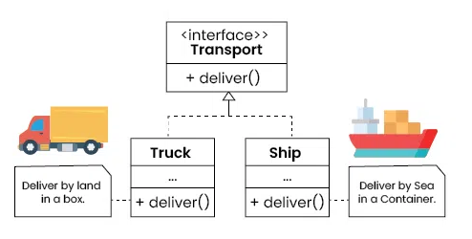
Criteria for the refactor:
I chose to refactor in order to decompose the code and adopt a more modular approach.
From this analysis, I also decided to extend the analysis to the class level, taking into account nested inner classes within the same file.
The refactoring was based on applying a registry pattern, where a factory uses a JPQL node to return the corresponding JPQL expression.
[Refactor generated by Deepseek] I chose to refactor in order to decompose the code and adopt a more modular approach.From this analysis, I also decided to extend the analysis to the class level, taking into account nested inner classes within the same file.The refactoring was based on applying a registry pattern, where a factory uses a JPQL node to return the corresponding JPQL expression.[Refactor generated by Deepseek]
It can handle more workload that oder ia wont to elaborate
Refactored
Methods

Slide 30
Resulting refactored method:
For the refactoring, I chose to subdivide the method into multiple functions, each assigned a specific responsibility.
The expectation was to increase the overall complexity metrics while reducing the complexity values of the individual methods.
release | method | className | loc | wmc | assignmentsQty | mathOperationsQty | qtyTryCatch | qtyReturn | fanin | fanout | nSmell
…
0.09.07 | evaluate | JPQLExpressionBuilder$NotEvaluator | 3 | 1 | 0 | 0 | 0 | 1 | 0 | 3 | 0
0.09.07 | evaluate | JPQLExpressionBuilder$TrimEvaluator | 14 | 9 | 7 | 0 | 0 | 1 | 0 | 8 | 0
0.09.07 | evaluate | JPQLExpressionBuilder$LocateEvaluator | 10 | 4 | 4 | 0 | 0 | 1 | 0 | 11 | 0
0.09.07 | setImplicitTypes | JPQLExpressionBuilder | 13 | 12 | 5 | 0 | 0 | 4 | 2 | 3 | 2
0.09.07 | getIdentifier | JPQLExpressionBuilder | 17 | 4 | 4 | 0 | 0 | 3 | 2 | 5 | 0
0.09.07 | getParameter | JPQLExpressionBuilder$EvaluationContext | 3 | 1 | 0 | 0 | 0 | 1 | 1 | 1 | 0
0.09.07 | evaluate | JPQLExpressionBuilder$LikeEvaluator | 11 | 3 | 5 | 0 | 0 | 2 | 0 | 9 | 2
0.09.07 | supports | JPQLExpressionBuilder$ComparisonOperatorEvaluator | 3 | 7 | 0 | 0 | 0 | 1 | 0 | 0 | 0
0.09.07 | supports | JPQLExpressionBuilder$BetweenEvaluator | 3 | 2 | 0 | 0 | 0 | 1 | 0 | 0 | 0
 |  | Total | 792 | 348 | 135 | 10 | 3 | 199 | 162 | 296 | 46
 |  | Average | 7,135135 | 3,135135 | 1,216216 | 0,09009 | 0,027027 | 1,792793 | 1,459459 | 2,666667 | 0,414414
0.09.07 | eval | JPQLExpressionBuilder | 213 | 83 | 61 | 2 | 0 | 57 | 12 | 55 | 14
The old method pre-refactor
Refactored
Methods

Slide 31

Milestone 4
What if Analysis
Francesco Astolfi

Slide 32
Your Project (2/2)
Create:
  B+: Portion of A with NSmells >0
  C portion of A with NSmells =0.
  B: B+ manipulated with feature NSmells set to 0
Train BClassifier on A, aka BClassifierA
Predict A, B, B+, C and create a Table like in slide 14
Analyze the Table and answer: How many buggy methods could have
been prevented by having zero smells?
In total
In proportion
Out of the preventable ones

Slide 33

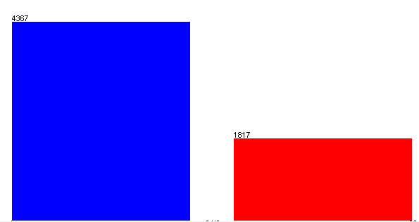
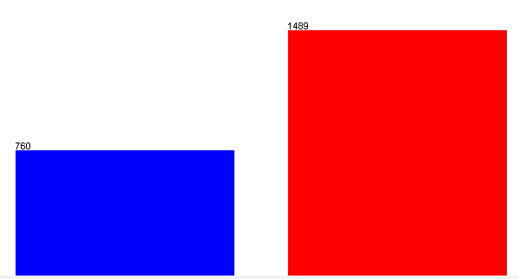
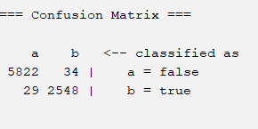
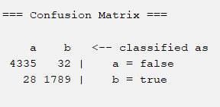
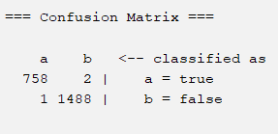
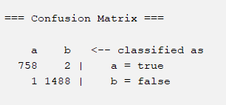
What if 0 smells?
Actual
A
Matrix
C
Matrix
B+
Matrix
B
Matrix
5856
42945
10702
10702
42959
1489
4367
1489
6095
6095
6102
2577
14514
6102
760
1817
14251
760
2577 actual bug
1817 actual bug
smell==0
1489 actual bug
smell>0
1489 actual bug
smell set to 0
Random Forest Trained on A
A
Matrix
C
Matrix
B+
Matrix
B
Matrix
What if
analysis
2552
predicted bug
1821
predicted bug
1490
predicted bug
1490
predicted bug

Slide 34
Experimental learning:
B
Matrix
B
Matrix
Link to the document
10702
1489
6095
760
6102
BOOKKEEPER |  | Smell Correlation | Bug Correlation
1 | loc | 0.69269 | 0.09747
2 | wmc | 0.57613 | 0.04225
3 | assignmentQTY | 0.58412 | 0.04935
4 | mathOpQTY | 0.41173 | 0.07979
5 | TryCatchQTY | 0.3765 | 0.0954
6 | qtyReturn | 0.14486 | 0.0868
7 | fanin | -0.00431 | 0.00761
8 | fanout | 0.26399 | 0.1683
9 | age | 0.0151 | 0.10463
10 | nAuth | 0.01244 | 0.2206
11 | nr | 0.02656 | 0.14766
12 | nSmell |  | 0.07386
1490
predicted bug
1489 actual bug
smell set to 0
  In the Bookkeeper dataset, the model is able to accurately predict bugs even in the absence of smells. In fact, performance slightly improves without them — for example, in the C matrix (where smell = 0), the model misclassifies only 3 bugs compared to the original A matrix.
What if
analysis
  As a result we can see that there is a low correlation between smell and bug, but also that all the strong correlated feature with the nSmell are not so much strong also for the bug prediction maybe this is also due to the fact that the number of instance is to low for training ( the model not learned the correlation between loc and buggyness as we generally expected)

Slide 35
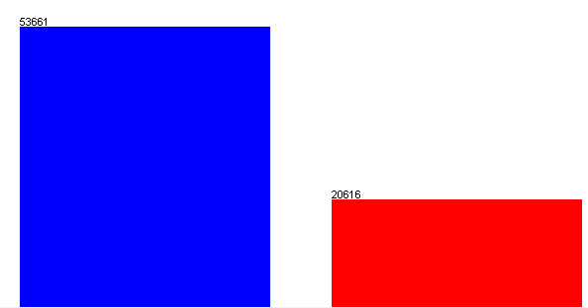


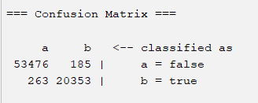
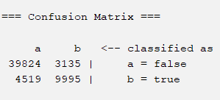
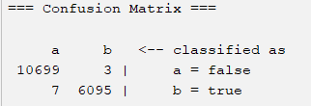
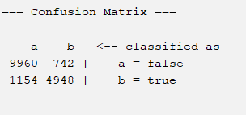

What if 0 smells?
Actual
A
Matrix
C
Matrix
B+
Matrix
B
Matrix
42945
10702
53661
42959
10702
6095
14514
6102
6102
20616
14251
20616 actual bug
14251 actual bug
smell==0
6102 actual bug
smell>0
6102 actual bug
smell set to 0
Random Forest Trained on A
A
Matrix
C
Matrix
B+
Matrix
B
Matrix
20538
predicted bug
13130
predicted bug
6098
predicted bug
5690
predicted bug

Slide 36
Lesson learned :
B
Matrix
B
Matrix
10702
Link to the document
6102
OPENJPA |  | Smell Correlation | Bug Correlation
1 | loc | 0.5847 | 0.1386
2 | wmc | 0.4341 | 0.1221
3 | assignmentQTY | 0.4538 | 0.1061
4 | mathOpQTY | 0.2166 | 0.0463
5 | TryCatchQTY | 0.1635 | 0.0737
6 | qtyReturn | 0.174 | 0.0868
7 | fanin | 0.0135 | 0.0847
8 | fanout | 0.3762 | 0.1683
9 | age | 0.0217 | 0.1195
10 | nAuth | 0.041 | 0.2574
11 | nr | 0.0568 | 0.4395
12 | nSmell |  | 0.0731
6102 actual bug
smell set to 0
5690
predicted bug
  The number of bug that could be removed without the smell is:
  6102 – 5690 = 412 the ( 7.2%)
  [Actual] – [Predicted with 0 smell]
  OpenJPA shows a relatively low injection of code smells. Only about 7.2% of bugs appear to be correlated with the presence of smells.
  Note: This is an approximate analysis, as no normalization or filtering was applied to reduce the influence of features correlated with buggyness (e.g., LOC). In particular, large methods with hundreds of lines can still be marked as "0 smell" but be highly defect-prone.

