Slide 1

Machine Learning
Project of Sentiment Analysis
Francesco Astolfi
Laurea Magistrale in Ingegneria Informatica – A.Y. 2024/25
Dipartimento di Ingegneria Civile e Ingegneria Informatica

Slide 2
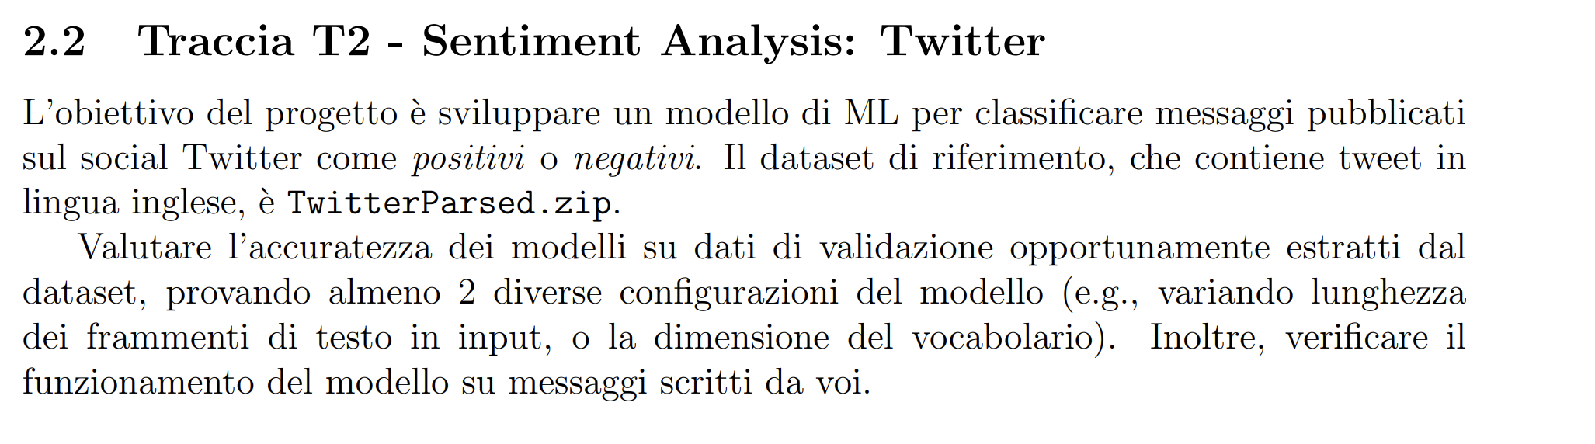
The task
The project :
link to the project

Slide 3
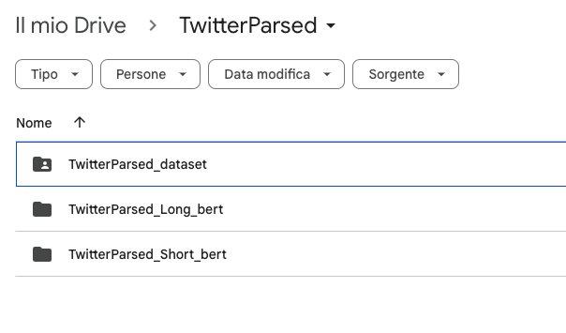
Dependencies
The following directory need to be loaded on the drive account that want to start the project drive-directory .
This directory is essential because it contains the fine-tuned model and the dataset required for the project. Ensure that the drive is properly configured to access these resources.

Slide 4
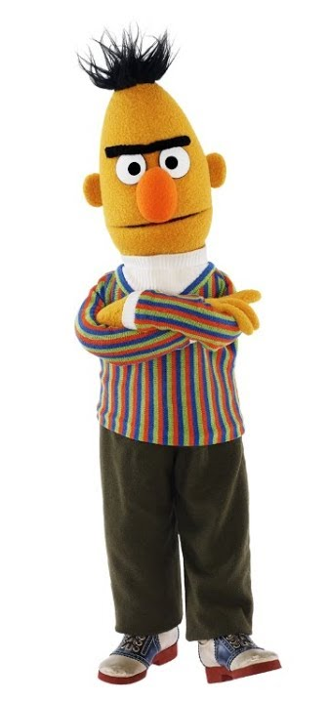
About the project
What is the sentiment analysis?
Sentiment analysis is the task of determining whether a given sentence expresses a positive or negative sentiment. In this specific case, the sentences are tweets. This task is particularly challenging because it requires a deep understanding of the semantics and context of the sentence. This is why BERT is used.
Why it’s used Bert?
BERT is a powerful model in the field of Natural Language Processing (NLP). It is primarily used to generate contextual embeddings of the input text. These embeddings capture the meaning of words in context, making them highly effective for various downstream tasks.
For example: Sentiment analysis, Topic classification, Fill-in-the-blank tasks (e.g., masked language modeling)…
However, BERT is not designed for tasks that require text generation, such as question answering or text translation. For such tasks, models with both encoder and decoder components (e.g., Transformer-based architectures) or decoder-only models (e.g., GPT) are more suitable.

Slide 5

Steps in the project
Loading of the libraries
Loading of the dataset and the extraction from the zip file
Splitting of the data
Selecting of the model
Defining of the model structure
Fine- tuning
See the performance of the model

Slide 6
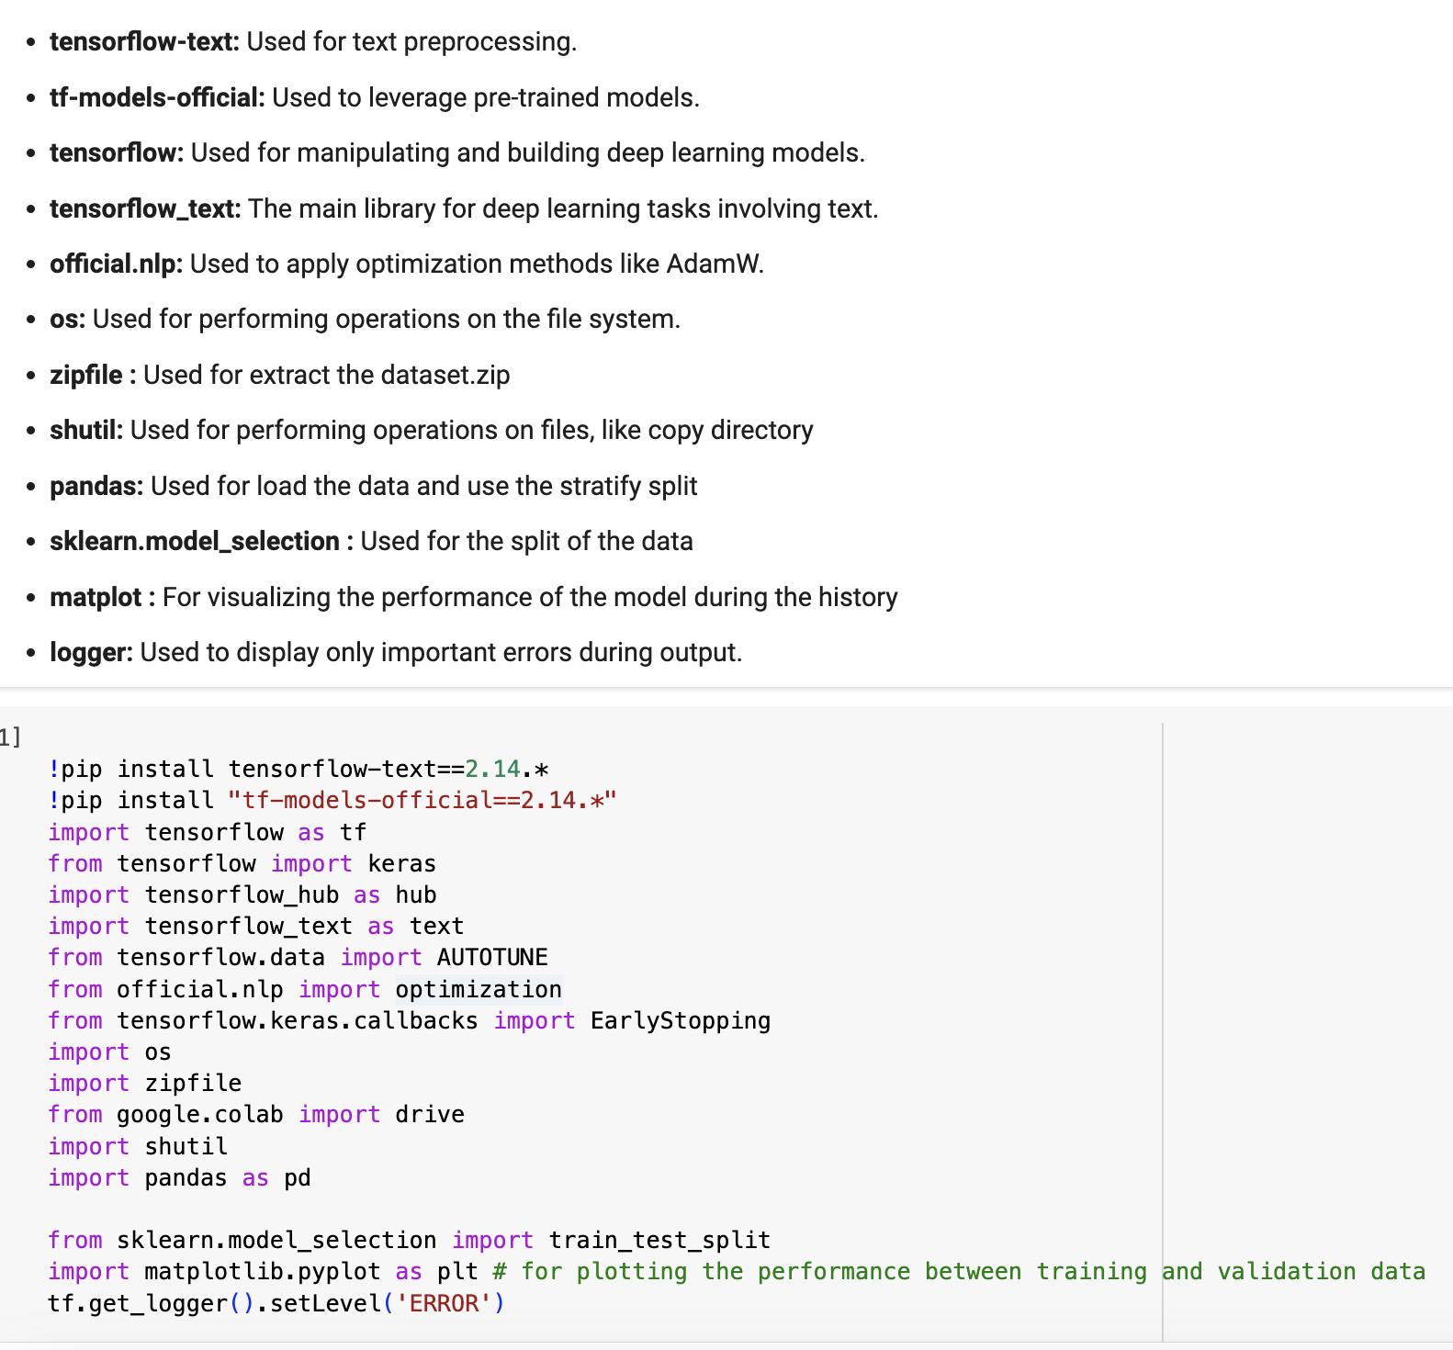

Loading of the libraries
The imported libraries are essential for:
Working with deep learning models.
Managing transformer-based models, including preprocessing tasks.
Handling and organizing files within directories.

Slide 7
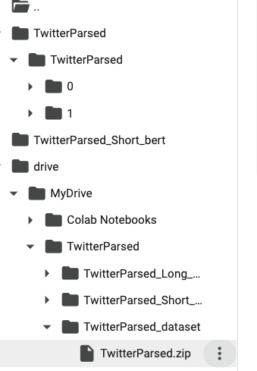
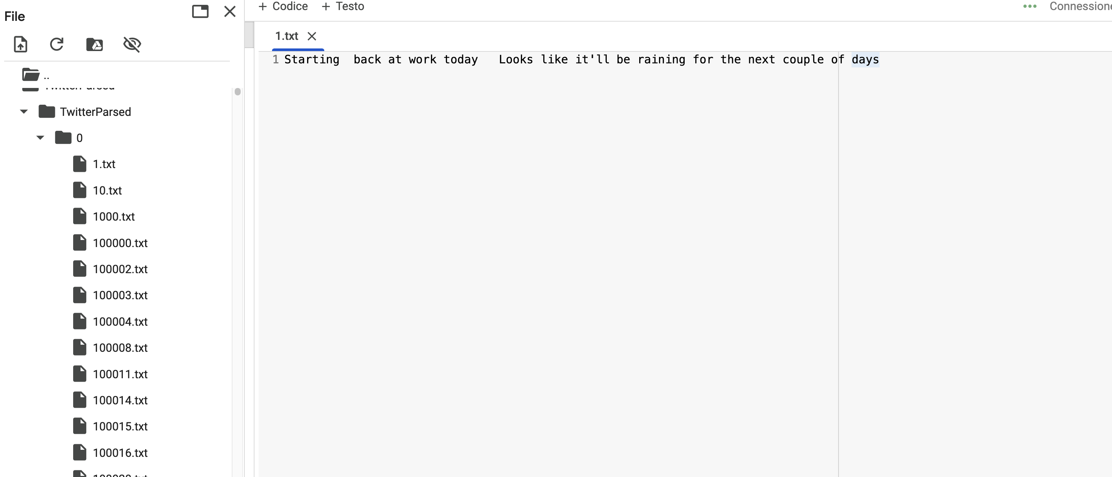

The dataset
The original data is provided as a zip file in the directory of drive and automatically loaded in other way, without drive, the zip must be added every new runtime.
The data is organized into two subdirectories, where each directory acts as a label.
Inside these directories, there are .txt files containing individual tweet instances.

Slide 8

Splitting the data
The data split is a crucial step in this project to ensure that not all the data is used at once. In this case, the data is divided into three sets:
Training Data: Used for fine-tuning the model.
Validation Data: Used to evaluate the model during training and to implement early stopping. Early stopping is particularly useful if the training process takes too long, as it prevents overfitting by stopping training after a few epochs if no improvement is observed.
Test Data: Used to evaluate the model on unseen data, providing an unbiased assessment of its performance.
Dataset
0.7
0.2
0.1
Testing
Validation
Training

Slide 9

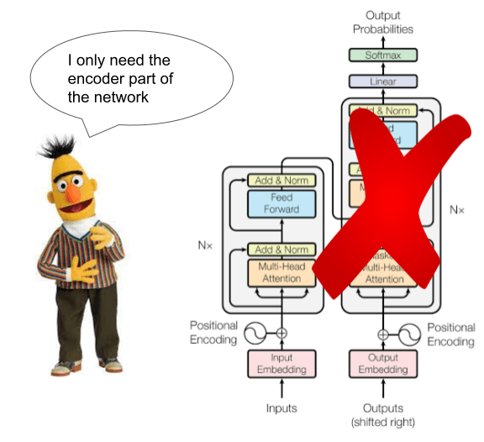
Selecting the model
The model was chosen for experimental purposes.
While it may not represent the best possible performance, it’s used as a solid starting point for working with transformers.
The model was downloaded from TensorFlow because training a model from scratch requires significant effort and resources. Instead, it’s opted to use a pre-trained model and then applied fine-tuning to adapt it to our specific task.

Slide 10
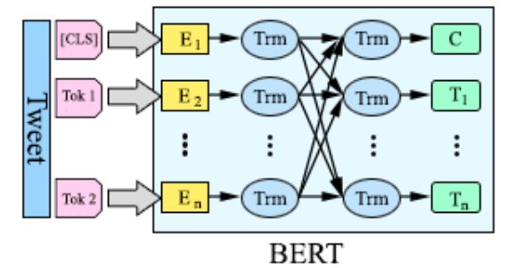
Defining the model structure
BERT does not process raw text autonomously; the text must be preprocessed and encoded beforehand.
The preprocessing involves several steps, such as cleaning the data, tokenizing it add the padding or truncate it.
The encoder uses the preprocessed data to generate a tensor from the tokens. These tokens are then passed to BERT, which processes them and produces a cumulative, contextually significant embedding for the entire sentence. This embedding is subsequently used for classification within the neural network.
Sentiment classification

Slide 11
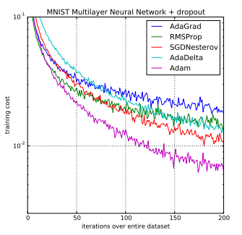
Fine Tuning
Fine-tuning the model is a computationally intensive process. Training the model for just 5 epochs takes a significant amount of time. During fine-tuning, the following configurations were applied:
A starting learning rate was set to control the step size during optimization.
An early stopping algorithm was implemented to prevent overfitting by monitoring validation performance and stopping training if no improvement is observed.
The AdamW optimizer that consent to use a mobile exponential average to efficiently update the model's weights while incorporating weight decay for regularization.
This setup ensures that the model is fine-tuned effectively while managing computational resources and avoiding overfitting.

Slide 12
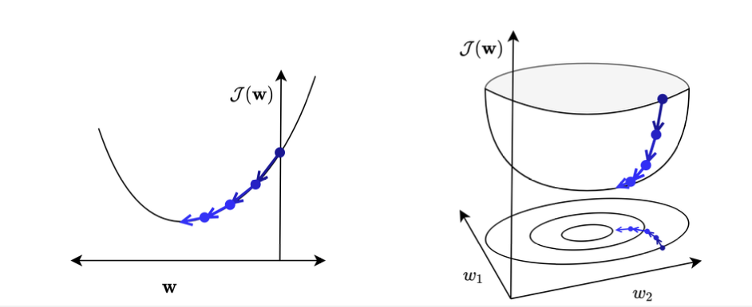
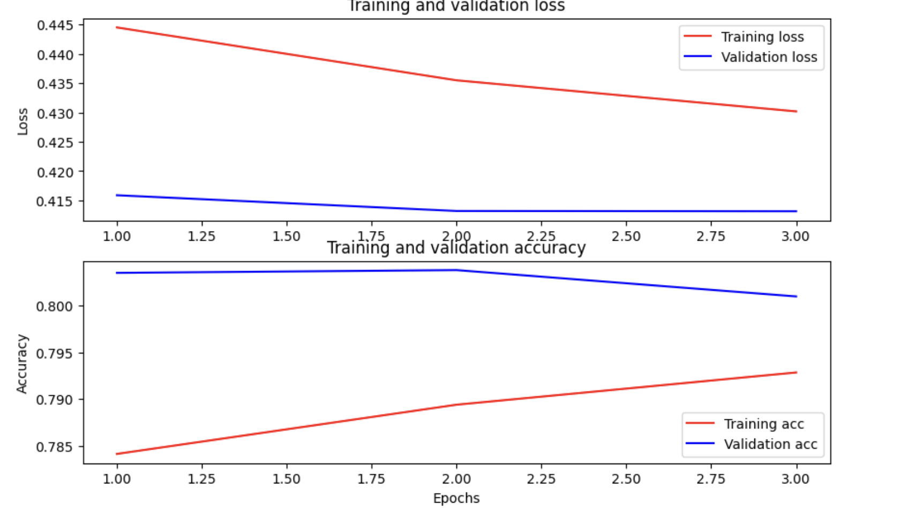


Metrics evaluated
Loss on the cross entropy
$$ℒ$$
$$\text{=−(}\text{y}\text{⋅}\text{log}\text{(}\text{p}\text{)+(1−}\text{y}\text{)⋅}\text{log}\text{(1−}\text{p}\text{))}$$
Y: True label (1 = positive class, 0 = negative class).
p: Predicted probability of belonging to the positive class.
When classifying an instance as y = 1, the prediction should be penalized if it deviates significantly from 1. If p is close to 1, the logarithmic loss approaches 0, indicating a correct prediction. When p is close to 1, the loss approaches 0, indicating accurate predictions.
Larger deviations require greater corrections.
A loss near 0 means the model performs well, with no further corrections needed.

Slide 13
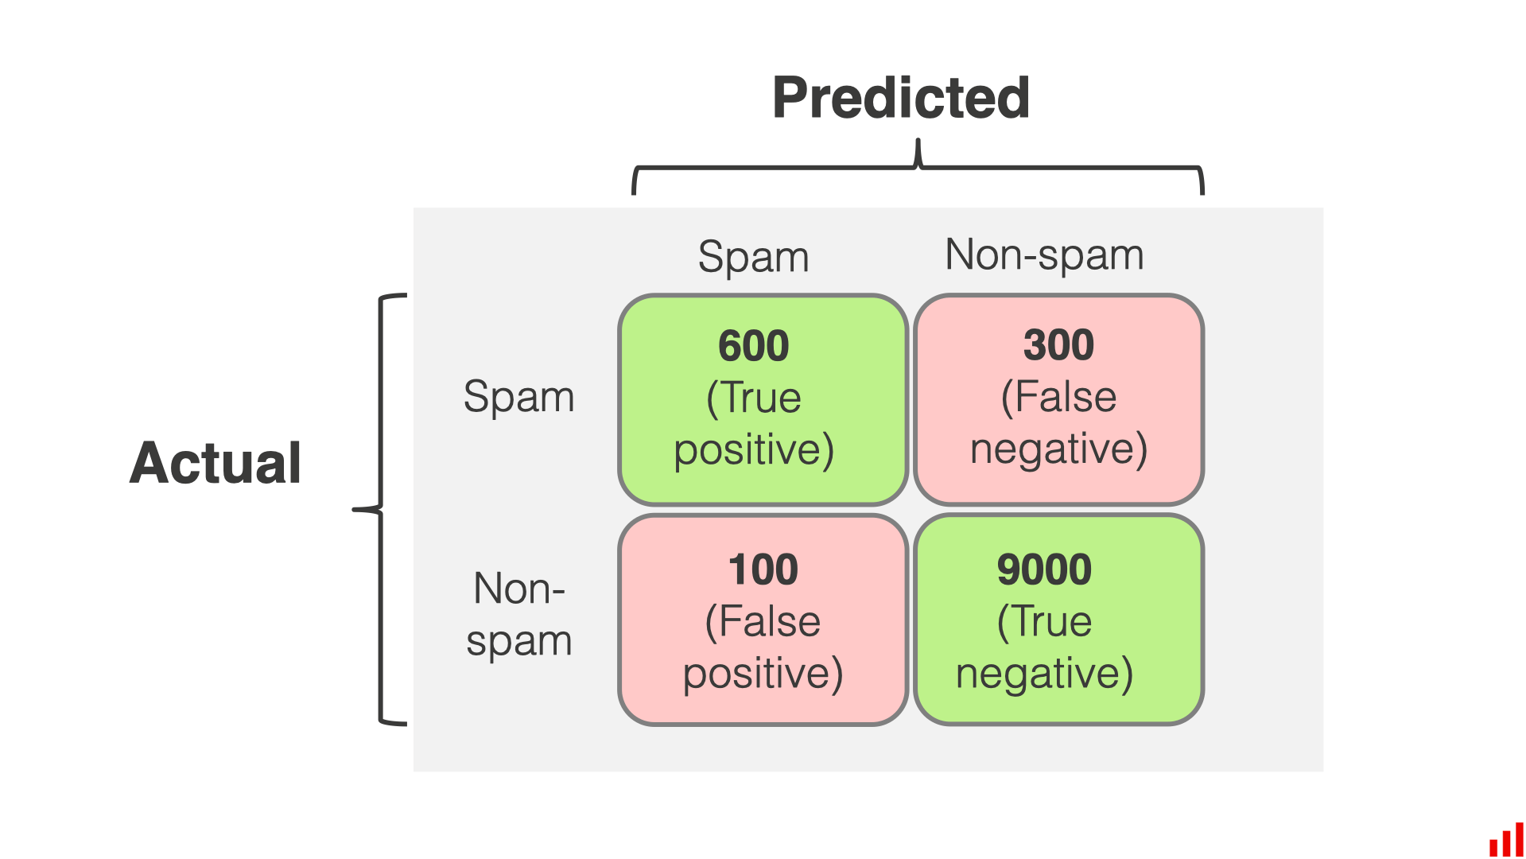

Metrics evaluated
Binary accurancy
Confusion Matrix:
Columns: Predicted values. Rows: Real values.
Diagonal: Correct predictions.
Accuracy:
Calculated as: Correct predictions / Total predictions.
Close to 1 indicates high performance.
Note:
Accuracy is meaningful only when there’s a good balance between positive and negative examples.
$$A\text{ccurancy} \text{=−}\frac{correct predictions}{all the predictions}$$

Slide 14
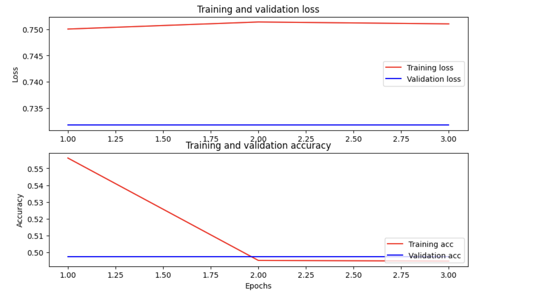
Performance on the validation data
The fine-tuned model, which was recursively refined and saved in the repository on Google Drive, after the cycle of something like 6 epoques . The performance of the models accurancy and loss during the training history is as follows:
Performance of extended model
Performance of shorter model
Extented model go to overfit the data and get worst performance. The early stopping doesn’t start because is setted with 3 epoques of patience.
Short model get better performance
through the last 3 epoques.

Slide 15
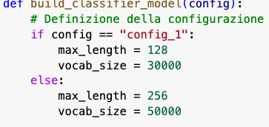
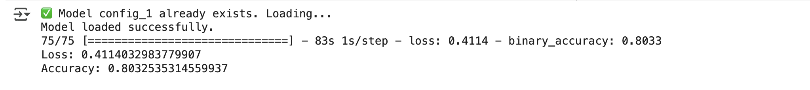
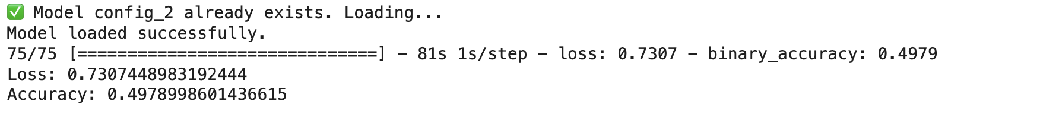
Performance on the test data
The fine-tuned model, which was recursively refined and saved in the repository on Google Drive, after the cycle of something like 6 epoques .
The performance of the models on the test data :
Performance of
shorter model
Performance of
extended model

Slide 16

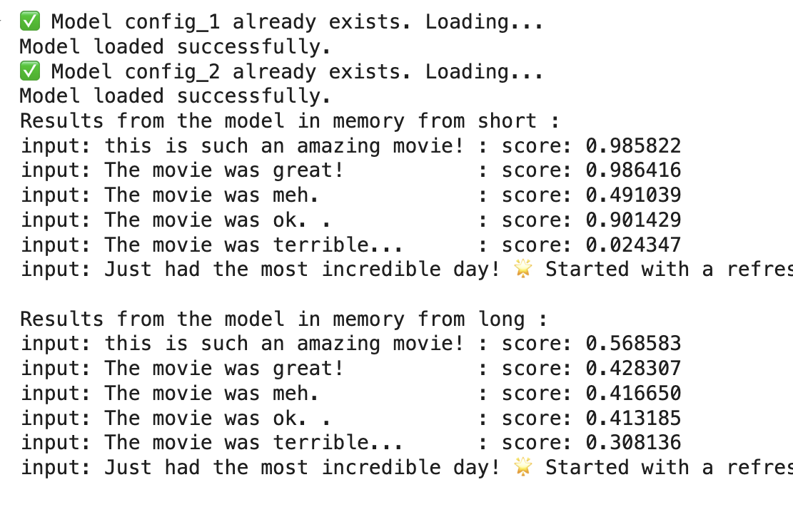
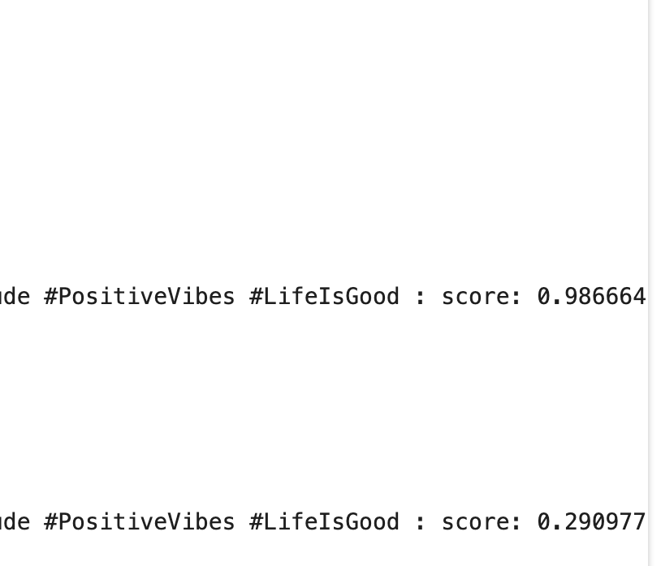
Performance on the manually input data
The fine-tuned model, which was recursively refined and saved in the repository on Google Drive, after the cycle of something like 6 epoques .
The performance of the models on the manually input data :
Performance of shorter model
…
Performance of extended model
…

Slide 17


Conclusions
Its seems that the shorter model with have more good performance on
restricted proposition but when it’s become more larger the larger one
have more good performance. The other fact is that there
are to loss example and the larger model go to overfit them.

