Slide 1

Connected Bus Monitor
For Sustainable Mobility
Francesco Giuseppe Crinò
Constanta Efros
Ashkan Ansarifard

Slide 2
CONCEPT

Slide 3
What is sustainable mobility?
The transport sector has the potential to improve the lives and livelihoods of billions of people. However, as well as meeting people’s needs today, the sector must be ready to respond to future generations’ expectations:
Shared mobility
Public transport
Smart mobility
Access to mobility
Walking & cycling
Safety
Reducing emissions

Slide 4
The problem
Improve the service quality of surface public transport solutions providing trustworthy information about the availability of surface public transport options and the air quality conditions onboard.
Reducing the waste of time
Improving the travel conditions
Providing trustworthy information to help making informed mobility choices
Guaranteeing safety and salubrity
Reducing congestion and occupation of parking spaces

Slide 5
Project Goals
Provide a cost-effective solution to improve public transport by meeting the needs of potential users
Affordability
Reliability
Safety and Salubrity
Sustainability

Slide 6
Proposed Solution
Connected Bus Monitor: a service aimed at providing (near) real time estimates of waiting times/proximity and indoor air quality of the surface public transport units.
Aims to provide incentives to use public transport as a reliable and affordable means of sustainable mobility oriented at reducing emissions, congestion and occupation of parking spaces in urban areas.

Slide 7
Proposed Solution
How?
Monitor transport unit position/location
GPS, acceleration
Monitor air quality onboard
Temperature, humidity, CO2 levels
Why IoT?
Collect and aggregate data from transport units (things)
Scalability
Feasability (financial, technical)

Slide 8
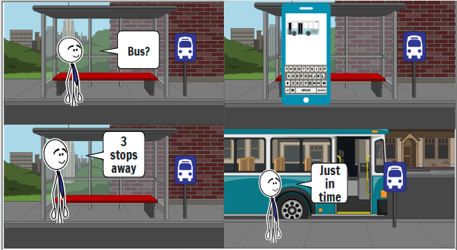
Actors and Use Cases
Who?
Public transport users
Private sector employee, Student
Public transport drivers
Use Case Scenarios

