Slide 1

K-Means Implementation
Mid-Term Parallel Computing Course Project
Francesco Gigli
Supervisor: Prof. Marco Bertini
Dipartimento di Ingegneria dell’Informazione Università degli Studi di Firenze

Slide 2

Index
Francesco Gigli| K-Means
1
Introduction
Formal Definition
Proposed Implementation
Sequential Version
Parallel Version OpenMP
Parallel Version Cuda
Experiment
Results
Conclusion

Slide 3

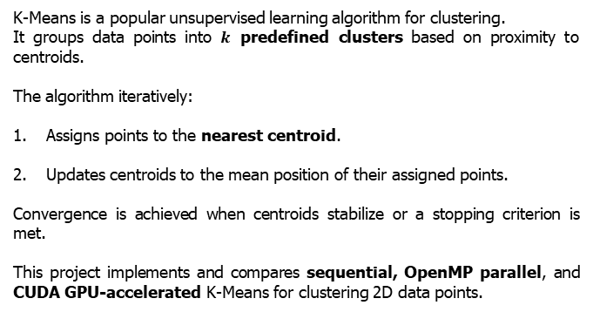
Introduction
Francesco Gigli| K-Means
2
K-Means is a popular unsupervised learning algorithm for clustering.
It groups data points into $k$ predefined clusters based on proximity to centroids.
The algorithm iteratively:
Assigns points to the nearest centroid.
Updates centroids to the mean position of their assigned points.
Convergence is achieved when centroids stabilize or a stopping criterion is met.
This project implements and compares sequential, OpenMP parallel, and CUDA GPU-accelerated K-Means for clustering 2D data points.

Slide 4
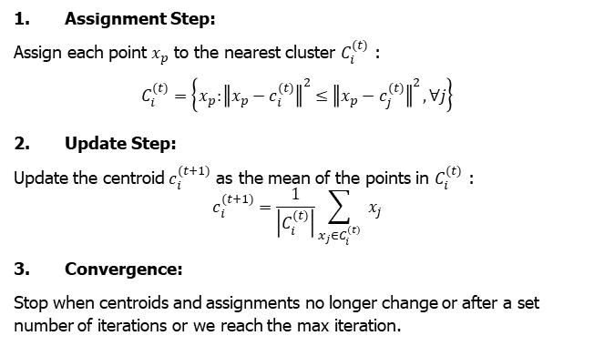
Formal Definition
Francesco Gigli| K-Means
3
Input: A set of $K$ initial centroids selected randomly.
Assignment Step:
Assign each point $x_{p}$ to the nearest cluster $C_{i}^{(t)}$ :
$$C_{i}^{(t)}=\left\{x_{p}:{∥x_{p}−c_{i}^{(t)}∥}^{2}≤{∥x_{p}−c_{j}^{(t)}∥}^{2},∀j\right\}$$
Update Step:
Update the centroid $c_{i}^{(t+1)}$ as the mean of the points in $C_{i}^{(t)}$ :
$$c_{i}^{(t+1)}=\frac{1}{\left|C_{i}^{(t)}\right|}\sum_{x_{j}∈C_{i}^{(t)}}{ }x_{j}$$
Convergence:
Stop when centroids and assignments no longer change or after a set number of iterations or we reach the max iteration.

Slide 5
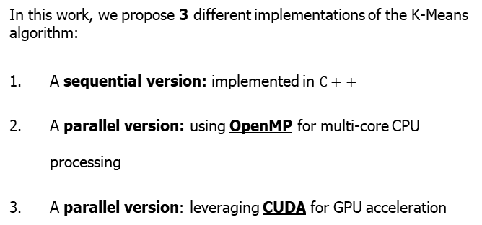
Proposed Approach
Francesco Gigli| K-Means
4
In this work, we propose 3 different implementations of the K-Means algorithm:
A sequential version: implemented in $C++$
A parallel version: using OpenMP for multi-core CPU processing
A parallel version: leveraging CUDA for GPU acceleration

Slide 6
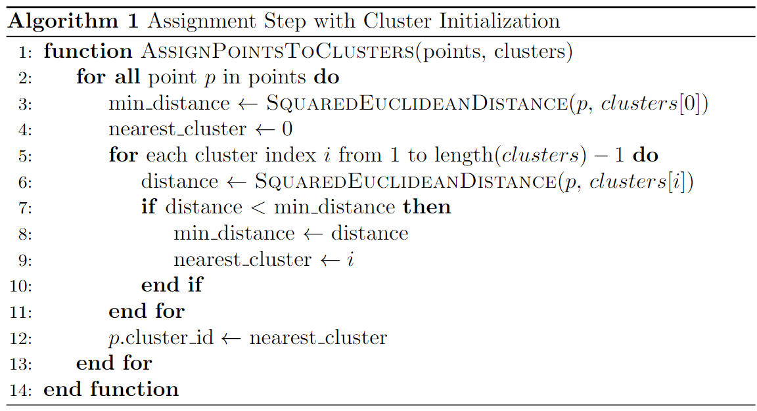
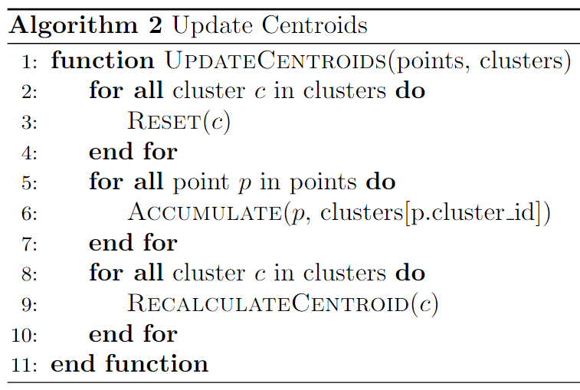
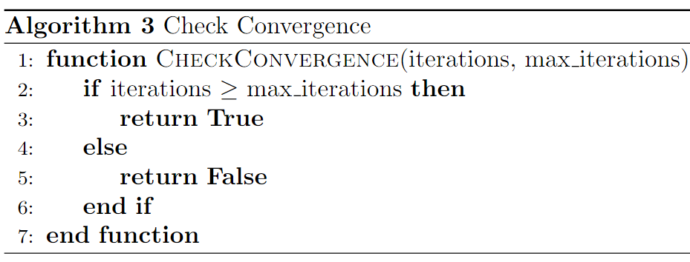
Sequential Version
Francesco Gigli| K-Means
5
This pseudocode outlines the key steps of the sequential K-Means algorithm, showing Initialization, Assignment, and Update steps

Slide 7
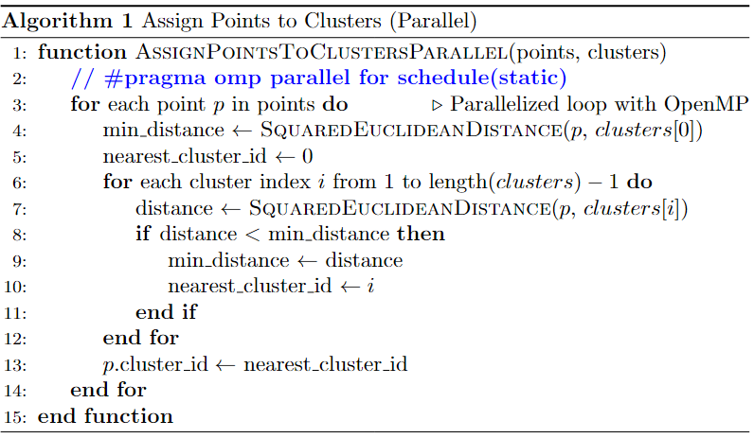
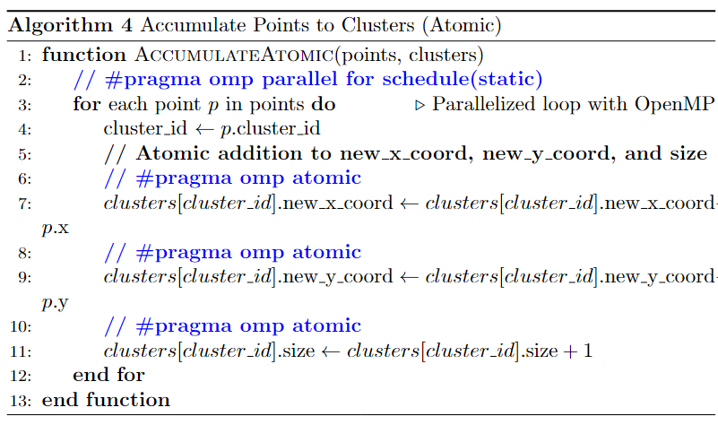
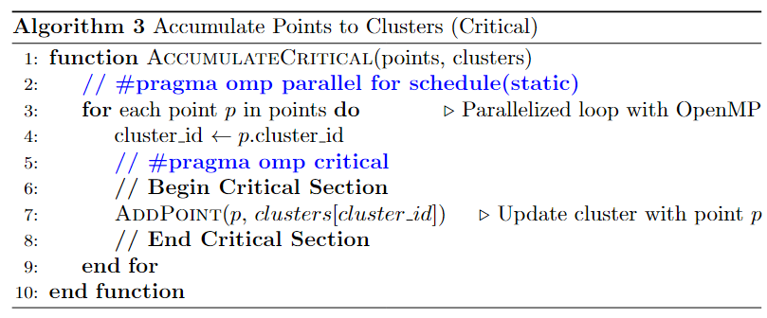
Parallel Version: OpenMP
Francesco Gigli| K-Means
6
OpenMP transform the sequential K-Means algorithm into a multi-threaded parallel version, efficiently utilizing multi-core CPUs and employing #pragma omp critical or #pragma omp atomic to synchronize cluster data updates.

Slide 8
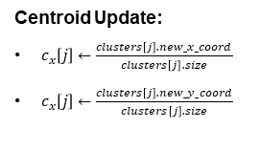
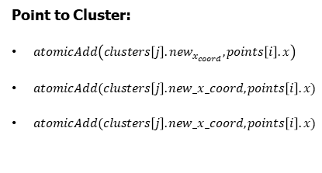
Advantage of CUDA Implementation
Francesco Gigli| K-Means
7
Massive Parallelism: Thousands of lightweight GPU cores execute large-scale computations simultaneously.
Thread Organization: Threads are structured in blocks and grids, with each thread assigned to process a single point or cluster.
Atomic Operations:
Point to Cluster:
$atomicAdd\left(clusters\left[j\right].new_{x_{coord}},points\left[i\right].x\right)$
$atomicAdd(clusters\left[j\right].new_x_coord,points\left[i\right].x)$
$atomicAdd(clusters\left[j\right].new_x_coord,points\left[i\right].x)$
Centroid Update:
$c_{x}\left[j\right]←\frac{clusters\left[j\right].new_x_coord}{clusters\left[j\right].size}$
$c_{x}\left[j\right]←\frac{clusters\left[j\right].new_y_coord}{clusters\left[j\right].size}$

Slide 9
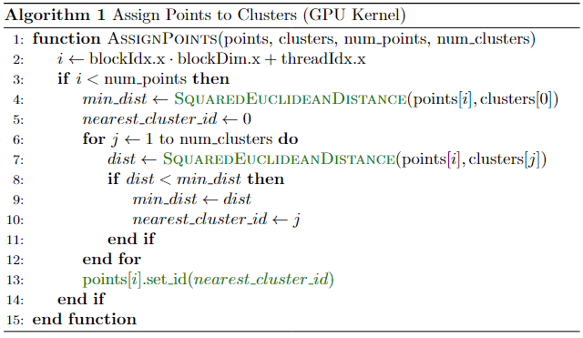
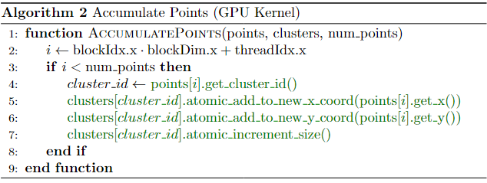
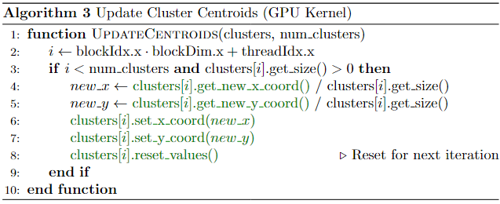
Francesco Gigli| K-Means
Parallel Version: CUDA
8
The CUDA version parallelizes K-Means using GPU kernels for: points assignment, accumulate points and centroid updates.

Slide 10
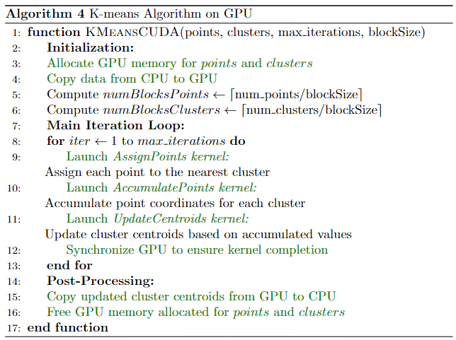
Francesco Gigli| K-Means
Parallel Version: CUDA
8
The complete CUDA implementation of the K-Means algorithm using GPU and the previously defined kernels.

Slide 11
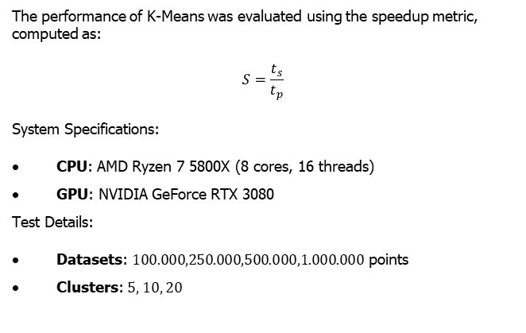
Francesco Gigli| K-Means
Experimental Setup
9
The performance of K-Means was evaluated using the speedup metric, computed as:
$$S=\frac{t_{s}}{t_{p}}$$
System Specifications:
CPU: AMD Ryzen 7 5800X (8 cores, 16 threads)
GPU: NVIDIA GeForce RTX 3080
Test Details:
Datasets: $100.000,250.000,500.000,1.000.000$ points
Clusters: 5, 10, 20

Slide 12
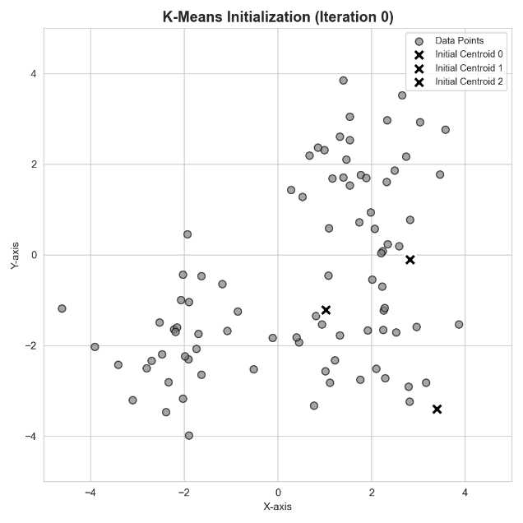
Francesco Gigli| K-Means
Experimental Visualization
10

Slide 13
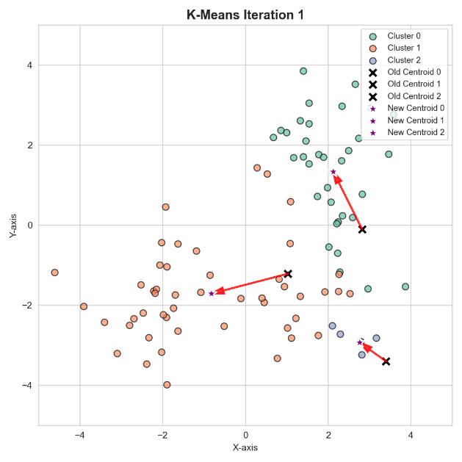
Francesco Gigli| K-Means
Experimental Visualization
10

Slide 14
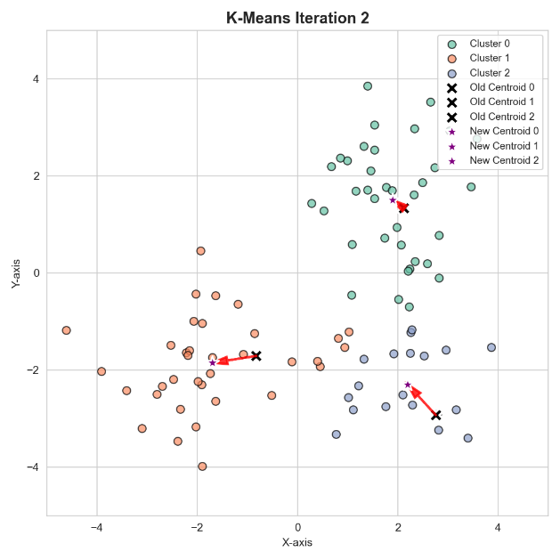
Francesco Gigli| K-Means
Experimental Visualization
10

Slide 15
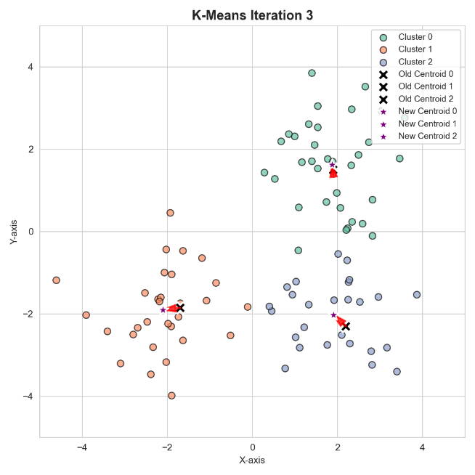
Francesco Gigli| K-Means
Experimental Visualization
10

Slide 16
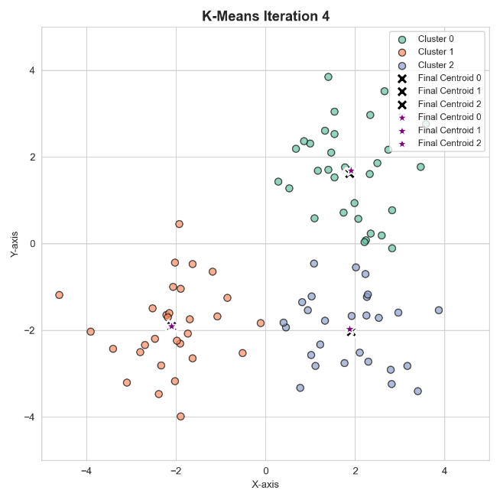
Francesco Gigli| K-Means
Experimental Visualization
10

Slide 17
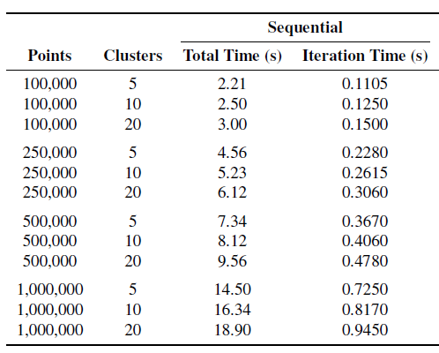
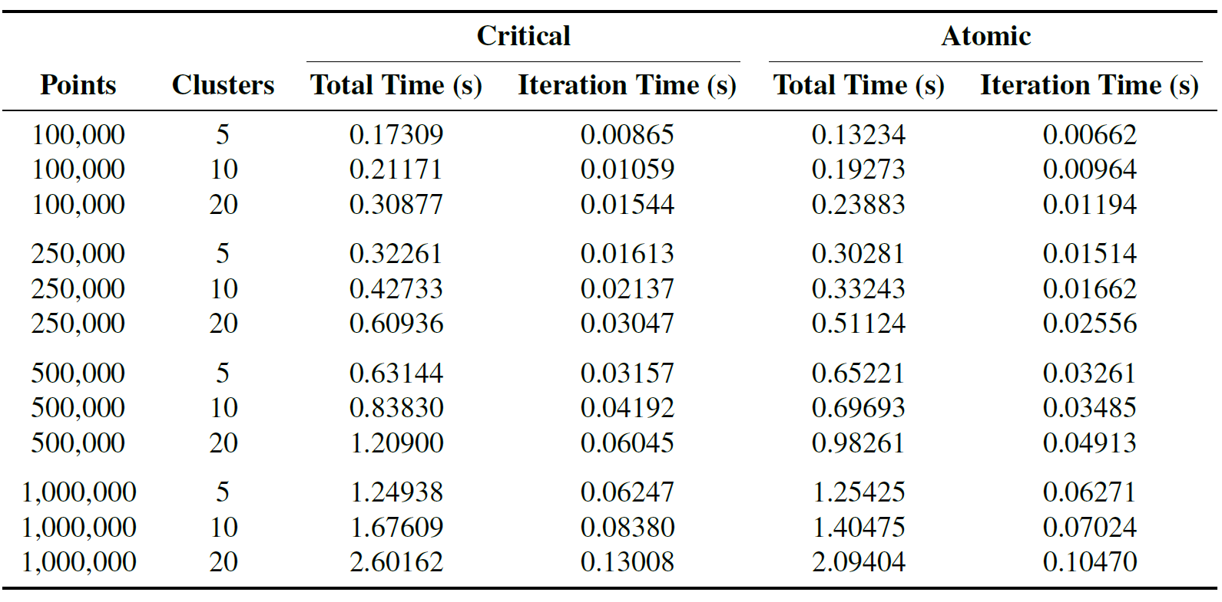
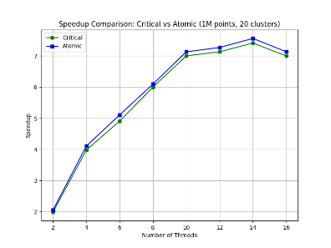
Francesco Gigli| K-Means
SpeedUp with OpenMP
11
OpenMP enhances performance by utilizing multiple CPU cores for parallel task execution.
Critical: Improves performance but adds overhead from synchronization.
Atomic: Achieves higher speedup by reducing synchronization overhead.

Slide 18
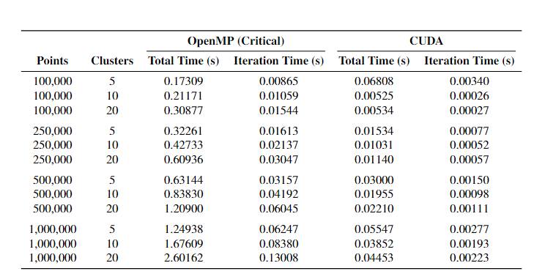
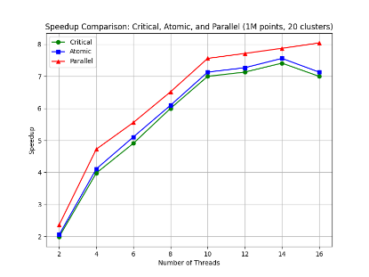
Francesco Gigli| K-Means
SpeedUp with CUDA
12
CUDA leverages massive parallelism by executing thousands of threads simultaneously on the GPU.
This leads CUDA to reduce execution times compared to OpenMP Critical, achieving superior speedup and scalability

Slide 19
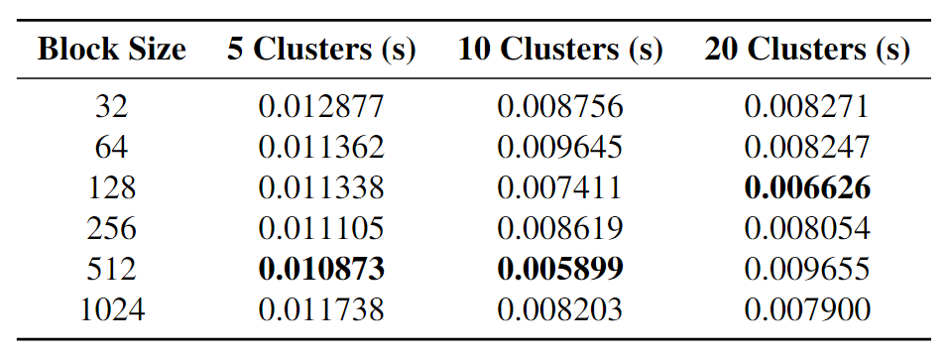
Francesco Gigli| K-Means
Block-Size Comparison
13
The table compares execution times for different block sizes (32 to 1024) when clustering 100,000 points into 5, 10, and 20 clusters.
Impact of Block Size on CUDA Performance:
512 Threads: Best for 5 and 10 clusters due to better GPU core utilization and reduced idle time.
128 Threads: Best for 20 clusters, balancing memory access and synchronization for higher cluster counts.

Slide 20
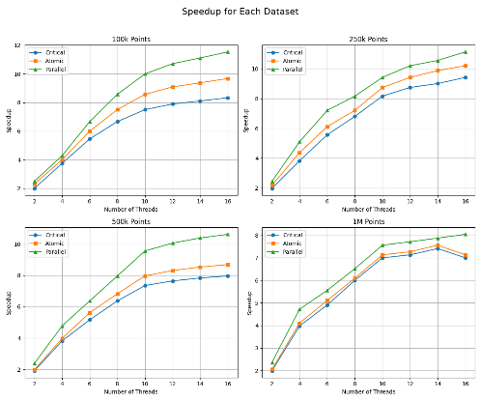
Francesco Gigli| K-Means
Global Comparison
14
The CUDA algorithm significantly outperforms both the sequential and OpenMP implementations, though at the cost of greater implementation complexity. On the other hand, OpenMP allows for noticeable speedup with minimal effort, requiring only a few directives.

Slide 21
Francesco Gigli| K-Means
Conclusion
15
The K-means clustering algorithm has an embarrassingly parallel structure, making it ideal for parallel computing.
Sequential vs. OpenMP (Critical):
100,000 points, 5 clusters: 12.8x (2.21 s → 0.17 s)
1,000,000 points, 20 clusters: 7.3x (18.90 s → 2.60 s)
Sequential vs. CUDA:
100,000 points, 5 clusters: 32.5x (2.21 s → 0.068 s)
1,000,000 points, 20 clusters: 424.6x (18.90 s → 0.044 s)
Thus, implementing this algorithm in CUDA is far more efficient, leveraging the GPU's significantly higher number of cores for massive parallelism.

