Slide 1
Mean Shift Implementation
Final Parallel Computing Course Project
Francesco Gigli
Supervisor: Prof. Marco Bertini
Dipartimento di Ingegneria dell’Informazione Università degli Studi di Firenze

Slide 2

Index
Francesco Gigli| Mean Shift
1
Introduction
Formal Definition
Proposed Approach
Sequential Version
Parallel Version: OpenMP
Parallel Version: CUDA
Experiment
Results
Conclusion

Slide 3

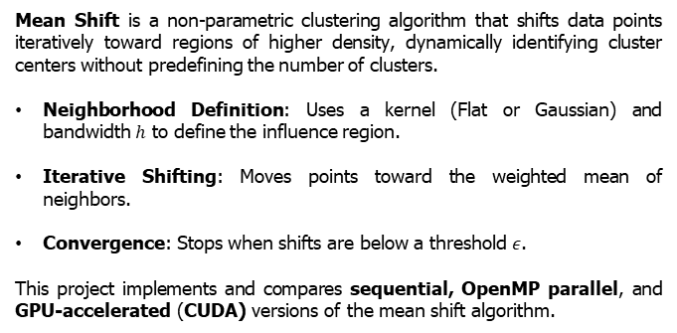
Introduction
Francesco Gigli| Mean Shift
2
Mean Shift is a non-parametric clustering algorithm that shifts data points iteratively toward regions of higher density, dynamically identifying cluster centers without predefining the number of clusters.
Neighborhood Definition: Uses a kernel (Flat or Gaussian) and bandwidth $h$ to define the influence region.
Iterative Shifting: Moves points toward the weighted mean of neighbors.
Convergence: Stops when shifts are below a threshold $ε$.
This project implements and compares sequential, OpenMP parallel, and GPU-accelerated (CUDA) versions of the mean shift algorithm.

Slide 4
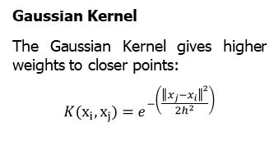
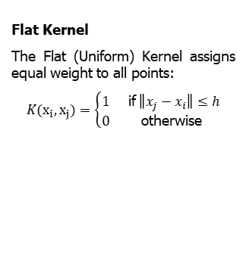
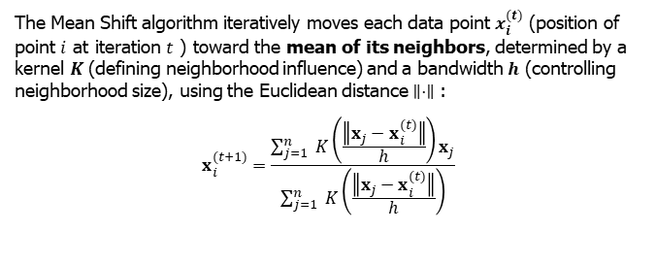
Formal Definition
Francesco Gigli| Mean Shift
3
The Mean Shift algorithm iteratively moves each data point $x_{i}^{(t)}$ (position of point $i$ at iteration $t$ ) toward the mean of its neighbors, determined by a kernel $K$ (defining neighborhood influence) and a bandwidth $h$ (controlling neighborhood size), using the Euclidean distance $∥⋅∥$ :
$$x_{i}^{(t+1)}=\frac{\sum_{j=1}^{n}{ } K\left(\frac{∥x_{j}−x_{i}^{(t)}∥}{h}\right)x_{j}}{\sum_{j=1}^{n}{ } K\left(\frac{∥x_{j}−x_{i}^{(t)}∥}{h}\right)}$$
Flat Kernel
The Flat (Uniform) Kernel assigns equal weight to all points:
$$K(x_{i},x_{j})=\left\{\begin{matrix}1 & \text{if} ∥x_{j}−x_{i}∥≤h \\ 0 & \text{otherwise} \end{matrix}\right.$$
Gaussian Kernel
The Gaussian Kernel gives higher weights to closer points:
$$K(x_{i},x_{j})=e^{−\left(\frac{{∥x_{j}−x_{i}∥}^{2}}{2h^{2}}\right)}$$

Slide 5
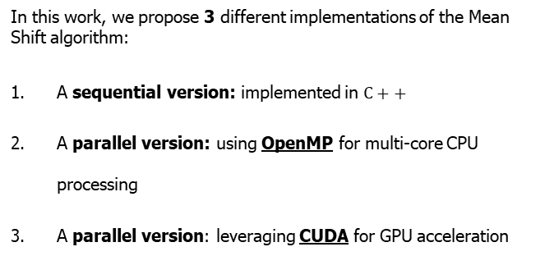
Proposed Approach
Francesco Gigli| Mean Shift
4
In this work, we propose 3 different implementations of the Mean Shift algorithm:
A sequential version: implemented in $C++$
A parallel version: using OpenMP for multi-core CPU processing
A parallel version: leveraging CUDA for GPU acceleration

Slide 6
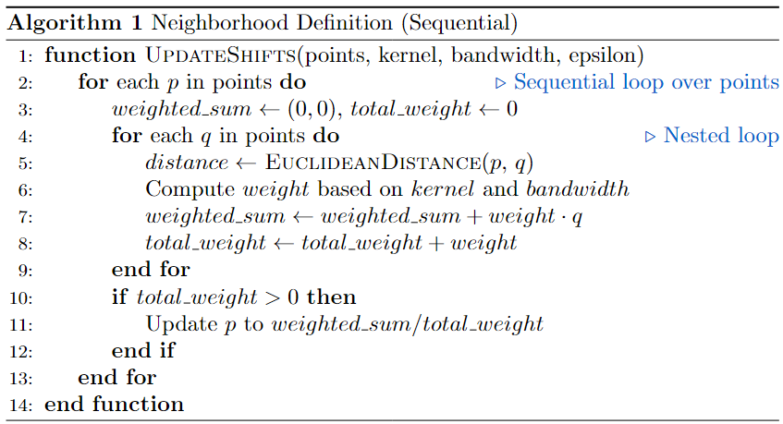
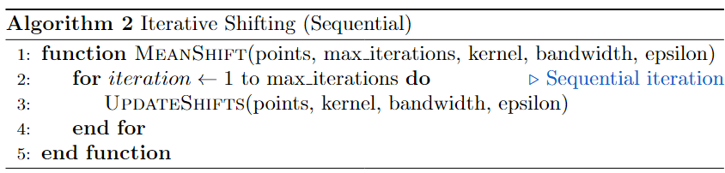
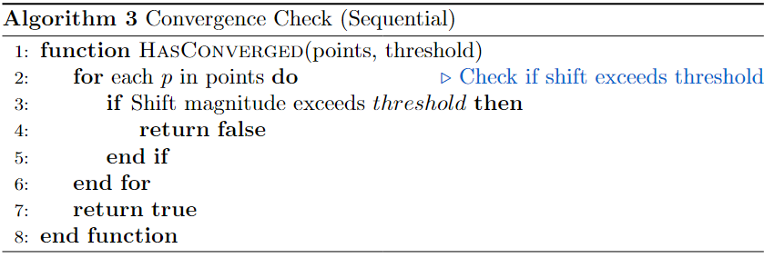
Sequential Version
Francesco Gigli| Mean Shift
5
This pseudocode outlines the key steps of the sequential Mean Shift algorithm, showing Neighborhood Definition, Iterative Shifting and Convergence

Slide 7
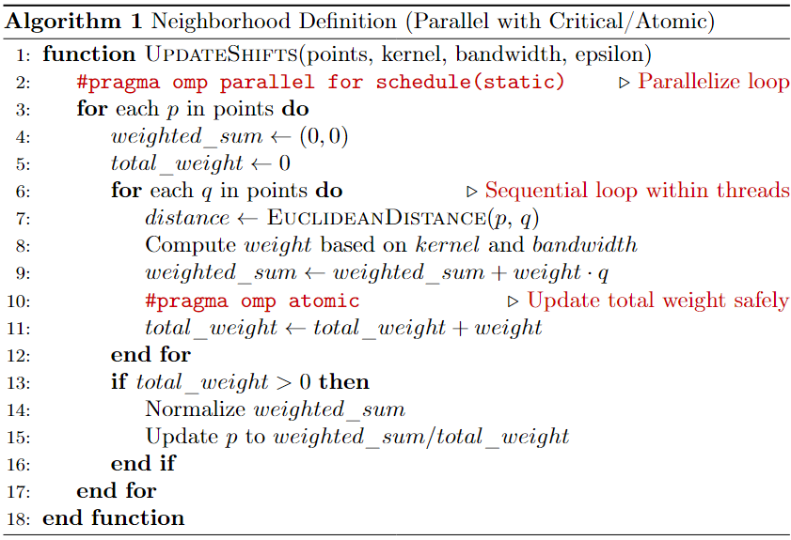
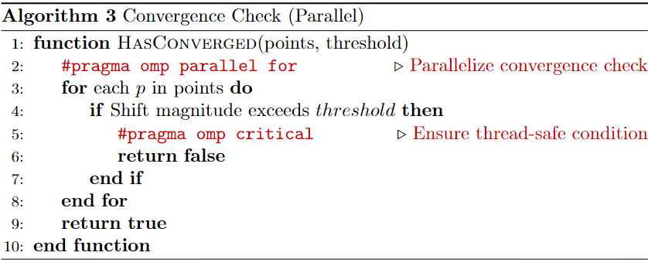
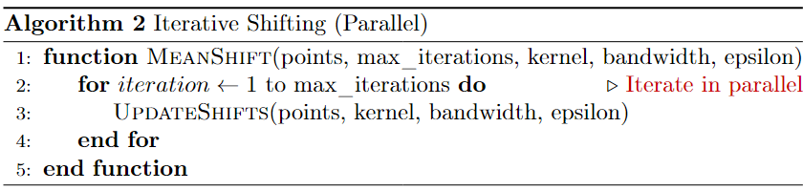
Parallel Version: OpenMP
Francesco Gigli| Mean Shift
6
The parallel version of the Mean Shift algorithm uses OpenMP with #pragma omp critical or #pragma omp atomic for thread-safe data updates.

Slide 8
CUDA Implementation of Mean Shift
Francesco Gigli| Mean Shift
7
Massive Parallelism: Each thread processes the shift computation for a single point, enabling thousands of points to be updated simultaneously.
Thread Organization: Threads are organized into grids and blocks:
Each thread computes:
Distance to neighbors.
Weighted sum of coordinates.
Convergence status.
Atomic Operations: Each thread operates independently on its assigned point, avoiding race conditions.
Data Transfer: Convergence status and final points are copied back to the CPU, introducing minor overhead.

Slide 9
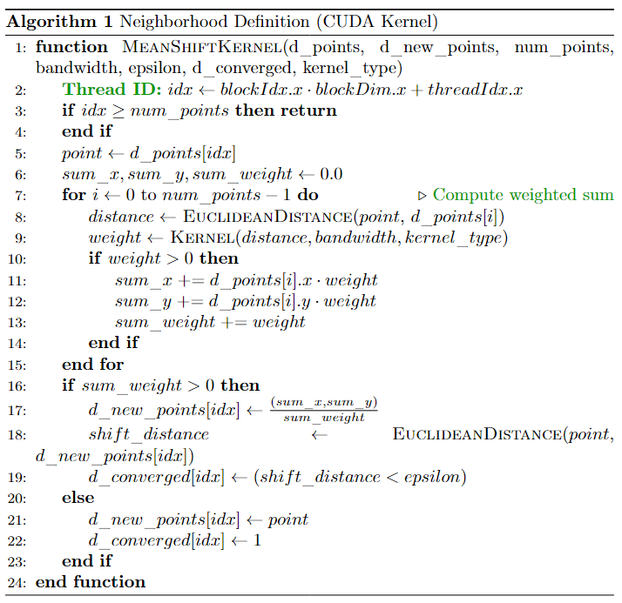
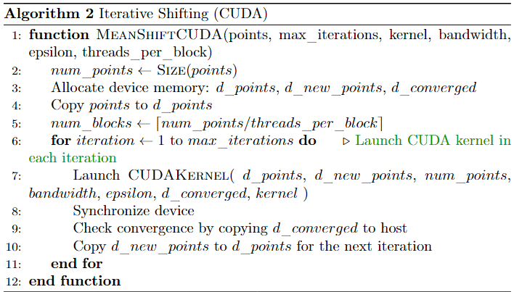
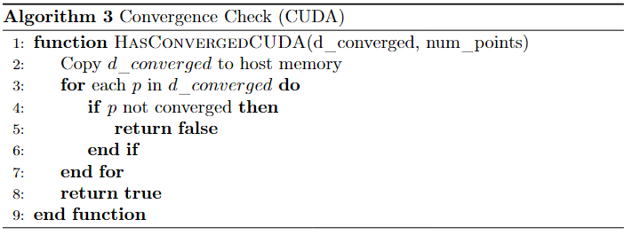
Francesco Gigli| Mean Shift
Parallel Version: CUDA
8
The CUDA implementation parallelizes neighborhood definition and iterative shifting to accelerate the Mean Shift algorithm.

Slide 10
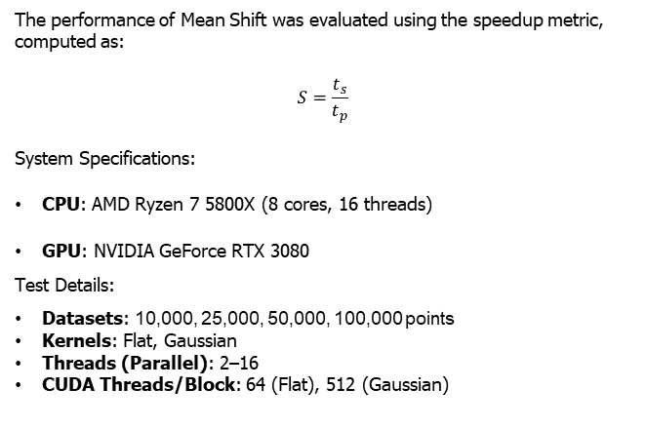
Francesco Gigli| Mean Shift
Experimental Setup
9
The performance of Mean Shift was evaluated using the speedup metric, computed as:
$$S=\frac{t_{s}}{t_{p}}$$
System Specifications:
CPU: AMD Ryzen 7 5800X (8 cores, 16 threads)
GPU: NVIDIA GeForce RTX 3080
Test Details:
Datasets: 10,000, 25,000, 50,000, 100,000 points
Kernels: Flat, Gaussian
Threads (Parallel): 2–16
CUDA Threads/Block: 64 (Flat), 512 (Gaussian)

Slide 11
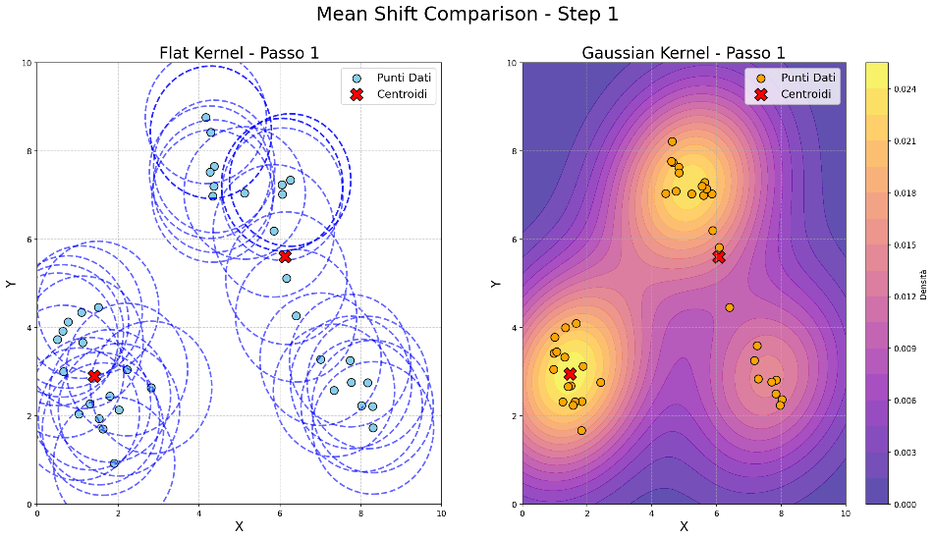
Francesco Gigli| Mean Shift
Experimental Visualization
10

Slide 12
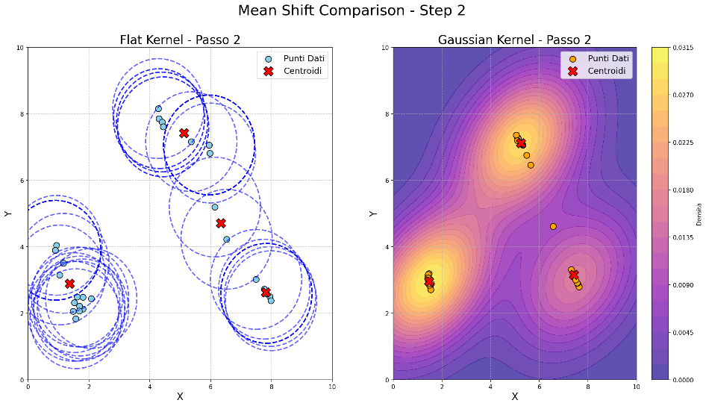
Francesco Gigli| Mean Shift
Experimental Visualization
10

Slide 13
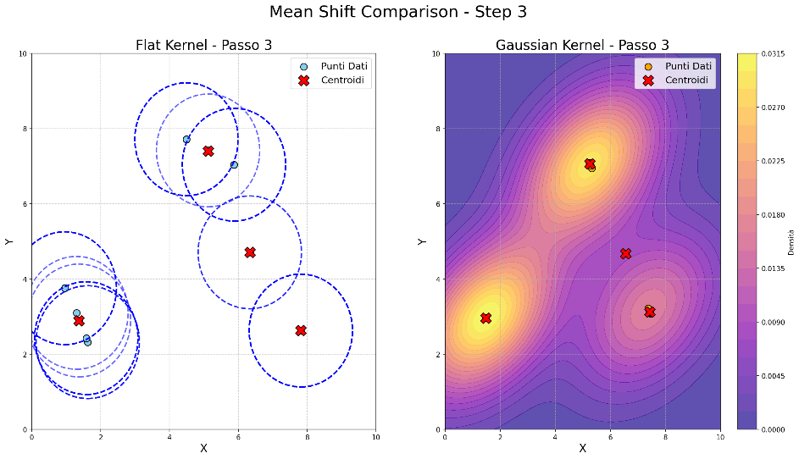
Francesco Gigli| Mean Shift
Experimental Visualization
10

Slide 14
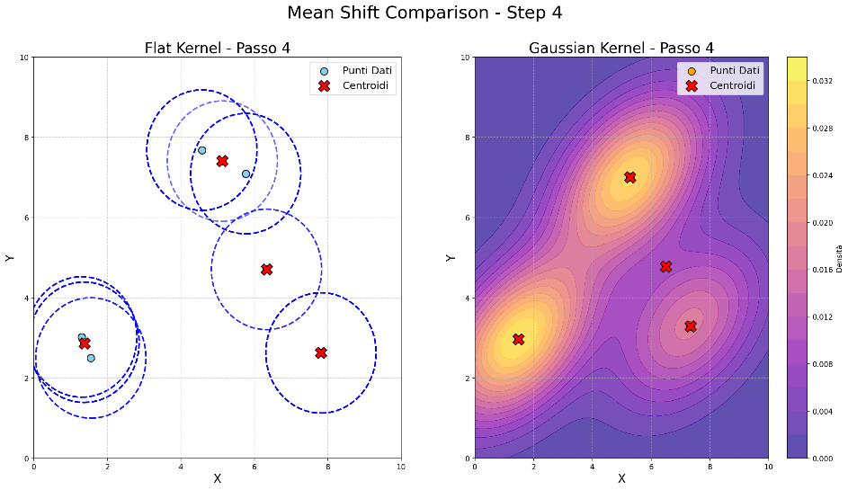
Francesco Gigli| Mean Shift
Experimental Visualization
10

Slide 15
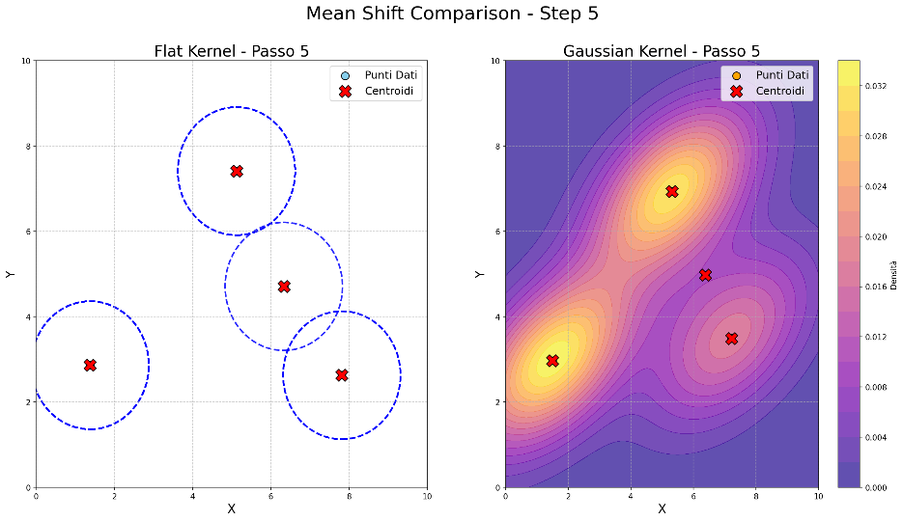
Francesco Gigli| Mean Shift
Experimental Visualization
10

Slide 16
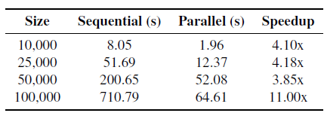
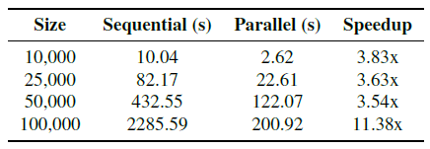
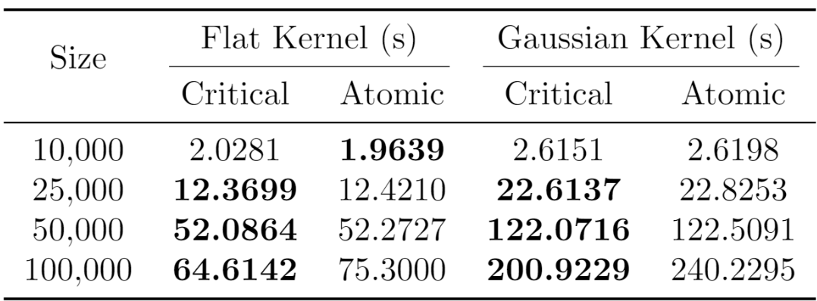
Francesco Gigli| Mean Shift
SpeedUp with OpenMP
11
OpenMP enhances performance by utilizing multiple CPU cores for parallel task execution.
Flat Kernel Gaussian Kernel
Critical: Improves performance but adds overhead from synchronization.
Atomic: Achieves higher speedup by reducing synchronization overhead.

Slide 17
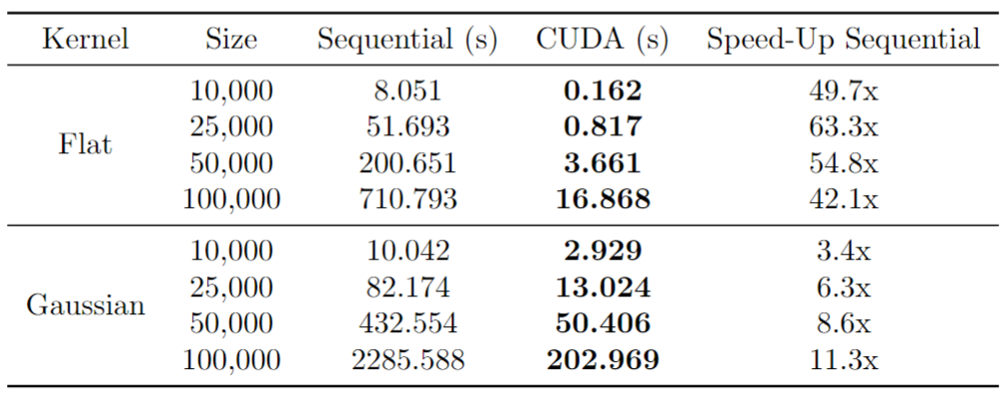
Francesco Gigli| Mean Shift
SpeedUp with CUDA
12
CUDA leverages massive parallelism by executing thousands of threads simultaneously on the GPU.
This leads CUDA to reduce execution times compared to OpenMP Critical, achieving superior speedup and scalability

Slide 18
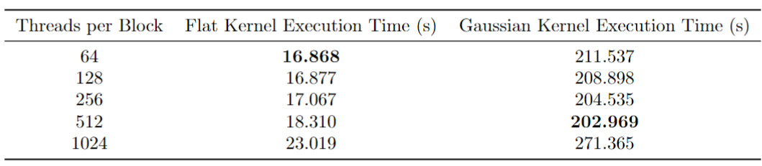
Francesco Gigli| Mean Shift
Block-Size Comparison
13
The table compares execution times for different block sizes (64 to 1024) when clustering 100,000 points.
Impact of Block Size on CUDA Performance:
Optimal Block Size for Flat Kernel: The Flat Kernel achieves the best performance with 64 threads per block due to its lightweight computations.
Optimal Block Size for Gaussian Kernel: The Gaussian Kernel performs optimally with 512 threads per block, as the higher thread count helps manage its computational complexity.

Slide 19
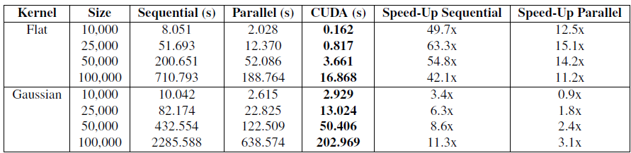
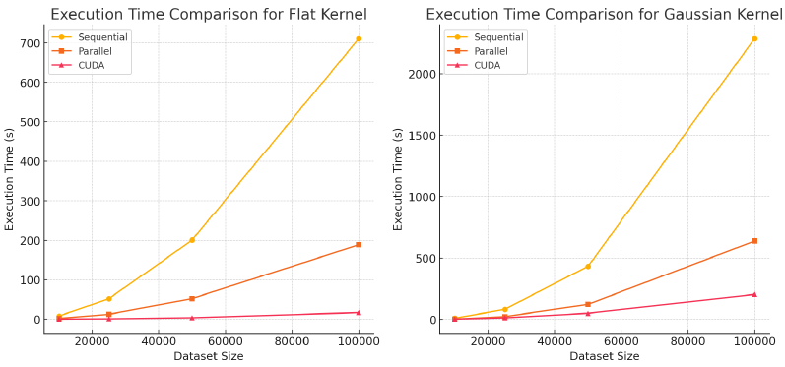
Francesco Gigli| Mean Shift
Global Comparison
14
The CUDA algorithm greatly outperforms sequential and OpenMP implementations but involves higher complexity. OpenMP, in contrast, provides significant speedup with minimal effort, requiring only a few directives.

Slide 20
Francesco Gigli| Mean Shift
Conclusion
15
The Mean Shift algorithm demonstrates excellent scalability, making it well-suited for parallel and GPU-based computing.
Sequential vs. OpenMP (Critical) for 100,000 points:
Flat Kernel: 11.2x speedup (710.793 s → 188.764 s).
Gaussian Kernel: 3.1x speedup (2285.588 s → 638.574 s).
Sequential vs. CUDA for 100,000 points:
Flat Kernel: 42.1x speedup (710.793 s → 16.868 s).
Gaussian Kernel: 11.3x speedup (2285.588 s → 202.969 s).
CUDA vastly outperforms both Sequential and OpenMP implementations, particularly for the Flat Kernel, by leveraging GPU parallelism for significant computational efficiency.

