Slide 1
M L F O R F I N T E C H · P O L I T E C N I C O D I M I L A N O — G S O M
Early Warning System
for Risk-Off Detection
A Quant Strategy: 1.5× Equity + Macro-Aware Safe-Haven Routing
Ercelli · Galli · Impenati · Mazzini
Bloomberg weekly · 2000–2021 · n ≈ 1,107 · 2026

Slide 2
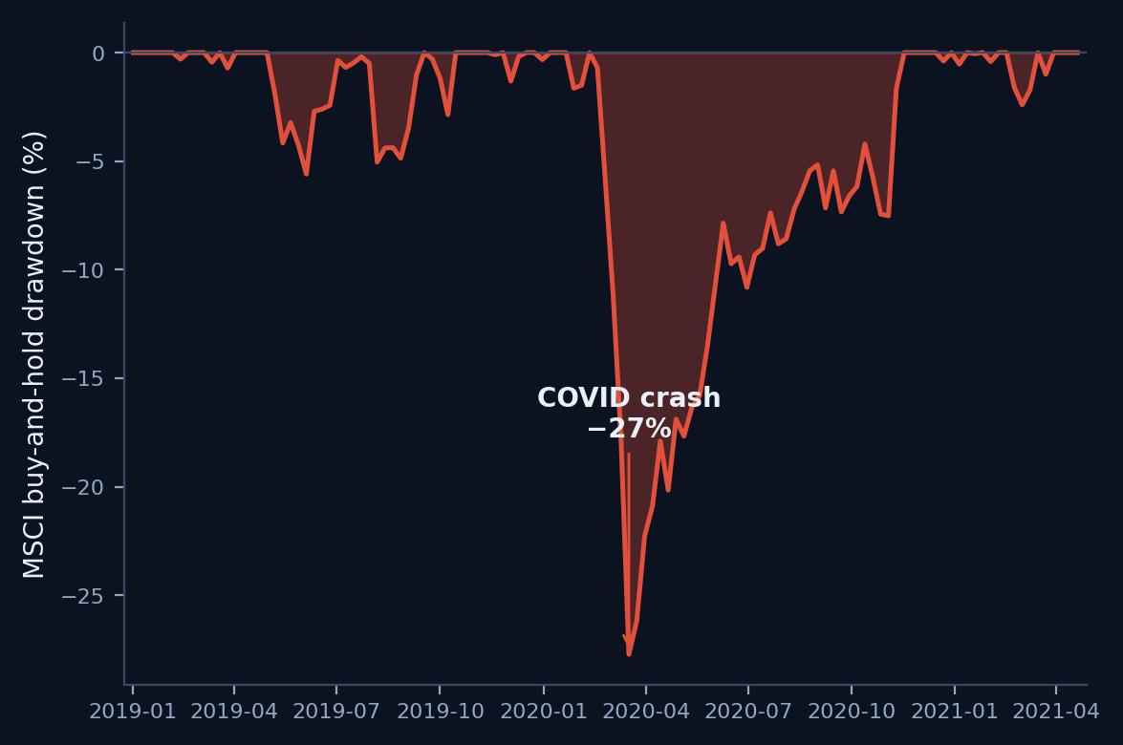
T H E P R O B L E M & B U S I N E S S C A S E
Avoiding the worst weeks beats picking the best
● Crashes cluster — buy-and-hold pays for every one in full.
● Skipping a handful of weeks compounds into far higher Sharpe & Calmar.
● Our answer is a Quant Strategy: aggressive in calm, defensive in stress.
● Nowcasting, not forecasting — recognise stress at birth, don't predict it.
−27%
MSCI buy-&-hold COVID drawdown
02 / 15

Slide 3
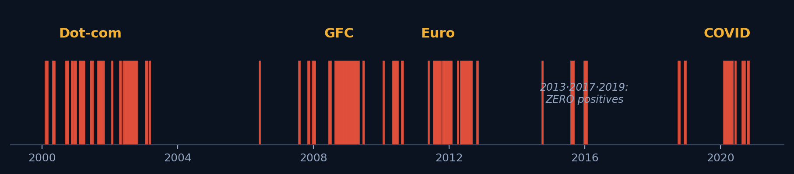
D A T A & T A R G E T
Weekly Bloomberg, two decades, one binary signal
1,111
43 → 56
21.3%
The CV challenge
2013 · 2017 · 2019 carry ZERO positives — folds must be weighted by event count.
raw weekly obs · 2000–2021
raw → engineered features
risk-off prevalence (Y=1)
● Asset classes: equity · FX · gold · oil · sovereign yields · credit · MBS.
● Risk-off clusters: Dot-com 2000–02 · GFC 2008 · Euro 2011 · COVID 2020.
03 / 15

Slide 4
F E A T U R E E N G I N E E R I N G
From 43 raw series to 56 stationary, decorrelated predictors
Stationarity by family
8 macro spreads
Collinearity cleanup
Log-returns for prices · first differences for yields · level passthrough for VIX & surprise indices.
Term, sovereign and credit (log-ratio) spreads — each as level and 4-week change.
Drop one of every pair with |corr| > 0.9 → a lean, non-redundant 56-feature set.
Hero feature — equity_bond_corr_13w
The 13-week stock–bond return correlation separates liquidity-driven crises (correlation turns positive, diversification fails) from inflation-driven regimes — a discriminating axis the price and yield features alone miss.
04 / 15

Slide 5
M E T H O D O L O G I C A L R I G O U R
“You must not fool yourself” — the traps we engineered against
TRAP
TRAP
Scaler fit on the full dataset
Random split on a time series
↓
↓
OUR FIX
OUR FIX
Fit StandardScaler on each fold's TRAIN only
Purged expanding walk-forward + 4-week embargo
TRAP
TRAP
Threshold tuned on the test set
Accuracy on imbalanced labels
↓
↓
OUR FIX
OUR FIX
Tuned on CV folds only; 2019–21 sealed holdout
F1 & AUC-PR on the anomaly class, weighted by n_pos
05 / 15

Slide 6
M E T H O D O L O G Y & E C O N O M I C R A T I O N A L E
Lead with why, not just what
Stationarity
›
Spreads
›
Walk-forward
›
4 detectors
›
Ensemble
›
Routing
›
Backtest
Stationarity — prices follow a random walk; their returns are stationary — ADF-clean inputs.
Purged walk-forward + 4-week embargo — the embargo gap kills 4-week-lookback leakage between train and validation.
Per-fold StandardScaler on train only — validation statistics never bleed into training — no cross-fold leakage.
Ledoit-Wolf shrinkage — 56 features vs ~254 normals → the sample covariance is ill-conditioned; shrinkage tames noisy eigenvectors.
06 / 15

Slide 7
T H E H O N E S T B A C K T E S T
Five expanding folds, weighted by what's rare
Fold
Validation window
Positives
Crisis
1
2007-01 → 2009-12
53
GFC 2008
● Folds 1–2 hold 117 of 135 positives — they carry the signal.
● CV metrics aggregated weighted by n_pos; thin folds 3–5 down-weighted.
● Sealed 2019–2021 test holdout: 121 weeks, includes COVID.
2
2010-02 → 2012-12
64
Euro 2011
3
2013-01 → 2014-12
2
Taper 2013
4
2015-02 → 2016-12
10
China–Oil 2015-16
87%
5
2017-01 → 2018-12
6
Q4-2018 selloff
of all positives sit in folds 1–2
117 of 135 risk-off weeks — why we weight folds by n_pos.
07 / 15

Slide 8
M A C R O I N T U I T I O N
Knowing THAT there's a crisis isn't enough —
you need to know WHERE to hide.
The right haven depends on the nature of the shock. We score three of them.
USD
GOLD
MBS
Funding stress / dollar squeeze
Real-yield · inflation · fiat distrust
Moderate-stress carry rule
LIBOR-OIS, DXY, VRP, 10Y move, US-vs-world
real yields, DXY, JPY, stock-bond corr, gold/oil
active in mild stress, blocked in acute crises
08 / 15

Slide 9
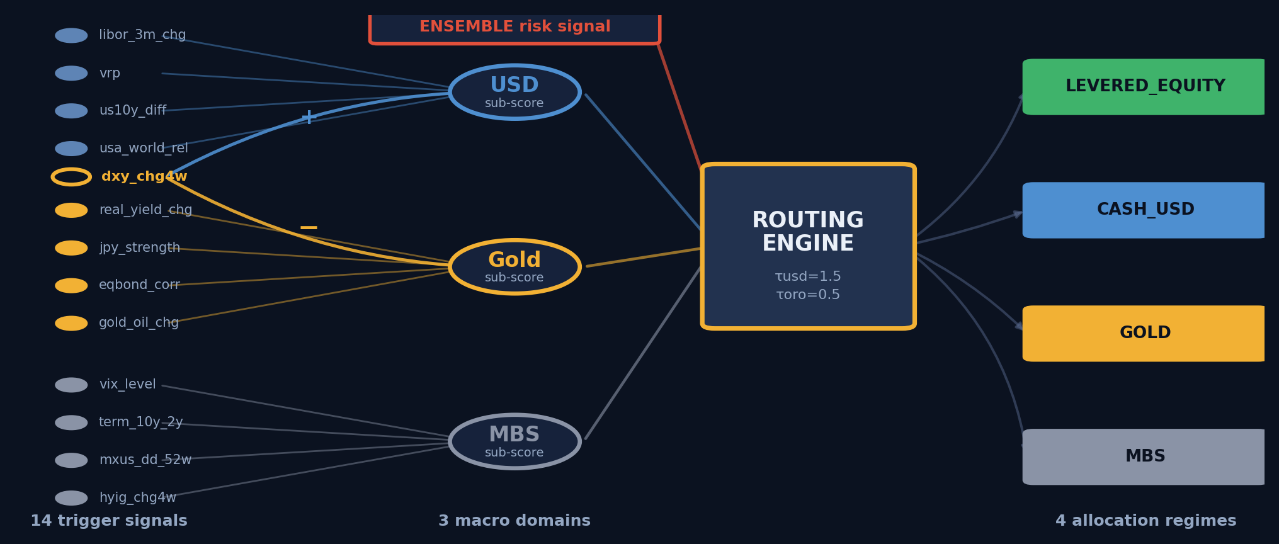
T H E E W S T R I G G E R M A P
14 signals → 3 domains → router → 4 regimes
dxy_chg4w is shared by USD (+) and Gold (−) — one variable, opposite economic readings.
09 / 15

Slide 10
D E C I S I O N M A T R I X
From signals to allocation
Ensemble = risk-on
LEVERED_EQUITY
Thresholds
1.5
risk-off · USD sub-score > 1.5 · dxy_chg4w > 0
CASH_USD
τ USD
risk-off · Gold sub-score > 0.5
GOLD
0.5
risk-off · MBS rule active
MBS
τ Gold
Tuned via walk-forward Calmar grid (duration-weighted median).
otherwise
CASH_USD (safe default)
10 / 15

Slide 11
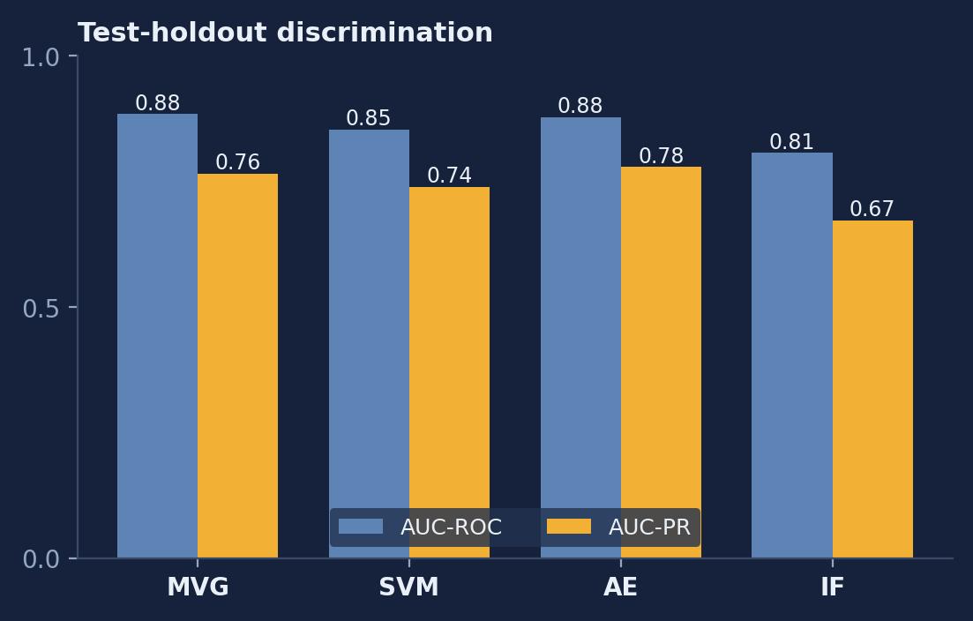
T H E F O U R D E T E C T O R S
Four inductive biases, one interface
MVG · Ledoit-Wolf
parametric — interpretable Mahalanobis distance
One-Class SVM (RBF)
flexible non-linear boundary; grid ν × γ
Autoencoder 56-…-6-…-56
non-linear reconstruction error; dropout 0.15
Isolation Forest
200 trees; robust, scale-invariant
AE wins AUC-PR (0.78); MVG best F1 — diversity that the ensemble exploits.
All fit on Y = 0 normals only.
11 / 15

Slide 12
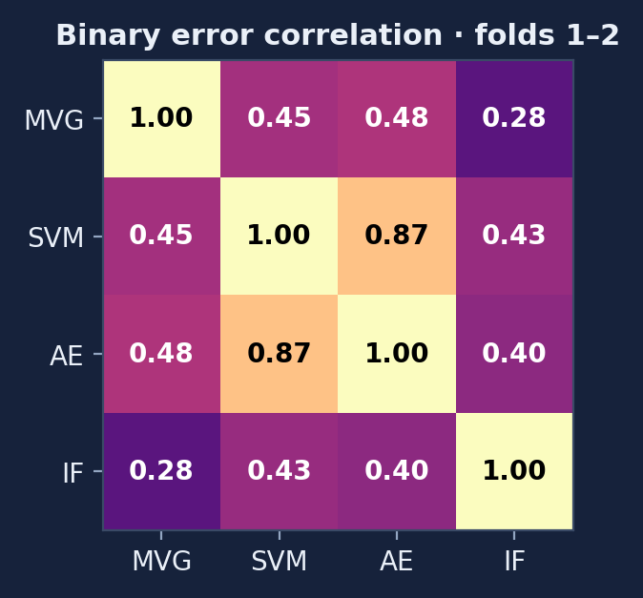
E N S E M B L E & E R R O R C O R R E L A T I O N
A real, but honest, lift
● Raw scores → empirical percentiles vs train normals (comparable scale).
● Three modes: hard vote (≥3/4), soft mean, soft median.
● Winner — soft median: test F1 = 0.647, beating the best single model (MVG, 0.635).
● Errors are correlated but far from identical → a genuine yet modest gain.
● To push further: diversify INPUTS — rates-only / equity-only / FX-only models.
0.507
mean pairwise error correlation (folds 1–2)
12 / 15

Slide 13
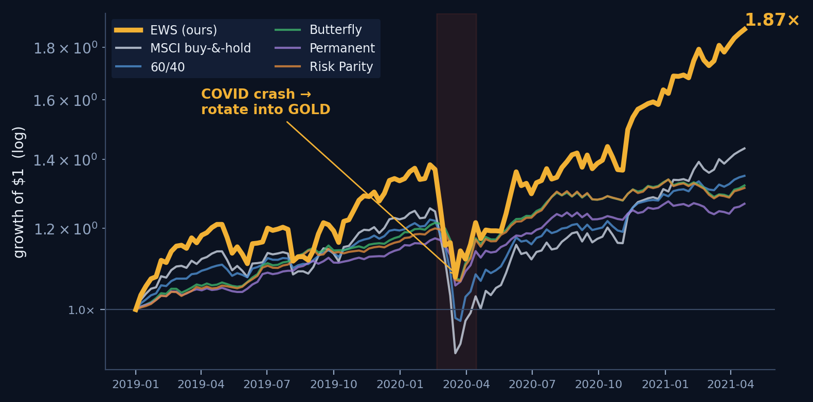
R E S U L T S — B A C K T E S T
Growth of $1 on the sealed test holdout
1.87×
EWS final — highest of 6
22 wks
COVID recovery (MSCI: 35)
GOLD
haven during the crash
13 / 15

Slide 14
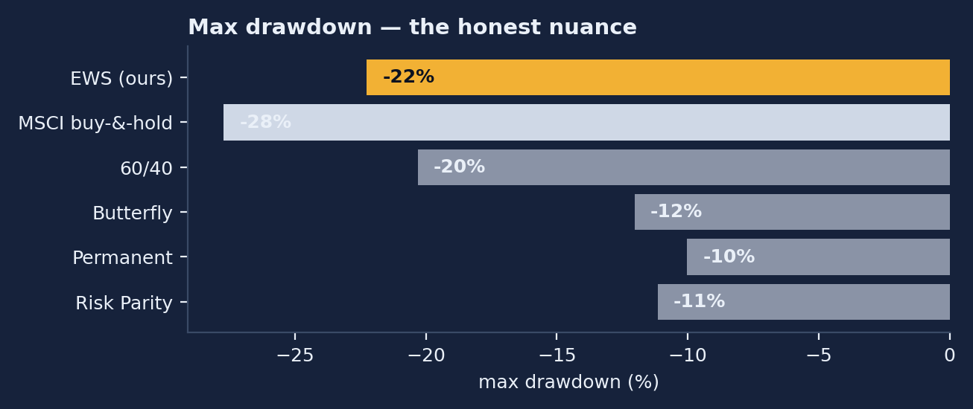
M E T R I C S & T H E D R A W D O W N N U A N C E
Best risk-adjusted return of all six
1.45
2.22
1.39
0.31
Sharpe
Sortino
Calmar
CAGR
EWS wins all four versus every benchmark.
The honest nuance
● EWS max DD −22% vs MSCI −28%; COVID crash −21% vs −27%.
● Always-defensive blends (Butterfly / Permanent / Risk Parity) show smaller ABSOLUTE drawdowns — they are never fully invested.
● EWS is a Quant Strategy (best risk-adjusted return), not a risk-management overlay.
14 / 15

Slide 15
L I M I T A T I O N S & E X T E N S I O N S
What we'd test next — tied to what's missing
Limitations
Roadmap
● Sparse labels post-2013 (thin folds).
● Training is liquidity/credit-driven — no 2022 inflation shock.
● MSCI World = equal-weight DM proxy.
● Credit = log-ratio of TR indices, not OAS.
● Static t-costs; 1-week execution lag.
Signal diversity
ensembles over DISJOINT feature sets to break the 0.507 error correlation
Regime modeling
HMM with 2–3 states for explicit switching
Frequency
daily signals — the 1-week lag cost us the first COVID week
Asset universe
REITs, EM bonds, commodity baskets
OOS stress
2022 inflation, 2023-24 geopolitical, 2025 tariff regime
15 / 15

