Slide 1
Early Warning System for Risk-Off Detection
A Quant Strategy: 1.5x Equity + Macro-Aware Safe-Haven Routing
Bocconi · GSoM Politecnico di Milano · 2025
Weekly Bloomberg dataset 2000–2021 (n=1107)
1 / 15

Slide 2
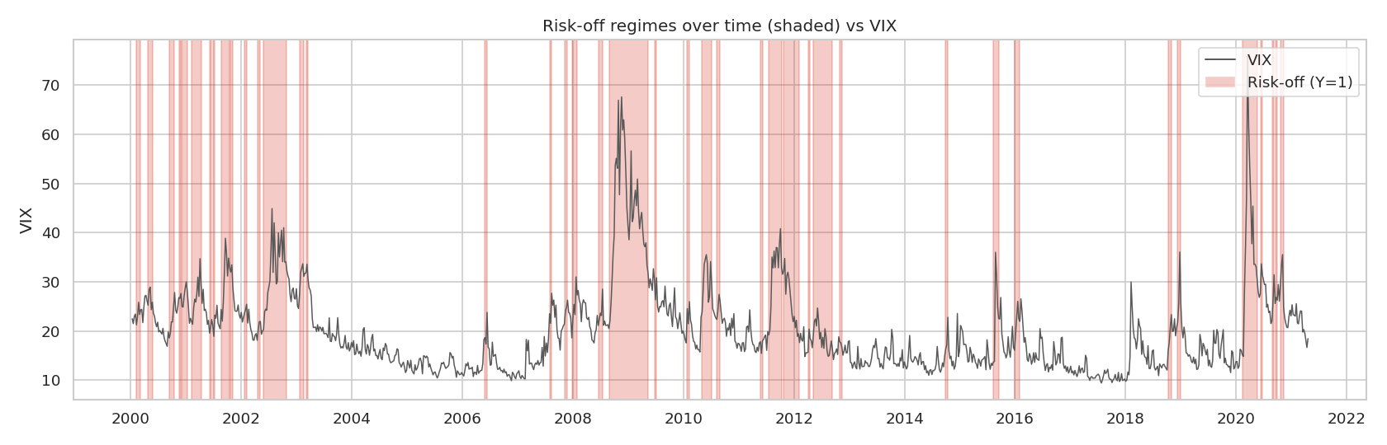
The problem
Avoiding the worst weeks is worth more than picking the best
• Markets crash, and tail events cluster: 2008, 2011, 2020, …
• Buy-and-hold pays for every drawdown in full.
• Avoiding a handful of weeks compounds into materially higher Sharpe / Calmar.
• Our business case: a Quant Strategy — aggressive in calm, defensive in stress.
• Framing: nowcasting, not forecasting. Detect stress at birth, not predict it.
2 / 15

Slide 3
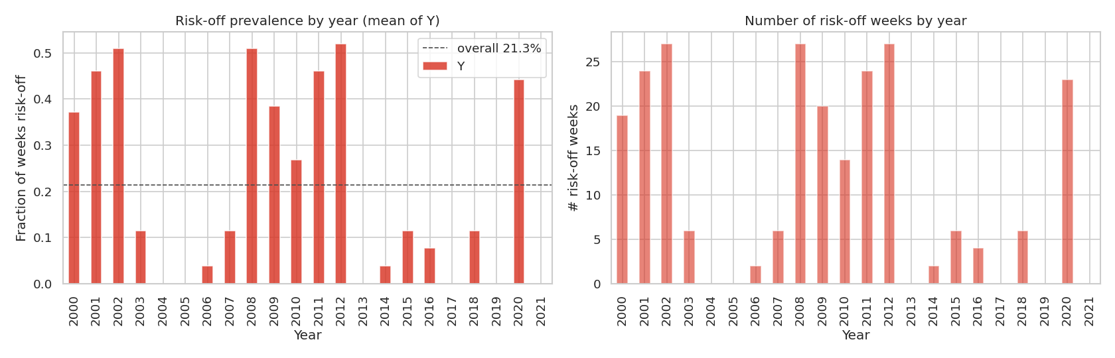
Dataset & target
Bloomberg weekly · 2000–2021 · imbalanced labels
• 1107 weekly observations, 43 raw features, binary target Y (1 = risk-off).
• Asset classes: equities (MSCI regional), FX, gold, oil, sovereign yields, credit & MBS total-return indices.
• Y imbalanced: overall prevalence ~21.3%.
• Risk-off clusters: 2000–02, GFC 2008, Euro 2011, COVID 2020.
• Years 2013/2017/2019 have zero positives → fundamental CV challenge.
3 / 15

Slide 4
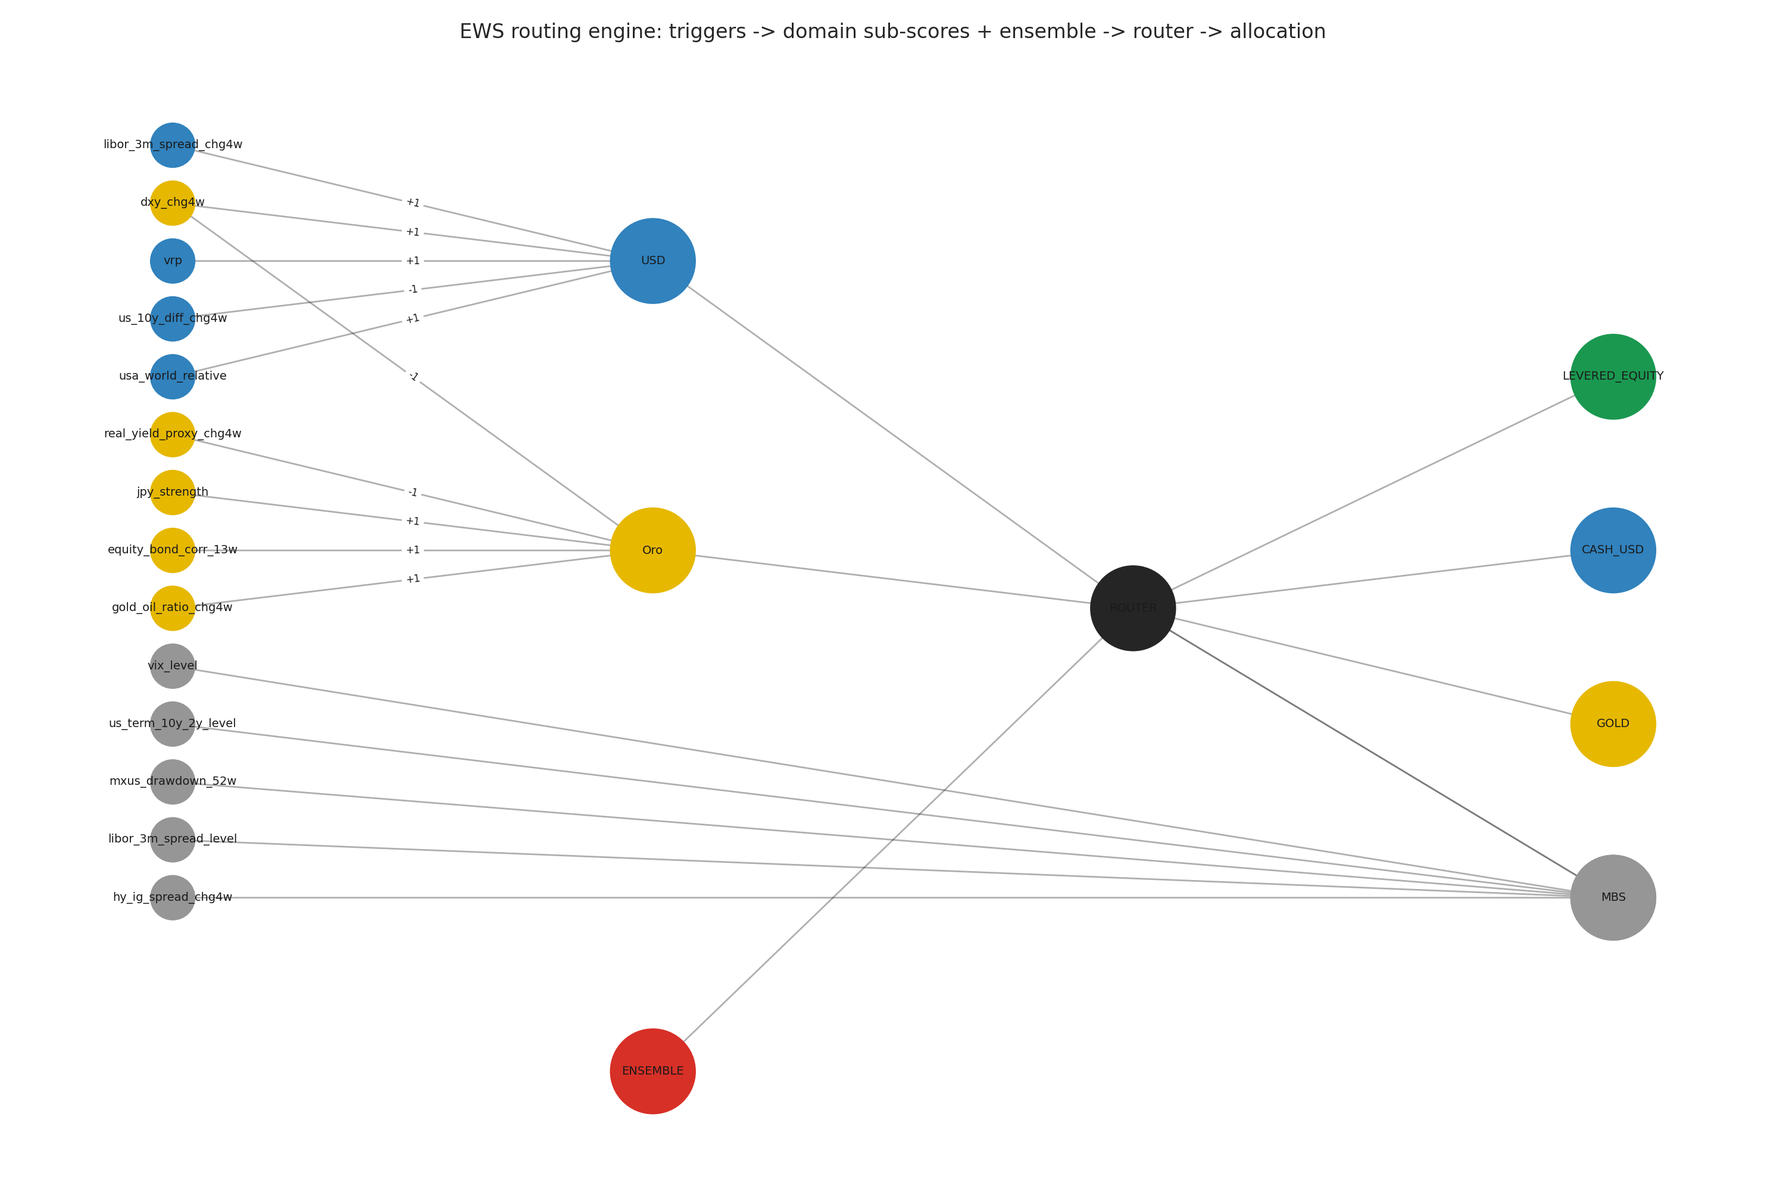
Methodology pipeline
Preprocessing is part of the model
• Raw → stationarity transforms (log-ret / diff / level by family).
• Engineered spreads (term, sovereign, credit, cross-asset) + collinearity cleanup.
• Purged expanding walk-forward CV (5 folds, 4w embargo) + sealed 2019–2021 test holdout.
• Four novelty detectors fit on Y=0 normals → percentile ensemble.
• Three macro domain sub-scores → routing engine → 4 allocation regimes.
• Backtest vs 5 benchmarks with full risk-adjusted metric suite.
4 / 15

Slide 5
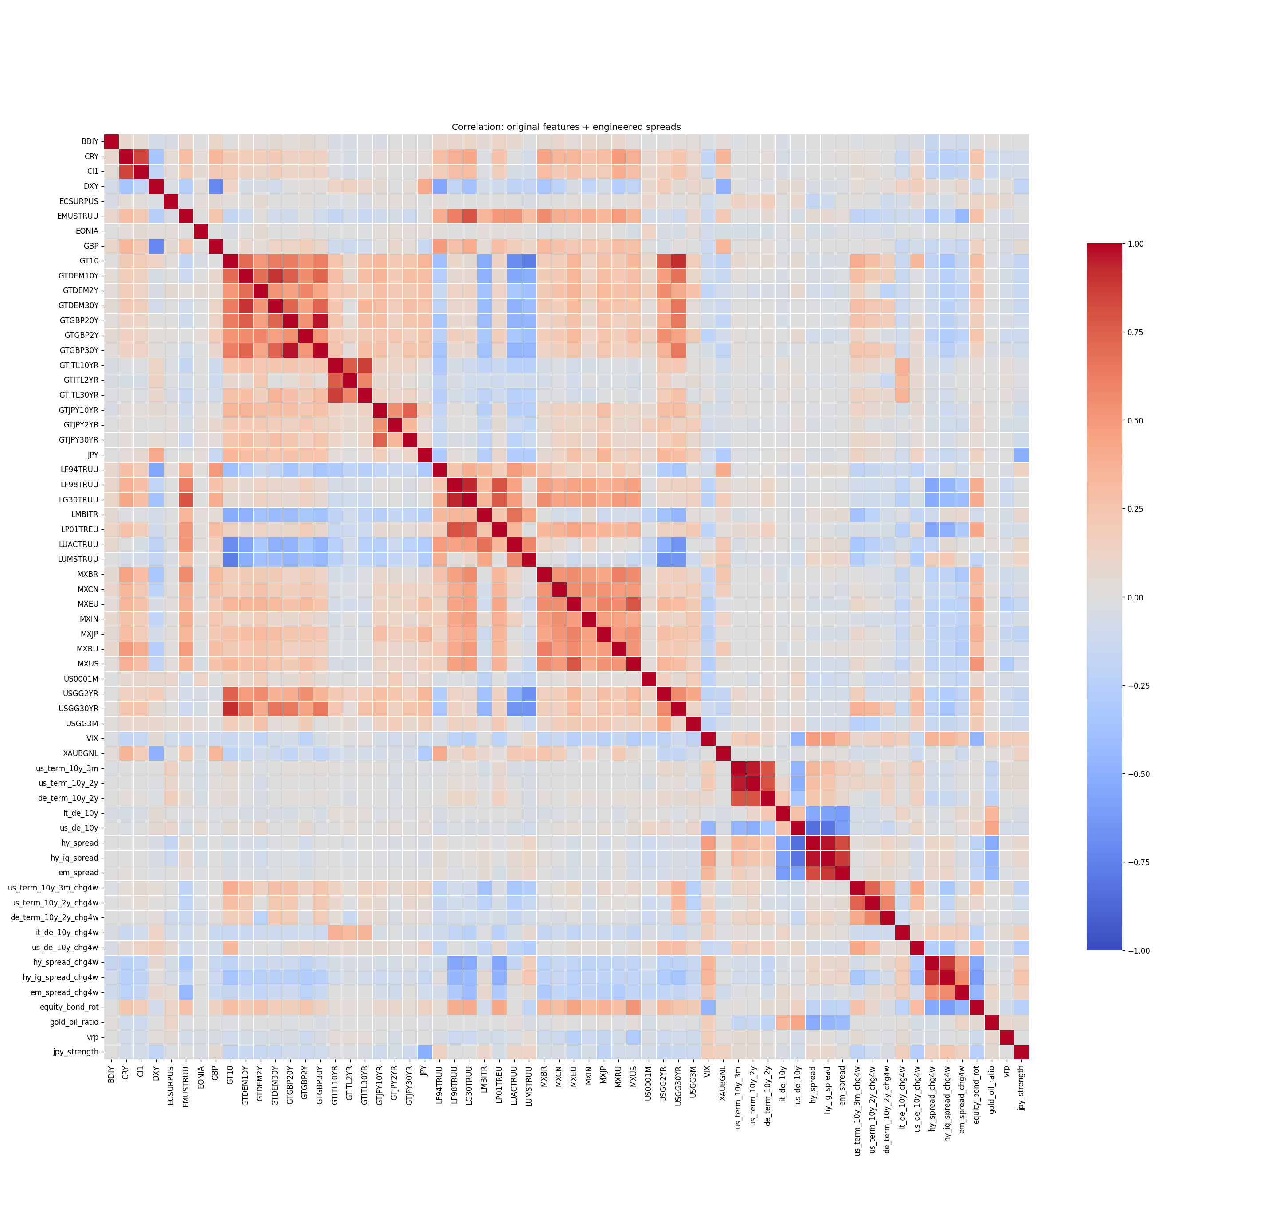
Feature engineering
From 43 raw series to 56 stationary, decorrelated predictors
• log-returns for prices (equity / FX / gold / oil / bond TR indices).
• First differences for yields and short rates.
• Level passthrough for already-stationary signals (VIX, ECSURPUS, target).
• 8 macro spreads (US term, BTP-Bund, US-DE 10Y, HY-IG, EM, …), each as level + Δ4w.
• Standalone signals: VRP, gold/oil ratio, equity-bond rotation, JPY strength.
• Highlight: equity_bond_corr_13w discriminates liquidity-driven (corr↑) vs inflation-driven crises.
• Collinearity cleanup drops |corr|>0.9 twins → 56 features into models.
5 / 15

Slide 6
Walk-forward CV with embargo
The honest backtest
• 5 expanding folds; train always starts at dataset start.
• 4-week embargo gap between train end and val start (kills 4w-lookback leakage).
• Sealed test holdout 2019-01 → 2021-04 (121 wks, includes COVID).
• Per-fold positives: 53, 64, 2, 10, 6 → folds 1–2 dominate.
• CV metrics aggregated weighted by n_pos (folds 1–2 carry the signal).
• Per-fold StandardScaler (fit on each fold's train only) — no cross-fold leakage.
6 / 15

Slide 7
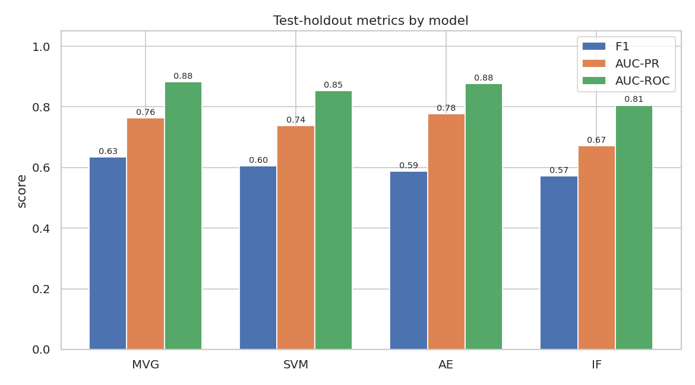
The four models
Different inductive biases on the same 56 features
• MVG (parametric) + Ledoit-Wolf shrinkage — interpretable Mahalanobis distance.
• One-Class SVM (RBF) — flexible kernel boundary; grid nu × gamma.
• Autoencoder 56-24-12-6-12-24-56, dropout 0.15 — non-linear reconstruction error.
• Isolation Forest (200 trees) — axis-aligned, robust to scale.
• All fit on Y=0 normals only; threshold tuned by walk-forward (n_pos-weighted median).
• Test AUC-ROC: MVG 0.88 / SVM 0.85 / AE 0.88 / IF 0.81. AE wins AUC-PR (0.78).
7 / 15

Slide 8
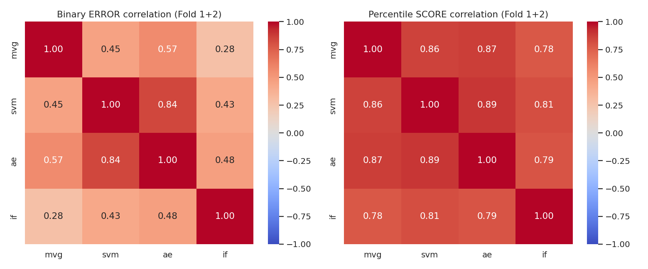
Ensemble + error correlation
An honest finding
• Map raw scores → empirical percentiles (vs train normals) for cross-model comparability.
• Three modes: hard (≥3/4 vote), soft mean, soft median.
• Winner: soft median — test F1 = 0.647 (> best single MVG 0.635).
• Mean pairwise error correlation = 0.507.
• Honest finding: shared feature space → marginal boost.
• To improve, diversify INPUTS (rates-only vs equity-only vs FX-only).
8 / 15

Slide 9
Routing engine — the macro intuition
Knowing THAT there's a crisis isn't enough — you need to know WHERE to hide
• Three domain sub-scores: USD, Gold, MBS.
• USD = funding-stress / haven (LIBOR-OIS, DXY, VRP, 10Y move, US relative).
• Gold = real-yield / inflation / fiat distrust (real yields, DXY, JPY, equity-bond corr, gold/oil).
• MBS = binary rule for moderate stress; blocked in acute crises (VIX>30, LIBOR>p90, fast HY widening).
• USD / Gold = signed-z-score means calibrated on development only.
• dxy_chg4w is intentionally shared by USD (+) and Gold (−) with opposite readings.
9 / 15

Slide 10
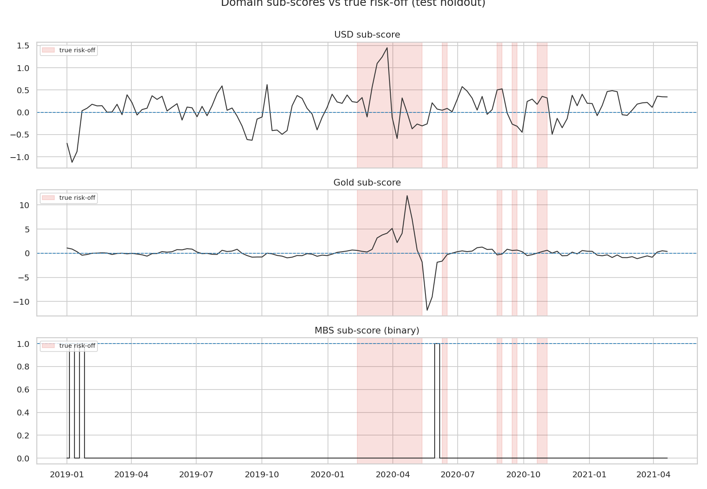
Decision matrix
From signals to allocation
• Ensemble = 0 (risk-on) → LEVERED_EQUITY (1.5x equity, -0.5x cash).
• Ensemble = 1 and sub_usd > th_usd and dxy_chg4w > 0 → CASH_USD.
• Ensemble = 1 and sub_oro > th_oro → GOLD.
• Ensemble = 1 and MBS rule active → MBS.
• Else → CASH_USD (safe default).
• Threshold τ_usd, τ_oro tuned via walk-forward Calmar grid (next slide).
10 / 15

Slide 11
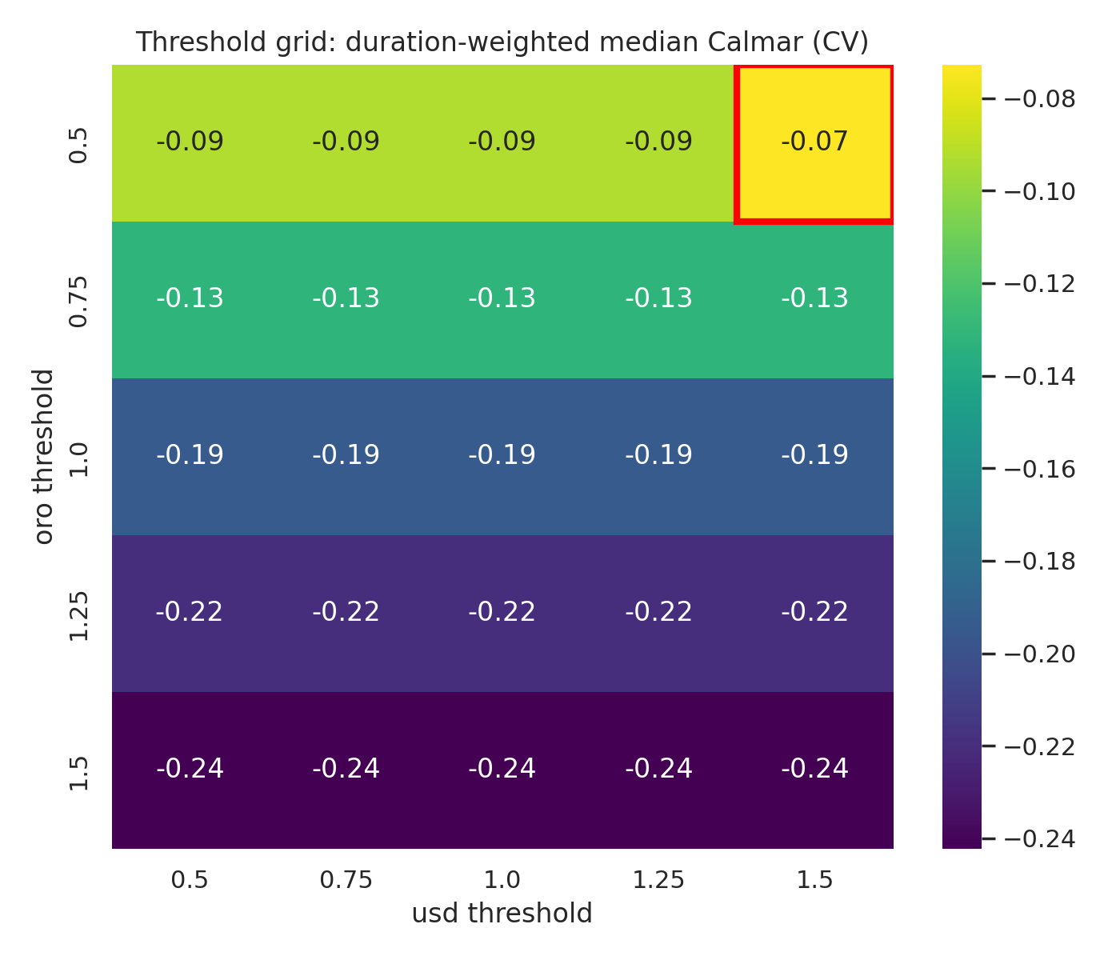
Threshold tuning
Calmar grid, duration-weighted median
• 5×5 grid: th_usd ∈ {0.5, 0.75, 1.0, 1.25, 1.5}, th_oro likewise.
• Per combo × fold val: route → backtest → Calmar.
• Aggregation: duration-weighted median (robust to thin folds).
• Selected: th_usd = 1.5, th_oro = 0.5.
• Threshold = business decision, not a statistical artifact (recall the prof's framing).
11 / 15

Slide 12
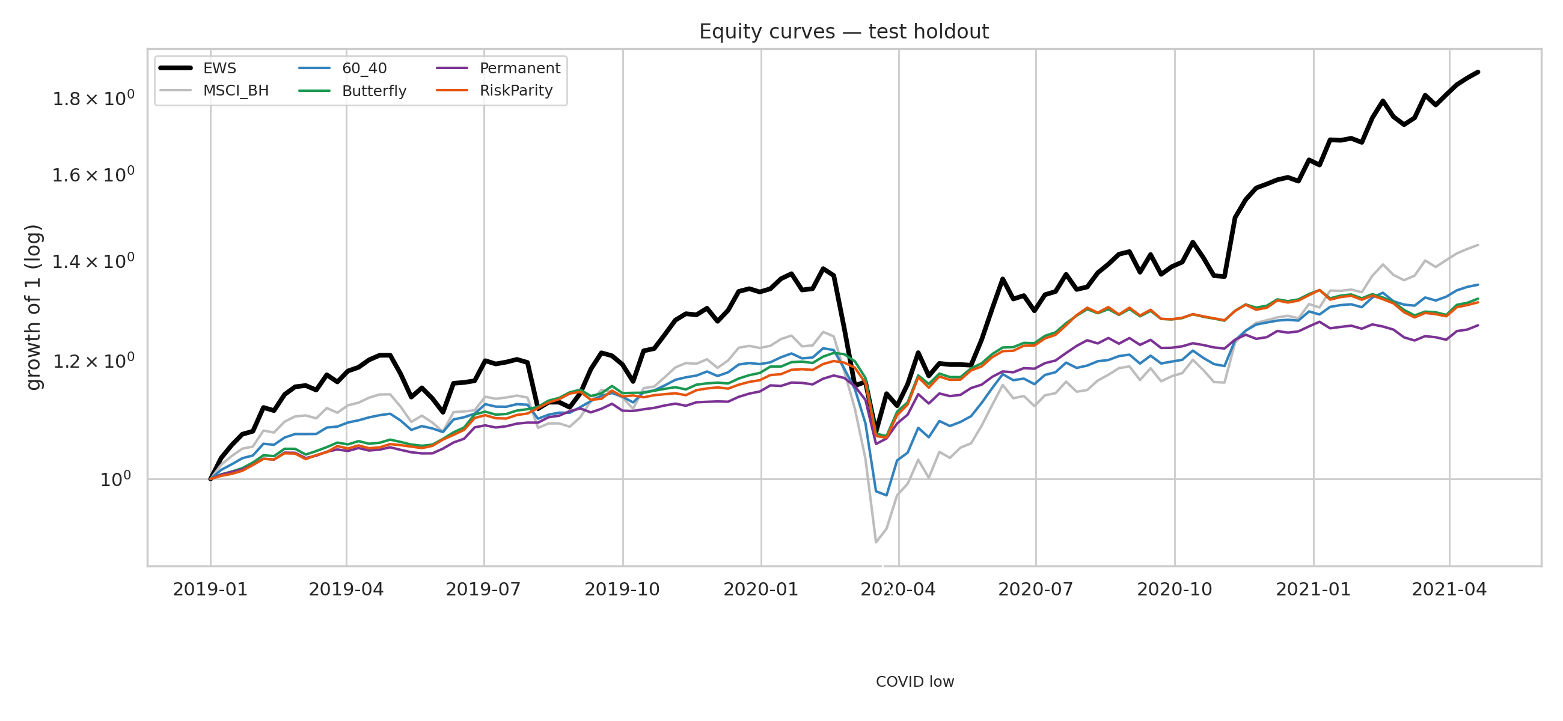
Backtest results
EWS dominates on growth of 1
• Six contenders: EWS · MSCI BH · 60/40 · Butterfly · Permanent · Risk Parity.
• EWS ends the test ~1.85× starting capital — the highest of the six.
• Clear regime rotation visible at the COVID crash (GOLD wedge).
• Recovery post-trough: EWS in ~22 weeks, MSCI in ~35.
• Transaction costs: 5/5/8/2/20 bps one-way (equity/bond/gold/cash/mbs).
12 / 15

Slide 13
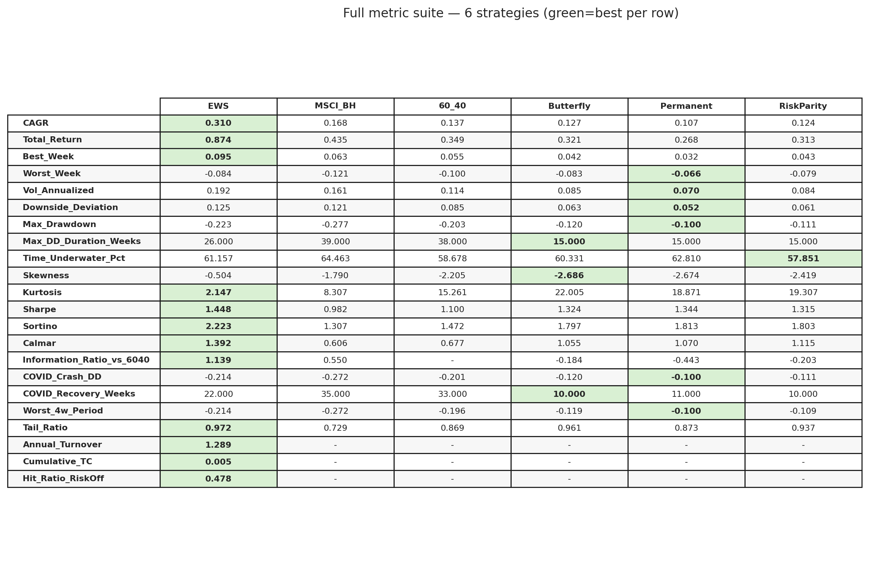
Metrics & crisis behavior
Sharpe 1.45 · Sortino 2.22 · Calmar 1.39 · CAGR 0.31
• EWS wins Sharpe, Sortino, Calmar AND CAGR across all 5 benchmarks.
• MaxDD −22% vs MSCI −28% vs 60/40 −20%.
• COVID crash DD −21% (vs MSCI −27%); rotation into GOLD during the crash.
• Honest nuance: always-defensive blends (Butterfly/Permanent/RiskParity) have smaller absolute DD because they're never fully invested.
• EWS is a Quant Strategy (best risk-adjusted return), not a Risk Management overlay.
13 / 15

Slide 14
Limitations — what we own up to
Stated before they are asked
• Sparse labels post-2013 → folds 3–5 thin (mitigated by n_pos weighting, not eliminated).
• Training dominated by liquidity / credit crises → no 2022-style inflation shock in data.
• Ensemble error correlation 0.507 → modest boost vs best single model.
• MSCI World = equal-weight DM proxy (no true global index in dataset).
• Credit spreads = log-ratio of total-return indices, not OAS in bps.
• Transaction costs are static estimates; real deployment needs market-impact / slippage modeling.
• 1-week execution lag is realistic but costs in fast crashes (COVID first week).
14 / 15

Slide 15
Future work & Q&A backup
Where this goes next
• HMM with 2–3 regimes for explicit regime switching.
• Ensembles over DISJOINT feature sets (rates / equity / FX) to reduce error correlation.
• Daily signals (vs weekly) for earlier warning in fast crises.
• Multi-asset extension: REITs, EM bonds, commodity baskets.
• Post-2021 stress tests: 2022 inflation shock, geopolitical 2023–24.
• Q&A backup: why walk-forward? Ledoit-Wolf? 1.5× leverage? Soft-median over hard vote?
15 / 15

