Slide 1
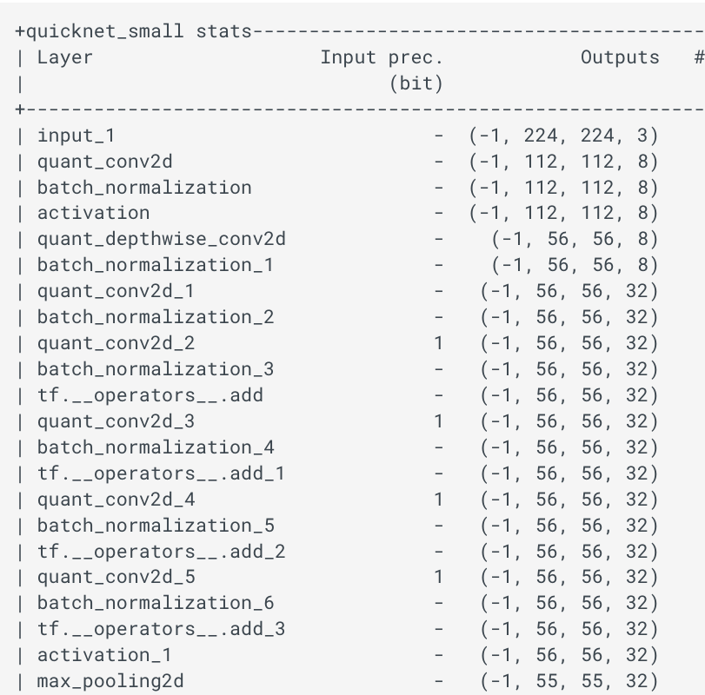
ZOO QKERAS VS LARQ
Loro Francesco

Slide 2
Agenda
#
Network Description
#
Weights
#
Network Summary
#
Test and Results

Slide 3
Network Description 1/2
From larq.zoo
QuickNetSmall
QuickNet
QuickNetLarge
From larq.literature
AlexNet
DenseNet 28/37/45
DenseNet 37 dilated
ResNet 18
BirealNet

Slide 4
Network Description 2/2
All of them are trained on the ImageNET dataset
Details about the hyperparameters used can be found in the larq zoo github repository
We performed a 1 to 1 translation of the networks from larq framework to qkeras framework and reuse the weights trained in larq

Slide 5
Weights
The weights used to run the test can be downloaded here:
QuickNet https://drive.google.com/file/d/1-JieqQOWmQ4sA8_A4akfS84O8xFT9_x8/view?usp=sharing
QuickNetSmall https://drive.google.com/file/d/1-N7GTBYI1dkibbxG-lKtvnRtEpveFGj_/view?usp=sharing
QuickNetLarge https://drive.google.com/file/d/1-Nm-kAYagGche_31eKDuvH2l9i9ANygN/view?usp=sharing
AlexNet https://drive.google.com/file/d/1-65sB1xnJuOoPhL00TYY0s3Fov0zxBHJ/view?usp=sharingBiRealNet
BiRealNet https://drive.google.com/file/d/1BuDYhydNAy-sFdvoh24gJbpA0zRDvGVq/view?usp=sharingBinary_resnet_e18
Binary_resnet_e18 https://drive.google.com/file/d/1-eRhwVTzIKm3D0WoOls3eyeXmJE7Q6Cn/view?usp=sharing
Binary_dense_e28 https://drive.google.com/file/d/1-Plw5XKKCeTP17nUpnzRM3JnUdlwv_MJ/view?usp=sharing
Binary_densenet_e37 https://drive.google.com/file/d/1PldbeERqq9-Xz8HQtaRAHtbtqItRznLp/view?usp=sharing
Binary_densenet e45 https://drive.google.com/file/d/1Lpc-rRAleNJSF-Y4SlDab9bW2L8cUkn0/view?usp=sharing
XNORNet https://drive.google.com/file/d/1-rDz7bFE0d9LmF1A0RfOfGIguuuuErPp/view?usp=sharing
Real to Binary Net https://drive.google.com/file/d/1-rDz7bFE0d9LmF1A0RfOfGIguuuuErPp/view?usp=sharing

Slide 6
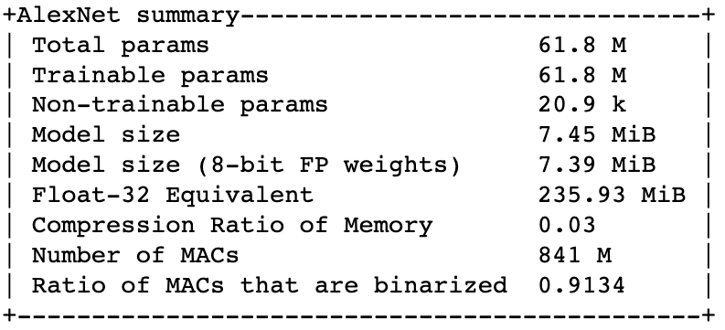
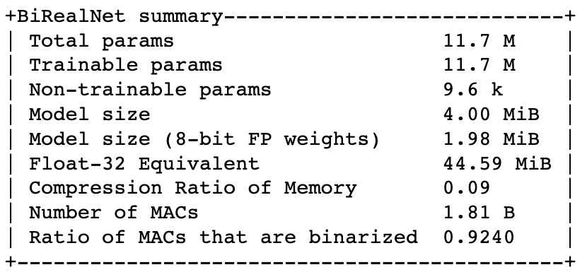
Network Summary
AlexNet
BiRealNet

Slide 7
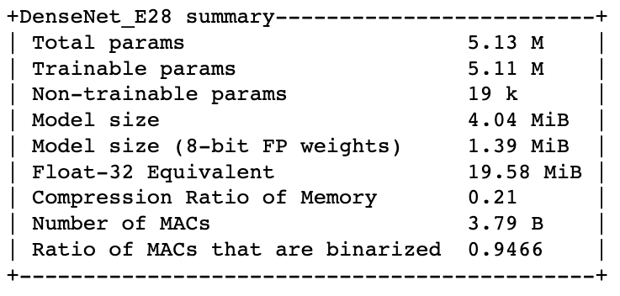

Network Summary
Binary DenseNet E28
Binary DenseNet E37

Slide 8
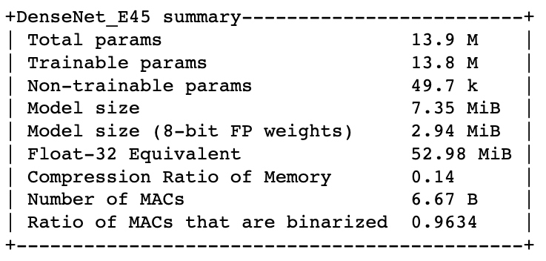
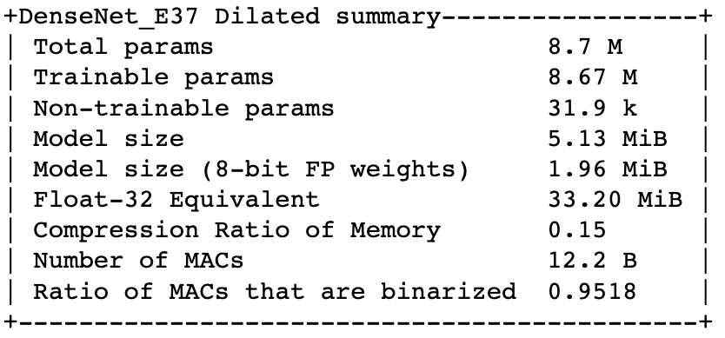
Network Summary
Binary DenseNet E45
Binary DenseNet E37 Dilated

Slide 9
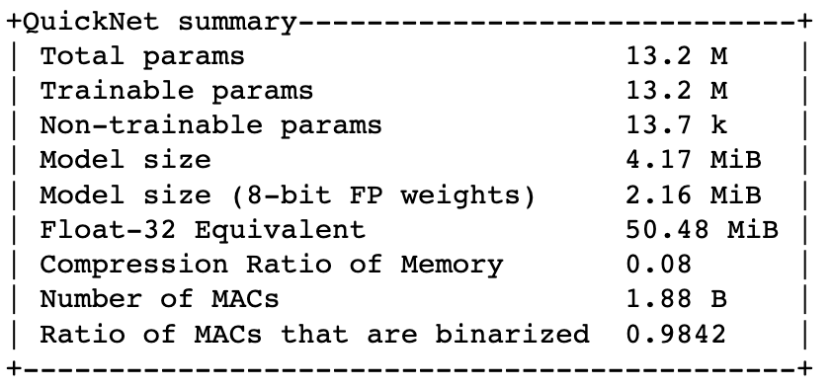
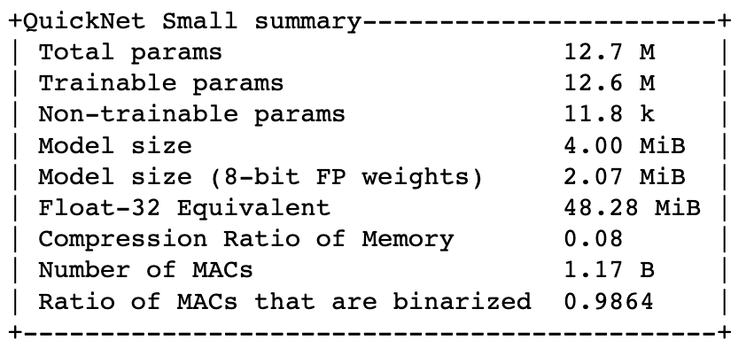
Network Summary
QuickNet
QuickNet Small

Slide 10
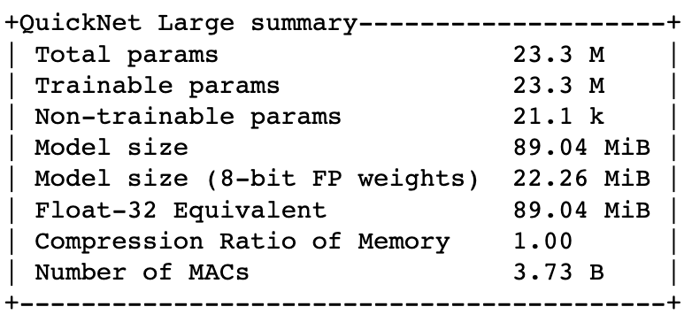
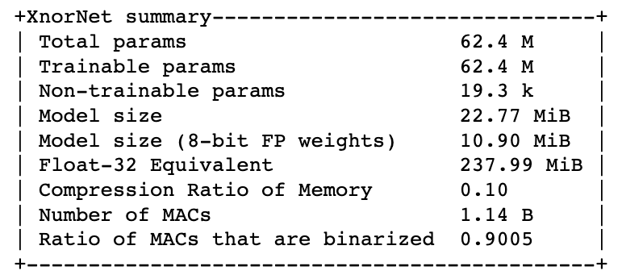
Network Summary
QuickNet Large
XNORNet

Slide 11
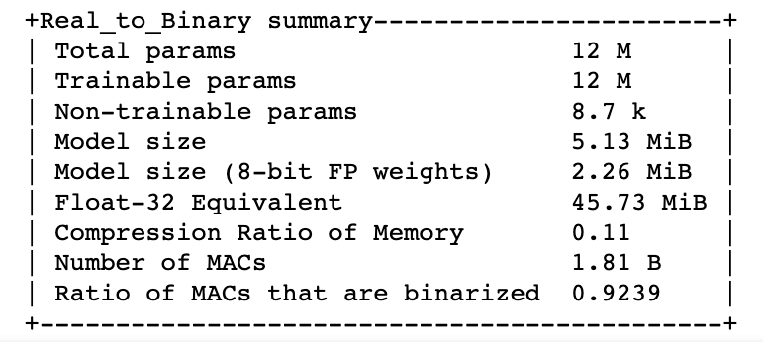
Network Summary
Real to Binary Net

Slide 12
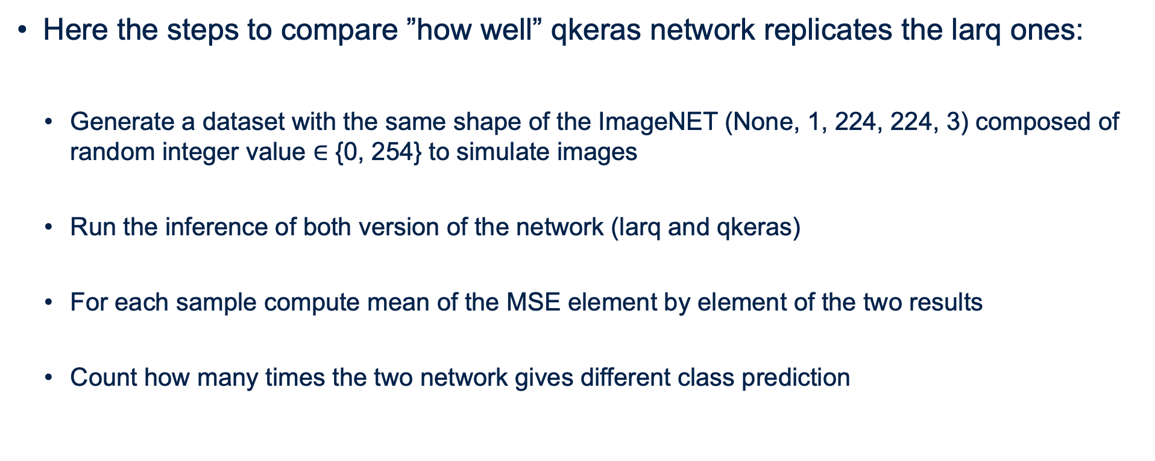
Random Generated Test
Here the steps to compare ”how well” qkeras network replicates the larq ones:
Generate a dataset with the same shape of the ImageNET (None, 1, 224, 224, 3) composed of random integer value $∈$ {0, 254} to simulate images
Run the inference of both version of the network (larq and qkeras)
For each sample compute mean of the MSE element by element of the two results
Count how many times the two network gives different class prediction

Slide 13
ImageNET Test
Here the steps to compare ”how well” qkeras network replicates the larq ones:
Load 2000 sample from the imageNET dataset
Resize the images to (224,224,3)
Count how many times the two network gives different class prediction

Slide 14
Results
NETWORK | RANDOM DATASET – 100 samples |  | IMAGENET DATASET – 2000 samples
 | Mean MSE | Misclassification | Mean MSE | Misclassification
QuickNet | 5.6e-05 | 0 | 0,00014
QuickNet Small | 0.0 | 0 | 0,00003
QuickNet Large | 6.9e-18 | 0 | 0,00023
AlexNet | 0.0 | 0
BiRealNet | 8.4e-05 | 6
Binary DenseNet E28 | 0.0 | 0
Binary DenseNet E37 | 0.0 | 0
Binary DenseNet E45 | 0.0 | 0
Binary DenseNet E37 Dilated | 0.0 | 0
XNORNet | 0.0 | 0
Real to Binary | 0.0 | 0

Slide 15
Integration on Qkeras repository
Follow the status of the pull request at: https://github.com/google/qkeras/pull/66

