Slide 1
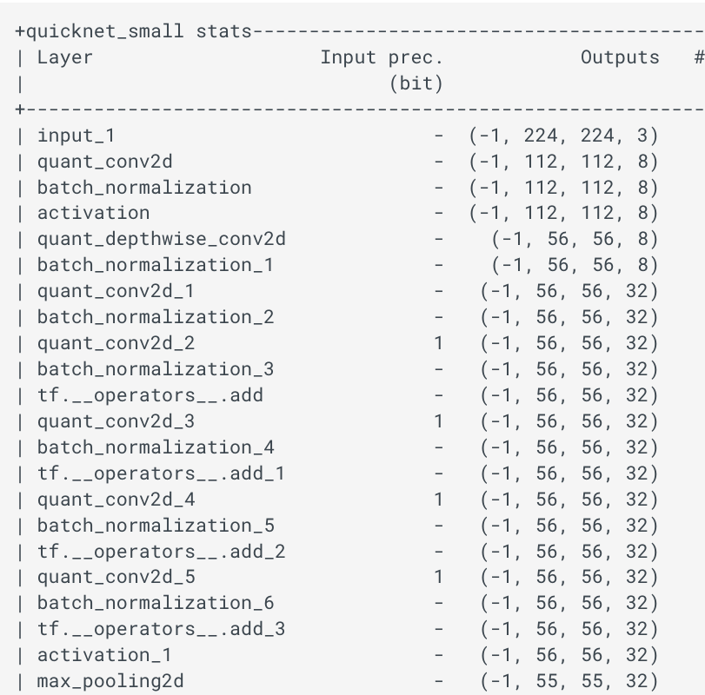
ZOO QKERAS VS LARQ
Presenter name

Slide 2
Agenda
#
Network Description
#
Weights
#
Saved Network
#
Test and Results

Slide 3
Network Description 1/2
Tested Network:
From larq.zoo
QuickNetSmall
QuickNet
QuickNetLarge
From larq.literature
AlexNet

Slide 4
Network Description 2/2
All of them are trained on the ImageNET dataset
Details about the hyperparameters used can be found in the larq zoo github repository
We performed a 1 to 1 translation of the networks from larq framework to qkeras framework and reuse the weights trained in larq

Slide 5
Weights
The weights used to run the test can be downloaded here:
QuickNet
https://github.com/larq/zoo/releases/download/quicknet-v1.0/quicknet_weights.h5
QuickNetSmall
https://github.com/larq/zoo/releases/download/quicknet-v1.0/quicknet_small_weights.h5
QuickNetLarge
https://github.com/larq/zoo/releases/download/quicknet-v1.0/quicknet_large_weights.h5
AlexNet
https://drive.google.com/file/d/1-65sB1xnJuOoPhL00TYY0s3Fov0zxBHJ/view?usp=sharingBiRealNet
BiRealNet
https://drive.google.com/file/d/1BuDYhydNAy-sFdvoh24gJbpA0zRDvGVq/view?usp=sharingBinary_resnet_e18
Binary_resnet_e18
https://drive.google.com/file/d/1-eRhwVTzIKm3D0WoOls3eyeXmJE7Q6Cn/view?usp=sharing
Binary_dense_e28
https://drive.google.com/file/d/1-Plw5XKKCeTP17nUpnzRM3JnUdlwv_MJ/view?usp=sharing

Slide 6
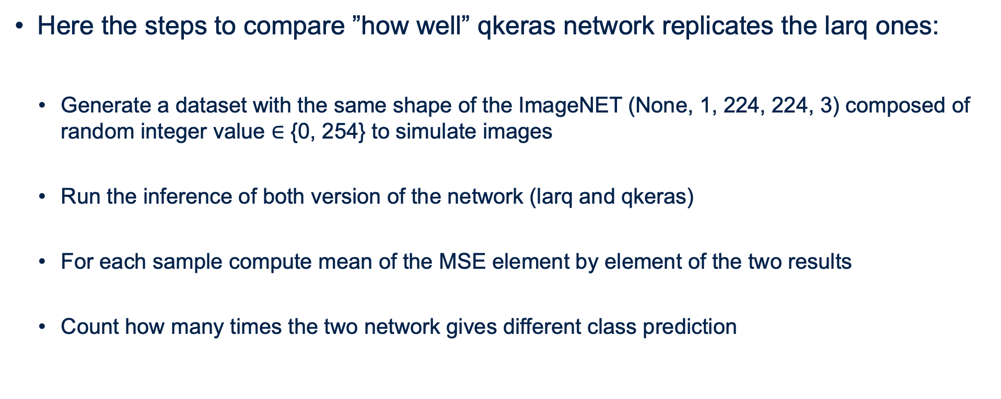
Random Generated Test
Here the steps to compare ”how well” qkeras network replicates the larq ones:
Generate a dataset with the same shape of the ImageNET (None, 1, 224, 224, 3) composed of random integer value $∈$ {0, 254} to simulate images
Run the inference of both version of the network (larq and qkeras)
For each sample compute mean of the MSE element by element of the two results
Count how many times the two network gives different class prediction

Slide 7
ImageNET Test
Here the steps to compare ”how well” qkeras network replicates the larq ones:
Load 2000 sample from the imageNET dataset
Resize the images to (224,224,3)
Count how many times the two network gives different class prediction

Slide 8
Results
NETWORK | RANDOM DATASET – 100 samples |  | IMAGENET DATASET – 2000 samples
 | Mean MSE | Misclassification | Mean MSE | Misclassification
QuickNet | 5.6e-05 | 0 | 0,00014
QuickNet Small | 0.0 | 0 | 0,00003
QuickNet Large | 6.9e-18 | 0 | 0,00023
AlexNet | 0.0 | 0
BiRealNet | 8.4e-05 | 6
Binary ResNet e18 | 0.0 | 0
Binary DenseNet e28 | 0.0 | 0

