Slide 1
Machine Learning and
Deep Learning
Incremental Learning in Image Classification
Genta, Massimino, Paesante
A.Y. 2019/2020
Notes:
Github source

Slide 2
Index
Introduction of the problem
Baselines
Joint Training
Fine Tuning
LwF
iCaRL
Ablation study
iCaRL Hybrid-1
Losses
Classifiers
Herding
Improvements
Conclusions

Slide 3
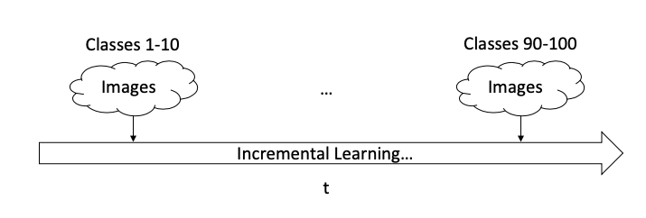
Introduction to Incremental Learning
Desirable properties of a class-incremental algorithm:
trainable from a data stream in which examples of different classes occur at different times,
provide at any time a competitive multi-class classifier,
limited computational requirements and memory footprint.

Slide 4
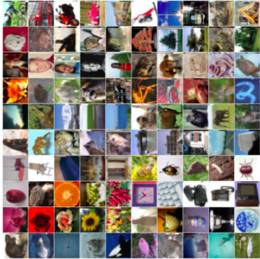
Dataset
100 classes
60’000 labelled images
50’000 training
10’000 testing
32x32 size
Our split: 10 batches of 10 random classes
src: Stanford

Slide 5
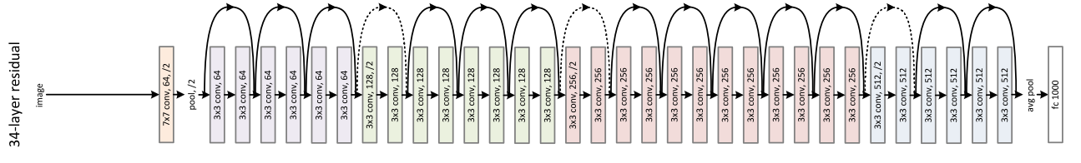
Model
Ad-hoc ResNet 34
Optimized on CIFAR100
Transformations on train and test images
src: Resnet paper

Slide 6
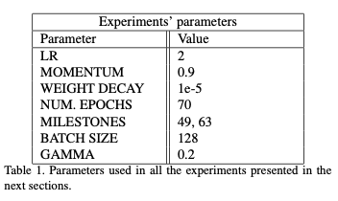
Baselines
Joint Training, Fine Tuning, LwF, iCaRL
iCaRL parameters
No validation set
Experiments performed in Google Colab
3 different splits considered
Common model: Resnet 32
Criterion: BCE with logits

Slide 7
Joint Training
Not actually Incremental Learning
Both train and test set involve all the classes seen so far
Upper Bound for our following experiments
Extremely long training time
Good accuracy on the test set
t
train and test set:
images classes 1-10
train and test set:
images classes 1-100
...

Slide 8
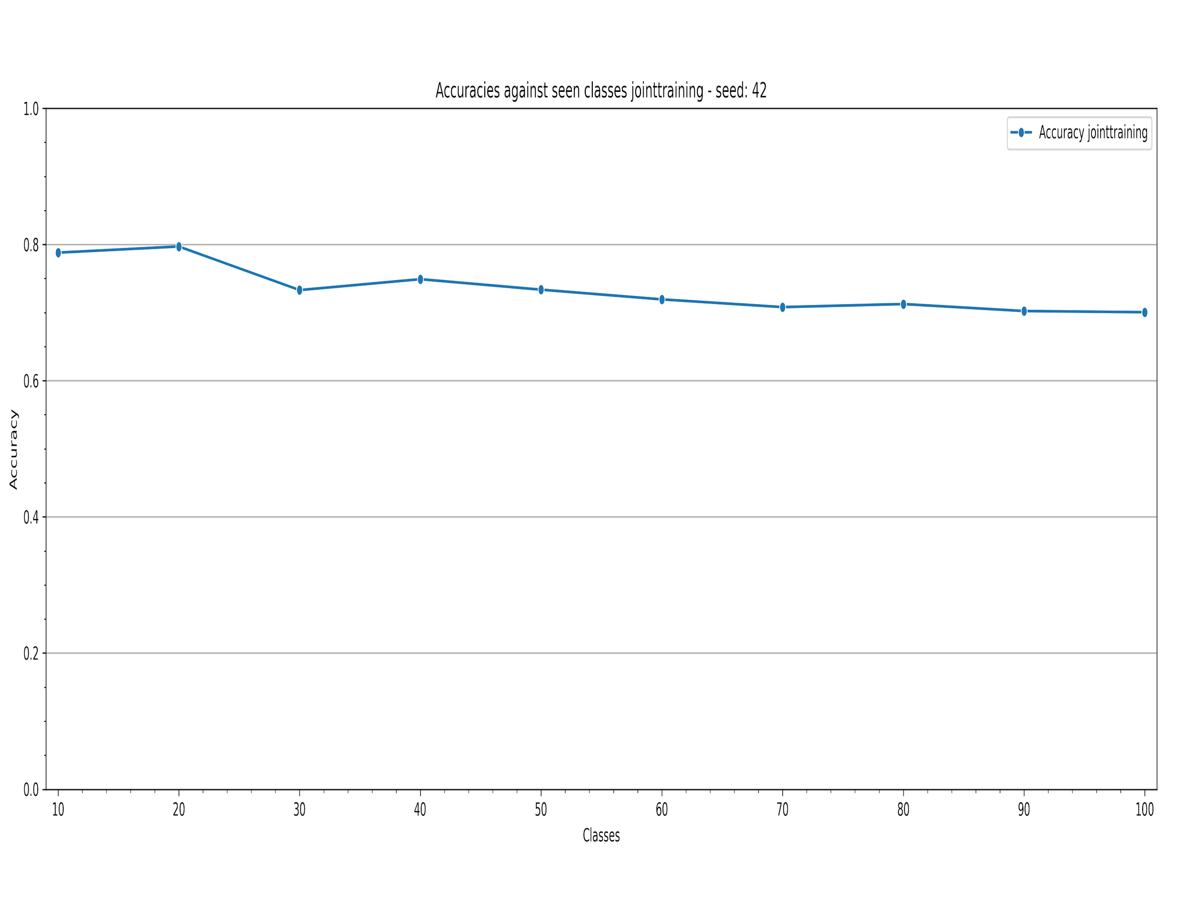
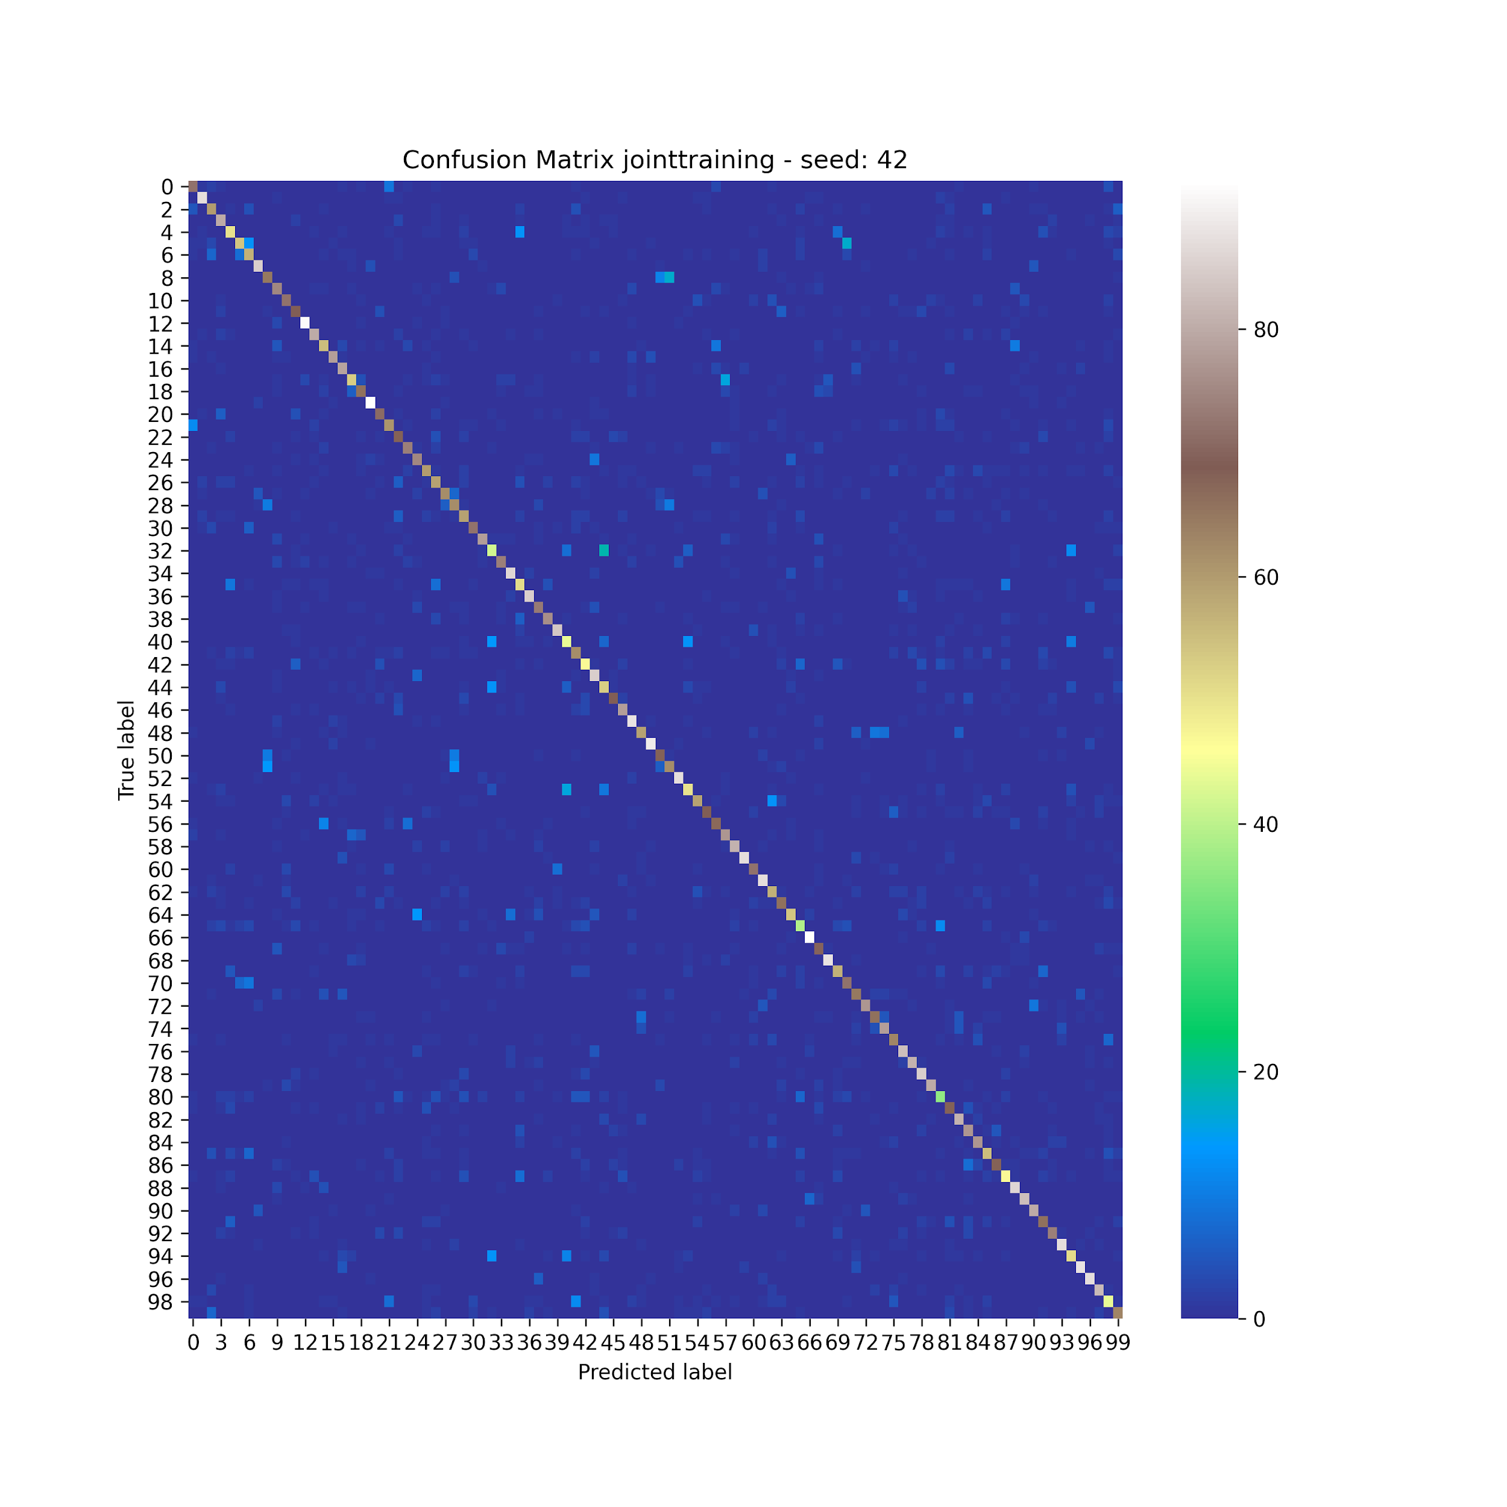
Joint Training - Results

Slide 9
Fine Tuning
Fine tune the network on new images
Loss based only on the last group
Good performances on single sets
Bad overall performance (Catastrophic Forgetting)

Slide 10
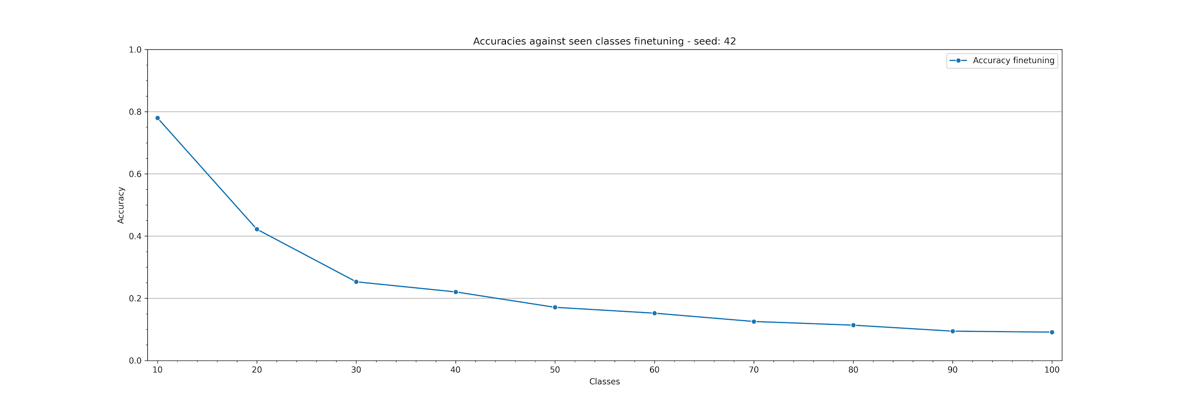
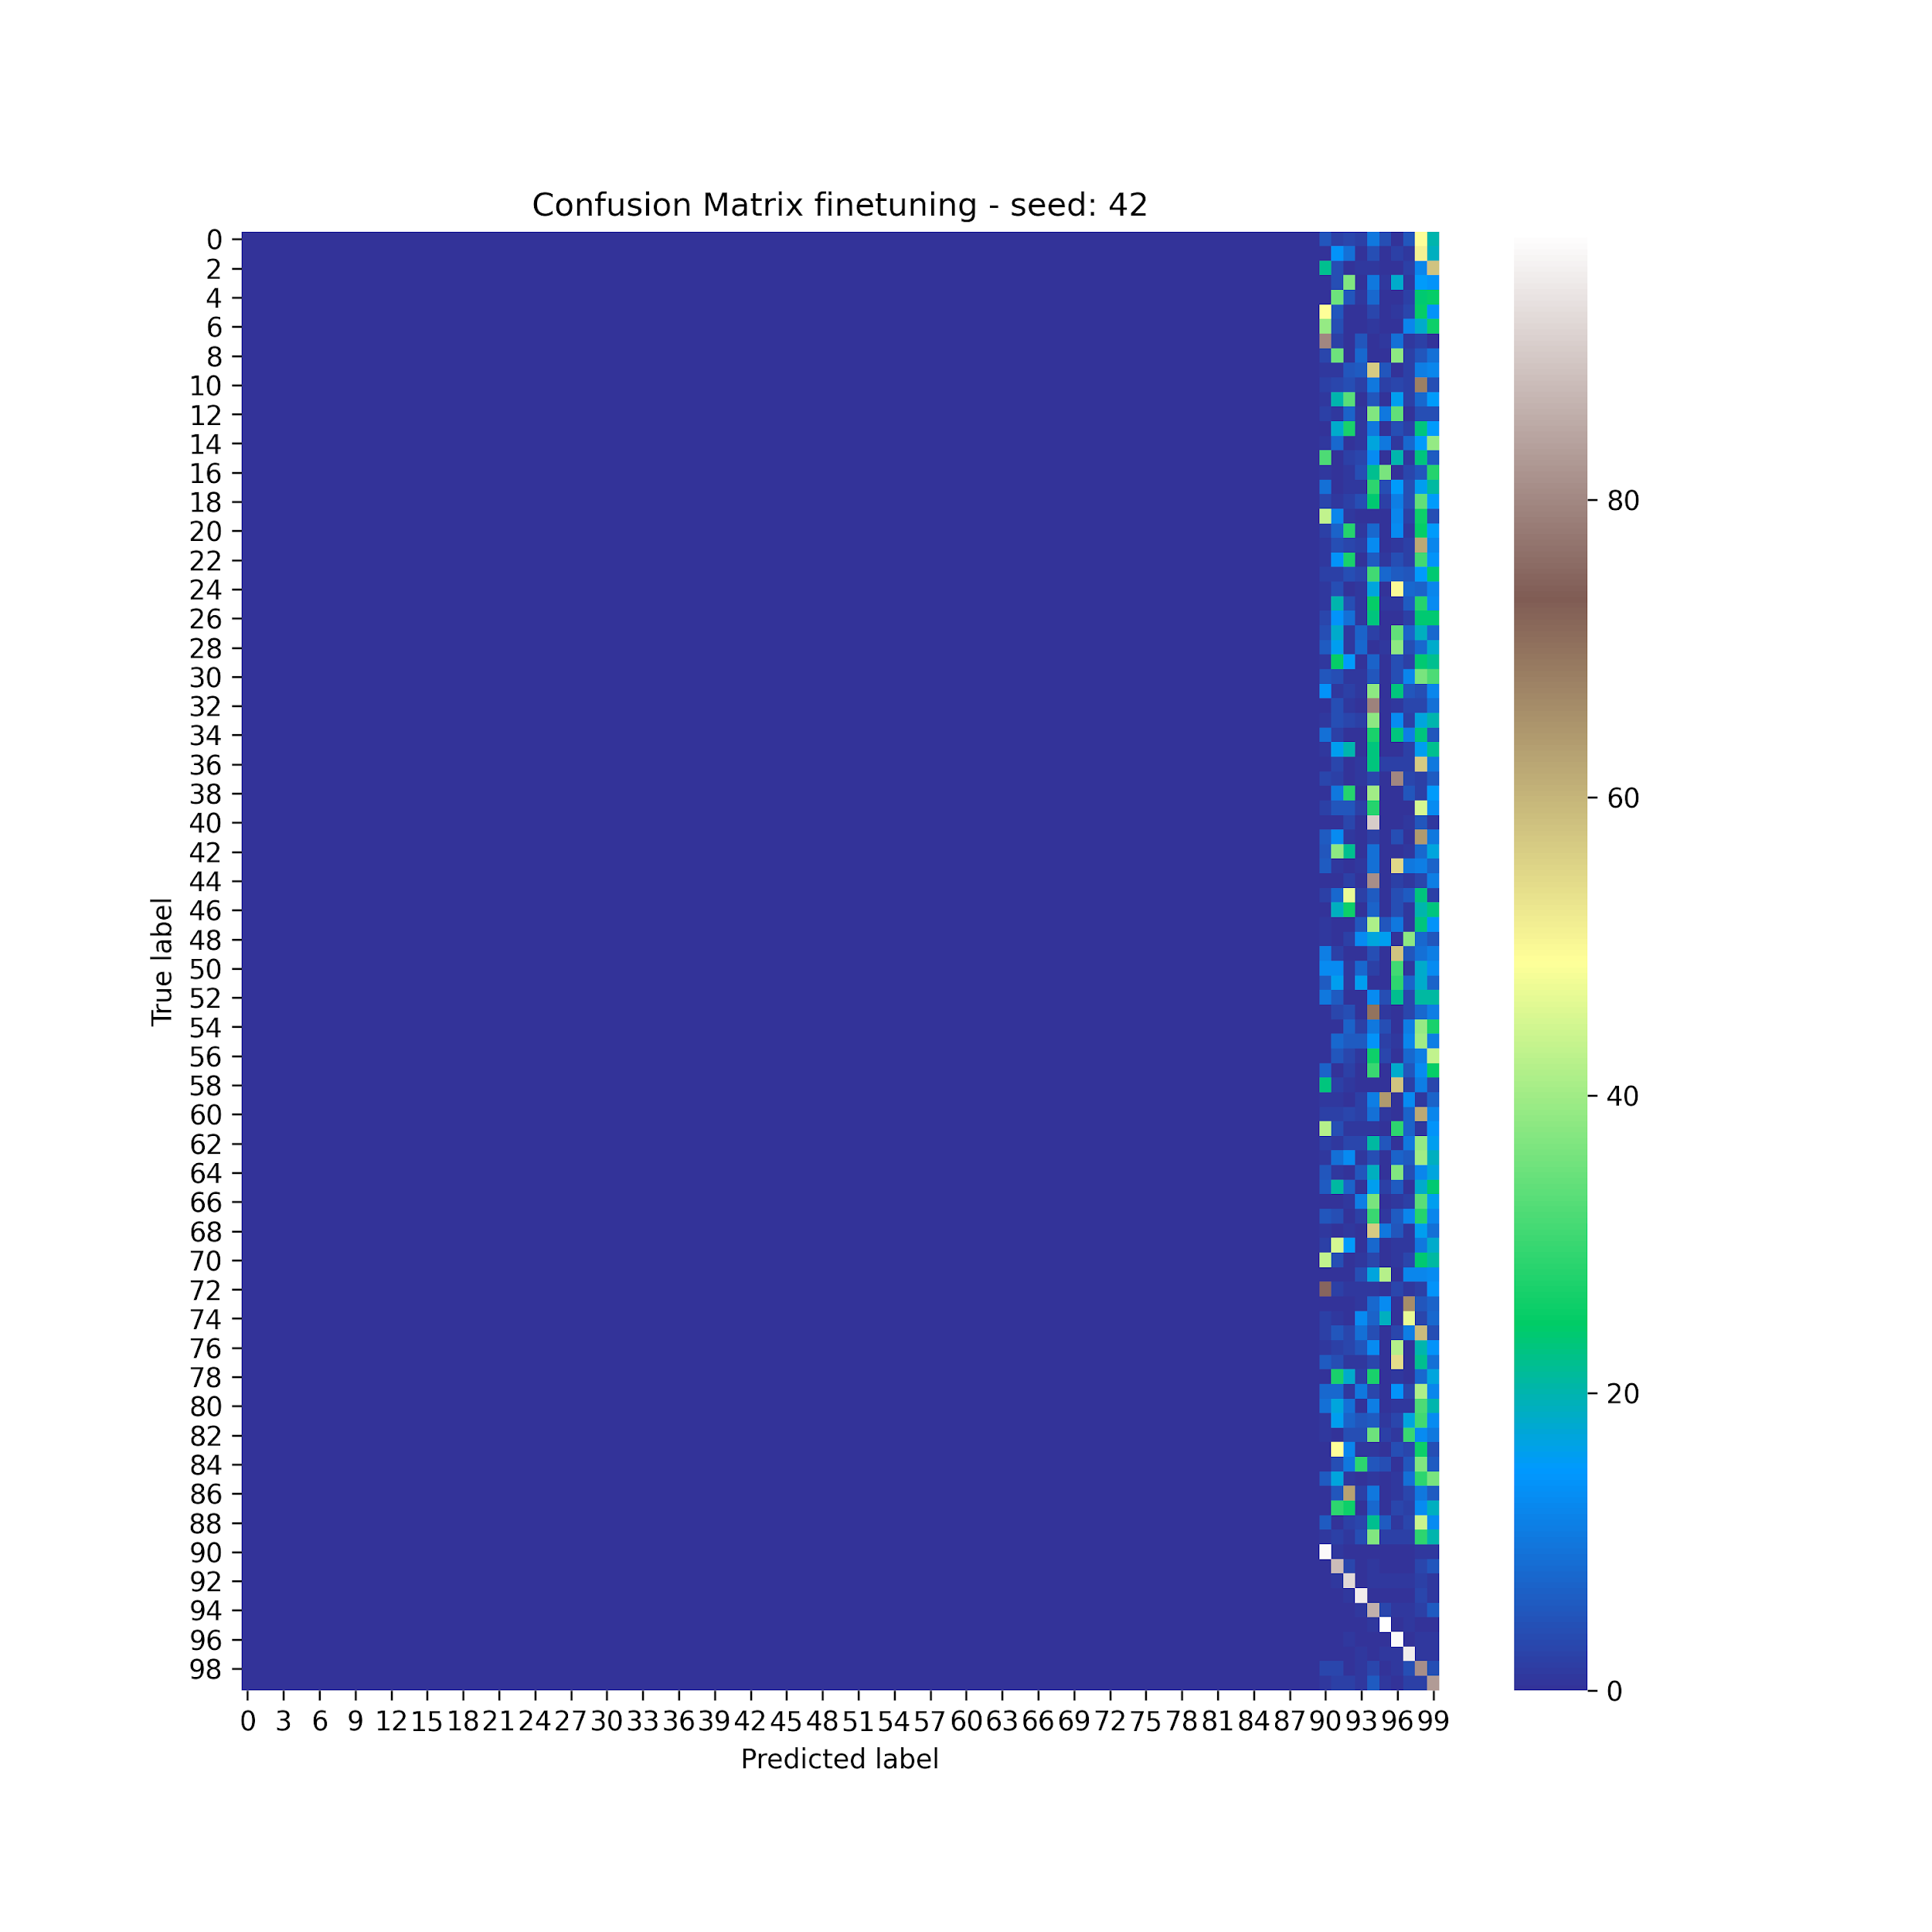
Fine Tuning - Results

Slide 11
Learning Without Forgetting
base on knowledge distillation
modification of Join Training
Use of the parameters of the previous classifications
Classification based on the probabilities returned by the network
Loss consisting of two parts
classification loss, encourages the network to correctly label new classes
distillation loss, encourages the network to reproduce the old score to label old classes
Z. Li and D. Hoiem. Learning without forgetting. In IEEE T-PAMI, 40(12):2935–2947, 2017

Slide 12
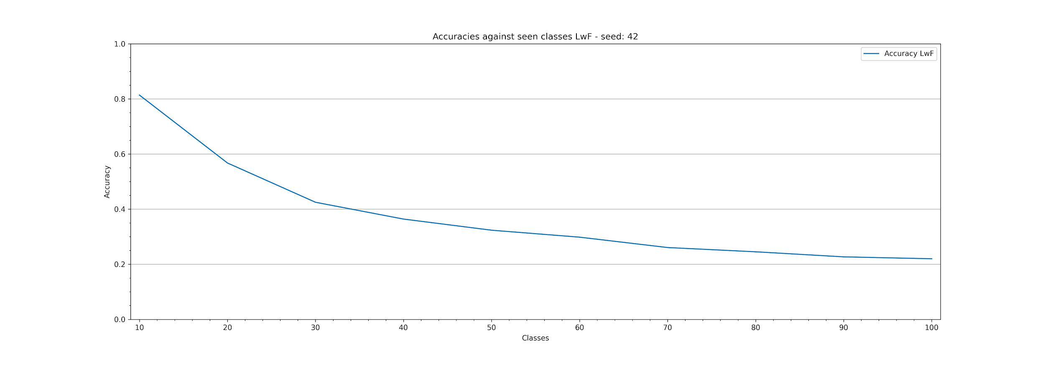
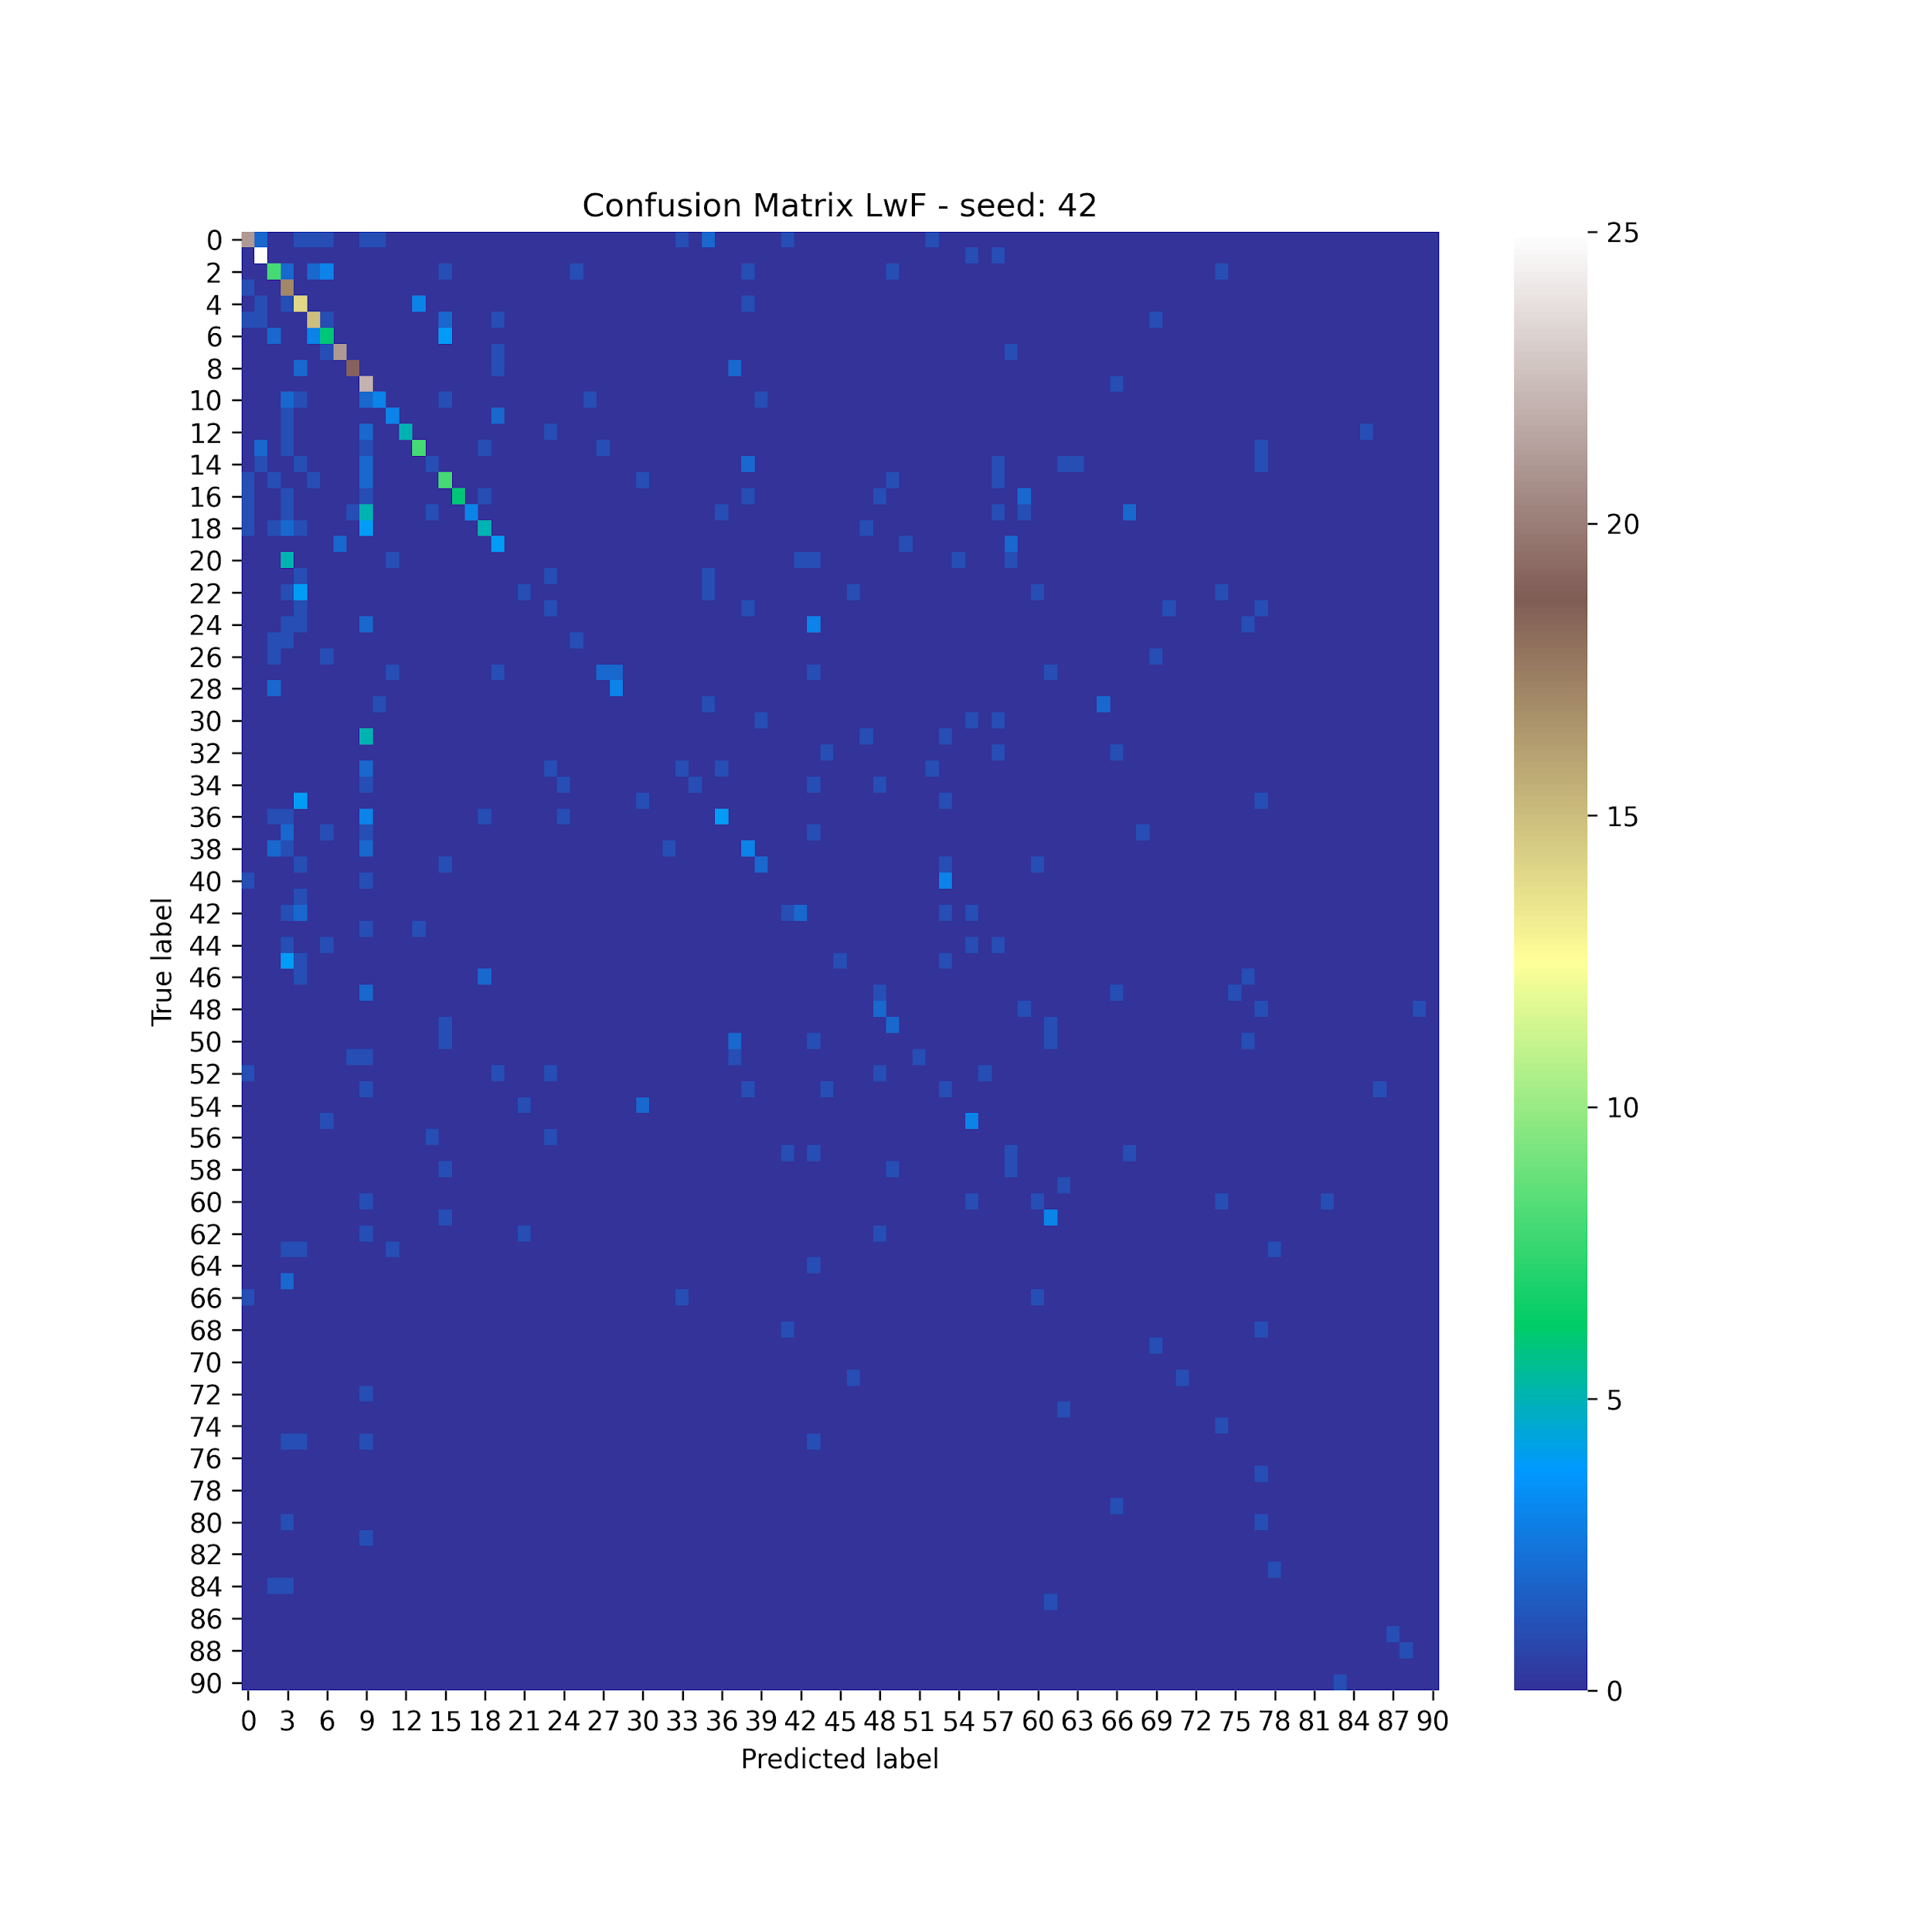
Learning Without Forgetting - Results

Slide 13
Learning Without Forgetting - Limitations
Distillation loss alone is not enough
Results are not so good
We need further implementations

Slide 14
iCaRL
3 main components:
classification by Nearest Mean Exemplars (NME) rule,
prioritized exemplar selection based on herding,
representation learning using knowledge distillation and prototype rehearsal
S. A. Rebuffi et al. iCaRL: Incremental Classifier and Representation Learning. CVPR 2017

Slide 15

iCaRL - classification
Prototype rehearsal, in order to assign a class label to an image we consider the most similar prototype according to:
A prototype vector for each class observed so far is computed based on exemplars
Each element of the vector is the mean feature vector of all exemplars for a certain class

Slide 16
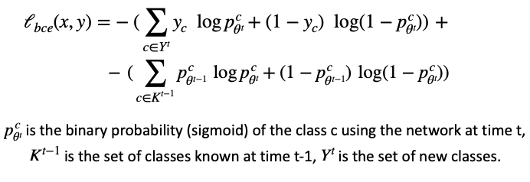
iCaRL - representation learning
Training on current examples set augmented with exemplars
Loss function made up of two parts:
classification loss, encourages the network to correctly label new classes
distillation loss, encourages the network to reproduce the old score to label old classes

Slide 17
iCaRL - exemplars management
Limited amount of exemplars, K
Selection based on herding
Progressive reduction of each exemplar set size
No duplicates

Slide 18
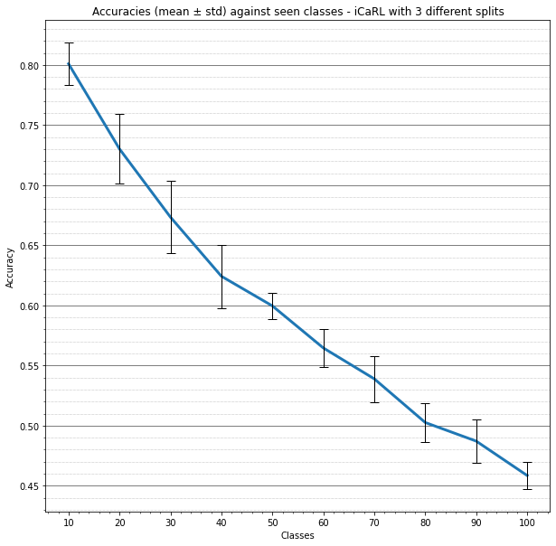
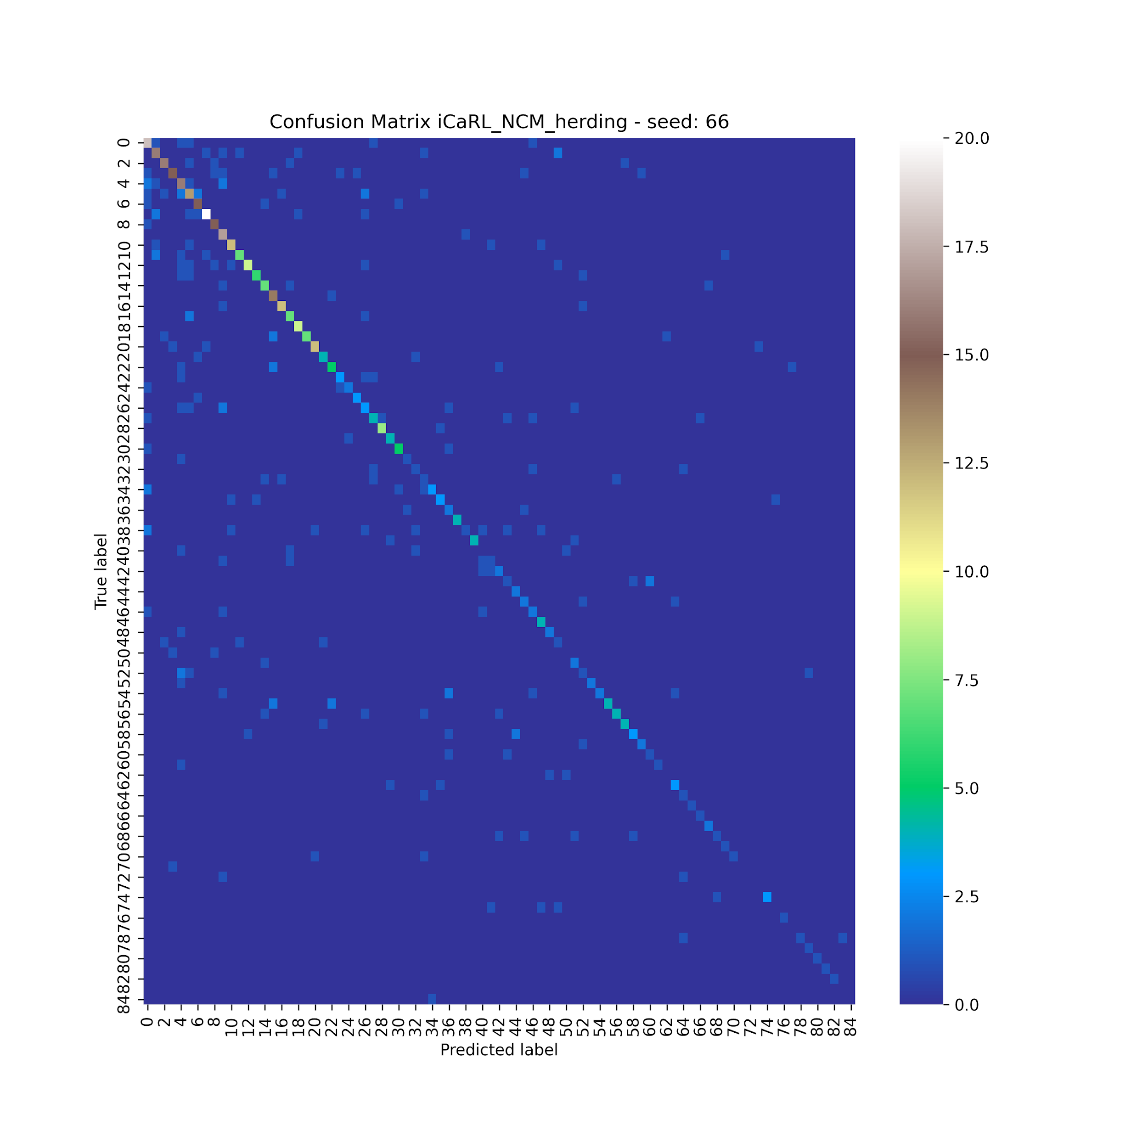
iCaRL - results

Slide 19
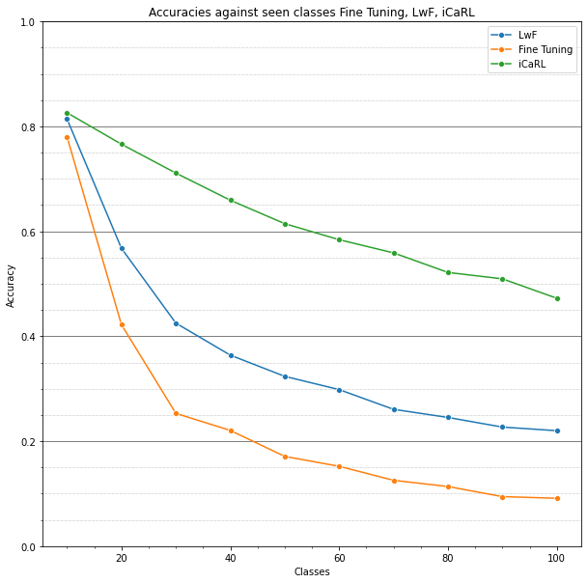
Baselines - conclusions

Slide 20
Ablation study
Influence of each iCaRL component on the overall performances
Eventual goodness of different choices with respect to the default implementation

Slide 21
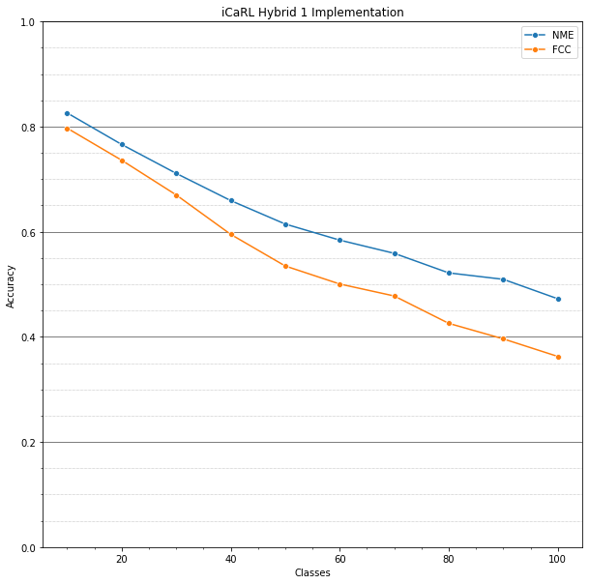
Ablation - Hybrid 1
Default NME based classifier
FCC classifier (similar to LwF)
we try to use the plain network’s output for classification
Softmax applied

Slide 22
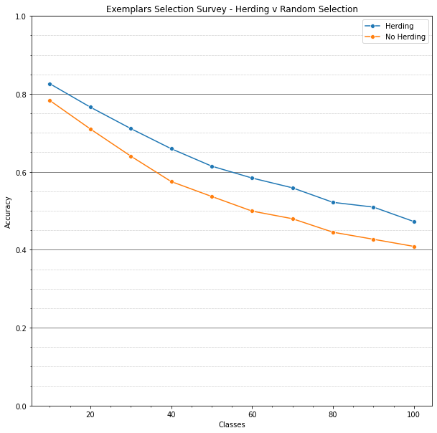
Ablation - Exemplars Selection
Herding Selection
Random exemplars selection
No duplicates

Slide 23
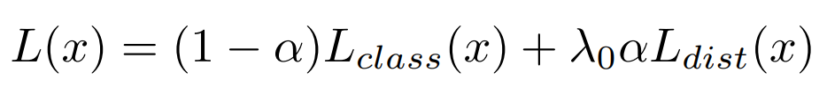
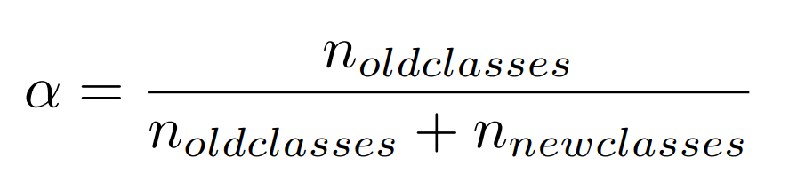
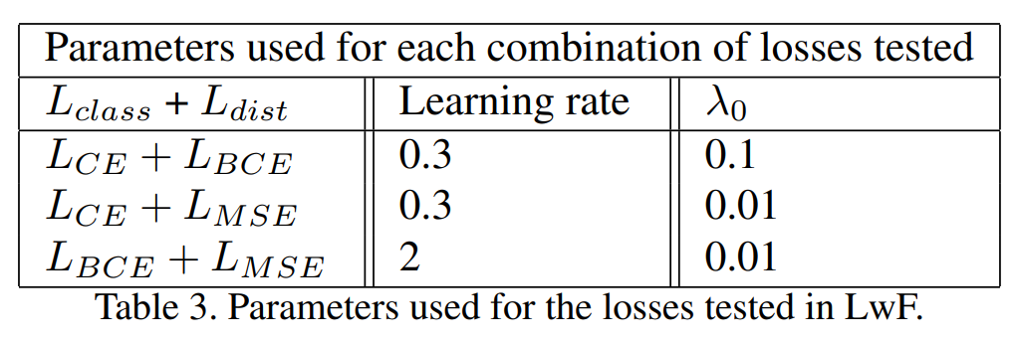
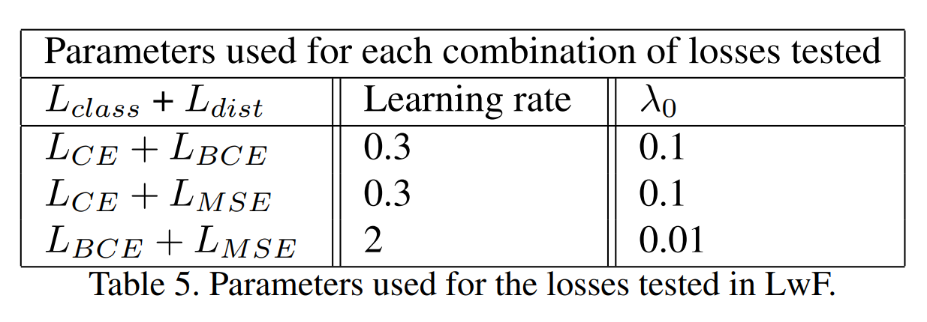
Ablation - Losses
Three different losses were tested on iCaRL and LwF: BCE, CE, L2 (or MSE loss). The hyperparameters used were the same used for the baselines except for the following:
LwF params: iCaRL params:

Slide 24
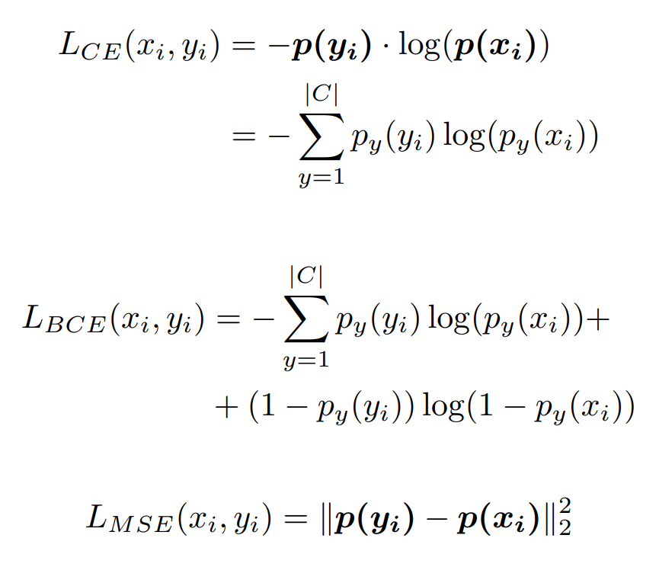
Ablation - Loss formulation

Slide 25
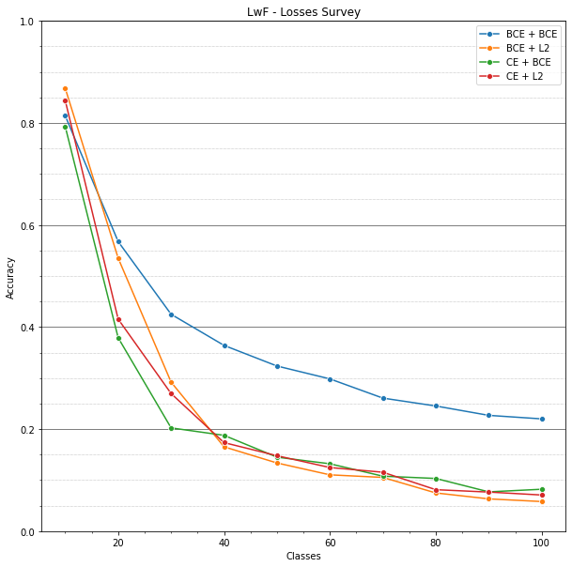
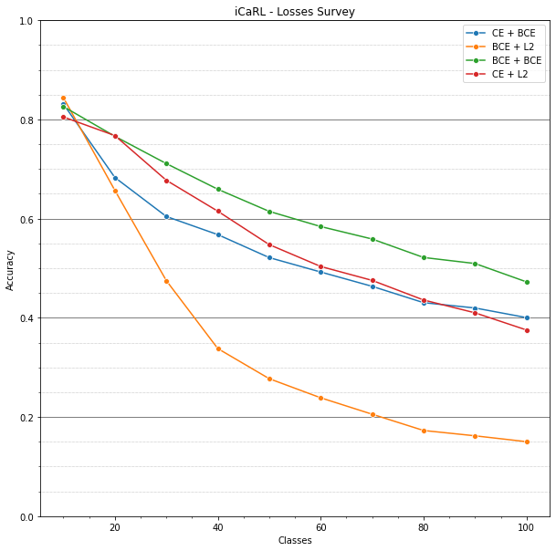
Ablation - Losses Results
LwF Results
iCaRL Results

Slide 26


Ablation - Classifiers
Cosine Similarity
methodology similar to NME
KNN
decreasing K_nn
trained on exemplars
Linear SVC
trained on exemplars
FCC (Hybrid 1)
methodology similar to LwF

Slide 27
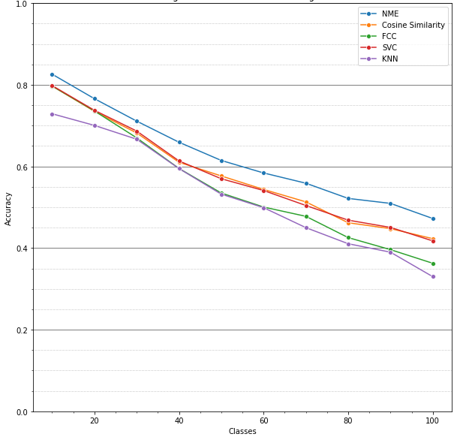
Ablation - Classifiers Results

Slide 28
Ablation - Conclusions and limitations
We understand how the different components of icarl influence the outcome
Still low performances with respect to Joint Training
Limitations:
single teacher net
imbalance between examples from new classes and exemplars dataset size

Slide 29
Improvements
Try to overcome iCaRL limitations
Use more than one teacher to retain better old knowledge
Two teachers
Progressive Neural Network approach
Use Data Augmentation techniques on the exemplars to balance the number of images of old classes and new classes
Reduce samples for new classes
Augment exemplars set at training time
K is fixed

Slide 30
Two teachers
Given the new group of classes g, our distillation loss will be composed of:
distillation loss obtained from the network trained on groups 1, …, g-1,
and the one obtained from the network trained on image groups 1, …, g-2.
It’s the same way iCaRL does it, but with two frozen networks.
Resulting Loss:

Slide 31
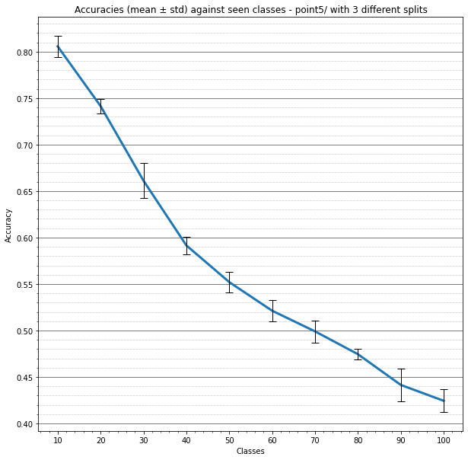
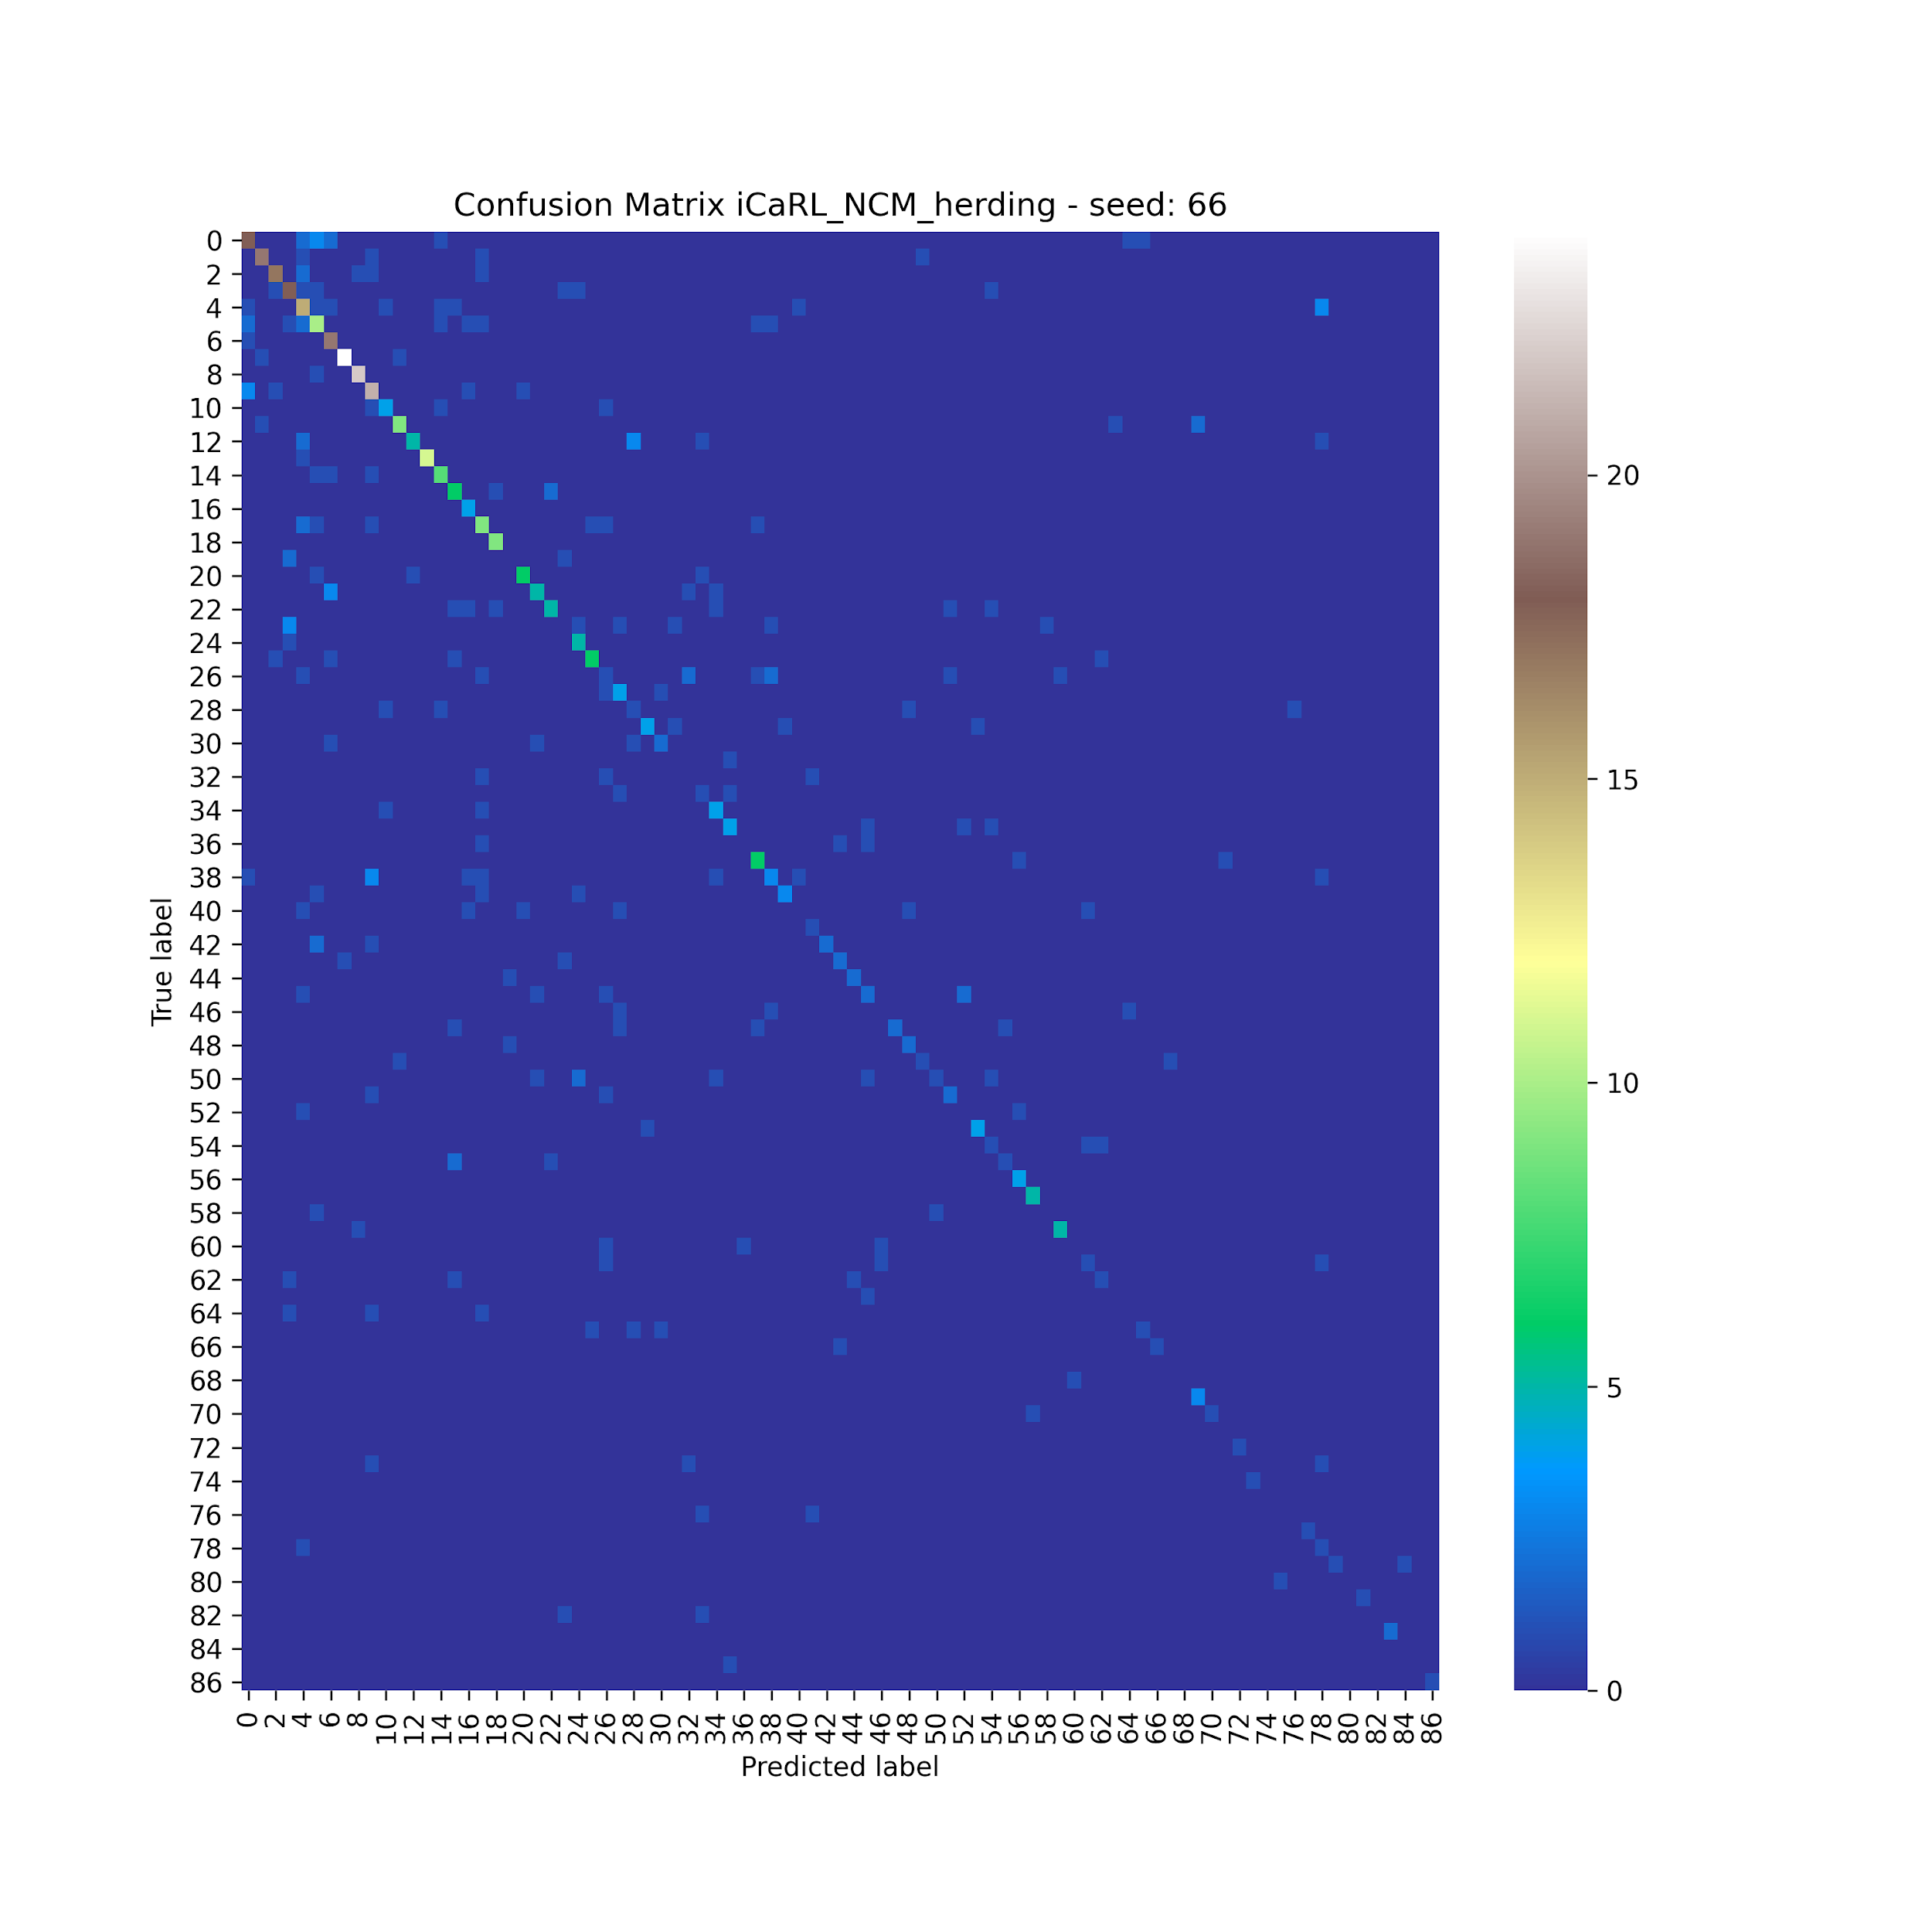
Two teachers - results

Slide 32
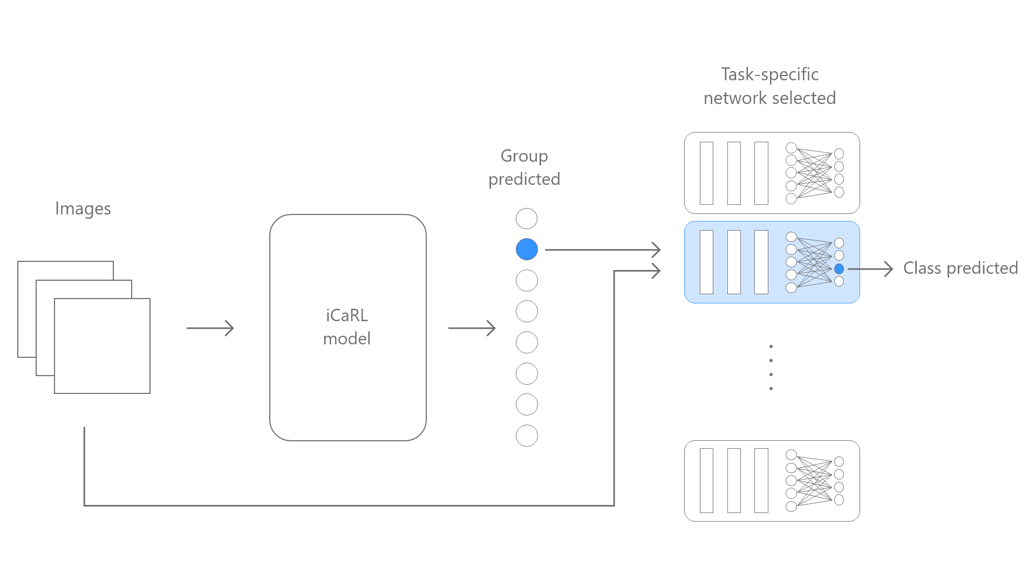
Task specific networks
The idea was to train a new independent networks for every new group of images.
iCaRL was then used to incrementally learn given an image, which group it belongs to. The iCaRL prediction was then used to select the network specifically trained for the group to predict the image class.

Slide 33
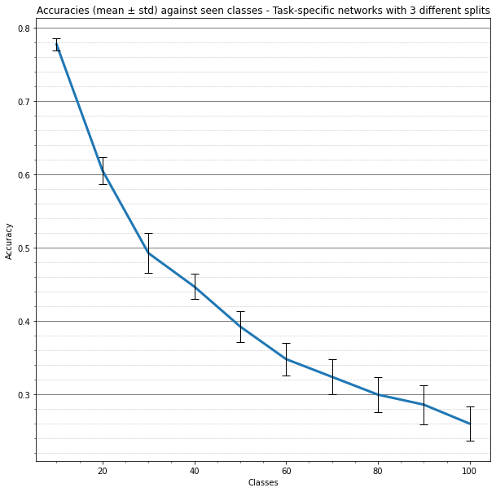
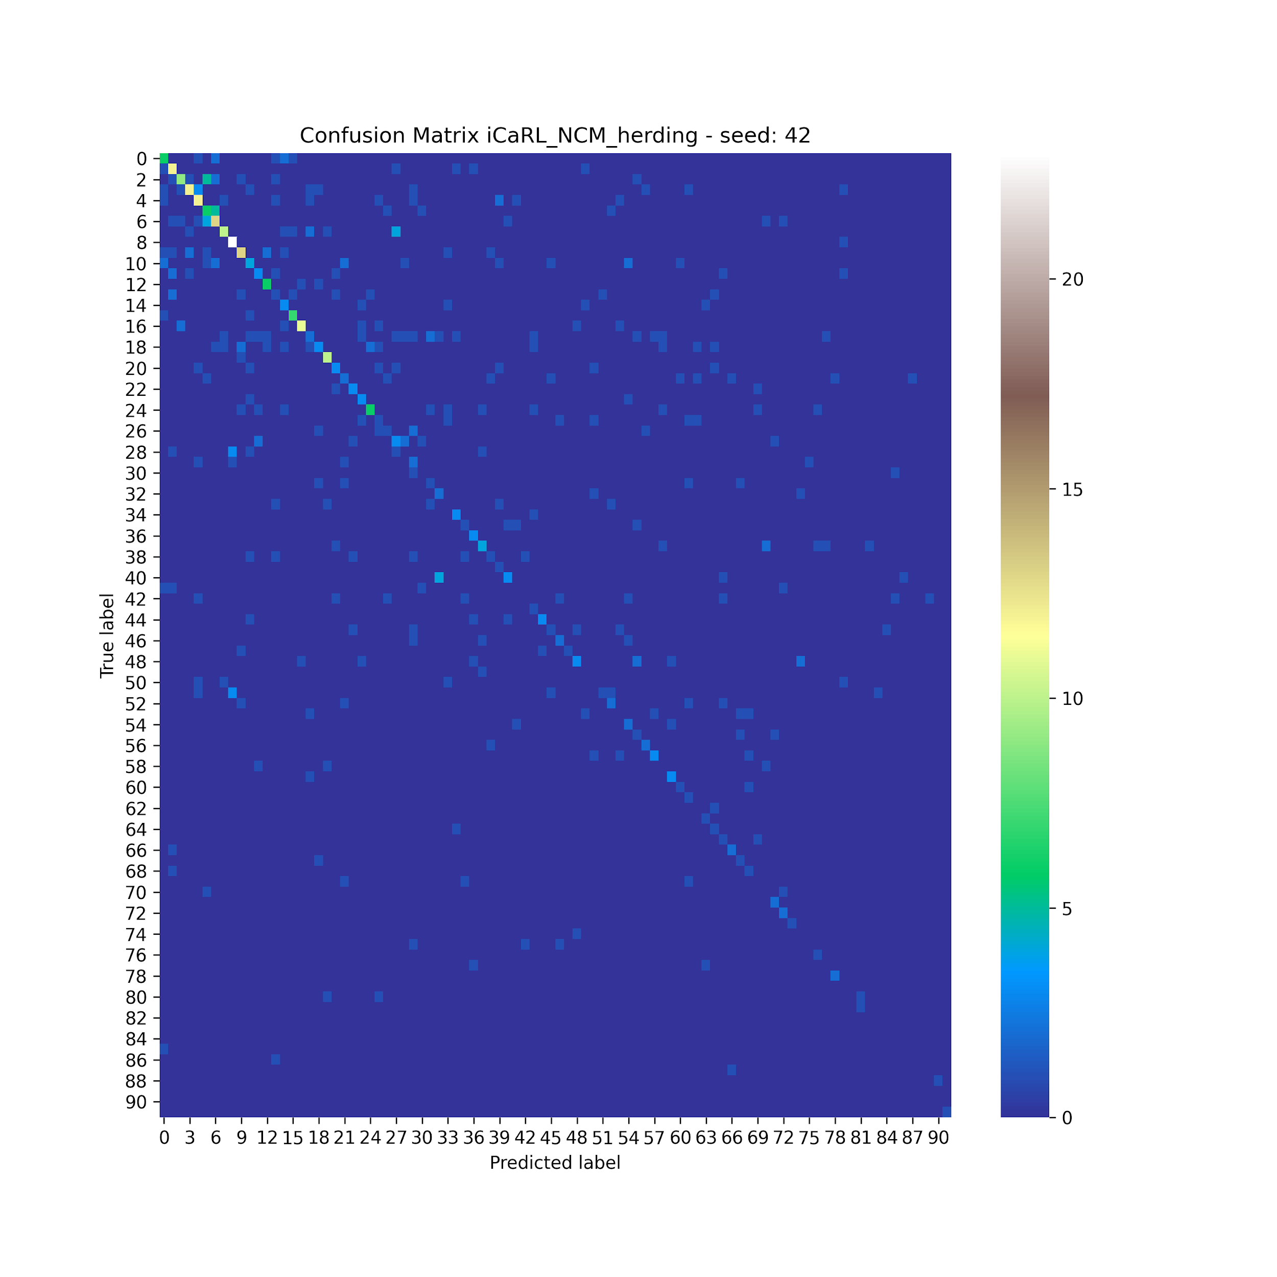
Task specific networks - Results

Slide 34
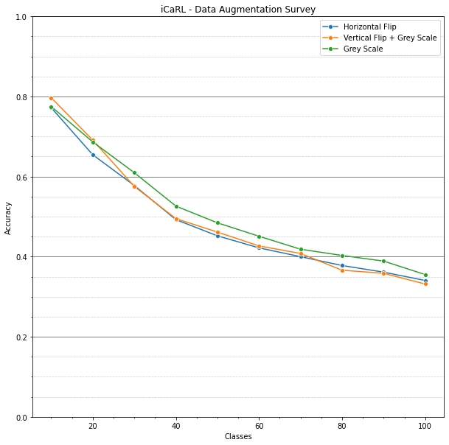
Exemplars Augmentation
Number of exemplars K fixed
Samples of new images reduced through random selection without replacement
Exemplars increased using Data Augmentation
Horizontal Flip
Vertical Flip + Grey Scale
Grey Scale
At a given incremental training, the resulting dataset was then more balanced between old and new images.

Slide 35
Conclusions and further studies
Our trials did not improve iCaRL performances
Further analysis to overcome the iCaRL limitations
Progressive Neural Networks to suppress catastrophic learning
GANs to enhance exemplars dataset
Very active research area

Slide 36
Thank You!

