Slide 1

Machine Learning and
Deep Learning
Incremental Learning in Image Classification
Genta, Massimino, Paesante
A.Y. 2019/2020
Notes:
Github source

Slide 2
Index
Introduction of the problem
Baselines
Joint Training
Fine Tuning
LwF
iCaRL
Ablation study
iCaRL Hybrid-1
Losses
Classifiers
Herding
Improvements
Conclusions

Slide 3






Introduction to Incremental Learning
Desirable properties of a class-incremental algorithm:
trainable from a data stream in which examples of different classes occur at different times,
provide at any time a competitive multi-class classifier,
limited computational requirements and memory footprint.
Classes 1-10
Classes 90-100
...
t

Slide 4
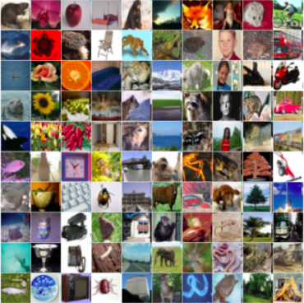
Dataset
100 classes
60’000 labelled images
50’000 training
10’000 testing
32x32 size
Our split: 10 batches of 10 random classes
src: Stanford

Slide 5
Model
Ad-hoc ResNet 34
Optimized on CIFAR-100
Transformations on train and test images
x
weight layer
F(x)
ReLU
x identity
weight layer
F(x) + x
+
src: Resnet paper

Slide 6
Baselines
Experiments parameters
Parameter | Value
LR | 2
MOMENTUM | 0.9
WEIGHT DECAY | 1e-5
EPOCHS | 70
MILESTONES | 49, 63
BATCH SIZE | 128
GAMMA | 0.2
Joint Training, Fine Tuning, LwF, iCaRL
iCaRL parameters
No validation set
Experiments performed in Google Colab
3 different splits considered
Common model: Resnet 32
Criterion: BCE with logits

Slide 7
Joint Training
Not actually Incremental Learning
Both train and test set involve all the classes seen so far
Upper Bound for our following experiments
Extremely long training time
Good accuracy on the test set
t
Train, Test set:
classes 1-10
Train, Test set:
classes 1-100
...

Slide 8
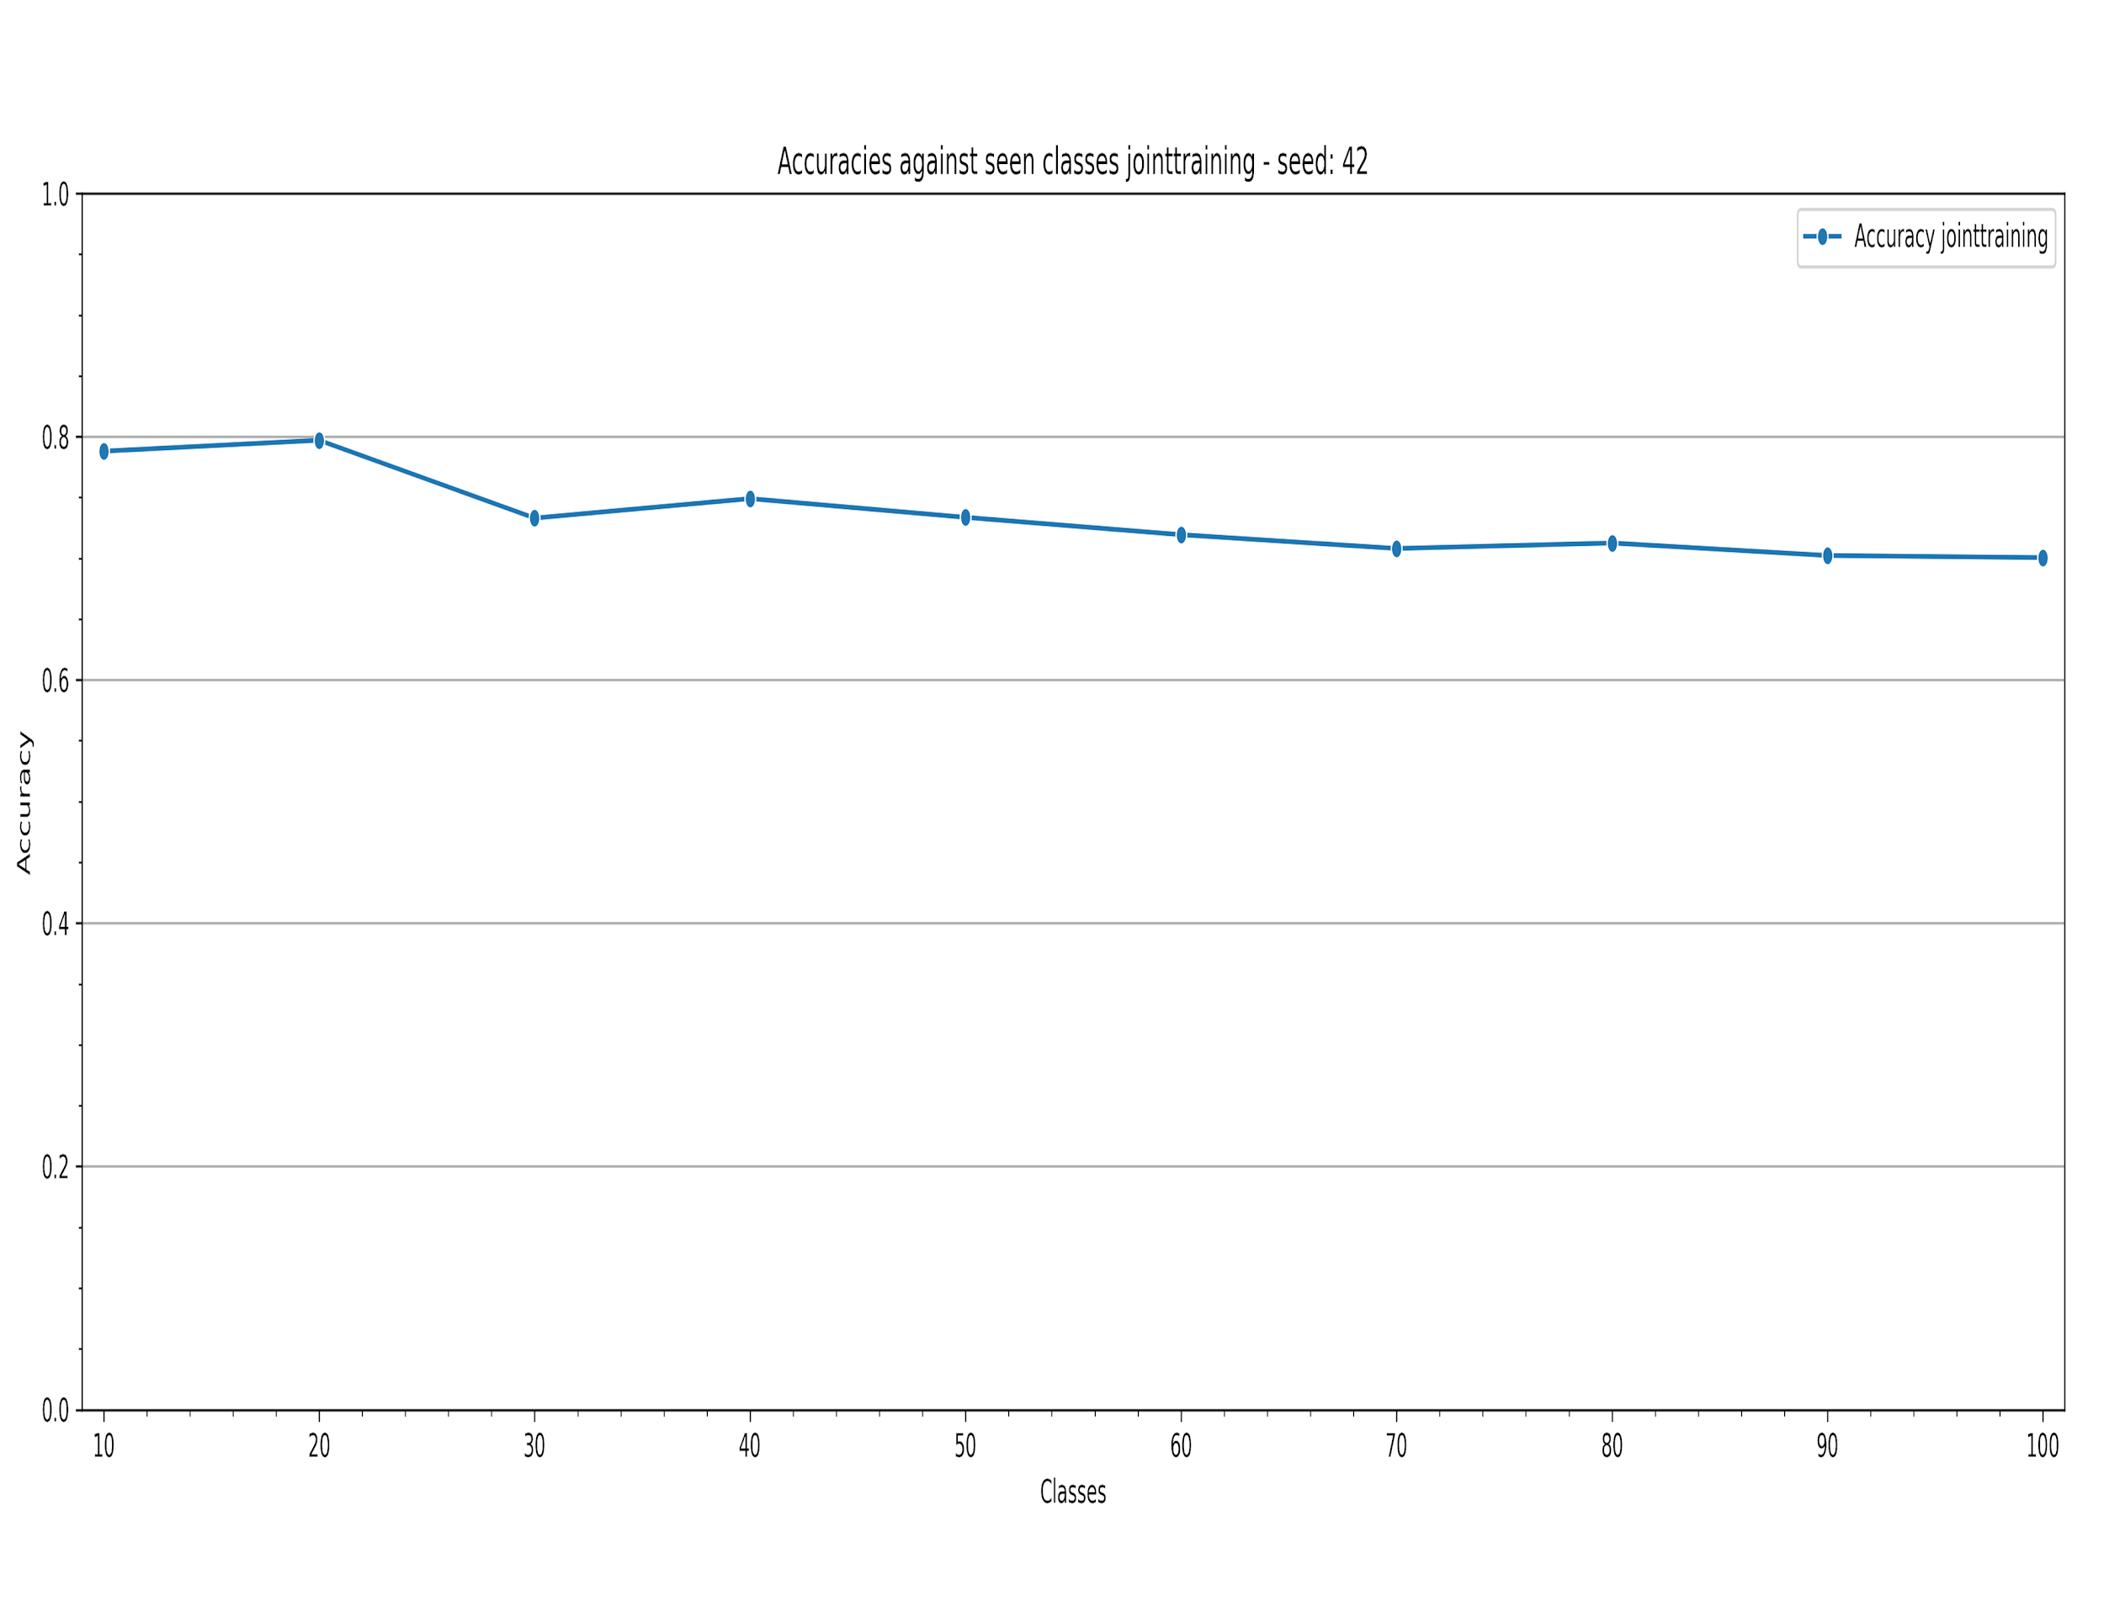
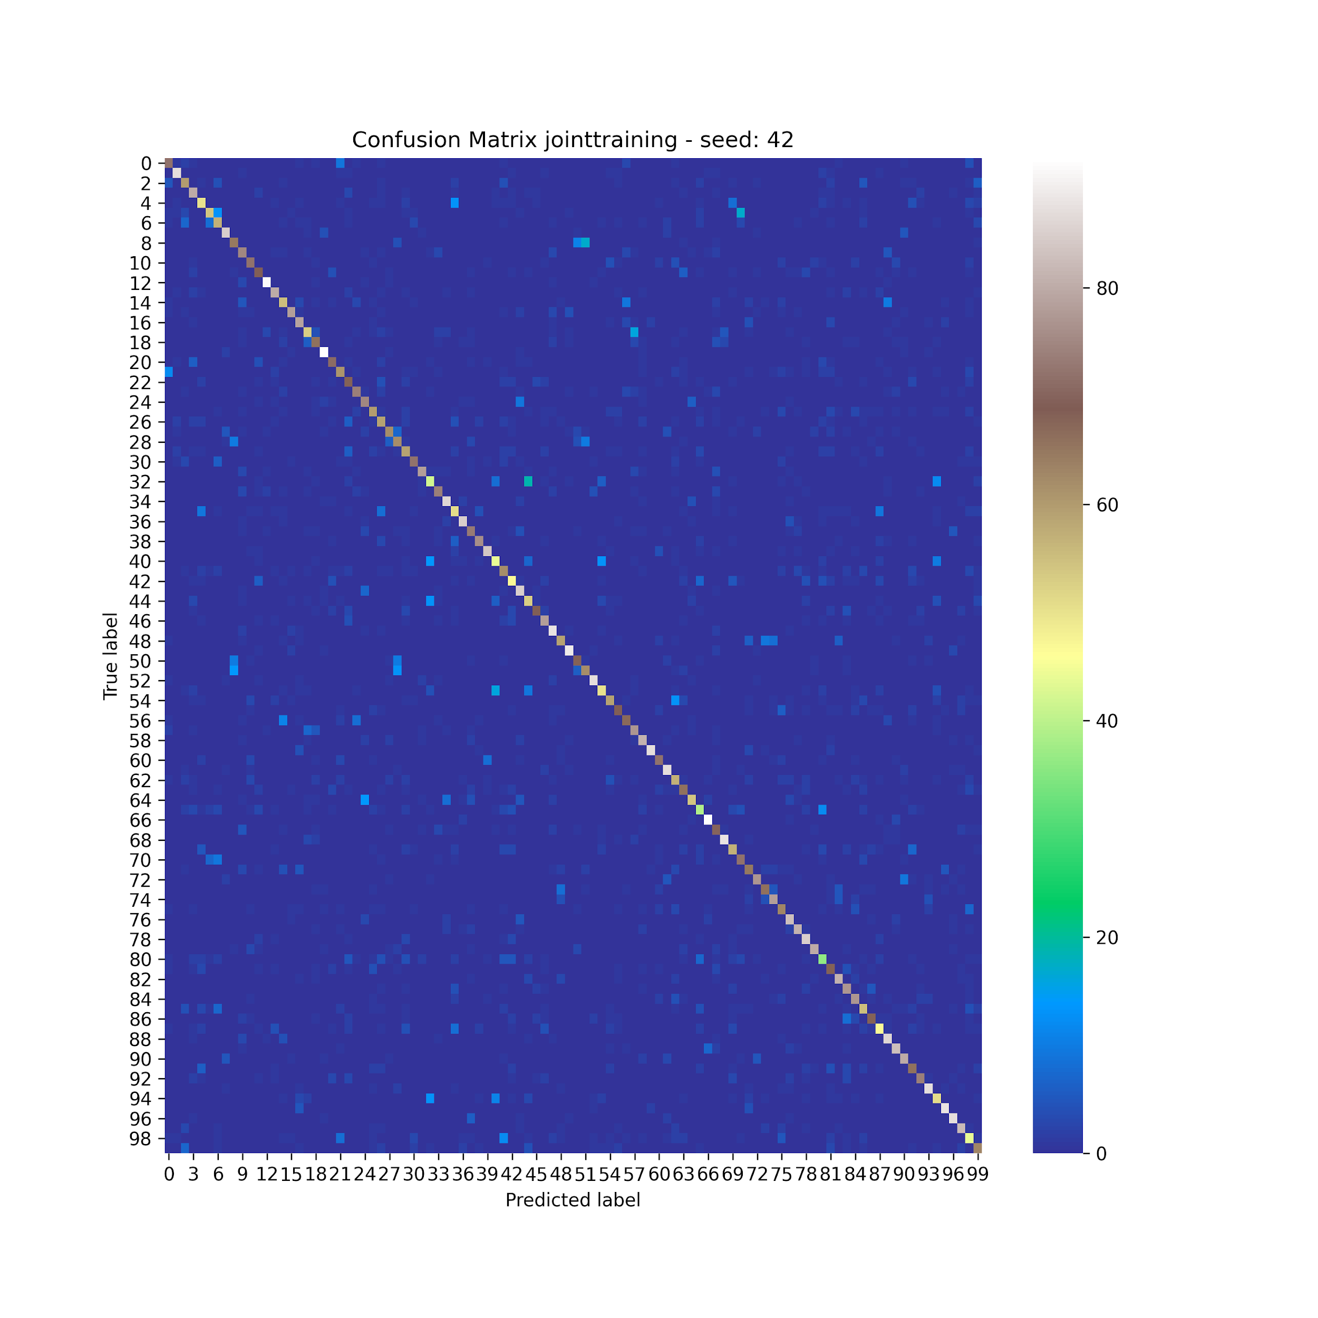
Joint Training - Results

Slide 9
Fine Tuning
Fine tune the network on new images
Loss based only on the last group
Good performances on last single set
Bad overall performances, i.e. Catastrophic Forgetting

Slide 10
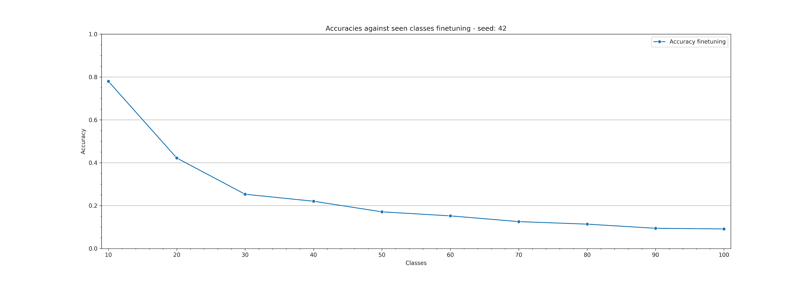
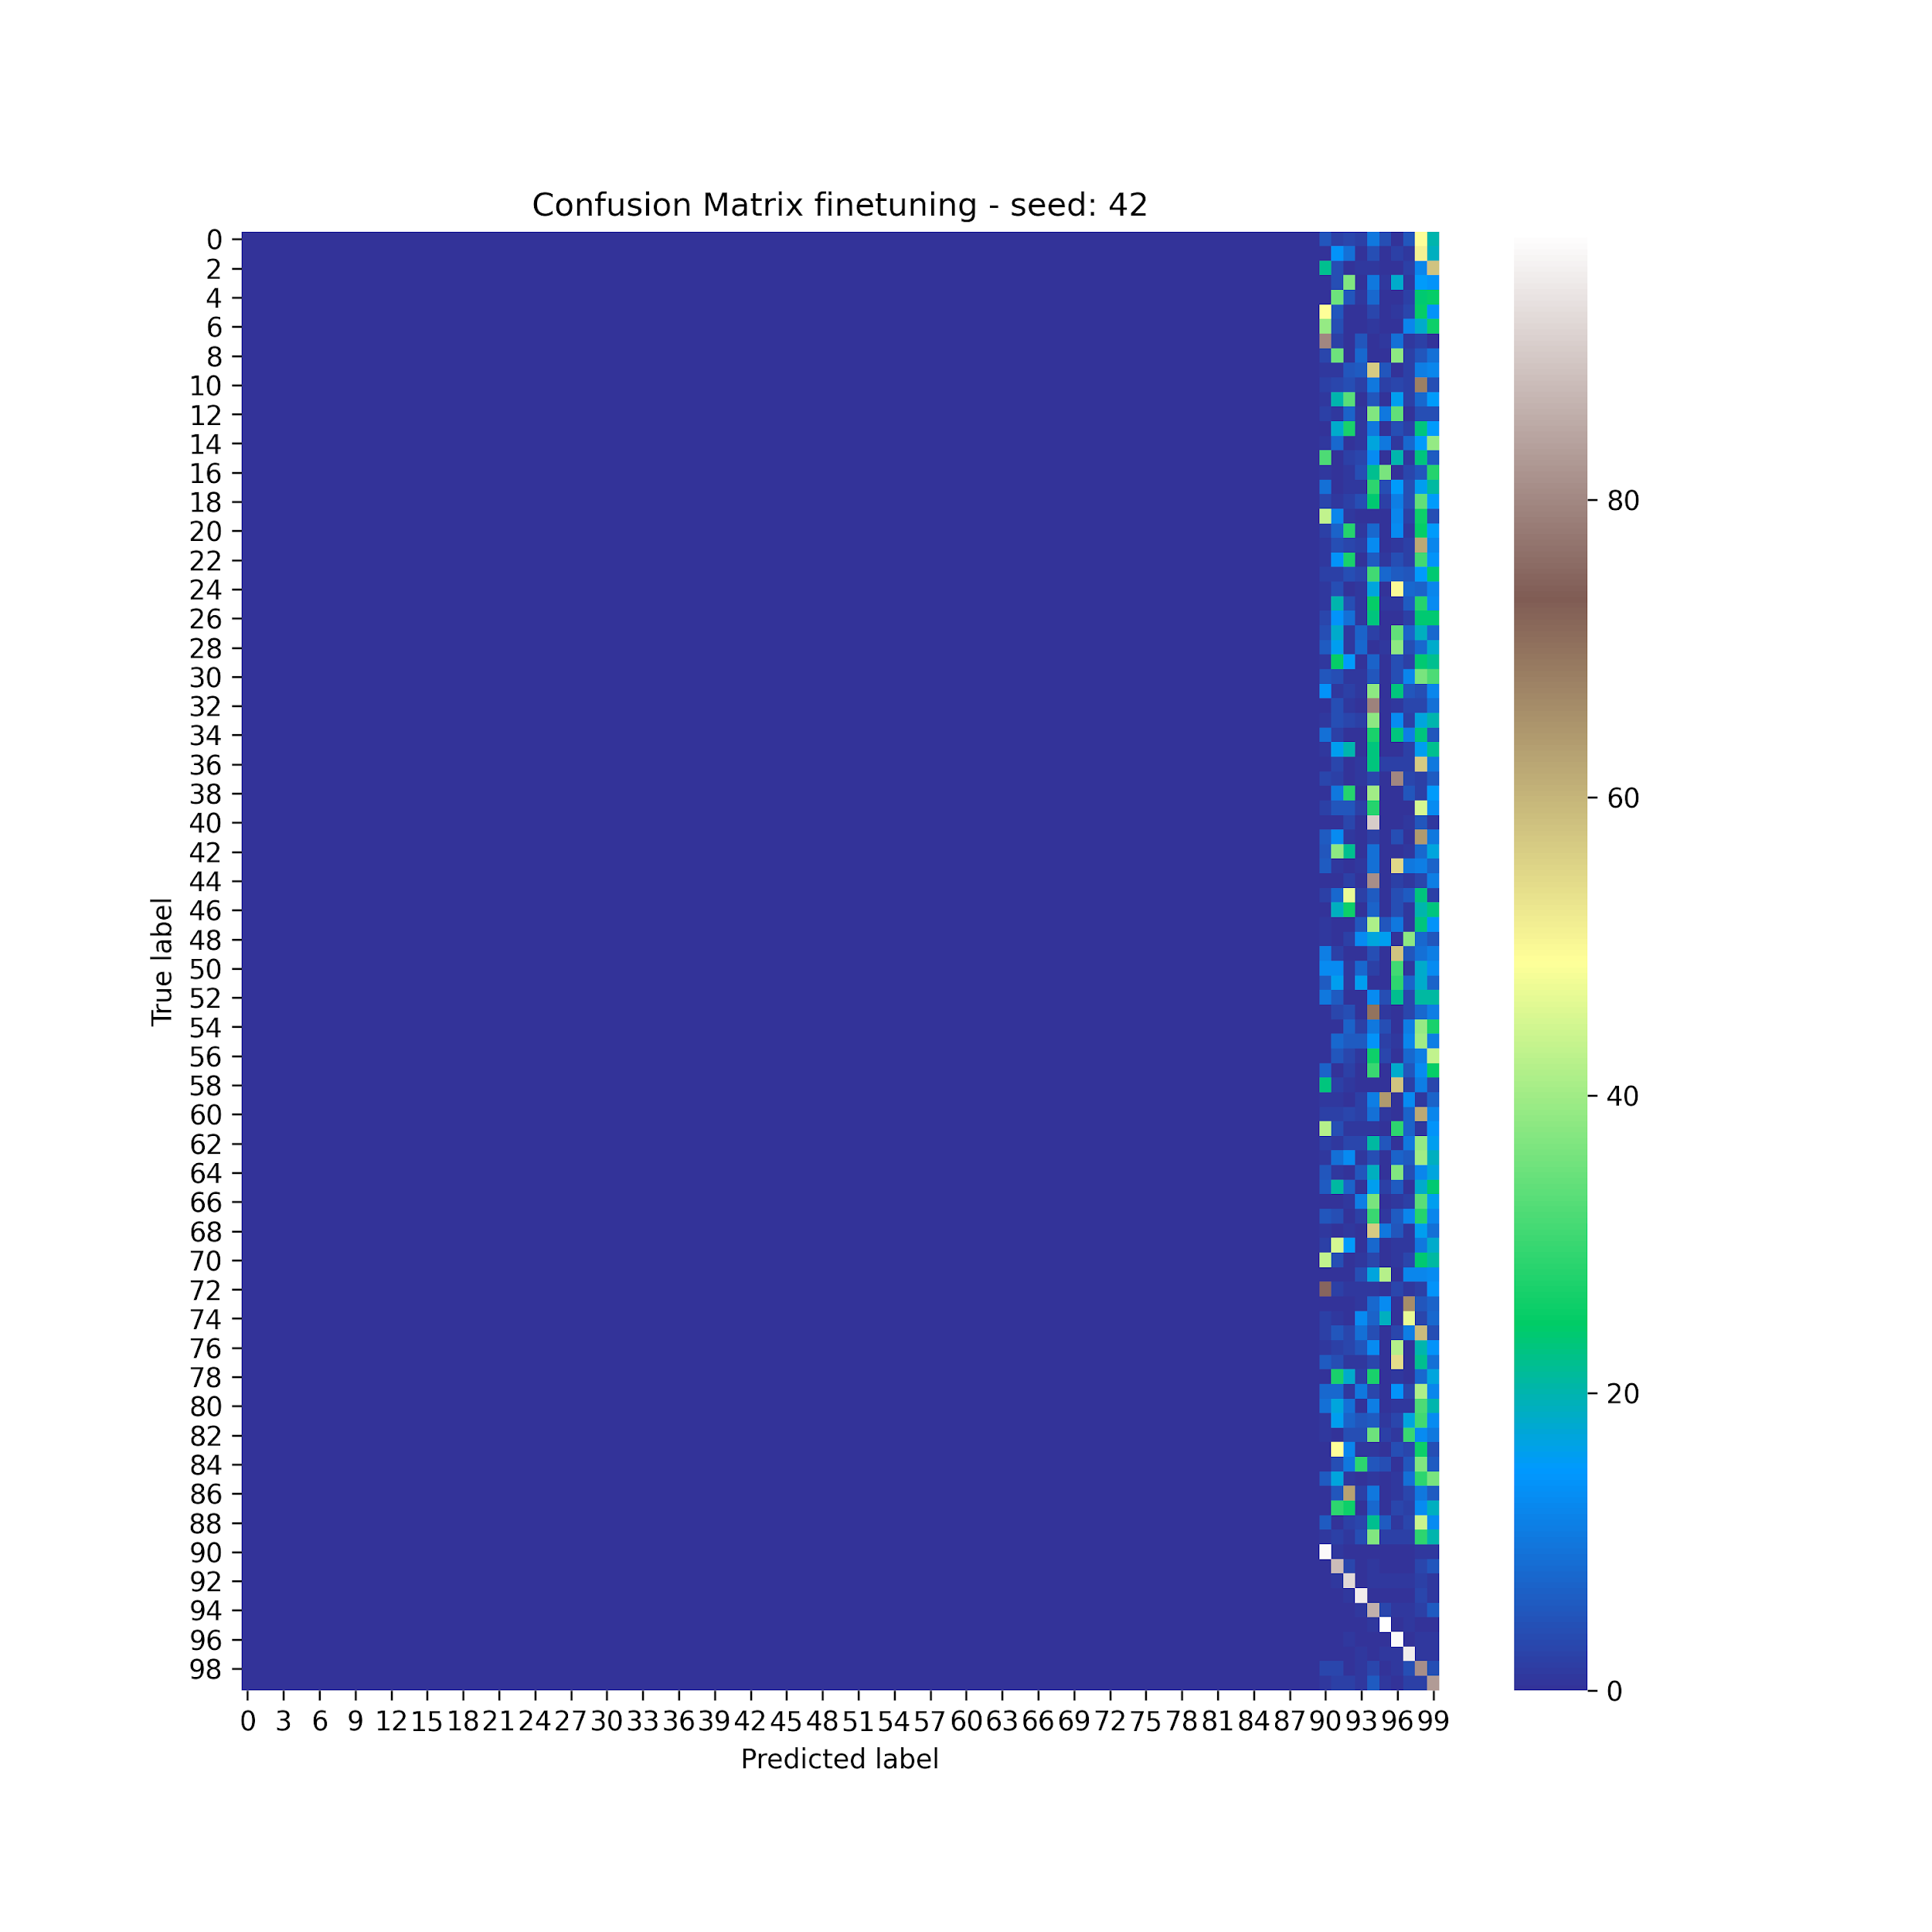
Fine Tuning - Results

Slide 11
Learning Without Forgetting
Modification of Joint Training
Use parameters of the previous classifications
Classification based on the probabilities returned by the network
Loss consisting of two parts
classification loss, encourages the network to correctly label new classes
distillation loss, encourages the network to reproduce the old score on old classes
Z. Li and D. Hoiem. Learning without forgetting. In IEEE T-PAMI, 40(12):2935–2947, 2017

Slide 12
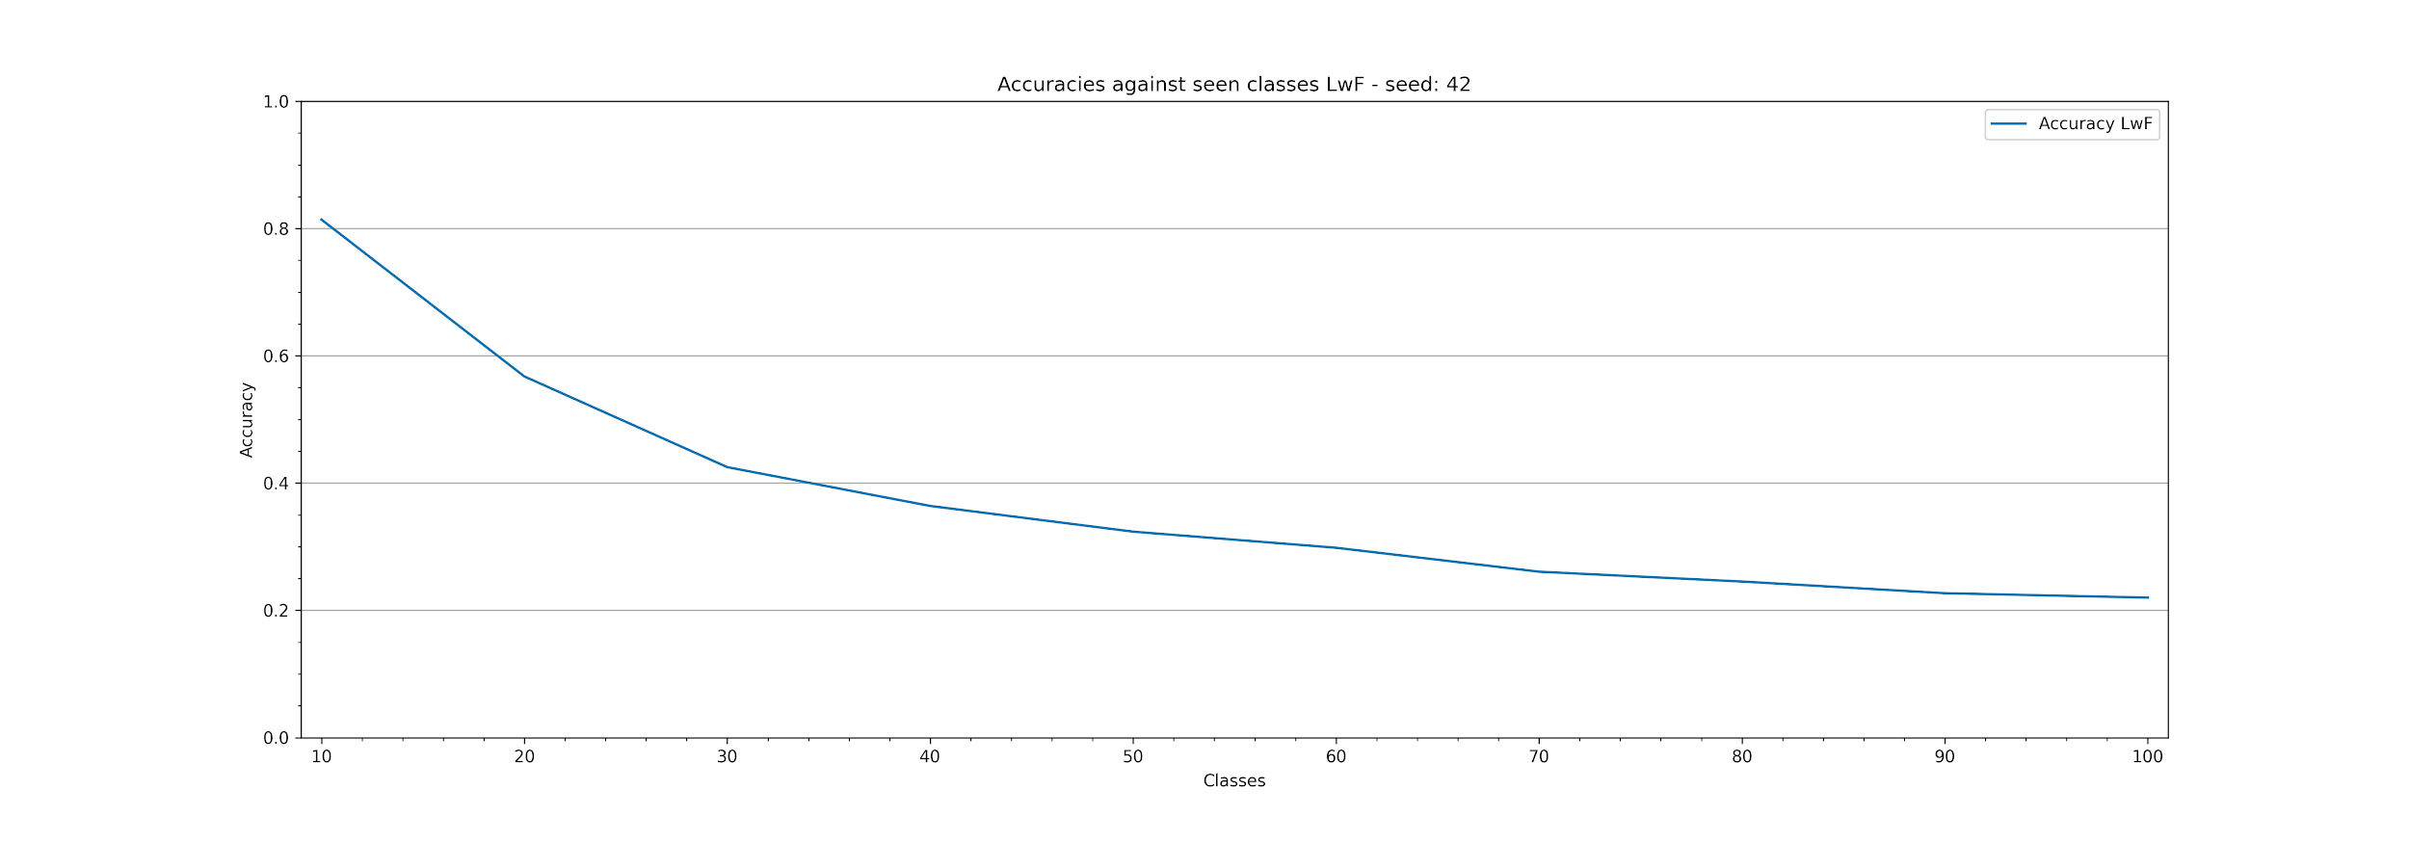
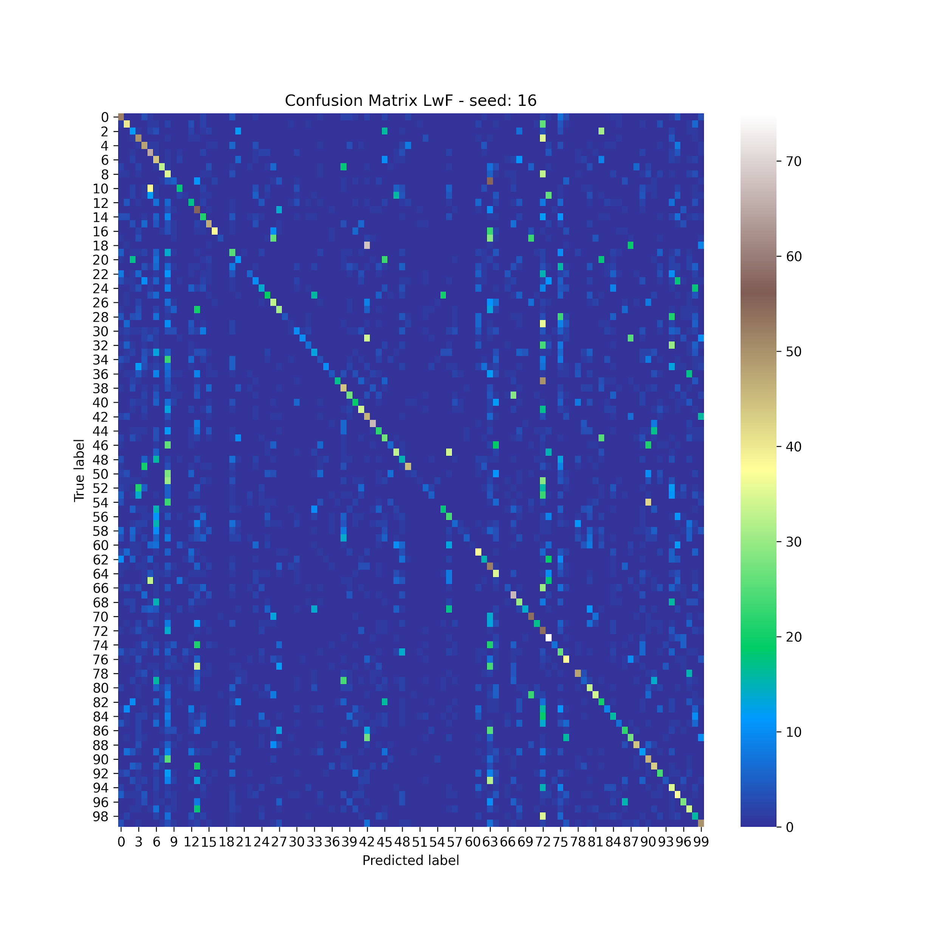
Learning Without Forgetting - Results

Slide 13
Learning Without Forgetting - Limitations
Results are not so good
Distillation loss alone is not enough
We need further implementations

Slide 14

iCaRL
3 main components:
classification by Nearest Mean Exemplars (NME)
Prototype rehearsal, in order to assign a class label to an image we consider the most similar prototype according to:
A prototype vector for each class observed so far is computed based on exemplars
Each element of the vector is the mean feature vector of all exemplars for a certain class
S. A. Rebuffi et al. iCaRL: Incremental Classifier and Representation Learning. CVPR 2017

Slide 15
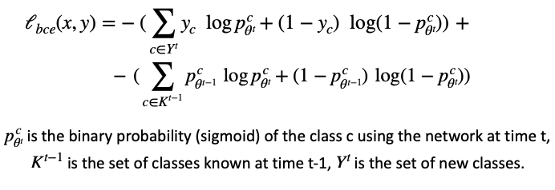
iCaRL
representation learning
Training on current examples set augmented with exemplars
Loss function made up of two parts:
classification loss, encourages the network to correctly label new classes
distillation loss, encourages the network to reproduce the old score on old classes

Slide 16
iCaRL
Prioritized exemplar selection
Limited amount of exemplars, K
Selection based on herding
Progressive reduction of each exemplar set size
No duplicates

Slide 17
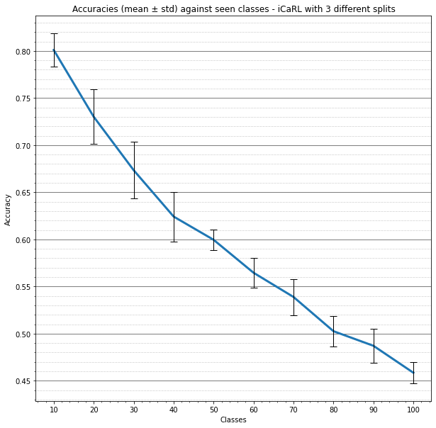

iCaRL - results

Slide 18
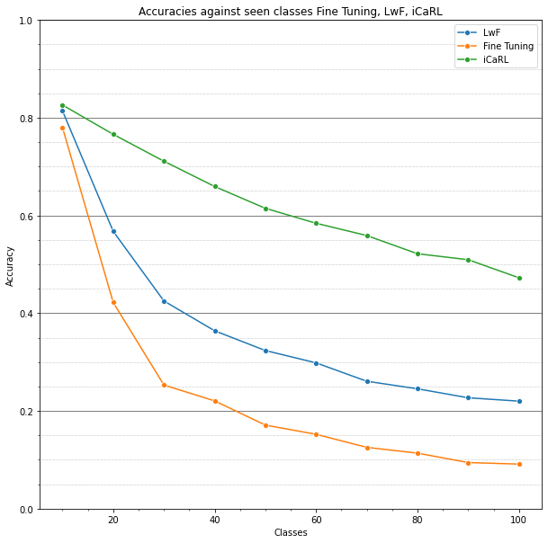
Baselines - conclusions

Slide 19
Ablation study
Influence of each iCaRL component on the overall performances
Eventual goodness of different choices with respect to the default implementation

Slide 20
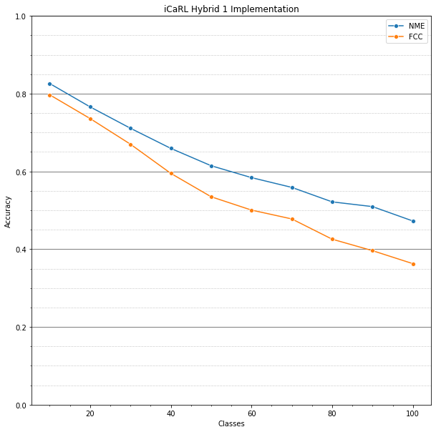
Ablation - Hybrid 1
Default NME based classifier
FCC classifier (similar to LwF)
Plain network’s output for classification

Slide 21
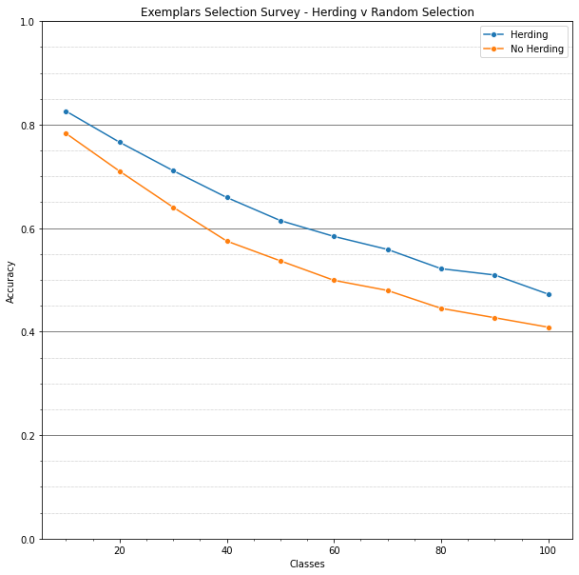
Ablation - Exemplars Selection
Herding Selection
Random exemplars selection
No duplicates

Slide 22
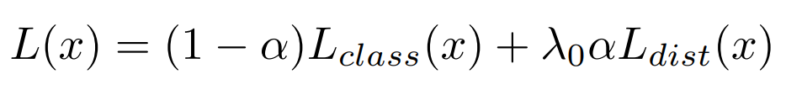
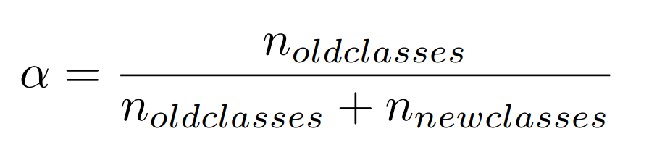
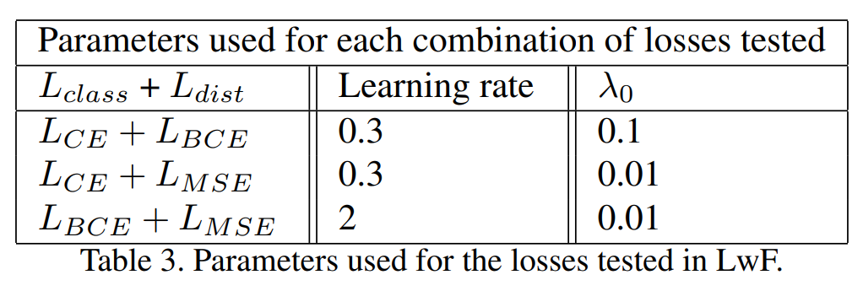
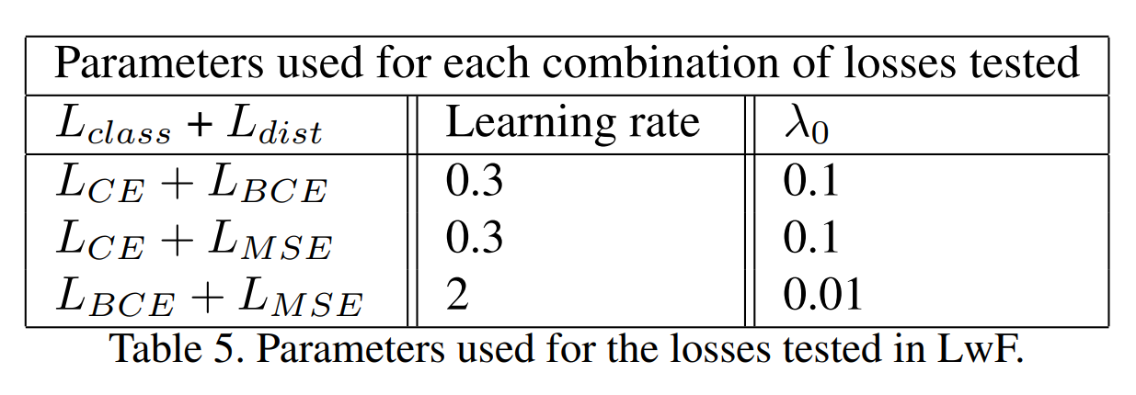
Ablation - Losses
Losses tested on iCaRL and LwF: BCE, CE, L2 (MSE). Same parameters as baselines, except:
LwF
iCaRL
Notes:
When we use CE as classification loss, by using a LR which is too high the model diverges, we have to decrease it

Slide 23
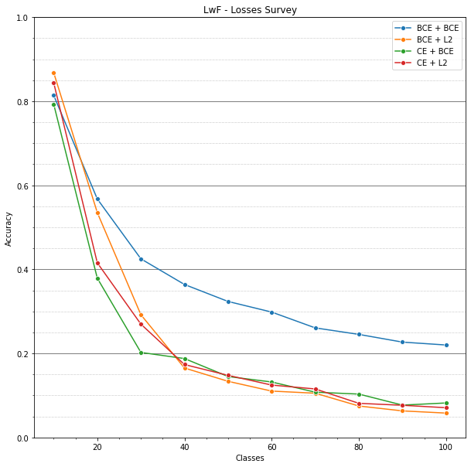
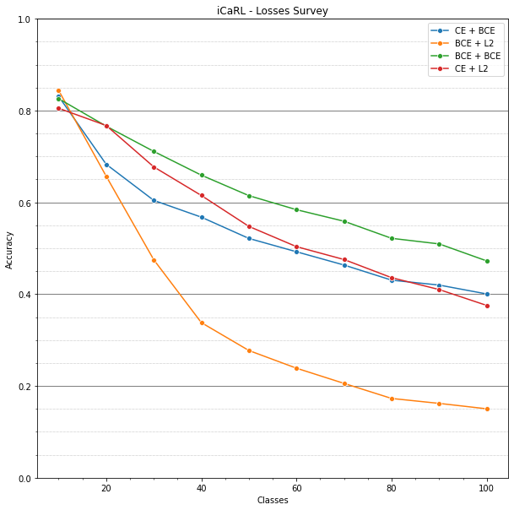
Ablation - Losses Results
LwF
iCaRL

Slide 24
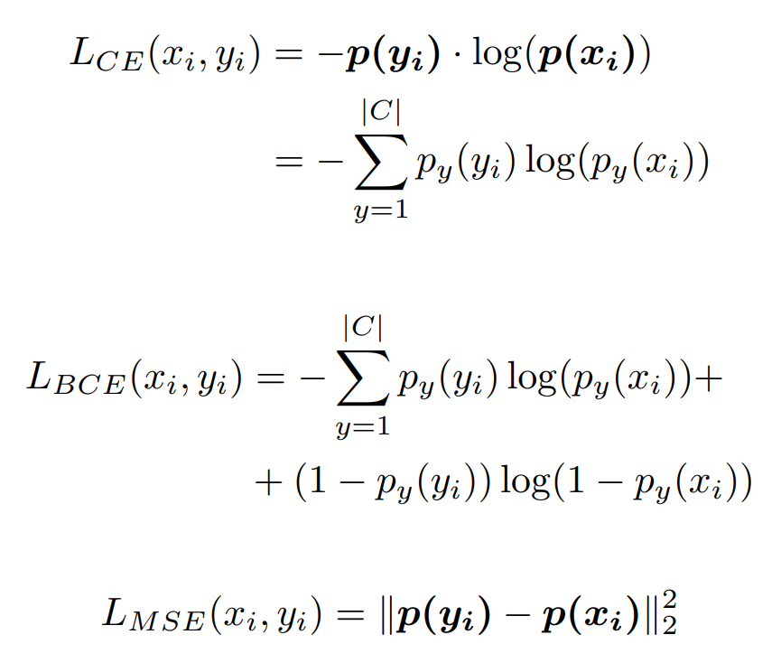
Ablation - Losses formulation

Slide 25


Ablation - Classifiers
Cosine Similarity
similar to NME
KNN
decreasing K_nn
trained on exemplars
Linear SVC
trained on exemplars
FCC (Hybrid 1)
similar to LwF

Slide 26
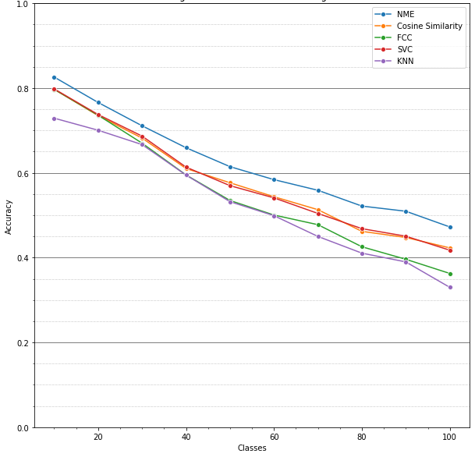
Ablation - Classifiers Results

Slide 27
Ablation - Conclusions and limitations
We understood how the components of iCaRL influence the outcome
Still low performances with respect to Joint Training
Limitations:
single teacher net,
imbalance between examples from new classes and exemplars dataset size.

Slide 28
Improvements
Try to overcome iCaRL limitations
Use more than one teacher to retain better old knowledge
Two teachers
Task-specific approach
Use Data Augmentation techniques on the exemplars to balance the number of images of old classes and new classes
Reduce samples for new classes
Augment exemplars set at training time
K is fixed

Slide 29
Two teachers
Given the new group of classes g, our distillation loss will be composed of:
distillation loss obtained from the network trained on groups 1, …, g-1,
and the one obtained from the network trained on image groups 1, …, g-2.
It’s the same way iCaRL does it, but with two frozen networks

Slide 30
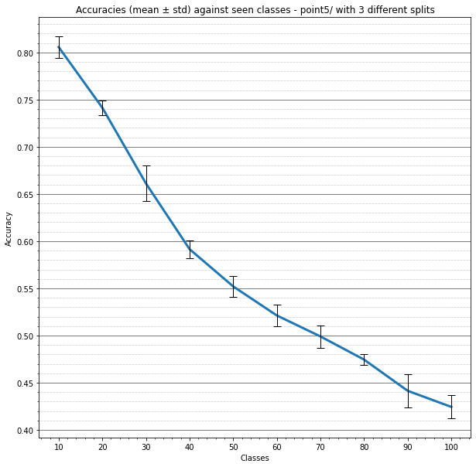
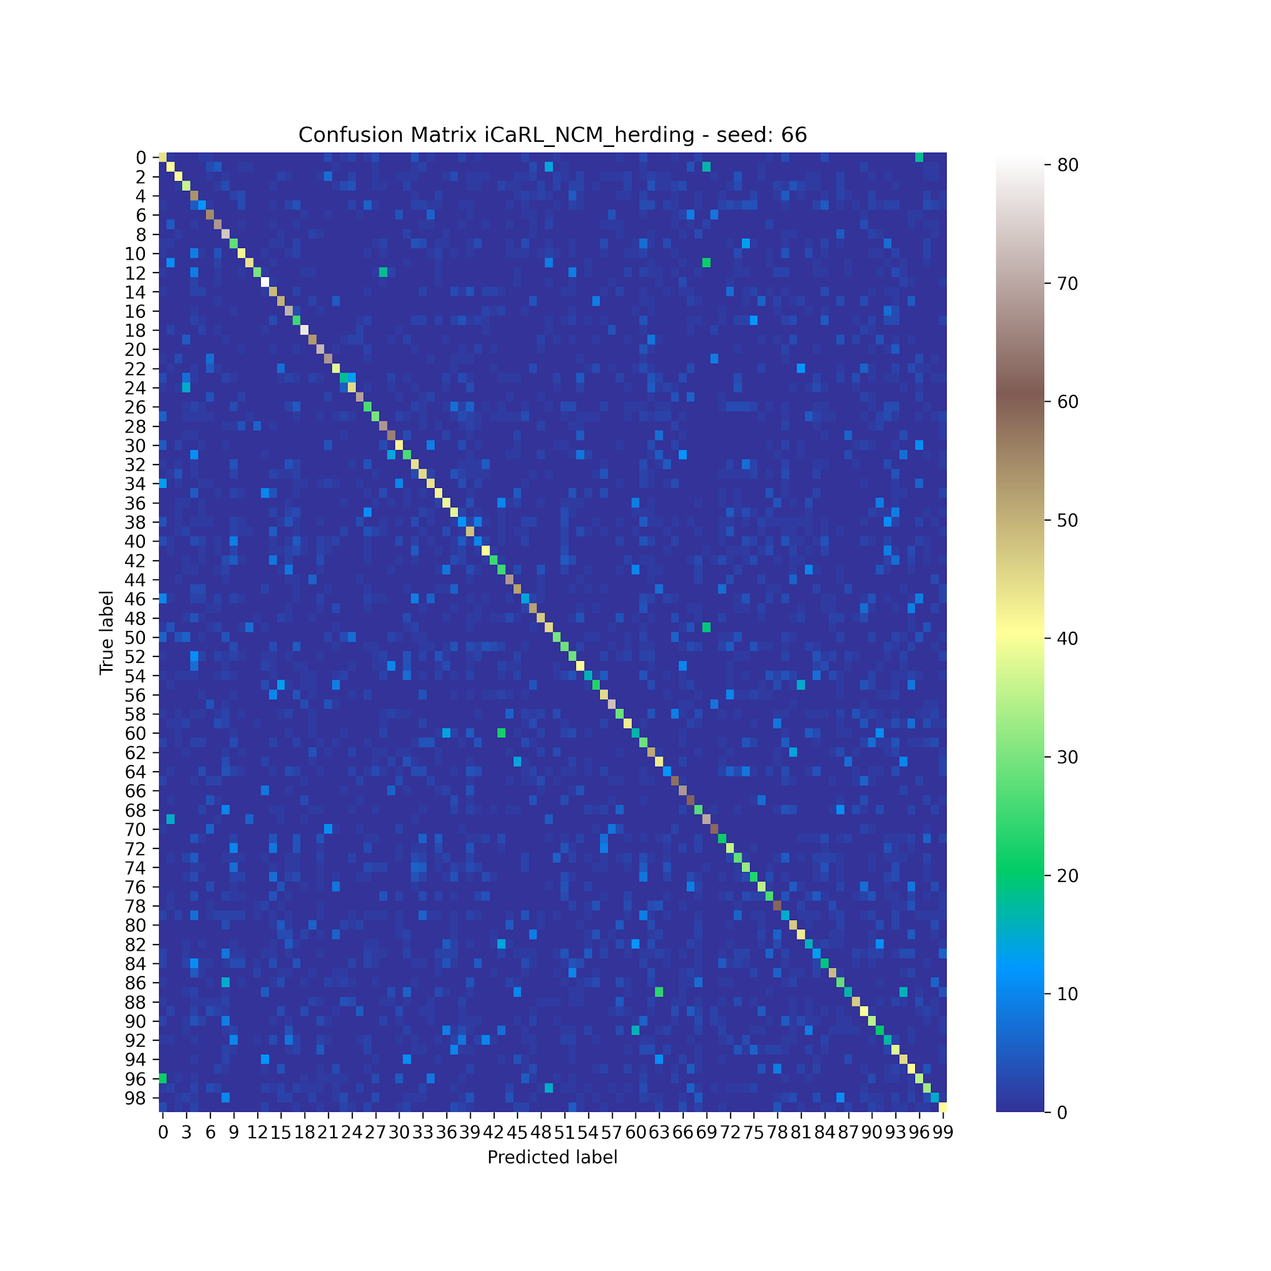
Two teachers - results

Slide 31
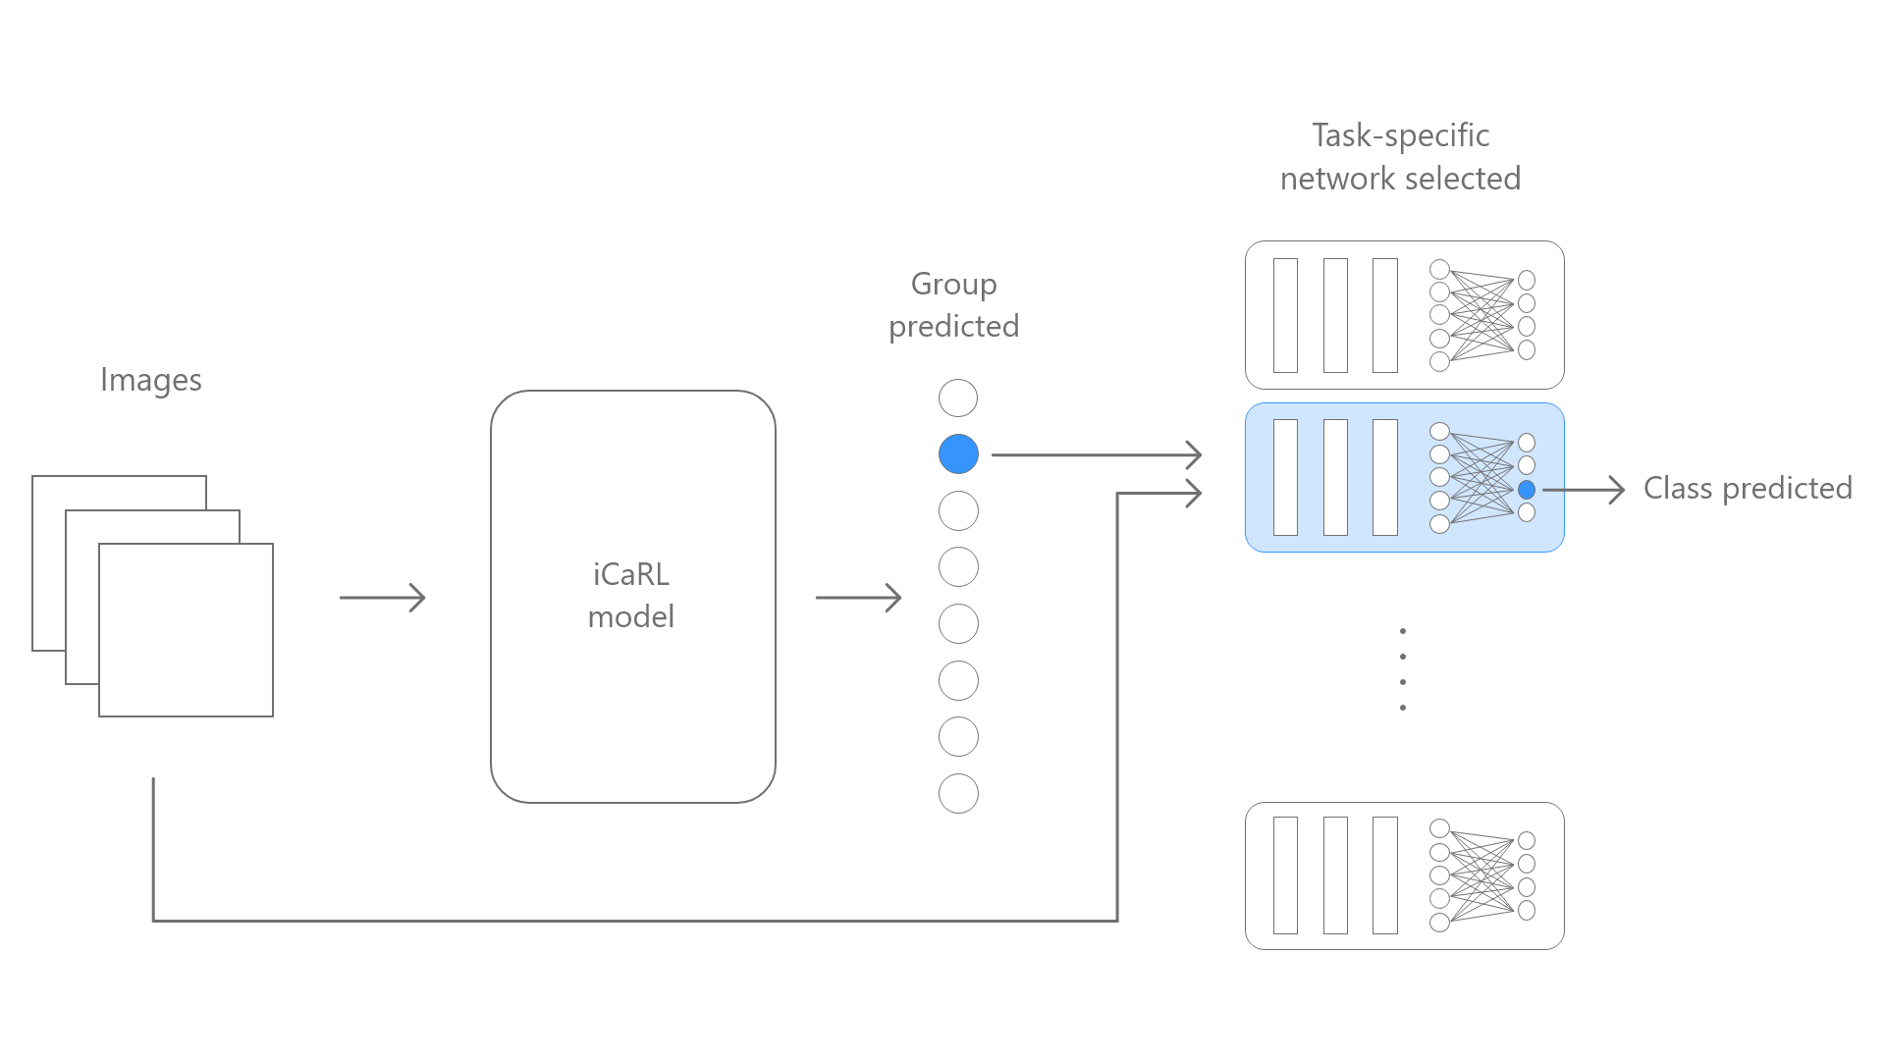
Task specific networks
The idea was to train a new independent networks for every new group of images,
iCaRL was then used to incrementally learn given an image, which group it belongs to,
The iCaRL prediction was then used to select the network specifically trained for the group to predict the image class.

Slide 32
Task specific networks - Possible benefits
For each iCaRL label (in this case for each group), iCaRL has more exemplars, given the same value for the parameter K.
The images of a given group, since they belongs to different classes, could enhance the learning of group dependent features. This could obtain more stable performances.
Since the total number of labels for iCaRL is lower, the iCaRL training could be easier.

Slide 33
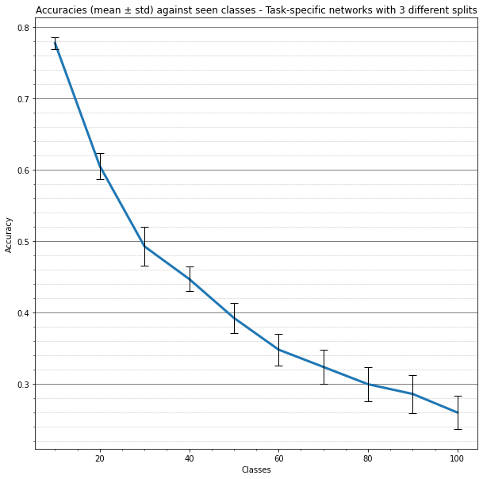

Task specific networks - Results

Slide 34
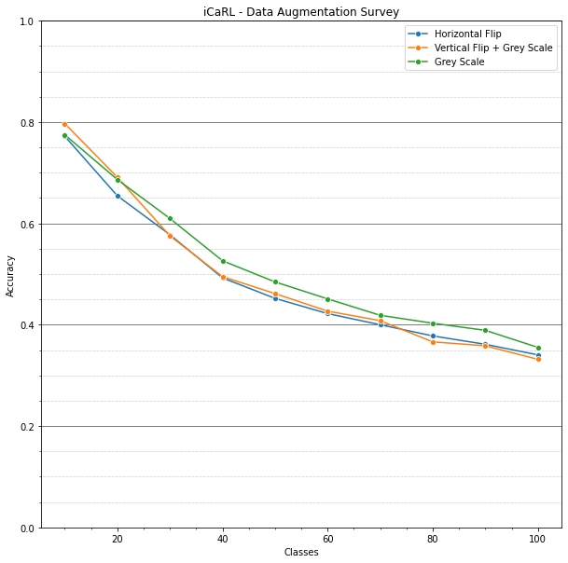
Exemplars Augmentation
Number of exemplars K fixed
Samples of new images reduced through random selection without replacement
Exemplars increased using Data Augmentation
Horizontal Flip
Vertical Flip + Grey Scale
Grey Scale
At a given time, the dataset is more balanced between old and new images.

Slide 35
Conclusions and further studies
Our trials did not improve iCaRL performances
Further analysis to overcome the iCaRL limitations
Progressive Neural Networks to suppress catastrophic learning
GANs to enhance exemplars dataset
Very active research area

Slide 36
Thank You!

