Slide 1

BeCode.org/BXL-Bouman-2.22
Real Estate Data
(Cleaning, Analysis,
Visualization and Interpretation)
Saba, Joachim, Francesco, Orhan

Slide 2
Introduction:
Data Cleaning
Data Analysis
Data Visualization
Data Interpretation

Slide 3
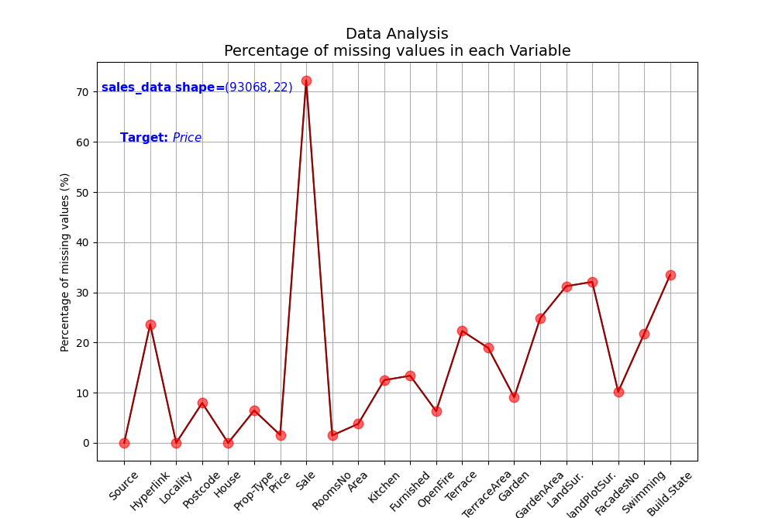
Data Cleaning and Analysis:
Percentage of missing values
Sale, hyperlink are deleted, merged locality and postcode

Slide 4
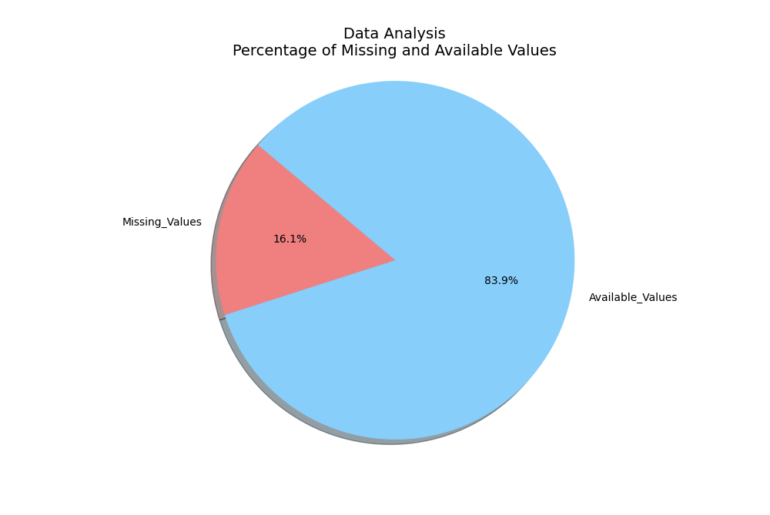
Data Cleaning and Analysis:
Percentage of missing values

Slide 5
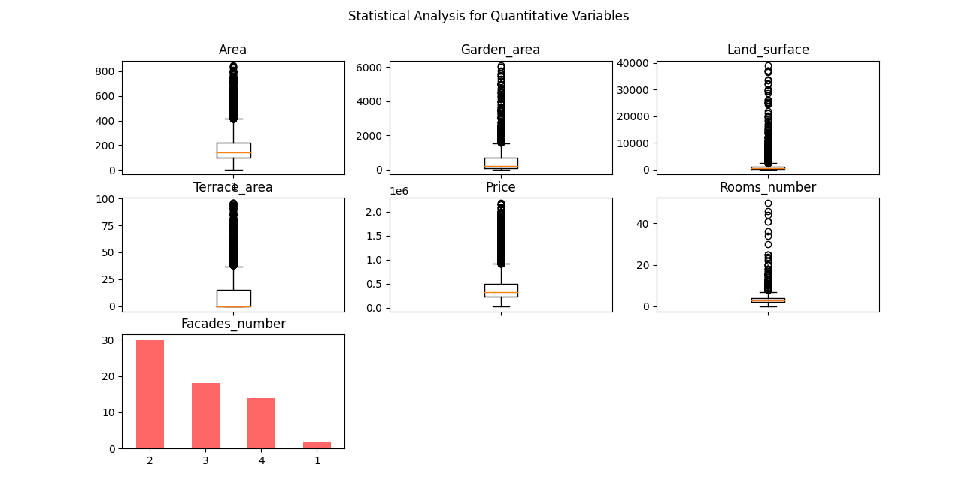
Data Cleaning and Analysis:
Outliers and quantitative variables
The number of observation of the original CVS file is 93068, after removing duplicated, empty rows and outlier, the number of observation is 10730

Slide 6
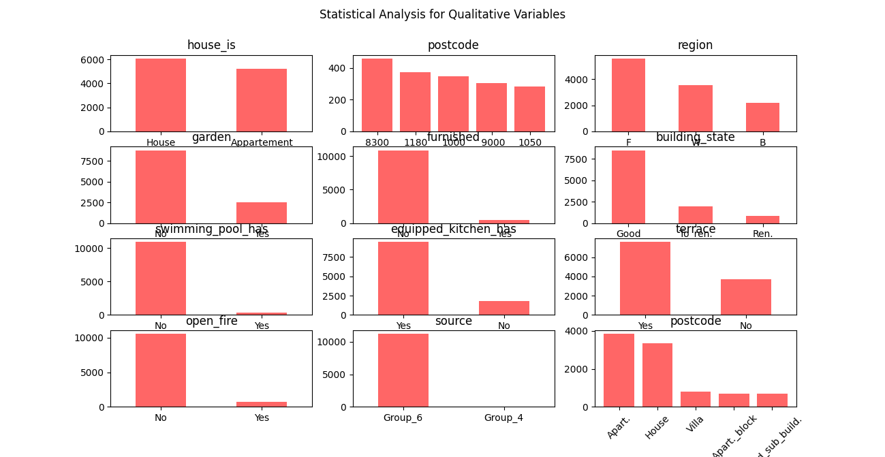
Data Cleaning and Analysis:
Qualitative variable

Slide 7
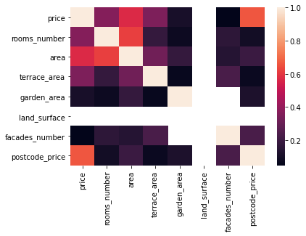
Data Cleaning and Analysis:
Correlations for apartment
postcode_price 0.66
area 0.57
rooms_number 0.36
terrace_area 0.35
garden_area 0.11
facades_number 0.04

Slide 8
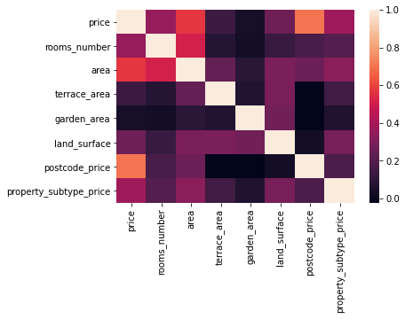
Data Cleaning and Analysis:
Correlations for house
postcode_price 0.70
area 0.57
property_subtype_price 0.38
rooms_number 0.36
land_surface 0.26
terrace_area 0.13
garden_area 0.04

Slide 9
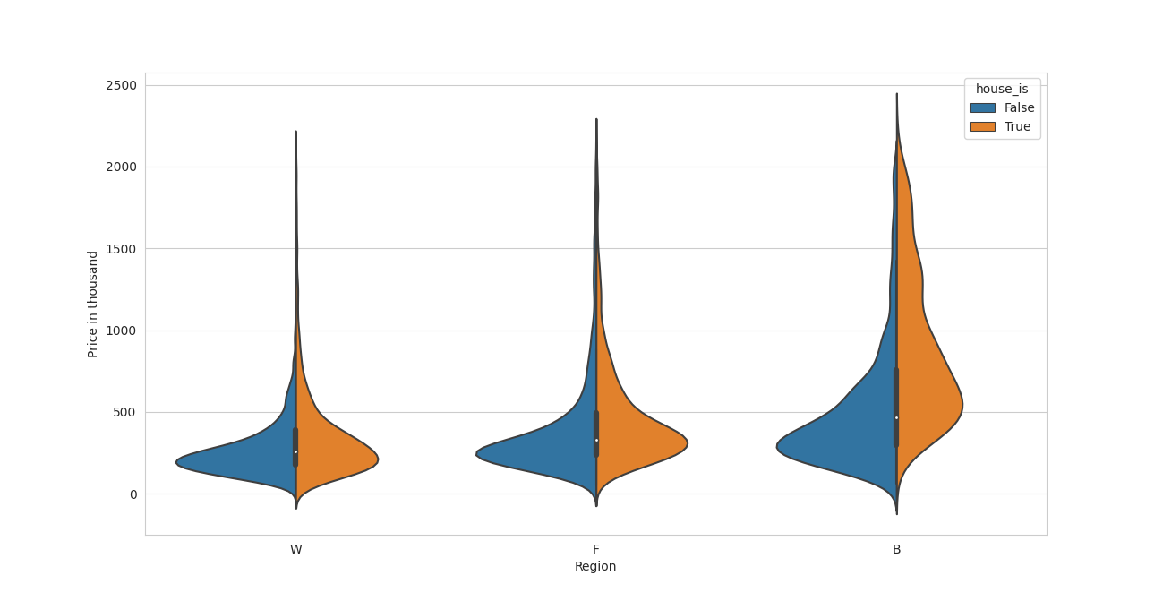
Data Visualization and Interpretation:
Price per region

Slide 10
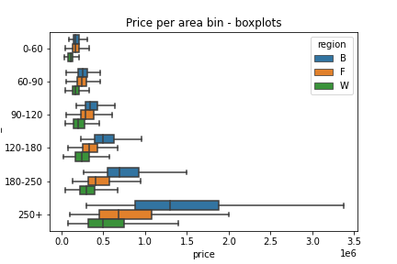
Data Visualization and Interpretation:
Price per area

Slide 11
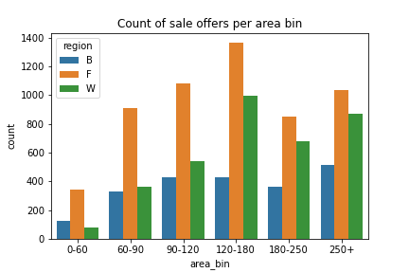
Data Visualization and Interpretation:
Count of sale by area

Slide 12
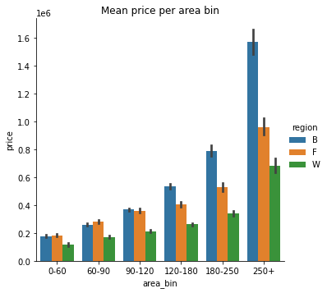
Data Visualization and Interpretation:
Mean price by area

Slide 13
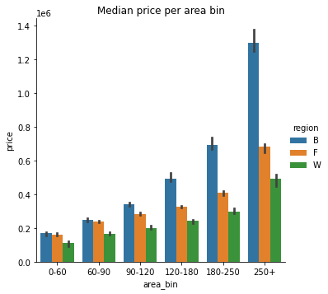
Data Visualization and Interpretation:
Median price by area

Slide 14
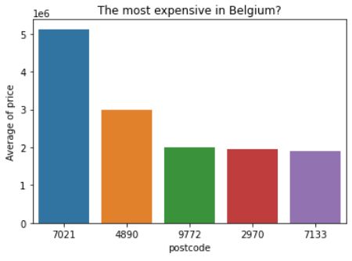
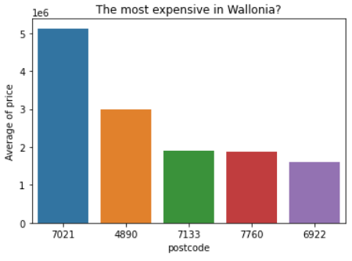
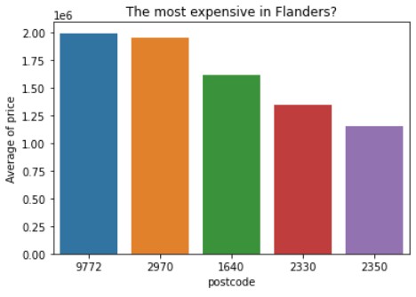
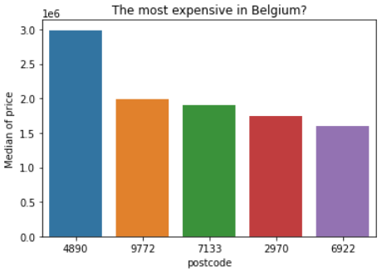
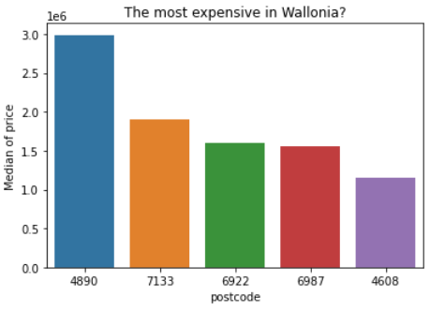
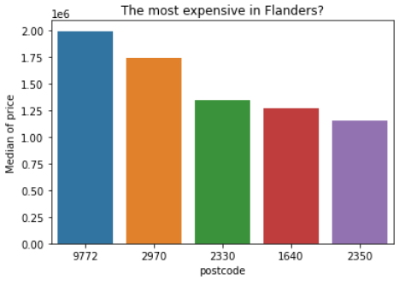
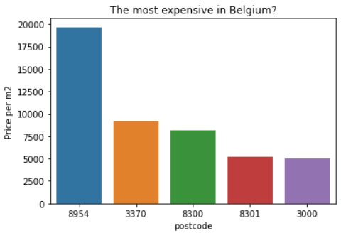
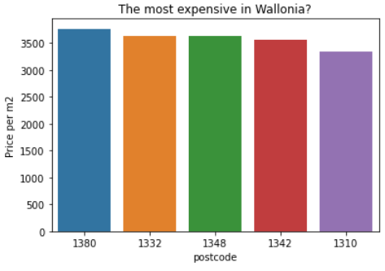
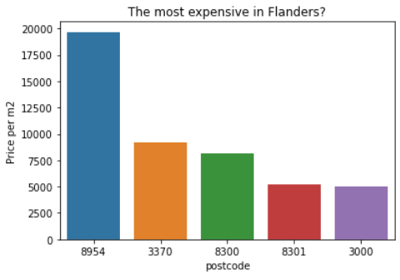

Slide 15
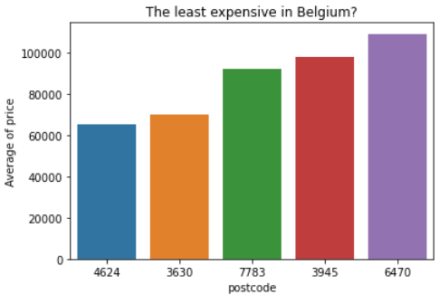
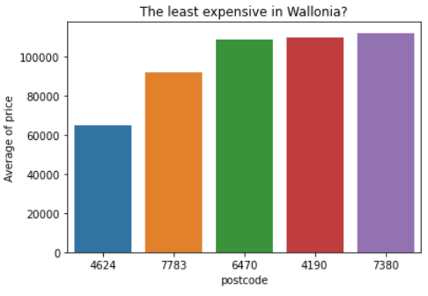
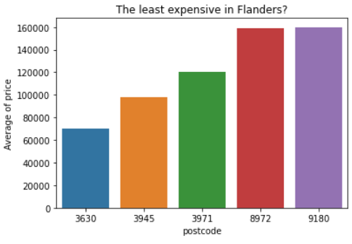
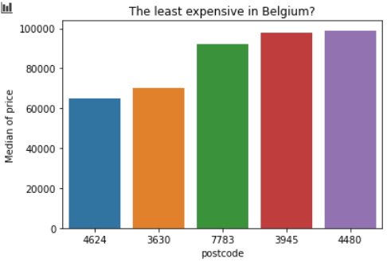
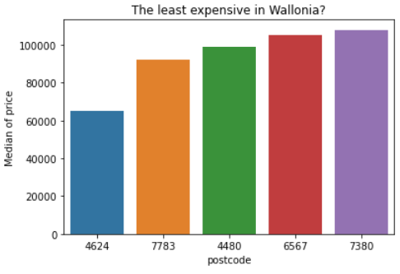

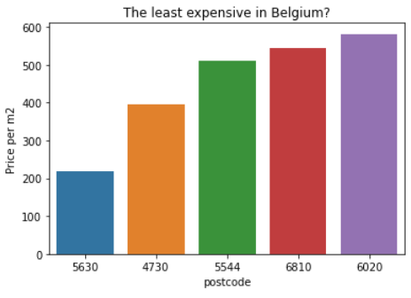
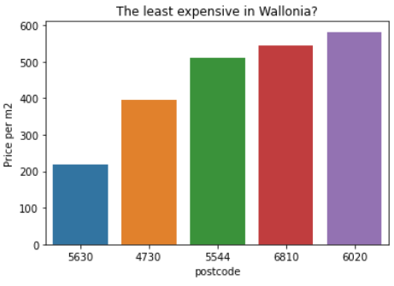
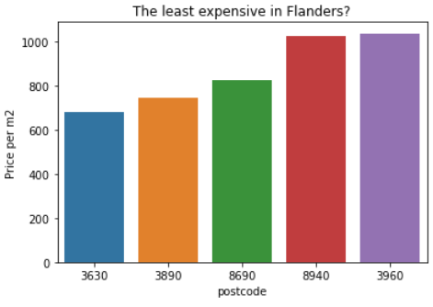

Slide 16
Conclusion:
Brussels is the most expensive region in Belgium for houses and apartment.

Slide 17
Machine Learning Model:
We use Random Forest to predict the Price since we have qualitative and quantitative features.

Slide 18
Questions

Slide 19
Thanks

