Slide 1

BeCode.org/BXL-Bouman-2.22
Real Estate Data
(Cleaning, Analysis,
Visualization and Interpretation)
Saba, Joachim, Francesco, Orhan

Slide 2
Introduction:
Data Cleaning
Data Analysis
Data Visualization
Data Interpretation

Slide 3
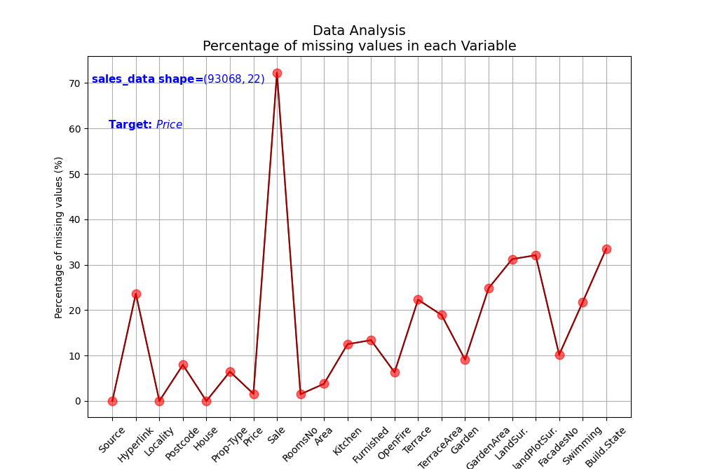
Data Cleaning and Analysis:

Slide 4
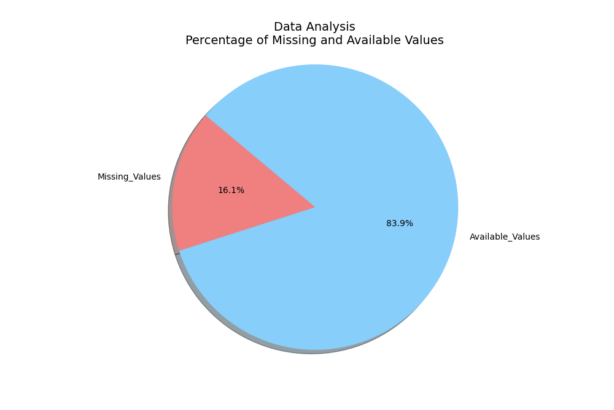
Data Cleaning and Analysis:

Slide 5
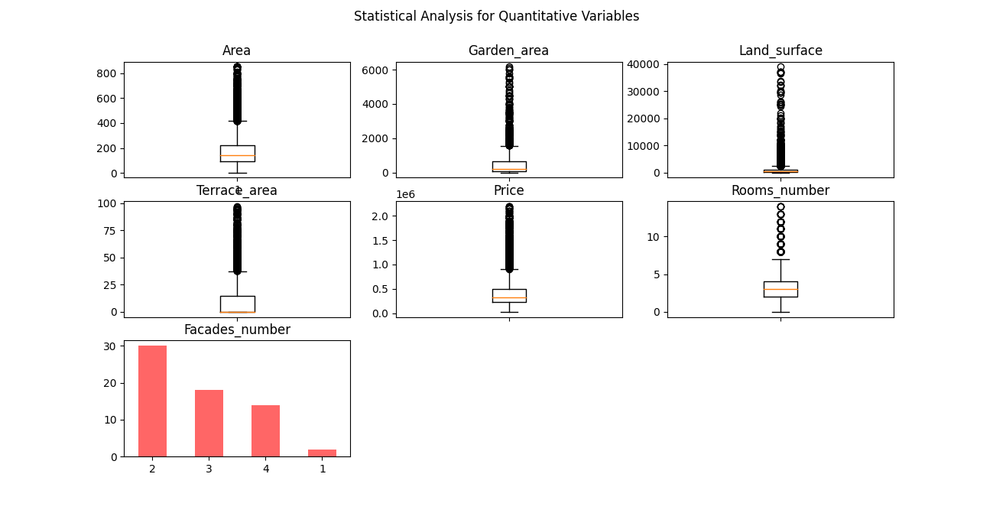
Data Cleaning and Analysis:

Slide 6
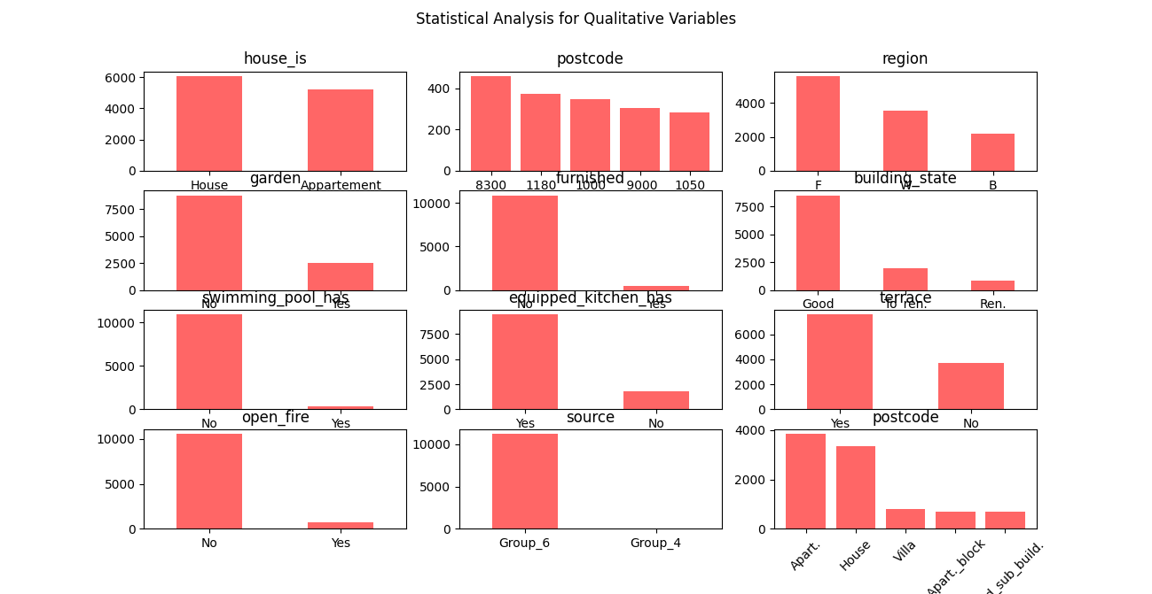
Data Cleaning and Analysis:

Slide 7
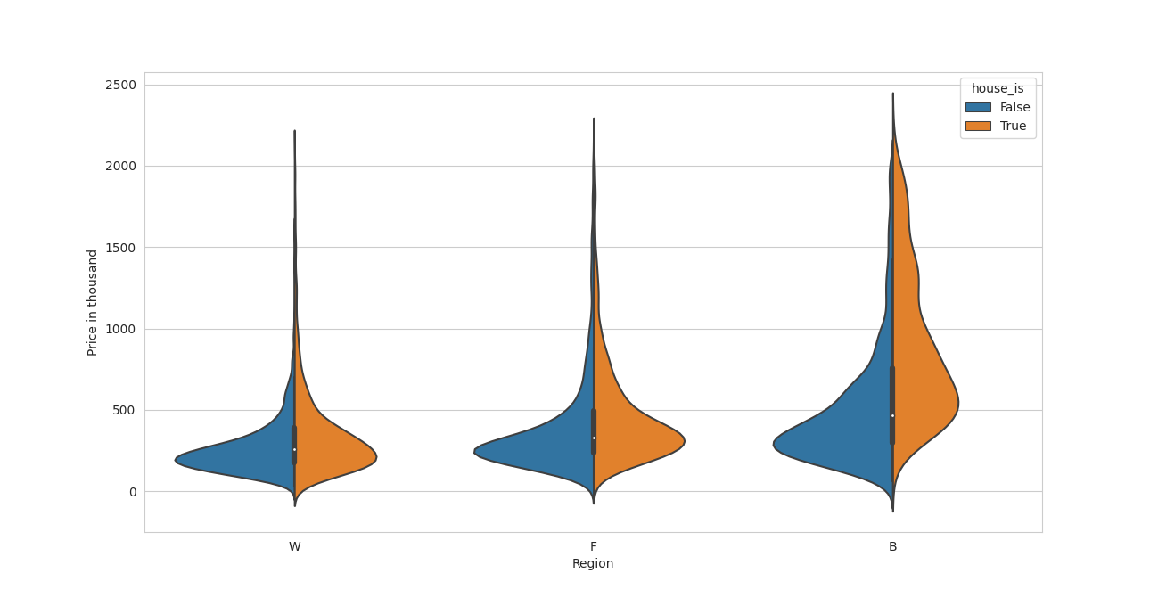
Data Visualization and Interpretation:

Slide 8
Conclusion:
Brussels is the most expensive region in Belgium for houses and apartment.

Slide 10
Questions

Slide 11
Thanks

