Slide 1
Algorithms for Bioinformatics
Enrico Blanzieri
March 30 2020 Lecture 11
Part 1

Slide 2
In the previous lectures
Global sequence alignment (Needleman-Wunsch algorithm)
Local sequence alignment (Smith-Waterman algorithm)
Substitution matrices (PAM and BLOSUM series)
Complexity of exact alignments methods
Heuristic alignment methods (FASTA, BLAST and its versions) score statistics
Multiple sequence alignment: CLUSTALW
In this lecture: multiple sequence alignment, T-COFFEE

Slide 3
Multiple sequence alignment
Problem with high complexity (NP-complete)
But, being very important in order to understand function and evolution within proteins families, heuristics have been developed
The main ideas that has been proposed are:
Progressive alignment (seen in lecture 10)
Consistency (in this lecture)
We can observe that, being heuristics, there is a part of modelling of the nature of the phenomenon.

Slide 4
Progressive Alignment in multiple sequence alignment
Feng and Doolittle algorithm
CLUSTAL
CLUSTALW
The rationale is that the progressive alignment is done along a tree that reprensents the evolutionary relationships between the sequences

Slide 5
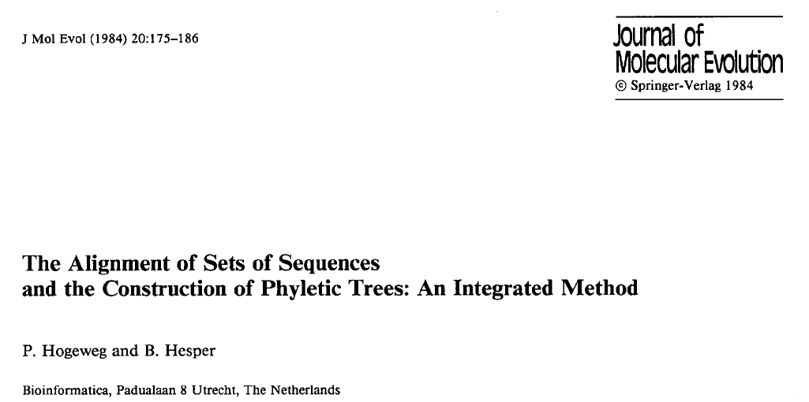
Integration between multiple sequence alignment and Phyletic trees construction
The alignment of sets of sequences and the construction of phyletic trees cannot be treated separately.
The concept of 'good alignment' is meaningless without reference to a phyletic tree, and the construction of phyletic trees presupposes alignment of the sequences.
An integrated method that generates both an alignment of a set of sequences and a phyletic tree.
a putative tree is used to align the sequences and the alignment obtained is used to adjust the tree; this process is iterated

Slide 6
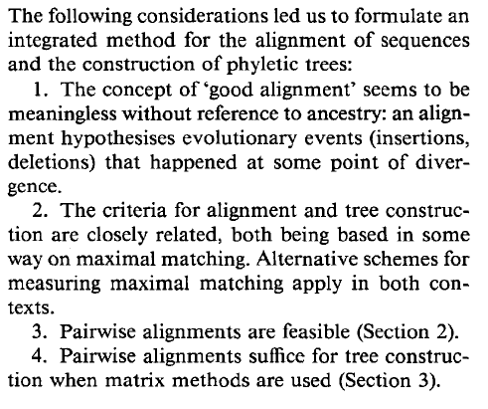
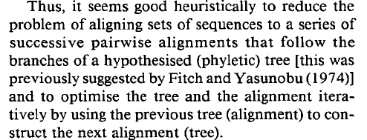
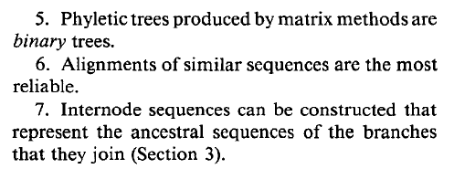
Hogweg and Hesper 1984

Slide 7
Hogweg and Hesper 1984
All pairs of the sequences are aligned independently
The similarity matrix is used for building the first phyletic tree
Sequences are pairwise aligned following the tree with internodes
A consistent multiple alignment is obtained
Compute number of mutations along the branches
Compute the mutational frequency at each position (possibly with character weights
Recompute the similarity matrix using the multiple alignment and the character weight
Goto step 2 until convergence

Slide 8
Consistency in multiple sequence alignment
What is consistency?
The fact that the pairwise alignment is ‘consistent’ with the overall alignment.
The problem with progressive alignment is ‘once a gap always a gap’
The misalignments done in the the pairwise phase are found in the final overall multiple aligment
Can consistency be defined?
Can it be computed in a way that it can be used in an heuristics?
Yes Various attempts.

Slide 9
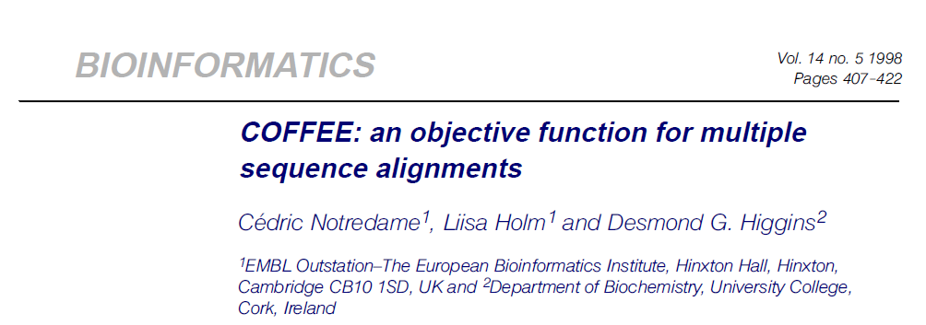
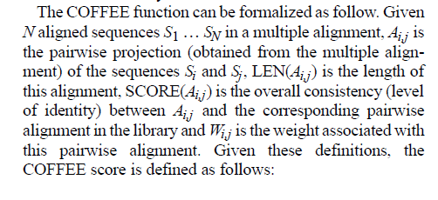
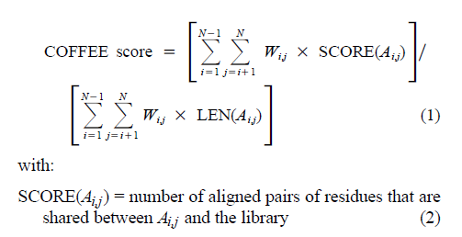
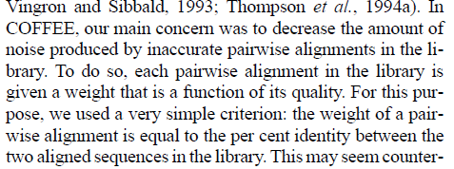
COFFEE

Slide 10
T-COFFEE
https://www.sciencedirect.com/science/article/abs/pii/S0022283600940427?via%3Dihub

Slide 11
Next: lecture 11 part 2

Slide 12
Algorithms for Bioinformatics
Enrico Blanzieri
March 30 2020 Lecture 11
Part 2

Slide 13
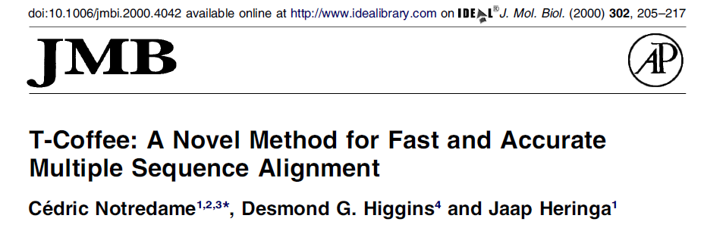
T-COFFEE
Consistency
Progressive Alignment along a Tree

Slide 14
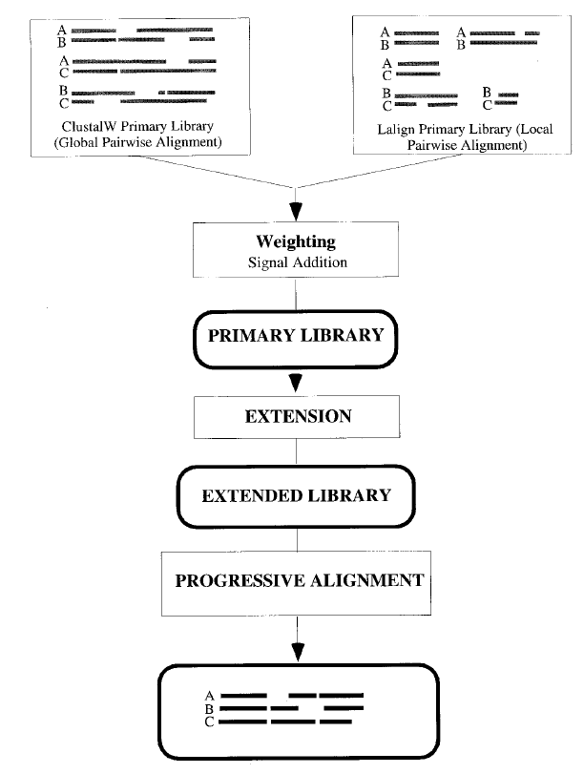
T-COFFEE
Weighting
The overall procedure
Primary Library
Extended Library
Progressive alignment

Slide 15
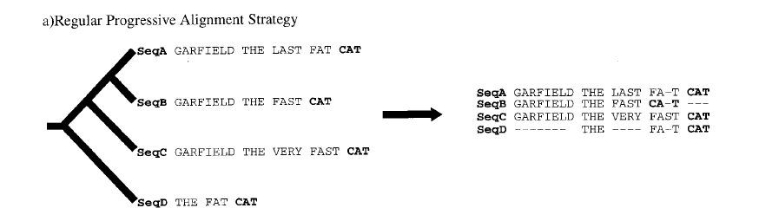
T-COFFEE Figure 2

Slide 16
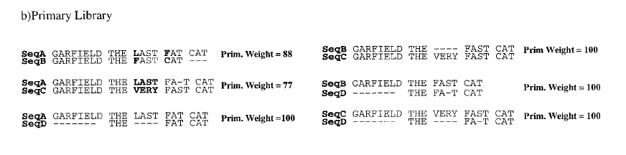
Primary library
$$weight(A(a,b)=\frac{matches(A(a,b))⋅100}{matches(A(a,b))+mismatches(A(a,b))}$$

Slide 17
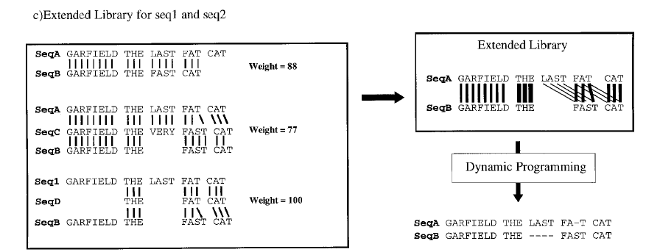
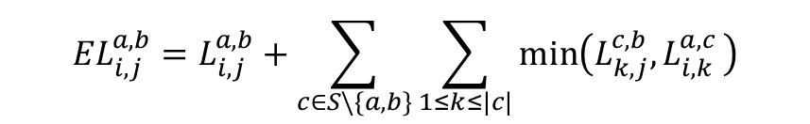
Extended Library
$${EL}_{i,j}^{a,b}=L_{i,j}^{a,b}+\sum_{c∈S\backslash \{a,b\}}{\sum_{1≤k≤|c|}{min⁡\left(L_{k,j}^{c,b}{, L}_{i,k}^{a,c}\right)}}$$

Slide 18

T-COFFEE Figure 2

Slide 19
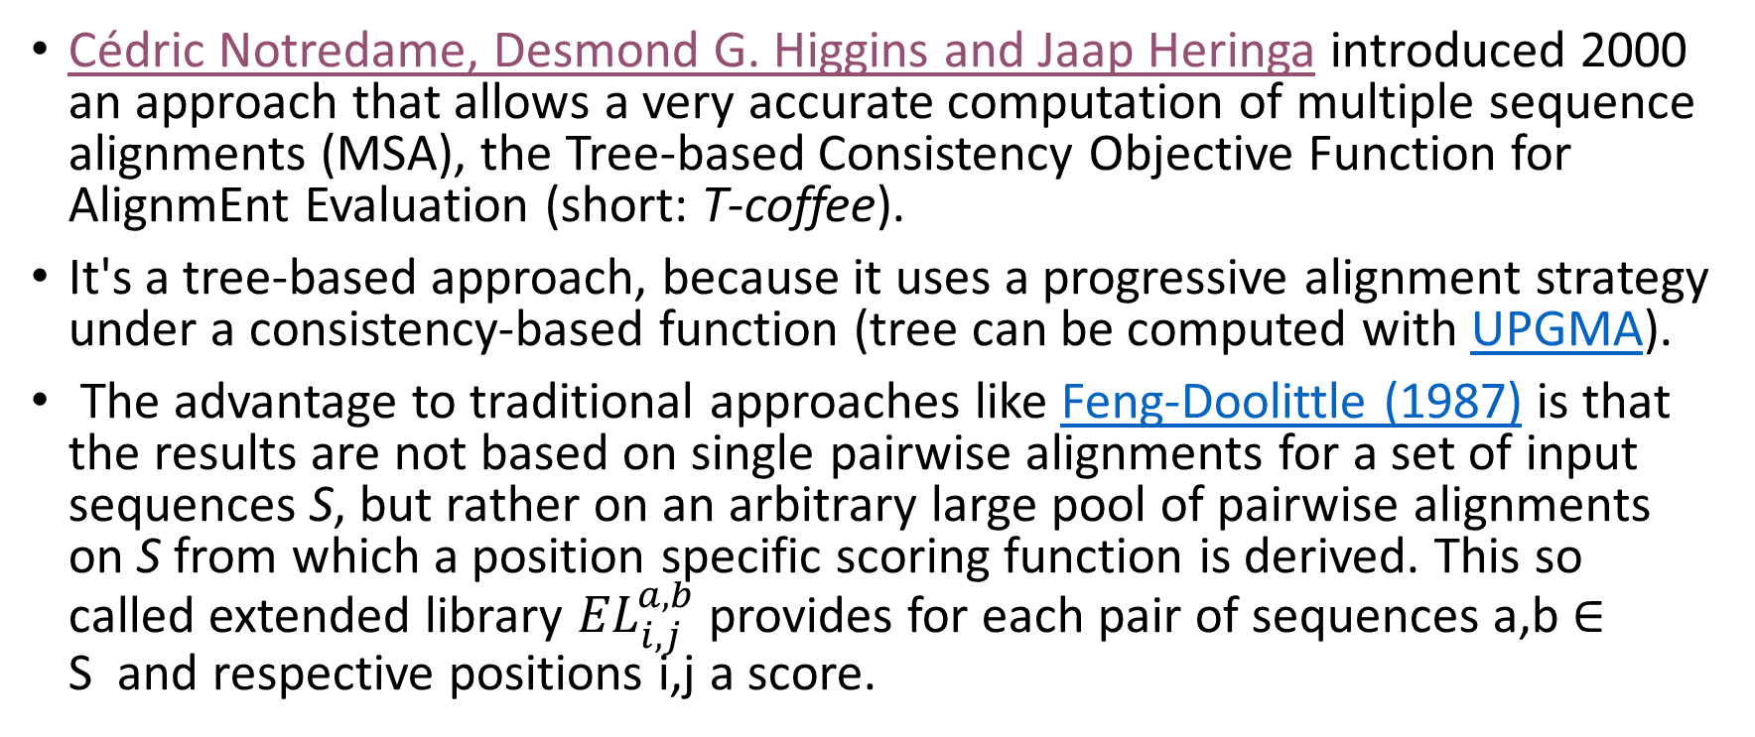
T-COFFEE on the Freiburg resource
Cédric Notredame, Desmond G. Higgins and Jaap Heringa introduced 2000 an approach that allows a very accurate computation of multiple sequence alignments (MSA), the Tree-based Consistency Objective Function for AlignmEnt Evaluation (short: T-coffee).
It's a tree-based approach, because it uses a progressive alignment strategy under a consistency-based function (tree can be computed with UPGMA).
The advantage to traditional approaches like Feng-Doolittle (1987) is that the results are not based on single pairwise alignments for a set of input sequences S, but rather on an arbitrary large pool of pairwise alignments on S from which a position specific scoring function is derived. This so called extended library ${EL}_{i,j}^{a,b}$ provides for each pair of sequences a,b ∈ S and respective positions i,j a score.

Slide 20
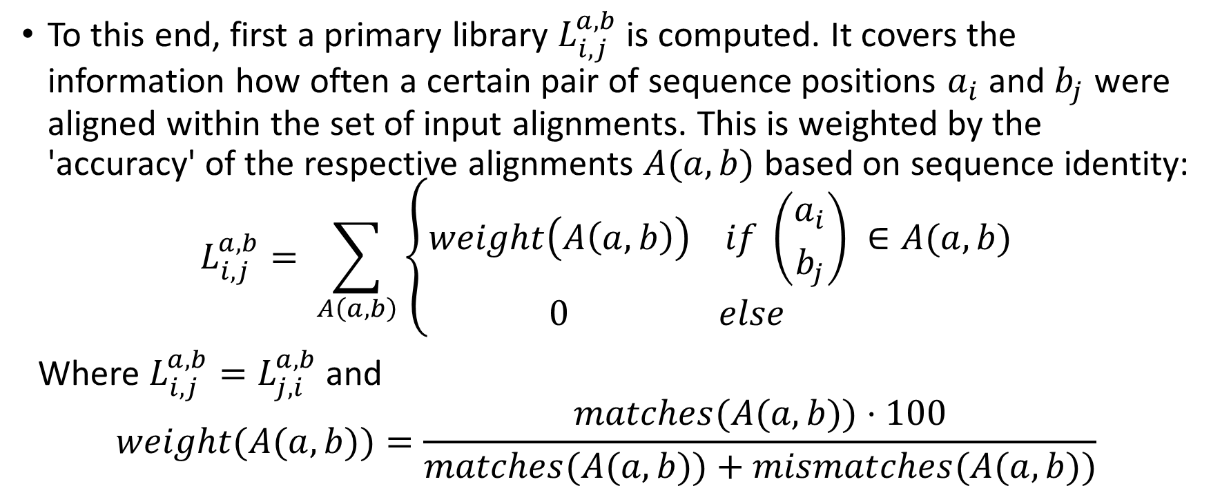
Primary Library
To this end, first a primary library $L_{i,j}^{a,b}$ is computed. It covers the information how often a certain pair of sequence positions $a_{i}$ and $b_{j}$ were aligned within the set of input alignments. This is weighted by the 'accuracy' of the respective alignments $A(a,b)$ based on sequence identity:
$$L_{i,j}^{a,b}= \sum_{A\left(a,b\right)}{\left\{\begin{aligned}weight\left(A\left(a,b\right)\right) if \left({a_{i} \atop b_{j}}\right) ∈A(a,b) \\ 0 else \end{aligned}\right.}$$
Where $L_{i,j}^{a,b}{=L}_{j,i}^{a,b}$ and
$$weight(A(a,b))=\frac{matches(A(a,b))⋅100}{matches(A(a,b))+mismatches(A(a,b))}$$

Slide 21
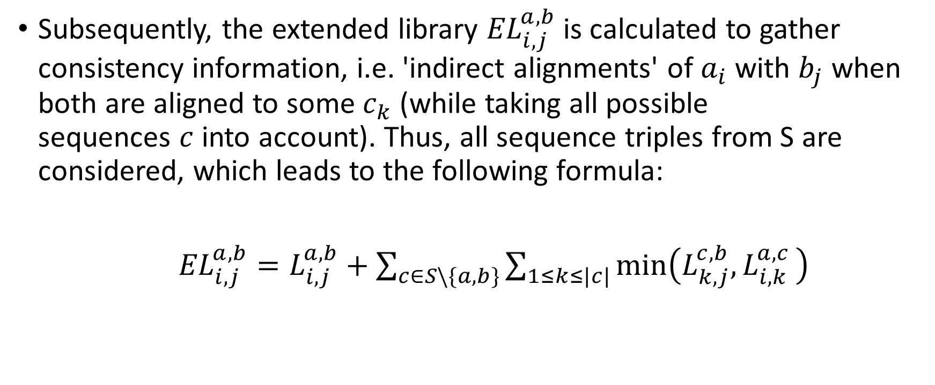
Extended Library
Subsequently, the extended library ${EL}_{i,j}^{a,b}$ is calculated to gather consistency information, i.e. 'indirect alignments' of $a_{i}$ with $b_{j}$ when both are aligned to some $c_{k}$ (while taking all possible sequences $c$ into account). Thus, all sequence triples from S are considered, which leads to the following formula:
${EL}_{i,j}^{a,b}=L_{i,j}^{a,b}+\sum_{c∈S\backslash \{a,b\}}{\sum_{1≤k≤|c|}{min⁡\left(L_{k,j}^{c,b}{, L}_{i,k}^{a,c}\right)}}$

Slide 22
Progressive Alignment
Finally, this scoring function EL is used in a progressive alignment scheme (see Feng-Doolittle) to compute a multiple sequence alignment.
Unlike in the Feng-Doolittle (1987) approach, the whole columns (aligned positions of all sequences) of two groups are used to score/compute their joint alignment. To this end, the average alignment score of two columns is used (all chars of first column aligned with all chars of second column) while gaps are ignored by setting α=β=0 (parameters of Gotoh algorithm). The latter is based on the idea that the library already indirectly reflects the gap scoring that was present in the underlying input alignments.

Slide 23
T-COFFEE at the Freiburg Resource
In the algorithm, it is possible to add information from arbitrary alignments to emphasize particularly important positions of aligned sequences. Here, you can use (multiple optimal) global and local alignments of the input sequences using the Gotoh algorithm. Each alignment is used in the formula from above to compute L. For a given input, the computation steps are
pairwise alignments
primary and extended library
phylogenetic tree
MSA via progressive alignment
multiple sequence alignment (MSA) with SoP score which are represented in reverse order below. The sum-of-pairs (SoP) score of the final MSA is simply the score sum of all pairwise alignments within the MSA, i.e. the global alignment scores of pairwise row combinations where gap-only columns are removed.

Slide 24
T-COFFEE
http://rna.informatik.uni-freiburg.de/Teaching/index.jsp?toolName=Notredame-Higgins-Heringa

Slide 25
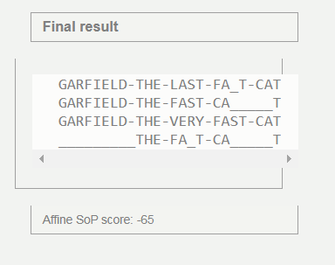
Feng-Doolittle

Slide 26
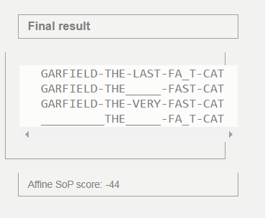
T-COFFEE

Slide 27
Comparison of the results from Freiburg resources
Feng and Doolittle
T-COFFEE

Slide 28
Credits for the online material
Martin Mann, Mostafa M Mohamed, Syed M Ali, and Rolf Backofen
Interactive implementations of thermodynamics-based RNA structure and RNA-RNA interaction prediction approaches for example-driven teaching
PLOS Computational Biology, 14 (8), e1006341, 2018.
Martin Raden, Syed M Ali, Omer S Alkhnbashi, Anke Busch, Fabrizio Costa, Jason A Davis, Florian Eggenhofer, Rick Gelhausen, Jens Georg, Steffen Heyne, Michael Hiller, Kousik Kundu, Robert Kleinkauf, Steffen C Lott, Mostafa M Mohamed, Alexander Mattheis, Milad Miladi, Andreas S Richter, Sebastian Will, Joachim Wolff, Patrick R Wright, and Rolf Backofen
Freiburg RNA tools: a central online resource for RNA-focused research and teaching
Nucleic Acids Research, 46(W1), W25-W29, 2018.

Slide 29
Next: lecture 11 part 3

Slide 30
Algorithms for Bioinformatics
Enrico Blanzieri
March 30 2020 Lecture 11
Part 3

Slide 31
Hogeweg and Hesper (elective)

Slide 32
COFFEE (elective)

Slide 33
T-COFFEE

Slide 34
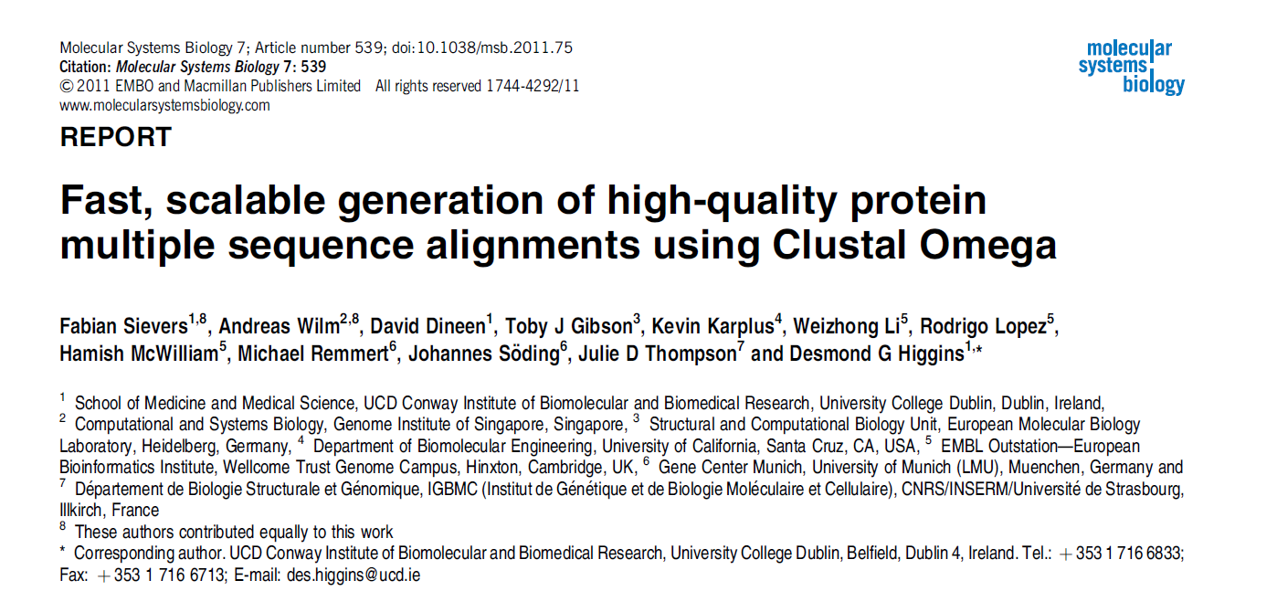
Clustal Omega (elective)

