Slide 1
Algorithms for Bioinformatics
Enrico Blanzieri
March 23 2020 Lecture 9
Part 1

Slide 2
In the previous lectures
Global sequence alignment (Needleman-Wunsch algorithm)
Local sequence alignment (Smith-Waterman algorithm)
Substitution matrices (PAM and BLOSUM series)
Complexity of exact alignments methods
Heuristic alignment methods (FASTA and BLAST) and score statistics
In this lecture: other versions of BLAST
https://blast.ncbi.nlm.nih.gov/Blast.cgi

Slide 3
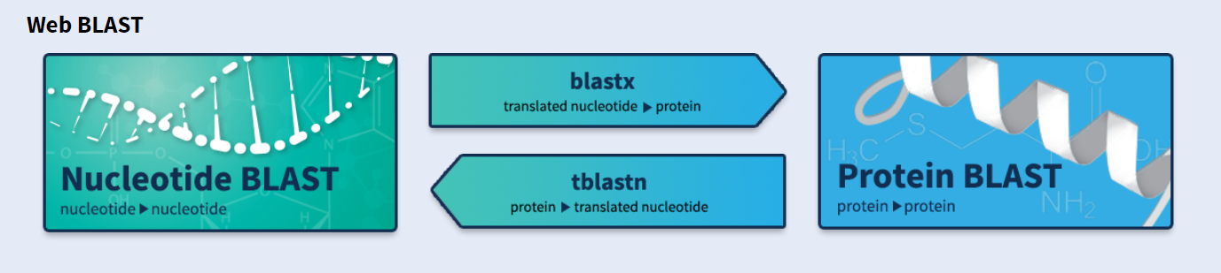
BLAST and its versions
BLAST has grown over time
BLAST is now implemented with a two-hit method, which provides that the extension of the HSPs can only take place if two independent hits occur within a number of A residues, with no gaps in between.
BLAST now triggers gapped extensions
Various specialized versions were also born:

Slide 4
BLAST and its versions
blastn: look for similarities in nucleotide databases from a nucleotide query.
blastp: look for similarities in protein databases starting from an amino acid query.
blastx: look for similarities in protein databases starting from a nucleotide query that is translated into all frames.
tblastn: looks for similarities in nucleotide databases starting from an amino acid query, all subjects in the database are translated into amino acids, in all frames.
tblastx: look for similarities in nucleotide databases starting from a nucleotide query, all subjects in the database are translated into amino acids

Slide 5
Nucleotides to amino acids in all the frames
Given a generic sequence of nucleotides GATCGATCGAATCGATGCTTGAGCT there is more than one way to translate it depending on the frame
GATCGATCGAATCGATGCTTGAGCT
# DNA_sequence gatcgatcgaatcgatgcttgagct
# 5'3' Frame 1 D R S N R C L S
# 5'3' Frame 2 I D R I D A Stop A
# 5'3' Frame 3 S I E S Met L E
# 3'5' Frame 1 S S S I D S I D
# 3'5' Frame 2 A Q A S I R S I
# 3'5' Frame 3 L K H R F D R
A tool for doing it explictly:
https://web.expasy.org/translate/
 | GAT | CGA | TCG | AAT | CGA | TGC | TTG | AGC | T
G | ATC | GAT | CGA | ATC | GAT | GCT | TGA | GCT
GA | TCG | ATC | GAA | TCG | ATG | CTT | GAG | CT

Slide 6
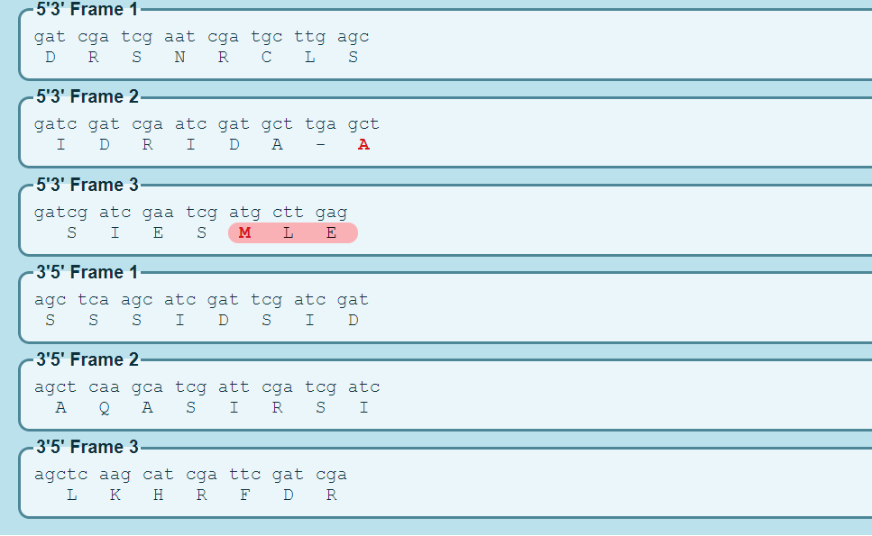
Nucleotides to amino acids in all the frames
GATCGATCGAATCGATGCTTGAGCT

Slide 7
Versions of BLAST from NIH

Slide 8
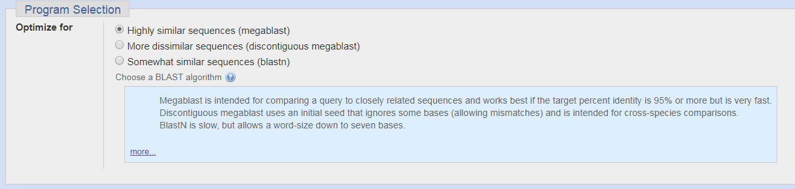
BLASTn program choices

Slide 9
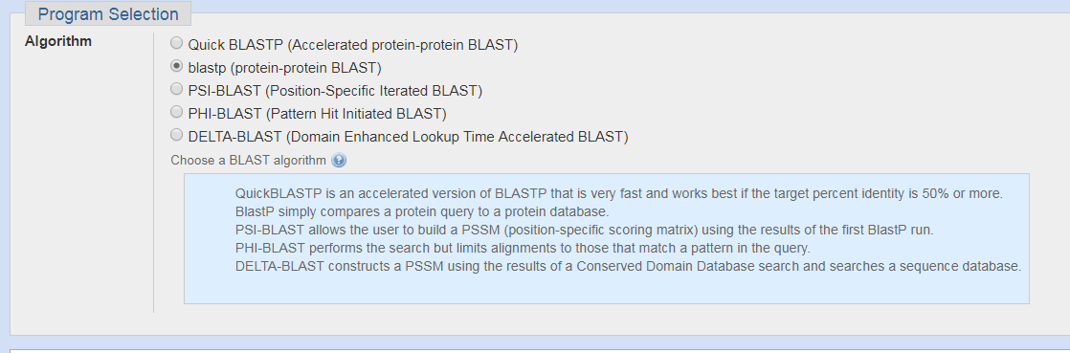
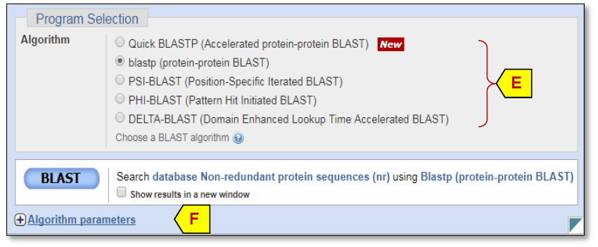
BLASTp program choices
From the guide:

Slide 10
BLAST and its versions
gapped-blast: continues the HSP extension phase considering the possibility of inserting the gaps.
MegaBLAST: it can concatenate many queries together to minimize the execution time in a sequential way too long queries (it is suitable for nucleotide sequences very similar to each other)
Discontiguous Mega BLAST: like MegaBlast (it is suitable for more dissimilar nucleotide sequences)
QUICK-BLAST: accelerated protein-protein search
PSI-BLAST: used an iterative search uses the HSP to generate the characteristic profiles of the query.
PHI-BLAST: extension of PSI-BLAST for the search in the database of protein patterns rather than exact queries.
DELTA-BLAST: searches a protein sequence database using a PSSM (Position-Specific Scoring Matrix)constructed from conserved domains matching a query.

Slide 11
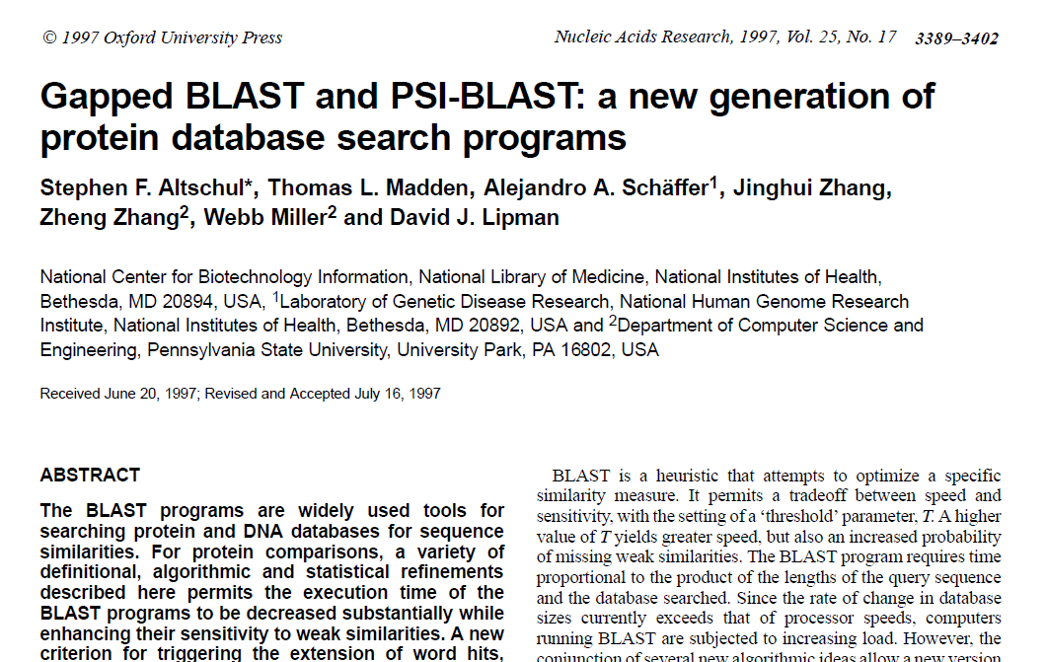
Gapped BLAST

Slide 12
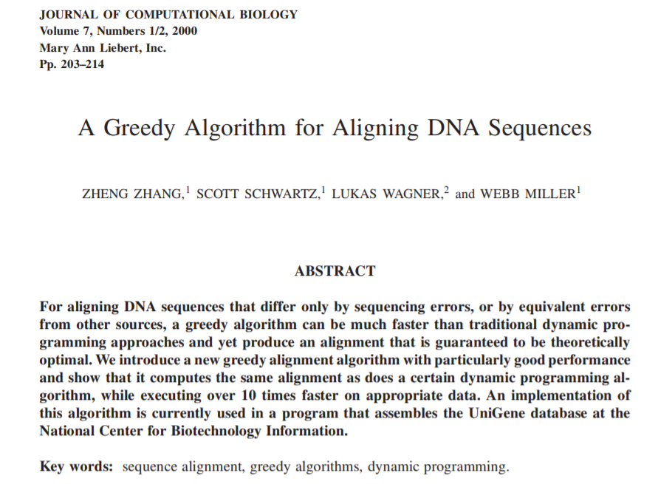
Mega BLAST (elective)

Slide 13
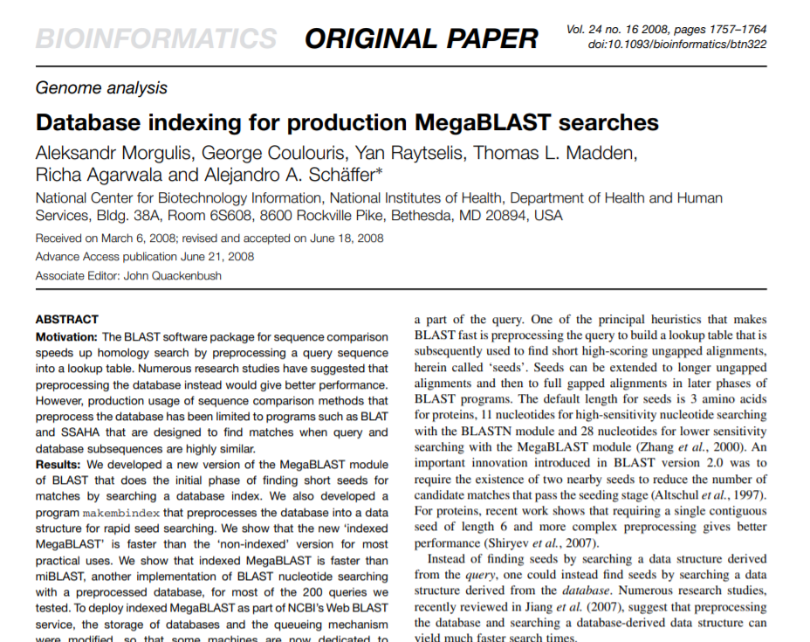
Mega BLAST (reference)

Slide 14
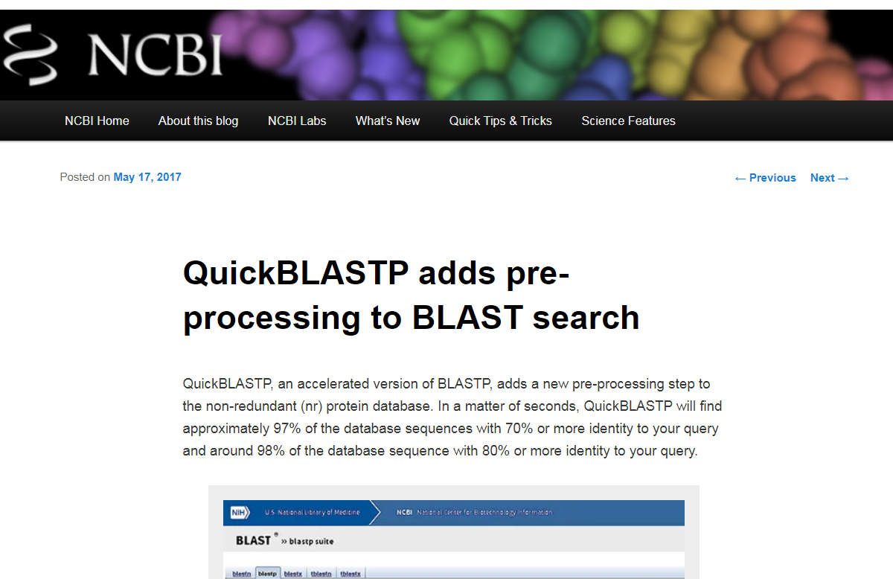
Quick BLAST

Slide 15
PSI-BLAST

Slide 16
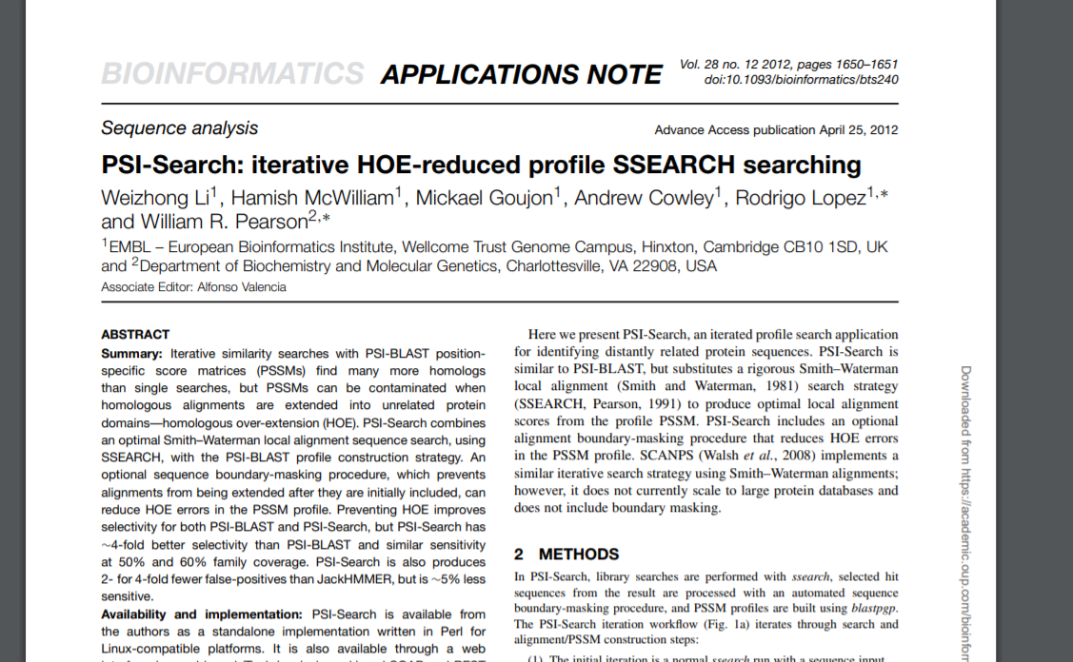
PSI-BLAST

Slide 17
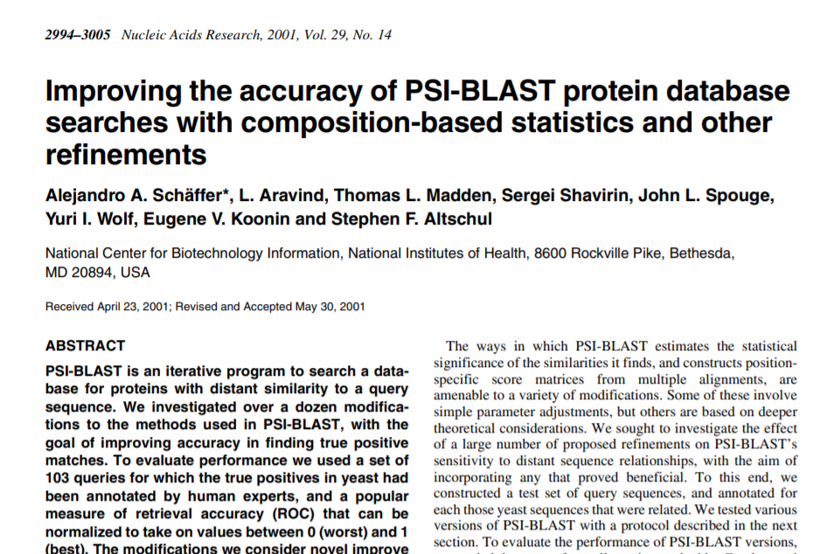
PSI-BLAST Composition-Based Statistics (CBS) (elective)

Slide 18
Next: Lecture 9 part 2

Slide 19
Algorithms for Bioinformatics
Enrico Blanzieri
March 23 2020 Lecture 9
Part 2

Slide 20
BLAST and its versions
gapped-blast: continues the HSP extension phase considering the possibility of inserting the gaps.
MegaBLAST: it can concatenate many queries together to minimize the execution time in a sequential way too long queries (it is suitable for nucleotide sequences very similar to each other)
Discontiguous Mega BLAST: like MegaBlast (it is suitable for more dissimilar nucleotide sequences)
QUICK-BLAST: accelerated protein-protein search
PSI-BLAST: used an iterative search uses the HSP to generate the characteristic profiles of the query.
PHI-BLAST: extension of PSI-BLAST for the search in the database of protein patterns rather than exact queries.
DELTA-BLAST: searches a protein sequence database using a PSSM (Position-Specific Scoring Matrix)constructed from conserved domains matching a query.

Slide 21
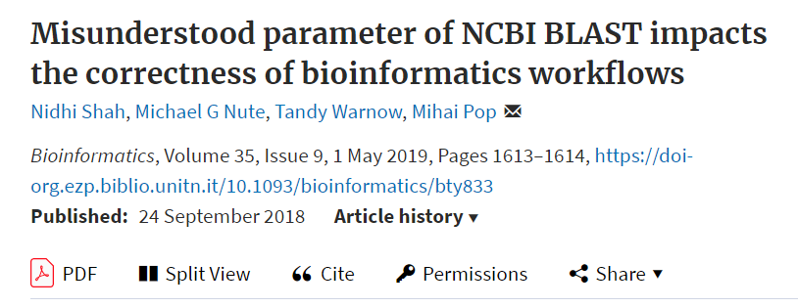
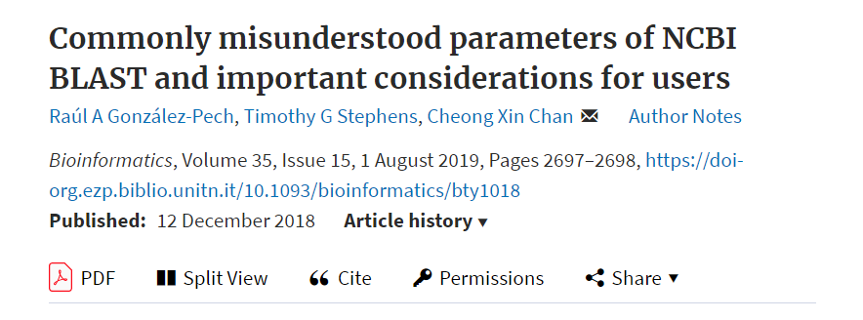
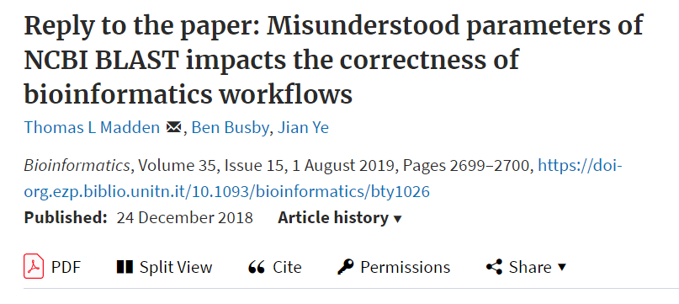
BLAST fatigue? You are not the only one
We have created new documentation describing how BLAST works, and it is available at https://go.usa.gov/xPVqM.
https://www.ncbi.nlm.nih.gov/books/NBK279684/#_appendices_Outline_of_the_BLAST_process_

Slide 22
Gapped BLAST outline
Introduction
BLAST performs several steps as it searches through a database and winnows the matches, finding the most significant matches that it finally presents to the user. The initial step in this process is the fastest and examines every sequence. Each successive step takes longer but examines fewer sequences. The outline below provides details on the process and a figure provides a visual representation. This outline applies only to gapped BLAST. A letter and number in the figure (e.g., C3) refers to a step in the outline. BLAST is described in greater detail in https://www.ncbi.nlm.nih.gov/pubmed/9254694.

Slide 23
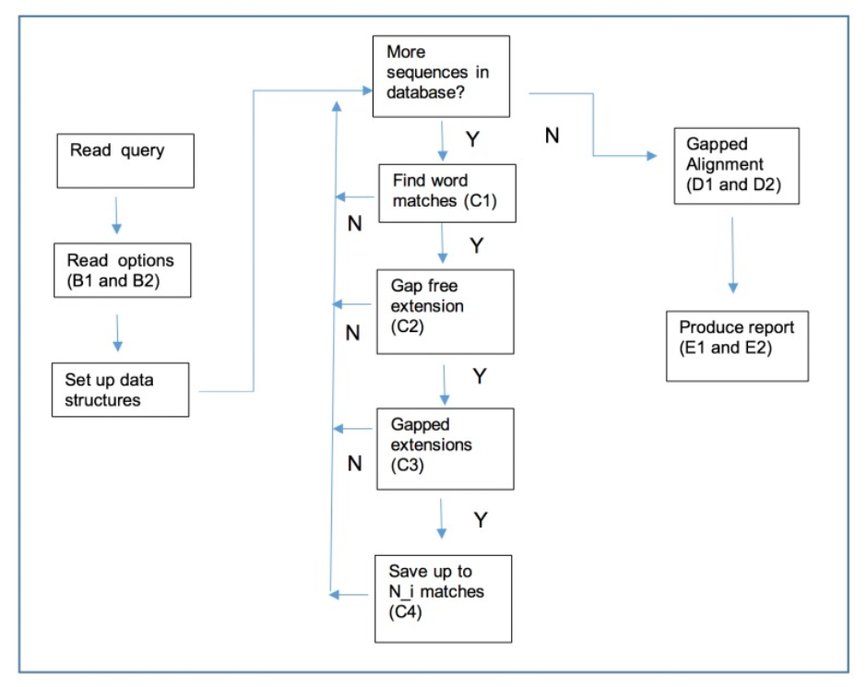
BLAST process
https://www.ncbi.nlm.nih.gov/books/NBK279684/#_appendices_Outline_of_the_BLAST_process_
Outline
A,B,C,D,E [...]
A

Slide 24
gapped BLAST outline: A and B steps 1-2
A. Read in user query and preprocess (mask for low-complexity, etc.)
B. Read user options and set parameters for the search. This includes examining how many matches (database sequences) the user wants returned and the expect value. If the user wants N database sequences returned and sets an expect value of E, then:
1. For Composition-based statistics (CBS), set an (internal) maximum limit of N_i=2*N+50 database sequences and an internal expect value of E_i = 5*E. CBS applies only to protein-protein comparisons and is available for BLASTP, BLASTX, TBLASTN, RPSBLAST, and RPSTBLASTN.
2. Otherwise, set a maximum limit of N_i=MAX(MIN(2*N, N+50),10) database sequences.
C,D,E […]

Slide 25
gapped BLAST outline: C step 1
A,B […]
C. Loop over every sequence in the database, performing the following actions:
1.
Scan for initial matching word hits. If an initial hit is found, then move on to step 2, otherwise move on to next sequence. Example initial matching word hits are:
a. 11 bases exact match for BLASTN.
b. 28 bases exact match for MegaBLAST
c. 3 residue match with score above threshold for BLAST[PX]/TBLASTN (default requires 2 word hits on a diagonal)
d. 6 residue match with score above threshold for BLAST[PX]/TBLASTN for fast task “blastp-fast” etc. (default requires 2 on diagonal)
2. […] (next slide)
3. […] (next slide)
4. […] (next slide)
D,E […]

Slide 26
gapped BLAST outline: C steps 2-4
A,B […]
C. Loop over every sequence in the database, performing the following actions:
1. […] (previous slide)
2. Perform a gap free extension based on the initial word hits. If this extension has a score above S_g (set so that about one in 50 database sequences pass) then move on to step 3. Otherwise move on to next sequence.
3. Perform a gapped extension based on the gap free extension. This gapped extension does not collect traceback information, but only the extent of the alignment and the resulting score (making it fast). This gapped extension uses a modified dynamic programming algorithm that only explores a limited space based on a parameter called X_g. If the resulting alignment passes the score cutoff (determined by expect value) move on to next step, otherwise move on to next sequence.
4. Save the result for further processing unless there are already N_i better matching sequences saved. Save the results in order of significance, keeping the best N_i thus far. Move on to next sequence.
D,E […]

Slide 27
gapped BLAST outline: D steps 1-2
A,B,C […]
D. For each entry in the list saved in step C4 above:
1. Perform a gapped alignment with traceback (i.e., collect score, extent, position of indels, etc.) using an X_fg that is larger than X_g. The larger X_fg means that the score and ranking of a match may change. If CBS, then also adjust the score and expect value based on the composition of the subject sequence (the composition of the query is always considered). This may change the score and ranking of a match, sometimes dramatically.
2. Add the resulting match to a new ordered list. A tie (two matches with identical score and expect value) is broken by the order of the sequences in the database. Almost every entry processed in the last step results in a significant match, but an alignment calculated with CBS may become much less statistically significant and will no longer be saved.
E […]

Slide 28
gapped BLAST outline: E steps 1-2
A,B,C, D […]
E. Format a report based on the list saved in D2:
1. Discard the N_i-N least significant matches.
2. Print results for the first N matches.
The retention of N_i > N matches through the internals of BLAST is intended to ensure that if some matches become more or less significant, in the last phase of constructing the alignment, that BLAST will still show the user the most relevant matches. For CBS, we increase N_i by a larger amount than for standard gapped BLAST, as the application of CBS may result in a larger change in the significance of a match. For the same reason, the internal expect value is also increased from the user requested value if CBS is requested.

Slide 29
BLAST process
https://www.ncbi.nlm.nih.gov/books/NBK279684/#_appendices_Outline_of_the_BLAST_process_

Slide 30
PSI-BLAST: the procedure
Score Matrix architecture
Instead of a substitution matrix a specific matrix can be used. The matrix is computed within the procedure. The procedure is iterated.
The procedure:
Multiple alignment construction
Several aligned sequences are needed
Sequence Weights
Not all the sequences are born equal
Target Frequency Estimation
Computing a Position Specific Score Matrix
Run BLAST with the Position Specific Score Matrix
Iterate

Slide 31
BLAST and its versions
gapped-blast: continues the HSP extension phase considering the possibility of inserting the gaps.
MegaBLAST: it can concatenate many queries together to minimize the execution time in a sequential way too long queries (it is suitable for nucleotide sequences very similar to each other)
Discontiguous Mega BLAST: like MegaBlast (it is suitable for more dissimilar nucleotide sequences)
QUICK-BLAST: accelerated protein-protein search
PSI-BLAST: used an iterative search uses the HSP to generate the characteristic profiles of the query.
PHI-BLAST: extension of PSI-BLAST for the search in the database of protein patterns rather than exact queries.
DELTA-BLAST: searches a protein sequence database using a PSSM (Position-Specific Scoring Matrix)constructed from conserved domains matching a query.

Slide 32
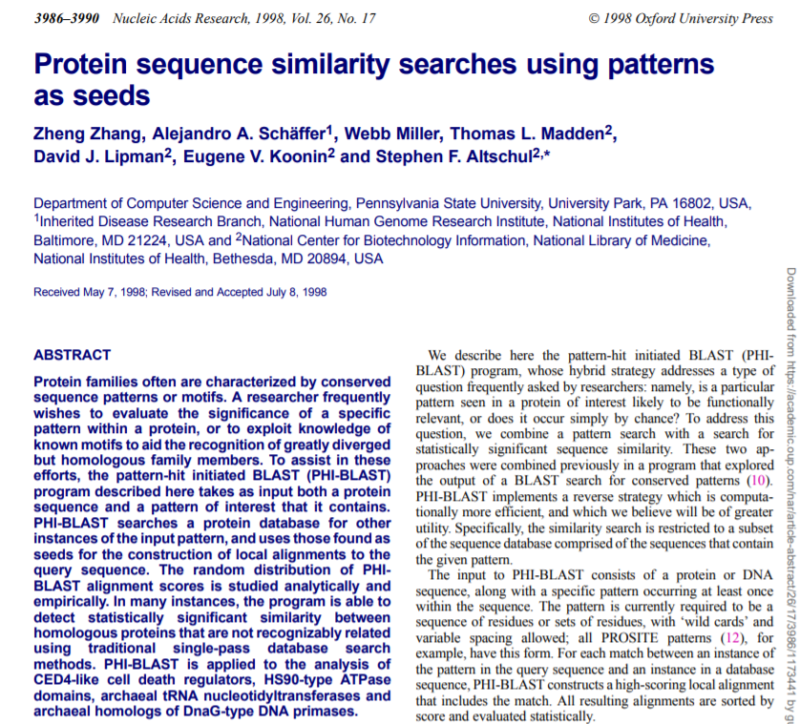
PHI-BLAST

Slide 33
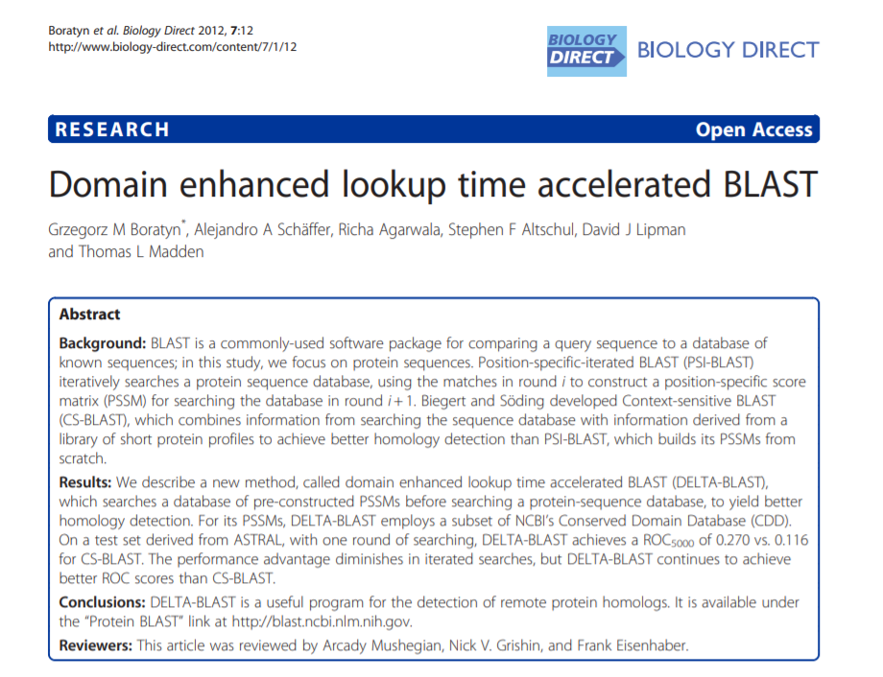
DELTA BLAST

Slide 34
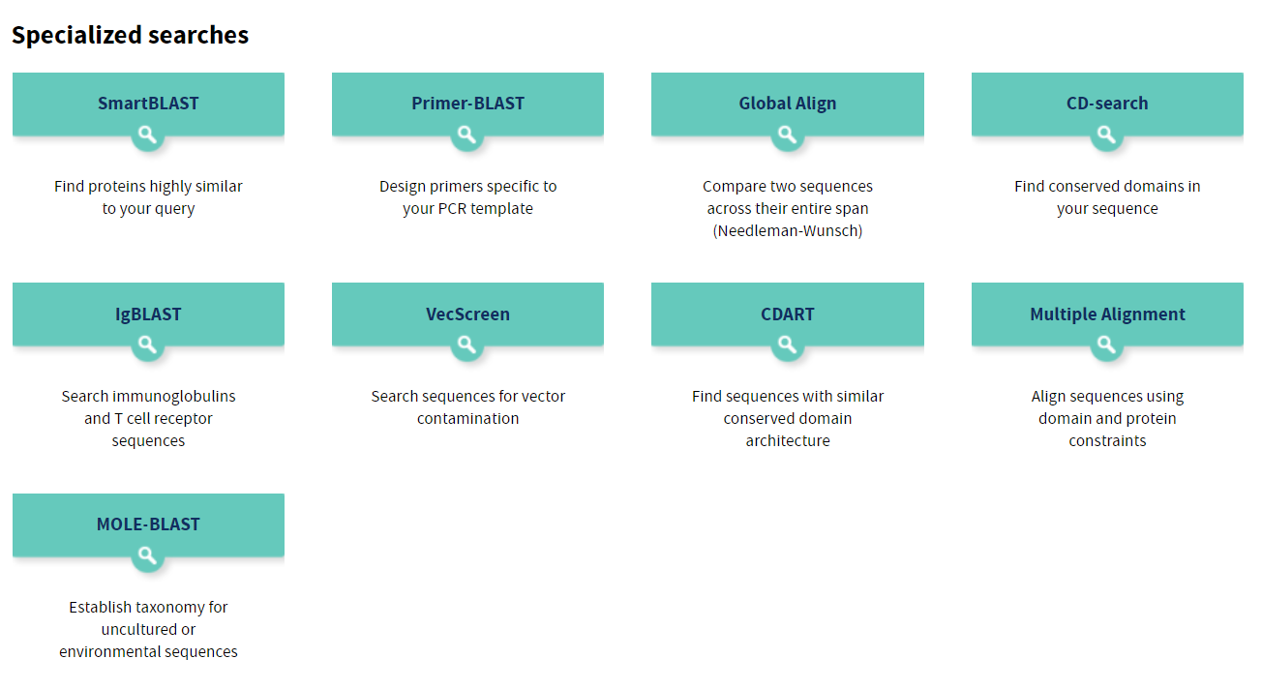
BLAST specialized searches

Slide 35
Next: Lecture 9 part 3

Slide 36
Algorithms for Bioinformatics
Enrico Blanzieri
March 23 2020 Lecture 9
Part 3

Slide 37
Gapped BLAST and PSI-BLAST

Slide 38
Two-hit method
For increased speed, the criterion for extending word pairs has been modified.
The original BLAST program seeks short word pairs whose aligned score is at least T. Each such ‘hit’ is then extended, to test whether it is contained within a high-scoring alignment. For the default T value, this extension step consumes most of the processing time.
The new ‘two-hit’ method requires the existence of two non-overlapping word pairs on the same diagonal, and within a distance A of one another, before an extension is invoked. To achieve comparable sensitivity, the threshold parameter T must be lowered, yielding more hits than previously.
However, because only a small fraction of these hits are extended, the average amount of computation required decreases.

Slide 39
Gapped BLAST
The ability to generate gapped alignments has been added.
The original BLAST program often finds several alignments involving a single database sequence which, when considered together, are statistically significant. Overlooking any one of these alignments can compromise the combined result. By introducing an algorithm for generating gapped alignments, it becomes necessary to find only one rather than all the ungapped alignments subsumed in a significant result. This allows the T parameter to be raised, increasing the speed of the initial database scan.
The new gapped alignment algorithm uses dynamic programming to extend a central pair of aligned residues in both directions. For speed, earlier heuristic methods (2,3) confined the alignments produced to a predefined strip of the dynamic programming path graph (4). Our approach considers only alignments that drop in score no more than Xg below the best score yet seen. The algorithm is able thereby to adapt the region of the path graph it explores to the data.

Slide 40
PSI-BLAST
BLAST searches may be iterated, with a position-specific score matrix generated from significant alignments found in round i used for round i + 1.
Motif or profile search methods frequently are much more sensitive than pairwise comparison methods at detecting distant relationships. However, creating a set of motifs or a profile that describes a protein family, and searching a database with them, typically has involved running several different programs, with substantial user intervention at various stages.
The BLAST algorithm is easily generalized to use an arbitrary position-specific score matrix in place of a query sequence and associated substitution matrix. Accordingly, we have automated the procedure of generating such a matrix from the output produced by a BLAST search, and adapted the BLAST algorithm to take this matrix as input.
The resulting Position- Specific Iterated BLAST, or PSI-BLAST, program may not be as sensitive as the best available motif search programs, but its speed and ease of operation can bring the power of these methods into more common use.

