Slide 1
Algorithms for Bioinformatics
Enrico Blanzieri
March 11 2020 Lecture 6
Part 1

Slide 2
In the previous lectures
Global sequence alignment (Needleman-Wunsch algorithm)
Local sequence alignment (Smith-Waterman algorithm)
Substitution matrices (PAM and BLOSUM series)
PAMn and BLOSUMn matrices model the substitution between amino acids from data with an evolutionary distance that is controlled by the parameter n. They permit to have the scores for aligning amino acids sequences (coding for proteins)
Both the alignment algorithms are exact (or correct) namely they compute the optimal solution

Slide 3
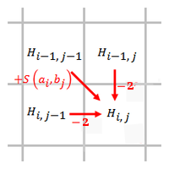
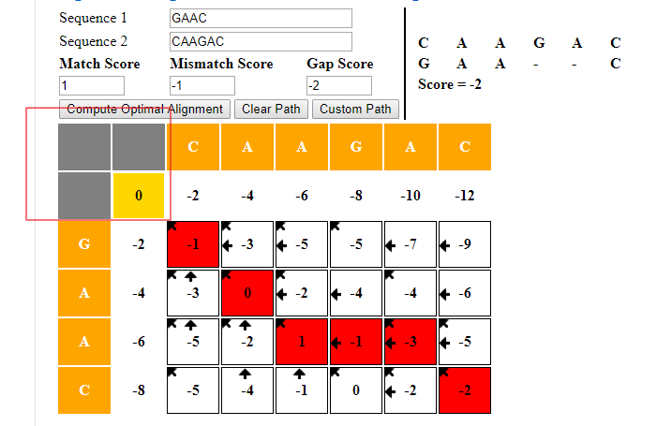
Needleman-Wunsch complexity

Slide 4
Needleman-Wunsch complexity
Needleman-Wusch complexity is O(mn)

Slide 5
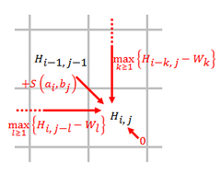
Smith-Waterman complexity
Needleman-Wusch is O(mn) and the only relevant difference is:

Slide 6
Smith-Waterman complexity
Needleman-Wusch is O(mn) and the only relevant difference is:
Smith Waterman the complexity is O(mn^2)

Slide 7
Complexity of the exact sequence alignment algorithms
Needleman Wunsch
The complexity is O(mn) where m and n, n ⪖ m are the length of the two sequences to be aligned. The time to compute the matrix dominates because the traceback is O(max(m,n))
(it is possible to have O(mn/logn), and it is possilbe to have O(n) space)
Smith Waterman
The complexity is O(mn^2) because gaps of variable lenght are considered during the computation of each element of the matrix*.
(matrix construction, keeping trace of the maximum scores, traceback)
(it is possible to have O(mn))
(*) Needleman Wunsch considers at each step only one additional gap

Slide 8
Global alignment in O(mn/logn)
Applying:
A faster algorithm computing string edit distances
William J.Masek Michael S.Paterson
Journal of Computer and System Sciences
Volume 20, Issue 1, February 1980, Pages 18-31
Abstract
The edit distance between two character strings can be defined as the minimum cost of a sequence of editing operations which transforms one string into the other. The operations we admit are deleting, inserting and replacing one symbol at a time, with possibly different costs for each of these operations. The problem of finding the longest common subsequence of two strings is a special case of the problem of computing edit distances. We describe an algorithm for computing the edit distance between two strings of length n and m, n ⪖ m, which requires
O(n max(1,m/logn) steps whenever the costs of edit operations are integral multiples of a single positive real number and the alphabet for the strings is finite. These conditions are necessary for the algorithm to achieve the time bound.

Slide 9
Global alignment in O(n) space
Optimal alignments in linear space
Eugene W. Myers, Webb Miller
Bioinformatics, Volume 4, Issue 1, March 1988, Pages 11–17,
Abstract
Space, not time, is often the limiting factor when computing optimal sequence alignments, and a number of recent papers in the biology literature have proposed space-saving strategies. However, a 1975 computer science paper by Hirschberg presented a method that is superior to the new proposals, both in theory and in practice. The goal of this paper is to give Hirschberg's idea the visibility it deserves by developing a linear-space version of Gotoh's algorithm, which accommodates affine gap penalties. A portable C-software package implementing this algorithm is available on the BIONET free of charge.

Slide 10
Local alignments in O(mn)
Optimal sequence alignment using affine gap costs
Stephen F. Altschul & Bruce W. Erickson
Bulletin of Mathematical Biology volume 48, pages 603–616(1986)
Abstract
When comparing two biological sequences, it is often desirable for a gap to be assigned a cost not directly proportional to its length. If affine gap costs are employed, in other words if opening a gap costsv and each null in the gap costsu, the algorithm of Gotoh (1982,J. molec. Biol. 162, 705) finds the minimum cost of aligning two sequences in orderMN steps. Gotoh's algorithm attempts to find only one from among possibly many optimal (minimum-cost) alignments, but does not always succeed. This paper provides an example for which this part of Gotoh's algorithm fails and describes an algorithm that finds all and only the optimal alignments. This modification of Gotoh's algorithm still requires orderMN steps. A more precise form of path graph than previously used is needed to represent accurately all optimal alignments for affine gap costs.

Slide 11
Exact alignments are in the order of mn
Is the complexity low enough for practical uses?
Consider the following tasks:
Sequence assembly (for example a whole genome)
Search of a sequence over a data bank of sequences
The plain answer is no.
Heuristics methods
They renounce to find exact solutions in order to gain in terms of complexity
FASTA
Blast and its variations

