Slide 1
Algorithms for Bioinformatics
Enrico Blanzieri
March 11 2020 Lecture 6
Part 2

Slide 2
FASTA
FASTA is an heuristic method for global/local sequence alignment
Pearson, W. R., Lipman, D. J., PNAS (1988) 85:2444-2448
A query sequence against a data base of subject sequences
It is based on four main ideas
Look-up table
Best initial regions
Connect the best intial regions heuristically
Computing an exact alignment limiting the search to a promising area
The subject sequences are filtered in stages

Slide 3
Look-up table
Each subject sequence is represented in a 'look-up table'. This table has all the amino acids in columns in the same order as they are found in the PAM250 scoring matrix.
The query sequence is compared with the positions in the look-up table of each subject sequence
The difference of the position for each amino acid gives the offset
When the same offset value appears it corresponds to an ungapped match of the query and subject sequences.

Slide 4
Look-up tables: amino acids
 | 1 | 2 | 3 | 4 | 5 | 6 | 7
Subject | F | L | W | R | T | W | S
Query | S | W | K | T | W | T
Ktup=1
 | 1 | 2 | 3 | 4 | 5 | 6
Subject | FL | LW | WR | RT | TW | WS
Query | SW | WK | KT | TW | WT
Ktup=2
For each element (ktup=1) or pair of elements (ktup=2) memorize its position in the sequence.
This can be organized efficiently for example with an hash table
In case of Ktup=2 the table contains no more of 20x20=400 namely the pairs of amino acids

Slide 5
Look-up tables: amino acids
 | 1 | 2 | 3 | 4 | 5 |  | 7
Subject | F | L | W | R | T | W | S
Query | S | W | K | T | W | T
Ktup=1
Look-up table
In PAM250 order
 | S | T | R | K | L | F | W
Subject | 7 | 5 | 4 | - | 2 | 1 | 3,6
For each element of sequence 2 look up its position in sequence 1 then compute its
Offset=lookup-position. For example 7-1=6 for S in position 1 and look-up 7
Query | S | W | K | T | W | T
look up | 7 | 3,6 | - | 5 | 3,6 | 5
offset | 6 | 1, 4 | - | 1 | -2, 1 | -1
The offset that appears more frequently (offset 1, 2 times) gives indication of a good alignment

Slide 6
Look-up tables: amino acids
 | 1 | 2 | 3 | 4 | 5 | 6 | 7
Subject | F | L | W | R | T | W | S
Query |  | S | W | K | T | W | T
Ktup=1
In fact, with an offset of 1 the two sequences align with three matches
Once the look-up table is built the comparison is linear with the lenght of the second sequence assuming constant the access to the look-up table.

Slide 7
Look-up tables: amino acids
 | 1 | 2 | 3 | 4 | 5 | 6
Subject | FL | LW | WR | RT | TW | WS
Query | SW | WK | KT | TW | WT
Ktup=2
Build the table as an exercise as done before
In this case the only common is pair TW with offset 1
With ktup=3 no triplets would be common

Slide 8
FASTA parameter ktup
The ktup parameter is specified by the user and can have an integer value from 1-6 inclusive (default = 2). This determines how many consecutive identical residues are required for a match. This has implications for the sensitivity and selectivity of the search.
A ktup value of 1 will be the most sensitive (i.e. will be the best at detecting evolutionarily distant relationships) but will sacrifice some selectivity (i.e. there may be some false positives).
A ktup value of 2 is usual for protein comparisons and a value between 4 and 6 is recommended for DNA comparisons.

Slide 9
 | 1 | 2 | 3 | 4 | 5 | 6 | 7
Subject | A | T | C | G | A | C | C
Query | T | C | G | A | G | C
Ktup=1
 | 1 | 2 | 3 | 4 | 5 | 6
Subject | AT | TC | CG | GA | AC | CC
Query | TC | CG | GA | AG | GC
Ktup=2
 | 1 | 5 | 3 | 4 | 5
Subject | ATC | TCG | CGA | GAC | ACC
Query | TCG | CGA | GAG | AGC
Ktup=3
Look-up tables Nucleotides
Build the look-up tables and
compute the offsets for ktup=3
 | 1 | 5 | 3 | 4
Subject | ATCG | TCGA | CGAC | GACC
Query | TCGA | CGAG | GAGC
Ktup=4

Slide 10
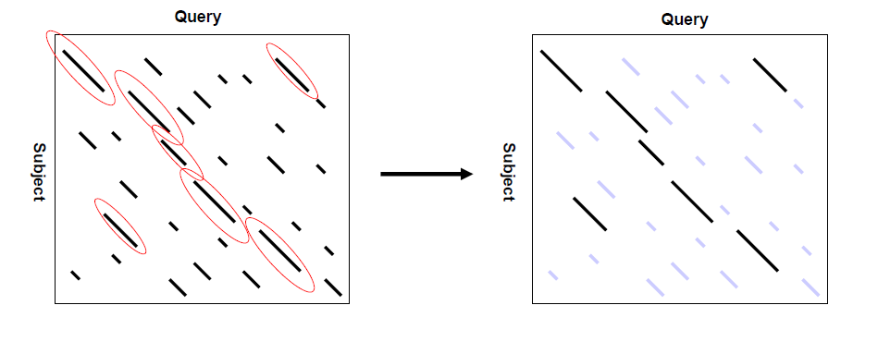
Best Initial Regions
Compute the scores of the diagonals using a substitution matrix
for instance PAM250.
The worst subjects are discarded

Slide 11
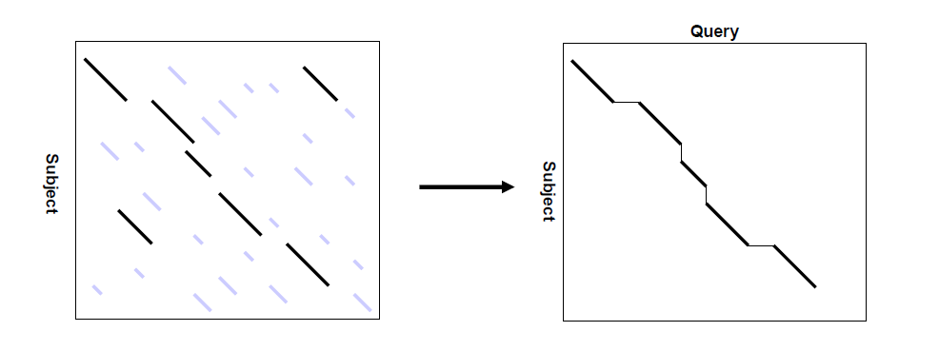
Connect the best initial regions with a series of heuristics
The worst subjects are discarded

Slide 12
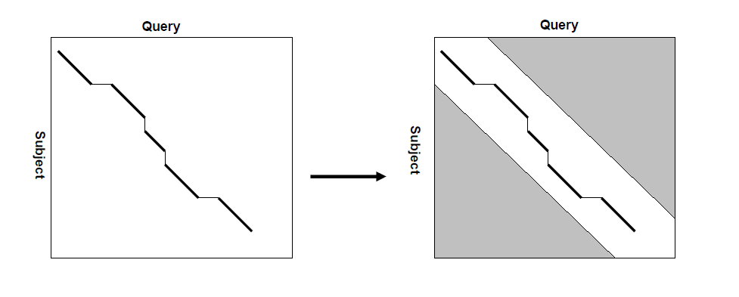
Exact Pairwise alignment with contraint
Smith Watermann limited around the area found (20 elements)

Slide 13
Fasta
Look-up table
Best initial regions
Connect the best intial regions heuristically
Computing an exact alignment limiting the search to a promising area
Compute the scores of the longest diagonals
Compute the scores of the longest diagonals

Slide 14
FASTA
FASTA works better for comparing sequences with high evolutionary distance (for example PAM250)
FASTA online at EBI
https://www.ebi.ac.uk/Tools/sss/fasta/

Slide 15
FASTA Format
A sequence in FASTA format begins with a single-line description, followed by lines of sequence data.
The definition line (defline) is distinguished from the sequence data by a greater-than (>) symbol at the beginning. The word following the ">" symbol is the identifier of the sequence, and the rest of the line is the description (optional).
There should be no space between the ">" and the first letter of the identifier. It is recommended that all lines of text be shorter than 80 characters in length. An example sequence in FASTA format is:
>gi|129295|sp|P01013|OVAX_CHICK GENE X PROTEIN (OVALBUMIN-RELATED)1515
QIKDLLVSSSTDLDTTLVLVNAIYFKGMWKTAFNAEDTREMPFHVTKQESKPVQMMCMNNSFNVATLPAE
KMKILELPFASGDLSMLVLLPDEVSDLERIEKTINFEKLTEWTNPNTMEKRRVKVYLPQMKIEEKYNLTS
VLMALGMTDLFIPSANLTGISSAESLKISQAVHGAFMELSEDGIEMAGSTGVIEDIKHSPESEQFRADHP
FLFLIKHNPTNTIVYFGRYWSP
Blank lines are not allowed in the middle of FASTA input
Source http://genetics.bwh.harvard.edu/pph/FASTA.html

