Slide 1
Algorithms for Bioinformatics
Enrico Blanzieri
March 16 2020 Lecture 7
Part 1

Slide 2
In the previous lectures
Global sequence alignment (Needleman-Wunsch algorithm)
Local sequence alignment (Smith-Waterman algorithm)
Substitution matrices (PAM and BLOSUM series)
Complexity of exact alignments methods
Heuristic alignment methods: FASTA
In this lecture: BLAST

Slide 3
BLAST
Basic Local Alignment Search Tool (BLAST)
Altschul SF, Gish W, Miller W, Myers EW, Lipman DJ. J Mol Biol. 1990 Oct 5;215(3):403-10. (original paper)
It is one of the cornerstones of bioinformatics/computational biology and it is impossible to overstate its importance
Initially presented in 1990 it evolved considerably and it has now several specialized versions (for example blastp, blastn, blastx etc.)
Being an heuristics method it is more a program and a system than an algorithm (in fact it is a “tool”) however:
Algorithmic aspects make it faster than FASTA

Slide 4
FASTA (brief summary)
In FASTA the subject sequence FLWRTWS is represented in a look-up table
The query sequence is scanned ad the offsets between the position in look-up table and the position in the query are computed
The offset values are used for defining the Best Initial Regions
Ktup=1
Look-up table
In PAM250 order
 | S | T | R | K | L | F | W
Subject | 7 | 5 | 4 | - | 2 | 1 | 3,6
 | TW | RT | LW | FL | WS | WR
Subject | 5 | 4 | 2 | 1 | 6 | 3
Ktup=2

Slide 5
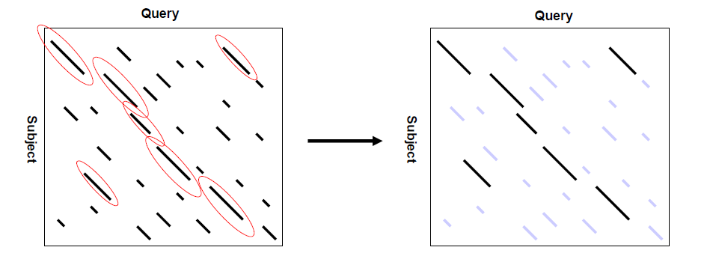
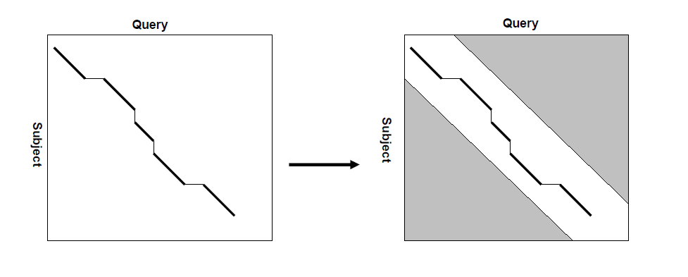
FASTA (brief summary)
Look-up table
Best initial regions
Connect the best intial regions heuristically
Computing an exact alignment limiting the search to a promising area
Compute the scores of the longest diagonals
Compute the scores of the longest diagonals

Slide 6
BLAST: the k-tuples-> words
Also in BLAST the sequences in the data banks are is represented in look-up tables, the minimal word size W is 2 and:
The words are
k-mers or k-tuples like in FAST and
sequences of word-size lenght whose scores (w.r.t. a substitution matrix ) are above a threshold T when they are aligned ungapped with the k-mers
FLWRTWS
FL
LW
WR
RT
TW
WS
FLWRTWS
FL FA,FR,.,FZ, AL,RL,.,ZL
LW LA,LR,.,LZ, AW,RW,.,ZW
WR WA,WR,.,WZ, AR,RR,.,ZR
RT RA,RR,.,RZ, AT,RT,.,ZT
TW TA,TR,.,TZ, AW,RW,.,ZW
WS WA,WR,.,WZ, AS,RS,.,ZS

Slide 7
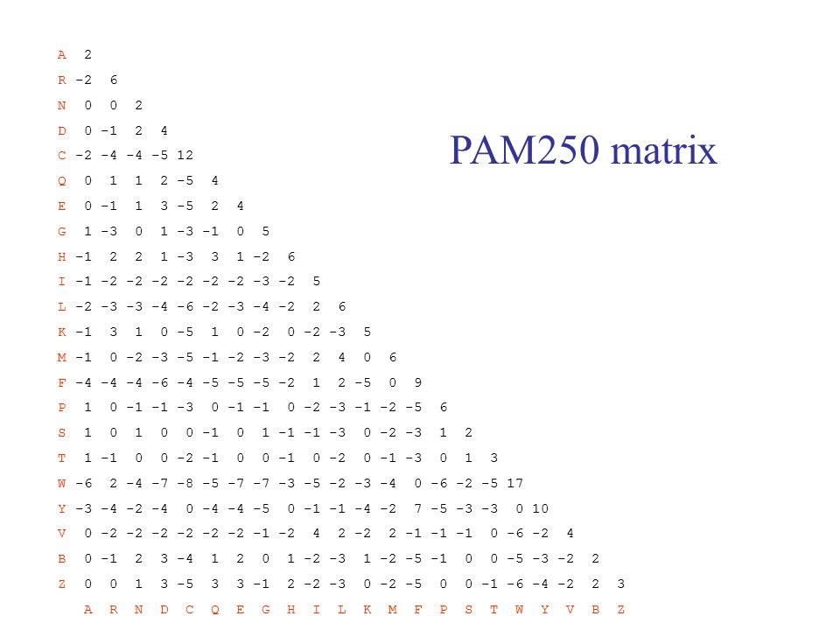
W=2
T=10
FLWRTWS
FL FA,FR,.,FZ, AL,RL,.,ZL
LW LA,LR,.,LZ, AW,RW,.,ZW
WR WA,WR,.,WZ, AR,RR,.,ZR
RT RA,RR,.,RZ, AT,RT,.,ZT
TW TA,TR,.,TZ, AW,RW,.,ZW
WS WA,WR,.,WZ, AS,RS,.,ZS
FL
|:
FA
9-2=7 0+3=3
-6+6=0 17+1=18
RT
:|
ZT
WR
:|
AR
WS
|:
WA

Slide 8
BLAST: words construction FLWRTWS example
Sequence FLWRTWS is represented in a look-up table
All the words whose score is bigger than T are in the table
The words can be many
FASTA
BLAST
Ktup=2
 | TW | RT | LW | FL | WS | WR
Subject | 5 | 4 | 2 | 1 | 6 | 3
W=2
T=10
 | TW | RT | LW | FL | WS | WR | FF | ... | WA
Subject | 5 | 4 | 2 | 1 | 6 | 3 | 1 | ... | 6

Slide 9
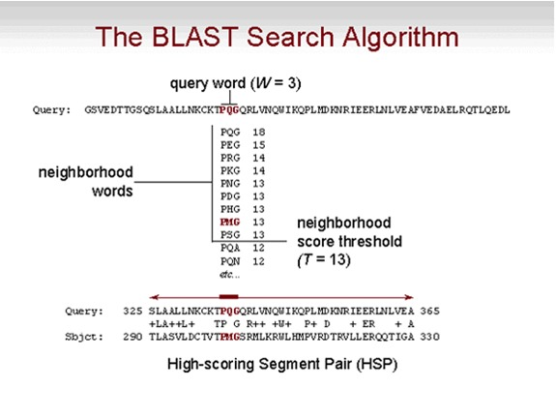
BLAST: words construction and hits
Like in FASTA hits are found
in this case:
PQG
|:|
PMG
Source: NHI (substitution matrix unspecified)

Slide 10
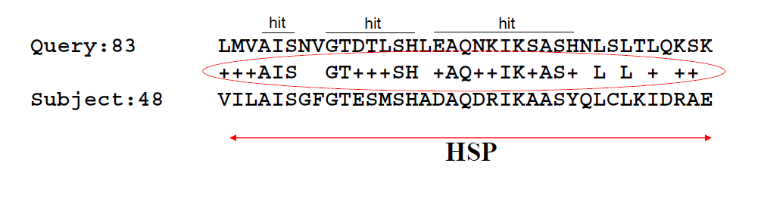
Ungapped extension and HSP
extending
BLAST start to connect the hits without gaps scanning in both directions and computing the scores
If the score falls below a threshold S of more of X the operation stops, the higher the thresold the smaller the scan
The sequence found is a HSP (High-scoring Segment Pair)
The parameters S and X regulates the scanning.
extension
extension

Slide 11
BLAST parameters
W: word size, the bigger W the smaller the number of generated words, faster the search, decrease of sensibility.
T: The bigger T the smaller the number of included words, faster the search, decrease of sensibility.
S: the smaller S the longer the HSPs
X: The bigger X the longer the HSPs that BLAST searches for;
In the current online version at NHI the only parameter to set is W, the other are set automatically or by default by the algorithm in the different versions.

Slide 12
Next: Lecture 7 part2

