Slide 1
Algorithms for Bioinformatics
Enrico Blanzieri
March 9 2020 Lecture 5
Part 2

Slide 2
Substitution Matrices: BLOSUM
“Amino acids substitution matrices from protein blocks” Henikoff and Henikoff PNAS 89:10915-10919 (1992)
Published after PAM
Based on “blocks” within protein sequences obtained by clustering them at a given level of similarity

Slide 3
Protein Blocks example
Each block has s sequences and a different number w of amino acids in ungapped multiple alignments

Slide 4
Block: a simple example
P | A | P | A
A | A | A | C
A | A | C | C
A | A | P | A
A | A | C | C
A | A | P | C
Amino acid | Observed times | proportion
A | 14 | 14/24
P | 4 | 4/24
C | 6 | 6/24
Aligned pair | Observed times | proportion
A to A | 26 | 26/60
A to P | 8 | 8/60
A to C | 10 | 10/60
P to P | 3 | 3/60
P to C | 6 | 6/60
C to C | 7 | 7/60
s=6 w=4
s*w=24
w*s(s-1)/2=60

Slide 5
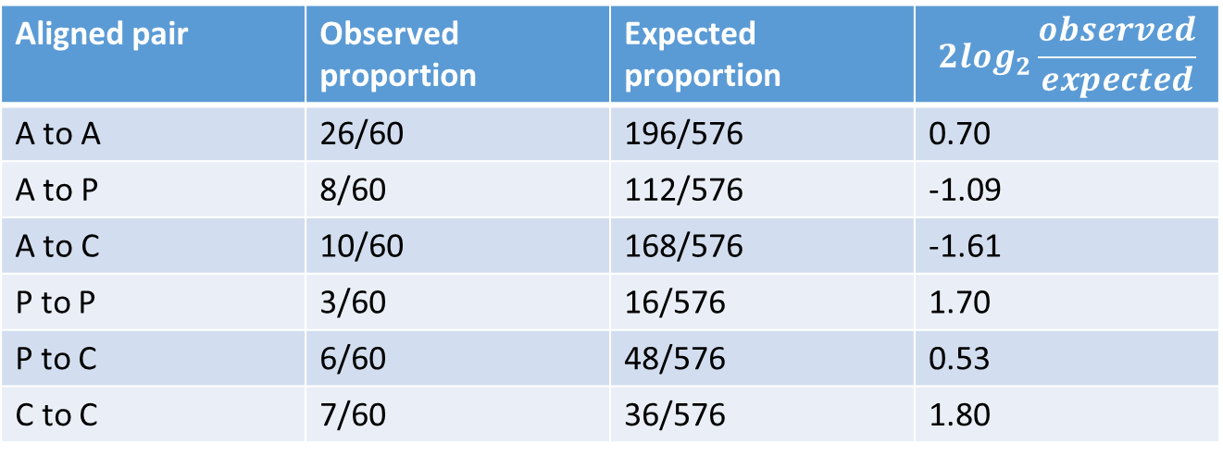
Block: a simple example
Aligned pair | Observed proportion | Expected proportion | $$2\log_{2}\frac{observed}{expected}$$
A to A | 26/60 | 196/576 | 0.70
A to P | 8/60 | 112/576 | -1.09
A to C | 10/60 | 168/576 | -1.61
P to P | 3/60 | 16/576 | 1.70
P to C | 6/60 | 48/576 | 0.53
C to C | 7/60 | 36/576 | 1.80
 | A | P | C
A | 1 | -1 | 2
P | -1 | 2 | 1
C | 2 | 1 | 2
Computation of the log odds ratio. Scaled by 2 and rounded.
The expected proportion is estimated from the data

Slide 6
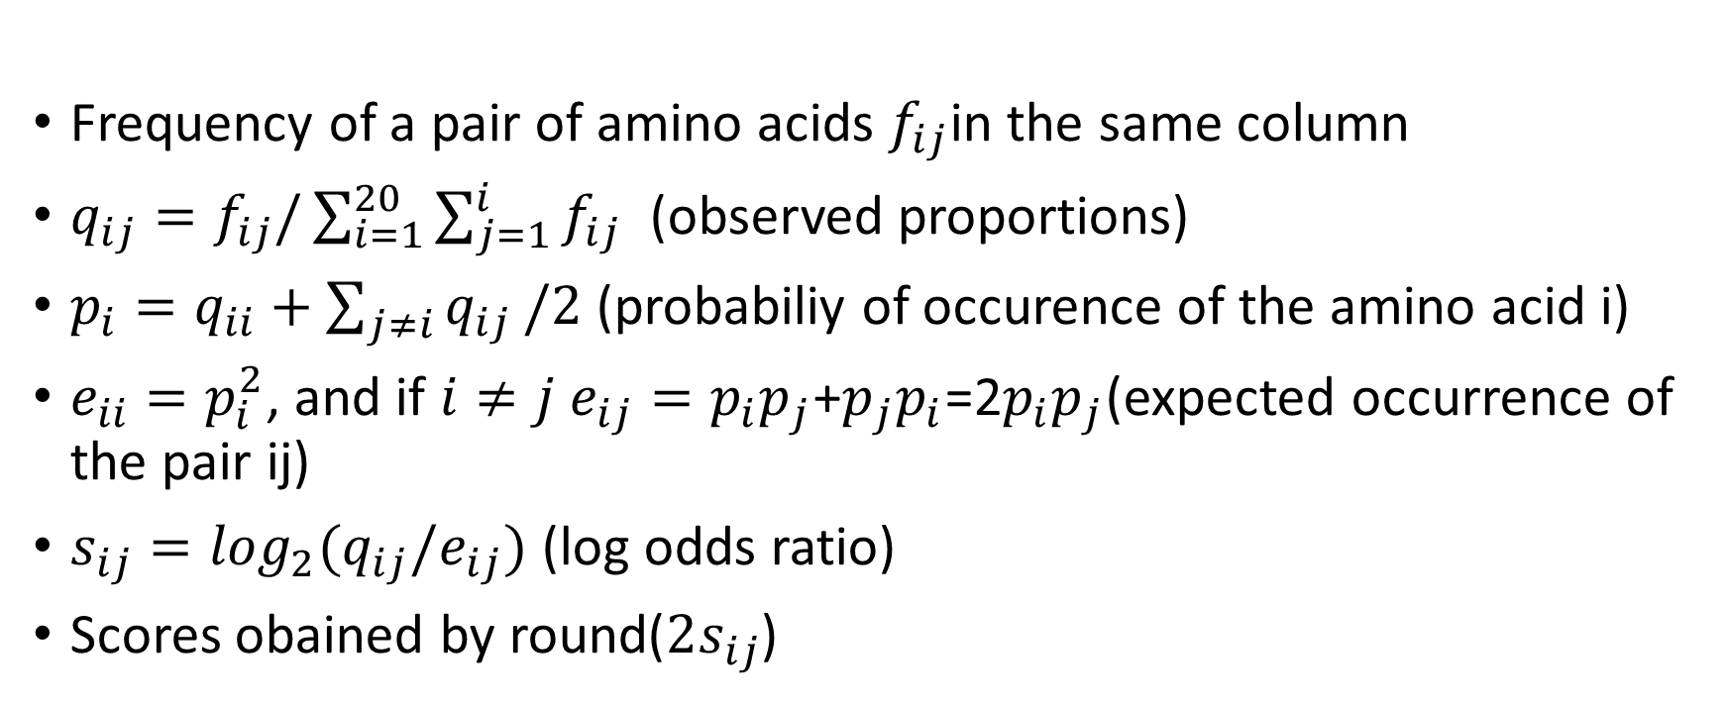
Computing the scores
Frequency of a pair of amino acids $f_{ij}$in the same column
$q_{ij}=f_{ij}/\sum_{i=1}^{20}{\sum_{j=1}^{i}{f_{ij}}}$ (observed proportions)
$p_{i}=q_{ii}+\sum_{j≠i}{q_{ij}}/2$ (probabiliy of occurence of the amino acid i)
$e_{ii}=p_{i}^{2}$, and if $i≠j e_{ij}=p_{i}p_{j}$+$p_{j}p_{i}$=2$p_{i}p_{j}$(expected occurrence of the pair ij)
$s_{ij}=\log_{2}(q_{ij}/e_{ij})$ (log odds ratio)
Scores obained by round($2s_{ij}$)

Slide 7
How to extend the scores to more blocks?
Blocks can be very different in size, length and also level of similarity of the sequence
segment
Size and length are already controlled by the proportion computation seen above
But, for example, the following block has four identical sequence segments
A | P | A | A
A | P | A | A
A | P | A | A
A | P | A | A
A | A | P | D
A | C | P | A
D | A | P | A
Very similar sequences have less evolutionary distance, ideally the comparison should be made at the same evolutionary distance

Slide 8
Clustering of similar sequences within a block
In order to adjust the contribution to the frequencies from different blocks in term of similarity, similar sequence segments are clustered together At a level of similarity of n% the sequence segments that are similar.
The cluster is extended in a single-linkage way:
An additional sequence segment can be included in the cluster if it is similar at the n% to at least ONE of the sequence segments that are already in the cluster
The scores are computed as above with the contribution in terms of frequencies of each cluster to be averaged.
At different levels of similarity n different matrices BLOSUMn are build, for example BLOSUM62 or BLOSUM80

Slide 9
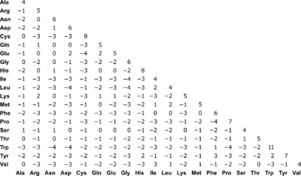
BLOSUM62

Slide 10
Comparison between PAM and BLOSUM
 | PAM | BLOSUM
Evolutionary Model | Explicit | None
Data | Multiple sequence alignments of closely related sequences | Conserved Blocks in protein
structure | Trees | Clustering
Evolutionary distance | From markov models | From clustering fo sequences
Matrices | Transition and log odds scoring matrices | Log odds scoring matrix only
Parameter n | Distance increases with n | Distance decreases with n
Biophysical properties | Derived indirectly from data | Derived indirectly from data

Slide 11
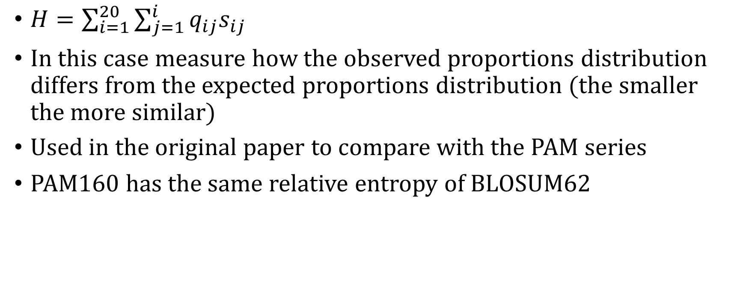
Relative entropy
$H=\sum_{i=1}^{20}{\sum_{j=1}^{i}{q_{ij}s_{ij}}}$
In this case measure how the observed proportions distribution differs from the expected proportions distribution (the smaller the more similar)
Used in the original paper to compare with the PAM series
PAM160 has the same relative entropy of BLOSUM62

