Slide 1
Algorithms for Bioinformatics
Enrico Blanzieri
March 9 2020 Lecture 5
Part 1

Slide 2
Previous lectures of the course
The previous four lectures of the course were given in the classroom with chalk and blackboard:
Lecture 1 (2/17/2020) : Introduction to the course. The role of algorithms and computation in biology. Turing Machine
Lecture 2 (2/19/2020) Global sequence alignment (Needleman Wunsch algorithm)
Lecture 3 (3/2/2020) Local sequence alignment (Smith Waterman Algorithm)
Lecture 4 (3/4/2020) Substitution Matrices: PAM
Lecture 5 will be given as videoregistered material organized in parts:
Lecture 5 (3/9/2020) Substitution Matrices: BLOSUM

Slide 3
Introduction to the course
Description of the course on the Syllabus
Algorithms and computation
Solve practical problems in biology
Model biological phenomena
Elucidate the computation that the biological systems perform
Turing Machine
A TM online simulator:
http://morphett.info/turing/turing.html

Slide 4
Global sequence alignment
The problem: align two complete sequences of symbol belonging to an alphabet maximizing a score
For example the score can be match 1, mismatch -1 gap -2
for example consider the sequences GACFGCATAAC and ACTGATACAGT over the alphabet {A,G,T,C} one optimal alignment with score -3 will be
_ACTG_ATACAGT
GACFGCATA_AC_
The exact solution is given by the Needleman-Wunsch algorithm (see the orginal paper)
See an online demonstrator at http://experiments.mostafa.io/public/needleman-wunsch/

Slide 5
Local sequence alignment
The problem find the alignments within two sequences of symbols that maximizes a score
The same sequences showed previously give as an optimal solution
GACFGCATAAC-- 13
|| | |||
-ACTG-ATACAGT 13
The alignment is not requested to cover the whole sequences (as in the global cases) and
(not showed in the example) several alignments can be found.
The exact solution is given by the Smith-Waterman Algorithm (see the original paper, SW will be covered extensively in the lab part)
An oline demonstrator:
http://insilico.ehu.es/align/

Slide 6
Different alphabets for sequence alignments
DNA {G, A, T, C}
RNA {G, A, U, C}
Amino Acids {G, A, L, M, F, W, K, Q, E, S, P, V, I, C, Y, H, R, N, D, T}
G Glycine Gly P Proline Pro
A Alanine Ala V Valine Val
L Leucine Leu I Isoleucine Ile
M Methionine Met C Cysteine Cys
F Phenylalanine Phe Y Tyrosine Tyr
W Tryptophan Trp H Histidine His
K Lysine Lys R Arginine Arg
Q Glutamine Gln N Asparagine Asn
E Glutamic Acid Glu D Aspartic Acid Asp
S Serine Ser T Threonine Thr

Slide 7
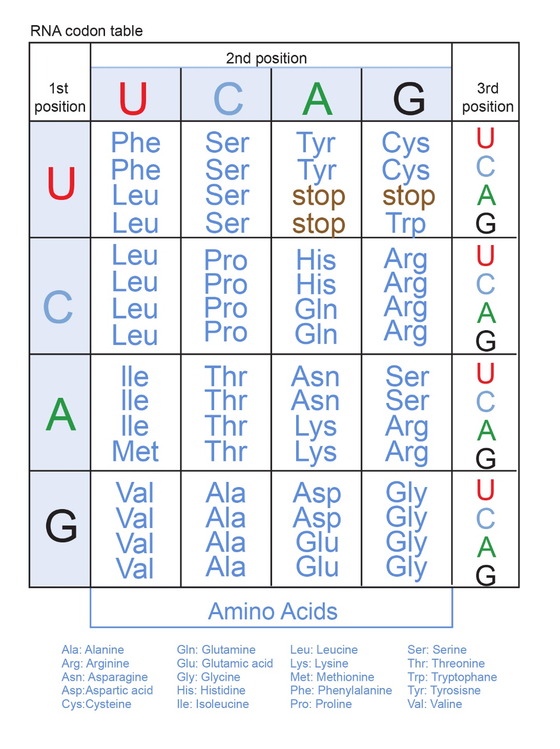
Genetic Code
Used in the ribosomes to translate the mRNA into proteins
From an alphabet {A,C,G,U} to the alphabet
of Amino Acids by triplets called codons
AUG signals the start
UAA, UAG and UGA signals the stop
Source NIH

Slide 8
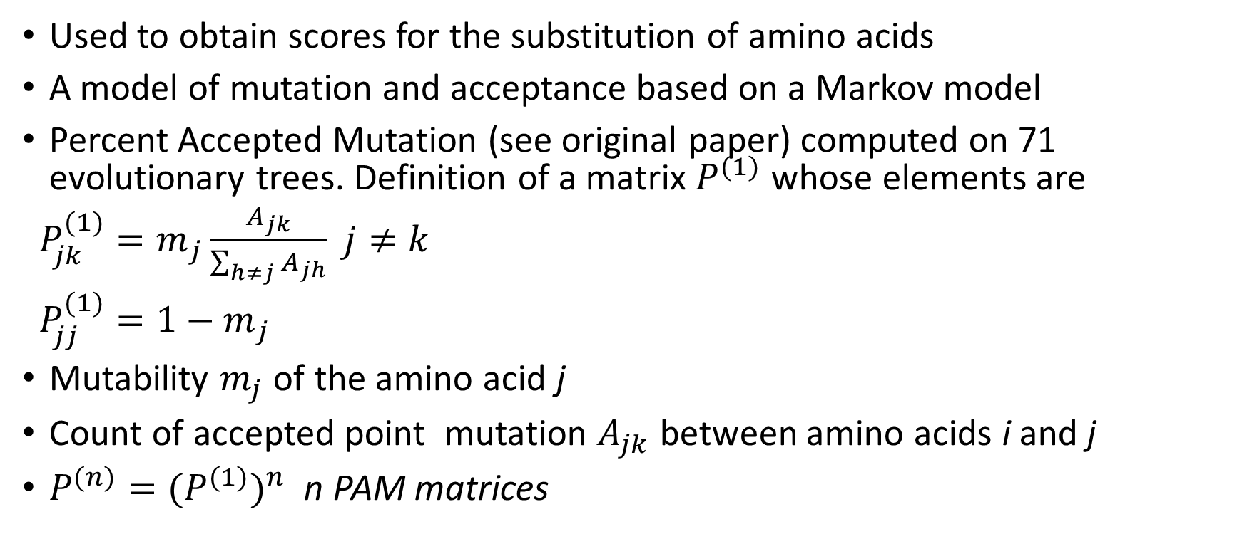
Substitution Matrices: PAM
Used to obtain scores for the substitution of amino acids
A model of mutation and acceptance based on a Markov model
Percent Accepted Mutation (see original paper) computed on 71 evolutionary trees. Definition of a matrix $P^{(1)}$ whose elements are
${P_{jk}^{(1)}=m}_{j}\frac{A_{jk}}{\sum_{h≠j}{A_{jh}}}$ $j≠k$
${P_{jj}^{(1)}=1−m}_{j}$
Mutability $m_{j}$ of the amino acid j
Count of accepted point mutation $A_{jk}$ between amino acids i and j
$P^{(n)}={{(P}^{(1)})}^{n}$ n PAM matrices

Slide 9
Next part of the lecture
Substitution Matrices: BLOSUM

