Slide 1
Algorithms for Bioinformatics
Enrico Blanzieri
March 16 2020 Lecture 7
Part 2

Slide 2
BLAST online version at NHI
BLAST was developed at the National Health Institute, USA
They run an online version and databases and code are available
for download
https://blast.ncbi.nlm.nih.gov/Blast.cgi

Slide 3
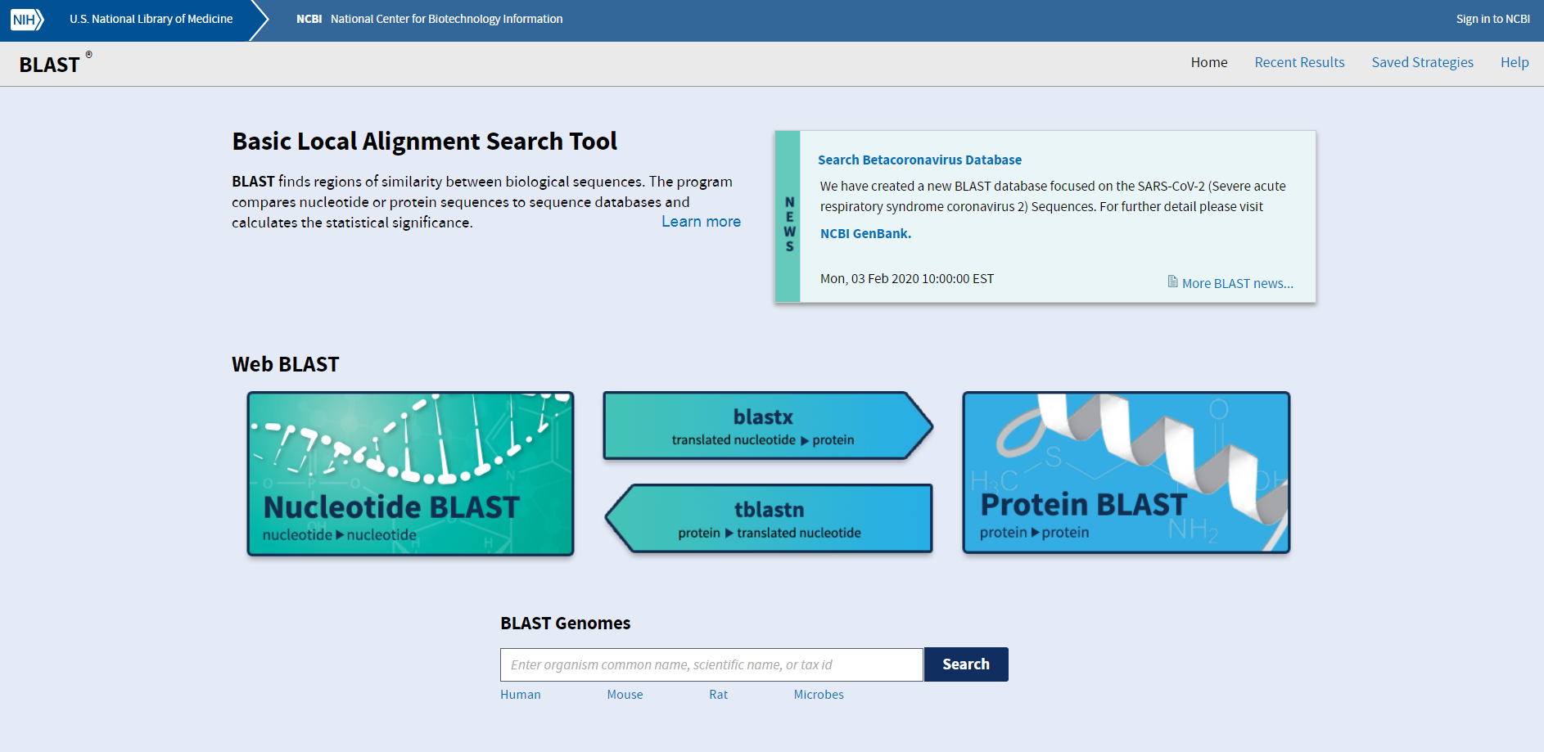
BLAST at NHI

Slide 4
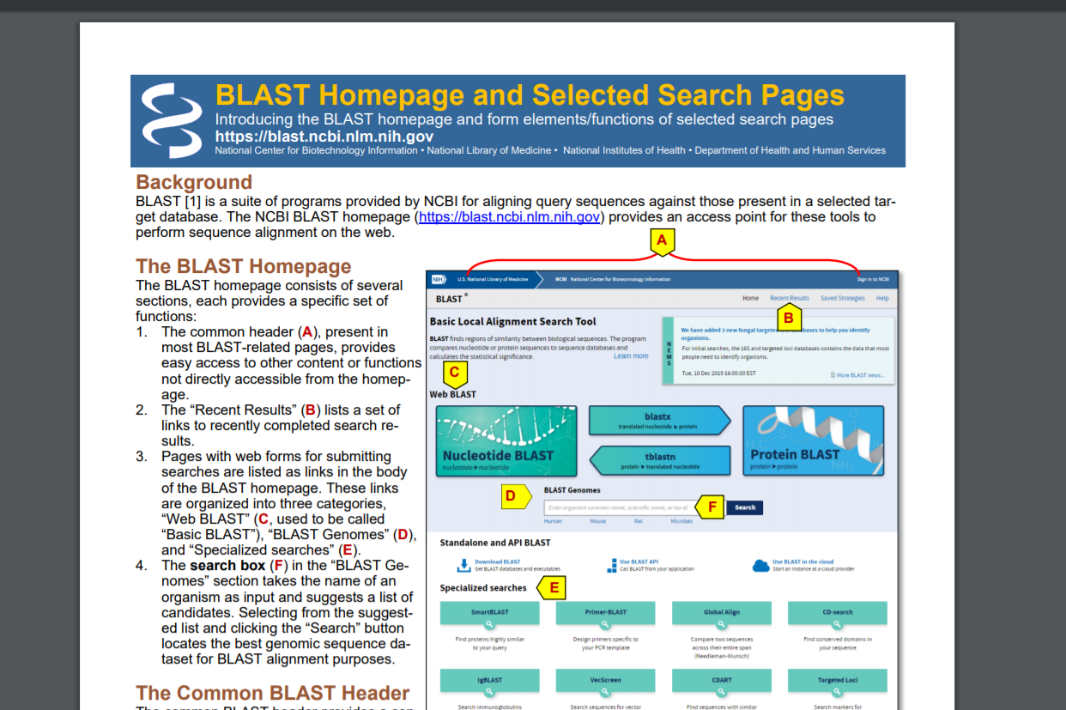
Guide to BLAST

Slide 5
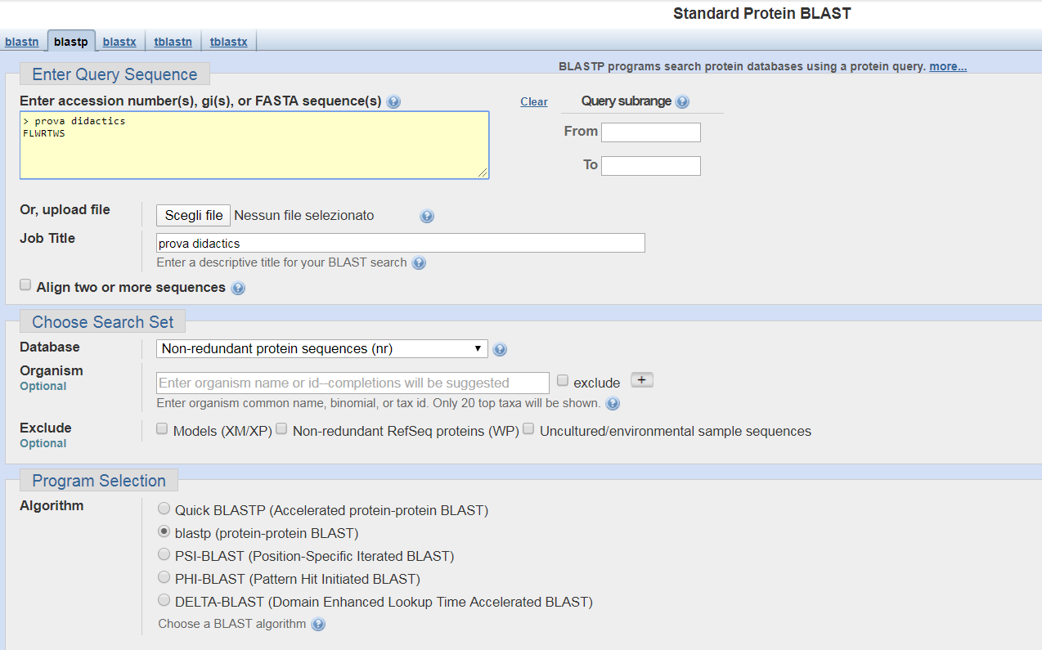
Searching FLWRTWS with BLAST

Slide 6
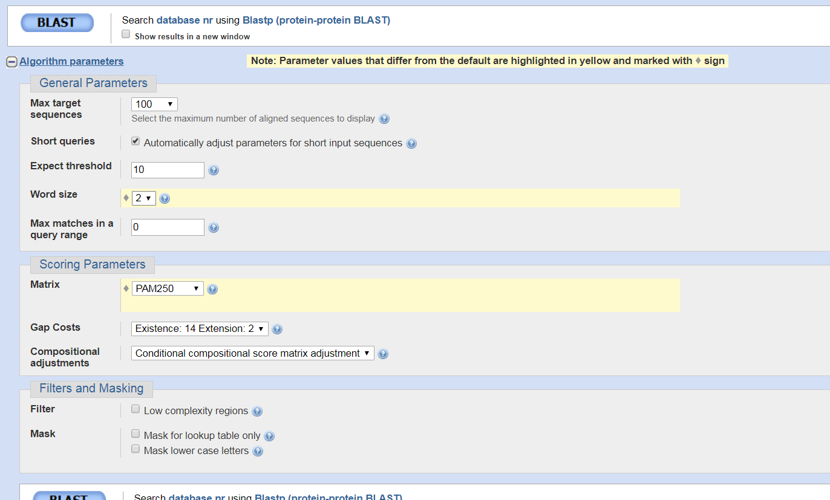
Searching FLWRTWS with BLAST

Slide 7
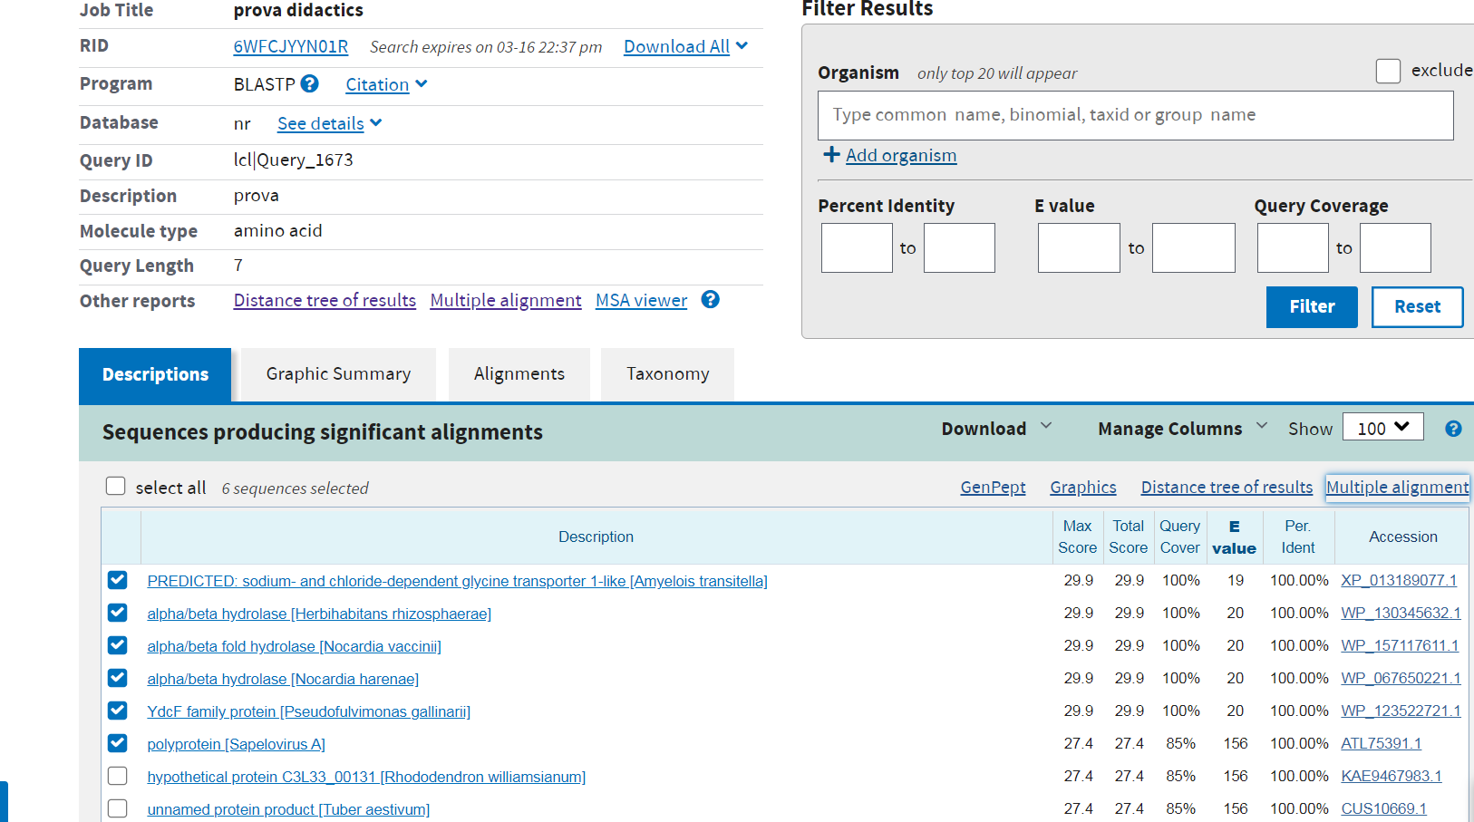
Searching FLWRTWS with BLAST:results

Slide 8
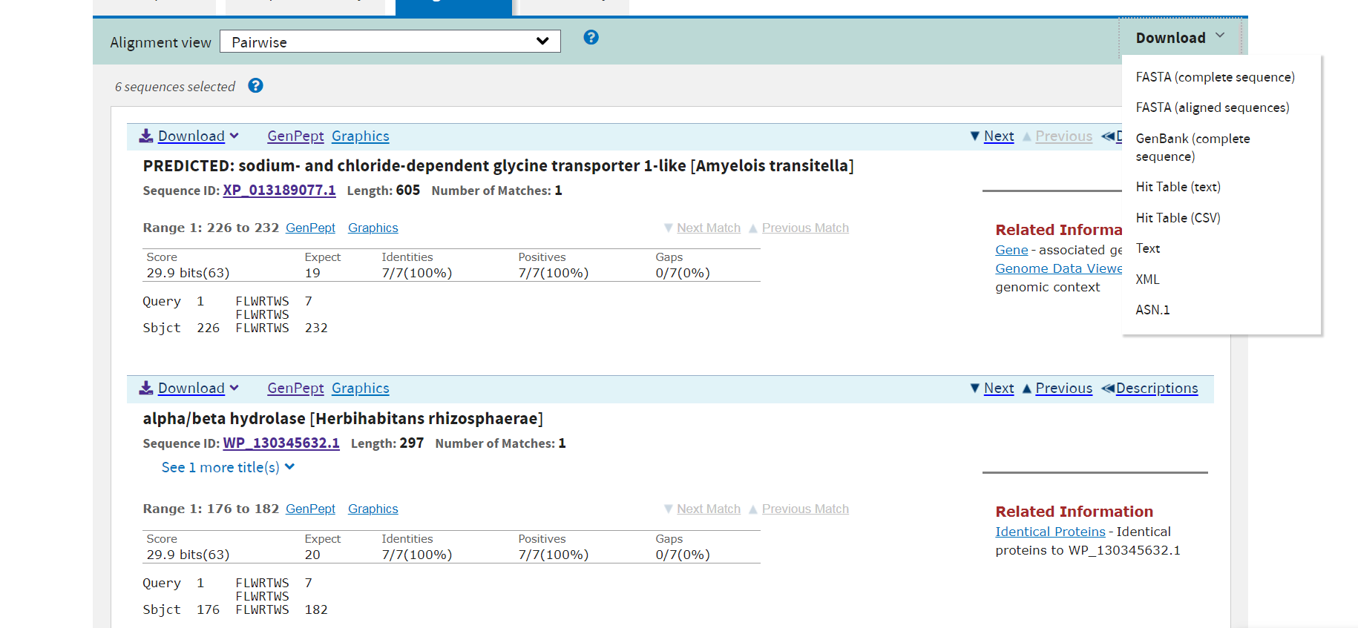
Searching FLWRTWS with BLAST:results

Slide 9
Searching FLWRTWS with BLAST:results first in FASTA format
>XP_013189077.1 PREDICTED: sodium- and chloride-dependent glycine transporter 1-like [Amyelois transitella]
MAPGHKAQMGADLSSSMSLLSEKGESGHDHFKWDSIKTFVYFAFAFSSSTFTFDMFSKIVDNIRLFDFIL
IQITIGMSYMFMDCFIRQYTRKLDFTQSLNPLLKGITYGAIIQSAMWALLHARDLADSFEYLAMILLARP
FNACKAGTHKANECLDYIYITLACNIGKKTPMNSTSVHIYYTKSFTHNMQRGSTTKVFALAVVWISNFFF
TTVSDETLLLISKISFLWRTWSTCFLAVVVSFSAQNMTTIVLGEIMNLNSPSSYGHSIDLVTHIYGIGNI
GVYDFQMISPYTMVDNAVIIFTVIFTLMGILRSYIMRILYKLMLKCITVDLKQISYHYLLFGILPLAADF
LNAHRLYLFVIYGNIMIATIAYLSTTTLAISKLLHREFRRLKNIYIVGILCFVGFATSVPLVLVSSTKVQ
GLAYGVHMTVLYVGGFKVALVMWIYGVKRFSKDIHFWLDFKPTKFWIVCWSIMPIILIGFLMHRILKLTG
MTDFPEMLTAALWFGISIILIDIFQLRTITKYMVANHFVNAFRSSRNYGPPEQEDRERRRNFNETLRLRK
CKHSCRVFDDTYDCNHMPLIFQIKERIQNIHRCRRRCPFIAVLPF

Slide 10
Searching FLWRTWS with BLAST: results second in FASTA format
>WP_130345632.1 alpha/beta hydrolase [Herbihabitans rhizosphaerae]
MGFSATAQISTPVLDIAYEQAGEAGGKPVILLHGFPYDVRAFDEVAPLLAAEGAFVLAPYLRGFGQTRFR
DEDTPRSGQQAALATDLLEFMDVLDIENPVLAGYDWGGRAACIVAALQPERVRGLVTVDGYNIQDIEHSA
EPGEPEWERTYWYQYYFHSERGRRALERDRDGLCEFLWRTWSPTWTGASEAFAASATSLHNPDFVDVVIH
SYRHRYDLVEGDPRYQRMEYLLADQPQIDVPAIVLEGADDGIGGPSAAEDRGMFTEKYEFRSLDGVGHNA
PQEAPREFADAVASLLG

Slide 11
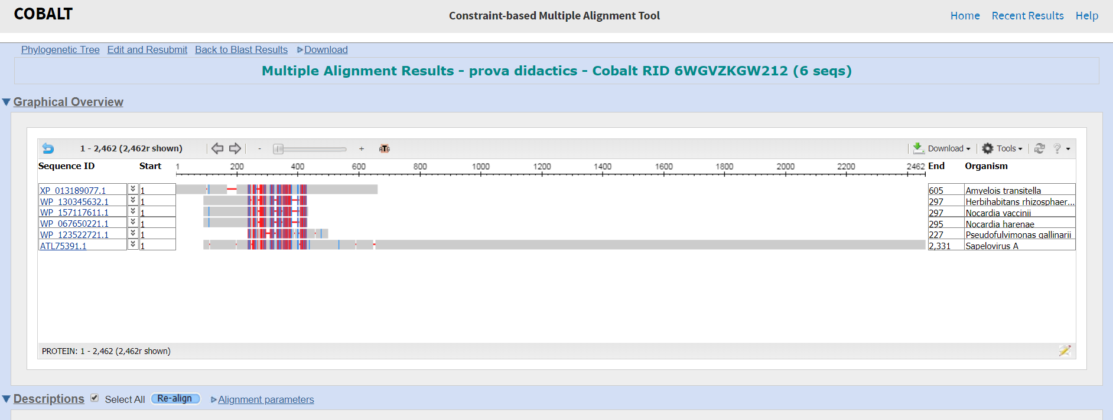
Searching FLWRTWS with BLAST: multiple alignment of the results

Slide 12
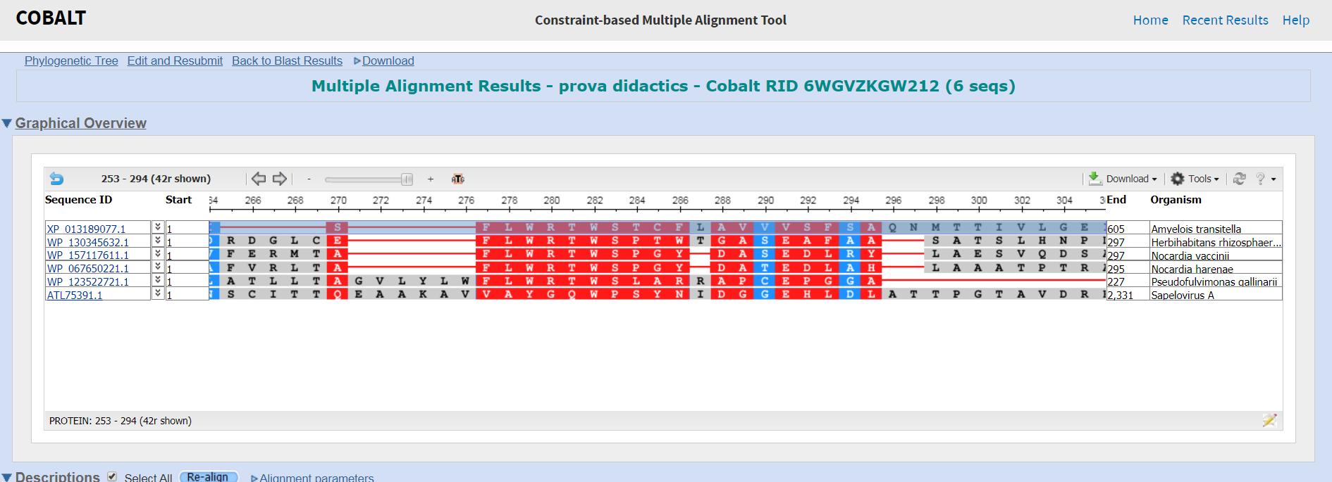
Searching FLWRTWS with BLAST: multiple alignment of the results

Slide 13
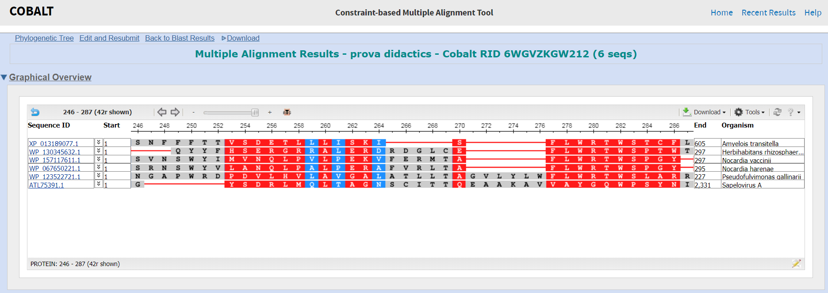
Searching FLWRTWS with BLAST: multiple alignment of the results

Slide 14
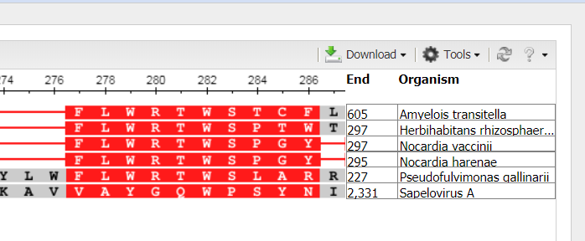
Searching FLWRTWS with BLAST: multiple alignment of the results

Slide 15
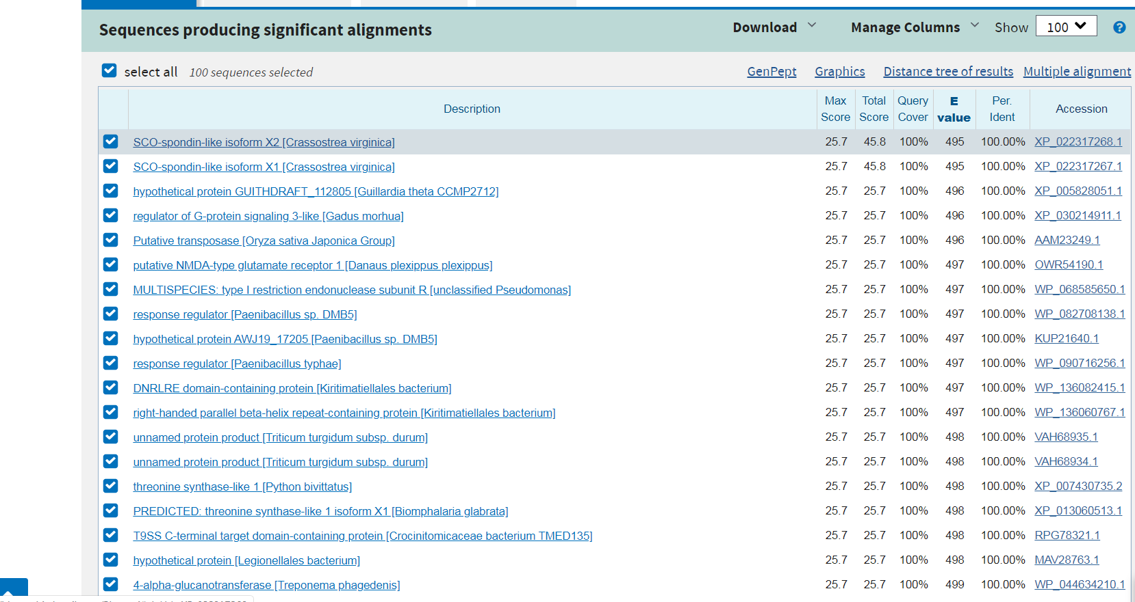
Serach SWKTWT with BLAST

Slide 16
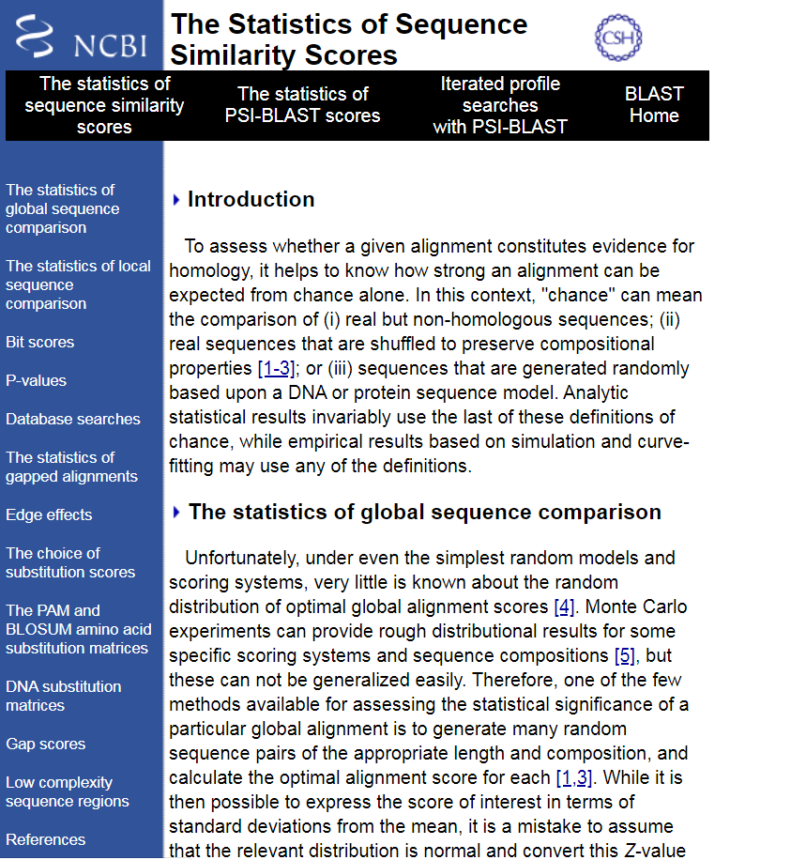
BLAST statistics of the alignments
https://www.ncbi.nlm.nih.gov/BLAST/tutorial/Altschul-1.html#head4

