Slide 1
Algorithms for Bioinformatics
Enrico Blanzieri
March 25 2020 Lecture 10
Part 1

Slide 2
In the previous lectures
Global sequence alignment (Needleman-Wunsch algorithm)
Local sequence alignment (Smith-Waterman algorithm)
Substitution matrices (PAM and BLOSUM series)
Complexity of exact alignments methods
Heuristic alignment methods (FASTA, BLAST and its versions) score statistics
In this lecture: multiple sequence alignment

Slide 3
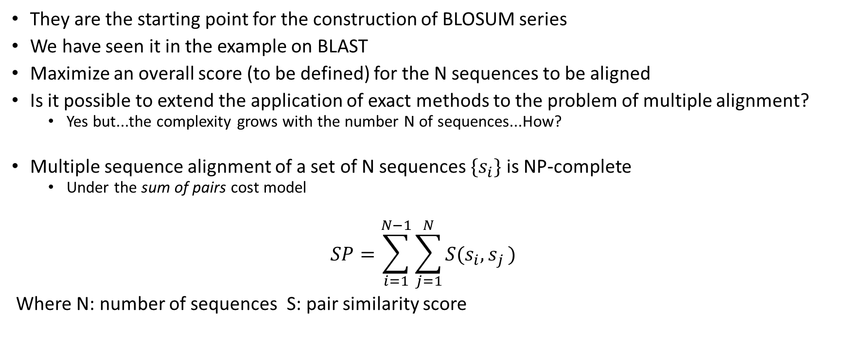
Already met multiple sequence alignment
They are the starting point for the construction of BLOSUM series
We have seen it in the example on BLAST
Maximize an overall score (to be defined) for the N sequences to be aligned
Is it possible to extend the application of exact methods to the problem of multiple alignment?
Yes but...the complexity grows with the number N of sequences...How?
Multiple sequence alignment of a set of N sequences ${\{s}_{i}\}$ is NP-complete
Under the sum of pairs cost model
$$SP=\sum_{i=1}^{N−1}{\sum_{j=1}^{N}{S(s_{i}{,s}_{j})}}$$
Where N: number of sequences S: pair similarity score

Slide 4
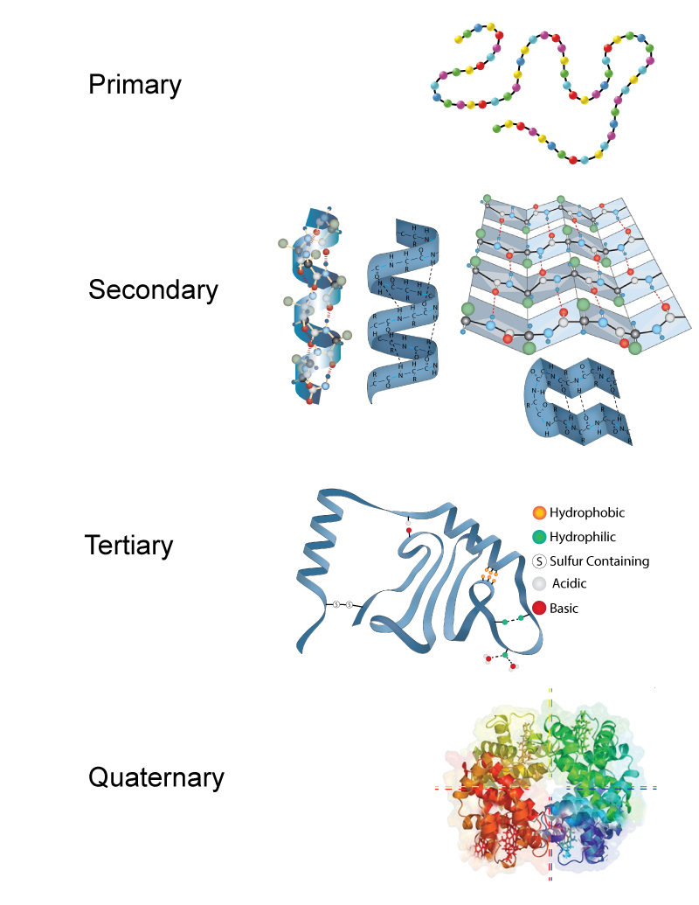
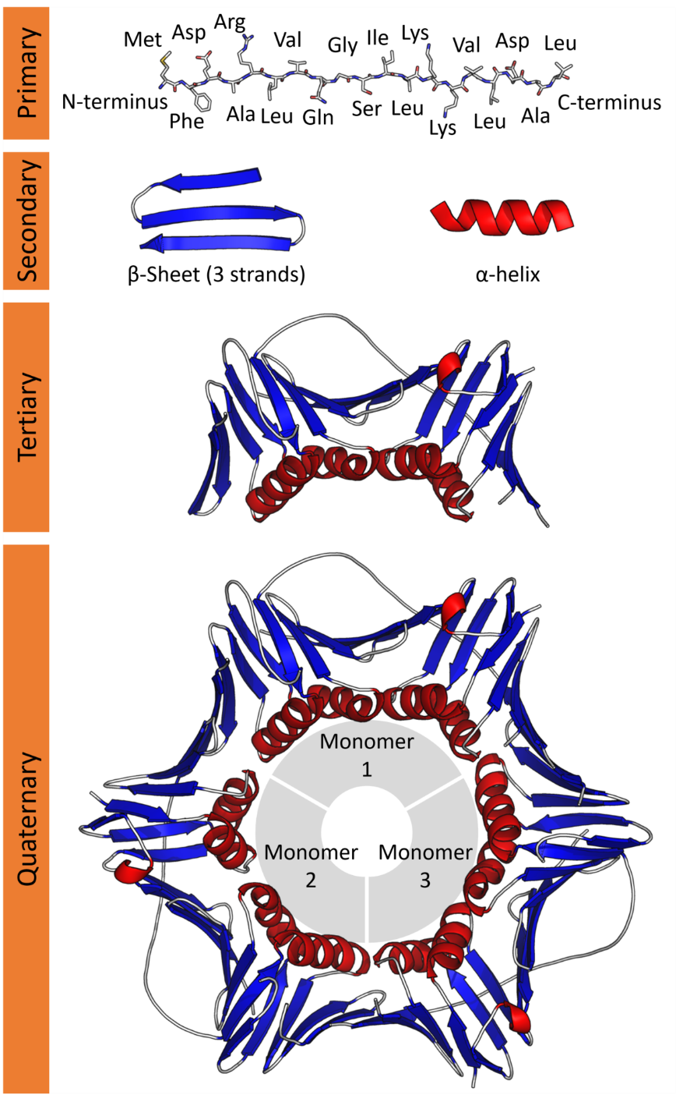
Protein Structure

Slide 5
Relevance of multiple sequence alignment
So far we have dealt with pairwise alignments and searches over sequences databases but
to understand the characteristics of a given family of proteins is necessary to align a set of proteins with a similar function.
The functionally or structurally most relevant sites tend to remain unchanged in the homologous proteins, while the sites that are less important can change a lot.
Observing and studying conservation means understanding:
how families of proteins work
what makes it different from each other
whether or not they exist inter- and intra-family phylogenetic relationships.
In this way it is possible to identify the function of an unknown protein only by looking at the sequence of its residues.

Slide 6
Relevance of multiple sequence alignment: Similarity and homology
Homology: QUALITATIVE character that those sequences have which derive from a common ancestor following the evolutionary process. Either two genes are homologous or are not. There is no percentage of homology.
Similarity: QUANTITATIVE character that originates from a alignment. The degree of identity that is determined between the aligned residues or the fact that similar residues may correspond in an alignment can be quantified by having objective evaluation meters, such as replacement matrices.
=> a high similarity between proteins can indicate homology, but not the reverse can be ruled out. There are in fact very similar proteins (species active sites) in phylogenetically unrelated organisms e very different proteins that can be traced back to homologues by means of other studies.

Slide 7
Relevance of multiple sequence alignment: Orthologous genes and paralogous genes
Orthologous genes: similar genes found in related organisms. The phenomenon of speciation leads to the divergence of genes and therefore of proteins they encode.
es. the α-globin of man and mouse began to diverge about 80 millions of years ago, when the division that gave birth to primates occurred to rodents. => The two genes are to be considered orthologues.
Paralogous genes: genes originating from the duplication of a single gene in the same organism.
es. α-globin and human β-globin began to diverge later duplication of an ancestral globin gene. => The two genes are to be considered paralogues.

Slide 8
Similar sequences and multiple alignment
Sequences to be multi-aligned are typically obtained by searching in database using similarity search systems such as BLAST and FASTA
They already derive from an alignment in pairs (even if produced with heuristic methods) and since they take themselves in consideration of sequences that have a high score (or a low expected),multiple alignment on these datasets should give satisfactory results

Slide 9
Similar sequences and multiple alignment
The problem of multiple alignment is in its abstract and formal definition NP-complete.
BUT
The sequences that have to be aligned do emerge from underlying biological phenomena:
They are similar
They are phylogenetically related
Also physical-chemical properties of the aminocids play a role
Again, also in multiple sequence alignmente the algorithms take advantage of the real nature of the sequence, namely there is a modelling component.

Slide 10
Next: Lecture 10 part 2

Slide 11
Algorithms for Bioinformatics
Enrico Blanzieri
March 25 2020 Lecture 10
Part 2

Slide 12
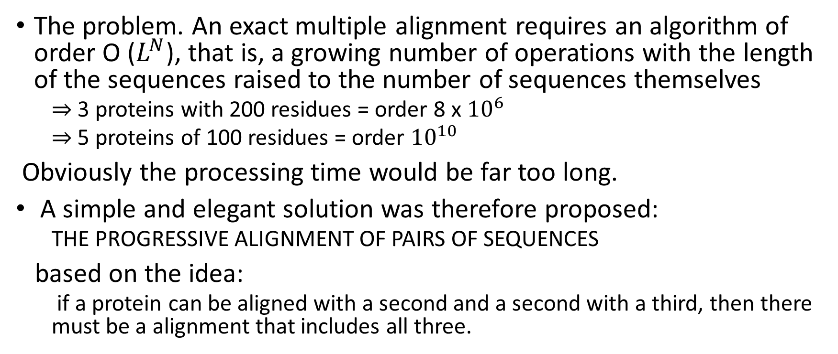
A solution for multiple sequence alignment: Progressive alignment
The problem. An exact multiple alignment requires an algorithm of order O ($L^{N}$), that is, a growing number of operations with the length of the sequences raised to the number of sequences themselves
⇒ 3 proteins with 200 residues = order 8 x ${10}^{6}$
⇒ 5 proteins of 100 residues = order ${10}^{10}$
Obviously the processing time would be far too long.
A simple and elegant solution was therefore proposed:
THE PROGRESSIVE ALIGNMENT OF PAIRS OF SEQUENCES
based on the idea:
if a protein can be aligned with a second and a second with a third, then there must be a alignment that includes all three.

Slide 13
Progressive alignment
Feng and Doolittle 1987
Input: N sequences (dataset) randomly arranged, not aligned
Align all sequences with all sequences N (N-1) / 2 alignments (all against all)
Determine a guide tree based on the similarity scores of all pairs
Starting from the closest pair
determine the columns to keep (Neutral X where the a gap is, “Once a gap always a gap”)
align on another sequence or pairs keeping the columns and re-calculating the total score
Repeat until all the sequences are aligned
Output N sequences aligned

Slide 14
Progressive alignment: the pairwise alignments step
Pairwise alignment: all against all
Feng and Doolittle used Needleman and Wunsch algorithm but others choices are possible
If local alignment is done:
1. Smith-Waterman: exact but slow
2. K-tuples (or w-mers), heuristic, fast.
The speed of this step is fundamental if you have many sequences to align, but it is equally true that if you make mistakes in this phase, these propagate to the final alignment.

Slide 15
Progressive alignment: The guide tree
Given the scores in pairs, it is possible to determine which is the best way to move from one protein to another following an order
Can it be considered an evolutionary progression? Yes and no
It captures some aspects of the evolution
It is not easy to capture the actual evolutioary history (Philogeny reconstruction)
The (quick) methods for building trees given a set of scores are essentially two:
Neighbor Joining (NJ)
Unweighted Pair Group Method with Arithmetic mean (UPGMA)
Based on Matrixes of Distance which have a meaning inverse with respect to scores:
Score: greater => more similar sequences
Distance: greater => more distant sequences => more different

Slide 16
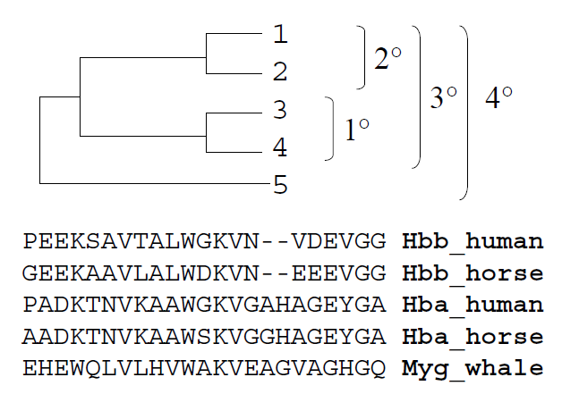
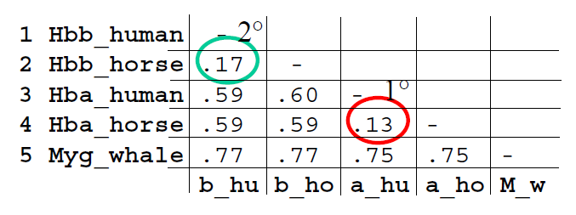
Progressive alignment: the Guide tree
Order
Distances
Final alignment

Slide 17
Feng Doolittle online
http://rna.informatik.uni-freiburg.de/Teaching/index.jsp?toolName=Feng-Doolittle

Slide 18
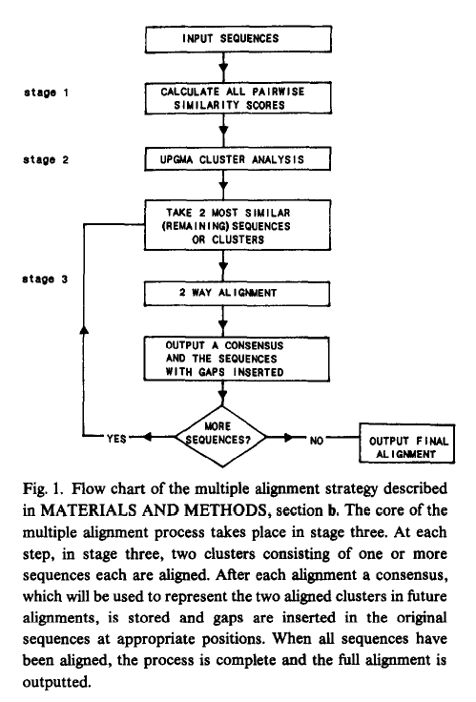
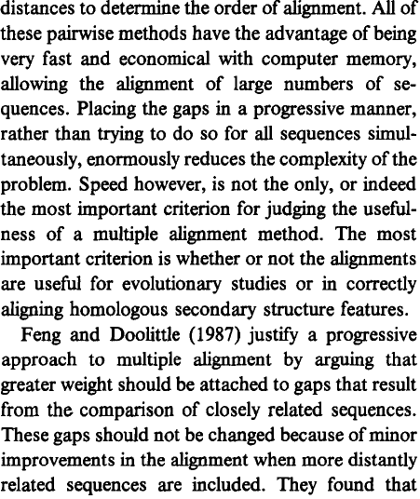
Clustal
Clustal - Higgins & Sharp 1989

Slide 19
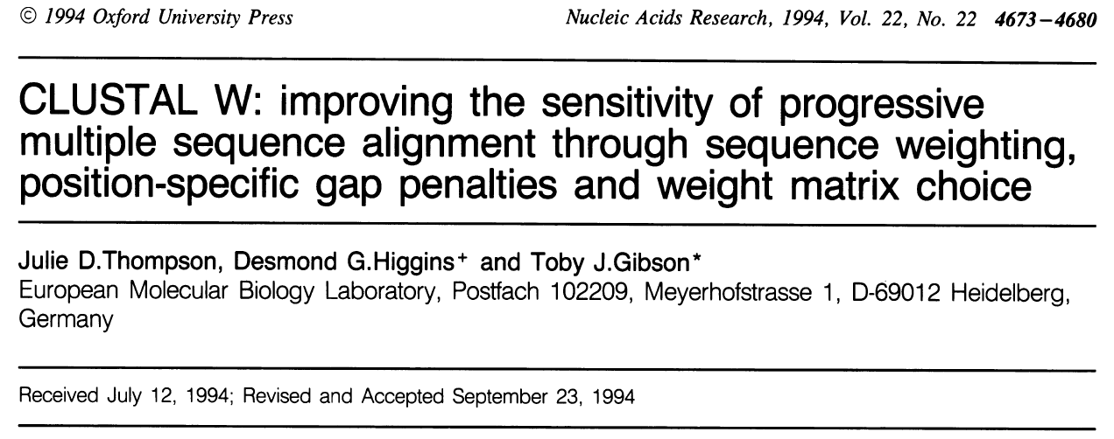
ClustalW

Slide 20
ClustalW
Thompson et al. NAR 1994
ClustalW - Clustal W is the most popular progressive alignment program and most used.
- the algorithm weighs the sequences differently and changes matrix gradually while it adds protein of increasing diversity
It is available on the EBI server, also recalled from the pages of the results when searching for similarity (FASTA or BLAST), but there are also downloadable versions (standalone) free that run under all platforms.
There is also a version with graphical interface, ClustalX and a follow-up Clustal-omega

Slide 21
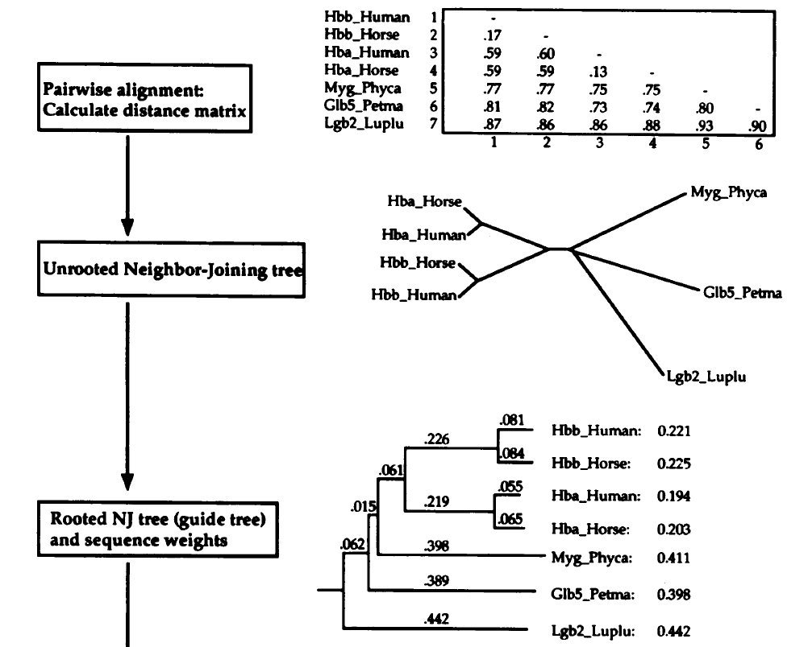
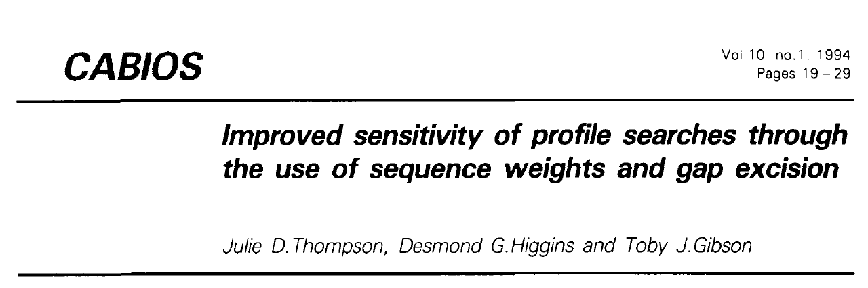
ClustalW
Each sequence is weighted
Each residue is weighted
The way the weights are computed
is specified in:

Slide 22
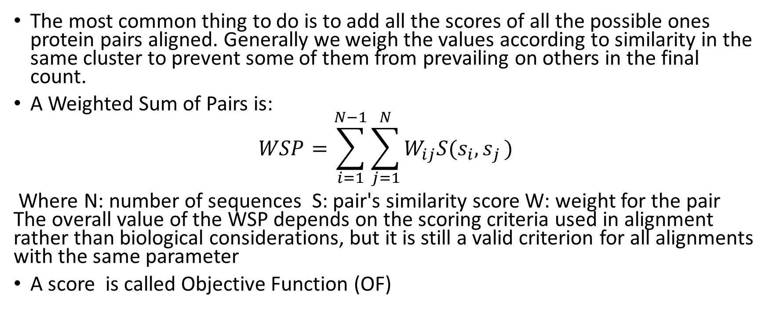
Evaluate the quality of a multi-alignment
The most common thing to do is to add all the scores of all the possible ones protein pairs aligned. Generally we weigh the values according to similarity in the same cluster to prevent some of them from prevailing on others in the final count.
A Weighted Sum of Pairs is:
$$WSP=\sum_{i=1}^{N−1}{\sum_{j=1}^{N}{W_{ij}S(s_{i}{,s}_{j})}}$$
Where N: number of sequences S: pair's similarity score W: weight for the pair The overall value of the WSP depends on the scoring criteria used in alignment rather than biological considerations, but it is still a valid criterion for all alignments with the same parameter
A score is called Objective Function (OF)

Slide 23
Further improvements Penalty masks
The penalty masks are series of numbers from 1 to 9 to be written as if they were a sequence of amino acids. They have been designed to alter the criteria of insertion of gaps based on information that may derive from various sources.
If you know the structure of one of the protein, this will be used for construction of penalty scores in preliminary pair alignment: in fact in a family of proteins, the tertiary and secondary structures they tend to retain more of the structure primary.

Slide 24
Further improvements: Iterative alignment
Clustal is characterized by the production of the guide shaft to proceed with alignments between sequences that are progressively less correlated.
Whenever it is added a sequence however the tree it is not recalculatedany initial errors fail are corrected.
http://bioinfo.genotoul.fr/multalin/
One way to correct the mistakes is to operate a series o iterations after each addition, aiming to maximize with various methods the global WSP and pairs, recreating a new tree, until the alignment stabilizes.

Slide 25
Multiple alignment: local or global?
Clustal in its alignment procedures maximizes the scores by looking to extend alignment along all available sequences
=> does a type of global alignment.
The same considerations seen for pairwise alignments still apply, therefore biologically it is better to find local than global alignments.
In MSAs the problem is actually more complex, because it depends on the average initial similarity between the sequences under consideration, something that can be done evaluate only retrospectively.
=> New progressive methods adjust existing MSAs
1. Looking for blocks of maximum conservation.
2. Creating patterns from them.
3. Using patterns to recreate other possible alignments.

Slide 26
Other programs for multi-alignment
Kalign (http://msa.cgb.ki.se/cgi-bin/msa.cgi)
it does not use the UPGMA method or the NJ to calculate distances in the generation phase of the guide shaft, but a faster and more precise system based on patterns and on finding strings with gaps (algorithm of Wu-Mabner)
T-Coffee (http://www.tcoffee.org)
optimizes the Clustal algorithm by introducing after multiple alignment a complex scoring system that allows you to "learn" hot areas and adjust the alignment based on these, allowing the "merging" of alignments made with different methods.

Slide 27
Next: Lecture 10 part 3

Slide 28
Algorithms for Bioinformatics
Enrico Blanzieri
March 25 2020 Lecture 10
Part 3

Slide 29
Display of multi-alignments
Viewing a multi-alignment well is very important to appreciate the information it can provide. The output of the multi-alignment programs is a string containing the aligned sequences formatted in different ways according to various standards:
MSF, NEXUS, PHYLIP, CLUSTAL, FASTA
In these changes the header, the portion of protein that is on the same line (to read all the alignment on the same screen), the additional information concerning the alignment itself.

Slide 30
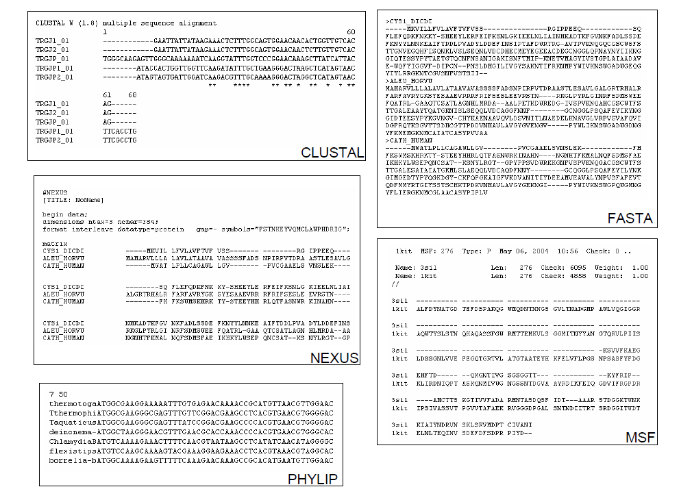
Format of multiple sequence alignment

Slide 31
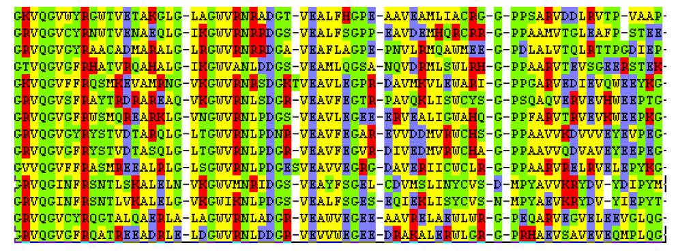
Color visualization

Slide 32
Color visualization
Raw-text files can be used to display columns
It is possible to associate different colors to residues with different physical-chemical characteristics.
This facilitates the inspection of multi-alignments.
Color visualization in alignments is typically done by complex programs that permits to execute also more sophisticated tasks than simple coloring, integrating real bioinformatics analysis environments.
Important examples are BioEdit or CLC Sequence Viewer.

Slide 33
The consensus sequences
Consensus sequence is defined as a sequence derived from a multi-alignment which has only the most conserved residues for each location and which has the following characteristics:
Summarizes a multi-alignment
It is not identical to anyone of the dataset proteins
Defined symbols indicate imperfect preservations in one position
It is possible to use precise formatting that allows to understand also the variations in one location, not just the conservations.

Slide 34
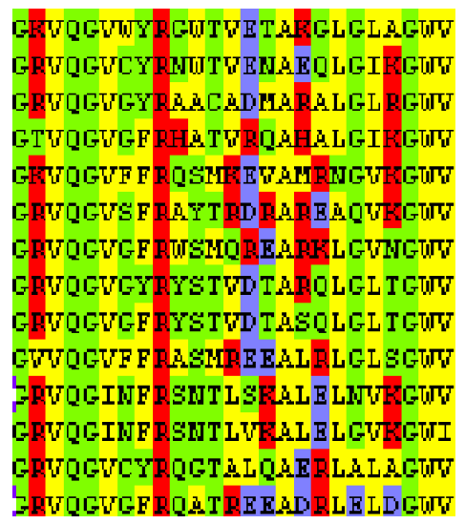
Consensus
Exact consensus
Consensus with symbols
Consenso with variants
Consensus with repetition ripetizioni
GRVQGV--R------A--LG—-GWV
GRVQGh-aRvvvvvvAvvLGivGWV
GRVQG[VI]-[FY]R------A—L----GWY
GRVQGV--R-6A—LG--GWV
Exact consensus
Consensus with symbols
Consenso with variants
Consensus with repetition ripetizioni

Slide 35
Weblogo
It is a type of visualization that gives a good idea of positions preserved on DNA / Protein tracts.
In practice, for each column a letter (Base / AA) is reported, even more the greater its presence in that position will be alignment.

Slide 36
ClustalW

