Slide 1


Optimal Lunar Landing Trajectory Design for Hybrid Engine
Project of Optimal Control.
Prof. Daniela Iacoviello
A.A. 2020/2021
Leonardo Salustri (M1762556)
Francesco Scotti (M1758391)

Slide 2
Introduction
The lunar landing trajectory is a good example for the optimal problem
because the dynamics is very simple, and the various energy-like values
can be selected as a candidate for the cost function of the optimization problems.
In general, the lunar landing is divided into two phases:
Deorbit burn (the Hohmann transfer method)
Powered Descent Phase
There are different approach to investigate the Powered Descent Phase
Continous Thruster with a two-dimensional (2D) dynamics
Variable thrust level
Vertical lunar landing by using spacecraft rotational motions
1

Slide 3
Assumptions
The gravity field of the moon is uniform through the whole path of the lunar lander,
and the moon is entirely spherical. So we can apply the two-body dynamics to this problem.
The moon rotates on its own axis with the constant angular velocity. Moreover the lunar
parking orbit, the lunar landing trajectory, and the lunar equator are placed in the same plane,
so one can easily apply the 2D dynamics.
The initial trajectory of the lunar parking orbit is the circular orbit, and Hohmann transfer
method is used for the deorbit burn phase. Therefore, the initial velocity of the powered
descent phase can be calculated.
During the powered descent phase, the thrust of the lander is constant and there are no
other perturbations.
We assume that the lunar lander retrofired the Impulsive thruster to reduce the horizontal
velocity rapidly at the initiated time for the powered descent phase.
2

Slide 4
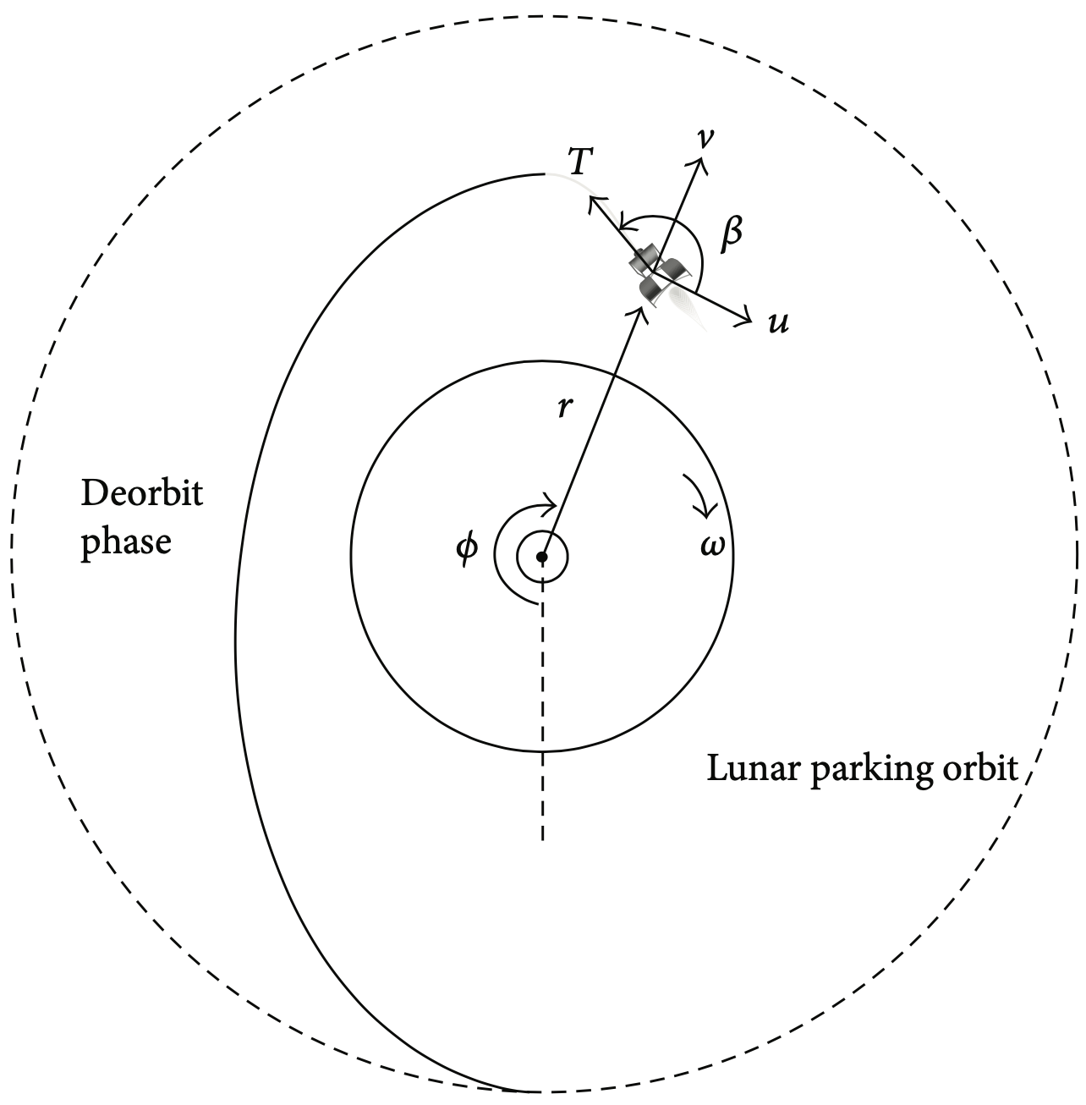
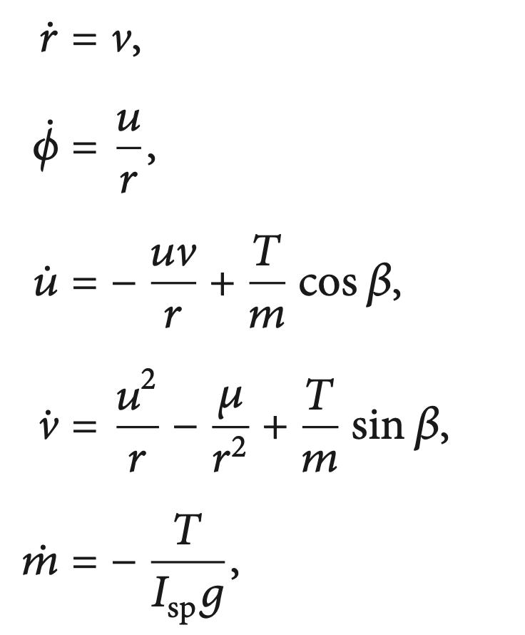
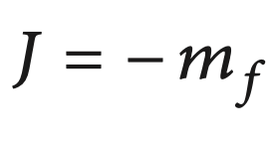
Governing Equations
r and 𝜙 are the radial distance and the position angle from the center of the moon.
u and v are the transverse and the radial velocity.
m is the proper mass of the lander and µ is the standard gravitational parameter.
I_{sp} is the specific impulse, while g is the gravitational acceleration on the Earth.
T and 𝜷 are used to express the thruster’s magnitude and its phase angle.
Cost Function
3

Slide 5
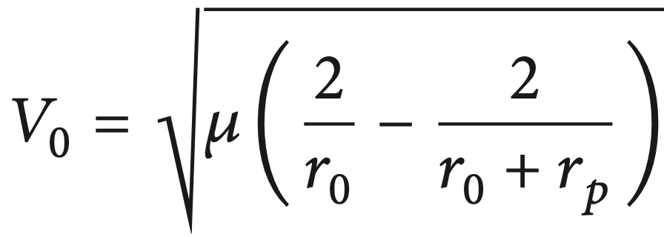
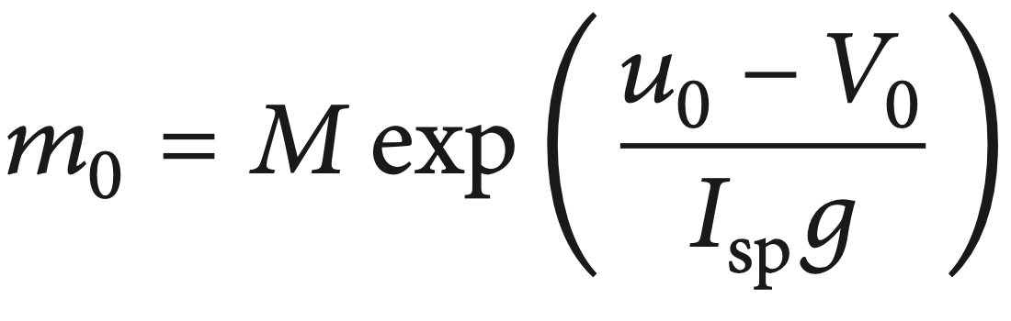
Boundary Conditions
Hohmann transfer method is used during the deorbit phase, thus:
The impulsive thruster retrofired at the initial time of the powered descent phase. Therefore, the initial horizontal velocity (𝑢₀) is not fixed and it is one of the optimal parameters.
However, there is a relationship between the initial horizontal velocity and the initial mass.
4

Slide 6
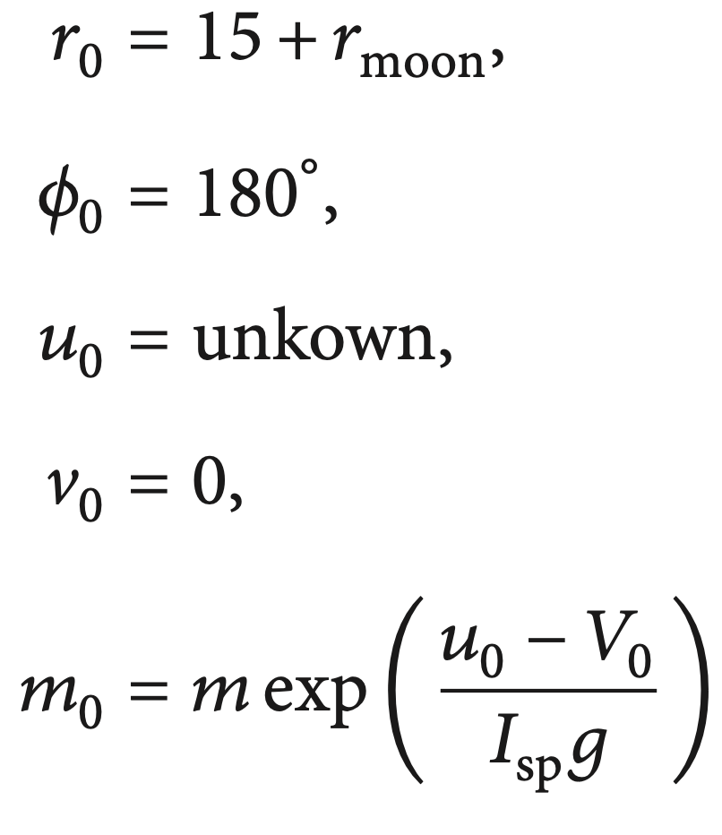
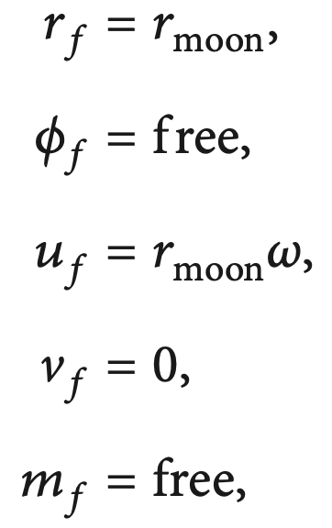
Boundary Conditions
The initial states of the lunar lander at the initiated time of the powered descent
phase and the final state constraints can be described as follows:
5

Slide 7
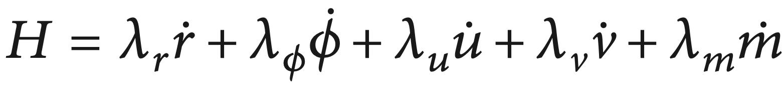
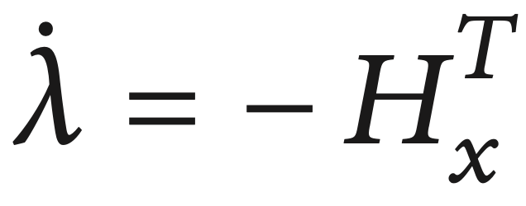
Optimal Trajectory Design
The Hamiltonian function is established from the system dynamics and cost function in the previous slides as follows:
where 𝜆_{r}, 𝜆_{ϕ}, 𝜆_{u}, 𝜆_{v} and 𝜆_{m} represent the costate variables for each state variable.
6

Slide 8
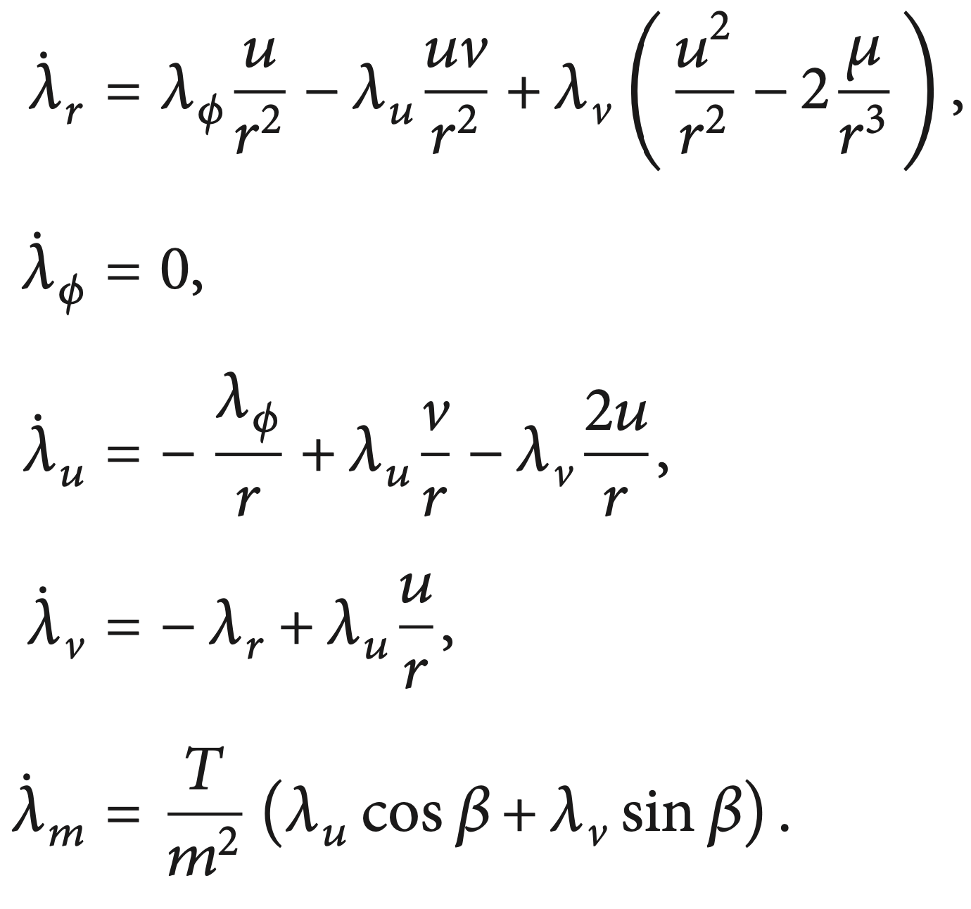
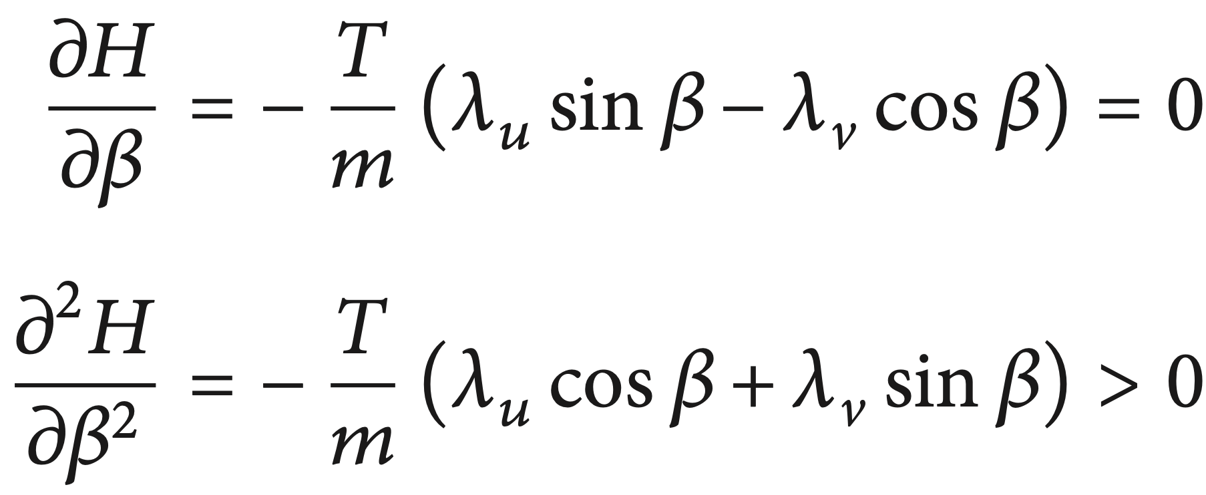
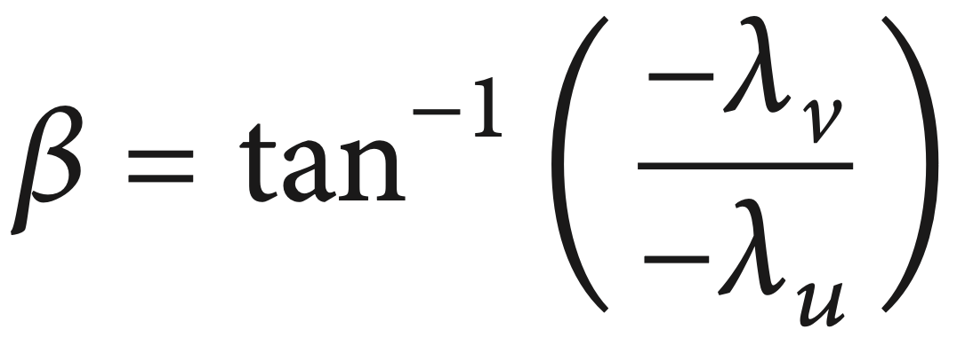
Optimal Trajectory Design
Then, the control command can also be obtained from the optimal control theory:
7

Slide 9
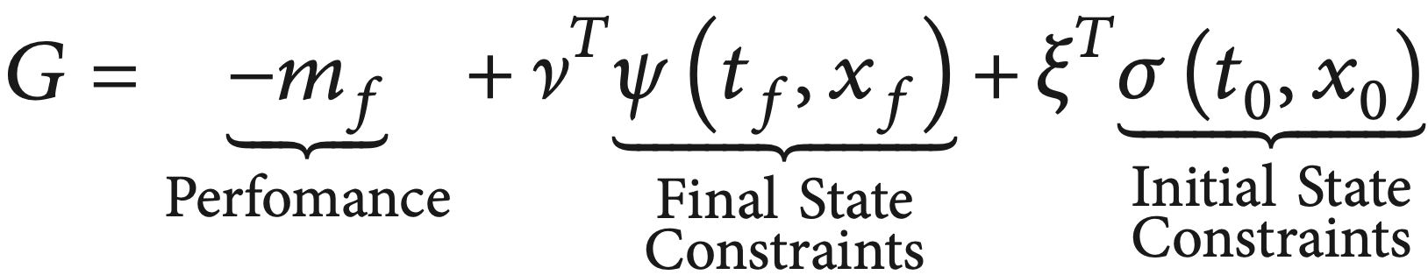
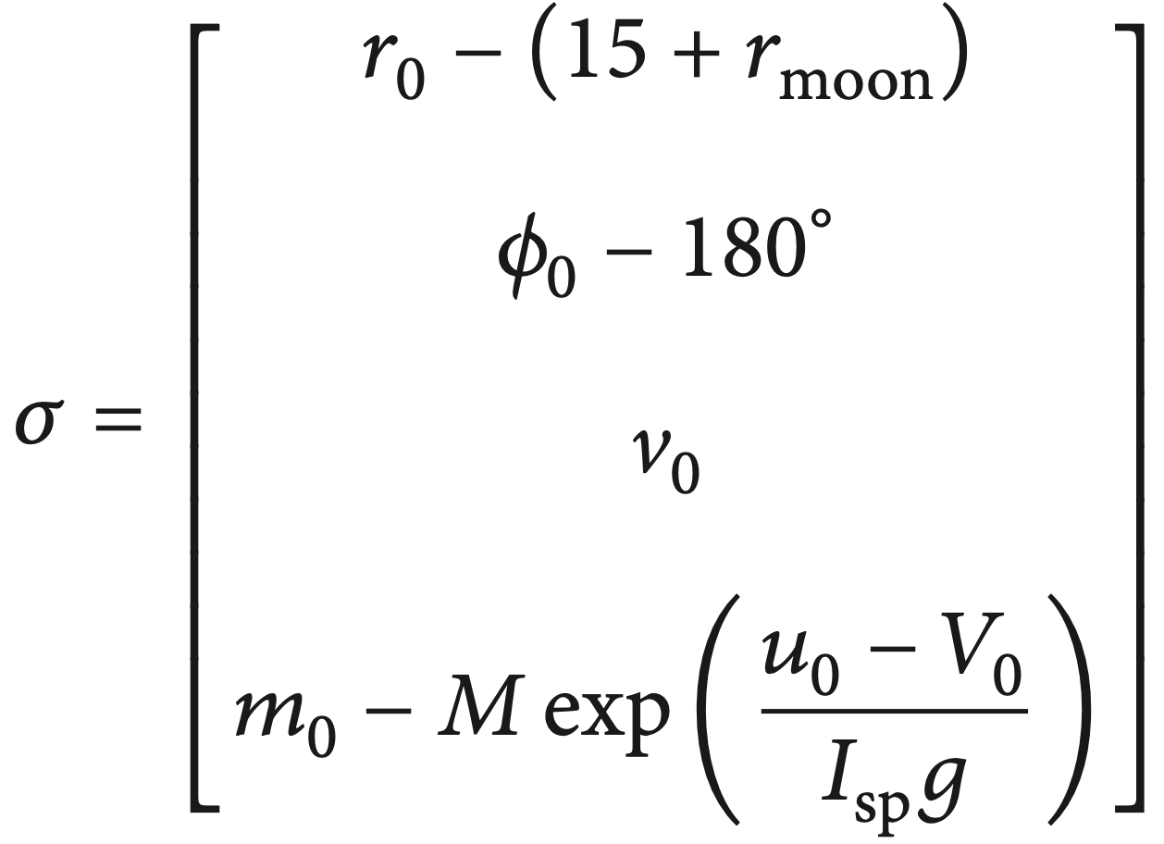
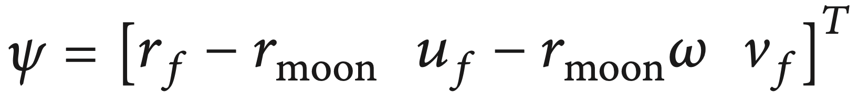
Optimal Trajectory Design
The augumented constraint function is written as follows:
Where the final and initial state constraints matrices are described as follows:
8

Slide 10
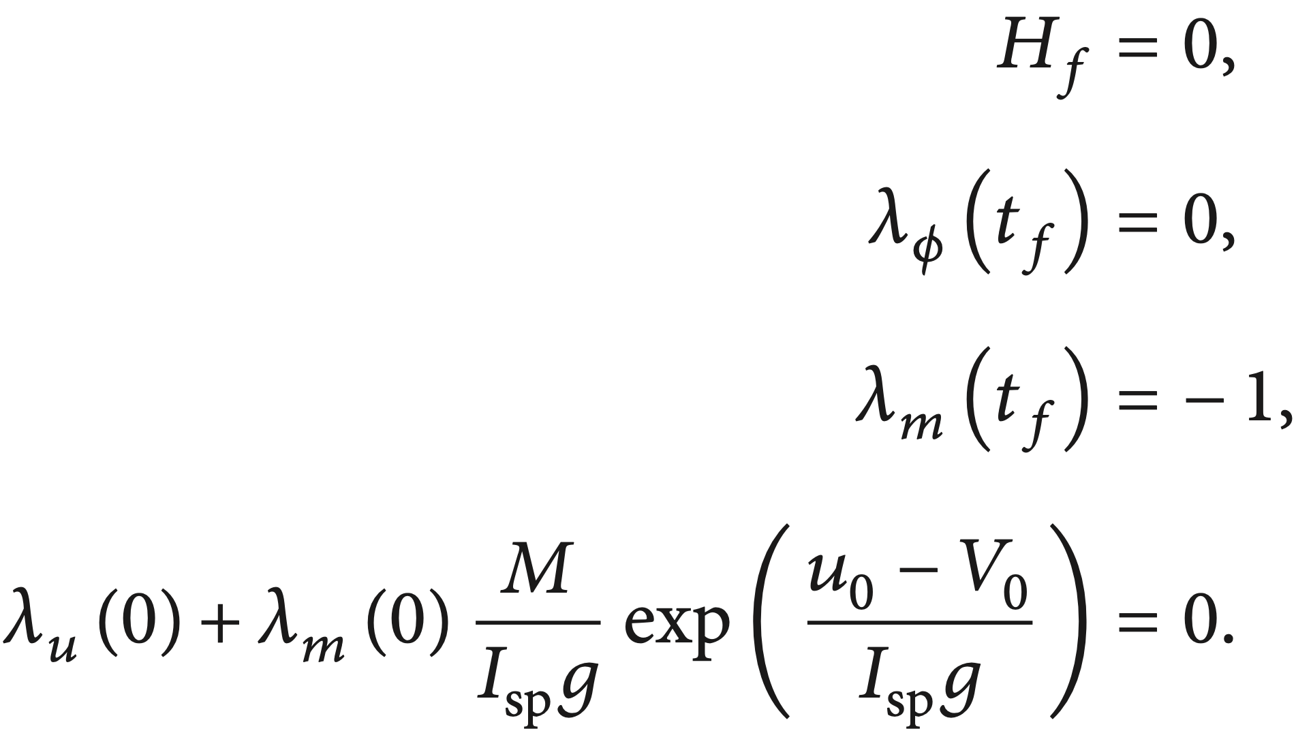
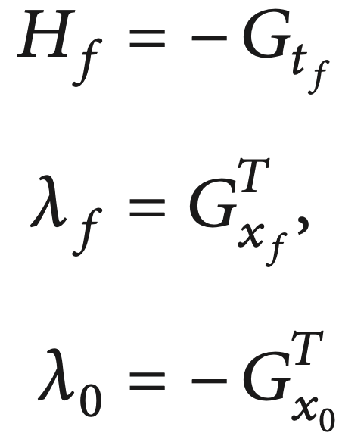
Optimal Trajectory Design
So, the boundary conditions for the costate and the Hamiltonian are:
9

Slide 11
Two-point boundary value problem
This optimal control problem can be reformulated to the two-point boundary
value problem, and it is usually solved by using parameter optimization
methods like:
Sequential dynamic programming
Evolutionary algorithm
Genetic algorithm
Particle swarm optimization
It is usually difficult to select a suitable search boundary of the solution.
Therefore, the shooting method is applied to find the optimal solution.
10

Slide 12
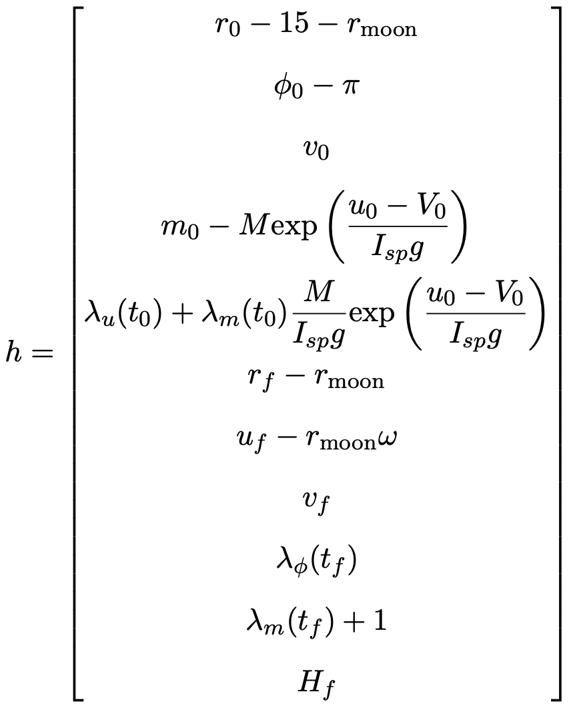
Shooting Method
For the shooting method, the constraints matrix (h) must be described at first.
11

Slide 13
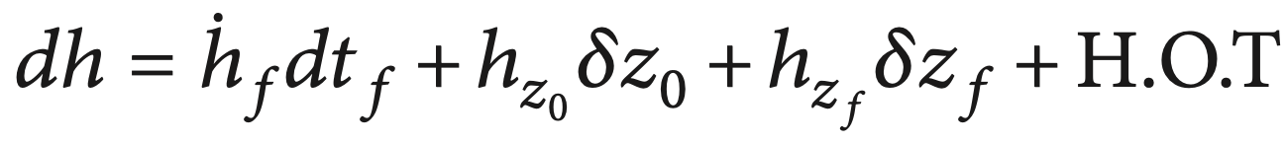
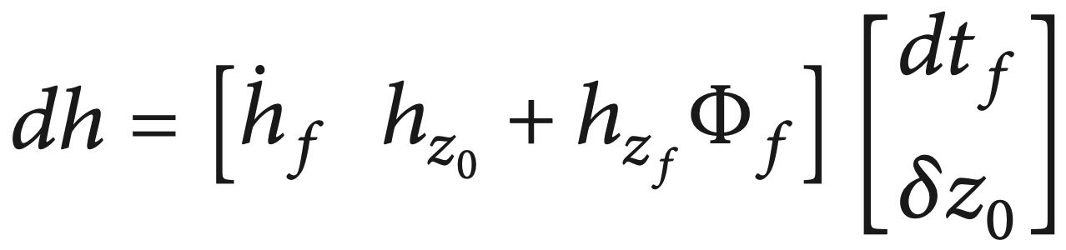
Shooting Method
The derivative of the constraint matrix is written as follows:
Where z = [x^{T} 𝜆^{T}]^{T} represents the augumented state matrix and t_{f} represents the
final time. Also, the subscription 0 and f mean the values at initial and final times.
1
Here the higher orders are neglected, and the equation is rewritten for only the
initial augumented state matrix and final time by using the transition matrix 𝚽:
12

Slide 14
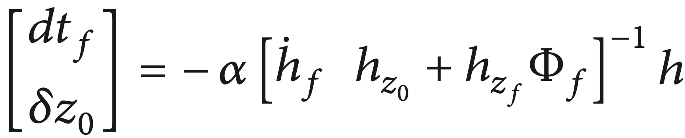
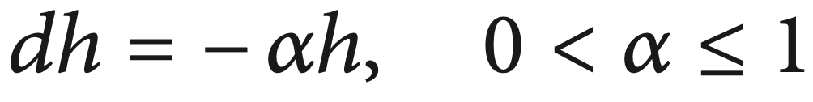
Shooting Method
To reduce the constraints, one can choose the derivative of this constraints matrix as:
(24)
Algorithm:
Initially guess the augumented state vector (z) and total flight time (t_{f}).
Propagate the system and the costates dynamics with the optimal control law for 𝛽.
Calculate the constraint matrix (h) and check it.
If ||h|| is less than tolerance value, then this shooting methos terminates.
If ||h|| is not less than tolerance value, then calculate the update value from
(24) and add this value to the initial guessing one. Then go to the second step,
with these updated values.
13

Slide 15
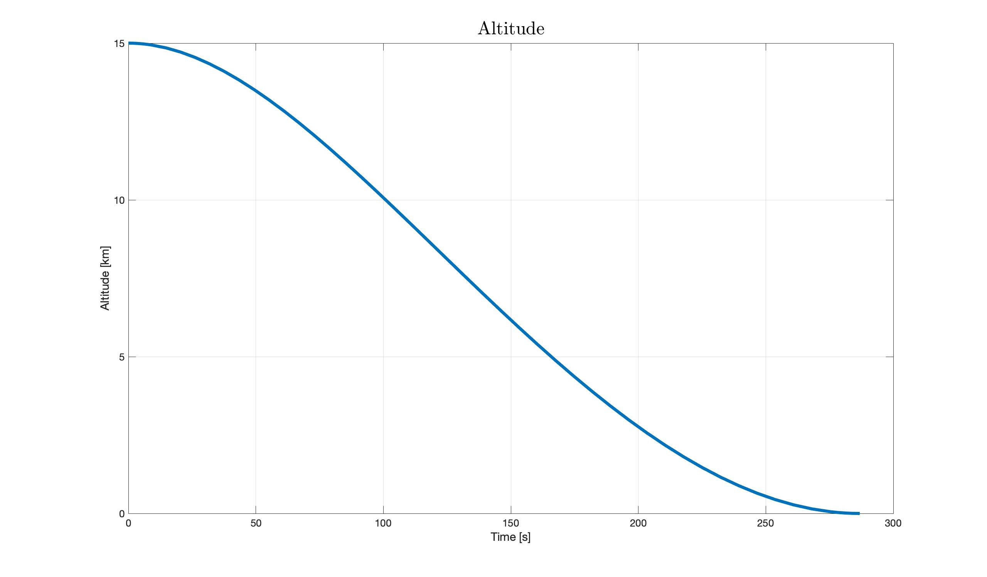
Simulations and results
14

Slide 16
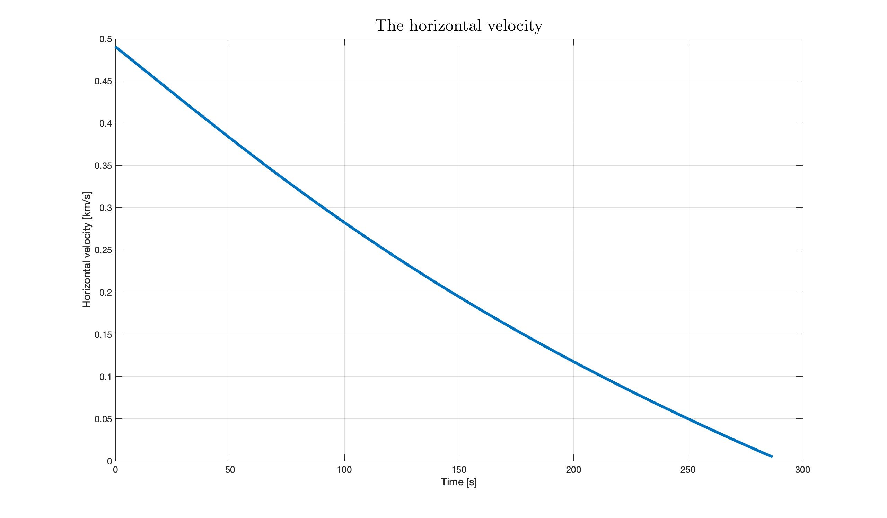
Simulations and results
15

Slide 17
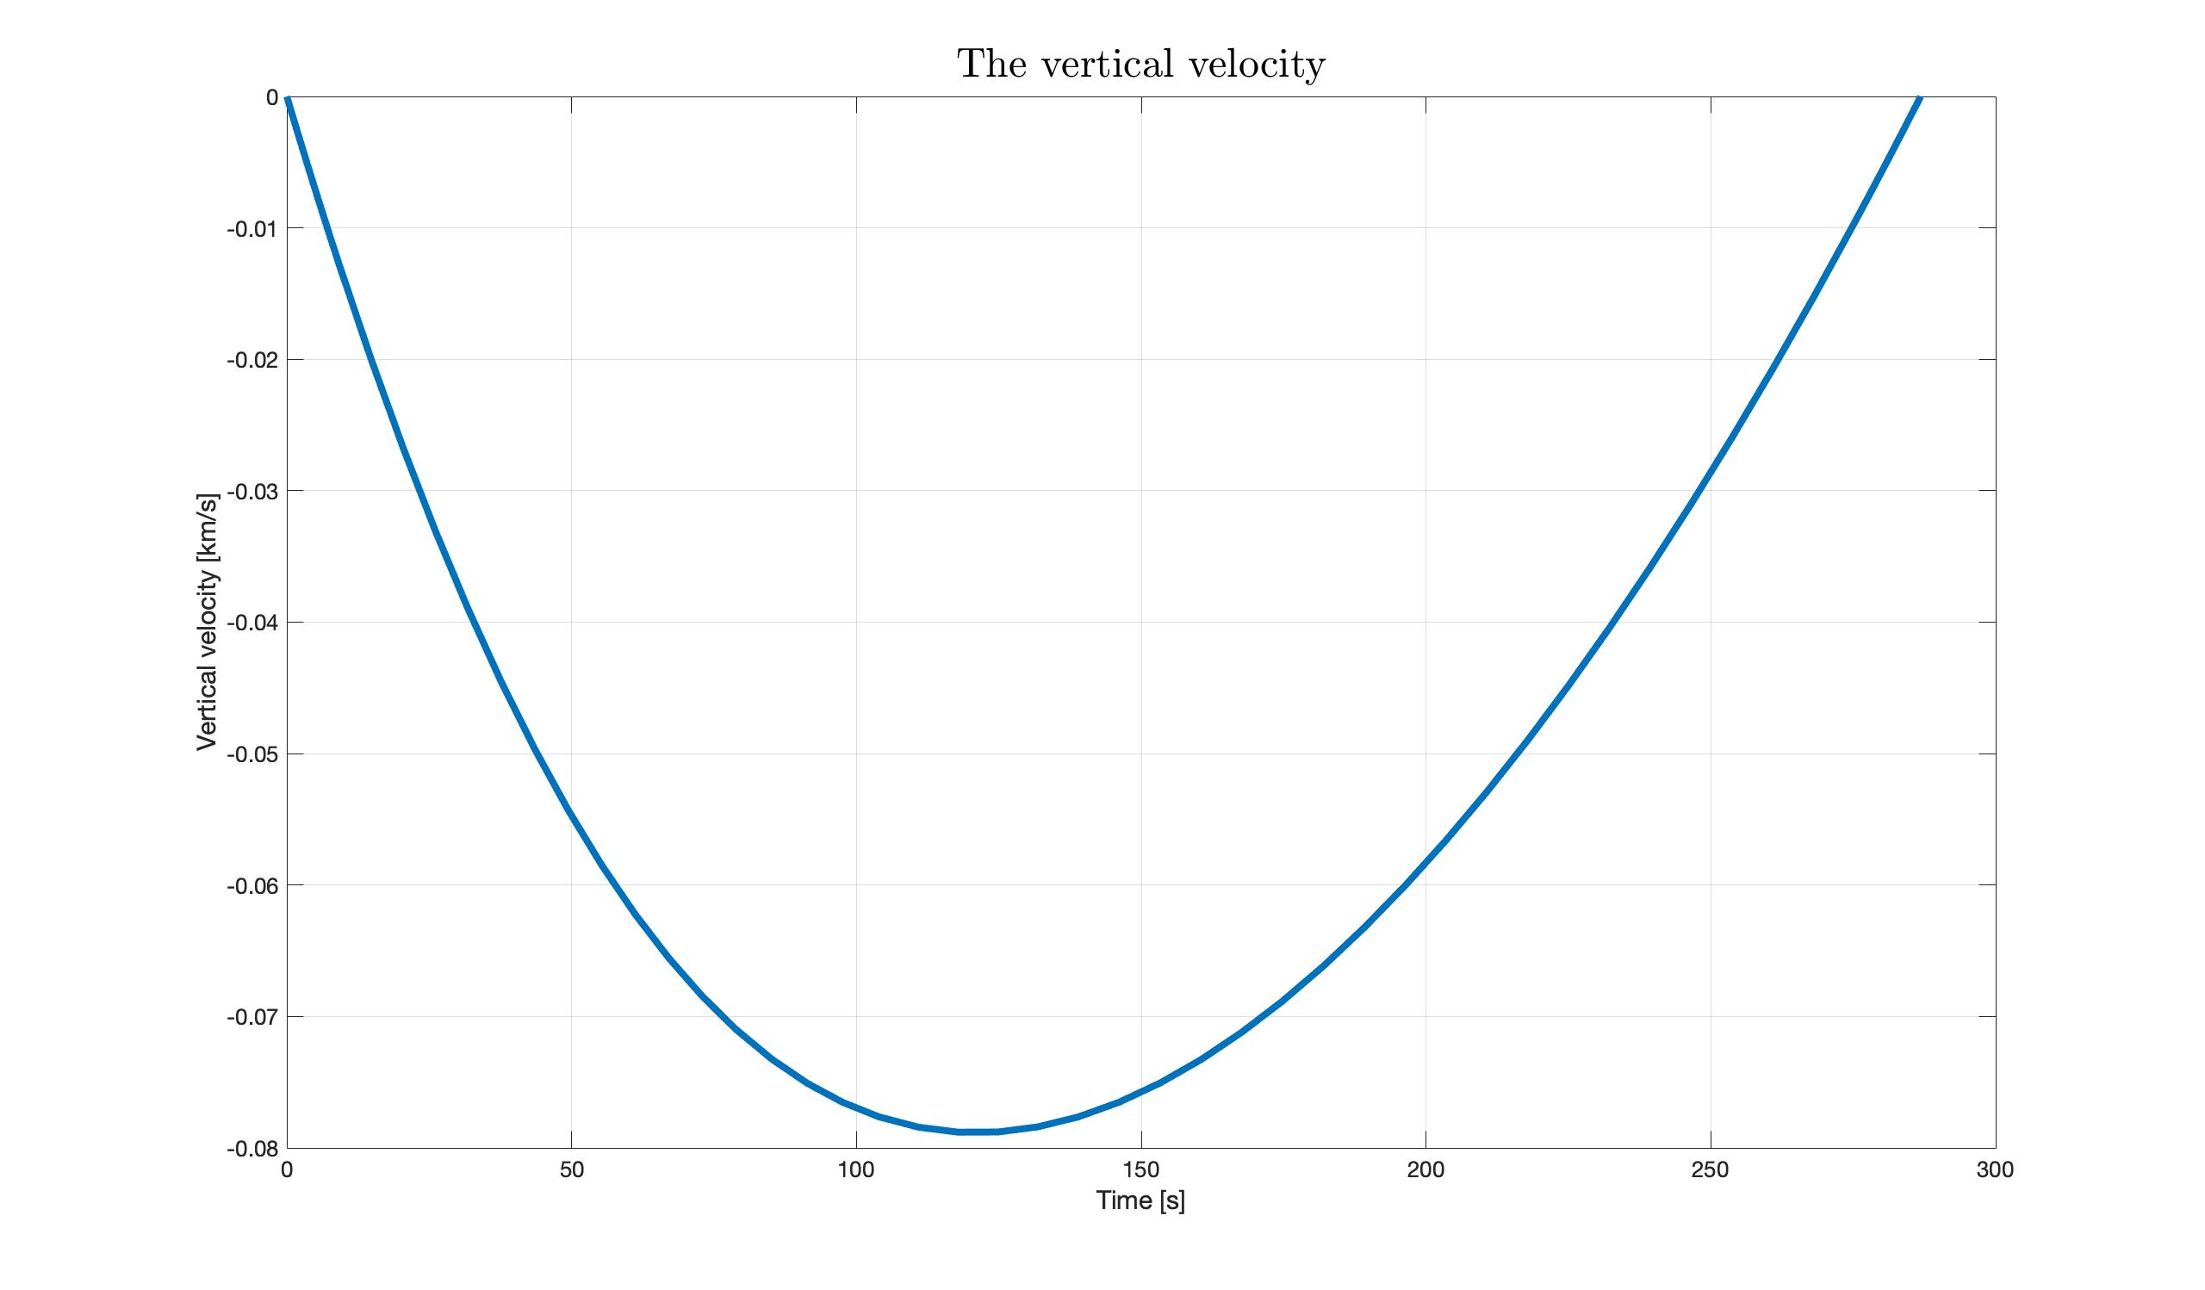
Simulations and results
16

Slide 18
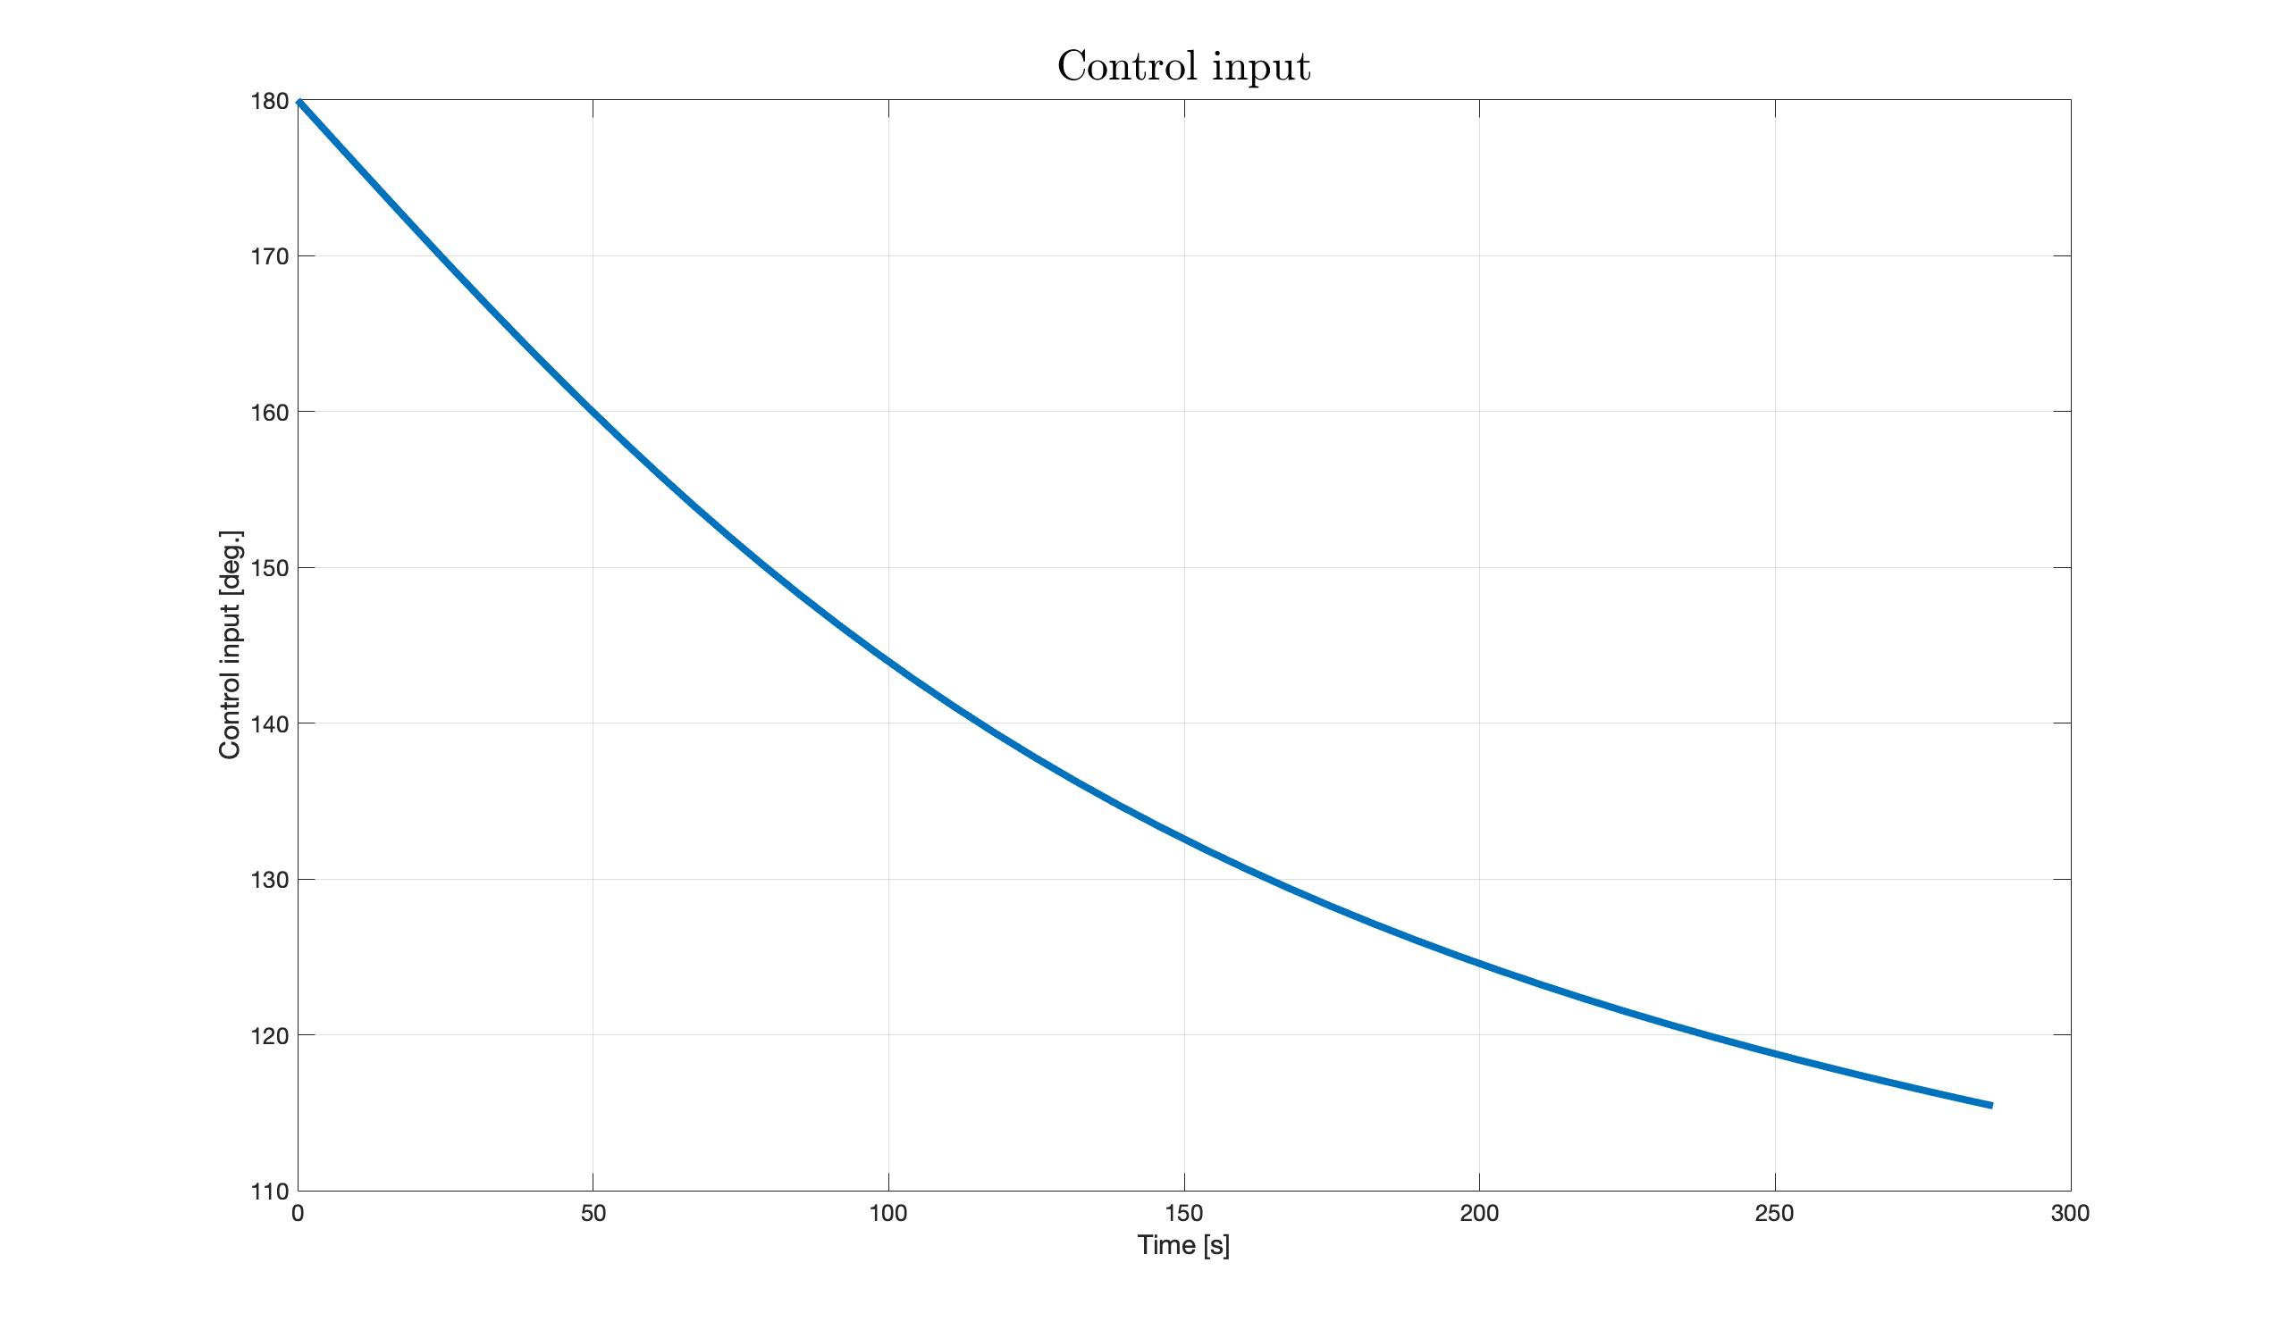
Simulations and results
17

Slide 19
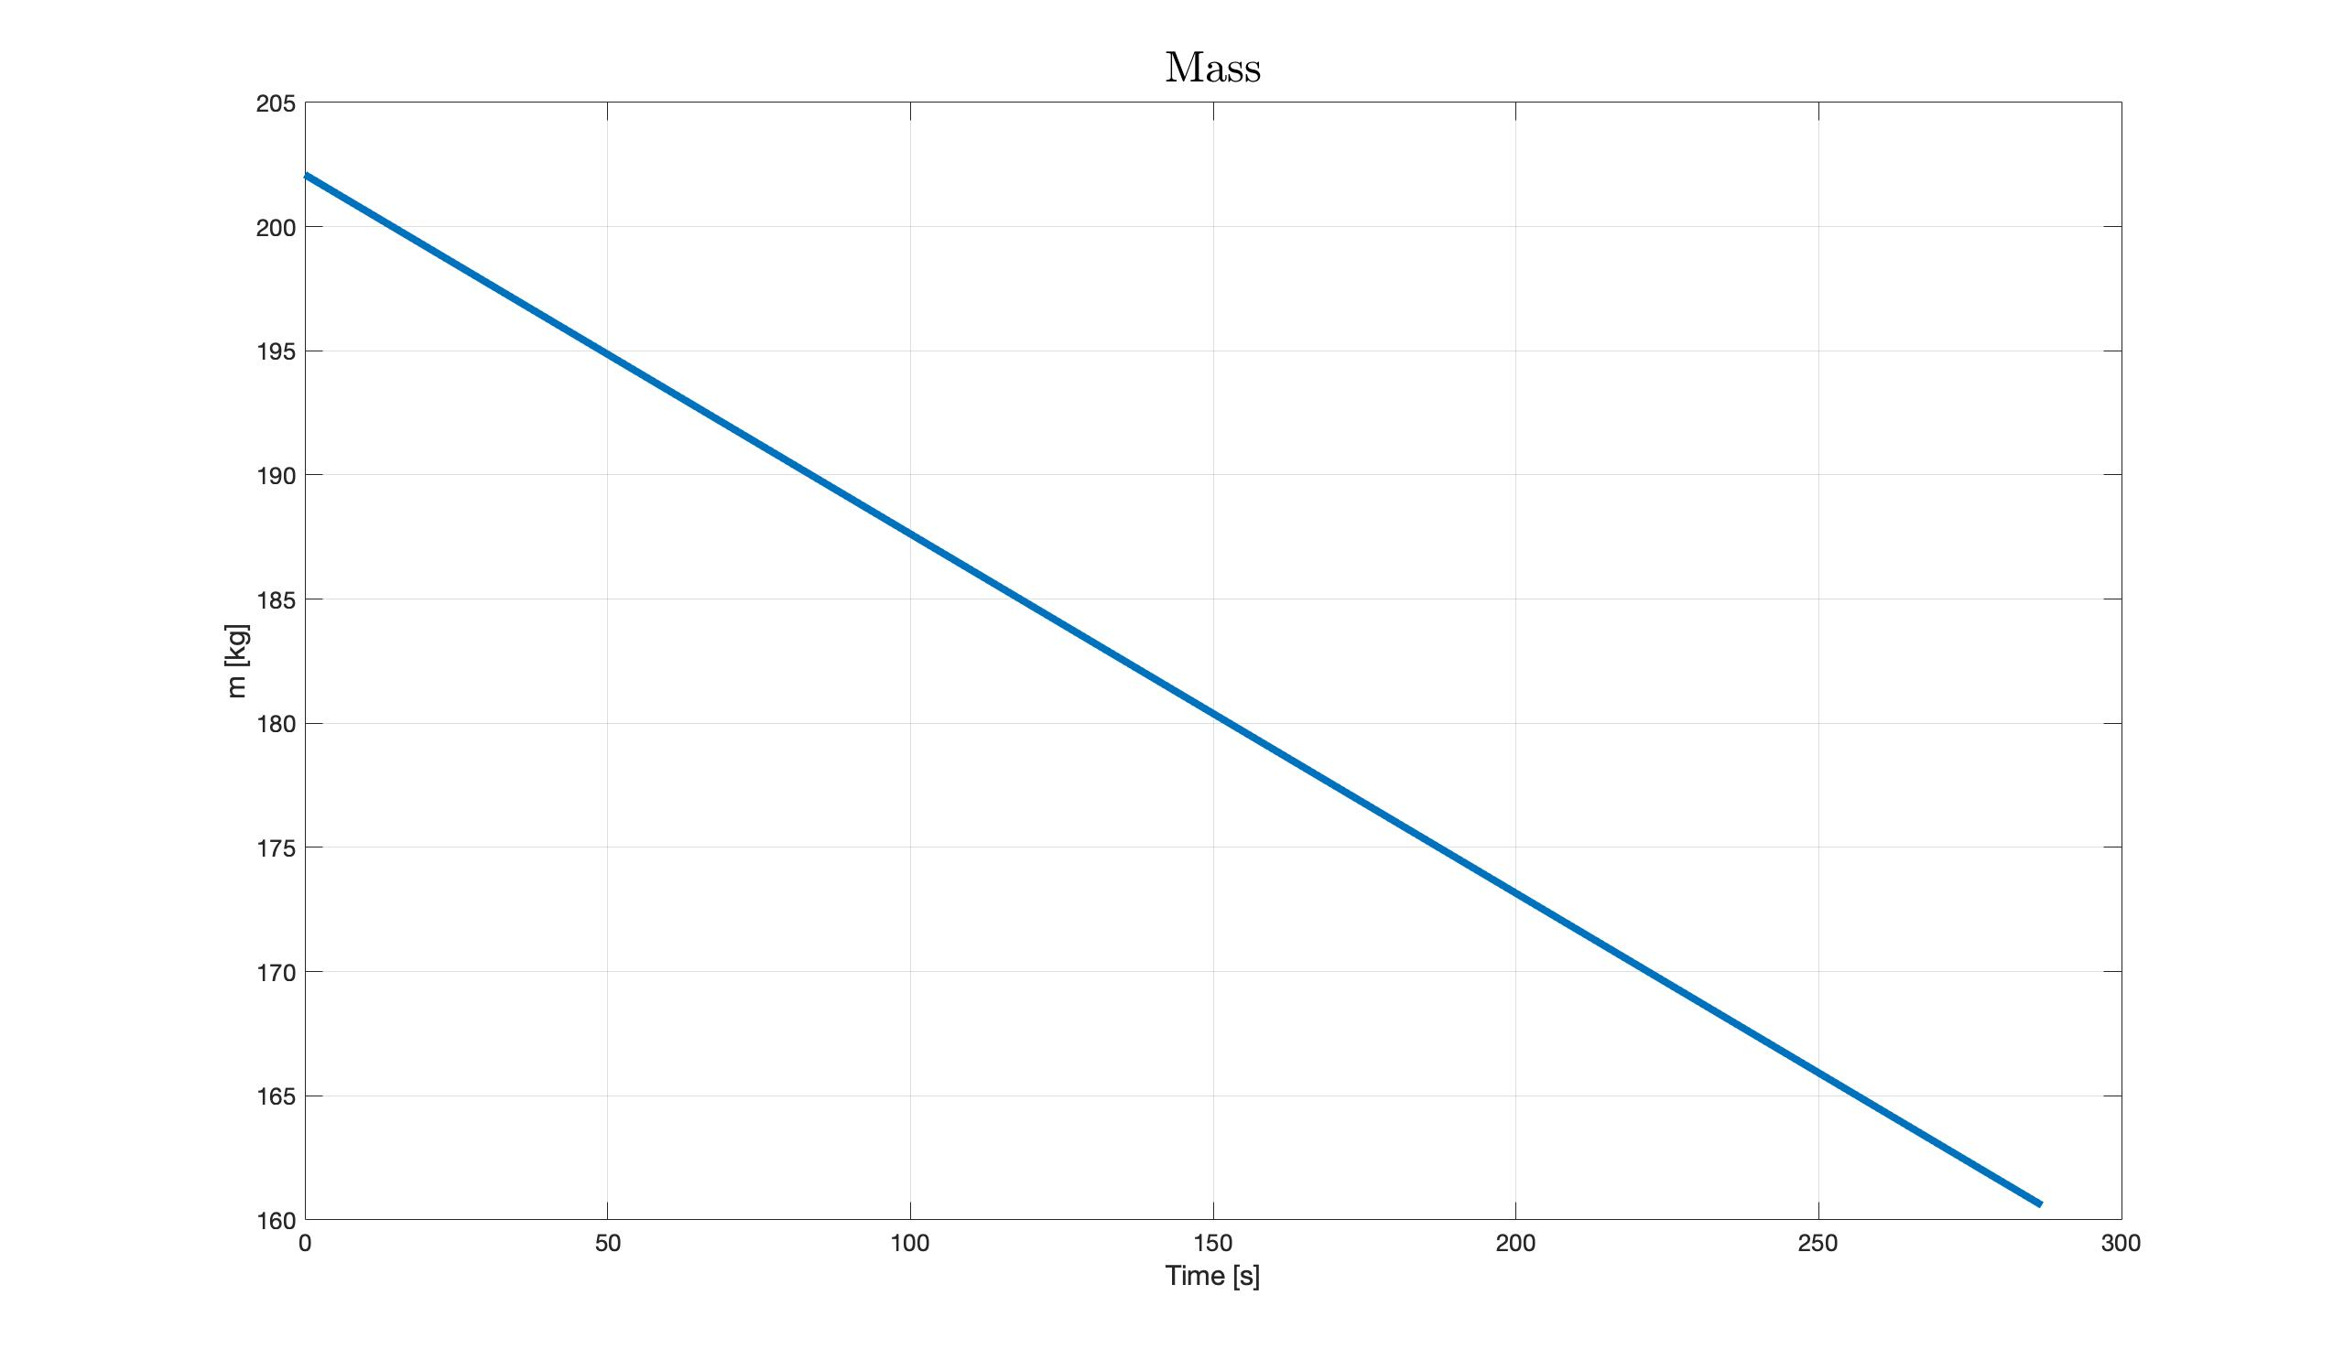
Simulations and results
18

Slide 20
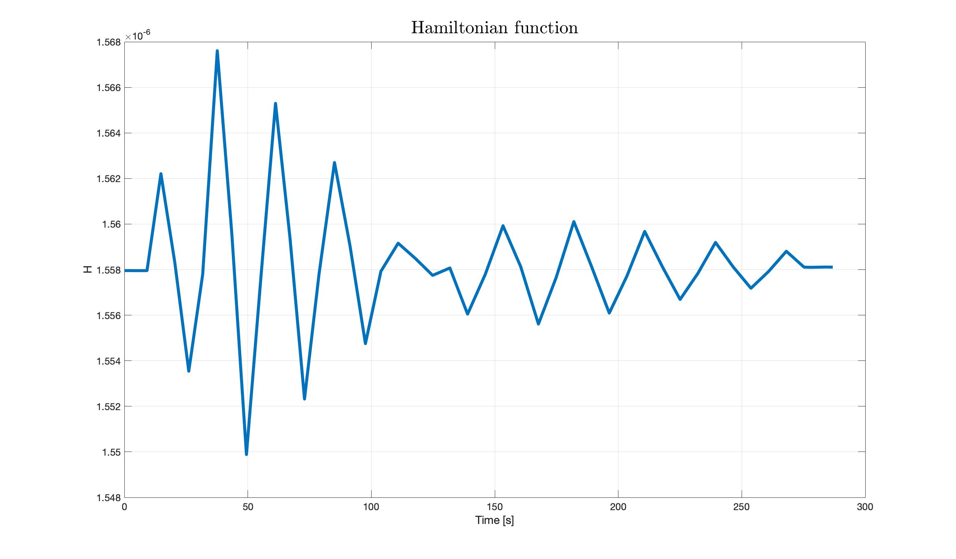
Simulations and results
19

Slide 21
Grazie per la Vostra Attenzione!
Leonardo Salustri (M1762556)
Francesco Scotti (M1758391)

