Slide 1
MHW1
Francesco Tamburella
O46002000
01/04/2022

Slide 2
Descrizione del progetto
Il progetto si bassa sulla realizzazione di un sito web che sarà uno store online per poter acquistare magliette di calcio sia italiano che estero, sia di nazionali.

Slide 3
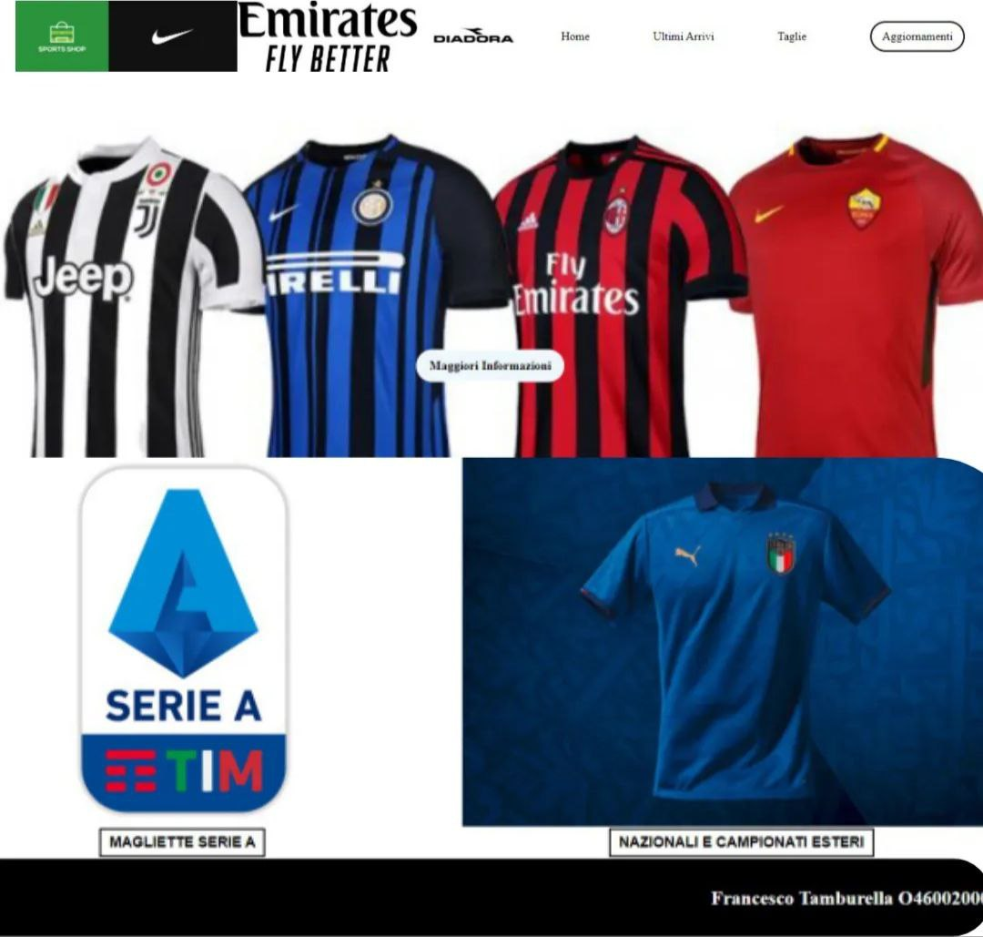
Layout complessivo HTML+CSS

Slide 4
Layout complessivo HTML+CSS
HTML
<!DOCTYPE html>
<html>
<head>
<meta charset="UTF-8" />
<meta name="viewport" content="width=device-width, initial-scale=1.0" />
<link rel="stylesheet" href="https://cdnjs.cloudflare.com/ajax/libs/font-awesome/5.15.3/css/all.min.css" />
<link rel="stylesheet" type="text/css" href="style.css" />
<title>Sport Shop</title>
</head>
<body>
<nav>
<div id="logo">
<img src="img/sport.png">
</div>
<div id="sponsor">
<img src="img/nike.png">
<img src="img/emir.png">
<img src="img/diadora.png">
</div>

Slide 5
Layout complessivo HTML+CSS
<div id="links">
<a>Home</a>
<a>Ultimi Arrivi</a>
<a>Taglie</a>
<a id="push">Aggiornamenti</a>
</div>
</nav>
<header>
<div class="info">
<strong>Maggiori Informazioni</strong>
</div>
</header>
<section>
<div id="box1">
<p>Magliette Serie A</p>
</div>
<div id="box2">
<p> Nazionali e Campionati Esteri</p>
</div>
</section>
<footer>
<h2>Francesco Tamburella O46002000</h2>
</footer>
</body>
</html>

Slide 6
Layout complessivo HTML+CSS
CSS
body {
margin: 0;
}
nav {
display: flex;
height: 100px;
}
#logo {
display: flex;
width: 10%;
justify-content: flex-start;
}
div#logo img,
div#sponsor img {
width: 100%;
}
a {
cursor: pointer;
}

Slide 7
Layout complessivo HTML+CSS
#push {
padding: 10px 15px;
border: 2px solid black;
border-radius: 100px;
}
a#push:hover {
background-color: grey;
}
#sponsor {
display: flex;
width: 45%;
justify-content: end;
}
#links {
display: flex;
width: 50%;
justify-content: space-around;
align-items: center;
}
header {
display: flex;
height: 500px;
width: 100%;
justify-content: center;
align-items: flex-end;
background-image: url(img/magliette.jpg);
background-size: cover;
}

Slide 8
Layout complessivo HTML+CSS
header div.info {
height: 200px;
width: 400px;
margin-bottom: 20px;
z-index: 1;
}
.info {
display: flex;
justify-content: center;
flex-direction: column;
align-items: center;
}
div.info p {
text-transform: uppercase;
background-color: transparent;
font-family: 'Open Sans', sans-serif;
font-style: normal;
letter-spacing: 1px;
text-transform: uppercase;
font-size: 1.25em;
}

Slide 9
Layout complessivo HTML+CSS
strong {
padding: 10px 15px;
background-color: aliceblue;
border: 2px solid white;
border-radius: 100px;
color: inherit;
cursor: pointer;
}
strong:hover {
background-color: goldenrod;
}
footer {
display: flex;
height: 100px;
width: 100%;
background-color: black;
justify-content: end;
align-items: center;
}
section {
display: flex;
height: 500px;
width: 100%;
justify-content: space-between;
flex-direction: row;
}

Slide 10
Layout complessivo HTML+CSS
#box1,
#box2 {
height: 90%;
width: 50%;
display: flex;
flex-direction: column;
background-size: cover;
justify-content: center;
align-items: center;
}
#box1 {
background-image: url("img/box1.png");
background-position: center;
background-size: 40%;
background-repeat: no-repeat;
background-color: white;
}
#box2 {
background-image: url("img/naz.webp");
background-position: center;
}

Slide 11
Layout complessivo HTML+CSS
div#box1 p,
div#box2 p {
margin-top: 75%;
border-radius: 1px;
font-family: 'Open Sans', sans-serif;
font-style: normal;
text-transform: uppercase;
font-weight: bold;
line-height: normal;
font-size: 1.10em;
padding: 5px 10px;
border: 2px solid black;
}
footer h2 {
color: white;
}

Slide 12
Layout complessivo HTML+CSS
@media(max-width:900px) {
a#push {
border: none;
}
div#logo img,
div#sponsor img {
width: 0%;
}
#links {
width: 100%;
}
a {
padding: 5px;
margin-left: 7px;
}
header {
align-items: center;
}
section {
height: 50%;
}
div#box1 p,
div#box2 p {
margin-top: 90%;
font-size: 15px;
cursor: pointer;
border: none;
}
div#box2 p {
color: white;
}
}

Slide 13
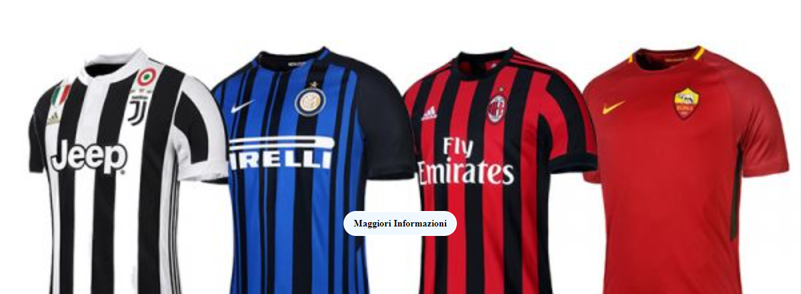
Header

Slide 14
Header
HTML
<header>
<div class="info">
<strong>Maggiori Informazioni</strong>
</div>
</header>

Slide 15
Header
CSS
header {
display: flex;
height: 500px;
width: 100%;
justify-content: center;
align-items: flex-end;
background-image: url(img/magliette.jpg);
background-size: cover;
}
header div.info {
height: 200px;
width: 400px;
margin-bottom: 20px;
z-index: 1;
}

Slide 16
Header
.info {
display: flex;
justify-content: center;
flex-direction: column;
align-items: center;
}
div.info p {
text-transform: uppercase;
background-color: transparent;
font-family: 'Open Sans', sans-serif;
font-style: normal;
letter-spacing: 1px;
text-transform: uppercase;
font-size: 1.25em;
}
strong {
padding: 10px 15px;
background-color: aliceblue;
border: 2px solid white;
border-radius: 100px;
color: inherit;
cursor: pointer;
}

Slide 17
Header
strong:hover {
background-color: goldenrod;
}

Slide 18
Menù navigazione

Slide 19
Menù navigazione
HTML
<nav>
<div id="logo">
<img src="img/sport.png">
</div>
<div id="sponsor">
<img src="img/nike.png">
<img src="img/emir.png">
<img src="img/diadora.png">
</div>
<div id="links">
<a>Home</a>
<a>Ultimi Arrivi</a>
<a>Taglie</a>
<a id="push">Aggiornamenti</a>
</div>
</nav>

Slide 20
Menù navigazione
CSS
nav {
display: flex;
height: 100px;
}
#logo {
display: flex;
width: 10%;
justify-content: flex-start;
}
div#logo img,
div#sponsor img {
width: 100%;
}
a {
cursor: pointer;
}

Slide 21
Menù navigazione
a#push {
padding: 10px 15px;
border: 2px solid black;
border-radius: 100px;
}
a#push:hover {
background-color: grey;
}
#sponsor {
display: flex;
width: 45%;
justify-content: end;
}
#links {
display: flex;
width: 50%;
justify-content: space-around;
align-items: center;
}

Slide 22

Sezione contenuti

Slide 23
Sezione contenuti
HTML
<section>
<div id="box1">
<p>Magliette Serie A</p>
</div>
<div id="box2">
<p> Nazionali e Campionati Esteri</p>
</div>
</section>

Slide 24
Sezione contenuti
CSS
section {
display: flex;
height: 500px;
width: 100%;
justify-content: space-between;
flex-direction: row;
}
#box1,
#box2 {
height: 90%;
width: 50%;
display: flex;
flex-direction: column;
background-size: cover;
justify-content: center;
align-items: center;
}

Slide 25
Sezione contenuti
#box1 {
background-image: url("img/box1.png");
background-position: center;
background-size: 40%;
background-repeat: no-repeat;
background-color: white;
}
#box2 {
background-image: url("img/naz.webp");
background-position: center;
}
div#box1 p,
div#box2 p {
margin-top: 75%;
border-radius: 1px;
font-family: 'Open Sans', sans-serif;
font-style: normal;
text-transform: uppercase;
font-weight: bold;
line-height: normal;
font-size: 1.10em;
padding: 5px 10px;
border: 2px solid black;
}

Slide 26
Footer

Slide 27
Footer
HTML
<footer>
<h2>Francesco Tamburella O46002000</h2>
</footer>

Slide 28
Footer
CSS
footer {
display: flex;
height: 100px;
width: 100%;
background-color: black;
justify-content: end;
align-items: center;
}
footer h2 {
color: white;
}

