Slide 1
Internal Reports
Detailed, information provided to help reader make informed decisions
Effectiveness determined by how well you provide information they need.

Slide 2
Answer your reader’s questions
Make the report’s purpose clear
Use appropriate structure for that purpose
Examine the topic at an appropriate level, and use appropriate language
Ensure that the report is readable; evaluate it objectively
Write ethically; admit limitations, do not hide contrary evidence
Forcefully make your points
Make report professional-looking and error-free

Slide 3
Identify the reader
Always do an audience analysis:
Position and responsibilities
Familiarity with background information
Personal needs and biases
Use this analysis to estimate their information needs.

Slide 4
Identify the situation
Always consider the broader context
Who solicited the report and why?
What are the main and secondary reasons for the report?
What are the business requirements that this report is responding to?
Who will be impacted by your report?

Slide 5
Audience Analysis
Situation Analysis
Purpose / Main Idea

Slide 6
Organize your information
Summary
Write this last! It’s a summation of the entire report (intro to conclusion).
Introduction / Background
Background, situation, context.
Main idea / purpose
Details
Facts, events, observations, support main idea
Conclusions and Recommendations
Provide logical conclusions
Provide definite recommendations for action. What should be done by whom, and when?

Slide 7
Elements of Analysis
Clearly identified problem or question Vague: this report discusses yoga in the workplace. Specific: this report examines and evaluates claims about the therapeutic benefits of yoga in the workplace.
Interpret evidence impartially. Stick to your evidence.
Accurate and adequate information for the reader (what do they need to know?)
Fully interpreted information
Clear and careful reasoning
Appropriate visuals
Logical conclusions and reasonable recommendations

Slide 8
Evaluation or Recommendation Reports

Slide 9
Recommendation Reports
Analyze the business situation
Evaluate alternatives
Conclude and make recommendations

Slide 10
Sections in a Recommendation Report
Summary
The problem, main factors to consider, and solutions
Intro / Background
Current circumstances and problems
Discussion (this is the main body of the report)
List and justify evaluation criteria
evaluate alternatives based on your criteria
Conclusions / Recommendation
Definite decision and recommend implementation / next steps

Slide 11


Slide 12
Introduction / Background
This report was prepared at the request of Kara’s Egyptian Tours, Inc. Kara Welsh is making preparations for a month-long journey into the Egyptian desert next spring, and she has asked us to evaluate suitable pack animals.
While this report includes alpaca and the camel, we did not consider the mule or donkey, as Kara has expressed an irrational fear of anything that looks like a horse. We also included the giraffe, because they smell nice, which was one of Kara’s specific requests.

Slide 13
Introduction / Background
This report was prepared at the request of Kara’s Egyptian Tours, Inc. Kara Welsh is making preparations for a month-long journey into the Egyptian desert next spring, and she has asked us to evaluate suitable pack animals.
While this report includes alpaca and the camel, we did not consider the mule or donkey, as Kara has expressed an irrational fear of anything that looks like a horse. We also included the giraffe, because they smell nice, which was one of Kara’s specific requests.
Authorization
Reasons for the Report
Scope of the Report
Other important information for the Reader

Slide 14
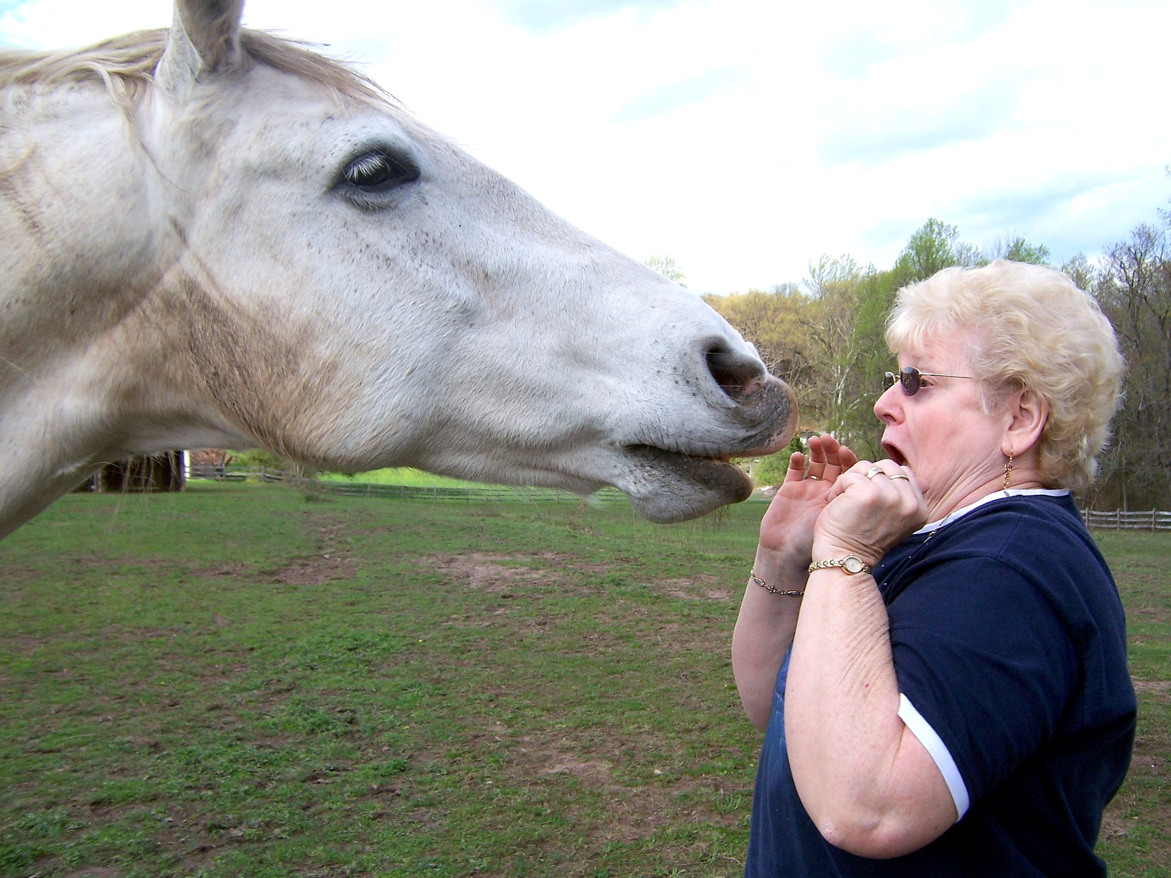

Slide 15
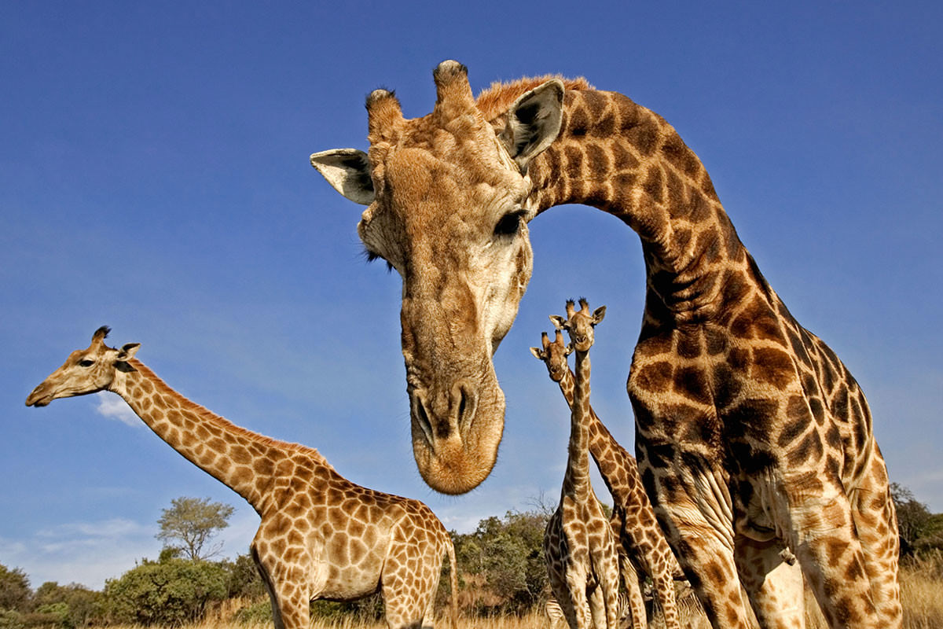

Slide 16
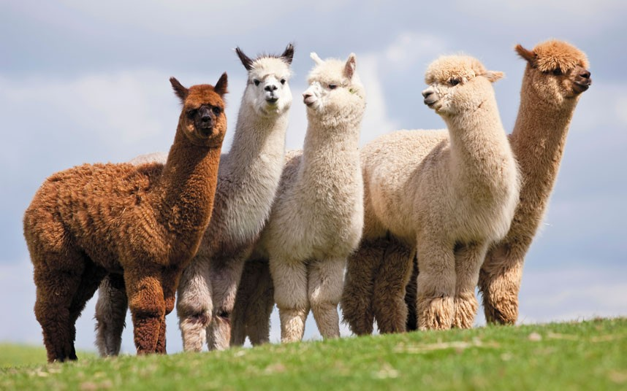

Slide 17
Discussion Section
Methodology
Explain criteria (persuasively)
Rank criteria
Evaluation
Lay out each alternative in turn and judge according to criteria
Often includes a table or chart at the end of the analysis to summarize

Slide 18
Discussion Section -- Methodology
Set up your evaluation criteria and be persuasive!
Make sure that you explain each criteria carefully, and say why it is more or less important than the others. Don’t just make a list!
Example
Criteria for choosing a pack animal for desert travel:
Criteria a) animal must be able to travel long distances without water
Criteria b) animal must be able to carry two people plus supplies
Criteria c) animal must obey commands
Criteria d) animal must smell nice
Ranked by order of importance

Slide 19
Evaluate alternatives based on criteria
Alternative 1 – Giraffe
Not able to travel long distances without water
Can carry two people plus supplies
Does not obey commands
Smells nice
Alternative 2 – Alpaca
Able to travel long distances without water
Cannot carry two people plus supplies
Obeys commands
Does not smell nice
Alternative 3 – Camel
Able to travel long distances without water
Can carry two people plus supplies
Obeys commands (mostly)
Smells terrible.
Again, explain each alternative using full sentences and paragraphs. Show your logic and reasons. Don’t just make a list like above!

Slide 20
Quick summary
Tables or other simplified data displays help the reader understand your reasoning at a glance.
 | Giraffe | Alpaca | Camel
Travels far without water | ✖ | ✔ | ✔
Can bear 2 riders plus supplies | ✔ | ✖ | ✔
Obeys commands | ✖ | ✔ | mostly
Smells nice | ✔ | ✖ | ✖

Slide 21
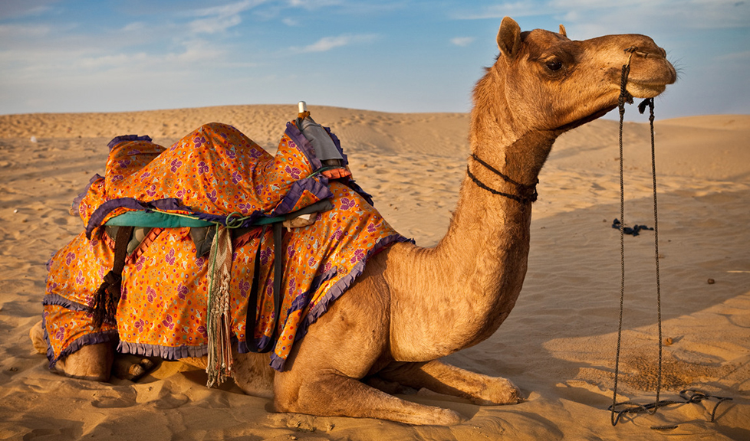

Slide 22
Conclusions and Recommendations
Conclusion:
Although the Alpaca can travel far without water, and it obeys commands, the camel is a better choice because it can carry more riders and supplies. Also, the camel mostly obeys commands, especially if you feed him well.
Recommendation:
I recommend we purchase fifteen camels for the journey. We should put the order in right away, and begin preparations for camel housing and food over the winter. This way, we can make sure that they are in good shape, and will respond well to orders in the spring journey.

Slide 23
Summary
This report evaluates three pack animals for Kara Welsh’s spring journey in the Egyptian desert. We analyzed the suitability of Camels, Alpacas and Giraffes (at the specific request of our client), based on their ability to travel without water, their carrying capacity, their obedience and their smell. We conclude that the camel is the best choice given these criteria, and recommend immediate purchase.
Write the summary last!
Put it at the beginning of the document
The summary should contain essential information from the entire report!

Slide 24
Make it easy for the reader
Readers are busy.
Your document (email, report, proposal) must be scannable.
Use summaries, and introductions to sections.
Use descriptive and specific headings and subheadings.
Use bullets and lists.
Number and label all graphics, tables and figures.

Slide 25
Useful and Useless Headings
Abstract nouns are useless:
Introduction
The problem / the solution
Stage 1
Etc.
Instead, use descriptive headings and subheadings
concrete, specific, meaningful terms to help the reader scan the document.
An examination of current market conditions
Staffing needs / Getting and retaining new staff.
Pouring the concrete slab
Choosing the best pack animal
etc.

Slide 26
Other tips
Write the summary last (but put it at the beginning)
The summary is NOT the same as the Introduction
The Introduction should mention:
Authorization
Scope
Purpose
Criteria
Conclusions are NOT the same as Recommendations
Presentation matters. See textbook for expectations or format layout (memo format).

