Slide 1
The customer does the work
Spark should be doing for them.
A validated 12-month usage-and-spend snapshot — embedded, not linked.
Spark New Zealand · Annual Mobile Plan Review · A2-D2 Business Case
01 / 16

Slide 2
02 — MARKET
A market under regulatory pressure
31%
73%
transparency score for Spark's own plan summary (Commerce Commission, 2024–2025).
of mobile customers don't switch providers —
it's too much effort.
late 2025
the Commission found Spark had discontinued its usage-based recommendation feature entirely.
02 / 16

Slide 3
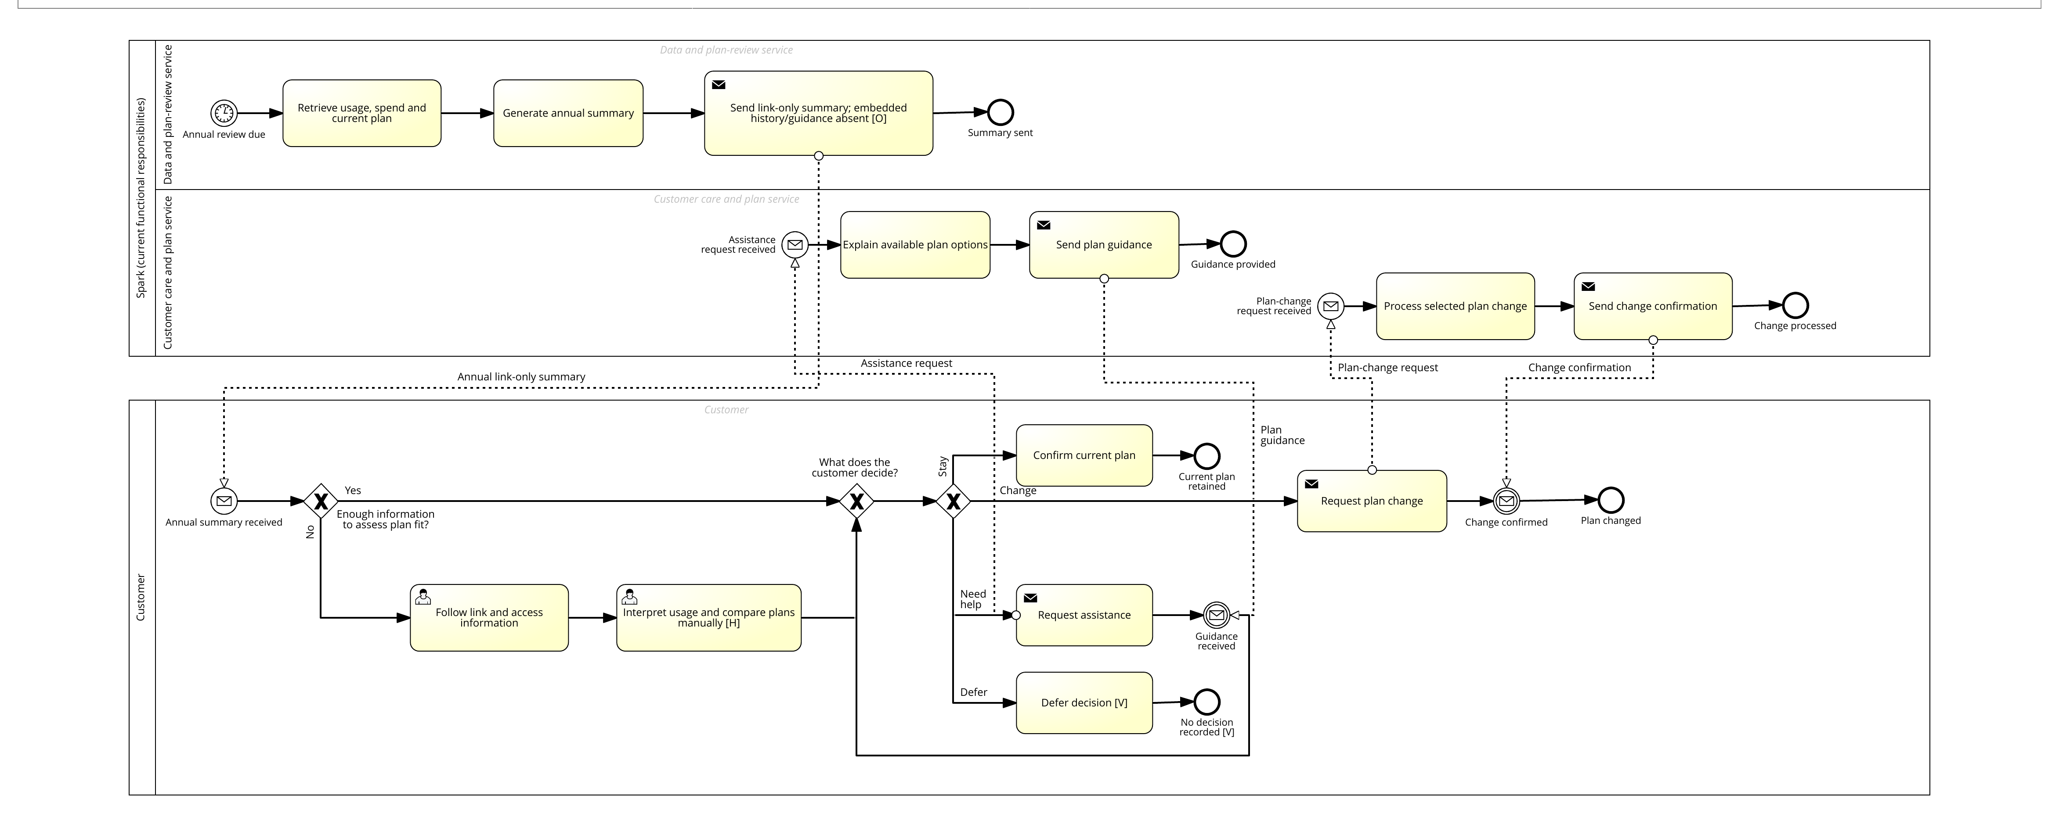
03 — PAIN POINT
The annual review journey today
The customer follows a link, interprets twelve months of data, and compares plans — alone.
Figure 1 (A2-D1), AS-IS process — customer lane, self-service branch
03 / 16

Slide 4
04 — INSIGHT
What's actually broken
SPARK
CUSTOMER
Sends a link
→
Does the analysis alone
Two exploratory responses — one human, one GenAI, same guide — converged on the same mechanism. A working hypothesis, not yet proof.
04 / 16

Slide 5
05 — RECOMMENDATION
Pathway A
Embed a validated 12-month usage-and-spend snapshot
directly in the annual summary.
Removes the self-service analysis step entirely.
Pathway B — personalised recommendations — deliberately deferred to a gated Phase 2.
05 / 16

Slide 6
06 — ALTERNATIVES
Not the alternatives
 | Impact | Feasibility | Risk | Evidence
A — Embed snapshot | High | High | Low | High
B — Personalise now | High | Low | High | Medium
C — Navigation only | Low | High | Low | Medium
D — Full transform | Med-high | Very low | Medium | Low
A offers the strongest overall balance. Each alternative trades off at least one criterion — C is folded in as a supporting element, not rejected outright.
06 / 16

Slide 7
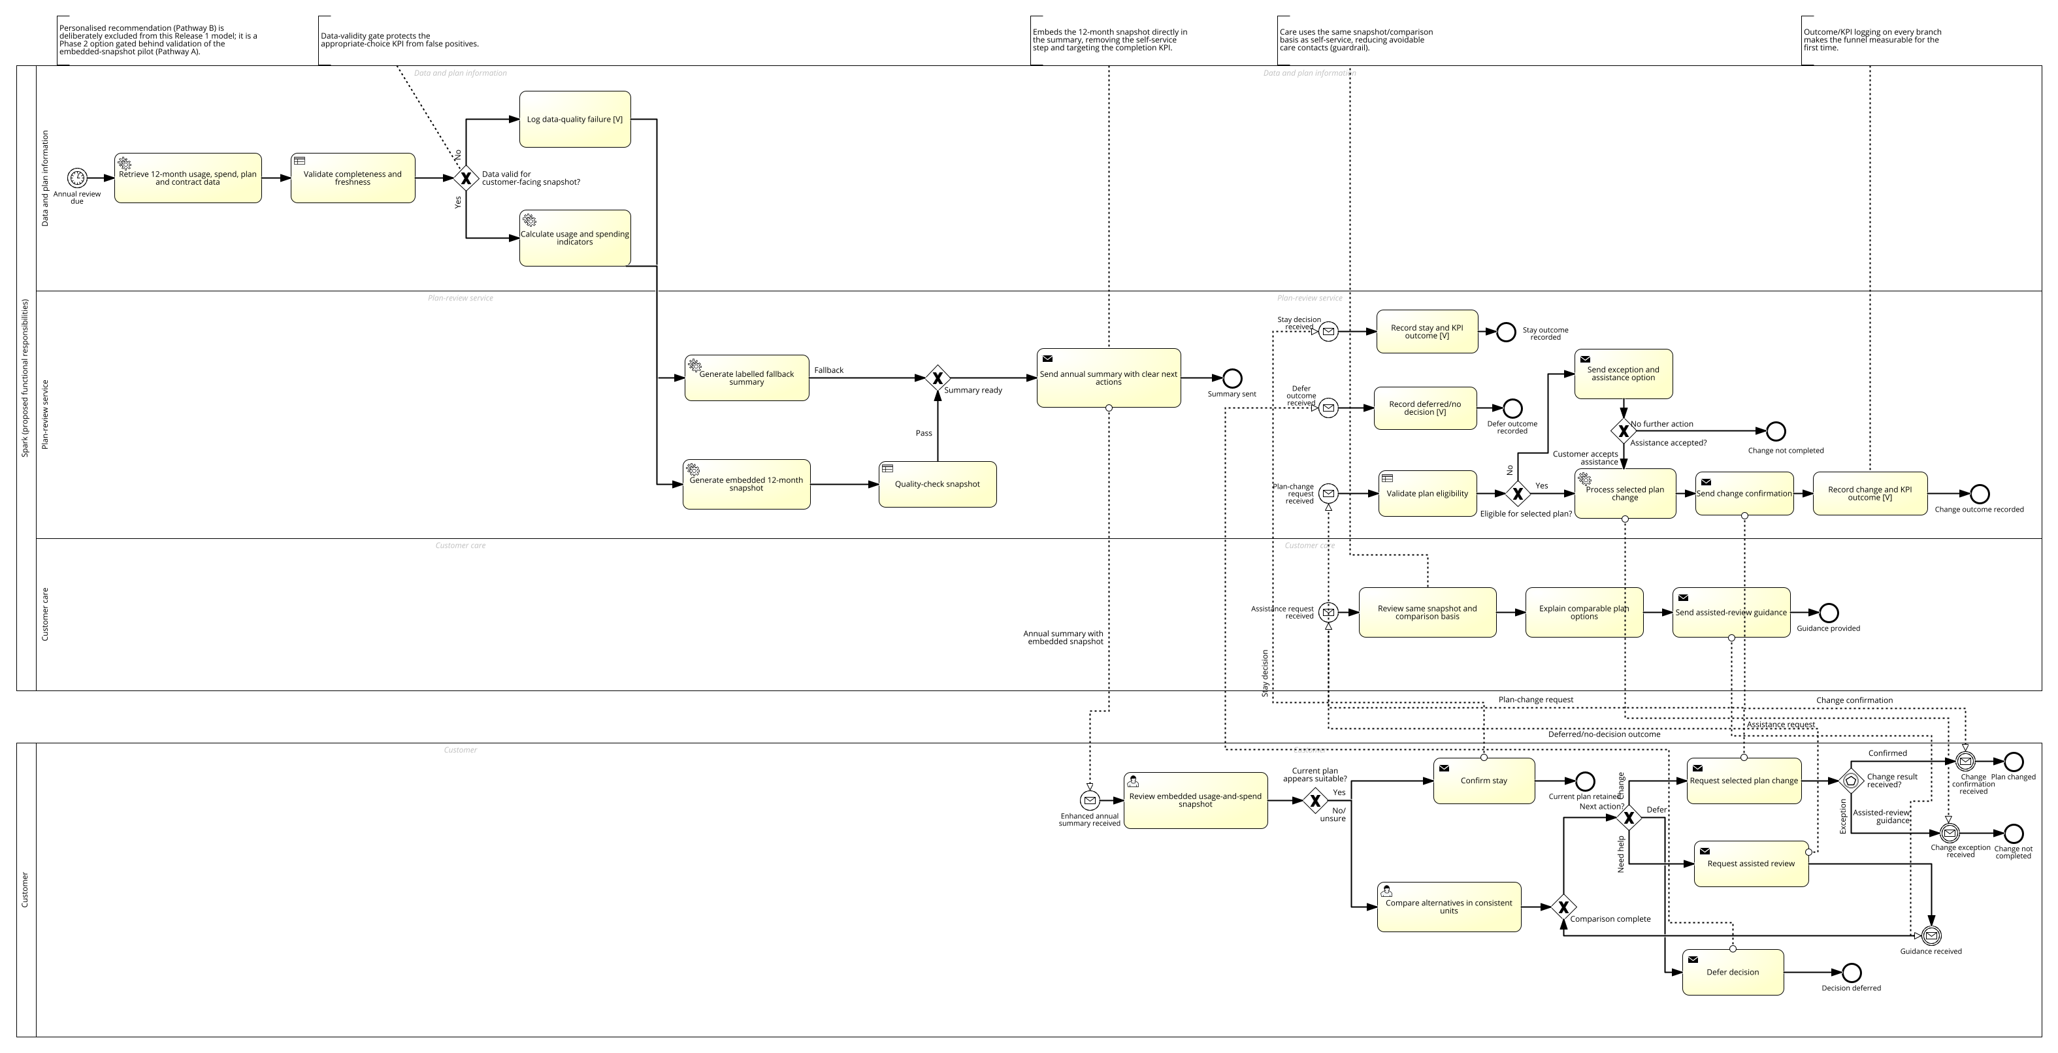
07 — MECHANISM
The redesigned journey
01
VALIDATE BEFORE EXPOSURE
Only complete and fresh data can enter the customer-facing snapshot.
First of three linked changes, with shared evidence and outcome logging downstream.
Figure 2 (A2-D1), TO-BE process — data-validity gate (excerpt)
07 / 16

Slide 8
08 — SUCCESS METRIC
How we'll know it worked
+5pp
Effective plan-review completion rate
Customers reaching an appropriate stay-or-change decision within 30 days, vs. a link-only control, by 30 June 2027.
08 / 16

Slide 9
09 — GUARDRAILS
Guardrails, not just growth
Retention value
ARPU
Complaint rate
A good headline number can't be allowed to hide a bad customer outcome underneath it.
09 / 16

Slide 10
10 — METHODOLOGY
Five-stage delivery
01 Diagnose
02 Design
03 Build & Test
04 Controlled Pilot
05 Scale & Sustain
Each stage gate is a real checkpoint and nothing proceeds until evidence from the previous stage clears it.
10 / 16

Slide 11
11 — TIMELINE
Timeline: 34 weeks
Kick-off: 2 November 2026
Diagnose
4w
Design
5w
Build & Test
6w
Pilot
10w
Scale
9w
Phased, not big-bang — the appropriate-choice rule hasn't yet been tested against real customer outcomes.
11 / 16

Slide 12
12 — TEAM
The team behind it
Engagement Manager
Rae Huang
Senior Process & Data Analyst
proposed, named at contracting
Change & Training Lead
proposed, named at contracting
12 / 16

Slide 13
13 — RISKS
Managing what could go wrong
Data quality
Process ownership
→
→
Inherent
Residual
Inherent
Residual
(residual = after mitigation)
(residual = after mitigation)
Validation gate before any snapshot reaches a customer.
Named owner required as a hard condition of kick-off.
Seven risks are actively managed across the register — these two are the highest-severity.
13 / 16

Slide 14
14 — ECONOMICS
The financial case
$576k
$160k
illustrative professional-services fee
illustrative annual benefit
$144k avoided Care cost + $432k retained margin
3.6×
≈4 months
benefit-cost ratio
simple payback
Every input is a Stage-1-to-be-confirmed assumption, not observed Spark data — this is not a cash-flow model from kick-off.
14 / 16

Slide 15
15 — COLLABORATION
What we need from Spark
01
A named process owner
02
Access to usage & spend data
03
Business SMEs for design workshops
04
A change-and-training resource for Care briefing
05
Two timely decisions
appropriate-choice rule sign-off · pilot go/no-go
15 / 16

Slide 16
The next step is simple.
01
Confirm acceptance.
02
Nominate an owner.
03
Kick off 2 November 2026.
Limited cost, manageable risk, and ongoing regulatory exposure — the case for deciding now.
16 / 16

