Slide 1
MEM MMU LIB
Tony-Nguyen

Slide 2
Scoreboard - Reality Problem
Score Board
Scenarios:
1. Write by AXI, Read by PCIE
2. Write by PCIE, Read by AXI
3. Write by AXI, Read by AXI
4. Write by PCIE, Read by PCIE
send port
recv port
send port
recv port
AXI-VIP
DUT
AXI-VIP
AXI-VIP
AXI-VIP
AXI-VIP 0
AXI-VIP 0
send port
recv port
send port
recv port
AXI-VIP
AXI-VIP
AXI-VIP
AXI-VIP
PCIE-VIP 0
PCIE-VIP 0
Difficult to do Scoreboard for predicting which are send port and receive port to be compared

Slide 3
Proposal
MEM MMU (Memory Management Unit)
Manage all sent data follow address
Need only receive ports
Score Board
mem_mmu::*
send port
recv port
send port
recv port
AXI-VIP
DUT
AXI-VIP
AXI-VIP
AXI-VIP
AXI-VIP 0
AXI-VIP 0
send port
recv port
send port
recv port
AXI-VIP
AXI-VIP
AXI-VIP
AXI-VIP
PCIE-VIP 0
PCIE-VIP 0

Slide 4
MMU-Binary Tree Structure – theory
Binary Tree - IMEM
Have 16 buffers adjacent
Buffer size is 256 bytes
Start address = 32’hffff_f000
roof
left_node
1
right_node
1
Bufer 0: 32’hffff_f000 - 32’hffff_f0ff
Bufer 1: 32’hffff_f100 - 32’hffff_f1ff
Bufer 2: 32’hffff_f200 - 32’hffff_f2ff
….
Bufer 15: 32’hffff_ff00 - 32’hffff_ffff
0
1
Buffer 13

Slide 5
MMU-Binary Tree Structure – classes building
mem_mmu
mem_mmu_binarytree_info
root_node
mem_mmu_node
left_node right_node

Slide 6
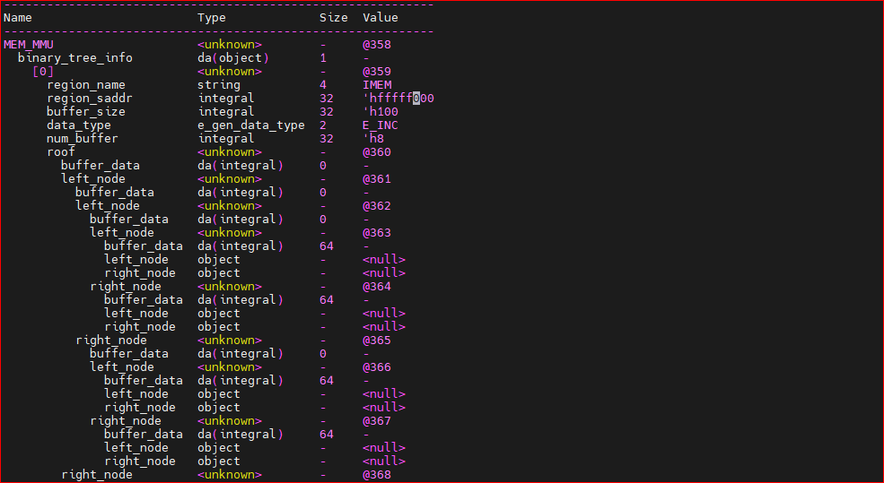
MMU-Binary Tree Structure – code implementing

Slide 7
MMU-Binary Tree Node -definition
Node attributes:
left_node
right_node
buffer_data[]
node
right_node
left_node

Slide 8
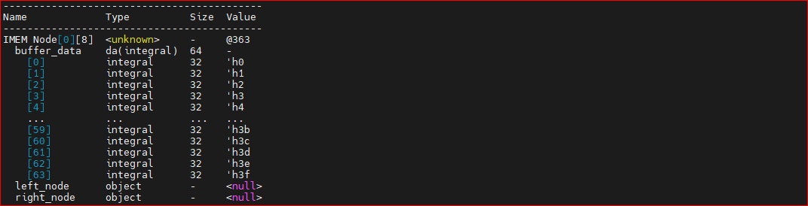
MMU-Binary Tree Node -definition

Slide 9
MMU-Binary Tree Functions - definition
class mem_mmu
create_binary_tree
string region_name
uint32_addr_t buffer_size
get_buffer_n_by_name_from_binary_tree
string region_name
uint32_addr_t buffer_n
get_buffer_by_address_from_binary_tree
uint32_addr_t buffer_addr
uint32_addr_t region_saddr
uint32_addr_t num_buffer
e_gen_data_type data_type

Slide 10
MMU-Binary Tree Functions - definition
virtual function create_binary_tree
string
region_name
Name of regions, example: IMEM, DRAMCHG,…
uint32_addr_t
buffer_size
Size of buffer: 2, 4, 8, 16, 32, … should be power of 2
uint32_addr_t
num_buffer
Start address of region
uint32_addr_t
num_buffer
Number of buffers will be allocated
e_gen_data_type
data_type
Generate data follows pattern: RANDOM, INC, DEC

Slide 11
MMU-Binary Tree Functions - definition
virtual function get_buffer_n_by_name_from_binary_tree
string
region_name
Name of regions, example: IMEM, DRAMCHG,…
uint32_addr_t
buffer_n
Buffer N from specified region will be read.

Slide 12
MMU-Binary Tree Functions - definition
virtual function get_buffer_by_address_from_binary_tree
uint32_addr_t
buffer_addr
Get buffer following address.

