Slide 1
Project 1.5: DFNB - Analyze History - Visualization and Presentation
Francisco Agballog

Slide 2
Strategies
Goal > Objective > Strategy > TacticWhat?
Goal: To understand howa bankworksObjective:
•Last year compared to the previous two years
•Several different measures: count, commitment, balance, revenue
•Production in terms of geographic regions, branches, and products
•New vs. existing customers
Why? To understand the bank income from loans in order to make better assumption ofthis year how to gain more profit by adjusting the interest rates and targeting specific costumer. So that the bank can compare what happen to their costumer who are more potential or eligible to loan from the bank.
How? Analyze the date of customers, their location/ addresses, credit/ income / balance, purchase item.
Strategy: Understanding account: Account has different types mainly are person account, checking account, saving account, business account, payment account, and investment account.
Tactic: every customer could have multiple accounts for various usage.

Slide 3
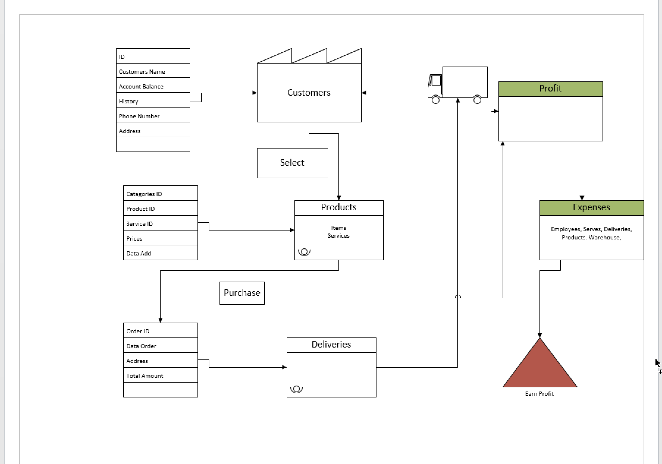

Slide 4
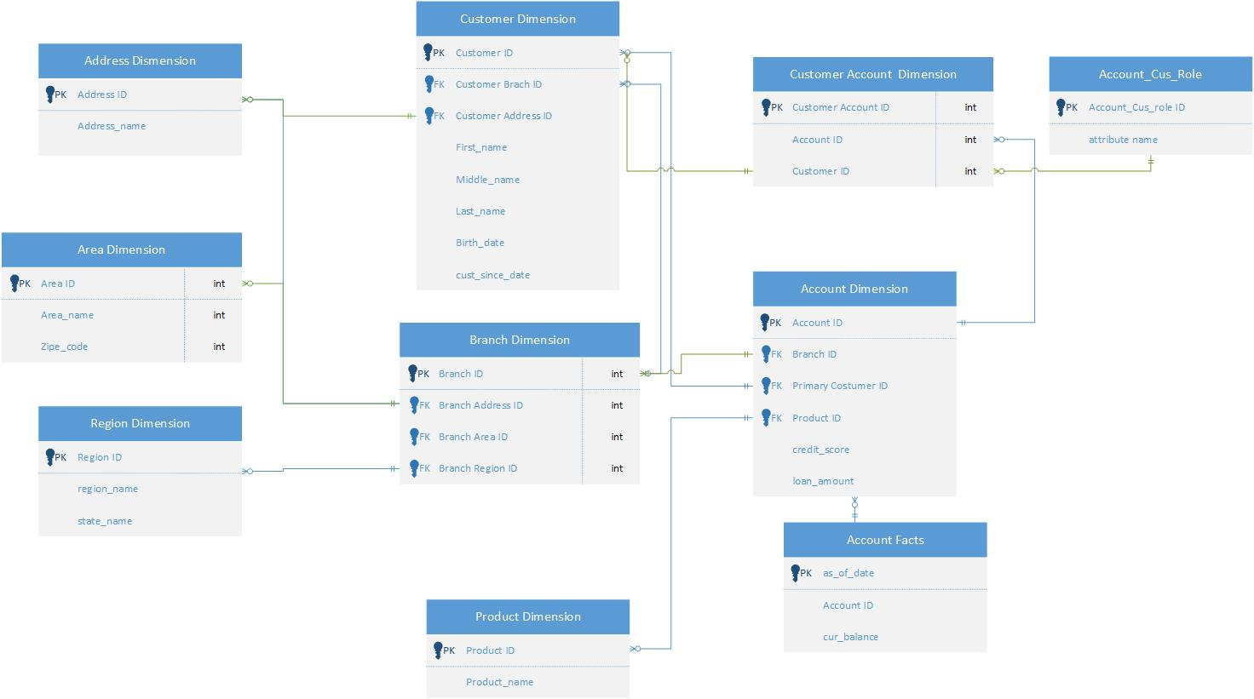

Slide 5
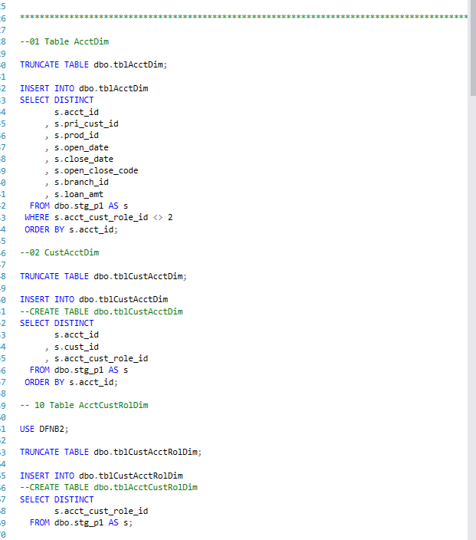
Scripts
Github
Tables
Views
Loads

Slide 6
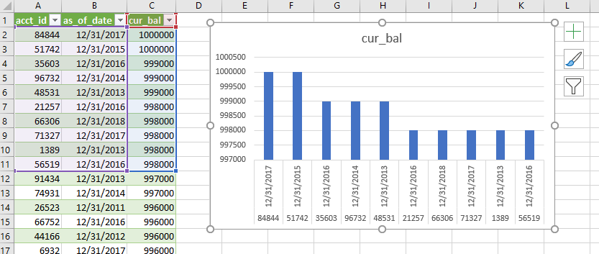
Excel

Slide 7
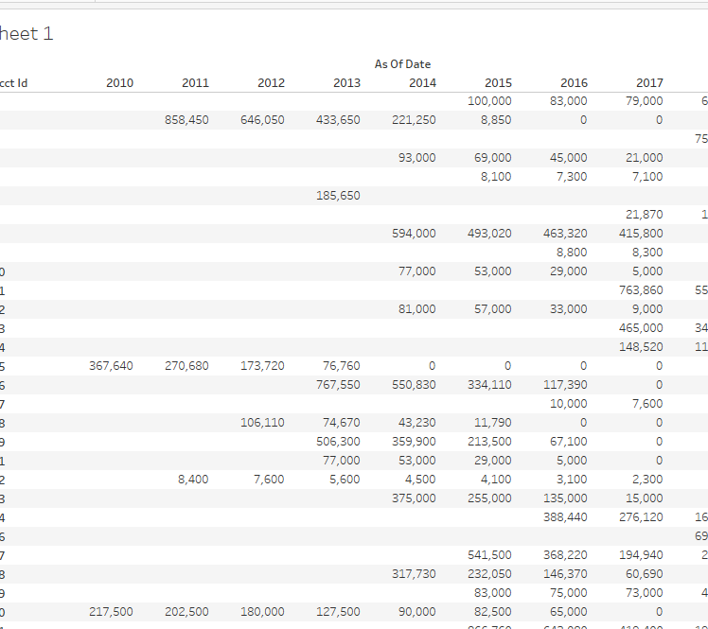
Tableau

