Slide 1

Serverless Workshop
Notes:
Hi, My name is Burke
I work at Microsoft where I am a principle content engineer.
I’ve spent a lot of time thinking about this question. What makes something serverless? How can we identify exactly what is and what is NOT serverless.
Most of all, how can we clearly articulate that to developers?
I believe, there are three fundamental principles that make something serverless. Three boxes. If something ticks all 3 of these boxes, then it’s serverless.

Slide 2

Notes:
Before we get started today, we’ve got a few housekeeping items to cover.
We’re going to be spending a lot of time together today, and we want everyone to be as successful as they can, and everything to run as smoothly as possible.
Has anyone ever been on an airplane? And you know they always do that safety talk that nobody listens to? Exists are here. Isle path lighting is there. Your seat is a flotation device.
This is that safety talk – so listen up! ☺
First off, let’s get the most important topic out of the way…

Slide 3

Notes:
WIFI. What matters more in life than a strong wifi connect? My kids would say, “nothing”.

Slide 4
MSFTGuest
Connect
Navigate to bing.com
Click on
Enter “msevent”
Event Attendee Code
Notes:
First connect to the MSFT guest wifi
Open a browser and navigate to bing.com. Possibly for the first time in your life.
You’ll be redirected to a capture page. Click on the “Event Attendee Code” button
Enter “msevent….”. That code is also display here in this room ???

Slide 5

From | To | Session
08:30 AM | 09:00 AM | Check-in & breakfast
09:00 AM | 10:00 AM | Greatest keynote of all time
10:00 AM | 10:15 AM | Break
10:15 AM | 10:30 AM | Challenge Overview
10:30 AM | 12:00 PM | Code Challenge
12:00 PM | 01:00 PM | Lunch Break
01:00 PM | 01:30 PM | Using Serverless Framework with Azure
01:30 PM | 03:00 PM | Code Challenge
03:00 PM | 03:15 PM | Break
03:15 PM | 04:30 PM | Code Challenge
04:30 PM | 05:00 PM | Wrap Up
Notes:
Here’s our agenda for today.
Hopefully you got checked-in and got a little breakfast.
Then we’re going to dive right into what is probably the best keynote you have ever heard in your entire life. Like a TED talk, but way, way better.
We know you’re probably going to load up on about 4 cups of coffee first thing in the morning, so we’re going to take a quick break after that. Besides, you’ll need the break to recover from the whole experience.
Then Mike Collier and David Barkol – I believe both of these guys are global black belts. Is that right? Man – that title is WAY better than mine! They’re going to come up give you an overview of the challenges today.
Then we’re going to break for lunch – probably the most important row in this table, am I right?
Then after lunch, you’re going to be some of the first to hear about how to use the “Serverless Framework” with Azure. This is going to be quite interesting as it abstracts away from you the implementation of Azure and allows you to be multi-cloud and write serverless functions for multiple cloud providers with one code base. Pretty rad. That’s going to be My Ho and ….. Who else am I missing?
Then we’re gonna spend the rest of the afternoon doing the code challenges. Let’s talk about those challenges.

Slide 6

Notes:
We would like to see you work in groups of 2 or 3 on these challenges. Things like this are so much easier when you have multiple people working together at the same time. You can solve problems as a group that you can’t solve so easily on your own.
So, turn around. Make a friend.

Slide 7
My Ho
Eduardo Laureano
Jeff Hollan
Anirudh Garg
Joseph Barnes
Mike Budzynski
Matthew Farmer
Michael Collier
David Barkol
Burke Holland
Notes:
Now, we’ve got a lot of folks directly from Redmond here today to work with you. This is a great chance for you to talk to some of these folks who work on these products day in and day out.
[Introduce folks
These folks are going to be proctoring all day. As you complete a challenge, you’re going to raise your hand and a proctor will come over, check you off and give you a little reward. Yes – we have prizes today for each item you complete.
The wonderful proctors can help with challenges, answer questions, point you in the right direction
So what are you gonna do if you finish or get stuck?

Slide 8

Notes:
Raise your hand. Someone will come over and help. We’ve got a lot of MSFT people here, so make sure you put them to work.
OK! Safety demonstration is over.
And now, I have a question for you…

Slide 9
?
Notes:
What is Serverless?
Do you know? Do you?
Can you turn to the person next to you and explain it in one sentence?
Could you explain it to someone who is not technical without inducing a coma?
A wise man once said this about the word “Serverless”

Slide 10
“It’s not important to understand what “Serverless” means. It’s only important that you know the word and you are not afraid to use it in a blog post”
- Me
: In a blog post.
About Serverless.
Notes:
That was me. In a blog post. About Serverless.

Slide 11

Notes:
“Serverless” is a buzzword.
Like all buzzwords, it’s kind of lost it’s meaning. It’s more useful now as marketing jargon than it is for conveying a technical or architectural concept.
My guess is that if I asked 10 people in this room what Serverless is, I would get 10 different answers.

Slide 12
Build applications without thinking about servers
Notes:
Some good attempts at distillation of the definition have been made.
This is a good one. Build applications without thinking about servers.
But…..I don’t ever really think about servers anyway. I mean – do you? Do you go to write a line of code, stop yourself and say, “WAIT. Stop. Before you declare that variable, what sort of server will this variable be declared ON. We’re not going any further until someone figures that out”.
And isn’t that the whole point of a Platform as a Service? Don’t places like Azure and Heroku and others already let you just deploy your code and not worry about a physical server or virtual machine?
And if all of that is true, does this mean that pretty much everything is already serverless? Wouldn’t it be easier to describe things that AREN’T serverless?

Slide 13
…custom code run in managed, ephemeral containers on a “Functions as a Service” (FaaS) platform.
Notes:
HUH!
Ephemeral? I’m not even 100% sure what that word means.
But the FaaS part – perhaps that’s the part that resonates with you.
Perhaps that’s how you would describe “Serverless”

Slide 14

Notes:
You would say, Azure Functions.
Maybe you would describe Serverless as a product. And you would be right.
These are products that are specifically designed and marketed as “Serverless”.
They are in a class of “as a service” products called….

Slide 15
FaaS
Notes:
FaaS
These services are the ultimate abstraction layer
Not only do you not have a virtual machine, but you don’t have a runtime either
All you have is literally a single code file that you can put up into the cloud and it can run.
No project file. No ASP.NET or Node web server necessary.
Now – lets talk a little bit about why you would want to use a Serverless service

Slide 16

1
Notes:
You have no knowledge of the underlying system – period. None.
This is different from platform as a service. While you aren’t exposed to the operating system, you still have some system knowledge.
For example, in Azure AppService, you must choose a “Service Plan” which defines the parameters of your app instance.
A P1V2 service plan includes 1 Core, 3.50 GB of RAM and 250 GB of storage.
With something that is serverless, none of that is your concern. You will get exactly what you need when you need it.
There is no provisioning things up front
That’s rule number 1 for serverless.

Slide 17

2
Notes:
You only pay for what you use
In Azure, a P1V2 service plan runs you a flat rate of 20 cents per hour. If that server is pegged all the time, 20 cents per hour. If it sits there and nobody uses it, 20 cents.
For those who haven’t already done the math in their head, that’s $144 per month. You pay that no matter what.
To qualify as serverless, you should only be paying for what you use. Kind of like water.
You could turn the water faucet on in your house and just leave it on. Then use it when you need to.
But we don’t do that. Why don’t we do that?

Slide 18

2
Notes:
Because it’s wasteful.
So we only turn the water on when we need it. And we turn it off when we don’t.
Consequently, your bill for the month will fluctuate based on how much water you use.
That’s the second principal of Serverless – only pay for what you use.

Slide 19

3
Notes:
And principal number 3
Scaling must be a solved problem. You never have to think about it.
In the case of a P1V2 service plan in Azure, you must set the plan to auto-scale out. And when it does, it does so at $144 per month a pop.
In other words, if you only need a little extra boost for traffic, you have to pay for an entire second service plan, even if you don’t need all of the compute that it provides.
With principal 3 – scaling just happens. And remember – scaling goes both ways – up and down. None of it is something that you should ever have to worry about.
If you need extra compute, the service should figure that out and scale up appropriately. Once you stop using that extra compute, it should scale back down because you are only paying for what you use.

Slide 20
$
Notes:
Cost.
The cloud offers amazing power, but it’s not cheap. The primary value proposition of Serverless is that you only pay for what you use, thus making cloud service adoption much more affordable.
That make Serverless inherently cheap. That means that the more parts of your applications that are serverless, the cheaper the whole application is to run.
Serverless is also GREAT for event driven systems. Now what do we mean by that?

Slide 21
$EVENT
Notes:
There are all sorts of events that happen in any system. An HTTP call is made. An item is inserted into a database. The time changes. All of these are events that you may want to use to trigger an action.
For instance, if I had an e-commerce store, and someone create a new order and submitted it – I might update the order flag in that record.
Now I need to execute some code that pull in that order, insert another record into a different database and create the actual invoice.
Traditionally, we would do that all in one system. These days, we do that in many different services that we call “Micro-services”. One service saves the order. This event triggers another service to update the order. This triggers yet another to pull that order and create the invoice and that one triggers yet another to kick off some process in the warehouse systems.

Slide 22
Notes:
Some common use-cases for things like serverless range all the way from a simple http api, all the way to elaborate micro-services architectures like the example of an entire e-commerce solution.
Serverless is also great for augmenting your existing API. Say you have an entire system and all you want to do is add a method that sends an email. You don’t have to redeploy an entire codebase to do that. You can just stand up a serverless function.
So let’s take a look at how this works.

Slide 23
/my-functions-project
/GetProducts
index.js
function.json
/ProcessOrders
/SendReport
Notes:
In Azure Functions, you create a functions project. You can do that right from the Azure Portal.
Let’s do that now: CREATE FUNCTION APP IN PORTAL
Then you create your functions. Each of these functions has a code file where you put code that gets executed. These code files to need to return the main entry point that Azure Functions should execute.
You can write Functions in C#, JavaScript, TypeScript, Python and Java
That’s really all there is to it as far as “where you put your code”.
Now there are two fundamental concepts that you have to understand when it comes to Azure Functions

Slide 24
Triggers Bindings
Notes:
Now, there are two main technical concepts in Functions that you need to understand.
Triggers and Bindings.
First, let’s talk about triggers.

Slide 25
/my-functions-project
/GetProducts
index.js
function.json
/ProcessOrders
/SendReport
Notes:
These functions here have to be executed somehow some way. How and when should Azure Functions execute these things?
Functions can be executed a variety of ways, and we calls these ways “Triggers”.

Slide 26
* HTTP Trigger * Timer Trigger * Queue Trigger * Event Grid Trigger
Notes:
You can create functions that are triggered by any of these things.
The second concept that you need to understand is bindings.
Bindings are kind of the “special sauce” of serverless.
When you are in the cloud, you likely have a lot of other services running in the cloud too.
You can pass those items into functions as the context in which the function runs. There is a literal “context” object that you get inside your function, and the item you are bound to just magically shows up on that object.

Slide 27
BLOB Storage
Cosmos DB
Event Grid
Event Hubs
HTTP & Webhooks
IoT Hub
Microsoft Graph
SendGrid
Twilio
Notes:
Here are just some of the items that you can have bindings to.
Bindings simply make it easier for you to interact with other services, data stores, ect because you don’t have to do anything to wire up the connection. It’s just already there in the context of the Function.
Conceptually, that may not make a ton of sense, but you’re going to do an exercise today where you explore the concept of bindings in a real concrete way.

Slide 28
Notes:
Alright – let’s take a look at Azure Functions in action – shall we?
So that’s Azure Functions. We’ll be doing a lot with that today.
But there are other services in Azure that could be considered Serverless. Another one that we’re going to work with today is called “Logic Apps”.

Slide 29
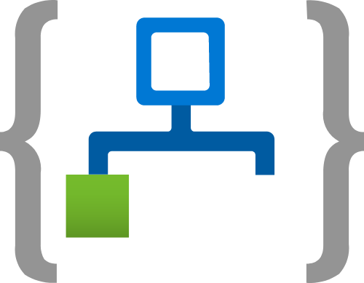
Notes:
Logic apps is a workflow and task automation system within Azure.
Who here is familiar with iftt? That’s a good way to think about Logic Apps, except with deep integration to all sorts of systems.
Process and route orders across on-premises systems and cloud services.
Send email notifications with Office 365 when events happen in various systems, apps, and services.
Move uploaded files from an SFTP or FTP server to Azure Storage.
Monitor tweets for a specific subject, analyze the sentiment, and create alerts or tasks for items that need review.
And Logic Apps are Serverless. You only pay for when they are running and the compute that they use. Let’s take a look at Logic Apps.

Slide 30
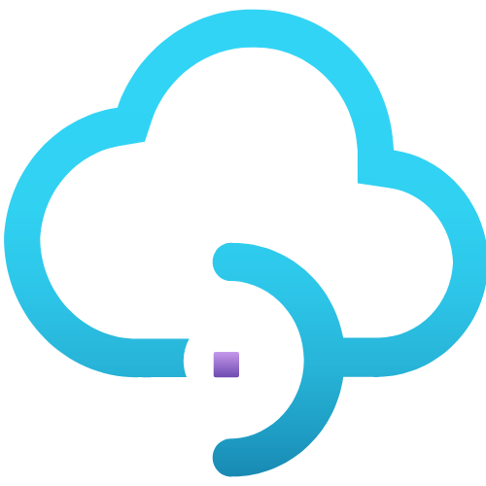
Notes:
API Management is another service that is considered “serverless”.
API Management is a great example of a service that you don’t know that you need until you need it.
It allows you to create an API surface that sits on top of disparate endpoints. It’s a struggle to create a logical, clean API surface with code alone. Especially as your projects grow.
API M allows you to do that, and provides addional tools like service discovery. If you work in a massive service driven organization with thousands of services, API M is the best friend you could ever hope to have.

Slide 31
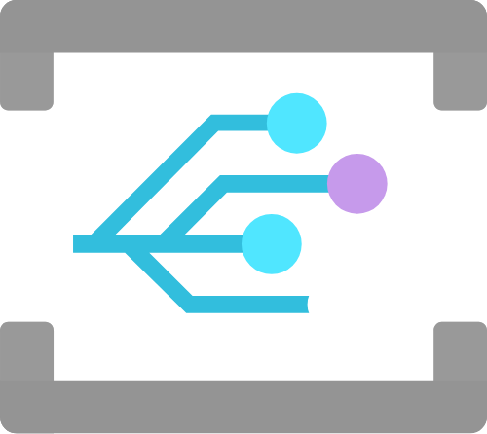
Notes:
The last “serverless” service we’ll be look at is called “Event Grid”.
We already said that apps are event based, right? There are HTTP calls, button clicks, database inserts, files moved here and there.
As our systems get more and more distributed, managing these events gets harder and harder.
Event Grid allows you to control the sending and receiving of events all from one central source.
It’s a bit hard to understand exactly what Event Grid does just by talking about it, so let’s have a look at a demo.

Slide 32

Notes:
Alright – that’s your crash course in the products you’re going to be working with today.
Now, we’re gonna take a break
And when we come back we’ve got….
Mike and David
Giving an overview of the challenges
Unleash your creativity
But before we do that – there’s one more thing

Slide 33
Gustavo Machado 🎂
Notes:
Where is Gustavo Muchado?
Are you here? We heard that it’s your birthday. Happy Birthday.
What a way to spend a birthday – learning about Serverless! Let’s all sing a round of happy birthday to Gustavo….

