Slide 2
Nemo and OnDemand
Chris Hadjigeorgiou
Todd Fallesen

Slide 3
Topics overview
Nemo Overview
OnDemand overview and basics
Nemo modules
Folder structure
Command line usage
SLURM
Jupyter
Fiji installation

Slide 4
Nemo
Nemo is the Crick’s HPC platform. It’s a Linux-based high-performance storage and computing system which is a replacement of the previous CAMP system.

Slide 5
Nemo Overview
Nemo is currently composed of:
5 partitions available migrated from CAMP(Intel based):
cpu : 190 CPU nodes, 32 threads, 256GB RAM
gpu : 40 GPU nodes, 80 threads, 754GB RAM, 4x NVidia V100 GPGPU(32GB RAM)
hmem : 4 High Memory, 96 threads, 1500GB RAM, minimum RAM is 750GB
int : 8 Interactive nodes, 48 threads, 376GB RAM, only available with srun/salloc
vis : 4 Visualization nodes, 48 threads, 376GB RAM, Quadro RTX 5000, only available with srun/salloc
3 new partitions(plus 2 more in the future) which will be publicly available soon(AMD based):
ncpu: 92 CPU nodes, 256 threads, 2TB RAM
nhmem: 2 High Memory, 256 threads, 4TB RAM
nint: 4 Interactive nodes, 256 threads, 2TB RAM
Any user can submit jobs to any queue but each queue has different constraints.
Storage
16+ PB GPFS Filesystem
Networking to each compute and storage
[200/100/56]Gb/s (NDR/HDR/FDR) Infiniband network
40Gb/s Ethernet network

Slide 6
OnDemand overview and basics
OnDemand is a web portal for access to HPC resources on CAMP
Provides:
Shell access
File manager – currently limited to personal home directory
Interactive apps
Queue listing/job management
The interface has two main components:
The main window
The dashboard

Slide 7
Nemo Access
OnDemand
In your browser go to https://ondemand.nemo.thecrick.org and sign in using your Crick username and password. You can then open a terminal on a login node from Clusters -> _Nemo shell access
SSH
For Windows download and install MobaXterm, Powershell or PuTTY. Start a new SSH session and set login.nemo.thecrick.org as host, your Crick username
For Mac/Linux simply open a terminal and use the following: ssh –i $HOME/.ssh/id_rsa username@login.nemo.thecrick.org
Important:
Never share any credentials or the private part of an SSH key. Try to use different keys for different systems and always password protect them. Use SSH agent and password manager for convenience.

Slide 8
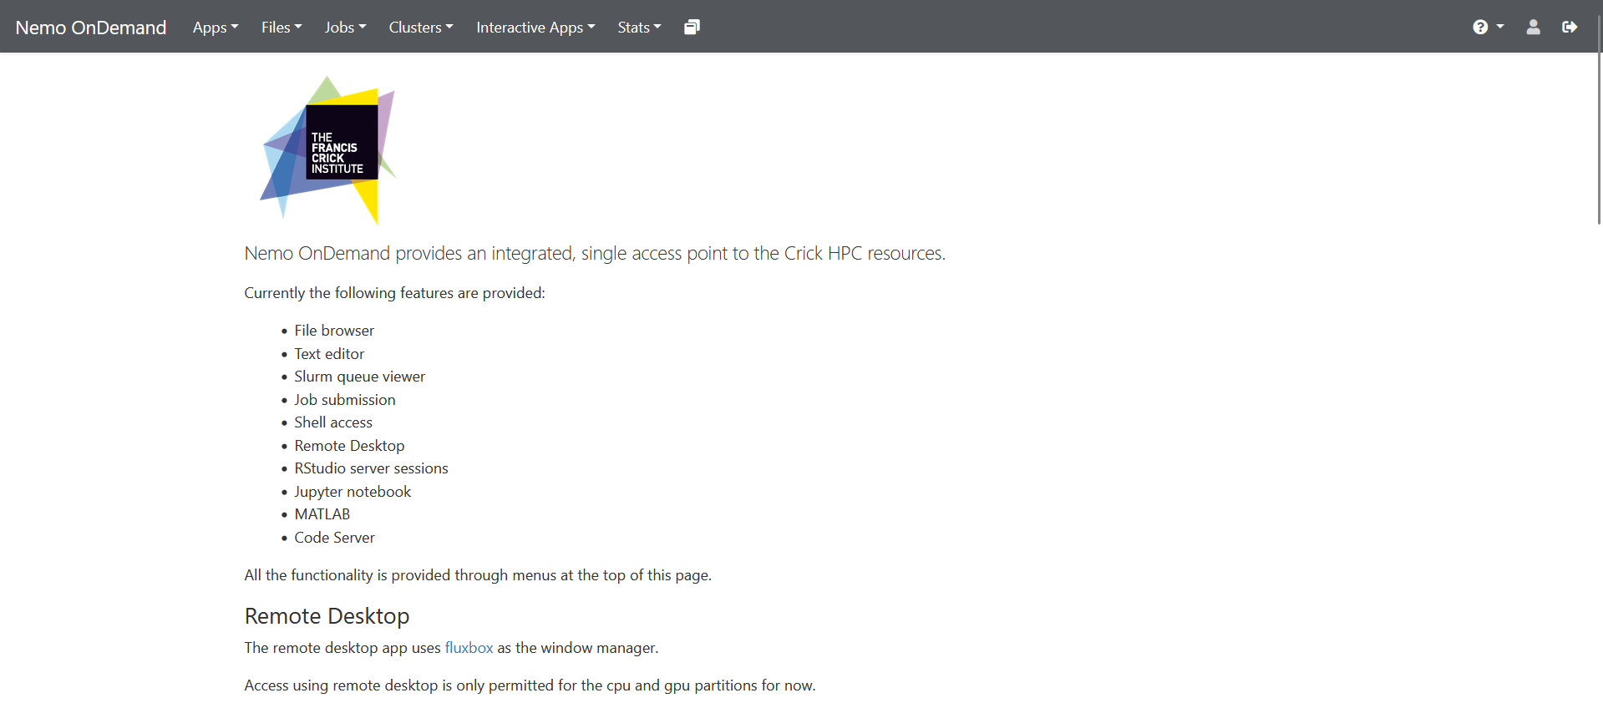
OnDemand interface

Slide 9
Remote Desktop
Start a Remote Desktop session, set the following:
gpu partition
2 hours
1 node
1 GPU card
Memory leave blank
Tick to receive email
Reservation: stardist

Slide 10
Remote Desktop
Once the session has started press Launch.
In the window that opens right click(2-finger tap for OSx) on the desktop and start xterm

Slide 11
Software Modules
There are centrally installed software on Nemo available to all users
Accessible through the module(or ml) command
To check if a module is available either of the following can be used:
ml avail software
ml spider software
To load a module:
ml modulename
List currently loaded modules
ml

Slide 12
Software Modules
To remove a module
ml unload modulename
To remove all loaded modules
ml purge
You can also create your own modules or use modules shared by a colleague or different lab/STP. To do so you just need to add the path of the directory which contains those modules:
ml use /path/to/directory

Slide 13
Exercise (ml)
List the SpaceFM module – ml av SpaceFM
Load SpaceFM – ml SpaceFM
Run SpaceFM(Case might be different) - spacefm
Check what modules were loaded - ml
Investigate Nemo’s folder structure
Close SpaceFM
Unload the SpaceFM module – ml unload SpaceFM
Check if any modules are still loaded - ml
Purge all the modules – ml purge
Tip: Some commands can autocomplete using the Tab key, ml can do that with module names

Slide 14
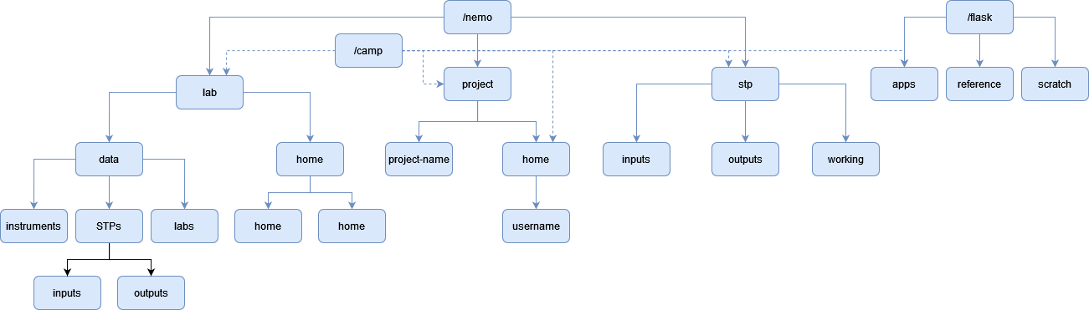
Folder structure

Slide 15
Command line basics
Get directory listing
ls
ls path
Print working directory
pwd
Change directory
cd path
cd # without arguments takes you back to your home directory
cd .. # change to the directory one level up

Slide 16
Command line basics
Copy files or directories
cp source destination
cp –R source_directory destination_directory
Move files/directories
mv source destination
Create a new directory
mkdir /path/to/directory # Assumes parent directories already exist
mkdir –p /path/to/new/directory # Creates parent directories if they don’t exist
Print or display a file
cat filename # prints file contents, great for small files
less filename # display the files in an interactive viewer, q to quit
Manual pages
man ls

Slide 17
Exercise 1(pwd, ls, cd, cp, df, cat, less, man)
Open a terminal/shell and check which directory you’re currently in
pwd
List the files in the directory
ls
Optional - List the hidden files in the directory
ls -a
Go to your lab home or working directory
cd /nemo/lab/<labname>/home/users/<username>
Go back to your own home and copy the fiji file /camp/apps/training/stardist/StarDist_Course_Feb_2024/fiji-linux64.zip to your home
cp /camp/apps/training/stardist/StarDist_Course_Feb_2024/fiji-linux64.zip .
Check how much space you have available in your personal home
df –h $HOME

Slide 18
SLURM
Most HPC systems utilise job schedulers to manage how users can access resources.
Nemo uses Slurm for job scheduling on the compute resources.
A number of policies/limits are implemented to allow fair usage by labs/users

Slide 19
SLURM commands
Check your jobs in the queue squeue –u username
Get overall info for all the partitions sinfo
Submit a batch script/job(only for cpu/gpu/hmem partitions) sbatch script.sh
Start an interactive job srun –p int –t 00:10:00 --pty bash

Slide 20
Jupyter
Web-based interactive development environment for notebooks, code, and data
Also has a simple file manager and can be extended modified with libraries/plugins.

Slide 21
Fiji
A distribution of ImageJ which includes many useful plugins
You’ll setup a personal Fiji installation for easier plugin management
Start a Remote Desktop session
Open xterm(right click on desktop to open menu)
Copy the fiji app from the training folder to your user folder in your lab
Unzip the file
Unzip fiji_linux64.zip
Go into the directory which was extracted
cd Fiji.app
Launch fiji with ./ImageJ-linux64
https://downloads.imagej.net/fiji/latest/fiji-linux64.zip

Slide 22
Command line basics
Remove files
rm
Read manual pages
man ls
Create symbolic links
ln –s target link_name
Get filesystem usage
df /path/to/directory

Slide 23
Command line basics
Absolute and relative path
You can specify the absolute path to a file or directory or a relative path which depends on the directory you’re currently in.
For example if you are in your home directory and want to list a file in a subdirectory:
ls /camp/home/username/subdirectory/filename # absolute path
ls subdirectory/filename # relative path

Slide 24
Exercise 3
Copy the sbatch-example-new.sh from the training directory to your home folder
cp /camp/apps/training/stardist/sbatch-example-new.sh $HOME/
Modify it with following(you can edit the file via the OnDemand File explorer):
Change the partition from cpu to gpu
#SBATCH –-partition=gpu
Comment out memory per cpu(add another # to line beginning)
##SBATCH –-mem-per-cpu=
Use reservation stardist(Only valid during workshop)
#SBATCH --reservation=stardist
List and load a python module and print python version
ml <pythonmodule>
python -v
Submit the job with sbatch
sbatch sbatch-example-new.sh
Check output with cat or less command
cat slurm-<jobid>.out

Slide 25
Conda
Package and environment management software
Conda environments are a method for creating an isolated space with different software and their dependencies installed.
Two different software may require different tensorflow versions
Conda environments can also help with reproducibility.

Slide 26
Conda
Before starting up do the following to avoid filling up your personal home:
Make sure .conda doesn’t exist yet in your home folder: ls $HOME/.conda # should give an error
Create a .conda directory in your lab home folder: mkdir /camp/lab/<labname>/home/users/<username>/.conda
Link to the directory you just created from your home folder: ln –s /camp/lab/<labname>/home/users/<username>/.conda $HOME/.conda

Slide 27
Conda initialisation
.conda is the folder where Conda stores environments and packages by default. Conda automatically creates that directory the first time it’s run in your home directory. Since users’ home directories have limited space we create(or move) .conda in their lab folder and use a symbolic link from the personal home directory.
$HOME is an environment variable with the path of your home directory.
Now you can initialize Conda:
conda init

Slide 28
Create and (de)activate a Conda environment
ml Anaconda3/2023.09-0
conda init #This is only run once the first time you start using Conda
conda create –n testenv
# OR conda create –n testenv python=3.9
ml purge # Always remove the Anaconda module before using the env
conda activate testenv
conda deactivate

Slide 29
Conda with Jupyter in OnDemand
To integrate conda environments with Jupyter in OnDemand we’ll make use of remote kernels. This only needs to be done once for each environment.
First install the necessary packages inside your conda environment:
pip install remote-ikernel ipykernel
Install an ipython kernel(necessary for Jupyter):
python –m ipykernel install --user --name=testenv
Install the remote Jupyter kernel:
python3 -m remote_ikernel manage --add --kernel_cmd="ml purge && conda activate testenv && ipython3 kernel -f {connection_file}" --name=“testenv" --interface=local --workdir="~/" --language=python3
You should be able to launch a kernel now with your conda environment called “Local testenv”

Slide 30
References
https://wiki.thecrick.org/display/HPC/
https://openondemand.org/
https://lmod.readthedocs.io/
https://slurm.schedmd.com/
https://jupyter.org/
https://docs.conda.io/
https://fiji.sc/

